Slide 1
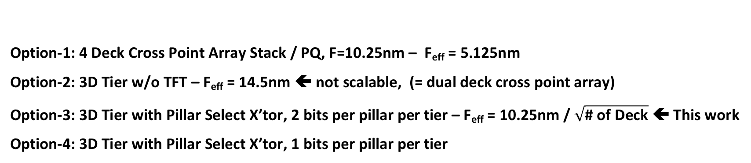
Beyond P1241
Option-1: 4 Deck Cross Point Array Stack / PQ, F=10.25nm – F_{eff} = 5.125nm
Option-2: 3D Tier w/o TFT – F_{eff} = 14.5nm ⬅ not scalable, (= dual deck cross point array)
Option-3: 3D Tier with Pillar Select X’tor, 2 bits per pillar per tier – F_{eff} = 10.25nm / $\sqrt{\text{\# }\text{of} \text{Deck}}$ ⬅ This work
Option-4: 3D Tier with Pillar Select X’tor, 1 bits per pillar per tier

Slide 2
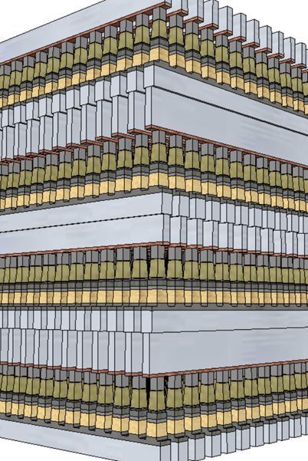
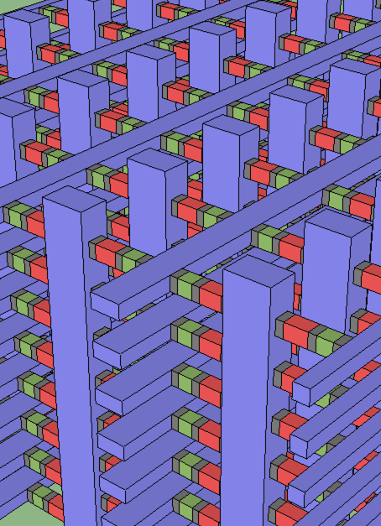
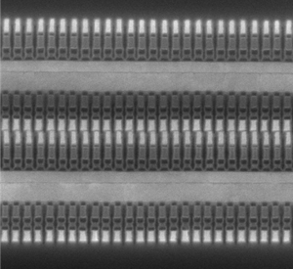
3DXP stacking: From Deck to Tier
DerChang, Prashant, Max, Khaled, Mase 11/27/2018
3D Tier Features
Design Rules
Tile Size
Process Flow
TFT
Product Physical attributes
Scaling
4 decks
S26

Slide 3
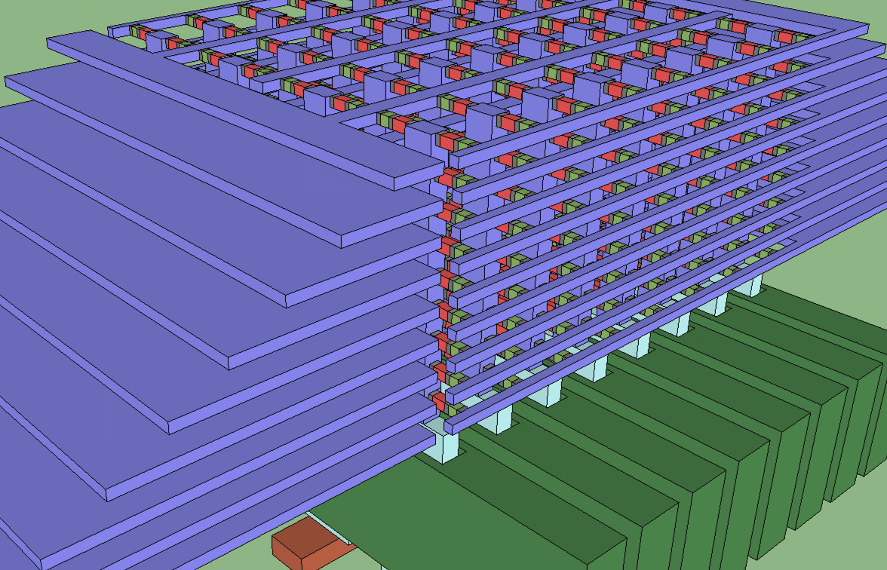
8X8X9 example: 9 Tiers, 4X8 Pillars, 2b/(pillar X tier)

Slide 4
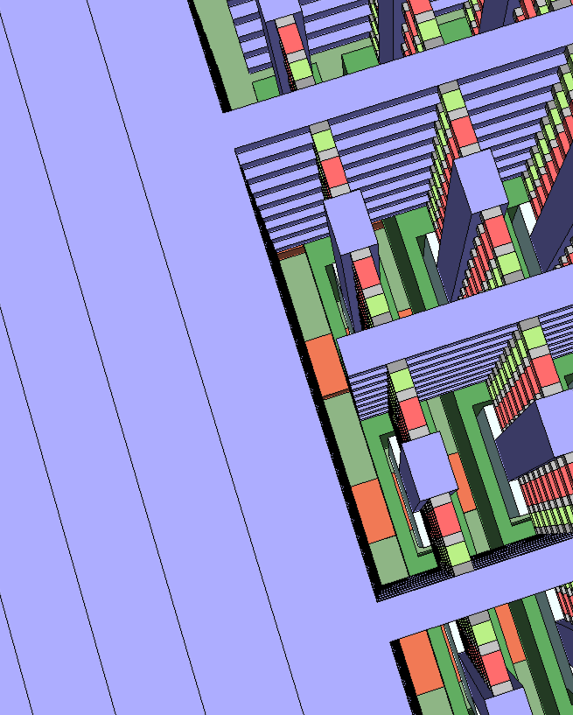
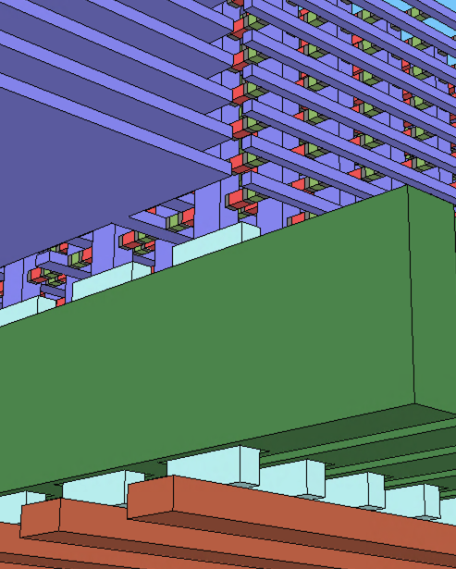
WL Comb: 2 WL Decoders per Tier
Pillar Select Transistor (PST)

Slide 5
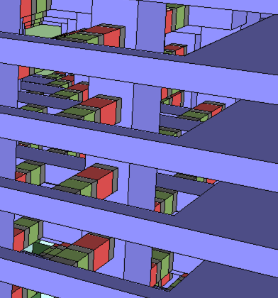
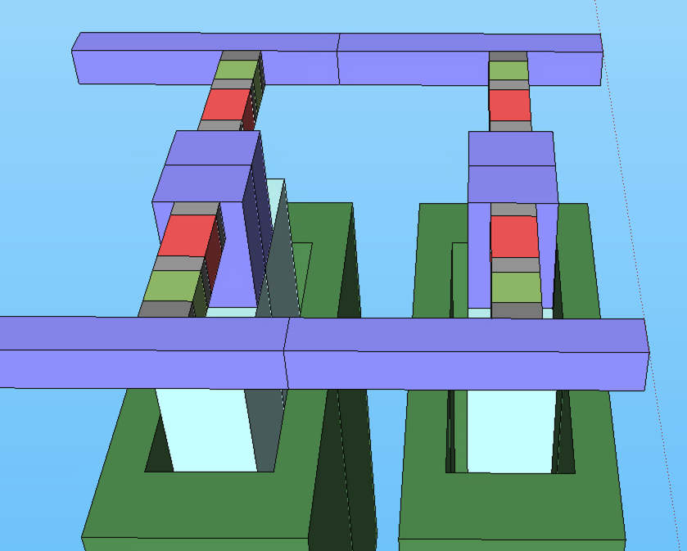
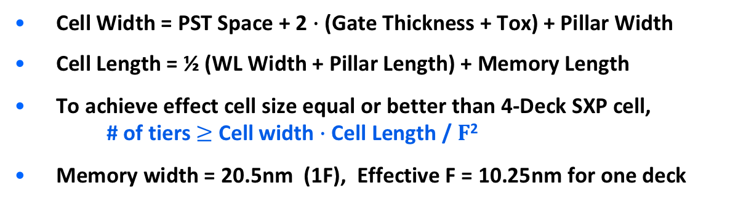
Design Rules
Design Rules | nm | 130 ref
Cell Width | 164 | 164
PST Space | 62
Gate Thickness | 20
Tox | 10
Pillar Width | 63 | 67 (ch)
Memory width | 20.5
Memory Space | 120
Pillar Space | 101
Cell Length | 164 | 148
WL Width | 42
Memory Length | 110
Pillar Length | 64 | 67 (ch)
PST Width | 270
Effective F (SLC) | 10.25 | 6.49
Cell Width
Cell Length
Mem Width
Pillar Length
Pillar Width
PST Space
Tier Height
Mem Length
Tier Space
½ WL Width
PST Width
Tox
Gate Thickness
Cell Width = PST Space + 2 $∙$ (Gate Thickness + Tox) + Pillar Width
Cell Length = ½ (WL Width + Pillar Length) + Memory Length
To achieve effect cell size equal or better than 4-Deck SXP cell,
# of tiers $≥$ Cell width $∙$ Cell Length / $F$²
Memory width = 20.5nm (1F), Effective F = 10.25nm for one deck
3D Construct |  | 130 ref
F | 20.5nm
Cell footprint | 64F² | 58F²
# of Tier: | 64 | 48x3
Tier Height | 20nm | 35nm
Tier Space | 30nm | 20nm
Pillar Metal AR | 50 | 45

Slide 6
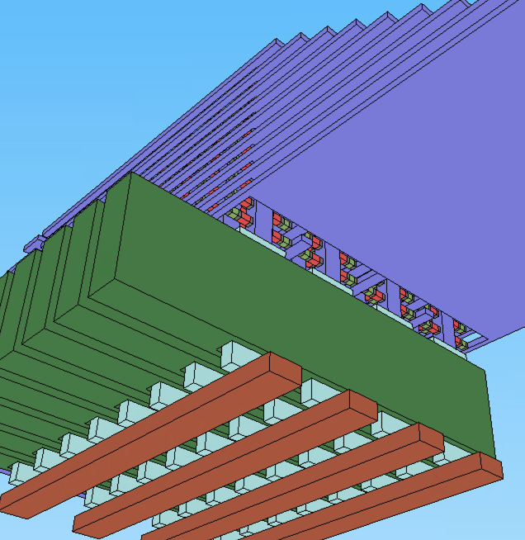
Strategy to Construct Multi-Tier Array
Goal: Equal or better than 4D 3DXP in BW/(GB/$)
  ≤ 1F²/bit, CUA & ≤ 13 immersion layer to increase GB/$
  Build smaller tile (parallelism, lower CV²) to increase BW
≤ 1F²/bit: Multi-tier
  N_{Tier} ≥ length_{cell} ∙ width_{cell} / F²
2 bits per pillar per tier
  Tile Capacity = 2 ∙ N_{Pillar} ∙ N_{BL} ∙ N_{Tier}
CUA: Decoders and Tile control/logic 100% under Array
  ∵ footprint_{array} ≥ footprint_{CMOS}
  ∴ min number of BL and Pillar can be estimated
Optimize Tile size vs. WL capacitance
  To lower WL (tier-to-tier) cap,
  orient WL the same as BL geometrically &
  chop the stack evenly into n_{pile}
WL:
Tier Bias
PS:
Pillar Select
BL:
Pillar Bias
N_{BL}
∙
∙
∙
N_{BL}
∙
1
∙
∙
∙
∙
∙
∙
∙
∙
∙
∙
∙
N_{PS}
∙
N_{PS}
∙
∙
N_{pile}

Slide 7
Product Physical Architecture
Technology | P1240 | P1240.T1 | P1241 | P1241 PF | P1241.T2 | P1242.T3 | P1243.T4
Product | ALF32 |  | ATF-64 | ATF-64
Effective F [nm] | 10.25 | 10.25 | 7 | 7 | 7.25 | 5.92 | 5.125
Die Capacity [GB/die] | 32 | 32 | 64 | 64 | 64 | 96 | 128
Array overhead [%] | 16 | 22.5 | 16 | 16 | 22.5 | 22.5 | 22.5
# of Partition | 32 | 72 | 64 | 64 | 72 | 72 | 72
# of tile / Partition | 128 | 128 | 128 | 128 | 128 | 128 | 128
Tile Capacity [Mb/Tile] | 64 (75) | 28 (32) | 64 (75) | 64 (75) | 57 (64) | 86 (96) | 114 (128)
Tile Footprint [𝜇m²/Tile] | 181 X 181 | 88 X 175 | 124 X 124 | 124 X 124 | 88 X 175 | 88 X 175 | 88 X 175
# Deck | 4 | 1 | 4 | 4 | 2 | 3 | 4
# of Tier / Deck | N/A | 64 | N/A | N/A | 64 | 64 | 64
# of Pile / Tile | N/A | 28 | N/A | N/A | 14 | 9 | 7
# of WL Driver / Tile | 8K | 1*2*64*28 | 8K | 8K | 2*2*64*14 | 3*2*64*9 | 4*2*64*7
# of BL Driver / Tile | 8K | 512 | 8K | 8K | 512 | 512 | 512
# of PS Driver / Tile | N/A | 512 | N/A | N/A | 512 | 512 | 512
WL Resistance [KΩ] | 23.8 | 21.3 | 29.7 | 29.7 | 21.3 | 21.3 | 21.3
BL Resistance [KΩ] | 10.4 | 4.26 | 13 | 13 | 4.26 | 4.26 | 4.26
Pillar Resistance [KΩ] | N/A | 0.16 | N/A | N/A | 0.32 | 0.48 | 0.72
PST on-resistance [KΩ] | N/A | 3 | N/A | N/A | 3 | 3 | 3
WL Cap [fF] | 92 | 143 | 92 | 92 | 287 | 446 | 573
BL Cap [fF] | 92 | 2.61 | 92 | 92 | 2.61 | 2.61 | 2.61
PS cap [fF] | N/A | 28 | N/A | N/A | 28 | 28 | 28
Net Array [mm²] | 141 | 143 | 141 | 141 | 143 | 143 | 143
Net CMOS [mm²] | 143 | 144 | 143 | 143 | 144 | 143 | 144
WL:
Tier Bias
PS:
Pillar Select
BL:
Pillar Bias
Assumption:
P1240 Cell char used
𝜌_{metal} = 203 Ω∙nm (WL, BL, P)
𝜖_{dielectric} = 8𝜖₀ (for isolation)
PST (L_{G}=75nm, 5Volts, 110uA)
ON-resistance 3KΩ
Off leakage 10nA (V_{G}=0V)
Non-decoder area:
9500 𝜇m²/Tile (vs.
11750 𝜇m²/Tile of ALF32)
Decoder size:
1.331 𝜇m²/driver
Use P1240 driver
Same size for WL, BL, PS
Array overhead: sockets, spares, redundancy & dummies: 22.5 % of net array size (vs. 16% of ALF overhead)

Slide 8
Product Roadmap Discussion
Technology |  | P1240 | P1240.T1 | P1241 | P1241 PF | P1241.T2 | P1242.T3 | P1243.T4
Product |  | ALF32 |  | ATF-64 | ATF-64
Platform PRQ |  | Eo’20 |  | Eo’21 | TBD | Eo22 | Eo23 | Eo24
Capacity [GB/die] |  | 32 | 32 | 64 | 64 | 64 | 96 | 128
Read BW [MB/s] |  | 3200 | 7200 | 4800 | 48-5400 | 7200 | 7200 | 7200
Write BW [MB/s] |  | 1100 | 2400 | 2200 | 2200 | 2400 | 2400 | 2400
Read E [pJ/b] |  | 39 | 21 | 28 | 25-21 | 21 | 21 | 21
Write E [pJ/b] |  | 100 | 66 | 77 | 72-66 | 66 | 66 | 66
Power [W] |  | 1 | 1.27 | 1.15 | 1.15-1.39 | 1.27 | 1.27 | 1.27
I/O Interface |  | DDR5/LPDDR5 | LPDDR5+ | LPDDR5+ | LPDD5+ | LPDDR5+ | LPDDR5+ | LPDDR5+
DDR Rate [MT/s] |  | 3200 | 3600 | 4800 | 4800-5400 | 3600 | 3600 | 3600
DQ |  | X8 | X16 | X8 | X8 | X16 | X16 | X16
Chop | Capacity [GB/die] | 16 (2D or 16P) | 16 (36P) | 32 (2D or 32P) | 32 (2D or 32P) | 32 (36P) | 48 (36P) | 64 (36P)
 | Read BW [MB/s] | 3200 | 4800 | 4800 | 48-5400 | 4800 | 4800 | 4800
 | Write BW [MB/s] | 1100 or 550 | 1200 | 2200 or 1100 | 2200 or 1100 | 1200 | 1200 | 1200

Slide 9
Enablers – PST
Pillar Select Transistor
  5V, 110uA GAA transistor (H_{75nm} , W_{270nm} , T_{42nm} , S_{62nm}), On-Resistance 3KΩ
  PST capacitance is 28fF ➔ Can we ½ dielectric constant (𝜖_{ox} = 4𝜖₀)? ➔ C_{ps} = 14fF,
  or sub ½ pJ to select a pillar.
  One immersion layer need
  Need to consider TFT formation flow, will channel dimension variation impact sigma of the select device? What is contact approach for control gate and does it impact design rule or landing pad area?
  Low temperature gate ox for pillar select – any reliability concerns?
  Contact to BL whether W BL or Cu w/ W plug, must form reliably at low temperature
  Contact resistance and Pillar-TFT interface needs to be capable within Cu thermal budget(~400’C) and interface clean must be selective to the tier isolation layer and 2nd cut isolation between pillars.
  Can add plug above and/or below for extra cost but require good contact formation at low temperature in all cases.

Slide 10
Enablers – Array
Tier Array Process
  Two immersion layers for high AR cuts –
  1st cut is similar to 3D-NAND’s, depending on WL sac layer or WL conductor layer in the stack.
  ALD Chal, Carbon & W lamina – maintain composition uniformity at high aspect ratio for chal films
  Recess process control: thickness control impacts - sigma in Vt, delta Vt, Iprogram (heaters) ~ endurance/WD
  2nd cut pattern generation (pillar wider than bit is required) OPC risk do we require two pass print + resist trim?
  2nd cut etch capable of W lamina removal over entire height of bit (vertical lamina) without chal damage
    PM and SD by definition exposed to full etch, GX style ALD dep protection possibly required. Reduce tier height (non-square area of bit).
  Replacement Pillar Metals, liner with good good contact to TE carbon and pillar select source/drain and barrier properties for W dep.
  Replacement or subtractive tier metal (Ruthenium Tier metal?)
    Flow does not have a clear replacement option currently. Need to either formulate replacement flow or enable tier stack “sac” layer as WL conductor.

Slide 11
Enablers – Design
Design Technology
  Non-decoding circuit and/or CMOS 20% area scaling
Read/Write Energy matches “P1241PF” BKM energy. (1.27W/die required)
  Additional 5 to 10% of Write Energy reduction (I_{RESET} = 110uA vs. 70uA in P1241 DTS)
Process Costs
  High Density Routing: two to four immersion layers are estimated
  TFT Technology: one immersion layer needed
  Two immersion layers for high AR cuts
  Invention of Etch/ALD
  vs.
  4D SXP reference – 13 immersion layers including
    8 PD or PQ + 5 OPV layers
    4 times “Rinse & Repeat” of 1st and 2nd partial cuts

Slide 12
Replacement Tier/Pillar Process Flow
Array Key Processes:
2 immersion layers, 2 high AR cuts, ALD Chal & Carbon
Replacement Tier & Pillar Metals

Slide 13
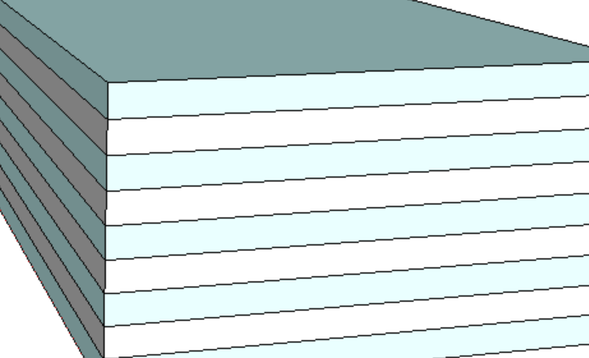
Memory Tier Stack – 4 Tiers in the exhibit
Dielectric, eg, oxide
Sacrificial material, eg. silicon
Cell 2nd Cut
Cell 1st Cut
Memory Tier
WL Poly
BL Poly
Silicon Pillar
Alternate stacking sacrificial layer and dielectric layer to build memory tiers.

Slide 14
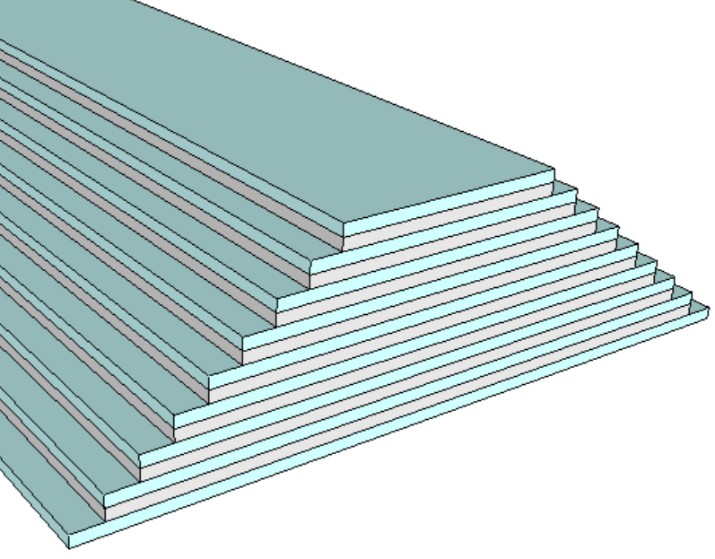
Tier Stair Formation – an 8-tier exhibit
Tier Stair Etch
Mask
Mask
Mask
Mask

Slide 15
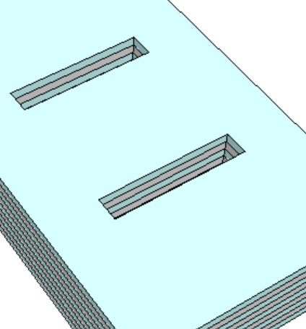
1st Cut: Opening for Cell Stack Materials
A
A’
A
Cell 2nd Cut
Cell 1st Cut
64nm
Memory Tier
A’
WL Poly
BL Poly
Silicon Pillar
Tier Stair not shown

Slide 16
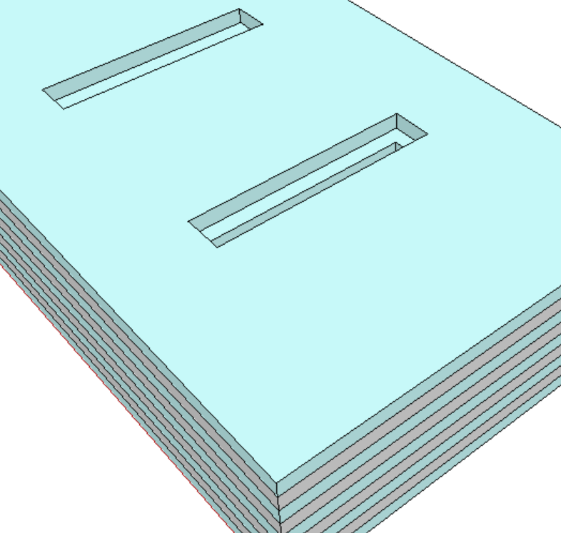
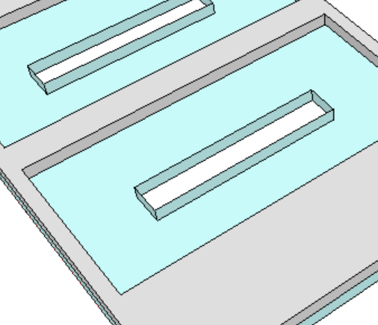
Tier Sacrificial Layer Recess Etch
A
A
A’
A’

Slide 17
1st Electrode
First Electrode Conformal Dep
First Electrode Recess Etch
A
A’
A
A’

Slide 18
SD
SD Conformal Dep
SD Recess Etch
A
A’
A
A’

Slide 19
2nd Electrode & PM
2nd Electrode dep/etch, PM Conformal Dep
PM Etch
PM Etch
A
A’
A
A’

Slide 20
3rd Electrode & Fill: Replacement for Pillar
2nd Electrode Dep/Etch
Sacrificial Pillar Nitride Dep Etch/CMP
A
A’
A
A’

Slide 21
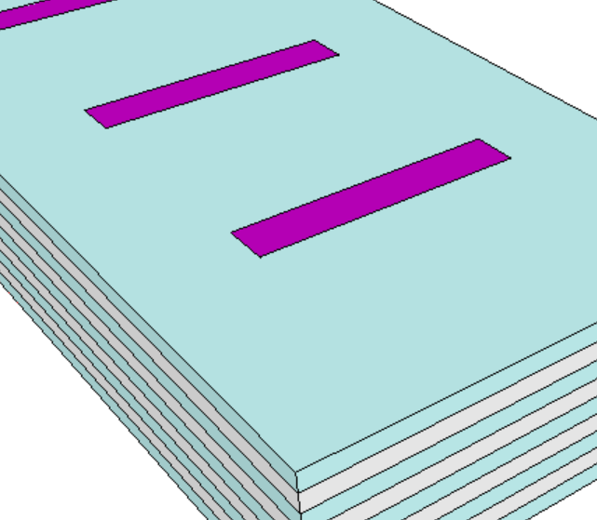
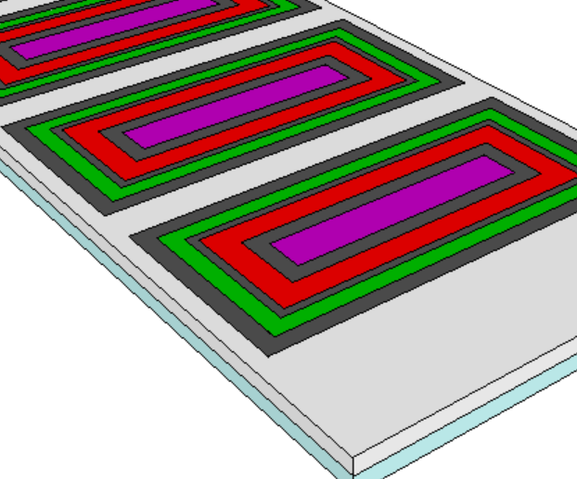
End of 1st Cut module
Tier Dielectric, eg. Oxide
Sacrificial material for Pillar metal (BitLine), eg. Nitride
A
A
A’
A’
Memory,
eg. GST
1^{st,} 2nd, 3rd Electrode, eg. Carbon
Selector, eg. SAG
Sacrificial material for Tier metal (WordLine), eg. amorphous Silicon

Slide 22
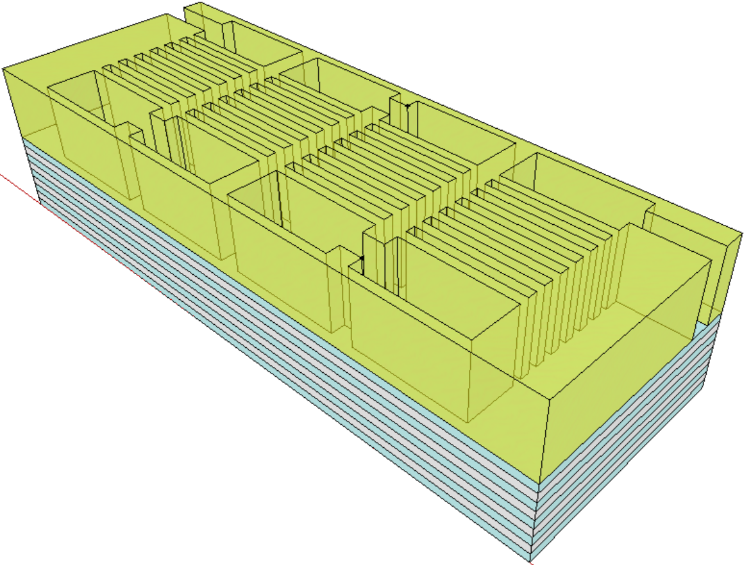
2nd Cut definition
Cell 2nd Cut
Cell 1st Cut
Memory Tier
WL Poly
BL Poly
Silicon Pillar

Slide 23
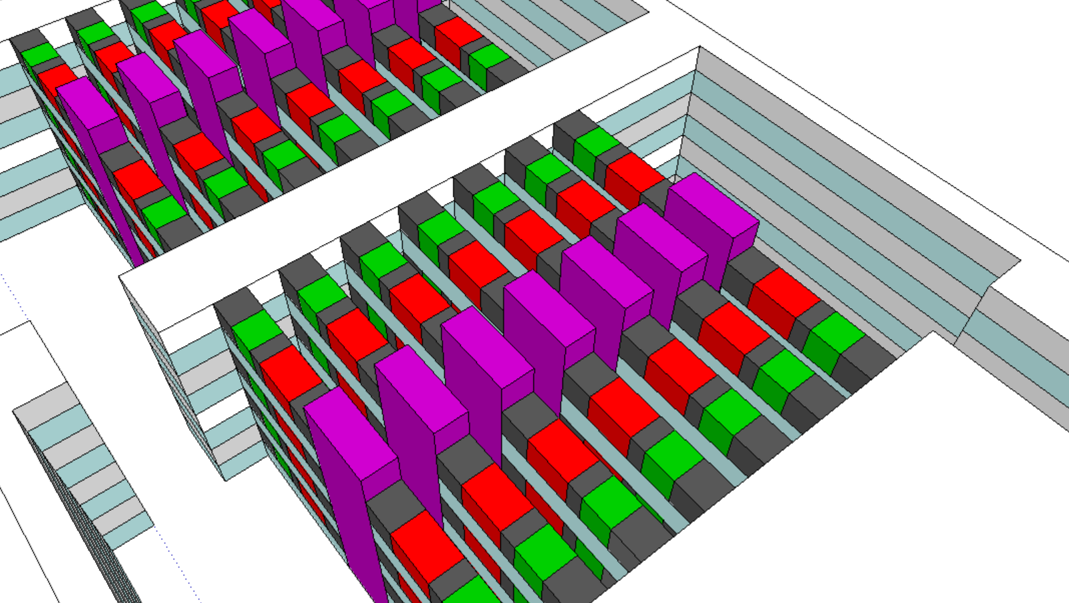
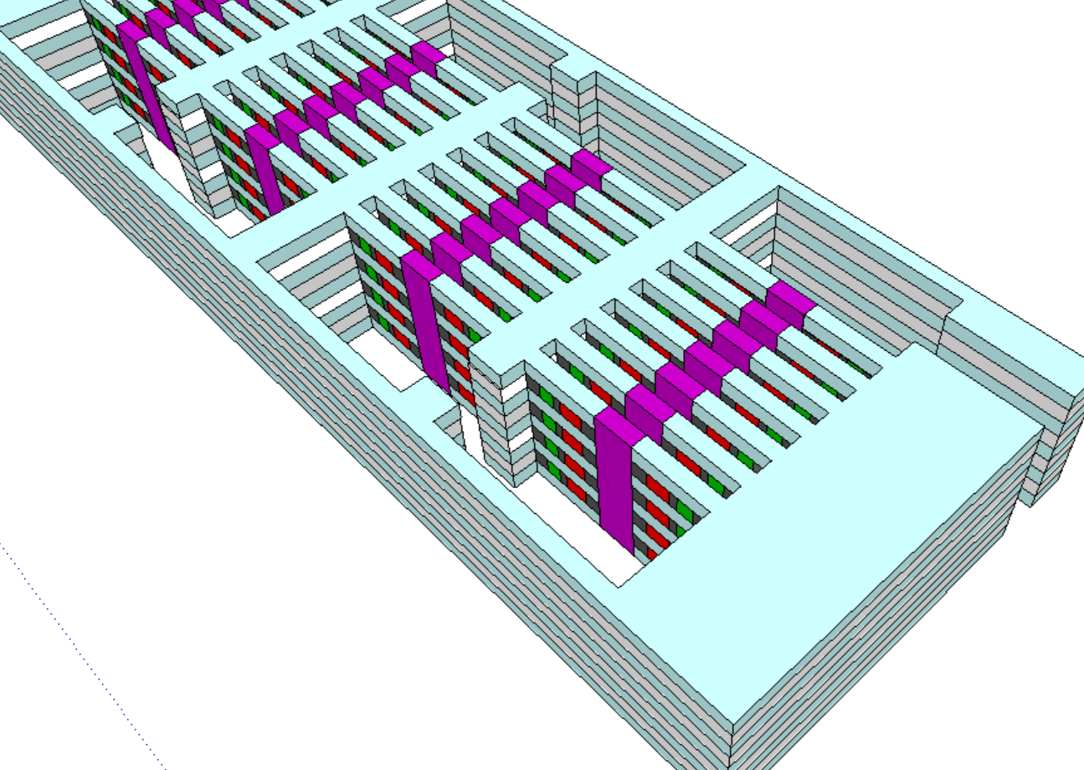
2nd Cut
Top Dielectric Removed

Slide 24
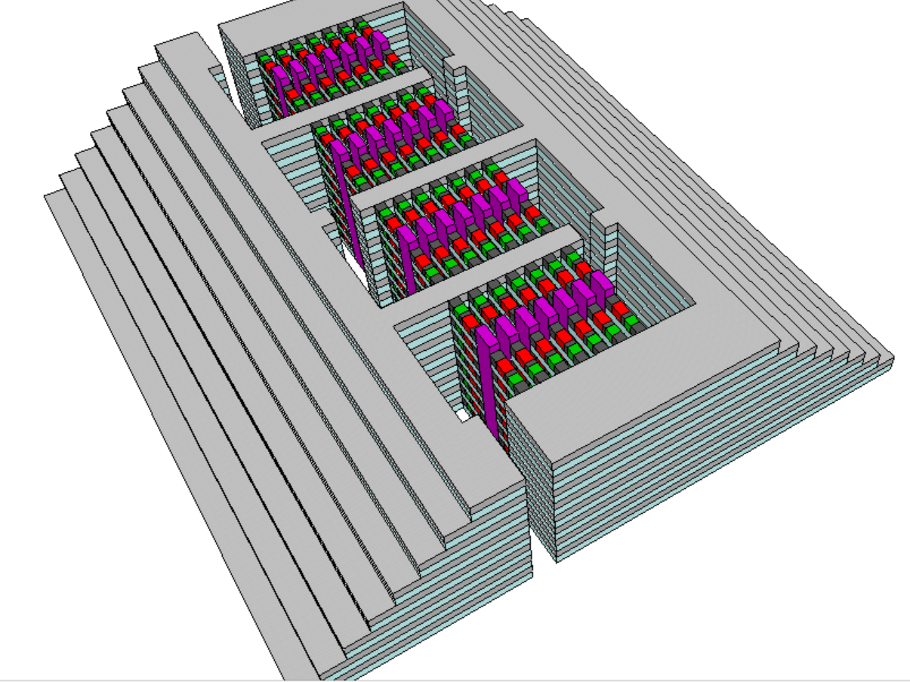
Tier Metal Replacement
Isotropic sacrificial tier material (eg. amorphous silicon) etch then conformal Metal dep
(eg. ALD W) fill the gap,
followed by anisotropic
metal etch removing
metal in the 2nd cut
opening region then gap
filled with oxide(not shown)
With
top dielectric
removed, Array with
Tier Stair (termination)

Slide 25
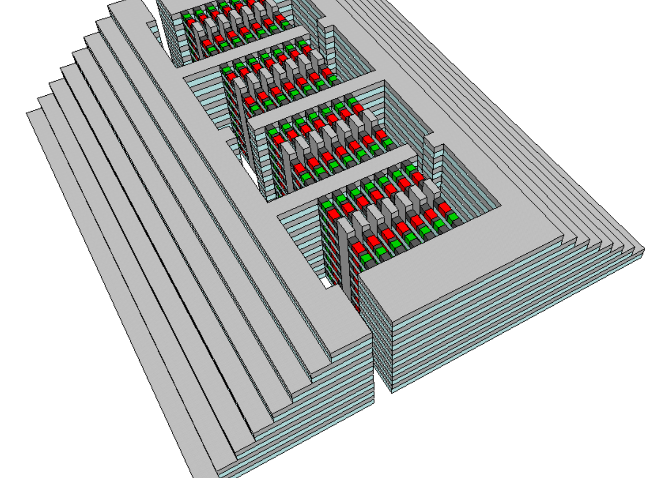
Pillar Metal Replacement
Isotropic sacrificial pillar material (eg. nitride) removed then
Metal (eg. W) fill the gap
gap filled oxide and top tier dielectric are not shown
(not shown)

Slide 26
Backup Material

Slide 27

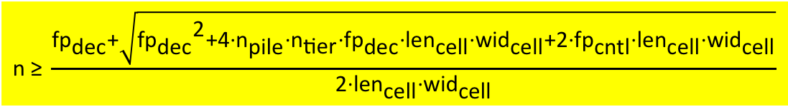

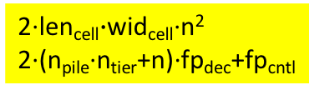
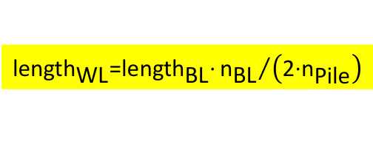
Strategy to Construct Multi-Tier Array
Goal: Equal or better than 4D 3DXP in BW/(GB/$)
  1F²/bit, CUA & ≤ 13 immersion layer to increase GB/$
  Build smaller tile (parallelism, lower CV²) to increase BW
Assumptions
  Number of BL = Number of Pillar = n
1𝝀²/bit: Multi-tier
  n_{tier} = length_{cell}$∙$width_{cell}/F²
CUA: Decoders and Tile control/logic 100% under Array
  footprint_{array} = 2∙len_{cell}$∙$wid_{cell}∙n²
  footprint_{CMOS} = 2∙(n_{pile}∙n_{tier}+n)∙fp_{dec}+fp_{cntl}
  ∵ footprint_{array} ≥ footprint_{CMOS} ∴ $\text{n} \text{≥} \frac{{\text{fp}}_{\text{dec}}\text{+}\sqrt{{{\text{fp}}_{\text{dec}}}^{\text{2}}\text{+4}\text{∙}{\text{n}}_{\text{pile}}\text{∙}{\text{n}}_{\text{tier}}\text{∙}{\text{fp}}_{\text{dec}}\text{∙}{\text{len}}_{\text{cell}}\text{∙}{\text{wid}}_{\text{cell}}\text{+2∙}{\text{fp}}_{\text{cntl}}\text{∙}{\text{len}}_{\text{cell}}\text{∙}{\text{wid}}_{\text{cell}}}}{\text{2}\text{∙}{\text{len}}_{\text{cell}}\text{∙}{\text{wid}}_{\text{cell}}}$
Optimize Tile size vs. WL capacitance for BW
  To lower WL (tier-to-tier) cap,
  orient WL the same as BL geometrically &
  break the stack evenly into n_{pile}
  ∴
WL:
Tier Bias
PS:
Pillar Select
$$\text{Density}\text{=2∙}{\text{n}}_{\text{PS}}\text{∙}{\text{n}}_{\text{BL}}\text{∙}{\text{n}}_{\text{tier}}$$
$${\text{length}}_{\text{PS}}\text{=2}\text{∙}{\text{length}}_{\text{cell}}\text{∙}{\text{n}}_{\text{BL}}$$
$${\text{length}}_{\text{BL}}\text{=}{\text{width}}_{\text{cell}}\text{∙}{\text{n}}_{\text{PS}}$$
BL:
Pillar Bias
2∙len_{cell}$∙$wid_{cell}∙n²
2∙(n_{pile}∙n_{tier}+n)∙fp_{dec}+fp_{cntl}
$$\text{n}\text{ ≥} \frac{{\text{fp}}_{\text{dec}}\text{+}\sqrt{{{\text{fp}}_{\text{dec}}}^{\text{2}}\text{+4}\text{∙}{\text{n}}_{\text{pile}}\text{∙}{\text{n}}_{\text{tier}}\text{∙}{\text{fp}}_{\text{dec}}\text{∙}{\text{len}}_{\text{cell}}\text{∙}{\text{wid}}_{\text{cell}}\text{+2∙}{\text{fp}}_{\text{cntl}}\text{∙}{\text{len}}_{\text{cell}}\text{∙}{\text{wid}}_{\text{cell}}}}{\text{2}\text{∙}{\text{len}}_{\text{cell}}\text{∙}{\text{wid}}_{\text{cell}}}$$
n_{BL}
∙
∙
∙
n_{BL}
∙
1
∙
∙
∙
∙
∙
∙
∙
∙
∙
$${\text{length}}_{\text{WL}}\text{=}{\text{length}}_{\text{BL}}\text{∙}{{\text{n}}_{\text{BL}}}/{\left(\text{2∙}{\text{n}}_{\text{Pile}}\right)}$$
∙
∙
Y
∙
n_{PS}
∙
∙
n_{pile}

Slide 28
Partition Control/Logic/Referencing impact to Tile Attributes

Slide 29
Array Architecture
SXP Tile Reference: 64Mb/tile of 4𝝀² cell in 4Kx4KX4D –
Floor space = 4K∙4K∙4𝝀², # of decoders = 2∙(4K+4K) ➔
decoder footprint (f_{D})= 4K𝝀² ⬅ decoder footprint assumption for all
WL/BL Length for Lumped capacitance = 2𝝀∙8K = 16K𝝀
Tier architecture: 96 WL (48 tiers of comb pair), X BL & Y PS,
PS length = 2 ∙ 6.93𝝀 ∙ X, BL Length = 6.93𝝀 ∙ Y, WL Length= PS Length ∙ Y / 2
To ensure 100% decoders 100% under the tile
(96 + X + Y) ∙ 4K𝝀² ≤ X ∙ Y ∙ 2 ∙ 48𝝀²
If X = Y ➔ A Tile will be 96 WLs, 120 BL/PS or 1.318Mb/tile
BL length = 1.623K𝝀, PS Length= 0.812K𝝀, WL Length= 48.7K𝝀
WL:
Tier Bias
PS:
Pillar Select
BL:
Pillar Bias
∙
N Piles of 48-Tier array: N ∙ 96 WL
BL length = 6.93𝝀∙Y, PS Length= 6.93𝝀∙X, WL Length= PS Length∙Y/(2∙N )
To ensure 100% decoders 100% under the tile
(N ∙ 96 + X + Y) ∙ 4K𝝀² ≤ X ∙ Y ∙ 2 ∙ 48𝝀²
If N=128, X = Y ➔ 12K WLs, 768 BL/PS or 54Mib/tile
BL length = 10.4K𝝀, PS Length= 5.2K𝝀, WL Length= 16K𝝀
If N=16, X = Y/N ➔ 1.5K WLs, 91 BL, 1.4KPS or 47Mb/tile
BL length = 20K𝝀, PS Length= 630𝝀, WL Length= 28K𝝀
∙
∙
X
X
∙
1
∙
∙
∙
∙
∙
∙
∙
∙
∙
∙
∙
Y
∙
N
Y
∙
∙
To reduce WL Cap, breaking down one tile into multiple piles of of 48-tiers of WL

Slide 30
Tile Size and First order WL/BL capacitance estimate (𝝀 = 20.5nm)
4 decks of 4K BLs x 4K WLs
8 Piles of 48 Tiers in 229 pillars x 229 BLs
1𝝀²/b, 64Mb/Tile, 64M𝝀²/Tile
Tile size: 168𝝁m X 168𝝁m
L_{BL} = L_{WL} = 2𝝀 ∙ 4K = 8K𝝀
H_{BL} = H_{WL} = 100nm ≈ 5𝝀
S_{BL} = S_{WL} = 20.5nm = 1𝝀
C_{BL} + C_{WL} = 2 ∙ 𝝐 ∙ L ∙ H / S = 80K𝝀𝜺
1𝝀²/b, 4.8Mb/Tile, 4.8M𝝀²/Tile
Tile size 33𝝁m X 65𝝁m (1 : 13.3)
L_{BL} = 2 ∙ L_{PS} = 2 ∙ 6.93𝝀 ∙ 229 = 3K𝝀
L_{WL} = L_{PS}∙Num_{PS}/(2∙8) = 22K𝝀
C_{BL} = 𝝐∙L_{BL}∙H_{BL(40nm)}/S_{BL(180nm)} = 0.689K𝝀𝝐
C_{WL} = 𝝐∙L_{WL}∙W_{WL(40nm)}/S_{WL(40m)} = 22.2K𝝀𝝐
C_{PS} = 𝝐∙L_{PS}∙H_{PS(300nm)}/S_{PS(40m)} = 14.2K𝝀𝝐
C_{BL} + C_{WL} + C_{PS} = 37.1K𝝀𝝐

Slide 31
130 Design Rule

Slide 32
Tile Density & Dimension Estimate
Cell size = (164nm)², Tier count = 64
To ensure 100% decoders 100% under the tile, N_{PS} = N_{BL} = N_{dec} is calculated for effective F = 10.25nm
(2 ∙ 64 ∙ N_{pile} + 2 ∙ N_{dec}) ∙ FP_{dec} + FP_{cntl} ≤ 2 ∙ N_{dec}² ∙ (164nm)²
  Assumption:
  FP_{cntl} – 30% of a P1240 tile floorspace is used by control
  FP_{dec} -- 70% of a P1240 tile floorspace is taken by 16K decoders
Benchmark reference tile: ATF32 64Mb/tile (4Kx4KX4D, Effective F = 10.25nm) –
Iso memory density: 1𝝀²/bit
Tile size reduces to 32Mb/tile @ Npile=16
Bandwidth
  Operable bit density increase 2X
  ➔ Latency constraint BW doubled
  Displacement energy of a tile reduces 2X
  ➔ Power constraint BW doubled
Reliability
  BL capacitance reduces ~50X
  ➔ Snapback impact alleviated
Ratio to ALF32 Tile Attributes

Slide 33
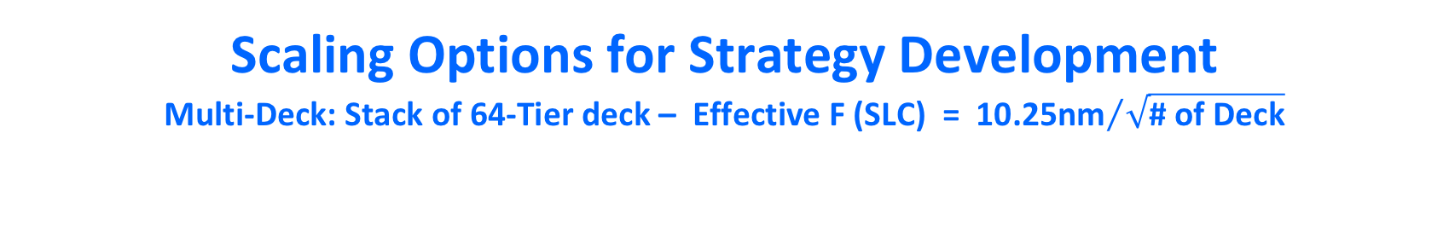
Scaling Options for Strategy Development
Multi-Deck: Stack of 64-Tier deck – Effective F (SLC) = ${\text{10.25}\text{nm}}/{\sqrt{\text{\#} \text{of} \text{Deck}}}$
ALF32 Reference
#_{WL} = #_{BL} = 4K
Density_{Tile}=64Mb/tile
R_{WL} = 23.9K𝛀
R_{BL} = 9.8K𝛀
C_{WL} = 47fF
C_{BL} = 82fF
Moving 100fF 0V↔3V consumes ~1pJ.
Opt 1:
Constant N_{pile} = 16
Opt 2:
Constant Tile Size
Opt 3:
Constant C_{WL}

Slide 34
3D XPoint™ Roadmap
Technology |  | 10s | 20s | P1240 | P1241 | P1241.PF
Product |  | S15 | S26 | ALF32 | ATF-64 | ATF-64
Platform PRQ |  | Eo’18 | Eo’19 | Eo’20 | Eo’21 | TBD
Capacity [GB/die] |  | 16 | 32 | 32 | 64 | 64
Read BW [MB/s] |  | 1600 | 1600 | 3200 | 4800 | 48-5400
Write BW [MB/s] |  | 550 | 800 | 1100 | 2200 | 2200
Read E [pJ/b] |  | 71 | 52 | 39 | 28 | 25-21
Write E [pJ/b] |  | 170 | 118 | 92 | 77 | 72-66
Power [W] |  | 0.9 | 0.75 | 1 | 1.15 | 1.15-1.39
X8 I/O Interface |  | DDR4 | DDR4 | DDR5/LPDDR5 | LPDDR5+ | LPDD5+
DDR Rate [MT/s] |  | 1600 | 1600 | 3200 | 4800 | 4800-5400
Chop | Capacity [GB/die] |  |  | 16 (2D or 16P) | 32 (2D or 32P) | 32 (2D or 32P)
 | Read BW [MB/s] |  |  | 3200 | 4800 | 48-5400
 | Write BW [MB/s] |  |  | 1100 or 550 | 2200 or 1100 | 2200 or 1100

