Slide 2
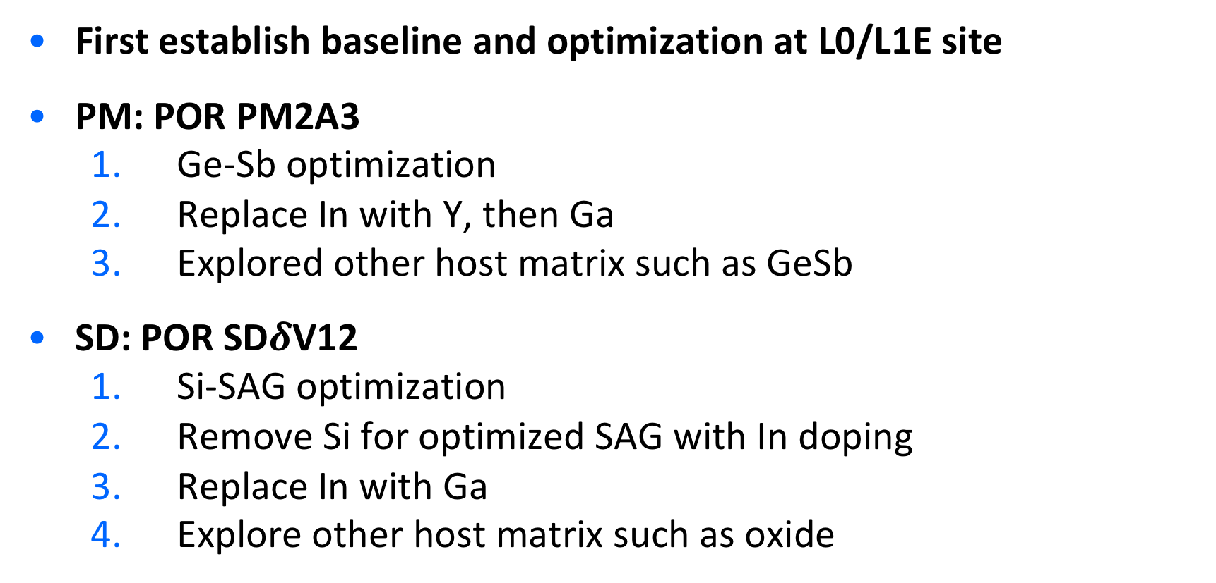
Strategy
First establish baseline and optimization at L0/L1E site
PM: POR PM2A3
Ge-Sb optimization
Replace In with Y, then Ga
Explored other host matrix such as GeSb
SD: POR SD$δ$V12
Si-SAG optimization
Remove Si for optimized SAG with In doping
Replace In with Ga
Explore other host matrix such as oxide

Slide 3
PM Milestone and Decision Point
Establish Baseline & fingerprint (PM2A3) & Ge-Sb Optimization
IMI based L0 and L1E Metric is used
Phase–I: Y-GST
Deposit a PM2A3-like GST matrix with 1 to 9% Y substituting In
Phase–II: Ga-GST
Same Strategy to Y-GST.
Phase–III: Ga-GeSb
GeSb based publication
Phase–IV: Sc-GST
(this is questionable based on paper published)

Slide 4
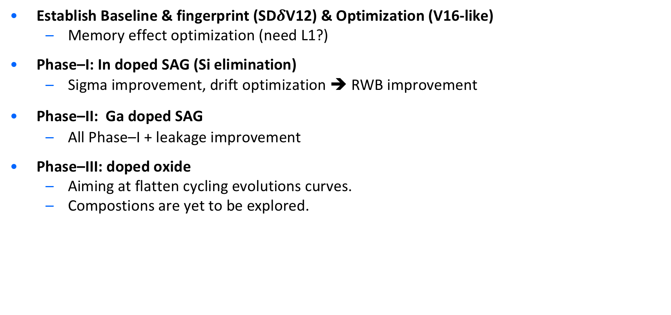
SD Milestone and Decision Point
Establish Baseline & fingerprint (SD$δ$V12) & Optimization (V16-like)
Memory effect optimization (need L1?)
Phase–I: In doped SAG (Si elimination)
Sigma improvement, drift optimization ➔ RWB improvement
Phase–II: Ga doped SAG
All Phase–I + leakage improvement
Phase–III: doped oxide
Aiming at flatten cycling evolutions curves.
Compostions are yet to be explored.

Slide 5
JDP Learning

Slide 6
JDP Campaign priorities & planning
Tentative plan, could change soon and frequently based on results and priorities

Slide 7
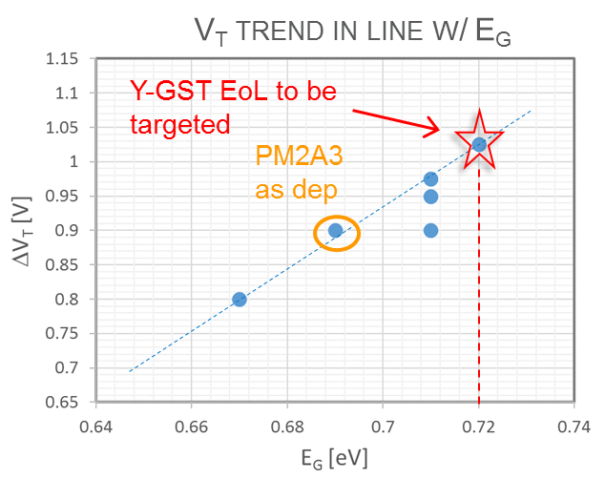
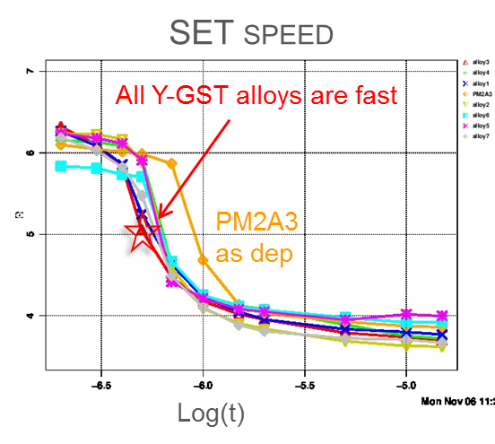
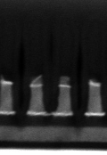
PM exploration in short term: Y-program
Status of learning on Y-GST:
On the basis of very preliminary and few:
E_{G} high enough w/ low Y% in the Sb-rich EoL region
Just only one CLV data available
Strategy:
Deposit a PM2A3-like GST matrix with ~3% Y substituting In to check the value at L3
Extend the mapping moving to the 4C
Integration:
Trials on going to find the path for etching avoiding the pronounced tapering
Agotti/Pavan
Y-GST
PM2A3
SD punch thru

Slide 8
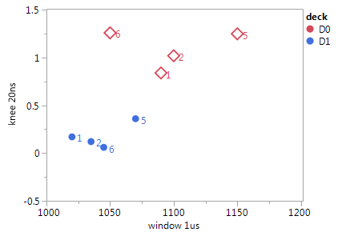
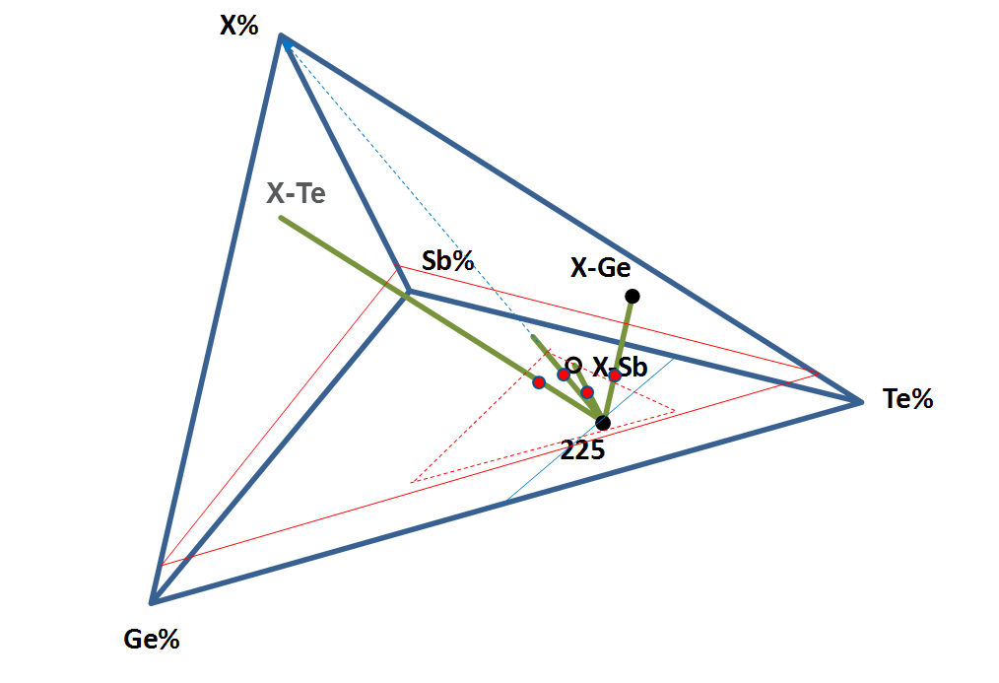
PM exploration: further options
GST Corners
Sb poor/ Te rich
Alternatives to paths to Y:
Optimization of the GST matrix → corner (Ge-Sb ratio) is suggesting some room of improvement w/ Sb-poor GST compared to PM2A3; WLR pending
Ga-GST → Ga could play, electrically, the role of Indium, but it is expected to be easier for integration (higher Ga content allowed?); sequentially to Y-GST in the 3C, wk#21
GaSbGe (GSG) → pro: Scalable due to high Tx, low volume expansion, easier to etch (no In); cons/unknown: GaSb phase separation? V_{T}-set speed correlation?; exploration can start the completion of GST corners (tentatively: wk #21)
Sc-GST → only suggestions from literature and atomistic simulation results, just lighter than Y (easier sputter etch), but not so strong value to support targets purchase now (new assessment after Y data)
Standard slope
~ 1sigma/100mV
Limited Degrees of Freedom w/ 3C

Slide 9
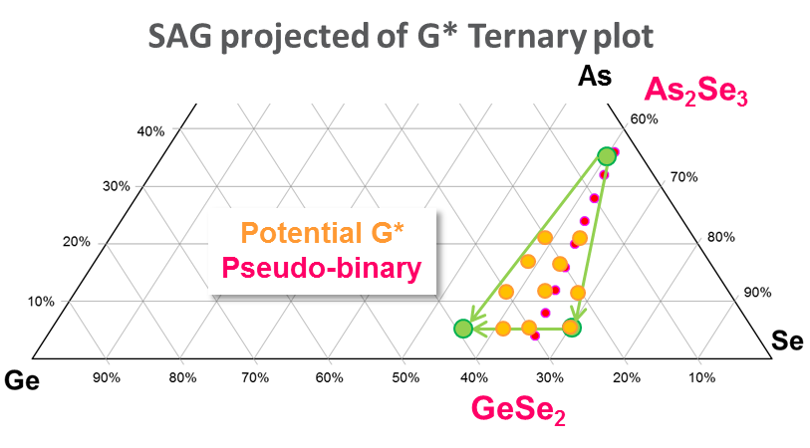
SD campaigns in the short term:
Link to all presentations
SD.K2
DTS goal
Focus on In-SAG system actually privileged alloy for some upsides:
Sigma → down up to 80/90 mV
SSM window → > 1.3 Volts
Memory Effect → ~400mV, although degrading w/ cycling
SDK.2 candidate to meet the SSM window:
SDK.2 w/ 9% will be installed in the MUM500 from week#17 w/ 2 SDK.1 mono-tgs
K* campaign still under completion exploring As% reduction possibly beneficial for SSM window → Readout wk#21
G* campaign is exploring further As% reduction, in addition to:
The role of each Ge, As, Se thru extended mapping
Stair case emulation of the programming induced segregation thru the bi-layered SD
Large In-SAG targets fabrication will focus on SDK2
2 large tgs of V16 delivered
ΔVt (1 μs)
Alloy6
SD.K1
CR5.3

Slide 10
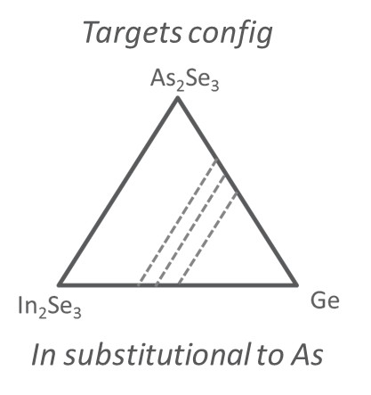
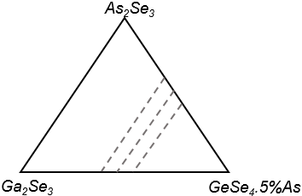
SD: medium term activity → Ga-SAG (O* campaign)
Ga-SAG value proposition:
To catch all the benefits of In-SAG (namely: good sigma, good SSM window and controlled drift), w/ plus: facilitate the integration substituting In with Ga (Gallium based SD expected to be easier for dry etch and pattern as compared to Indium based SD)
Ga₂Se₃ target available, installation after G*
Strategy:
Replicate the K* camp in a 3C with Ga sub. of In by means of As₂Se₃, Ga₂Se₃ & Ge
Replicate the K*+E* camp in a 3C with Ga sub. of In by means of As₂Se₃, Ga₂Se₃ & GeSe₄.5%As
News:
Just signed the purchase of a new 4C: this will allow to merge the two strategy speeding up the exploration!
Ga skew in the ~5-15%
Ge skew in the ~15-20%
Ga₂Se₃
Ga substitutional to As
Targets config
Ge skew in the ~15-20% (@ lower As)
Ga skew in the ~5-15%
Keep As/Se lower w/o increased Ga + Ge

Slide 11
SD: medium term activity → Ga-SAG (O* campaign)
Ga-SAG value proposition:
To catch all the benefits of In-SAG (namely: good sigma, good SSM window and controlled drift), w/ plus: facilitate the integration substituting In with Ga (Gallium based SD expected to be easier for dry etch and pattern as compared to Indium based SD)
Ga₂Se₃ target available, installation after G*
Strategy:
Replicate the K* camp in a 3C with Ga sub. of In by means of As₂Se₃, Ga₂Se₃ & Ge
Replicate the K*+E* camp in a 3C with Ga sub. of In by means of As₂Se₃, Ga₂Se₃ & GeSe₄.5%As
News:
Just signed the purchase of a new 4C: this will allow to merge the two strategy speeding up the exploration!
Ga skew in the ~5-15%
Ge skew in the ~15-20%
Ga₂Se₃
Ga substitutional to As
Targets config
Ge skew in the ~15-20% (@ lower As)
Ga skew in the ~5-15%
Keep As/Se lower w/o increased Ga + Ge

