Slide 1
P1241 Material PF Schedule Logic and Schedule
DerChang @ MWG/WW46.4
Schedule Logic is based on ATF64 Memory Qual. Spider Chip drives P1241 2D PG3 yield.
14 nm HM TD on New Material with Quad-Gun to improve speed.
IMI to narrow down PM exploration and monolithic target TD
ECD | Milestone/Deliverables
WW52 '20 | ATF64 DIMM samples (PG2 20% yield)
WW13 '20 | ATF64 Skip Array yield WW13, 1D RWB/WLR works start
WW09 '20 | Spider 14nm 2D PG2 PG3 yield
WW52 '19 | ATF64 DBR, P1241 based on Spider Block Functional with self consistent MTS/DTS
WW44 '19 | P1241 material stack validated, 2D Spider based
WW14 '19 | Spider Silicon Starts
ECD | Milestone/Deliverables
Monolithic targets – slotting for new monolithic target spec every other week
WW26 '19 | Final Set of Target defined/ordered (to support 2LC for P1241 stack definition @ WW44)
WW12 '19 | Initial Set of Target defined/ordered (Y-doped GST and In-doped SAG are prioritized)
Cosputter targets for HM development
WW08 '19 | Final Set of Cosputter targets defined/ordered with QG S/U WW16 assumption
WW01 '19 | Initial Set of Cosputter targets defined/ordered to intercept fab FL start

Slide 2
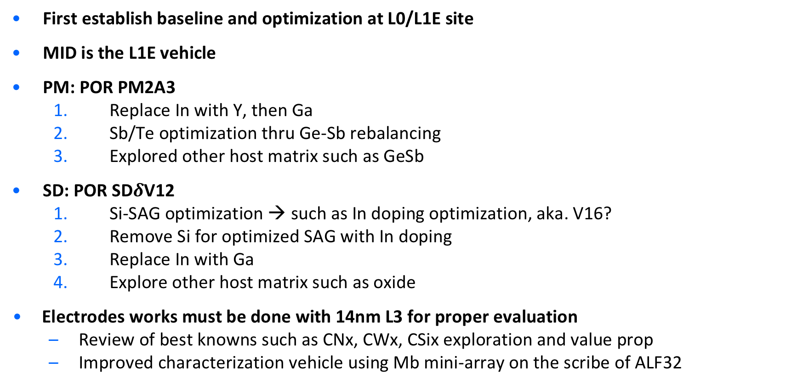
Strategy
First establish baseline and optimization at L0/L1E site
MID is the L1E vehicle
PM: POR PM2A3
  Replace In with Y, then Ga
  Sb/Te optimization thru Ge-Sb rebalancing
  Explored other host matrix such as GeSb
SD: POR SD$δ$V12
  Si-SAG optimization → such as In doping optimization, aka. V16?
  Remove Si for optimized SAG with In doping
  Replace In with Ga
  Explore other host matrix such as oxide
Electrodes works must be done with 14nm L3 for proper evaluation
  Review of best knowns such as CNx, CWx, CSix exploration and value prop
  Improved characterization vehicle using Mb mini-array on the scribe of ALF32

Slide 3
PM Milestone and Decision Point
Establish Baseline & fingerprint (PM2A3)
  IMI based L0 and L1E Metric is used
Group – I: Y-GST
  Deposit a PM2A3-like GST matrix with 1 to 9% Y substituting In
Group – II: Ga-GST
  Same Strategy to Y-GST.
Group – III: Ga-GeSb
  GeSb based publication
Group – IV: Sc-GST
  (this is questionable based on paper published)

Slide 4
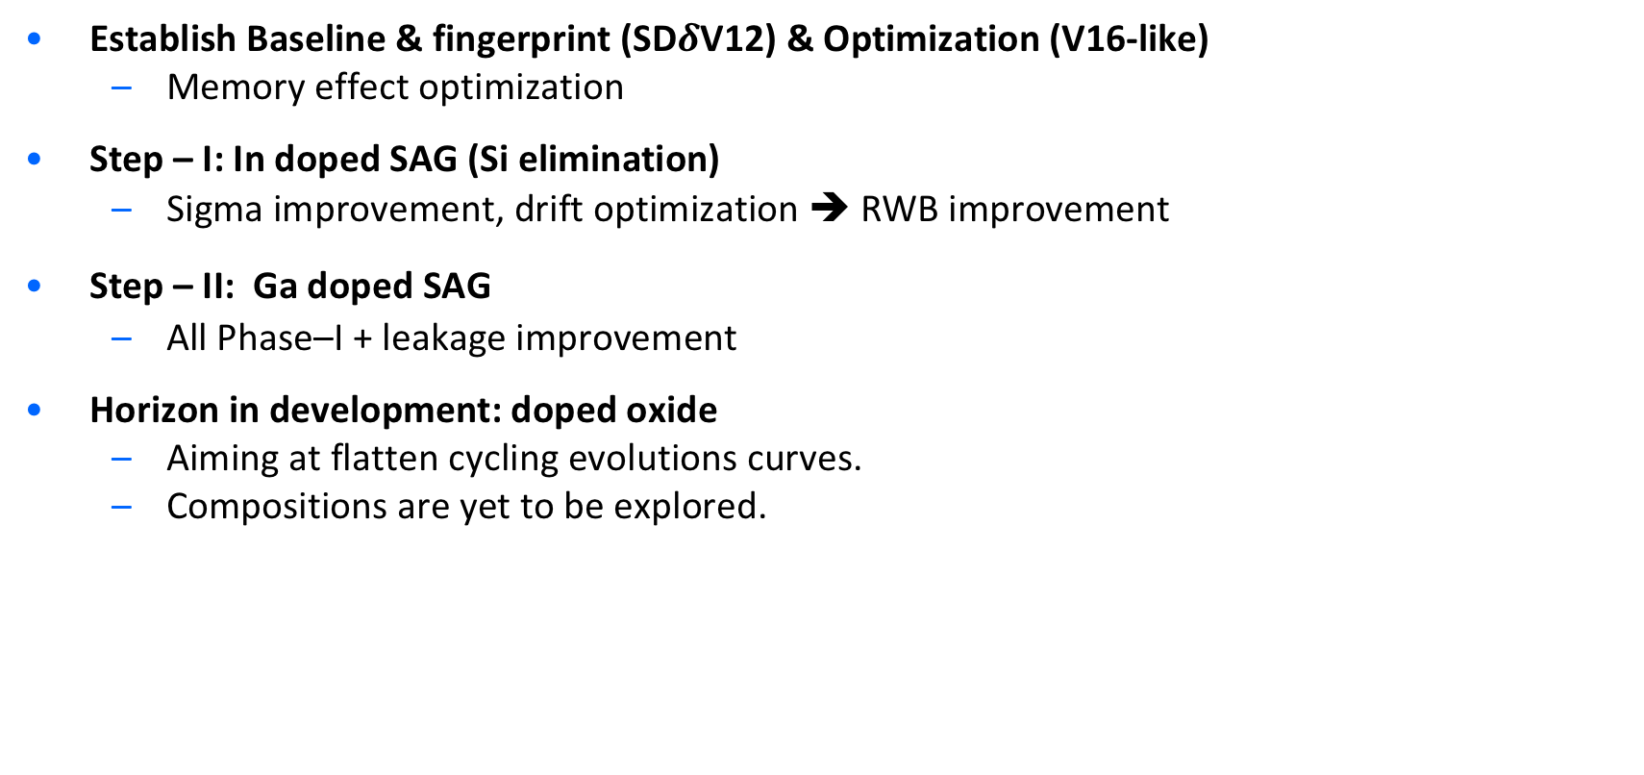
SD Milestone and Decision Point
Establish Baseline & fingerprint (SD$δ$V12) & Optimization (V16-like)
  Memory effect optimization
Step – I: In doped SAG (Si elimination)
  Sigma improvement, drift optimization ➔ RWB improvement
Step – II: Ga doped SAG
  All Phase–I + leakage improvement
Horizon in development: doped oxide
  Aiming at flatten cycling evolutions curves.
  Compositions are yet to be explored.

Slide 5
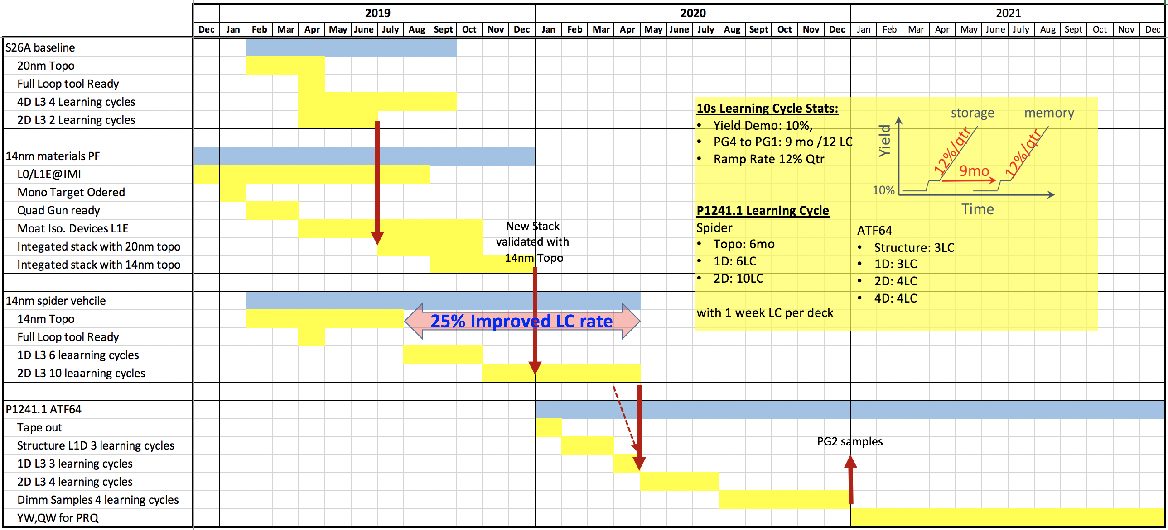
Gannt Chart & Dependencies
F11X array line is topo ready BoFeb'19 (common to 20nm baseline startup)
  Toolsets enabling key process segments (PVD, carbon, darc, litho, xp8, FX, TSN nitride, autostem, gapfill, XRF, XRD, inline metro)
S26A 2D F11X Yield Demo – EoJune'19
  Gates new material(s) integrated validation

