Slide 1
2020 Memory CSD Kickoff
Welcome!
April 27, 2020

Slide 2
The team (draft)

Slide 3
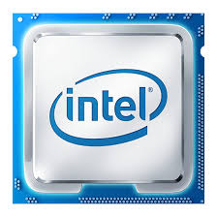






Whomever solves “data” best, wins
More data accessed more quickly by new applications stressing the hierarchy
New applications require access to more data, faster
Intel® SRAM
Intel®?
DRAM
Intel® Optane
Data is growing faster (2x/3yrs)
Intel® Optane
Intel® 3D NAND
CSD Goal: A comprehensive set of executable memory platform strategies with a unified One Intel memory technology strategy

Slide 4
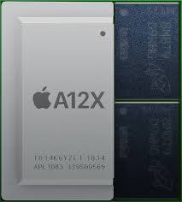
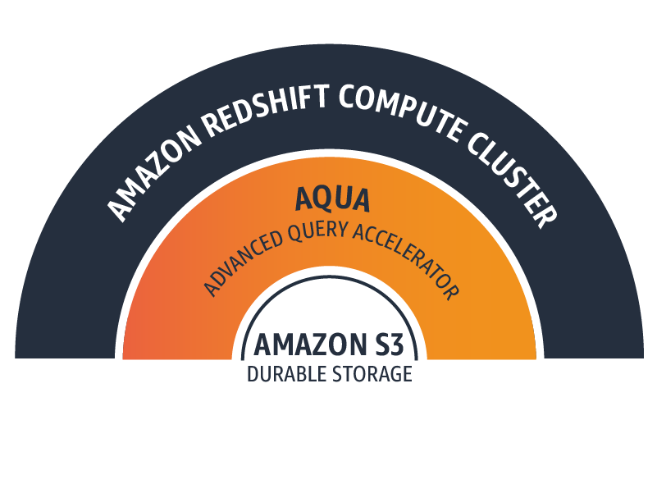
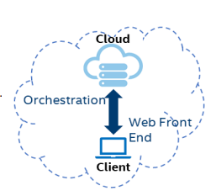


New Memory and Systems Technologies Across the Hierarchy
Potential Disruptions /
Opportunities
Technology Trends
SRAM Evolution
HBM, ADM…
New Mem
Tech/Packaging
Capacity grows 2x/4yrs
BW/capacity constant
Computational memory/storage
Optane
Memory
Pooling
Optane, SLC
Cloud
First Client
Capacity grows 2x/2yrs
BW/capacity drops
NVM Hierarchies
Italics = new technologies entering
Software

Slide 5
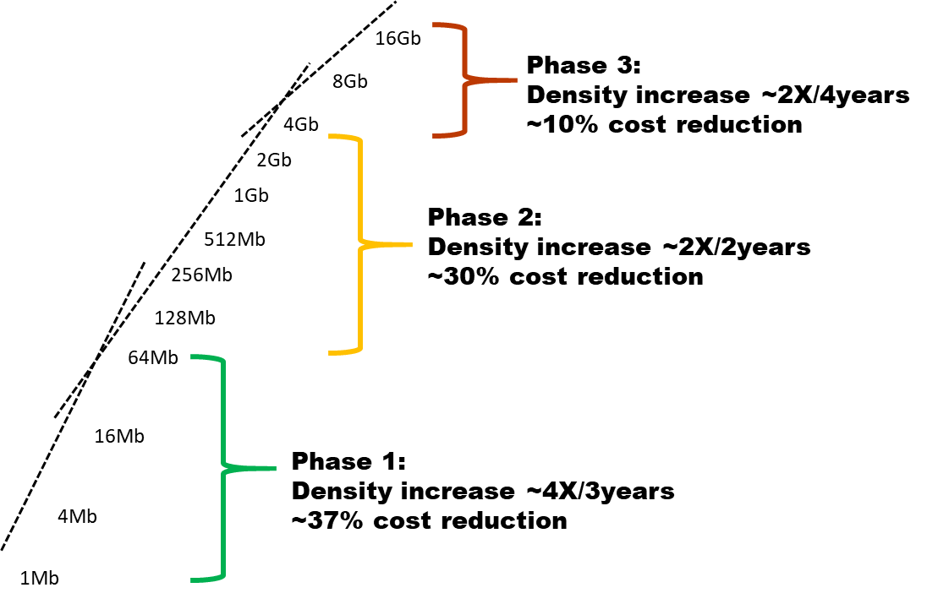
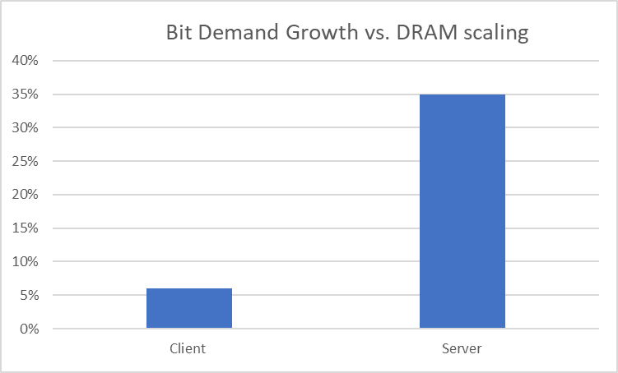
Macro Trends Forcing Economic Tradeoffs between CPU and Memory
DRAM Scaling at odds with Data Center and Client Demand
Slowing DRAM Scaling
Bifurcating Demand Growth
Demand > growth = Memory BOM growth
Demand < growth = Performance tradeoff to keep BOM stable
DRAM
Scaling
Minimum Client
Capacity too large
DRAM Dominates
Server BOM

Slide 6
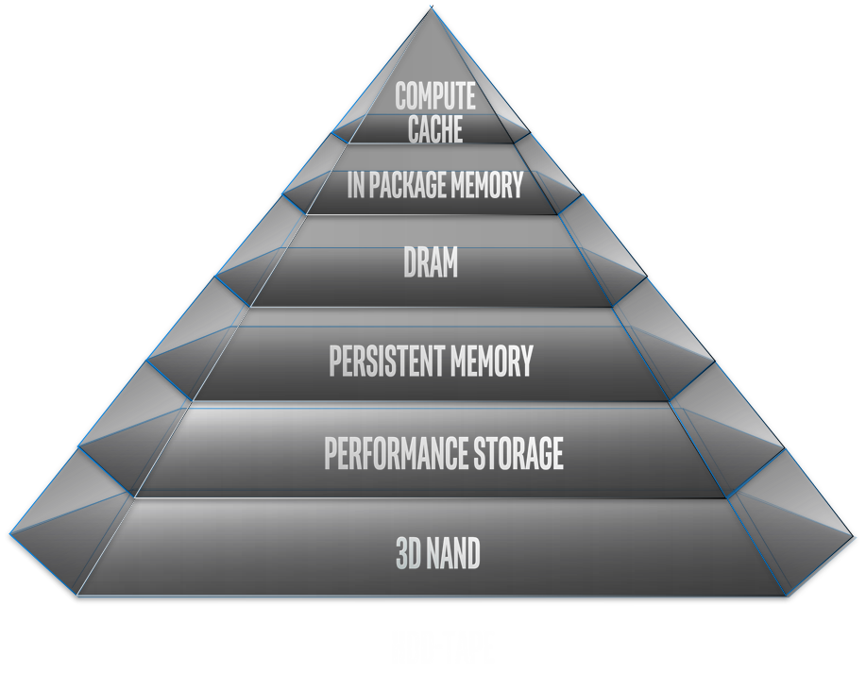
Grand Challenges Across the Hierarchy: CSD Focus
Drivers | Intel Tech Solutions | Competitors | Key Server Platform Challenges | Key Client Platform Challenges | Key VTT Platform Challenges
BW | SRAM | Startups, TSMC | SRAM competitiveness |  | RAMBO SRAM implementation, HBM/GDDR TTM
BW, BW/Cap ratio | ADM | Samsung, SK, Micron, startups | Point solutions have failed; need volume BW and BW/capacity ratio increasingly a limiting factor in *system* performance
BW, capacity | None | Samsung, SK, Micron | ↑ cores → ↑↑ DRAM Mem BOM >> CPU BOM | ↑ density driving ↑ min capacities than needed for volume segments
Capacity | Optane PM |  | Scaling PMem Application Software to drive increased volume/value
Performance | Optane SSD | Micron, Samsung | Legacy software overhead, unramped cost versus NAND
Capacity | 3DNAND SSD | Multiple | Transitioning platforms to QLC
Data center pooling
Disaggregated Cloud Clients
Areas of most acute challenges
  ‘One Intel’ memory technology considerations:
  Optimizing for platform cost and customer TCO at key points in the hierarchy
  Failing a “magical caching hierarchy” we must enable code/apps to better operate in high BW/low capacity
    GP/GPUs & accelerators designed this way from the start; core was not
  Modules may need to become *smarter* to address performance, power limitations and/or security needs
    Includes compute in memory, compute near memory

Slide 7
The Path Forward
Develop:
IPM/DRAM Layer strategies where we are lacking or incomplete
Coordinated solutions across business to drive scale and consistency across memory technologies
While Ensuring:
IPM/DRAM layer strategies fit holistically, forming a full hierarchy strategy per platform
Proposed solution(s) are business rational and reasonable
Concerns/Considerations
  Proposed disruptive solutions may shift BOM to Intel, but if they do not
  achieve the best customer performance/TCO, they will not win
  Optimization of current hierarchies will change the slope,
  but not solve the problem
  “CPU Market Relevance” or “Intel Market Relevance”? ($300B TAM)
  Manufacturing Relevance – Make or Buy?

Slide 8
Our Mission: A unified One Intel memory technology plan to enable a comprehensive set of executable memory platform strategies
Hosts of memory challenges in front of us (immediate and future)
  Not enough bandwidth
  Competing with DRAM on power, SoW
  Too much capacity
  Stranded capacity
  ...
Hosts of effort sprinkled across the company, operating relatively independently.
Need to partner together to determine a path forward.

Slide 9
Goals for Today
Quick review of ELT slides
Overview of timeline and expectations
Review key questions posed in kickoff
  How shall we hone scope? In/out/ZBB
Proposed framework
Logistics
  Who did we miss?
  Meeting frequencies (workstreams and advisory)
  Engagement expectations

Slide 10
Timeline
April: Define scope
May (primarily separate workstreams):
Explicitly define “what is needed” based on customer use cases
Assess what is and will be available (memory technologies)
Platform architecture: define target hierarchies with assumptions
May 18: 50% checkpoint @CSO
June (collective CSD teams):
June 1: 60% checkpoint @CSO; June 8: 60% Review with ELT
Business assessment
Begin for formulate option/strategy proposals → look for gaps
July:
Refine strategies
July 13: 95% checkpoint @CSO; July 20: CSD report out to ELT

Slide 11
Key questions: Understanding platform challenges and identifying where Intel can use its IDM advantage to capture value
How are the relevant application trends, use cases, and KPIs impacting the full memory hierarchy and system architecture in the segments of interest (cloud, edge, client)?
How do we lead in software solutions for all platforms and hierarchies so that we are a *preferential* solution for our customers and the developer ecosystem?
How do we solve for bandwidth and capacity in Data Center? Is IPM a necessary part of the solution? If so, which one? Make or buy?
How do we solve for bandwidth versus capacity in client? Is IPM a necessary part of the solution? If so, which one? Make or buy? How do we align the IPM needs of Client and DC to provided needed memory technology scale?
What is the right prioritization of Intel’s current memory/compute technologies that maximizes customer benefit and Intel’s IDM business potential?
Is there a scenario where the architectures of the future shift Intel's future IDM output from 80% logic, 20% memory to 50% memory or more?
How do we focus efforts to drive volumes on Optane to fill the fab?
Is there a play in DRAM?
Where will memories become *smarter*? Do we invest there?

Slide 12
Key Questions: Understanding the ecosystem, identifying and effectively addressing competitive threats
What internal hurdles to new technology adoption must be removed?
Can a power/performance/cost 'wall' be used to identify markets ready for a tipping point or about to rapidly expand as a result of innovation in memory and compute architecture?
What are our competitive threats, and how do we get in front of them?
What are those ‘black swan’ scenarios where the industry grows but we are left behind due to missed memory innovations?
Does driving memory innovation necessarily mean competing in the memory market at scale?

Slide 13
Engagement Expectations
All:
One Intel
ALL ideas are on the table
Active listening, constructive confrontation
Data driven
Advisory: Timely, constructive feedback on progress. Help team identify and address blind spots
Workstreams:
Commitment to task, rolling up the sleeves and doing the work.(most work will take place outside formal meeting structure)

Slide 14
Proposed Structure
Advisory
Data Teams
Business
Platform Architecture
Memory Technology

Slide 15
The team (draft)

Slide 16
BACKUP

Slide 17
CSD Process
Apr 2020 SLRP
Apr - Jul 2020
Jul 2020
+2 weeks
Ongoing execution
August
Sept. Strategy BOD
March / April
CSD & leads identified
Develop CSD
ELT discussion
Mobilization plan alignment
Mobilize CSD
SLRP Direction Check
SBOD
2021
SLRP
CSD: a tool to resolve “strategic dissonance”
Potential to lead Intel in new direction
Grounded in a clear problem statement
Prep options to address problem statement
May involve 5-10 orgs, 50 + people
Multiple swimlanes
Many sessions & deck revisions
Develop detailed plan of action, OKRs
Drive the company to execute the plan
Regular report-outs of progress against the plan
ELT check point for CSDs
Lead up to the SBOD
Strategic options/plans expressed in SBOD
Includes TAM / revenue upside & level of investment
Deck and white paper provided in advance
Discussion goal:
25% intro / context and 75% options / plan
Review detailed plan (milestones & OKRs) with ELT exec sponsor
Identify accountable leaders
2020 CSD scorecard / progress report out
Notes:
Strategic Dissonance - which is the divergence between the basis of competition and the firm’s distinctive competence and strategic intent and strategic action.

