Slide 1
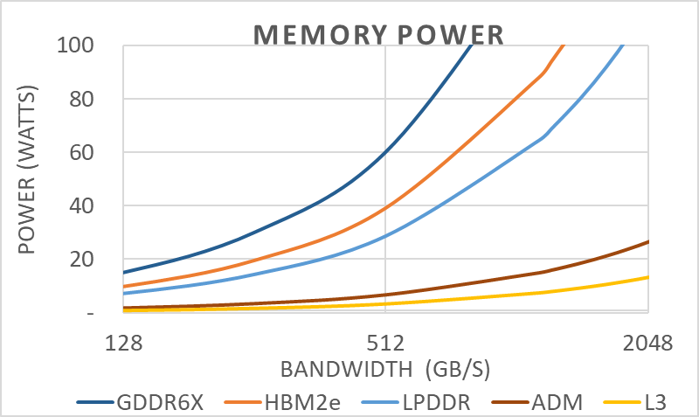
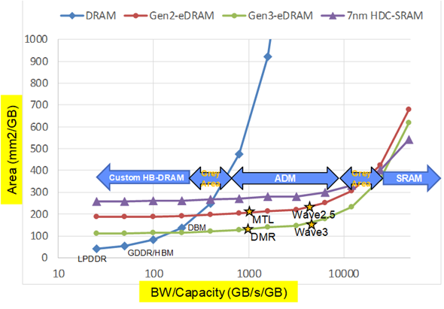
overall_0_132394837709409303 columns_1_132394770639920655 3_1_132394770639920655 7_1_132394770639920655 10_1_132394770639920655 16_1_132394770639920655
Technical Fundamentals Drive High Bandwidth Memory Selection
 | Specification
Process | 7nm CMOS
Die Size | 9 x 9 mm (SRAM die)
Package Size | 12 x 12 mm
SRAM Capacity | 64Mb/die
Supply Voltage | 0.85V(Logic/SRAM), 1.0V (TSVIO), 1.8V (GPIO)
Frequency | ~760MHz
# of channel | 128bit x 2ch
Power | 0.156W (SRAM+TSVIO)
Bandwidth | 24.3GB/s per channel
Latency | 7.2 ns(read), 2.6 ns (write)
Mb/mm² | 0.79
mm²/GB | 10368
GB/s/GB | 6221
1R1W [pJ/b] | 6
Memory Power:
Changing Memory type required eventually as bandwidth grows but power budget remains
Interconnect Power:
Lower capacitance memory interconnect required as bandwidth grows but power budget remains
Bandwidth/Capacity:
The area efficient memory depends on the combination of capacity / bandwidth needed
(6221, 10368)
~6 pJ/b (1R/1W)
SoC
1pJ/b
Core
0.1pJ/b
2.4pJ/b
2pJ/b
ADM
3.7pJ/b
SoC
DRAM
Lower Power
Tightly Coupled
Power Efficient
On die connect
Higher Power
Board Connect
Board Capacitance
Phy power
Source: Randy Osborne
Source: Fatih Hamzaoglu, Bob Royer
Source: Fatih Hamzaoglu
With low pJ/b, tight integration, and high bandwidth/capacity
ADM promises a unique opportunity for Intel
1

Slide 2
overall_0_132394837709409303 columns_1_132394770639920655 3_1_132394770639920655 7_1_132394770639920655 10_1_132394770639920655 16_1_132394770639920655
Technical Fundamentals Drive High Bandwidth Memory Selection
Memory Power:
Changing Memory type required eventually as bandwidth grows but power budget remains
Interconnect Power:
Lower capacitance memory interconnect required as bandwidth grows but power budget remains
Bandwidth/Capacity:
The area efficient memory depends on the combination of capacity / bandwidth needed
(6221, 10368)
~6 pJ/b (1R/1W)
SoC
1pJ/b
Core
0.1pJ/b
2.4pJ/b
2pJ/b
ADM
3.7pJ/b
SoC
DRAM
Lower Power
Tightly Coupled
Power Efficient
On die connect
Higher Power
Board Connect
Board Capacitance
Phy power
Source: Randy Osborne
Source: Fatih Hamzaoglu, Bob Royer
Source: Fatih Hamzaoglu
With low pJ/b, tight integration, and high bandwidth/capacity
ADM promises a unique opportunity for Intel
2

