Slide 1
Agenda
DRAM Ecosystem Update (20 min)
CSD scope/hypothesis – Discussion (20 min)
Working Logistics (10 min)

Slide 2
Recent Roadmap Gap Resolution
Intel’s Vision | Resolution
No more DDR4 Extensions | No DDR4 extension, 1znm is the last shrink for all suppliers.
DDR4 RAS/Row Hammer improvements for ICX | Suppliers cooperating to improve RAS. Praises to Intel for openness and desire to use as model for future cooperation.
Long term LP3, LP4 supply line for AML and CML | Suppliers extended LP3/LP4 life according to customer demand
LP5 7400 availability for MTL in 2022 | Supplier roadmaps aligned. Spec implementation under debate in JEDEC. Voltage outcome could still limit benefits in client.
Custom packages for MTL: OPM and low cost x64 | Intel move OPM TR to standard package. Intel MTL M package drives high cost MB, little volume would benefit from lower cost x64 BGA
Low cost external IPM to boost graphics performance | Intel investing on ADM instead.
GDDR6 20Gb support for DG2 | Intel design is only reaching 16-18Gbps.
12Gb support for SPR, 12 & 24Gb support for GNR and beyond. | All suppliers maximizing their ROI and planning to support 24Gb for GNR and beyond. Resulting in SPR competitive exposure (est. $600M) & overprovisioning in future 2LM vision.
Suppliers improve HBM2e power/thermals | Intel having to address the issue through system design (e.g. cooling) or manufacturing (e.g. BSM)
HBM3 supports 24Gb die for higher capacity and lower power | Suppliers pursuing 12H with 16Gb die due to process/die size limitations to meet FF.
Suppliers enable lower-cost, 2DIMM population by reducing min die density (DDR5 8Gb, LPDDR5x 8Gb) | Supplier limited by process/economic die size availability. Need to move to higher die density to keep density, speed, cost, power progressing.
Ack. Percy Soto
Industry Adapting
Intel Adapting
Request Dropped

Slide 3
Intel DRAM Alignment Roadmap
(Updated 4/14/20, ack Percy Soto)
Blue = Intel
Black = Industry
Underlined = Volume driver
Numbers=Memory speed
 | 2020 | 2021 | 2022 | 2023 | 2024
ICX
SPR
GNR
DMR
CYR
DPG
3.2
DDR5
Comp.
risk
DDR5
No 12Gb Support
24Gb alignment
Samsung health risk
6.4
DDR5 EOL alignment
Power/Si scalability limitations
Speed roadmap alignment >6.4
DDR4
5.6, +MCR, +24Gb
7.2
!
RAS
!
4.8
!
!
3.2
4.8
4.8 (5.2)
!
Pricing Risk, No DDR4
RAS/RH
5.6 (6.4)
TDB
!
8GB/Channel Min
TGL
ADL
MTL
LNL
NVL
CCG & IOTG
LP3/LP4
7.4 (8.5)
8.5
TBD
LP4x
4.2
!
>6.4 Voltage implementation
Capacity overprovisioning
Continued 4GB support
!
Hierarchy
Requirements
5.4 (6.4)
!
Visibility
5.5
6.4
7.4 (8.5)
-8Gb
8.5
Mobile Ind.
LP5
!
Visibility (LP6, IPM?)
+16Gb
!
Lack of BW pull/power focus
ATS/PVC/SPR+HBM2e
JPS
GNR+HBM
AI/Visual
2.8 /3.2
4.8+
Schedule
Power/thermals
4.8+
Speed vs capacity vs thermal issues
Single voice across groups
!
!
HBM Ind.
HBM3
HBM2e
Schedule (moving towards alignment)
Speed/capacity alignment
Predominantly Procured
3.2 (3.6)
3.2-(3.6)
3.6
4.0
!
DG1
Niagara Falls (DG2)
DG3
Intel Graphics
LP4x
TBD
2Gb
16
Procurement model
>20
!
Graphics Ind.
GDDR6*
GDDR7
16
18/20
20-24(SS, GDDR6e)
!
Visibility (IPM?)
* GDDR6 speed can go above stock speeds depending on system level signal integrity
Intel Restricted Secret
Notes:
HBM3 initial power OK probably, later they may need to use HKMG and/or Logic process based die.

Slide 4
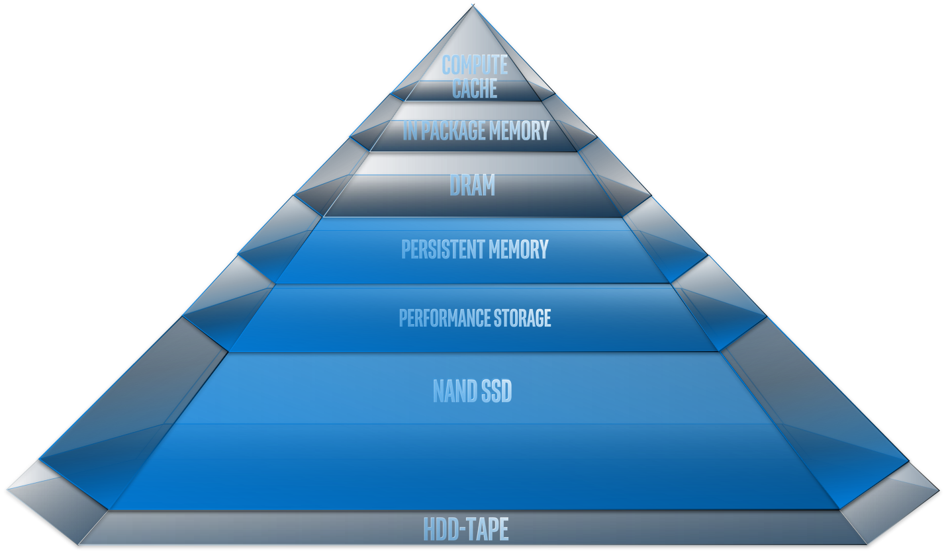
Scope Discussion
DC Hypothesis: DRAM technology vector is not favorable for continued DC process use - it is consuming increasing the capex(Cost) and opex (power) creating unsustainable condition for DC unless we do something
Client Hypothesis: DRAM BW per capacity ratio is driving too much capacity and not enough bandwidth increasing cost and not providing the performance needed
Graphics Hypothesis: Delivering the Bandwidth required draws too much power
Hypothesis: Unlike in the past, DRAM technology advances will not deliver what IA compute needs in Client and DC resulting in an increasingly suboptimal platform solutions from Intel. Intel needs to actively address this problem at the technology, system, and business level.
Need to show
  DRAM technology won’t deliver what we need (technology and business driven)
  Why Intel needs to solve this rather than industry alone
  What success looks like for our customers, and us
  Path to solution
  Others...

Slide 5
Logistics
Split into Advisory Group and Working Groups
3 working groups convene this week:
  Business – facilitated by Carolyn
  Technology – facilitated by Mark
  Systems – facilitated by Frank
Advisory Group engaged via email and timely meetings
  Meet before milestones
  Please provide timely feedback
Small Coordination team keeps us moving forward
CSD Milestones:
May 18 50% checkpoint at CSO
June 1 60% checkpoint at CSO
June 8 60% review with ELT
July 13 90% @CSO
July 20 ELT report out

Slide 6
Business WG Data/questions (Carolyn)
Examples
What are the biggest pain points for our customers
  How do we measure this?
  How is our competition (memory or CPU) attempting to solve them?
What do folks get paid for today, and how is that changing (If it is)?
What is the effect on margin? How does it change our approach? Keep it pure, or is it getting in the way?
What compelled our decisions to enter into 3D NAND, Optane, eDRAM, ADM?
How does out business model change (or not) if the memory comes from Intel
How would we change our way of doing business to move away from “not shipping memory” History of controlling b/w to SRAM as discrete same as HBM right now?
Proposed team:
Haluk Balkan/Eric Leta
Eyran Eylon
Melissa Gregg
Nate Mather
Adrian Moga
Madhu Rangarajan
Edi Roytman
Percy Soto
Sanjay Talreja

Slide 7
Technology WG Data/questions (Mark)
What memory capability exists today, and roadmap?
  What are the memory technology “holes” we see?
What are the relevant packaging technologies that should be applied
How does the physics of high bandwidth memory access drive out direction
What are the disruptive memories we should be prepared for?
How easy would it be to integrate alternatives into a system?
Proposed team:
Kuljit Bains
Wilfred Gomes
Fatih Hamzaoglu
Ramune Nagisetty
Dmitri Nikonov
Shigeki Tomishima

Slide 8
Systems WG Data/questions (Frank)
What are the Memory hierarchy challenges (by vertical)?
What customer usages are not well supported now, and in the future?
What platform trends do we see that are relevant
What CSP driven solutions do we expect in DC
What are the software driven opportunities and limitations
What memory hierarchy is needed for leadership discrete graphics and AI
Proposed team:
Wajdi Feghali
Josh Fryman
Duane Galbi
Randy Osborne
Jay Pickett
Bob Royer
Mark Sharpness
Dimitrios Ziakas

Slide 9
Next Steps
WG members: look for an invite from Carolyn, Frank or Mark
Advisory members: meet again before May 18th, watch for email updates
All: contact Carolyn, Mark, Frank with guidance, comments
  Especially now with scope and hypothesis input

Slide 10
Backup

Slide 11
Timeline
From last meeting
Today: Define scope
May (primarily separate workstreams):
Explicitly define “what is needed” based on customer use cases
Assess what is and will be available (memory technologies)
Platform system/architecture: define target hierarchies with assumptions
May 18: 50% checkpoint @CSO
June (collective CSD teams):
June 1: 60% checkpoint @CSO; June 8: 60% Review with ELT
Business assessment
Begin for formulate option/strategy proposals → look for gaps
July:
Refine strategies
July 13: 95% checkpoint @CSO; July 20: CSD report out to ELT

Slide 12
Advisory team
Sailesh Kottapalli
Becky Loop
Peter Onufryk
Matt Adiletta
Srinivas Chennupaty
Rick Coulson
Al Fazio
Ronak Singhal
Eric Karl
Sponsors: Rob, Raja, Navin, Murthy

