Slide 1
DC CSD Problem to solve
Environment
# of cores increasing rapidly to meet competition (faster than DRAM scaling)
CSPs maintain a fixed core to DRAM capacity and performance ratio
End of Dennard scaling means increasing DRAM performance = increasing power draw; Racks have fixed power limits
Data scaling 2x in 3 years, DRAM capacity scaling 2x in 4 years
BW and BW/capacity ratio increasingly a limiting factor in *system* performance
Widely recognized problem with all players motivated to solve/innovate – it’s a race
Problem statement options
↑ core count trend coupled with ↑↑ DRAM capacity/power is creating unsustainable increases in Capex(cost) and Op/Ex(power) for our customers. (Industry issue)
CPU + DRAM platform trajectory is leading to a decreasing relevance for Intel’s products: Less $s for the CPU, Less power for CPU (Intel issue)
As customers optimize for TCO and revenue per core, Intel’s current IA platform trajectory forces DRAM/memory tradeoffs that lead to decreasing relevance for Intel’s products – lower ASP/per core, less available power per core, and greater adoption of workload specific custom silicon.
If we don’t solve these issues best ourselves, it will get solved to our detriment.

Slide 2
Client Problem to Solve
Environment
DRAM bandwidth is lagging graphics and AI needs
Platform bandwidth need already driving greater capacity (2x) than needed (at 2x the price) and getting worse
Intel is behind on packaging innovation (Apple with A12x) while Intel is planning first IPM with MTL in small % of high-end platforms
Increasing DRAM bandwidth will decrease platform battery life without platform direction change (packaging, memory technology or other)
Problem statement options
DRAM lagging the bandwidth needed for compute and not allowing desired platform power reductions while simultaneously requiring capacities (and cost) larger than needed.
DRAM technology driven DRAM/Power/Capacity combination increasingly mismatched to client platform needs, eroding client platform power, performance, and cost while retarding graphics performance – ripe for inflection.

Slide 3
Graphics/AI Problem to be solved
Environment
Graphics Hypothesis: DRAM vector is consuming too much power to deliver the bandwidth needed (BW/Watt issue)

Slide 4
Problem statement by point of view
Business
Intel – what does our business need
Customers – what will our customers optimize for
Memory Suppliers – what will memory suppliers optimize for
Technology
Physics problem
Computer architecture problem

Slide 5
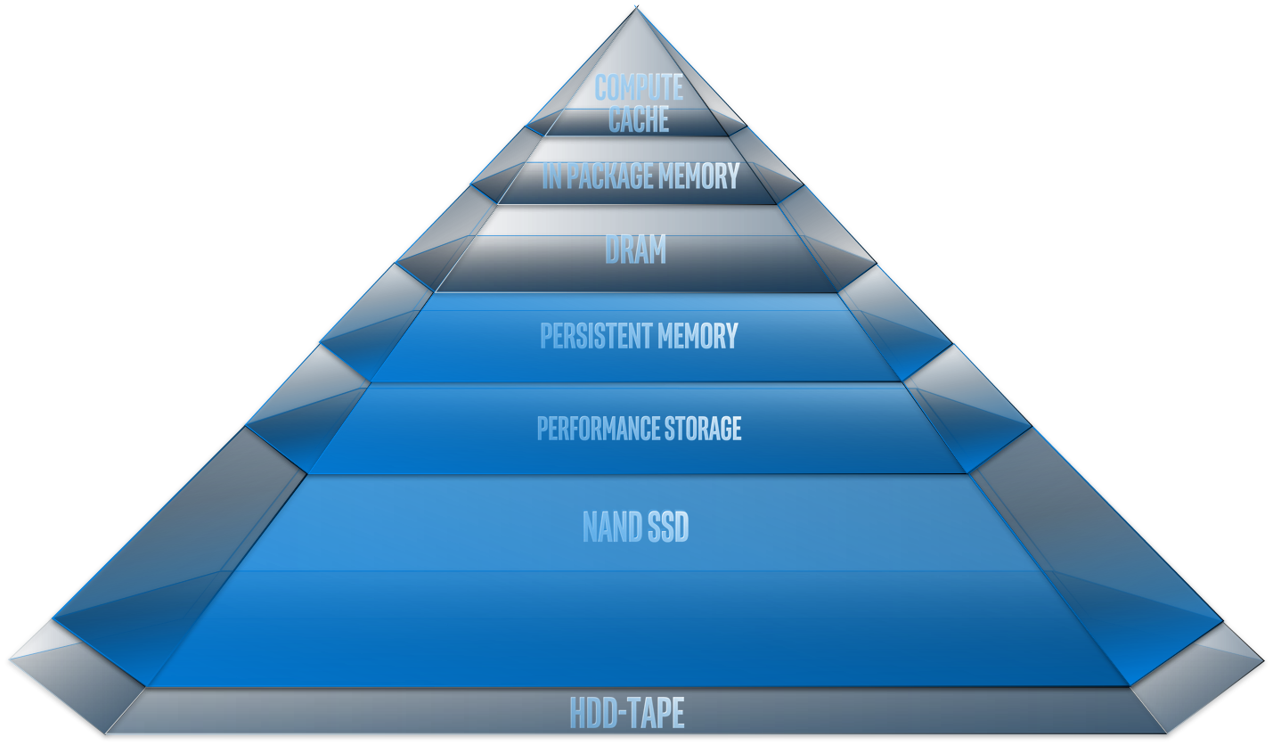
Scope/Approach
Focus on ld/st memory (not file open, read/write storage)
Focus on DRAM Technology Vector driven issues
Vector means co-rate of change in cost, capacity, power, bandwidth
Versus CPU and Platform technology directions
List the issues driven from that level
Identify hierarchy wide solutions (DRAM and rest) to those issues
Power / BW
Bandwidth / GB
1 DRAM
Die
Capacity / $
Rate of Cap. growth = BW growth
Rate of Pwr growth > BW growth

Slide 6
What is different now?
Technologies hitting a power/thermal wall – with end of Denard scaling increases in throughput require more power
DRAM I/O reaching electrical limit
Core scaling is driving need for commensurate increase in DRAM capacity and bandwidth at great cost (DC)
Delivering needed bandwidth results in more DRAM capacity than is needed – and more cost (client)

