Slide 1
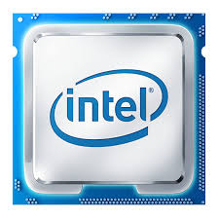
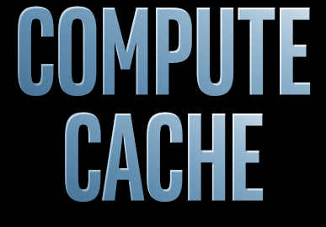



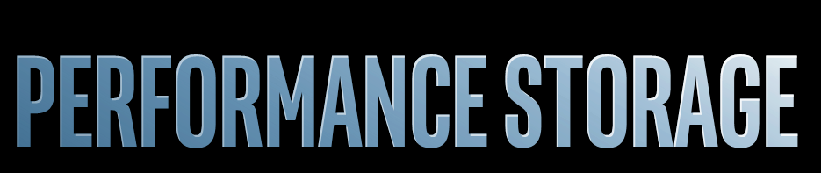
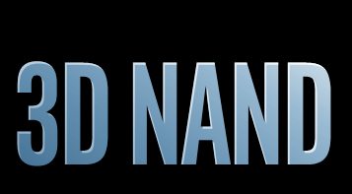

Whomever solves “data” best, wins More data accessed more quickly by new applications stressing the hierarchy
New applications require access to more data, faster
Intel® SRAM
Intel®?
DRAM
Intel® Optane
Data is growing faster (2x/3yrs)
Intel® Optane
Intel® 3D NAND
CSD Goal: A comprehensive set of executable memory platform strategies with a unified One Intel memory technology strategy

Slide 2
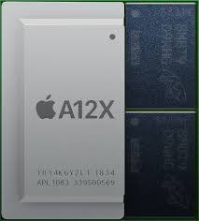
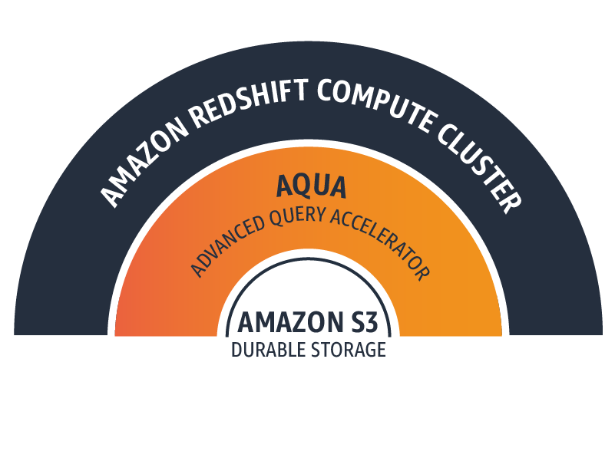
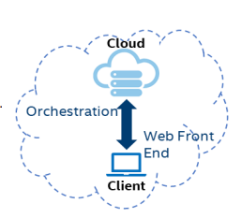
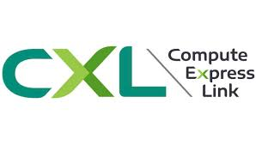

New Memory and Systems Technologies Across the Hierarchy
Potential Disruptions /
Opportunities
Technology Trends
SRAM Evolution
HBM, ADM…
New Mem
Tech/Packaging
Capacity grows 2x/4yrs
BW/capacity constant
Computational memory/storage
Optane
Memory
Pooling
Optane, SLC
Cloud First Client
Capacity grows 2x/2yrs
BW/capacity drops
NVM Hierarchies
Italics = new technologies entering
Software

Slide 3
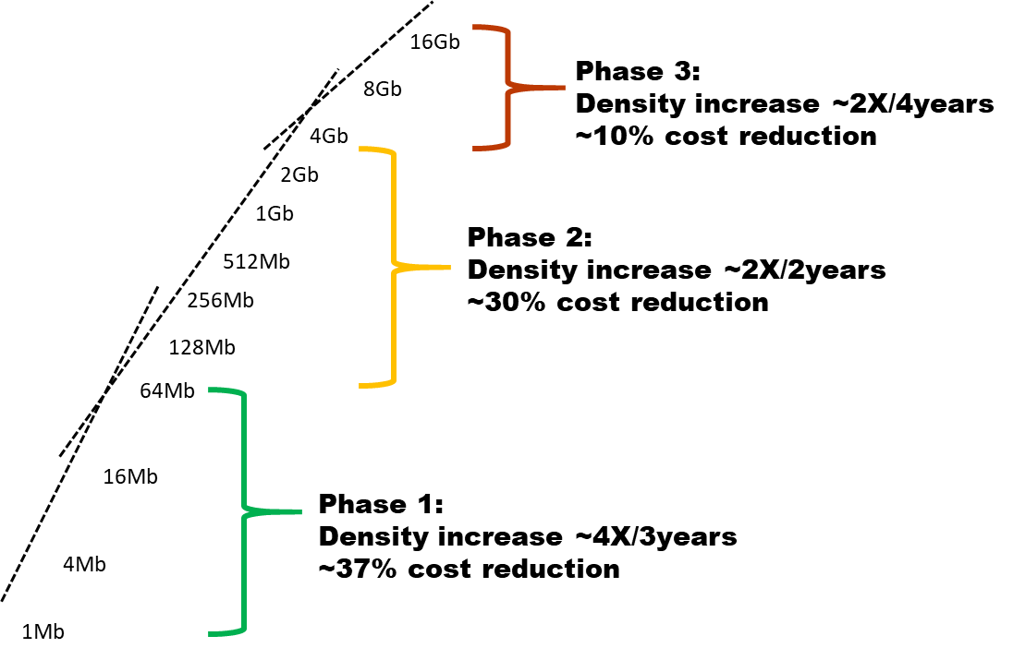
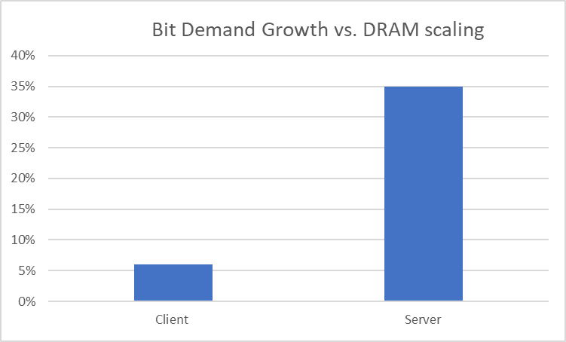
Macro Trends Forcing Economic Tradeoffs between CPU and Memory DRAM Scaling at odds with Data Center and Client Demand
Slowing DRAM Scaling
Bifurcating Demand Growth
Demand > growth = Memory BOM growth
Demand < growth = Performance tradeoff to keep BOM stable
DRAM
Scaling
Minimum Client
Capacity too large
DRAM Dominates
Server BOM

Slide 4
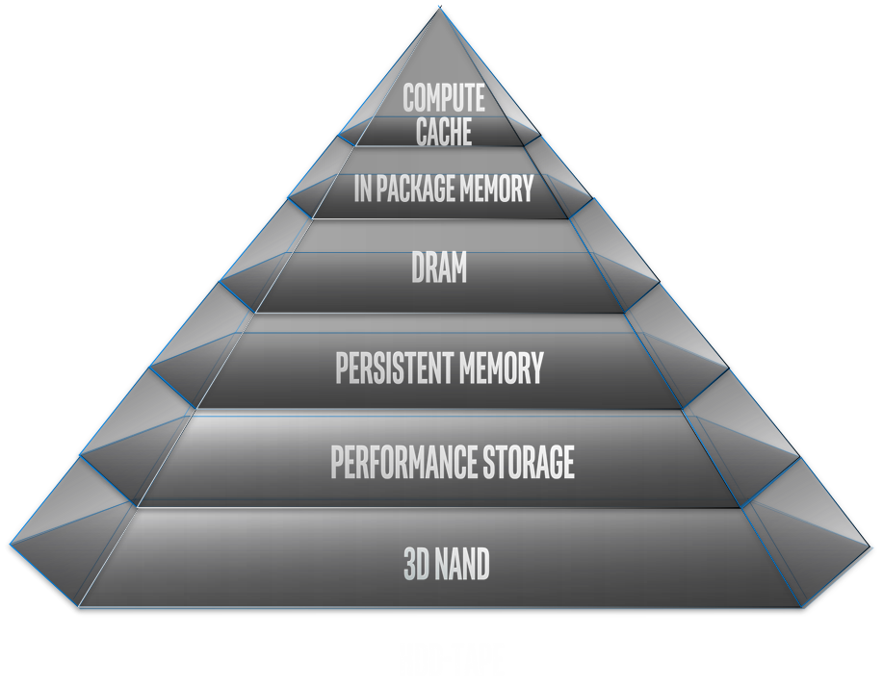
Grand Challenges Across the Hierarchy: CSD Focus
Drivers | Intel Tech Solutions | Competitors | Key Server Platform Challenges | Key Client Platform Challenges | Key VTT Platform Challenges
BW | SRAM | Startups, TSMC | SRAM competitiveness |  | RAMBO SRAM implementation, HBM/GDDR TTM
BW, BW/Cap ratio | ADM | Samsung, SK, Micron, startups | Point solutions have failed; need volume BW and BW/capacity ratio increasingly a limiting factor in *system* performance
BW, capacity | None | Samsung, SK, Micron | ↑ cores → ↑↑ DRAM Mem BOM >> CPU BOM | ↑ density driving ↑ min capacities than needed for volume segments
Capacity | Optane PM |  | Scaling PMem Application Software to drive increased volume/value
Performance | Optane SSD | Micron, Samsung | Legacy software overhead, unramped cost versus NAND
Capacity | 3DNAND SSD | Multiple | Transitioning platforms to QLC
Data center pooling
Disaggregated Cloud Clients
Areas of most acute challenges
‘One Intel’ memory technology considerations:
Optimizing for platform cost and customer TCO at key points in the hierarchy
Failing a “magical caching hierarchy” we must enable code/apps to better operate in high BW/low capacity
GP/GPUs & accelerators designed this way from the start; core was not
Modules may need to become *smarter* to address performance, power limitations and/or security needs
Includes compute in memory, compute near memory

Slide 5
The Path Forward
Develop:
IPM/DRAM Layer strategies where we are lacking or incomplete
Coordinated solutions across business to drive scale and consistency across memory technologies
While Ensuring:
IPM/DRAM layer strategies fit holistically, forming a full hierarchy strategy per platform
Proposed solution(s) are business rational and reasonable
Concerns/Considerations
Proposed disruptive solutions may shift BOM to Intel, but if they do not achieve the best customer performance/TCO, they will not win
Optimization of current hierarchies will change the slope, but not solve the problem
“CPU Market Relevance” or “Intel Market Relevance”? ($300B TAM)
Manufacturing Relevance – Make or Buy?

