Slide 1
Memory CSD 2020
overall_0_132387070454352721 columns_1_132387070454352721
July 30th, 2020
ELT discussion
1

Slide 2
overall_1_132401064422993502 columns_1_132401064422993502
Thank you to the MANY who helped make this CSD Happen
High Engagement / Inclusive / Corporate-Wide
Leads: Carolyn Duran / Frank Hady
CSO: Mark Pontarelli
Corporate Effort
Team of Experts and Advisors
DPG* CCG
IAGS TMG
NSG CSO
SMG CEG
ICAP XPG
Finance
Supply Chain
Intel Labs
IP Engineering
Bain
*CESG, DPEA, IOTG, MIO, NPG, SBDO, XMG
Sponsors: Rob Crooke, Raja Koduri, Murthy Renduchintala, Navin Shenoy
2

Slide 3
overall_1_132401064676556521 columns_1_132401064676556521
Expected Outcome
Align: We *must* do something to address the fundamental physics limitations of high bandwidth data movement in order to scale compute.
We are NOT suggesting Intel get into the DRAM business
Discuss/Decide: Strengthen XPU product leadership by establishing a differentiated cache strategy
Invest and deliver Adamantine technology roadmap for a differentiating 1s of Gigabytes cache
Commit to employing that solution for AI/Graphics/Xeon products
Act: As a result of this CSD we will also
Work with the DRAM industry and key customers to ensure Intel is competitive for 10s of Gigabyte high bandwidth working sets
Initiate an *ELT empowered* Memory Initiative to ensure cross BU alignment in memory requirements and systems innovations
3

Slide 4
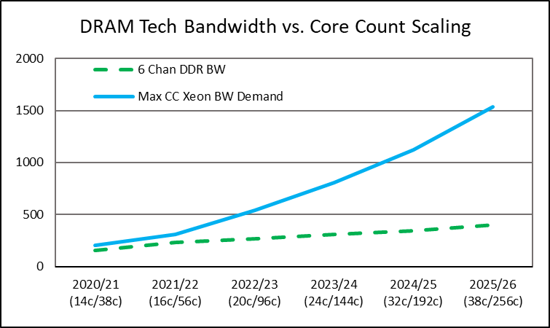
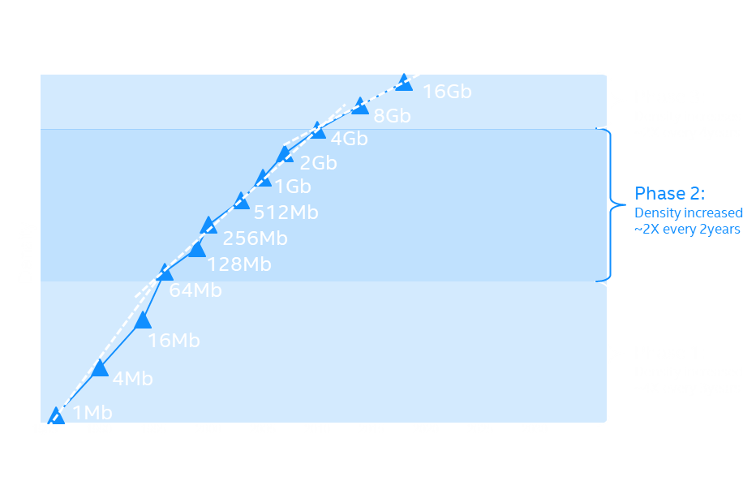
overall_0_132401078426434625 columns_1_132401065557642411 130_0_132401065557642411
Memory CSD Scope: SRAM to DRAM
Usages
Demand
Faster
Access
To
More
Data
SRAM
BANDWIDTH GAP
2020
Memory
CSD
Ack: Ziakas
DRAM is Falling Behind in Performance: This CSD
DRAM
Optane™ Memory & SSDs
2010
Memory
CSD
Optane™
DRAM is Falling Behind in Capacity: Optane™ Strategy
Data
growing
faster
(2x/3yr)
NAND
2006 NAND MFG
DRAM Capacity per Die
NAND SSDs
4
4
Ack: Soto

Slide 5
overall_0_132336803954484413 columns_2_132356797223791196 9_0_132336803960765045 4_1_132342923606233529 3_1_132399224063858672
Memory BW / system-bounded (AI/Graphics workloads)
Today’s DRAM challenges across segments: problem statements
TCO (BW/core)-bounded
Data center: Core count & AI are scaling faster than DRAM bandwidth/capacity/power
Client: Application needs are increasingly misaligned with DRAM technology
Accelerators: Memory performance bottlenecking system performance
% cores and workloads (today)
Client CPU volume (today)
Accelerator revenue TAM (today)
HPC, Scale-up DB & analytics, accel headnode
Mobility Performance
Lost performance – lack of needed bandwidth hurts Gaming (Graphics), AI and multi-core performance
Prosumer, Ultra-enthusiast
HPC, scale-out Big data analytics, AI training, etc.
Mobility Premium
Performance
HPC/ Exascale, DL/Training, Cloud Gfx, media, transcode, analytics, etc.
Mainstream IaaS/SaaS
Scale-out workloads
Cost focused platforms requiring less capacity than the minimum capacity available: Oppty to lower the cost or provide more performance at same cost
Enthusiast, Performance
App Dev, CRM, Media, etc.
Mainstream
Value, low-end IaaS/SaaS & storage
IT infra., collab, data warehousing, etc.
Other server accelerators
Mainstream & Entry
Entry
Cloud CPU
Enterprise CPU
Client CPU
Server Accelerator
Client dGPU
Creating unsustainable increases in our customer’s Capex (cost) and OpEx (power)
Not delivering performance customers can charge for (relative to GPU, accelerators)
Decreasing the relevance of Intel products because consumers cannot access full benefit
Cost focused platforms paying for more capacity than needed
Performance focused clients suffering low graphics performance due to DRAM bandwidth shortfalls
DC Accelerator: Customers want max BW, 10’s of GB capacity per chip, and min power and are prepared to pay for memory architecture innovations.
Client Accelerator: high Graphics performance depends on high memory bandwidth to a small working set (<1 to 10GB). Solutions are cost sensitive.
5
Source: Literature search, analyst reports, company reports, Intel
Source: Intel CCG, DCG, IAGS analysis

Slide 6
INTEL CONFIDENTIAL 20-07-30 Memory CSD_ELT_v10.PPTX
overall_0_132387083788731362 columns_1_132387082879504304 3_1_132392971801435592
Future: Large and growing share of our XPU TAM is memory bandwidth bound
2024 Server, Client CPU and accelerator TAM
Total = ~$90B
Two workload challenges
Memory BW Bounded = ~$20B
AI/graphics workloads across CPU and accelerators demanding high-bandwidth memory:
$20B TAM
Fastest growing segments
Highest gross margin (>70%)
Major growth bets for Intel (e.g. dGPU), challenging strong incumbent
Underpinning market cap
Large portion of datacenter scale-out workloads bounded by bandwidth per core, leading to a TCO wall as our core count grows to >100 in 2024
TCO Bounded = ~$25B
HPC, Scale-up DB and analytics, accel headnode
Mobility Performance
Prosumer, Ultra-enthusiast
Mobility Premium
HPC, scale-out Big data analytics, AI training, etc.
HPC/ Exascale, DL/Training, Cloud Gfx, media, transcode, analytics, etc.
Mainstream IaaS/SaaS
Scale-out workloads
Performance
Enthusiast & Performance
App Dev, CRM, Media, etc.
Mainstream
Value, low-end IaaS/SaaS and storage
IT infra., collab, data ware-housing, etc.
Other server accelerators
Mainstream & entry
Entry
CAGR
2019-24F
~13%
~1%
~1%
~28%
~1%
6
Source: Intel TAM model for server and client XPUs, excluding network appliance/NFV; Mercury Research

Slide 7
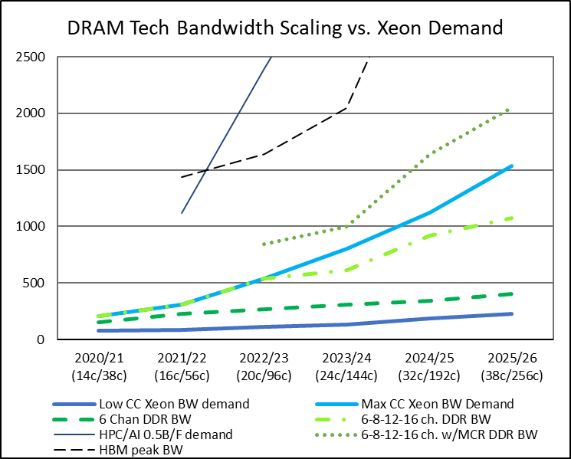
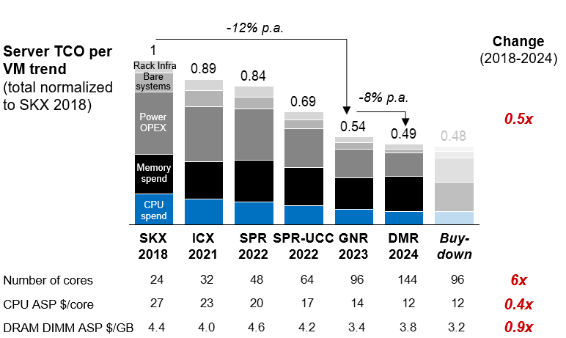
overall_1_132401065597480845 columns_1_132401065597480845
Our DC customers are impacted by the DRAM bandwidth gap
CSP TCO reduction limited by DRAM as CPU core count grows; client min. DRAM capacity drives BOM cost
CSP driven increased Xeon core counts and new Xeon AI accelerators requiring costly system changes to avoid DRAM bandwidth bottleneck
Server TCO per VM trend (normalized to SKX)
DRAM Tech Bandwidth Scaling vs. Xeon Demand
Source: Madhu Rangarajan
Source: Dimi Ziakas
A subset of server applications can benefit significantly from an ADM-based cache*
*Some benefit from ADM’s latency advantage, while others benefit from ADM’s bandwidth advantage.
With ADM at the right price, an optional ADM cache can provide advantage to server customers.
7

Slide 8
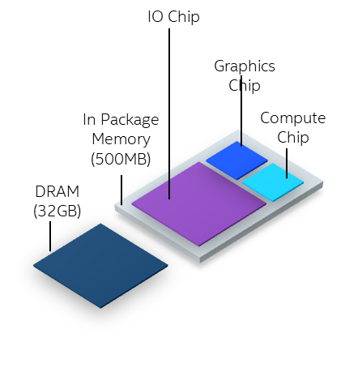
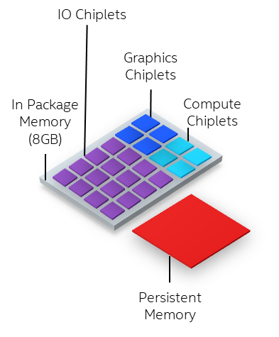
overall_1_132401065611385789 columns_1_132401065611385789
Client usages require lower power with high bandwidth
Source:Brijesh Tripathi
MTL (2022/2023)
Improved Gaming Experience w/ 30%-50% better graphics perf. (Integrated Graphics bandwidth)
Future (LNL+, 2023+)
Better Gaming Experience (Integrated Graphics bandwidth)
Better Content creation (Bandwidth for Multicore workloads) Better Form Factor (DRAM replacement) Better battery life (DRAM replacement for lower pwr bw)
Integration of a on SoC differentiated Cache (ADM*) across our Client products
would deliver leadership gains in Gaming, Content Creation and Battery life.
8
*assumes suitable ADM roadmap

Slide 9
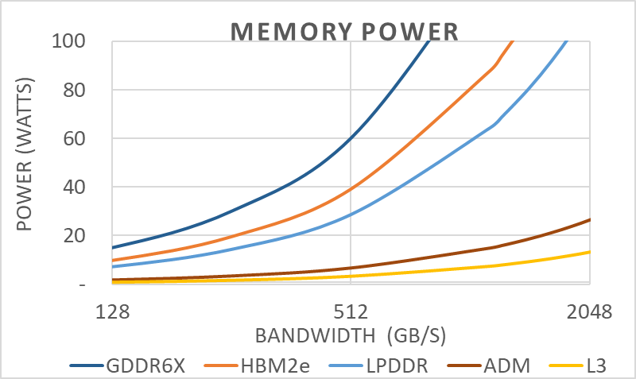
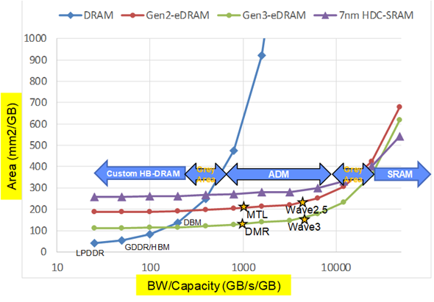
overall_0_132394837709409303 columns_1_132394770639920655 3_1_132394770639920655 7_1_132394770639920655 10_1_132394770639920655 16_1_132394770639920655
Technical Fundamentals Drive High Bandwidth Memory Selection
Memory Power: Changing Memory type required eventually as bandwidth grows but power budget remains
Interconnect Power: Lower capacitance memory interconnect required as bandwidth grows but power budget remains
Bandwidth/Capacity: The area efficient memory depends on the combination of capacity / bandwidth needed
SoC
1pJ/b
Core
2.4pJ/b
2pJ/b
ADM
3.7pJ/b
SoC
DRAM
Lower Power
Tightly Coupled
Power Efficient
On die connect
Higher Power
Board Connect
Board Capacitance
Phy power
Source: Randy Osborne
Source: Fatih Hamzaoglu, Bob Royer
Source: Fatih Hamzaoglu
With low pJ/b, tight integration, and high bandwidth/capacity
ADM promises a unique opportunity for Intel
9

Slide 10
overall_0_132388665532037256 columns_3_132388911261039113 8_1_132388911286314554 36_1_132388911342602469
Traditional DRAM solutions cannot address bandwidth/capacity/cost simultaneously
Bandwidth/capacity ratio
Capacity (min-max)
100GB
SRAM
BANDWIDTH GAP
DRAM
Blue: Intel
Green: industry
Gray texts: not in products yet or EoL’ed
Optane™
NAND
Manufacturing cost / GB
ADM is best for several TB/s bandwidth @ 1s of GBs in capacity
High bandwidth DRAM derivatives (HBM) are best for 10s of GB capacity with 100s of GB/s bandwidth
10

Slide 11
overall_0_132388665532037256 columns_3_132388911261039113 8_1_132388911286314554 36_1_132388911342602469
Usage Needs Drive Two Technology Choices
In-package memory (SW Visible Mem, 10s of GB)
Tightly-coupled memory (SW “invisible” Mem, 1s of GB)
SRAM
Client
Graphics Perf, Battery life, Form Factor. Needs low cost ADM at 4-8G
Graphics Perf
Tightly coupled (SRAM-like)
BANDWIDTH GAP
Adamantine
Mobility perf/prem
Mainstream Client
DRAM TCO reduction for IA workloads as L4 to reduce DRAM BW need
In package (DRAM-like)
DRAM Derivatives (HBM…)
Rest
Server
DRAM
DDR, LPDDR
Perf-optimized
Optane™
TCO-optimized
AI workload Performance Bandwidth
3D XPoint
AI Rambo SRAM replacement
For Capacity/Cost
Accelerators
NAND
AI
Graphics
Graphics perf. as GDDR successor
SSDs
POR
Under evaluation/exploratory
11

Slide 12
overall_0_132399173305508968 columns_1_132399086324442949 47_0_132399173310126627
What are others doing to address memory challenges?
In-package memory (DRAM-like, 10s of GB)
Tightly-coupled memory (SRAM-like, 1s of GB)
Competitors and customers are investing in industry-standard IPM, with pathfinding efforts in customization
A variety of efforts to further increase memory-compute intimacy. (No direct substitute to Adamantine)
Examples
Examples
Logic and memory vendors driving HBM standard to next-gen, in accelerators and CPU
Apple A13 LPDDR integrated with logic using TSMC InFo packaging
Google, TSMC, and Samsung or Hynix investigating HBLL (High Bandwidth Low Latency) memory (1s of GB)
Nvidia and Micron working on unique memory (limited info known)
TSMC and IP ecosystem investing in High-Bandwidth Interconnect PHY to increase compute and memory intimacy in chiplet designs
…
Logic vendors working on larger/better SRAM cache
AMD working on Foveros-like 3D stacking, likely with TSMC
Apple TSMC co-innovating on next-gen 3D stacking patents
TSMC, Samsung, Hynix, GloFo etc. investing in STT-MRAM with embedded NVM, potential to expand to tightly-coupled memory
Many investing in Compute in Memory pathfinding, limited commercialization success (Mythic AI early mover)
…
Note: Limited information on select projects, e.g. Google HBLL, Nvidia-Micron, AMD Foveros-like 3D stacking. Placement directional.
Source: Intel, company releases, industry interviews
12

Slide 13
overall_1_132397446747626164 columns_1_132397446747626164
No silver bullet: Framing the Intel Options
Increasing integration of compute and memory
1
Improve effectiveness with DRAM
2
3
In-package memory (DRAM-like, 10s of GB)
Tightly-coupled memory (SRAM-like, 1s of GB)
A
Opportunistically pursue system techniques
B
A
B
C
A
B
Partner w/ customers to co-optimize up-the-stack
Use: Industry standard
Drive: Custom
Make: Scale Adamantine to IPM capacity
Lead with Adamantine
Other
Need strong integration/packaging innovation and roadmap
Examples | Compression Monument Creek CXL.mem | Pooling | SPR + HBM | PUMA MCDRAM | None to date | MTL-P Halo | Compute in/near memory under investigation STT-MRAM
What you need to believe | Standard approach will be necessary but not sufficient to deliver a competitive product. | Customers will find other partners if we say no Customers have scale to justify investment | “Must do” as defense to keep up with competition Must be okay with minimal customization | Workloads / requirements well understood We will drive enough volume that memory vendors will work with us. We have learned from prior attempts | Customer and Intel benefit exist even with IPM implementation Solution can compete in commodity market Workloads / requirements well understood | Can only tightly couple if we control both CPU and memory design Memory NOT treated as commodity → acts like SRAM Workloads / requirements well understood | Can achieve same or better than competitive alternatives Workloads / requirements well understood
 | We have means to get paid Proposals push out power/BW “walls”; address TCO
We can stop here if.... | We believe these methods can solve our challenges through our roadmap horizon |  | We believe we’ve balanced competitive risks vs. additional investments required for tightly coupled memory
LPDDR/GDDR
13

Slide 14
overall_1_132401065775007310 columns_1_132401065775007310
Discussion Flow
Tightly Coupled → Adamantine
In Package Memory → high bandwidth DRAM variants
Systems → Many
14

Slide 15
INTEL CONFIDENTIAL 20-07-30 Memory CSD_ELT_v10.PPTX
overall_0_132391248485209053 columns_1_132391248485209053
Solving for high bandwidth needs in the 1s of GB memory capacity: Tightly-coupled ADM is a differentiator
Driving Factors
Graphics and AI workloads are driving the need for extremely high bandwidths at 1s of GB capacity
Tightly coupling compute and memory is the only way to meet bandwidth without hitting power/TCO walls.
Tightly coupled solutions require co-design of compute and memory
Adamantine Advantage
Only known solution in desired timeframe (~2yr adv?)
Best means to address BW, power, capacity challenges
Intel controls all input to maximize benefit to customer
“invisible” to higher level SW (like SRAM)
Not included:
IPM: Traditional solutions over-index on capacity and are power hungry
In-memory, Near-memory compute: Research should continue → to date, point solutions are likely
15

Slide 16
overall_0_132401087393755328 columns_1_132401065788985732
Staging ADM to achieve long term XPU differentiation
All available info indicates we have ~2yr head start relative to competition – use it!
ADM cost and Platform volume need to commit to scale together (key learning from eDRAM)
Technology Scaling and Cost: $/GB – TMG commitment
Product Volume: GB shipped – BU commitment
Phase
What We Mean
What it Takes
Success
 | Invest up front in tech roadmap Disrupt in graphics with MTL-P Invest in targeted Xeon use case → where we hit the physics wall first | Committed investment to roadmap (100s of $M, 22nm) Targeted, small volume (~10 MU for MTL-P; 1-2 MU for Xeon) Margin compromise | Design wins for MTL-P Early learning on ADM in DC applications – we figure out to do it right at the system level
 | Select targeted expansion at corporate level | Continued TD roadmap Committed BU / architecture resources Deep working set /use case knowledge Margin compromise | Maturing technology to drive scale; developing common requirements Design wins in key areas
 | Utilize ADM across the business as core business opportunity | Continued TD roadmap must hit cost metrics Committed BU / architecture resources Deep working set /use case knowledge Must compete against alternatives | Scale enables standard business model and margins
Disrupt and Commit by 2022/2023
Innovate and Establish by 2023/2024
Scale by 2024/2025
16

Slide 17
overall_0_132401070233314888 columns_1_132401047595347504 12_1_132401070140684101
Opportunities to scale are many, need resolution on each with aligned strategy
Proposed stage
BU
Area
Motivation
Maturity
Comments
 | CCG | Perf/Prem Mobility | As cache: Disrupt in graphics | POR for MTL-P | Compete and win against entry discrete graphics
 | DPG | Performance optimized | PoC in BHS or EGS? | Concept | Test value proposition with side attach
 | Accelerators | AI/Graphics | As cache: RAMBO SRAM replacement for capacity/cost | Under investigation | PVC-next, Elasti-Pro, Elasti-Sound
 | CCG | Premium mobility | As memory: Enable form factor & compute differentiator over dGx | Concept | Target same perf advantage as an ADM cache but lower system power
 | DPG | TCO optimized | As cache: DRAM TCO reduction for IA workloads | Under investigation for DMR | ADM L4 cache reduces DRAM BW needs, allows higher core count
 | DPG | Perf optimized | Performance and TCO reduction | Under investigation for DMR | Initial assessment shows 6% perf boost, equivalent TCO/VM at 50% margins; many assumptions
 | CCG | Mainstream mobility | As memory: Enable form factor & compute differentiator over dGx | Concept | As above but mainstream cannot tolerate cost premium
 | CCG | Prem/Perf mobility; Mainstream | As cache: Cost neutral with longer battery life and higher graphics performance | Under investigation | Need 4-8GB ADM, addresses power/thermal issues
 | Accelerators | AI/Graphics | As memory: Performance | Concept | GDDR successor
 | DPG | NPG | Virus scanning; small capacity | Concept | Need to address ECC, security
Disrupt
Innovate
Scale
17

Slide 18
INTEL CONFIDENTIAL 20-07-30 Memory CSD_ELT_v10.PPTX
overall_0_132336803954484413 columns_2_132356797223791196 9_0_132336803960765045 4_1_132342923606233529 3_1_132399280596386638 12_1_132399996240918032 16_0_132400032978643754
If ADM could increase dGPU POR MSS by ~1.5x-2x, it could contribute ~$10-20B valuation Up to $[100]M development cost per year, and ~$80-240M incremental CapEx at initial ramp (500 WSPW)
~$10B accelerator TAM bounded by memory bandwidth, beachhead for Adamantine
Potential dGPU value creation from ADM
2024 Server and Client CPU and accelerator TAM ($B)
Potential Intel dGPU revenue uplift from Adamantine ($B)
Special business condition: Offering ADM at cost to break into NVIDIA stronghold
Standard business condition: EPS driver for Intel
Bandwidth bounded
Illustrative scenario (resolution in Q4)
Need to innovate to win share in these segments
If.....ADM can help drive to #2 market position with traditional margins at scale
Then....it could be worth $10-20B in 2030
High case
TCO bounded
EBIT impact (high)
Not memory bounded
$1.2B
$1.3B
$0.9B
$1.1B
Server dGPU
EBIT impact (low)
$0.5B
$0.3B
Client dGPU
$0.1B
MSS uplift*
Disrupt entry dGPU (~$0.4B) from premium/perf Client segment (~$2B)
Gross margin [placeholder]
1
EBIT impact - high ($B)
Innovate in dGPU beachhead (~$10B)
EBIT impact - low ($B)
2
CapEx
1st 500 WSPW = ~$80-240M; Incremental 500 WSPW = ~$35M-$55M each
Scale to follow-on landing zones over time (~$30B)
Development cost
Up to ~$100M per year (directional)
3
~$1.3-2.6B revenue uplift and ~$1-2B EBIT contribution in 2029, leading to ~$10-20B valuation increase (at a multiple of ~10x)
18
Note: *Assuming Adamantine server dGPU intercept in 2023, Client following year. Could be uplift or derisking of current Graphics POR. Market cap valuation based on net income discounted to 2021. WACC = 9%, Terminal Growth Rate = 4%, Tax Rate = 20%
Illustrative – No BUs have attested to this upside and cost structure

Slide 19
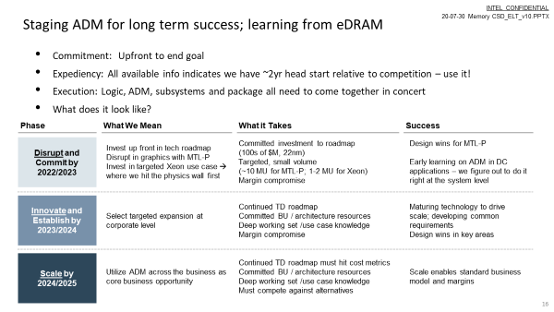
overall_1_132401065810487695 columns_1_132401065810487695
Discussion / Decision
Despite a very critical look ADM → team became convinced ADM will best strengthen XPU product leadership by establishing a differentiated cache strategy
This IS the POR plan to disrupt Graphics with MTL-P
Strategic Decision
Go: Phased Implementation of ADM
No Go on ADM
Require ADM “attach” volume necessary to hit expected core business ROI and margins out of the gate
Decommit client; suffer competitive risk
or
19

Slide 20
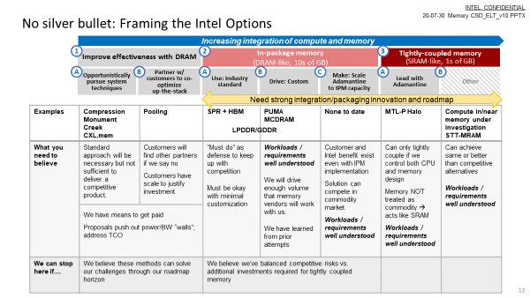
overall_1_132401065775007310 columns_1_132401065775007310
Discussion Flow
Tightly Coupled → Adamantine
In Package Memory → high bandwidth DRAM variants
Systems → Many
20

Slide 21
overall_0_132391248485209053 columns_1_132391248485209053
Intel Options to address 10s of GB needs
In-package memory (10s of GB)
Off-the-shelf (i.e. HBM)
Custom
Scale Adamantine to IPM capacity
Pros
Clear customer need
Workload intelligence
System optimization
Can provide differentiation
Opp for new business models
Reduces reliance on DRAM
Drives value to Intel
System optimization
Can provide differentiation
Minimal investment
Cons
Might not solve the problem
We need to adapt to adopt
We start from behind
Absorb memory “price”
Custom solution may limit scale
Absorb memory “price”
Multi-party alignment req’d
Might not solve the problem
ADM benefits degraded as IPM
Single/sole source to customer
Investment required to get to a memory to use
1’s of $M
10’s $M
$100’s of $M
Intel key contributions
Industry Influencing
Compute/memory Optimization
Industry Influencing
Packaging Innovation
ADM process
Compute/Memory Optimization
Packaging innovation
21

Slide 22
overall_1_132401065883237560 columns_1_132401065883237560
IPM key messages
Guiding beliefs (a.k.a. lessons learned)
We have to focus on solving the customer problem first → need deep understanding of workloads, their use of memory and their future trajectory.
Any IPM implementation requires optimization of the software stack.
New innovations must be judged against realistic internal and memory ecosystem business models and affordability assumptions.
10s of GB capacities need to start from a DRAM process; we have had decades of success guiding the industry and can continue to push capabilities
AI workloads drive high bandwidth memory needs
Plan
Continue to drive next gen memory with industry, deepening collaboration to even more strongly influence new-to-Intel memories (i.e. HBM, GDDR)
Determine opportunity to create a strategic partnership with a definitional customer to develop a differentiated solution.
Alternative
Adapt to adopt external IPM offerings as they become available
In-package memory technologies attempted & products landing zone
N = ~20
Work in progress
Commercialized (incl. end of lifed)
Canceled at late development/validation/ contract stage (incorrect assumption, underestimating what it takes)
Terminated in pathfinding
22

Slide 23
overall_1_132401065864471489 columns_1_132401065864471489 98_0_132401065864471489
Systems innovations remain crucial to mitigate DRAM’s limitations
Memory Tech Bounds the Experience
Systems Innovations Optimize Memory Use
SRAM
Innovation | Intercept |  | BW | Cap. | Pwr
Memory Side Cache – | GNR or DMR | DC | X
Monument Creek | GNR | DC | X
Cache compression/DeDup |  | DC | X | X
Increase IP Memory Efficiency | 2022, MTL | Client | X |  | X
Memory Compression | Now-2023 | All | X | X | X
Additional Channels | Ongoing | All | X | X
Page level Memory compression |  | DC |  | X
Optane™ Memory Mode/App Direct | now | DC |  | X
CXL capacity expansion (2LM) | GNR for CXL | All |  | X
Flat2LM | GNR (2023) | DC |  | X
Memory pooling | GNR (2023) | DC |  | X
Tightly coupled (SRAM-like)
In package (DRAM-like)
DRAM
Optane™
NAND
This CSD:
A new memory/level is necessary for multigenerational bandwidth improvements
Per BU:
Systems Innovations for one-time Memory bandwidth advantages
Recommendation: BU’s keep portfolio of programs to mitigate customer pain points, use Memory Initiative, solution should meet standard business model expectations (margin, etc.)
23

Slide 24
overall_0_132401113902799281 columns_1_132401065905247479
Plan: Proceed with creation of an Intel Memory Initiative
Expected Impact:
Robust technology portfolio
Anticipate/shape industry transitions
Reduce late stage roadmap changes
Reduce roadmap TTM
Improve solution stacks/SW @ launch
Next Steps:
Identify Initiative lead & ELT sponsor
Appoint ADM roadmap integration lead
Initiative lead and PM to align Initiative, DTO, MIO, and technical communities
Work with BUs to create tech roadmap <> product roadmap interfaces
Intel Memory Initiative
Design Technology Office
Product Group POP Intercepts
MIO
GSC
(Industry)
Disciplined Innovation Formal Technology Readiness
Diligent Business Intercepts
24

Slide 25
overall_1_132401064676556521 columns_1_132401064676556521
Expected Outcome / Next Steps
Align: We *must* do something to address the fundamental physics limitations of high bandwidth data movement in order to scale compute.
We are NOT suggesting Intel get into the DRAM business
→ Agreed?
Discuss/Decide: Strengthen XPU product leadership by establishing a differentiated cache strategy
Invest and deliver Adamantine technology roadmap for a differentiating 1s of Gigabytes cache
Commit to employing that solution for AI/Graphics/Xeon products
→ Path forward?
Act: As a result of this CSD we will also
Work with the DRAM industry and key customers to ensure Intel is competitive for 10s of Gigabyte high bandwidth working sets
Initiate a an *ELT empowered* Memory Initiative to ensure cross BU alignment in memory requirements and systems innovations
→ Agreed?
25

