Slide 1
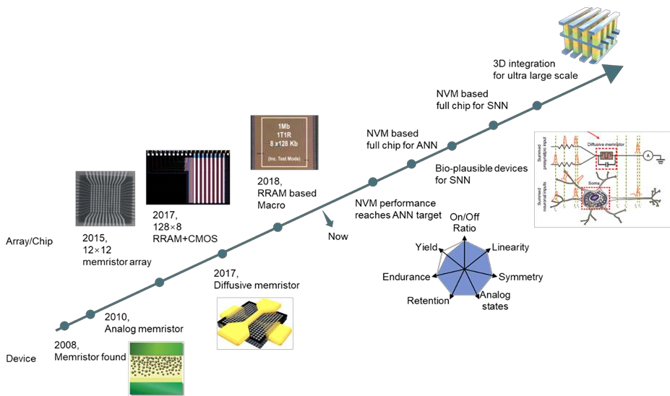

Slide 2
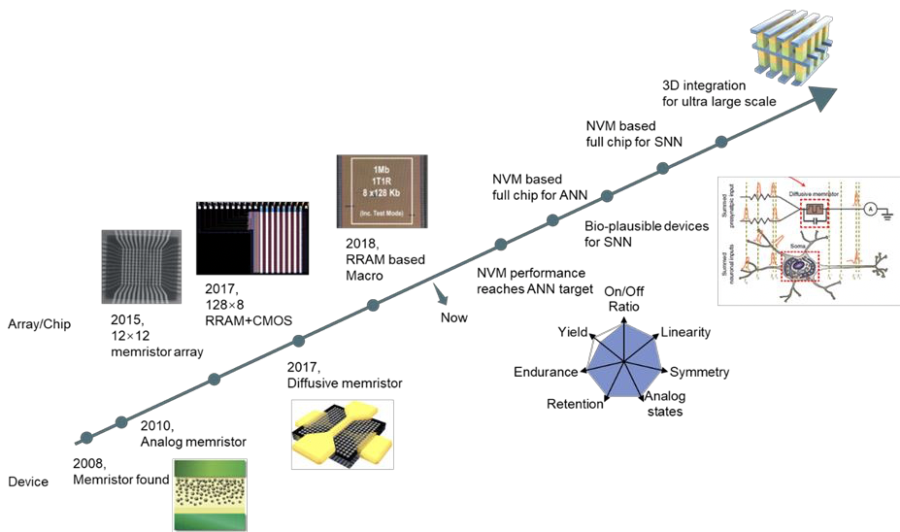
Future of Deep Learning Processors
SRAM based Deep Neural Network ( with Leveled Logic)
NVM based Spike Neural Network
Ext. Mem Ext. Mem
SRAM

Slide 3


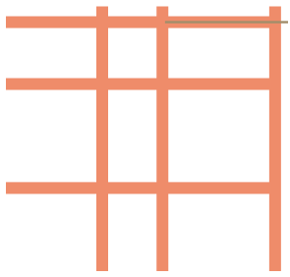
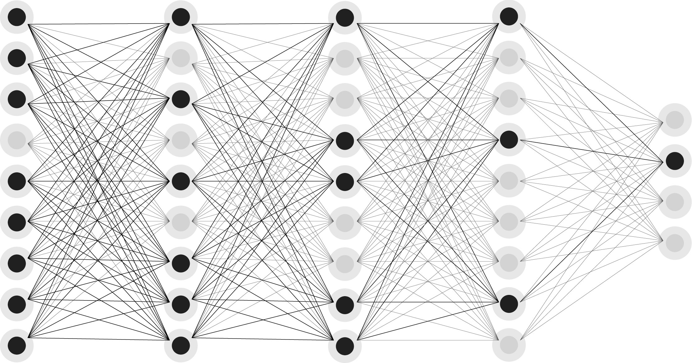

Analog AI Cores for In-Memory Computation
Reduce the Von-Neumann Bottleneck
Resistive Processing Unit (RPU)
½ V_{acces}
V_{access}
…
…
Translate neural network structure and weights arrays, using analog elements with variable resistance to store weights
½ V_{access}
0
Selector
NVM: Atomistic Memory (Resistive) Switch

Slide 4
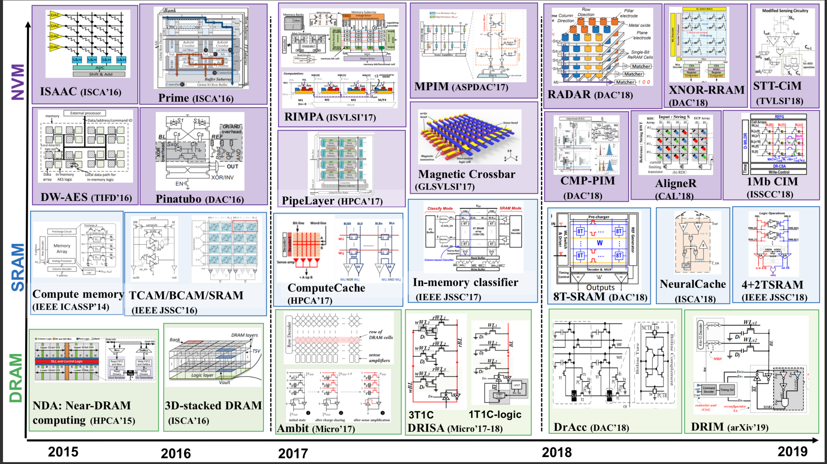

Slide 5
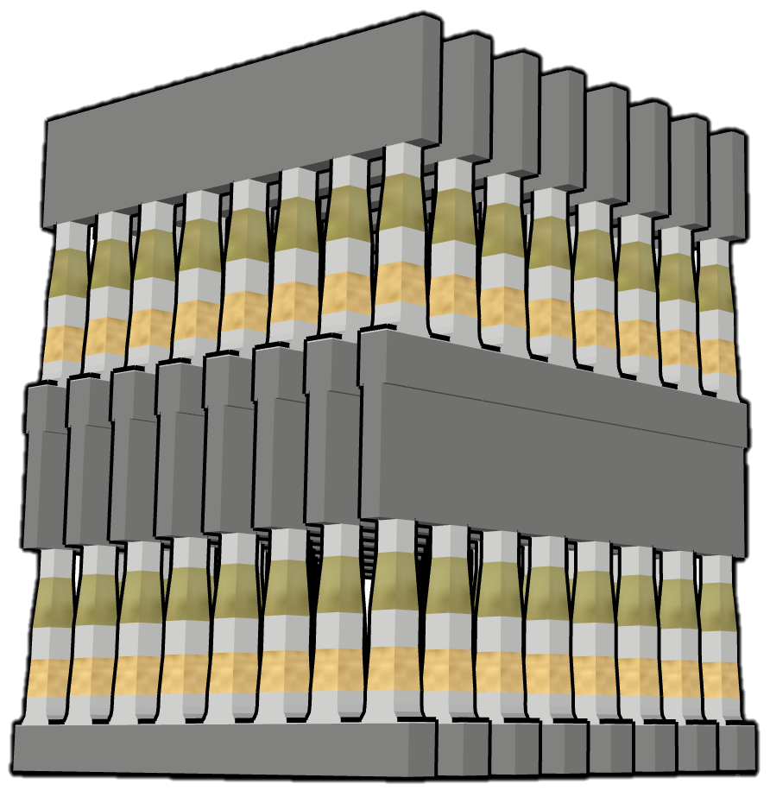
Wordlines
Memory & Selector
Bitlines
Wordlines

