Slide 1

Disrupt the Industry
Break Through the Bottlenecks With Intel® Optane™ Technology And Store More With Intel® QLC 3D NAND TECHNOLOGY
Rob crooke Senior Vice President and General Manager, Non-Volatile Memory (NVM) Solutions Group

Slide 2
discussion points
30 Mins: My Path & Career
60 Mins: Non-Volatile Memory Solutions Group
Strategy & Opportunity
Process Technology advantage
Memory & Storage technologies

Slide 3








What was my path?
‘85
‘89
University of massachusetts‘85
Sales
Boston
Suburb
R&D
Applications
Engineer
Computer Systems Engineer
CSI
Alliant
Computer Systems
Regional Apps
Manager
‘09
‘05
‘00
‘97
R&D
GM
Marketing
Atom and SOC
Development
GM
OPSD “Boards” , P&L bottom line,
Mfg, R&D, Marketing, Pricing,
Cost & Velocity, “Parking”
CPU Product
&Technical
Marketing
Desktop
… Segmentation
‘11
GM
NSG
Adjacency, Capacity,
Technology,
R&D Engine

Slide 4
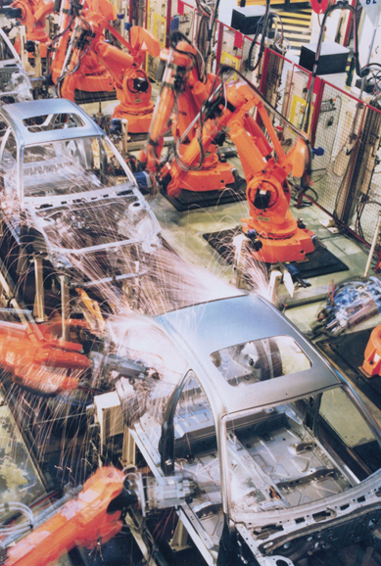


Every day data is exploding
3
1,000,000 GB
Smart Factory
2
3,000 GB Smart Hospital
1
3.0 GB
Average Internet User
Source: http://www.cisco.com/c/en/us/solutions/service-provider/vni-network-traffic-forecast/infographic.html
2. Source: https://datafloq.com/read/self-driving-cars-create-2-petabytes-data-annually/172
3. Source: http://www.cisco.com/c/en/us/solutions/collateral/service-provider/global-cloud-index-gci/Cloud_Index_White_Paper.html
Notes:
Key Takeaway: People used to drive data, now machines are driving data. WAY more data.
More compute == More networking
Key Message:
There is machine generated data vs human generated data with applications and workloads that are increasingly needing more and more data closer to the cpu
Internet of things example (GE Lightbulb)
There are new ways of interacting and analyzing data.
Companies are becoming increasingly reliant on their ability to deliver digital products, services and experiences, and the share of revenue from digital services and products is growing.
Massive amounts of data will need to be captured and analyzed in the process.
Captured Data is exploding
Services businesses - Smart Hospital: 3,000GB
Transportation: Airplane Data: 40,00GB
Manufacturing: Smart Factory: 1million GB
Transactions: NYSE- 1,000GB of trading data every day
Social media:
Twitter: >7,000GB of data generated every day
Facebook: >10,000GB of data every day

Slide 5
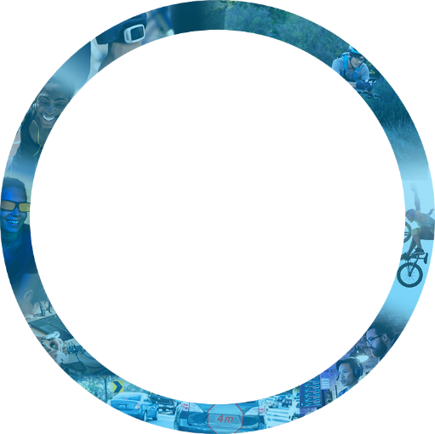

Virtuous Cycle of Growth: our technology drives experiences
Experiences
Experiences
connectivity
Cloud &
DATA Center
connectivity
MEMORY
Experiences
Things &
Devices

Slide 6


NSG Strategy: Adjacent, Disruptive Growth
Technology
Driven
Customer
inspired
Platform
connected
Notes:
Message: We do this by being technology driven, customer inspired, and platform connected.
Key Points:
Tech Driven
This is the root of what we do
Strategy is what you spend your money on and majority of R&D goes into our technology
Platform connected
We’re not some random memory company
We’re making memory to make computing better
Quality, Validation, Security
Customer inspired
- We make our computers better based off of your feedback

Slide 7

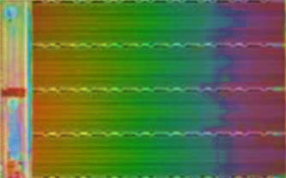
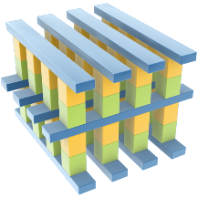

Intel IS A LEADER in two technologies
Intel® 3D NAND Technology
Intel® Optane™ Technology
Hard Disk Drive
Intel® QLC 3D NAND SSD
lower cost and higher density
Intel® Optane™ SSD
Bulk storage
Intel® Optane™ Memory
Working storage and memory
DRAM
LOWER
COST
HIGHER
LESS
DELAY
MORE
Notes:
Key Message:
We are working on two technologies that help drive NVM both inward and outward in the DataSphere.
3D NAND is about higher Density and lower cost. Pushing outward to capture more of the warm data on a media that is 1000X faster than a HDD.
Optane technology is solidifying our position in Hot Data for realtime processing while also pushing inward with memory media that is 10X the density of DRAM pulling more data on this faster storage and bigger memory.

Slide 8





Current State
Mega-mart
NAND
24,000 bottles of beer
3 hour drive
Refrigerator
DRAM
24 bottles of beer
10 sec walk
Bucket
SRAM
A few bottles of beer
Intel Confidential

Slide 9


Impact of Disruptive Technology
Mega-mart
NAND
24,000 bottles of beer
Refrigerator
DRAM
24 bottles of beer
3 hour drive
10 sec walk
40 sec walk
Bucket
SRAM
A few bottles of beer
Garage
Optane™
240 bottles of beer
Intel Confidential

Slide 10
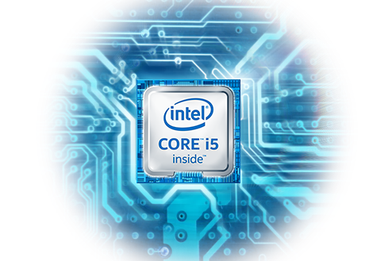


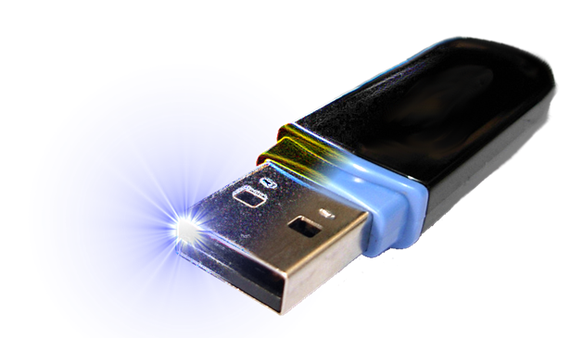

the future of client storage & Memory
Higher Performance, Lower Cost, Easier Migration
Working data
Options for capacity data
+
EXPANDABLE
REMOVABLE
CLOUD
External Card
USB /TBT
5G
Disrupt with Intel® Optane™ persistent memory
Intel Confidential
Notes:
Build core i5+ brand. LT integration into chipset. Today looking at storage, but LT will feel like memory.
Begin vision now.

Slide 11
REIMAGINING DATA CENTER STORAGE & MEMORY
With Intel Innovations
Hyperconverged
Hyperscale
Network
Network
Compute
Compute
Intel® Optane ™
QLC 3D NAND
Intel® Optane ™
Compute
Intel® Optane ™
QLC 3D NAND
Compute
Intel® Optane ™
Compute
Intel® Optane ™
QLC 3D NAND
Compute
Intel® Optane ™
Compute
Intel® Optane ™
QLC 3D NAND
Compute
Intel® Optane ™
Compute
Intel® Optane ™
QLC 3D NAND
Compute
Intel® Optane ™
Compute
Intel® Optane ™
QLC 3D NAND
Compute
Intel® Optane ™
Compute
Intel® Optane ™
QLC 3D NAND
QLC 3D NAND
Compute
Intel® Optane ™
QLC 3D NAND
QLC 3D NAND
Compute
QLC 3D NAND
Intel® Optane ™
QLC 3D NAND
Rack
Rack

Slide 12
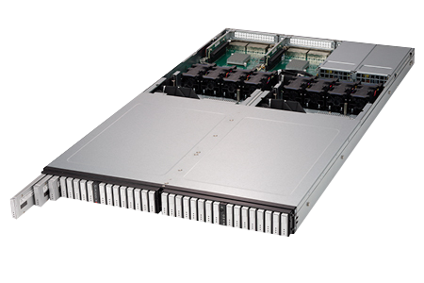

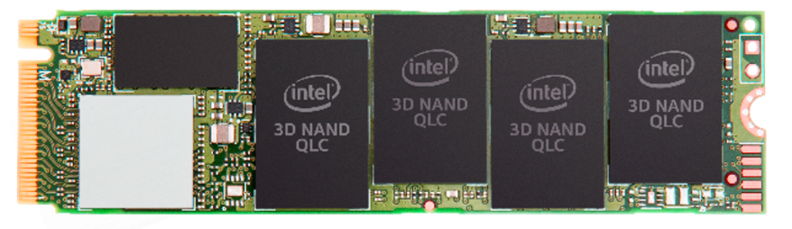
Intel® “RULER” SSD 1 PETABYTE IN 1U
Intel 3D QLC NAND innovation
Intel® ssd 660p World’s 1st PCIe*
qlc SSD for client
BUY TODAY!

Slide 13

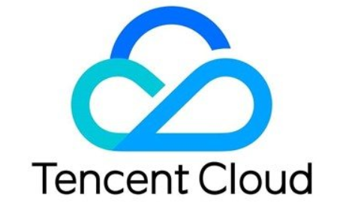
Intel® SSD d5-p4320 at tencent
“Tencent started deployment of Intel® SSD D5-P4320 series in our Content Delivery Network, which enabled us to dramatically improve scalability and customer service. We are looking forward to broad ramping of these 1st to market PCIe QLC SSDs. This enabled Tencent to…”
“…increased customer served per system by 10x…”
“…increased the quality of service by 300%…”

Slide 14
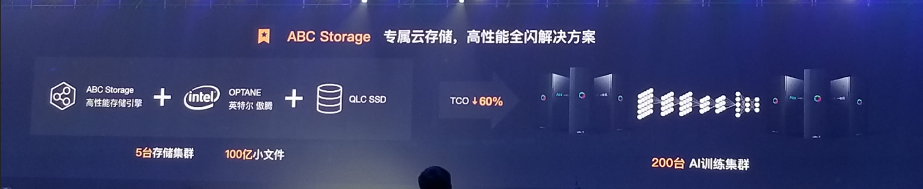
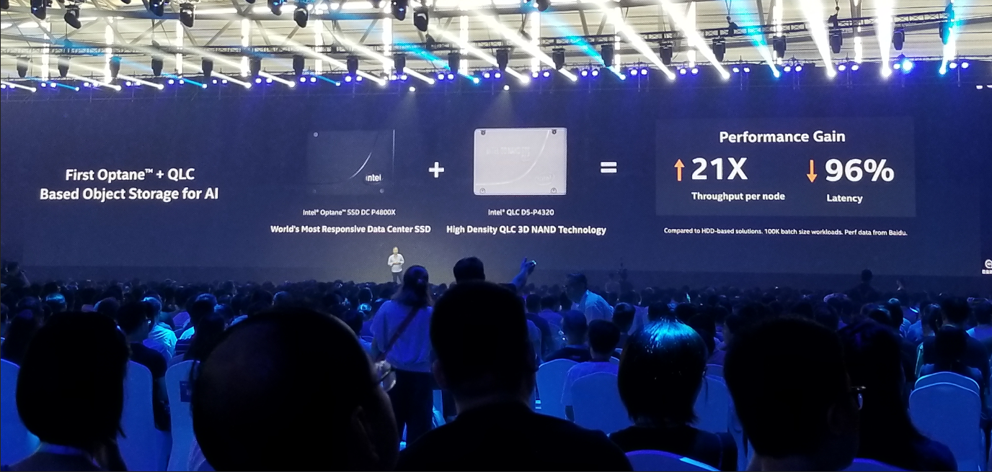
Baidu: Artificial Intelligence Intel Optane™ SSDS + Intel ® QLC SSDs
Baidu ABC summit, Shanghai September 4, 2018
Notes:
Monday, Sep 4 in Shanghai, China, Baidu showed Intel Optane™ Technology SSDS + our QLC 3D NAND SSDs and measured:
60% lower (TCO) Total Cost of Ownership
21X Better Throughput Per Node
96% Lower Latency
Pictures from Baidu’s presentation

Slide 15
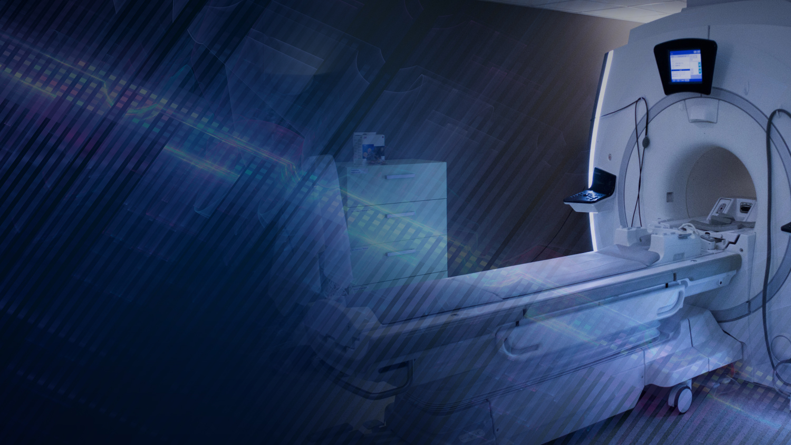


Powering research in
Mri technology
“ University of Pisa collaborated with Imago 7 and Intel® Optane™ technology to reduce the MRI examination process by expanding memory needed to support MRI undersampling techniques. With Intel® Optane™ SSDs, MRI research can now be done in 4min vs 42min and this is simply amazing for patients.”
Maurizio Davini CTO University of Pisa
“…MRI Scans from 42 min down to 4 minutes…”
Notes:
The U of Pisa is doing research on treatment for degenerative brain disease and MRI scans are a critical part of that.
Optane technology has allowed them to use new algorithms to reduce the time spent in an MRI…. from 42 mins down to 4 mins, if any of you have had an MRI you know that 42 minutes is nearly impossible… imagine the impact on patients… on doctors ….on the CFO of the hospital… The Return On Invested Capital.
That’s tech delivering a life changing experience for the patient…

Slide 16
NSG Strategy: Adjacent, Disruptive Growth
Technology
Driven
Customer
inspired
Platform
connected
Notes:
Message: We do this by being technology driven, customer inspired, and platform connected.
Key Points:
Tech Driven
This is the root of what we do
Strategy is what you spend your money on and majority of R&D goes into our technology
Platform connected
We’re not some random memory company
We’re making memory to make computing better
Quality, Validation, Security
Customer inspired
- We make our computers better based off of your feedback

Slide 17


Slide 18

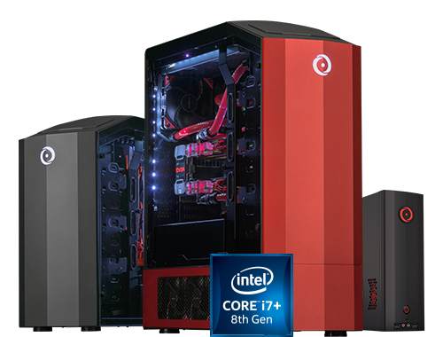
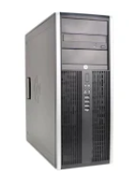
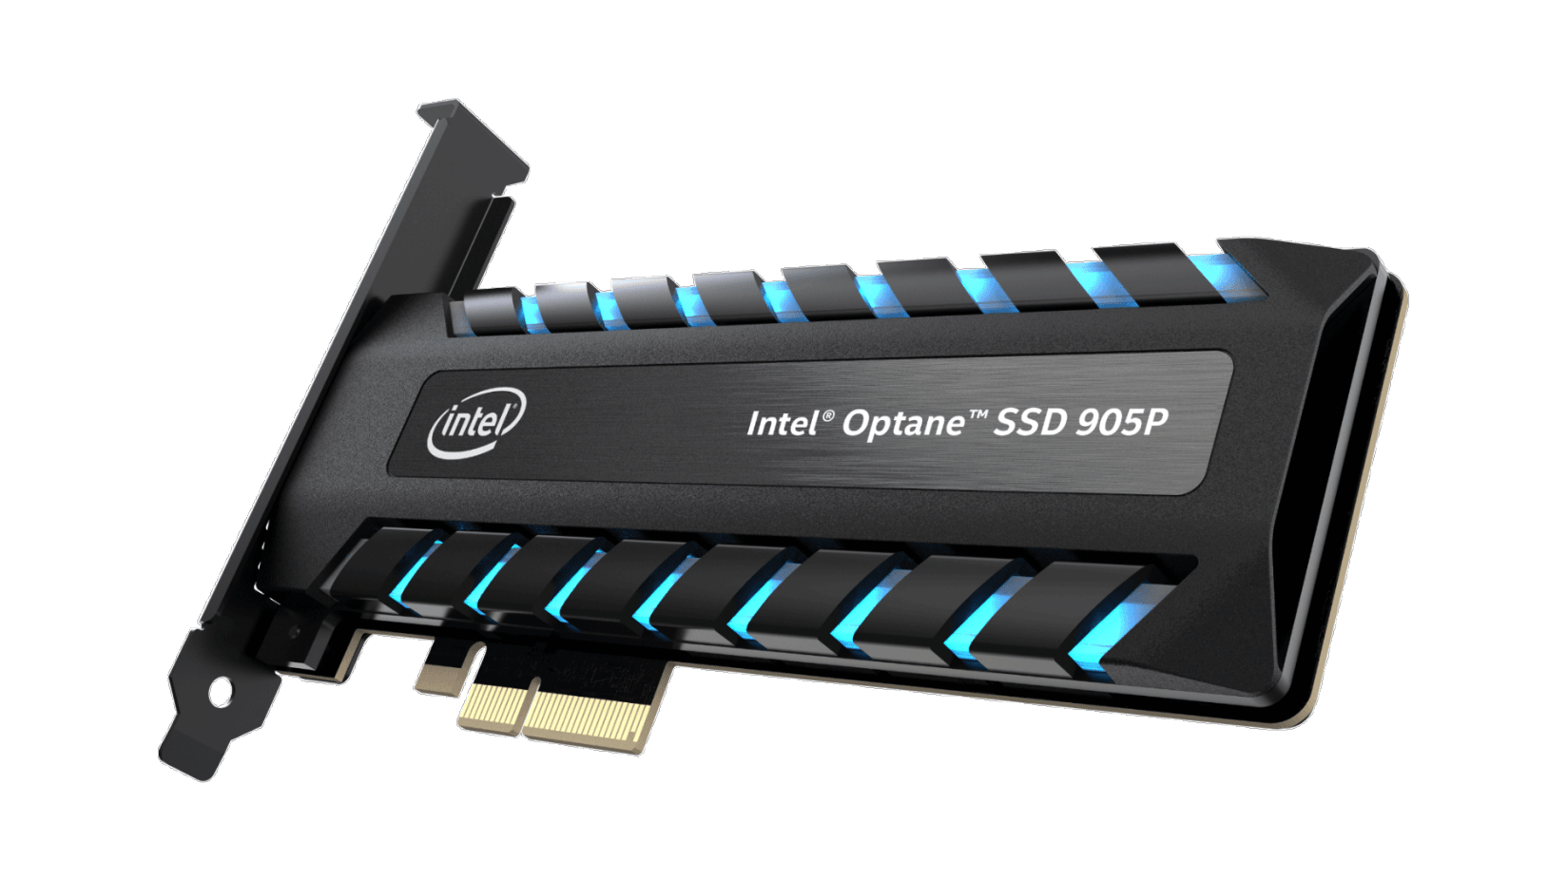
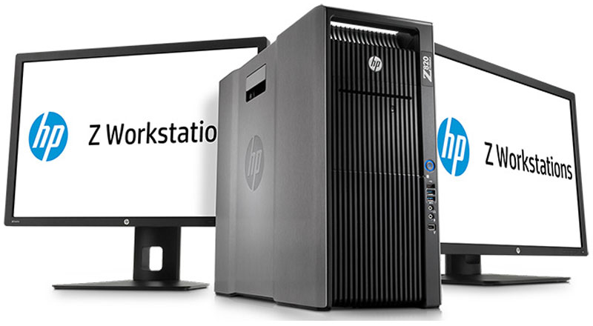
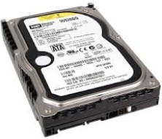


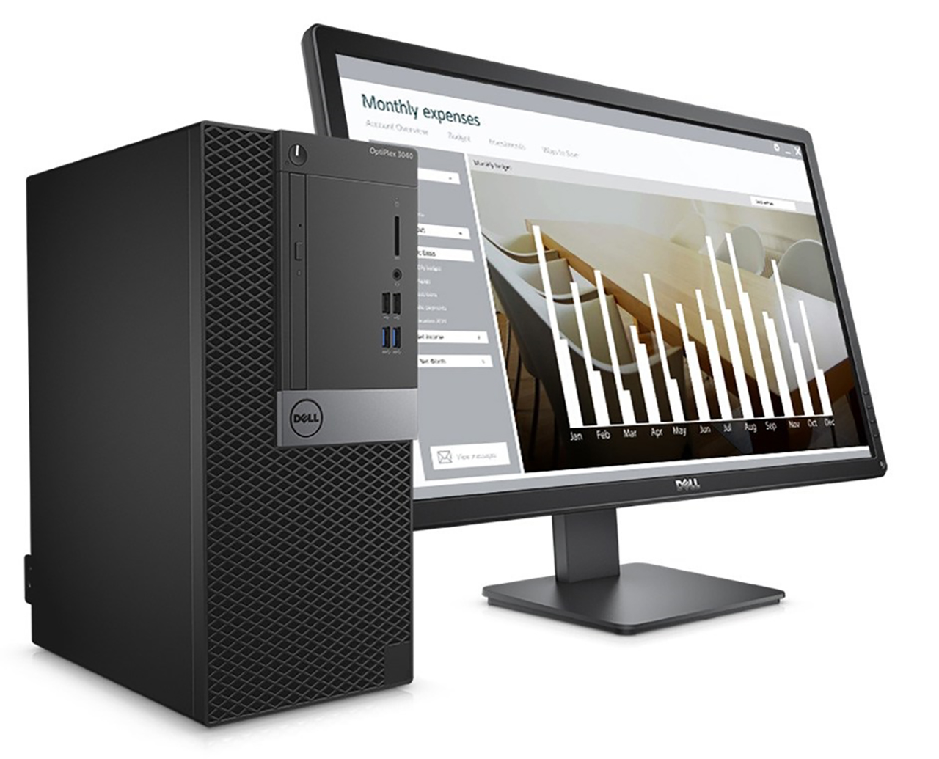
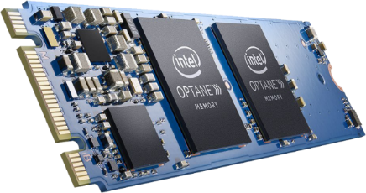


Optane™ Client solutions
BEFORE
AFTER
Corp
Desktop w/ HDD
Optane™ SSD w/ HDD
Major Studio
Up to 4X HIGHER
PERFORMANCE
+
Performance
Optane 900P
vs. current
1TB client SSD
22X Endurance
Optane™ 905P SSD
960GB or 1.5TB
2.7X Performance
Desktop w/ HDD
Optane™ MEMORY w/ HDD
Up to 2X
MORE RESPONSIVE
+
Lower overall
COST
+ 32GB
DRAM
Optane™ Memory
16GB or 32GB
+ 16GB
DRAM
16GB Optane™ + 4GB DRAM
Higher performance at lower cost than
16GB DRAM

Slide 19
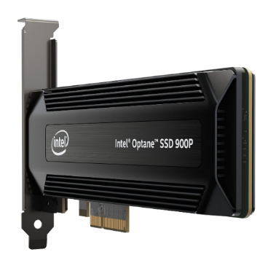
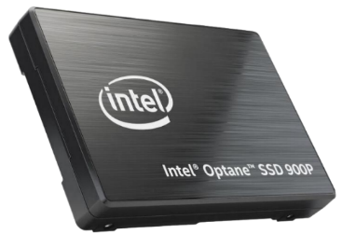
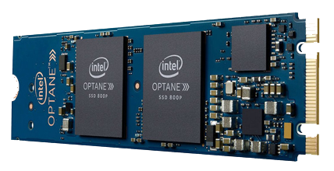
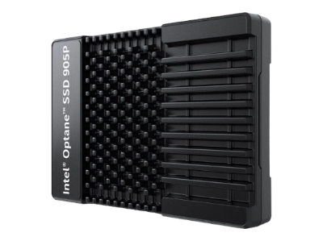
INTEL® OPTANE™ client Family
Intel® Optane™ memory
Intel® Optane™ SSDs
900P AIC
900P U.2
800P M.2
16 or 32GB Module
905P AIC
905P U.2

Slide 20
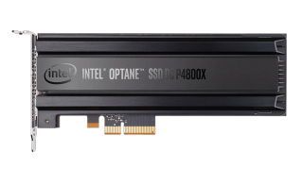
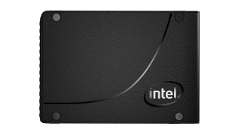
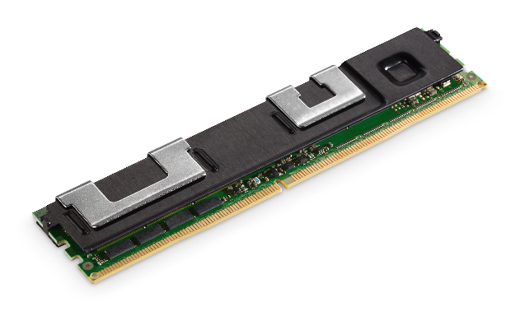
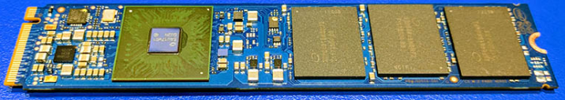
INTEL® OPTANE™ data center Family
Intel® Optane™
Intel® Optane™ DC SSDs
DC Persistent Memory
P4800X AIC
P4800X U.2
P4801X M.2
P4801X U.2

Slide 21
Platform connected
Data Center
Client
Virtual Raid on CPU/Volume Management Device
Rapid Storage Driver Better Together w/Intel® Optane™ Memory

Slide 22
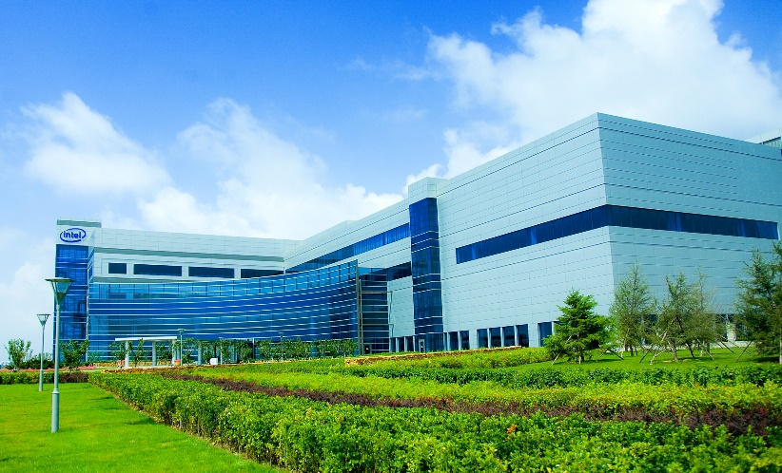
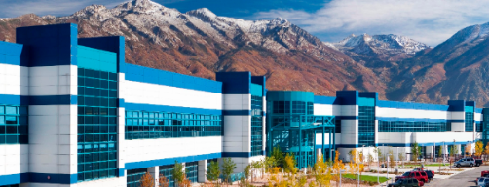
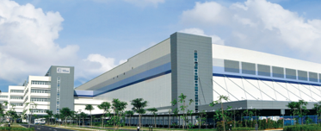
Disciplined investment Faster than Market Growth
IMFT Fab 2
Intel Fab 68
Micron Fab 10
2017 >60% GB growth YoY*
* Based on internal forecasting 2016-2017. Forecasts are Intel estimates,
based upon current expectations and available information and are subject to change without notice.

