Slide 1
Intel® memory and storage
An Introduction

Slide 2


We are in a data-centric world
All data must be
stored, processed, and analyzed

Slide 3





Data growth is happening all over
1
2
3
2
10 GB
3,000 GB
4,000 GB
2
1M GB
40,000 GB
Average Internet User
Smart Hospital
Autonomous
Driving
Airplane Data
Smart Factory
Source: http://www.cisco.com/c/en/us/solutions/service-provider/vni-network-traffic-forecast/infographic.html
Source: http://www.cisco.com/c/en/us/solutions/collateral/service-provider/global-cloud-index-gci/Cloud_Index_White_Paper.html
Source: https://datafloq.com/read/self-driving-cars-create-2-petabytes-data-annually/172

Slide 4

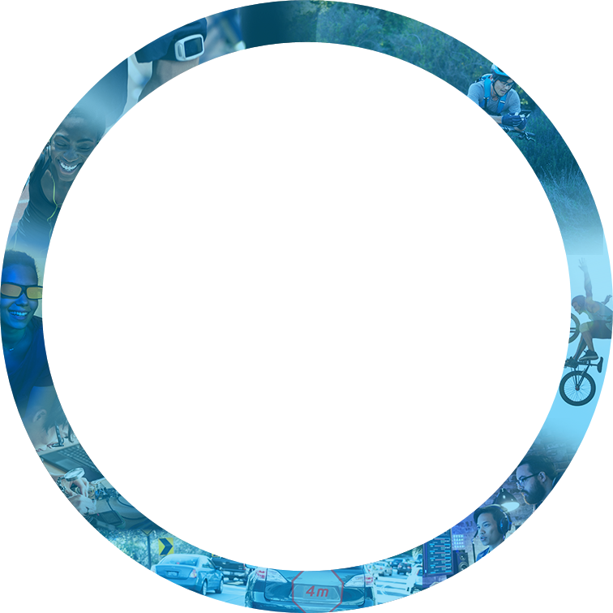



Virtuous cycle of growth
Customer Experiences
connectivity
Cloud &
DATA Center
connectivity
Memory
Customer Experiences
Things &
Devices

Slide 5
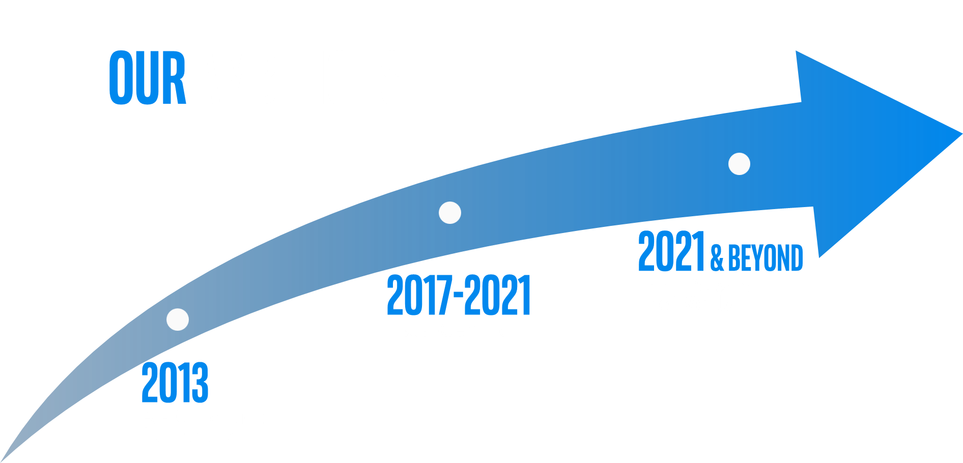
Notes:
The rapid growth and data and the potential to improve the world with it put us at an exciting moment in time as an industry AND especially for us here at Intel.
We are in the process of transitioning from a PC-Centric company to a Data-Centric company to better solve big challenges facing our industry.

Slide 6
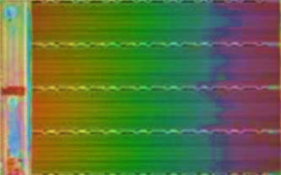
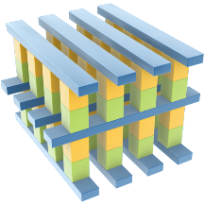
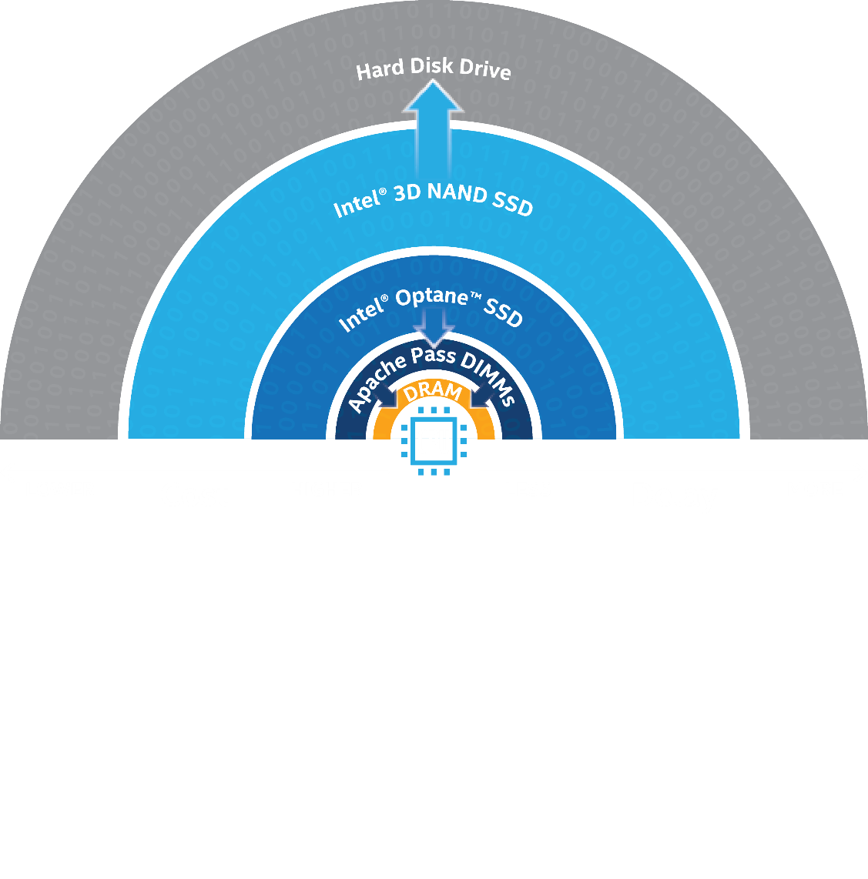
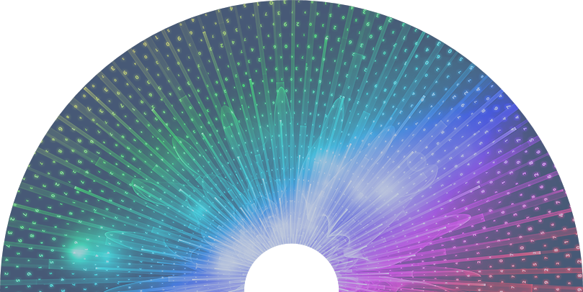
Intel is investing in two technologies
Intel® 3D NAND Technology
Intel® Optane™ Technology
lower cost and higher density
higher performance
Bulk storage
Working storage
Notes:
From IPC Client Session

Slide 7
Intel® Optane™ Technology
Highest performance to break the bottleneck
Intel® Optane™ Technology
QoS
ThrougHput (IOPS)
Latency
higher performance
Working storage
Notes:
From IPC Client Session

Slide 8
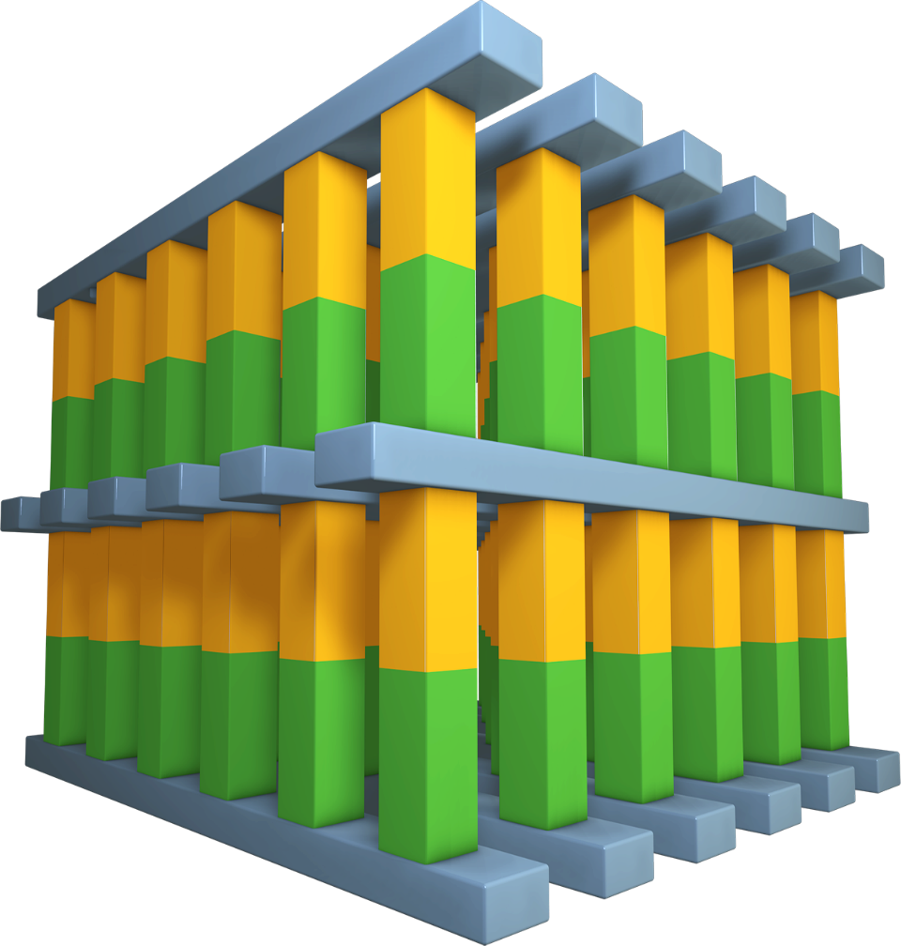

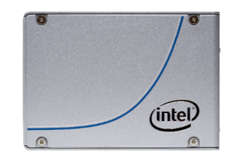
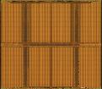
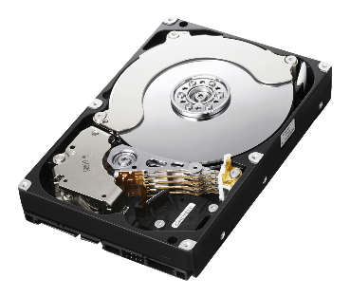
JR: Working on something different for this…in meantime, need to change header
The value is in the gap
MEMORY
Storage
Intel® Optane™ technology
SRAM
NAND SSD
New experiences
New levels of scale
Accelerate existing apps
DRAM
HDD
Technology claims are based on comparisons of latency, density and write cycling metrics amongst memory technologies recorded on published specifications of in-market memory products against internal Intel specifications.
Notes:
Products and solutions based on Optane deliver unique value - the new experiences, new levels of scale, and acceleration of existing applications
There is a huge gap in both performance and cost between Memory and Storage. The difference in Latency between storage and memory is more than 1000x. That’s 3 orders of magnitude. It is like comparing the pace of a turtle on land to the speed of the worlds fastest aircraft, the SR-71 Blackbird which goes mach 3.35. Huge gap. When you look at cost, there is a 35x gap in price between these technologies. This is another huge gap. There is significant opportunity to blur the lines between memory and storage, and fit into this gap. That is where you can position the value of Optane Technologies, combined with Intel 3D NAND, as fast storage and cache solutions and inside the Flexible memory tier.
If you look at existing technologies today – you have SRAM/DRAM – fast, low density, volatile memory and expensive…On right hand side, you have HDD and SSDs – higher capacity, lower cost, non-volatile but not as fast .
3D XPoint is a new memory media technology – First new MEMORY MEDIA IN 25 YRS, that closes the GAP, it fits in between. Starts to blur the lines between memory and storage: larger densities SRAM/DRAM, lower latency than those on HDD, SSD, less expensive than DRAM …..and it is Non-Volatile.
Intel Optane technology is a combo 3D XPoint media, Intel’s newest memory/storage controller, Intel Interconnect IP and Intel software.
We fine-tune our Intel hardware and software together to deliver optimal platform performance.
We are building a portfolio with Intel Optane solutions, for both client and DC.
Now, let’s take a look at 3D NAND.

Slide 9
A portfolio of solution components
Yesterday
TODAY
Future
CPU
CPU
CPU
CPU
CPU
CPU
2D NAND
Intel® Optane™ Technology
Intel® Optane™ Technology
“Apache Pass”
Intel® Optane™ Technology
“Apache Pass”
Intel® Optane™ Technology
HDD
HDD
3D NAND
3D NAND
3D NAND
3D NAND
HDD
HDD
3D NAND
3D NAND
3D NAND
3D NAND

Slide 10

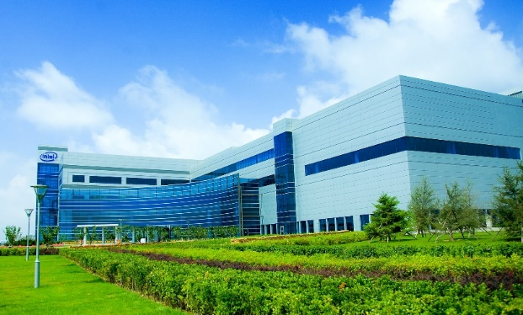
Disciplined investment
Ready for rapidly increasing demand
Intel® Optane™ Technology
Intel® 3d nand Technology
Increasing Capacity
Intel Fab 68: China
IMFT Fab 60: USA
Based on internal forecasting 2016-2017. Forecasts are Intel estimates, based upon current expectations and available information and are subject to change without notice.

Slide 11
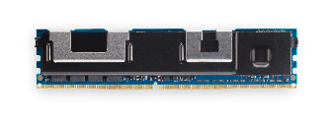
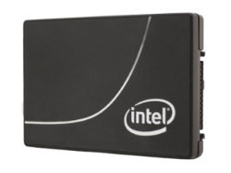
Dave Sierra working on new version
Redefining the memory/storage hierarchy
MEMORY
DRAM
NVDIMM
Expanding data insights with:
Intel® Optane™ SSD
Intel
persistent memory
PCIe* SSD
1
Persistent and large memory
PCIe* SSD
SATA SSD
Intel® Optane™ SSD
with software
2
Massively extended memory
STORAGE
SATA SSD
HDD
Multiple affordable solutions
HDD
Tape
*Other names and brands may be claimed as the property of others.

Slide 12
INTEL® CLIENT SSD POSITIONING
7th Gen Intel® Core™ i7 processor
Intel® Optane™ SSD
Intel® SSD 900P
Intel® SSD 800P
SSD
ENTHUSIAST
ESPORT GAMER
Intel® SSD 760p
Intel® SSD 660p
Intel® SSD 545s
7th Gen Intel® Core™ i5/i7 processor
NAND SSD
SSD or hybrid or dual
Intel® Optane™ Memory
FANATIC GAMER
Intel® Optane™ Memory
+
Intel® SSD or HDD
7th Gen Intel® Core™ i3/i5 processor
Intel® Optane™ Memory
MAINSTREAM
HDD

Slide 13





WHAT IS INTEL® OPTANE™ MEMORY?
3D XPOINT™ MEMORY MEDIA
Intel® Optane™ story
Intel® rapid storage technology
Scalability
High Performance
Cross Point structure
Breakthrough material advances
The two physical devices are paired into a single volume
M.2 2280 and 2242¹
Standard m.2 connector
Modular form factor
+
=
Files needed for important tasks are immediately recognized and accelerated
16gb 32gb 64gb
For 7th Gen and 8th Gen Intel® Core™ processor family
PCIe* 3.0 x2
M.2 2280 and 2242
Single-sided
Over time, frequently used files and applications are monitored and accelerated as well
FPO
Intel® Optane™ memory requires specific hardware and software configuration. Visit www.intel.com/OptaneMemory for configuration requirements.
1. M.2 2242 only available with 16GB Intel® Optane™ memory M10 modules
1

Slide 14

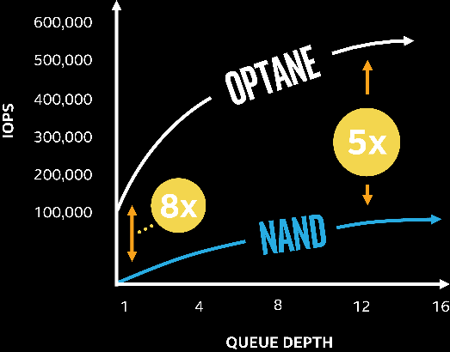



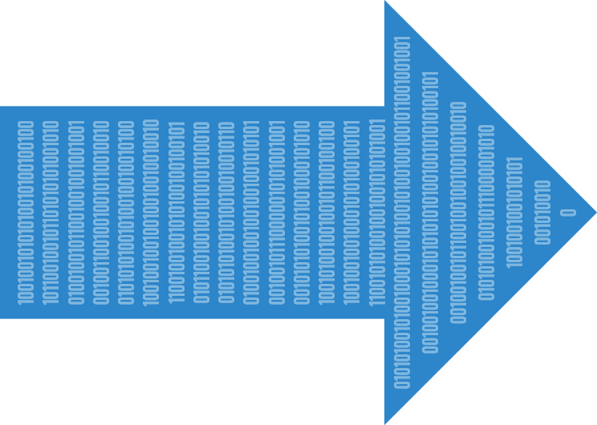
JR: Need to add footenotes
INTEL® OPTANE™ Technology is unique
HIGH PERFORMANCE
performance consistency
revolutionary material
4K 70/30 RW PERFORMANCE AT LOW QUEUE DEPTH
bit addressable
Up to 60x better
5x
8x
write in place
Vast majority of applications generate low QD storage workloads¹
Ideal for critical applications with aggressive latency requirements²
ultra-low latency
HIGH ENDURANCE
Up to 2.8x more total bytes written at similar capacity³
INTEL® OPTANE™ TECHNOLOGY
IS NOT NAND
1

Slide 15
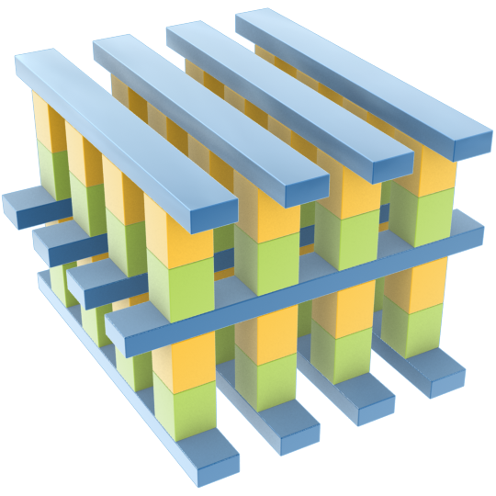
Intel® optane™ technology: 3d xpoint™ memory media
Cross Point Structure
Selectors allow dense packing and individual access to bits
Breakthrough Material Advances
Compatible switch and memory cell materials
Scalability
Memory layers can be stacked in a 3D manner
High Performance
Cell and array architecture that can switch states much faster than NAND
Notes:
From the Gold Slides – Intel Optane Technology

Slide 16

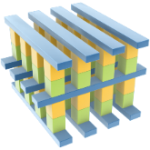

Intel® optane™ technology
Building Blocks
End-User Value
Latency (µS)
10,000
100
High
Endurance
Drive Latency
3D XPoint™ Memory Media
175
Controller Latency (ie. SAS HBA)
150
Software Latency
+
125
Responsive under load
Low latency
100
75
50
Predictably fast service
QoS
25
Intel Interconnect IP
Intel Software
Intel Memory and Storage Controllers
0
HDD
(SAS/ SATA)
NAND SSDs
(SAS/ SATA)
NAND SSDs
(NVMe*)
Optane™ SSDs
(NVMe*)
Breakthrough performance
IOPS
The latency comparisons above include internal Intel estimates for the SSD NAND NVMe* and SSD with Intel® Optane™ technology
*Other names and brands may be claimed as the property of others

Slide 17
Legal Disclaimers
Intel may make changes to specifications and product descriptions at any time, without notice. Designers must not rely on the absence or characteristics of any features or instructions marked "reserved" or "undefined". Intel reserves these for future definition and shall have no responsibility whatsoever for conflicts or incompatibilities arising from future changes to them. The information here is subject to change without notice. Do not finalize a design with this information. The products described in this document may contain design defects or errors known as errata which may cause the product to deviate from published specifications. Current characterized errata are available on request. Intel technologies’ features and benefits depend on system configuration and may require enabled hardware, software or service activation. Performance varies depending on system configuration. No computer system can be absolutely secure. Check with your system manufacturer or retailer or learn more at intel.com.
Intel disclaims all express and implied warranties, including without limitation, the implied warranties of merchantability, fitness for a particular purpose, and non-infringement, as well as any warranty arising from course of performance, course of dealing, or usage in trade.
Benchmark results were obtained prior to implementation of recent software patches and firmware updates intended to address exploits referred to as "Spectre" and "Meltdown". Implementation of these updates may make these results inapplicable to your device or system.
Tests document performance of components on a particular test, in specific systems. Differences in hardware, software, or configuration will affect actual performance. Consult other sources of information to evaluate performance as you consider your purchase.
Intel does not control or audit the design or implementation of third-party benchmark data or websites referenced in this document. Intel encourages all of its customers to visit the referenced Web sites or others where similar performance benchmark data are reported and confirm whether the referenced benchmark data are accurate and reflect performance of systems available for purchase.
Intel, the Intel logo, Intel Core, and Intel Optane are trademarks of Intel Corporation in the U.S. and other countries.
*Other names and brands may be claimed as the property of others.
© Intel Corporation

