Slide 1
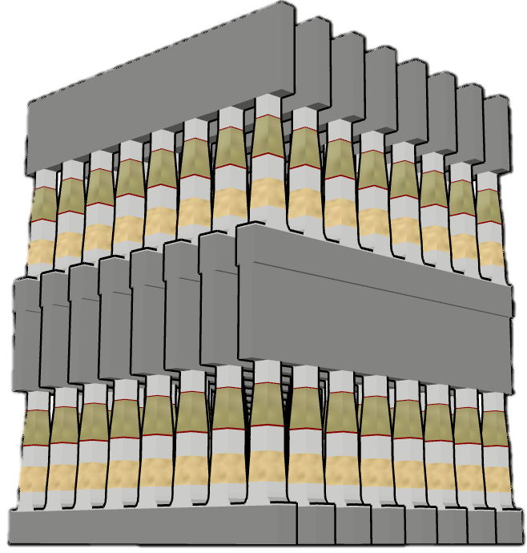
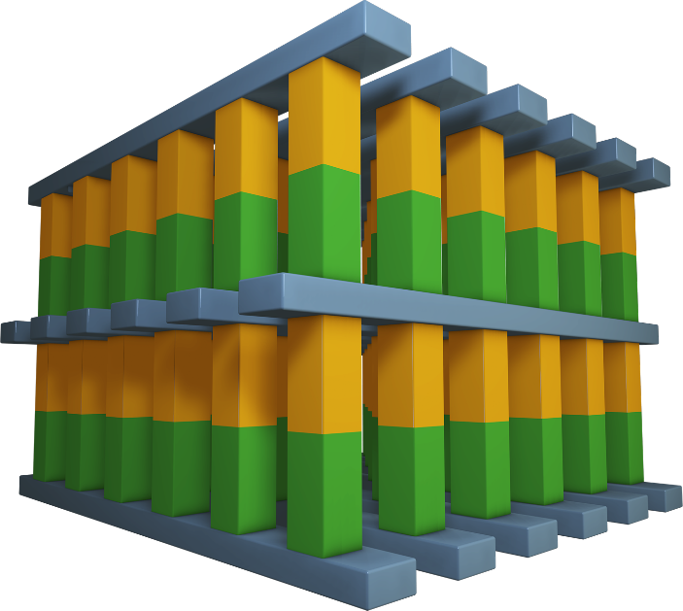
Wordlines
Wordlines
Memory & Selector
Memory & Selector
Bitlines
Bitlines
Wordlines

Slide 2
