Slide 1

3DxP Tech roadmap – Map day (Kick off)
2018 Sep’ WW38
Attorney-Client Privileged; Prepared at the Direction of Legal Counsel

Slide 2
Agenda for Kick off Meeting (ww39)
Why are we here; 3DxP biz goals – Al (20)
Map day goals, agenda and expectations – Ido (15)
Opens/discussion - All

Slide 3
Technology Programs / Nodes
IMFT:
20-Series Storage & Memory Qual & Yield Ramp
F11X:
0. Intermediate Programs:
A. F11x P1240 Advanced CMOS: On-going
B. F11x 20-Series Xfer: Tools end of year; Array start 4/1; Array Matched 7/1
1. P33 (= A + B): Advanced CMOS + 20-series array
Lead Product = Alpine Falls-32; DIMM samples WW40’19; Platform PRQ WW52’20
2. P34: Advanced CMOS + next generation array
Lead Product = Atlantic Falls-64; DIMM samples WW40’20; Platform PRQ WW52’21
3. Path-finding Programs (for next gen 3DXP cell) – not part of this Map Day

Slide 4
Crystal Ridge Roadmap – (including P33/P34 Alpine/Atlantic Falls)
Intel Confidential - Internal Use Only
Feature | Q4’18 | PO - Q4’18 PRQ - Q4’19 | PO - Q4’19 PRQ - Q4’20 | PO - Q4’20 PRQ -Q4’21 | PO - Q4’21 PRQ - Q4’22 | PO - Q4’22 PRQ - Q4’23
Platform CPU CR Pass 3DXP | Purley CLX AEP S15 | Whitley CPX/ICX BPS S2XA | Eagle Stream SPR CPS Alpine Falls | Eagle Stream GNR DPS Atlantic Falls | Mountain Stream DMR EPS S3X | Mountain Stream DMR+ FPS S3X
DDR-T Speed DDR-T2 Speed DDR Efficiency | 2666 MT/s - 80% | 3200 MT/s - 80% | 3200 MT/s 4400-4800MT/s 85-90% (DDR5) | - 5200-5600 MT/s 85-90% | - 6000-6400 MT/s 85% | - 6800-7200 MT/s 85%
DQ Buffer | DDR4 JEDEC | DDR4 JEDEC | Custom w/ LPDDR5 | Custom w/ LPDDR5 | Custom w/ LPDDR5 | Custom w/ LPDDR5
3DXP IO Rate/Signaling | 1333, DDR4 | 1467, DDR4 | 2667, LPDDR5 | 4800-5400, LPDDR5 | 6400, LPDDR5 | 7200, LPDDR5
TDP (DIMM, IAL) | <=18W | <=15W | <=15W | <=15W, <=25W+ | <=15W, <=25W+ | <=15W, <=25W+
BW Gen-to-Gen (DIMM, IAL) |  | 30% | 60-70% | 70-85% | 85%, 85% | 15%,15%
CR BW for 2R:1W vs DRAM (DIMM, IAL*) | Seq = 22% Rnd = 7% | Seq = 24% Rnd = 8% | Seq = 24% Rnd = 12% | Seq = 45%, 50% Rnd = 22%, 25% | Seq = 39%, 57% Rnd = 39%, 57% | Seq = 40%, 59% Rnd = 40%, 59%
3DXP Line Size | 256B | 256B | 128B | 128B | 64B | 64B
3DXP Read Energy (FF) 3DXP Write Energy (FF) | 69 pJ/b 159 pJ/b | 52 pJ/b 118 pJ/b | 39 pJ/b 88 pJ/b | 21 pJ/b 47 pJ/b | 21 pJ/b 50 pJ/b | 21 pJ/b 50 pJ/b
100% Read Seq 2:1 Rd:Wr Seq (DIMM, IAL*) | 7.0 GB/s 3.8 GB/s | 9.8 GB/s 5.0 GB/s | 16.0 GB/s 8.25 GB/s | 28 GB/s, 12 GB/s 17 GB/s, 19 GB/s | 34 GB/s, 46 GB/s 17.5 GB/s, 26 GB/s | 39 GB/s, 51 GB/s 20 GB/s, 30 GB/s
CR DIMM Capacity | 128GB, 256GB, 512GB | 64GB, 128GB, 256GB, 512GB, 1TB | 64GB, 128GB, 256GB, 512GB, 1TB | 128GB, 256GB, 512GB, 1TB, 2TB | 128GB, 256GB, 512GB, 1TB, 2TB | 128GB, 256GB, 512GB, 1TB, 2TB
TBD
Key roadmap adjustment – Alpine Falls Q4’20 & Atlantic Falls Q4’21

Slide 5
P33 / P34 Design Features
Base Density Landing Zone
Chop Density Landing Zone
 | S26A | Alpine Falls 32 | Atlantic Falls 64 | S25 | Alpine Falls 16/8 | Atlantic Falls 32/16
Landing Zone |  | Min | Target |  | Min | Target
Density (GB) | 32 | 32 | 64 | 16 | 16/8 | 32/16
Decks | 4 | 4 | 4 | 4 | 4/2 | 2/1 (?) | 4/2
Partitions | 32 | 32 | 64 | 16 | 16 | 32 (?) | 32/32
Slices/Partition | 1 | 1 | 1 | 1 | 1 | 1
Read BW (MB/s, SDP) | 1600 | 3200 | 4800 - 5400 | 1600 | 2400 | 3200 (?) | 4800 - 5400
Write BW (MB/s, SDP) | 800 | 1100 | 2200 | 550 | 550 | 1100 (?) | 1100
Min Number of Supplies | 4 | 4 | 5 | 4 | 4 | 5
Vdd/Vddq (V) | 1.2/1.2 | 1.05/0.6 or 1.05 | 1.05/0.6 | 1.2/1.2 | 1.05/0.6 or 1.05 | 1.05/0.6
Vhh/Vpp/Vnn (V) | 3.3/5.3/-4.7 | 3.3/5.3/-4.7 | 3.3/5.25/-4.0 | 3.3/5.3/-4.7 | 3.3/5.3/-4.7 | 3.3/5.25/-4.0
Optional Vnn2 (V) | NA | -3.3 | -3.3 | NA | -3.3 | -3.3
Read Energy (pJ/b) (Vnn2 opt.) | 52 | 44 (39) | 30 (28) | 52 | 44 (39) | 30 (28)
Write Energy (pJ/b) (MWr) | 118 | 102 (92) | 79 (77) | 118 | 102 (92) | 79 (77)
Interface | DDR4 | LPDDR+DDR (0.6V + 1.05V) | LPDDR (0.6V) | DDR4 | LPDDR (0.6V) + DDR combo (1.05V) | LPDDR (0.6V)
Read latency (ns) | 101 | 101 | <90 | 101 | 101 | <90
Write Completion (ns) | 475 | 475 | 475 | 475 | 475 | 475
1
A
B
2
(?) Chop deck strategy = better performance possible 2 deck and 1 deck at ~30%/50% $/GB increase

Slide 6
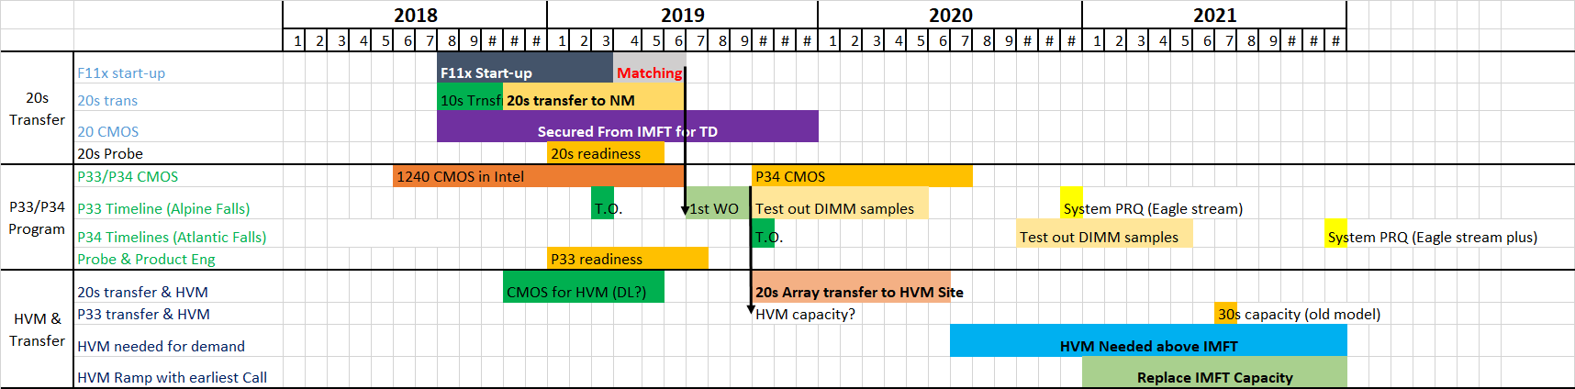
Program & Platform Sampling/PRQ Schedule
Gantt built mostly based on backwrods planning from biz need dates
Next- we will identify negative floats and nap risks
Note: Some line items were added as placeholder- need to validate dates

Slide 7
Map Day Scope
Map Day Objectives:
Define executable plan for 3DxP TD and Mfg. of next two Gen. (P33/P34)
Create holistic map for strategic 3DxP activities
Scope: TD, HVM, Transfers, Products/test, Platform alignment (off line)
Participants:
TD (Al, Giri, Max, Shafqat, Ted, Narahari, Shyam, Kiran, Sanjay, Derchang, Darren), Mfg (Keyvan, Paul, Rick, Shawn), MCD (Stephen, Geetha, Dan, Mat G., Mase Taub, Ed, Hanmant, ), FIN (Dave)
When: ww40.4 in RNB
Preparations required:
Owners to come with: key MS/schedule, dependencies, implications, help needed

Slide 8
Proposed Agenda
Time | Duration | Topic | Owner | Expected outcome
09:00-09:30 | 30 | Map day opening | Ido | Align on agenda, intro, expected outcome, P2i context
09:30-10:00 | 30 | Program overview | Al | What success looks like, Platform schedule, naming, biz opportunity
10:00-10:30 | 30 | HVM dependencies, transfers | Paul | HVM & transfer requirements, sample volumes, 20s CMOS, BE?
10:30-11:00 | 30 | Break
11:00-11:30 | 30 | P33/P34 Advanced CMOS | Shafqat | Key MS, schedule, dependencies, risks, help needed, Next steps
11:30-12:00 | 30 | Alpine Falls/Atlantic Falls Design | Dan | Key MS, schedule, dependencies, risks, help needed, Next steps
12:00-12:45 | 45 | Lunch in room
12:45-1:30 | 45 | Probe & PE | Geetha/Ed | Key MS, schedule, dependencies, risks, help needed, Next steps
1:30-2:00 | 30 | P33 Program | Shafqat | Program integration
2:00-2:30 | 30 | P34 Array Dev' | Max (Darren), DerChang | Key MS, schedule, dependencies, risks, help needed, Next steps
2:30-3:00 | 30 | Break
3:00-4:00 | 60 | Summary | Ido | Schedule alignment, AR's, next steps
Inputs/suggestions by the team?

Slide 9
Next Steps
Required Preparations:
Owners to prepare and present: Key MS, schedule, dependencies, risks, help needed, Next steps
Please send your presentation to Ido & Al by Monday Oct’ 1st.
Please share information on need to know basis only.

Slide 10
Back-up

Slide 11
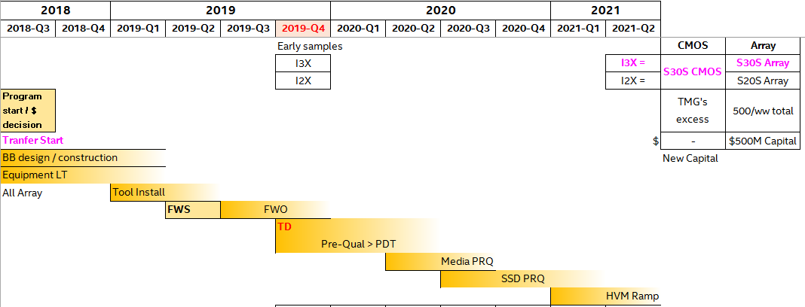
Critical Dates from last meeting
Sample dies needed from Q4’2019
Need to understand the Yield and total volume needed, translate into #wafers
SSD PRQ ~Q3/Q4’2020
Volume ramp in Year 2021 (Crow pass)
Key Take-away:
Requirements Gantt below, >3Qtr stretch vs standard Gantt to SSD PRQ
“Homerun” for this Technology (Transfer & Develop) of TD Capacity/samples starting Q4’19
F11X for TD (Array) Capacity in current scope
F11X for samples Capacity NOT in the scope

Slide 12
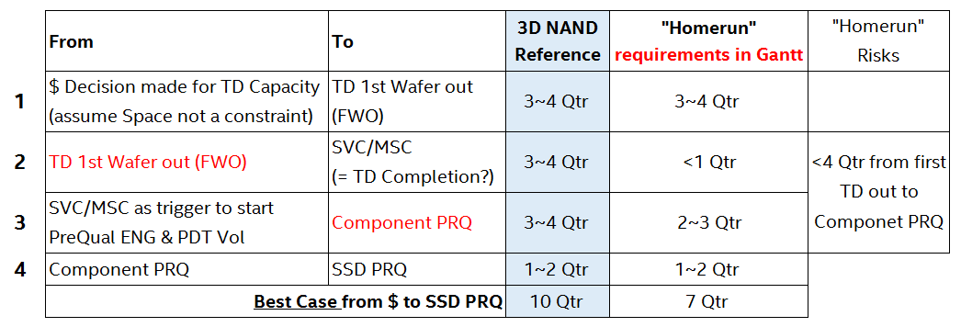

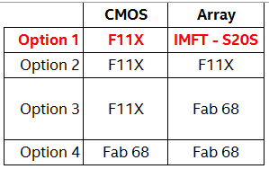
Lead-time side by side
TD side (Al, Giri) : Biggest risks
S20S Technology Readiness
I2X vs I3X speed to TD completion
Speed to deliver the samples meeting Spec
MFG side (Keyvan) :
Capacity locations, scale, Ramp, Transfer routes

Slide 13
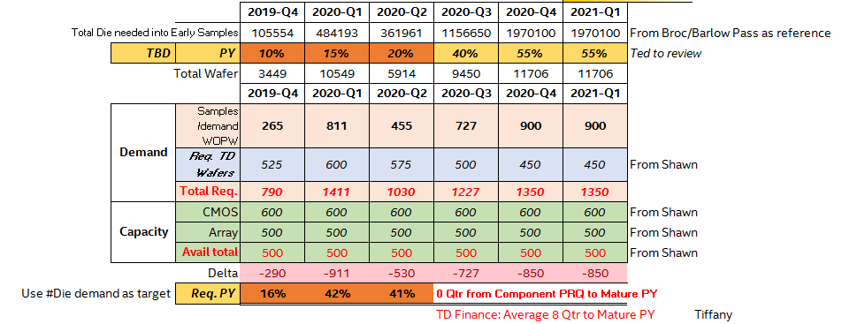
Negotiate CMOS Capacity with TMG
$600M~$700M for Capacity in F11X or IMFT

Slide 14
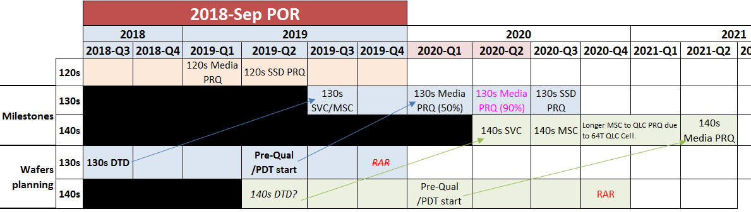
From 3D NAND TD reference
3~4 Qtr from TD to meeting Samples spec (~ align to TD SVC/MSC milestones)
3~4 Qtr from Samples (Fab Wafer starts) to Media PRQ
1~2 Qtr from Media to SSD PRQ

Slide 15
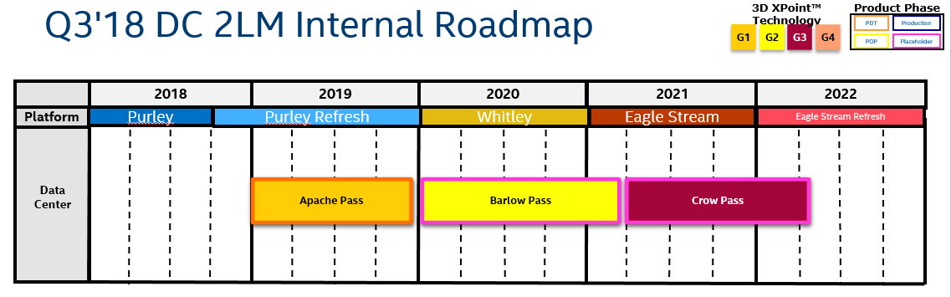
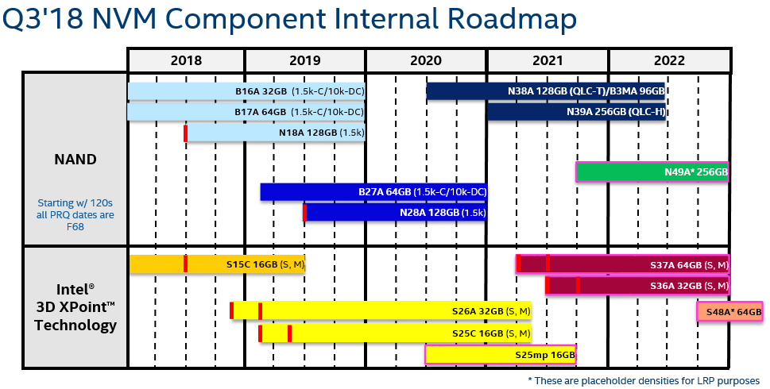

Slide 16
WIF: Value Proposition for 25s node
Attorney Client Privileged – Prepared at the Direction of Legal Counsel
Purpose of today’s discussion:
Understand legal constraints/boundary conditions related to DCSA/JDPa/MALA for future 3DXP nodes
Define next steps in evaluating feasibility/value prop for 25s node
1

Slide 17
WIF: Value Proposition for 25s node
Attorney Client Privileged – Prepared at the Direction of Legal Counsel
Legal: JDPA/DCSA/MALA terms & conditions: (Owner: Joe Bond)
Do we have to offer 25s SOW to Micron?
Any implications to leveraging 20s array?
Do we have to wait until 20s SOW (or SSM SOW?) is completed?
“Buy back” risk?
Any implications from a Micron IMFT call? (Governor restrictions in MALA)?
TD (Owner: Al/Dave Mc/Tiffany)
When would transfer to Mfg (SVC, EFF) be ready?
What investment will be required to develop this node?
Does the return offset the investment versus next best alternative?
Roadmap (Owner: Drew H)
Is the performance improvement compelling to DCG/CCG/NSG? (ASP uplift?)
Impact to Optane Inc.: how much volume would this apply to?
What is the value prop versus the next best alternative (leverage 20s longer then introduce 30s)
Can we leverage 20s for CCG/NSG (client) and 25s for DC
What product modifications (ASIC, FW, other) will be needed to take advantage of 25s capabilities?
Roadmap scenarios for timing of 25s delivery? (what is value depending on when 25s quals? PG1 vs. PG4 yields
1

Slide 18
WIF: Value Proposition for 25s node
Attorney Client Privileged – Prepared at the Direction of Legal Counsel
Manufacturing (Owner: Paul Whitlock/Hans)
How/where to manufacture? Pull in cap ex?
What capacity would be needed to support this and when could it be available?
Any implications to IMFT loadings (10s, 20s), with and without a Micron call?
Any implications to NAND loadings (cannibalization)?
How much of DCSA margin benefit would be offset by lower scale mfg line? (cost difference vs. 20s)
Transition with 20s (how to manage the 20s transfer to fit timing needs)
Next steps:
Do we have the right owners above?
Schedule meeting for next week for report outs on items above from owners
Decision Forum: RPM/RDM meetings? – who will own presentation?
1

Slide 19
Process
Kick off & pre-map day alignment – ww39.2
Build rev1 schedule – inputs by owners
Map day- ww40.4
Final schedule and plan in place
P2i review- ww41.5

