Slide 1
Cell Roadmap in 3DXP Architecture perspective
DerChang and Cell team, WW11/2017
Thick BECN / Full BECN→ Stay on (30+67)Å BECN [no change]
Neutral or slightly improvement for PG4 RWB due to drift upside (root cause unidentified)
10X cycling open to PG1 ⬅ net negative
Bi-layer MECN → worthy of continuing with large window upside exhibited in D1 [surprise]
Architecture direction validated with lower than expected improvement (optimization required?)
Pleasant surprise on 180mV D1 EOL window gain attributed to ∆VT, E3 shift, Vt sigma
G-TECN → Need more funding on the critical architecture element
To flatten thermal profile in PM (reduce power) for disturb and endurance
Architecture direction is partially validated as demonstrated on set speed, endurance and write disturb
Resistance is yet to be optimized/balanced for Read disturb (Vt-I shapes for deck asymmetry)
Bilayer TECN will improve velocity of architecture validation; followed by gradient CNx for optimization

Slide 2
BE: Thick (+3nm) BECN & Full BECN
Architecture as a “Remote-R”
Increase V_{ON} to decrease snapback wing and/or peak current
Lower thermal dissipation near PM → eliminate snap-back transient induced amorphization for read disturb
Lower snapback damage → improve snapback resiliency therefore endurances
Results vs. expectation
Initial RD improvement observed (5x in BER) but no gain @ EOL
Some improvement on E3 shift (upto 20mV)
Surprises
Cycling open increase – 10X @ 2M cycle
10% reduction in WD capability
Some improvement on drift (15 to 40mV); root cause unidentified
Follow-ups
Additional efforts needed in recovering 10X cycling open degradation.
Should not change to (30+97)Å BECN

Slide 3
ME: Bi-Layer MECN (vs. MEC)
Architecture as a “Local-R” with two purposes + exploring SD interface
Increase snap-back transient resiliency, similar to BE but local to PM therefore strong thermal coupling.
Thermal profile tuning with TE resistance, likely higher TE resistance needed given fireball at MEC today.
Results vs. expectation
RD slightly improvement for D1 but large degradation for D0 due to deck offset, D0 Vt increase 80mV and D1 Vt reduce 80mV.
Vt sigma reduction (5mV/σ*3.1σ for both decks) suggesting thicker CNx interfacing SD reducing Vt variability; component of variation yet to be investigated.
Surprises
Big improvement on ∆V_{T} (60mV for both decks), E3 shift (20mV/D0 and 120mV/D1) resulted in 180mV D1 EOL window improvement (D0 EOL window still need to quantified)
10% reduction in WD capability
Degrades D1 drift by 40mV (while improve D0 drift by 20mV)
Follow-ups
Seasoning optimization for MEC to reduce deck Vt offset
Vt variability improvement segmentation; quantification by random vs. systematic.

Slide 4
TE: G-TECN (vs. TEC)
Architecture as a “Local-R” to flatten thermal profile cross PM for lowering I_{Reset} and tuning Vt-I
To reduce D0/D1 set current offset: more square Vt-I for D0 (I_{melt} increase) and slope Vt-I for D1 (I_{melt} decrease or unchanged) due to Te-Sb segregation;
To improve WD with lower I_{Reset} and lower peak temp
To improve Endurance with lower I_{Reset} and snap-back transient
To improve Read disturb due to peak current reduction however lower D1 I_{melt} can counter the effect
Results vs. expectation
I₃/I₂ : 2. % improvement @ D0, 2% worse @ D1 vs. RD worsened for D0 (2X) and D1 (5X) ➔ D0 is not getting the squareness as demonstrated in bi-Layer TECN (natural @ D0 and 2X @ D1). Further resistance tuning (CNx ratio and FP etch profile) is needed
3~4μA I_{Reset} reduction and 3% I₃ variability reduction (CD?) → result in >10ns τ_{nuke}/τ_{grow} improvement, 10% WD improvement, WE (E3 shift) quantification on going.
Surprises
Noticeable improvement on D1 window (70mV coming from ∆V_{T} 20mV, M3S 60mV, Drift 25mV + E3)
Neutral D0 window impact to be segmented.
Follow-ups
PFA (see Fuga’s note)
Include bi-layer based tuning to validate the strategic direction in architecture (flat thermal profile)

Slide 5
Supporting Materials

Slide 6
Supporting Materials-I
1-page Summary scorecard

Slide 7
 | Thick BECN vs. BEC | Bilayer MECN vs. MEC | g-TECN (V4) vs. TEC | Bilayer TECN vs. TEC
WD
TD capability @ BOL | 0.9x in capability due to hotter cell with higher BEC resistance; Ireset is not changing can be also be narrower BEC CD by ~1nm | 0.9X in capability | average 1.1x | ~0.8-1.0x
TD capability @ EOL | should be better; no metrology | should be better; not tested | D0 no change; | should be better; not tested
RD
RD BER @ Probe [short delay] | No gain at D0 and D1 | D0 worse due to deck offset (D0 Vt increase and D1 Vt reduce) of spike mitigation impact; Spike contribute to SARD or interaction to set current level; More relaxed for D1 therefore worse for D0; C19 is needed | D0 equal
RD BER @ Probe [long delay] | 0.2X D1 RDG BER; speculatively, it has to be higher Von. 50mV increasing in QTT vs.??? to be estimated properly, using Vt vs, RD as a proxy) | Slightly better for D1 (increase Von voltage); D0 need new algo to see the same benefit; | D0: 2X, D1:5X with g-TECN, not getting square Vt-I in D0; square Vt-I with bilayer at D0 (with composition segregation Te at top) | No probe mon. available; From RDG mon@WLR: D0:~1x; D1:~2x
RD capability @ WLR (EOL) (long delay) | No gain at D0 and D1 Resistance converged yet to be validated | data review needed | D0: is 10X worse D1 is equal; Initial RBDR is worse impacting the visibility of EOL quantification.
RWB
EOL window, probe projection | matched or slightly | 0mV on D0, 180mV on D1 (component still need to added up right) Main contributors are D1 100~130mV E3 shift + both D0/D1 30mV sigma gain + some cross tile | D0 0mV, D1:+70mV contributors D1 ∆VT (20mV) | D0:+80 mV, D1:+10 mV
EOL window, probe + WLR |  | D1: 100mV higher at 200K, D0: neutral
M329S window | +20mV | D0 +70mV/ D1 +120mV | D0: 0mV D1:5mV | D0:+75 mV,D1:-30 mV
E2 margin loss due to knee@3.29sigma | 0 mV | D0 equal / D1 is -15mV (better)
Set VT | > 0 mV; PG1/T2/B1 showing Vt deck offset increase (D0 increase 20mV and D1 reduces 70mV) parallel shift up Vt vs. leakage curve by 0.03 decades or sub 10% | D0: +80mV, D1: -80mV Seasoning characterization seems not yielding conclusion |  | D0:+20 mV,D1:+70 mV
∆VT | 0 mV | D0/D1: +60mV | D0: 0mV, D1: +20mV | D0:+20 mV,D1:+40 mV
Set Cross Tile | +10mV | Slightly better ;Quantification ? |  | ~neutral
σSet Vt | 0mV, initial lot was worse | -5mV |  | D0:-6 mV; D1:0 mV
σReset Vt | 0mV | -5mV |  | D0:-5 mV; D1:+4 mV
UD @85C 100s-3Hr, probe |  |  | D0: 0mV, D1: -25mV
BD 3Hr, probe projection
UD @85C 100s-3Hr, DFT | -15~40mV | D0 -20mV, D1 +40mV
BD 48Hr, UDUDB | 0mV (need data) |  |  | D0:-25 mV, D1:+25 mV
E3 Shift @ 65K FW WLR | slightly better(up to 20mV) | D0: -20mV D1:-120mV | D0: 0mV, D1:upto -20mV @ 65K; can be worse at higher cycle counts. Root cause segmentation is needed; | D0:-15 mV, D1:-20 mV
Set Speed
Time-0 E2 knee | Neutral (highly varied from 3.2 to 3.5 sigma, lot to lot) | D0: -0.1/D1:+0.1; limited data (low wafer count per split) | D0/D1: neutral with MEC 1.1 D0/D1: slightly improvement (0.05) (with bilayer MECN)
EOL E2 Knee | Neutral (highly varied lot to lot,, generally 0.3 sigma reduction from time-0) | D0: -0.2/D1:+0.1; limited data (low wafer count per split) | D0:-0.1/D1:+0.2 with MEC 1.1 D0:+0.07/D1:matched (with bilayer MECN)
Nuke Nose (Probe) | roughly matched 30 to 56ns lot to lot, worst one comes from P1T2B1 | Neutral | D0:-20n, D1:-6ns with MEC D0:+12ns, D1:-2ns with MECN
Nuke Nose (EOL) | inconclusive @ D0; roughly match or minor improvement @ D1 need more stats analysis | Neutral | D0:-52n, D1:-13ns with MEC D0:+6ns, D1:-5ns with MECN
Growth Nose (Probe) | Matched or minor improvement | D0: -9ns/D1:0ns | D0:-12n, D1:-10ns with MEC D0:matched, D1:-10ns with MECN
Growth Nose (EOL) | Matched or minor improvement | D0: -9ns/D1:0ns (hik Seal)~+10nsec (POR seal); follow up with more silicon on w2w variability (envelope based characterization/quantification) | D0:-12n, D1:-10ns with MEC D0:+4ns, D1:-10ns with MECN

Slide 8
Supporting Materials-II
Electrodes Strategy, Validation and Follow-ups

Slide 9
BE
Architectural - PM-remote local R to increase VON (snap-back transient resiliency) | Upsides (i) 2D1 E2 RD containment (~2x) w/ BECN1.1, BECN1.2 (ii) Overall PG window based on (a) VT sigma (BECN1.2) post-normalization, (b) E2 VT 'drift' (tbq), (c) E3 VT shift (up to 30 mV) Downsides - E3 WD impact w/ BECN1.1, re-covered w/ BECN1.2 (and so-called 'seasoning' optimization') -Current delivery (~2uA) - OPEN RBER at 2M FW count for BECN1.1/BECN1.2 higher than BECN1 (~10x) Notes: HVM friendly version demonstrated (Full HUCN, BECN1.2) in F2 and to be included in next Bundles (>B40) | SWR (enablement): Incorporation in next F2 bundles (from B41 onwards)
 |  | SWR (enablement): PV SPUTTER degas deck mismatch closure by block SWR
 |  | SWR (model building): BE Etch time skew for FF VT and SET VT control
 |  | - OPEN RBER: Line trend and normalization w/ Electrode and 'seal' focus (AMG shared in ww07)
 |  | - Array init ('seasoning' optimization) margin and recommendations
 |  | - L0: WSiN/HUCN, WSiN/HUC TBR fingerprint
 |  | - L0: WSiN/HUC Vs. WSiN/HUCN R, ox., etc.(see 7452 Vs.6502)
 |  | - Model validation by numerical simulations: E3 WD

Slide 10
ME
Yield/Execution: > PG window expansion @ time-zero due to (i) increase in median VT window, (ii) tightening for SET/RST distributions (VT sigma lowering) - process integration margin gain Vs. ME PVD Vs. E/SD eng. Vs. …? Architectural: - besides local R increase (snap-bak transient resiliency), no clear additional propositions (mainly speculations around E/SD), - Follow-up: physical Vs. electrical characterization review ('LCDU', 'bounce, etc.) | Upsides (i) time-zero window opening by <DV_{T}> increase (~40-80mV) and E2/E3 VT sigma reduction (~7mV/sigma) by process integration margin and E/SD engineering (?) (ii) 2D1 E2 RD containment (limited in range of ~1x in recent Si) by local R-increase / cell morphology opt.(?) (iii) large containment of E3 VT shift through cycles mainly in D1 (~100+ mV), while contained in D0 Downsides - 2D1 Low and High (‘OPEN’) VT tail @ > 200k FW (mainly 2D0) - VT,SET deck offset (~.15-.20 V) partially mitigated w/ cycle and whose ‘seasoning’ opt. condition not found yet - E3 WD cap. lowering minimal (10%) in recent Si - Increase in E2 VT ‘drift’ (~40 mV @2d,85C) in latest Si (170A) Notes: - No HVM-friendly ('graded') version demostrated, yet (next read ww10) | - PFA: by bit physical analysis for OPEN bits in D0/D1 @ 2M cycles, including tails (9893632, 04E Vs. 01C)
 |  | - PFA: Morphological check for SET VT 'drift' increase (~40mV) in D1 (9810442, 3E Vs. 2E Vs. 1C): Any etch related component that can be addressed?
 |  | - OPEN RBER onset Vs. FW count: Additional point between 200k and 2M FW
 |  | - OPEN RBER: Line trend and normalization w/ Electrode and 'seal' focus (AMG shared in ww07)
 |  | - SET VT 'drift': VT normalization Vs. deck-offset: Strategy recommendation
 |  | - SET VT 'drift': Additional DFT data collection (to confirm DE signal) w/ recommendation
 |  | - SET VT 'sigma': bit to bit Vs. so-called 'bounce' ('repeatability'): SD/HUCN Vs. SD/HUC fingerprint (based on WLR flow results, BE signal included, if available
 |  | - L1D learning: Summary (morphology, tSD, and LCDU included) and follow-ups (see also above)
 |  | -SWR (enablement): PG1T2 Bundle #1(9836952,C17),#2(9860192,C19), G enablement w/ G var x DE skew (9860182, ww10)
 |  | -SWR (model building): OPEN segmentation w/ seal x G var (9874482,ww16); VT shift segmentation w/ ME Vs. 'seal' options (to be funded)
 |  | - SET latency improvement knobs: Revisit HUCN/W-lam2 splits (SET time distrib. tightening)
 |  | - SET VT deck offset: Eng. char for opt. working point for 'array init.' and recomm. for Si SWRs and algo
 |  | - E2 RD quantification: New WLR flow run (9810442,PG1T2)
 |  | - L0: SD/HUCN, SD/HUC, HUCN/HBC1, HUCN/TSN TBR fingerprint
 |  | - Model validation by numerical simulations: E3 WD, IRST, SET algo
 |  | AC I-V characterization through cycles: HUCN Vs. HUC @ ME/BE
 |  | Stress analysis on cell operation: ME impacts (HUC,HUCN,HBC1)

Slide 11
TE
Architectural: > PM T-profile flattening to contain PM elemental distribution response to electrical pulses, resulting in - Improvement in D1 SET algo working point: (i) I3,SET (and deck differential) reduction, (ii) reduced t3 SET latency - E3 WD capability benefit in D0 > Improve cell electro-thermal efficiency to address lateral losses from (i) r7.2→ r7.3 cell rev transition and (ii) future arch. changes for E3 WD mitigation (e.g. including 2nd cut gap fill low q_{TH}) | Upsides (i) increase (3-4uA) the margin in reset Vs. delivery current at matched/better(1x-1.2x) E3 WD capability, (ii) over-rst reduction (-3%) by I3 variability reduction and program response curve tuning VS. deck (I3/I2, ‘slope3’) (iii) Mitigation of SET algo gap between decks (~-50%) and E2 performances through cycles (+0.3s@EOL in D1) (iv) Possible PG window improvement (see VT 'drift', etc.) Downsides (i) D1 E2 RD (~5x mainly in TECN-G4 than TECN1, bi-layer), partially addressable (?) by morphology (TE undercut?) and SET VT retargeting - tbq Notes: Next activities to feature optimization of (i) DE conditions (morphology, etc.) and (ii) N-profile to harvest all the improvements, w/o downsides. | - PFA: PM elemental movie Vs. program pulses: (i) SET process (t1, t3) and (ii) RST process
 |  | - L1D @1st and 2nd to address TE undercut
 |  | - E2 RD quantification: Mitigation w/ tSD retargeting (both decks)? RWB test plan, included
 |  | - E2 RD quantification: New WLR flow run (9793632.013)
 |  | - SET VT 'drift' reduction (D0,D1): SET algo margin (optimized T-profile) Vs. process by-products - Additional opportunities?
 |  | - SET VT sigma reduction (D0): SET algo margin (optimized T-profile) Vs. 'intrinsic' (bounce) Vs. process by-products - Additional opportunities?
 |  | - E3 WD: (i) t1 correlations, (ii) TE morphology related (iii) Eng. char. w/ distrib. analysis Vs. PM elem. gradient
 |  | - Next SWRs (F4/F2?) to optimize graded version and apply L1D learning (to be funded)
 |  | - Model validation by numerical simulations: E3 WD, IRST, SET algo
 |  | - L0: HUCN/HUC, W/HUCN, etc. TBR fingerprint

Slide 12
Supporting Materials-III
Set Speed

Slide 13
Thick BECN vs BECN AMG
B36A 9888762 1E vs 2E
PG1T2 B1 9836952 1C vs 2E
B34C 9881282 2E vs 3E
Data from 40nm

Slide 14
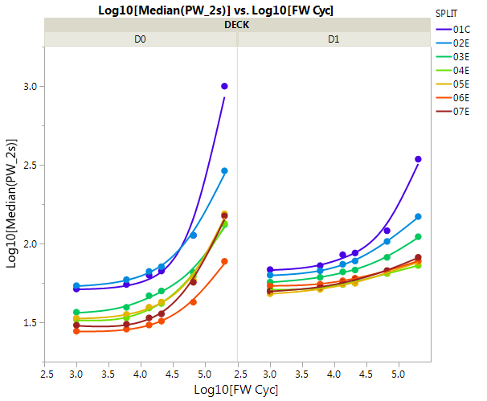
Thick BECN Set Knee and PW0_2s
Knee match
PW0_2s improve

Slide 15
Thick BECN
B36A 9888762 3E vs 4E
No signal
PG1T2 B1 9836952 2E vs 1C
Improvement in D0
B34C 9881282 2E vs 3E, improvement in both decks
D0
D0
D1
D1

Slide 16
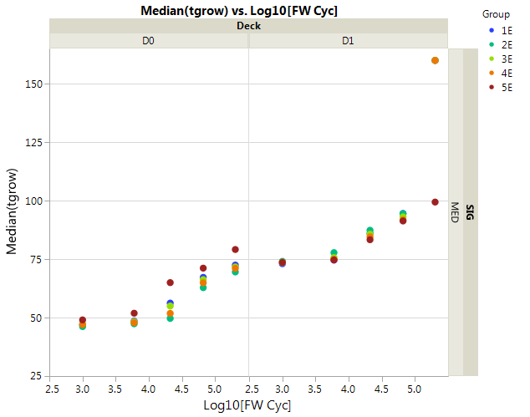
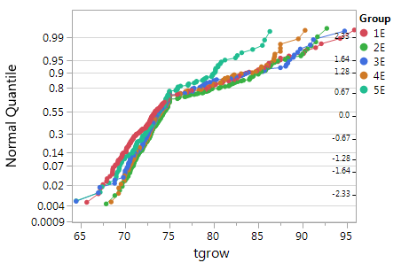
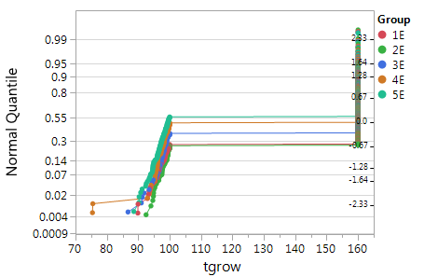
Thick BECN Tgrow
4ns improvement in PG1B1 in 2D1
Median bit median die
D0
1E0
D1
Matched tgrow 1C vs 2E in B36A
2E5

Slide 17
Bilayer MECN vs MEC
PG1T2 B1 9836952 4E vs 5E
Knee
time 0:
D0 -0.1 sigma
D1 +0.1 sigma
Post cycle:
D0: -0.2 sigma (low wafer count per split)
D1: +0.1 sigma
Rev7.32_thin MECN DE centering SWR
3E 2E vs 1C

Slide 18
Bilayer MECN vs MEC
PG1T2 B1 9836952 4E vs 5E
9810442 D0
~9ns tgrow improvement in D0
~7ns tgrow improvement in D0
D0
Matched at D1 pre-cycle, worse tgrow degradation on post cycle for bilayer MECN
Matched at D1
D1
Distributional analysis
.163 PG1 tape child lot readout
Check overstress
Zone A/B filter

Slide 19
TECN
GTECN vs TEC 2E vs 1C
D1 bilayer TECN vs GTECN vs TEC: 5E vs 4E vs 3E
BilayerTECN vs TEC 2E vs 1C
Knee:
GTECN vs TEC: (1) pre cyc no signal (2) post cycle, GTECN improves D1, degrades D0
GTECN vs TEC on top of MECN: (1) pre cyc no signal (2) post cycle, minor improvement on both decks
Bilayer TECN vs TEC on top of MECN: (1) pre cyc no signal (2) post cycle, minor improvement on D1
Bilayer TECN vs TEC: (1) pre cyc no signal (2) post cycle, improvement on D1.
Tnuc:
Tnuc:
GTECN vs TEC: improve D0 1.5X, D1 1.1X, the improvement increases post cycle
Bilayer TECN vs TEC on top of MECN: (1) improve D1 by 1.3x
Bilayer TECN vs TEC : (1) improve D0 by 1.1x, D1 by 1.3x, improvement is more significant post cycle

Slide 20
TECN
D1
GTECN vs TEC 2E vs 1C
D1 bilayer TECN vs GTECN vs TEC: 5E vs 4E vs 3E
D0
G-TECN: A->B, improve by 12ns, both pre and post cycle
Bilayer TECN works similar as G-TECN from 3E->5E signals

Slide 21
High N2 Flow Seal Package
B36A 9888762 3E vs 4E
B34C 9881282 3E vs 4E
PG1T2 B1 9836952 3E vs 2E no low NH3
Overall, high N2 flow provides match or better E2 knee and nuc capability

Slide 22
High N2 Flow Package
B36A 9888762 3E vs 4E
No signal
PG1T2 B1 9836952 3E vs 2E no low NH3
5ns improvement for both decks (C vs B)
B34C 9881282 3E vs 4E
No signal in D0, improve post cycle tgrow in D1
D0
D0
D1
D1

