Slide 1
Introduced to Chalcogenide – Memory devices, threshold switches and NVM cell
Introduction to 3DXP –
Operating point per IV and program transfer curves
Key material Attributes to device performance
Roadmap and Pathfinding
Roadmap and challenges in scaling and reliability
BiSM
3D Tiering
3D decoder
Long term research topic
Other RRAM

Slide 2
3DXP – 20nm, 2 deck, 128Gb example
Array architecture and Operating Principle
Cell Architecture and Electrical Characteristics (QS-IV and Program Transfer Curves)
Role of PM, SD and Electrode and success criteria
Roadmap and enablers
2nd Gen 20s’ ➔ –30% cost (by 4deck) and –30% energy (by circuit architecture)
3rd Gen P1240 ➔ bandwidth improvement, enabled by advance CMOS and Low K dielectric
4th Gen P1241 ➔ Device scaling, enabled by new material for window and disturb
Near term pathfinding topics and intercept horizon
BiSM: 4th Gen
3D Tiering: 6th Gen and beyond
Long term research topic
3DXP for embedded memory subsystem.
Alternative SD/BiSM to improve RWB and reduce voltage rail

Slide 3
Moore’s Law in action

Slide 4
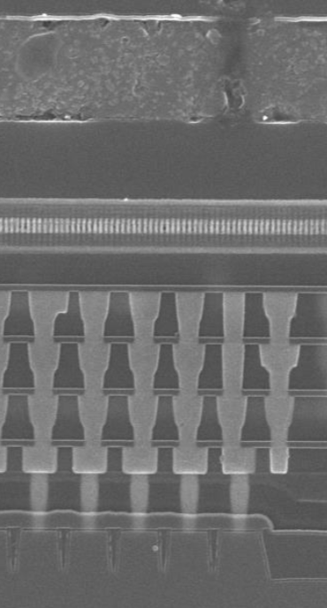
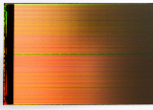
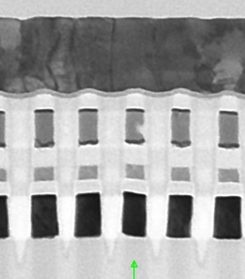
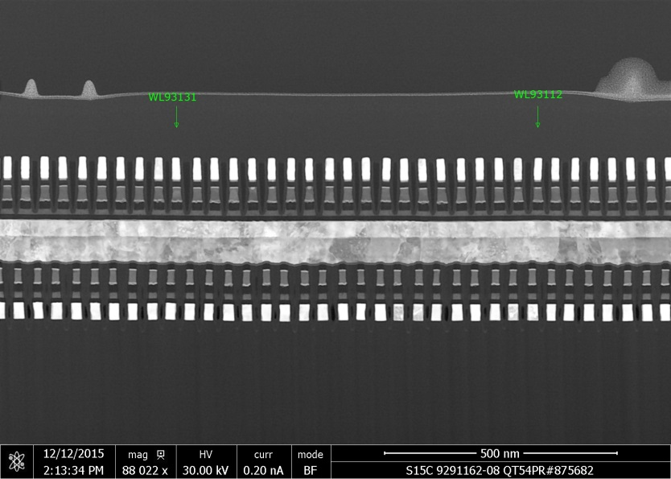
3D Xpoint™ Technology – eg. 20nm 2 deck 128Gbit

Slide 5
[N-1] ½V_{access}
V_{access}
…
…
[M-1]
½V_{access}
0V

Slide 10
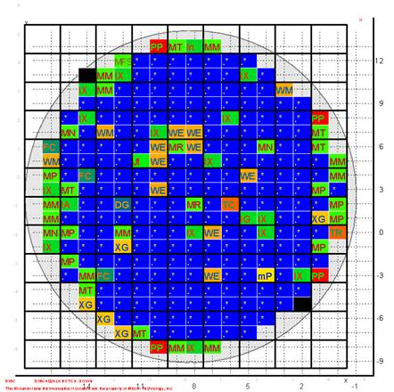


AEP Production Shipment Begins
Navin handing 1st
production DIMM to Google on 8/8/18
Yield on 8/8/18:
Record wafer from IMFT
Factory shipments

Slide 11
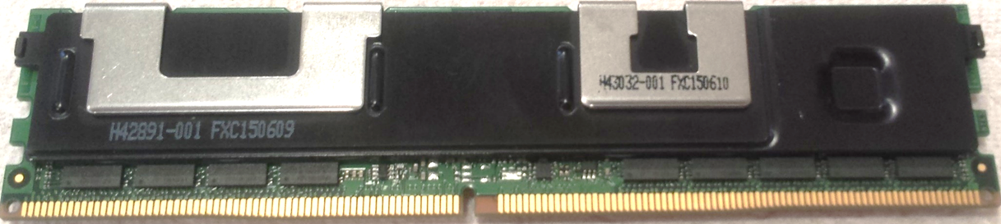
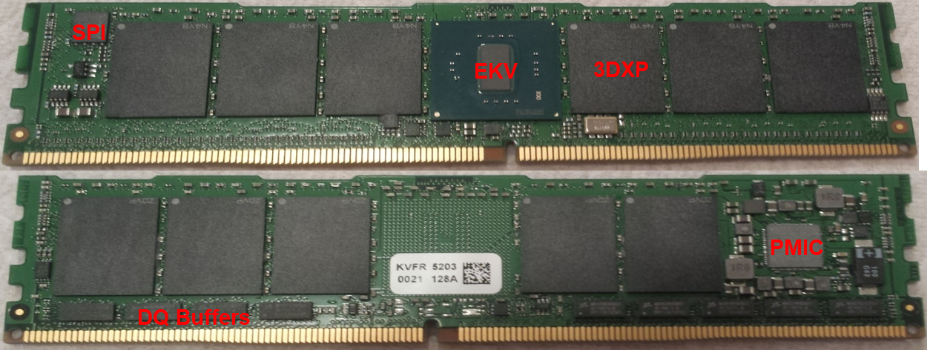
3DXP DIMM (Apache Pass, AEP)… Under the HOOD

Slide 12
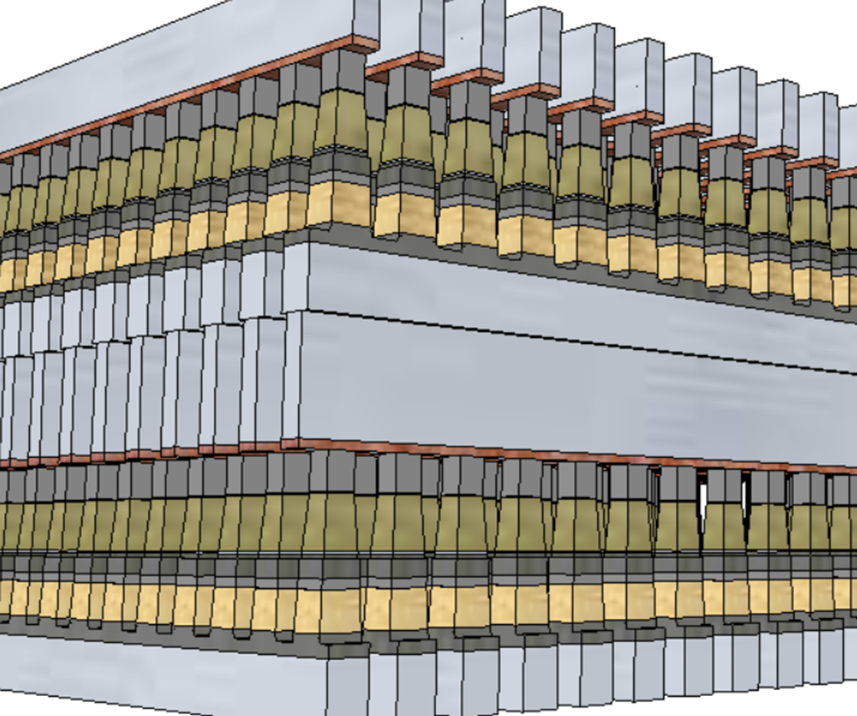
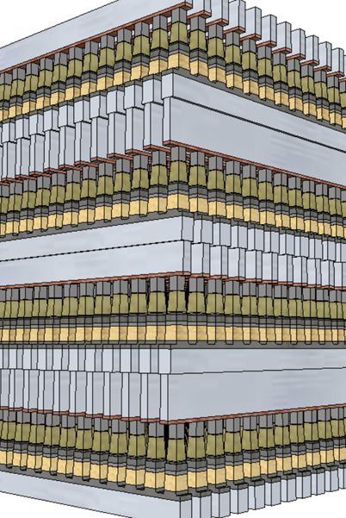
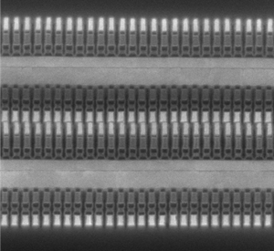
3D-Xpoint™ Roadmap
 | Attributes | 10s | 20s | P1240 | P1241 | P1241
Technology | α-Product | S15-128Gb | S26-256Gb | Alpine Falls-256Gb | Atlantic Falls 512Gb | Atlantic Falls 512Gb
 | ½ Pitch [nm] | 20.5 | 20.5 | 20.5 | 14 | 14
 | GB Footprint [mm²/GB] | 13 | 6.2 | 6.2 | 3 | 3
 | Eff. Bit Size[λ²] | 3.6 | 1.71 |  | 1.81 | 1.81
Array Arch | Access | SLC, 1b/tile
 | Tile density [Mb/tile] | 16 (2Kx4K, 2 decks) | 64 (4Kx4K, 4 decks) |  | 64 (4Kx4K, 4 decks)
 | Partition [GB/part] | 1 (128tiles X4 slices) | 1 (128 tiles X 1 slice) |  | 1 (128 tiles X 1 slice)
 | Core [GB/die] | 16 (16 Partitions) | 32 (32 Partitions) |  | 64 (64 Partitions)
Performance | R/W Energy [pJ/b] | 65/192 | 52/118 |  | 17/34
 | R/W Latency [ns] | 105/475 | 95/475 |  | 80/475
 | R/W BW [MB/s] | 1600/550 | 1600/800 |  | 4800/2200
 | I/O | x8, 1600MTS, DDR4 | x8, 1600MTS, DDR4 |  | x8, 4800MTS, DDR5
Reference Memory & Storage Technologies |  | LPDDR4 DRAM: 19nm, SLC, 40mm²/GB, 13λ² in 2017 HBM2E DRAM: 16nm, SLC, 60mm²/GB, 27λ² in 2020 2D-NAND: 20nm, TLC, 9.2mm²/GB, 2.5λ² in 2014 3D-NAND: 64tier, QLC, 1.4mm²/GB, in 2018
2 decks
4 decks
S26

