Slide 1
3D XPoint™ Technology
DerChang Kau, Max Hineman, Davide Fugazza, Kumar Virwani, Prashant Majhi & Al Fazio
WW50.4/2018
3DXP @ Intel
Architecture
Read / Write
SD, PM and Electrodes
Roadmap & Scaling
BiSM

Slide 2
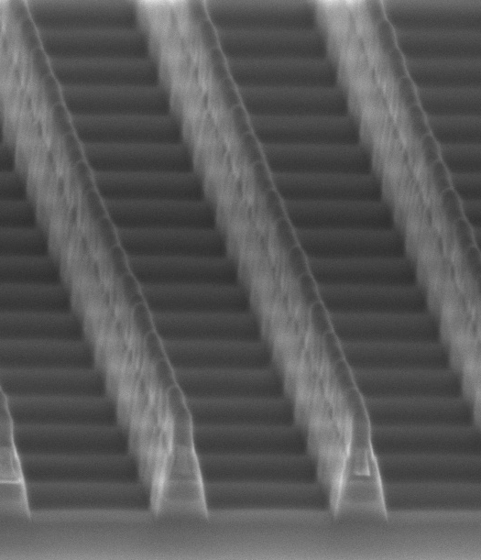
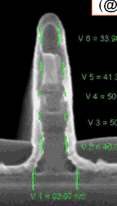
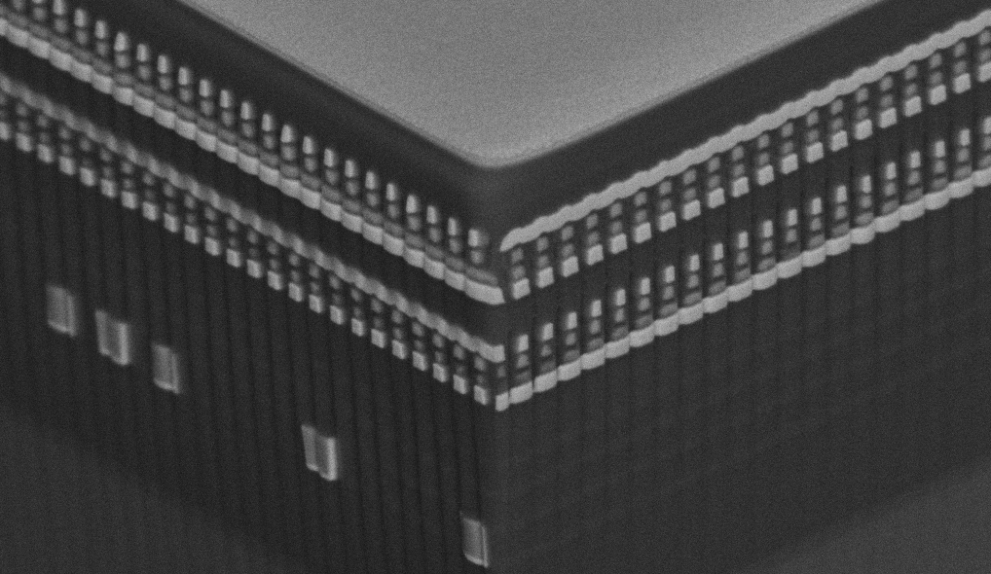
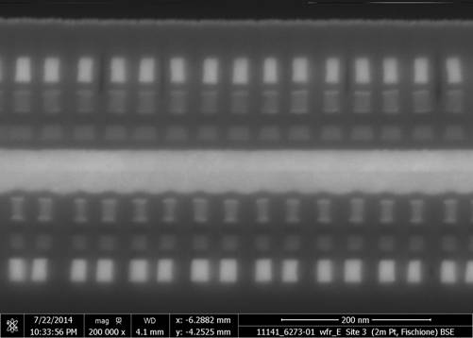
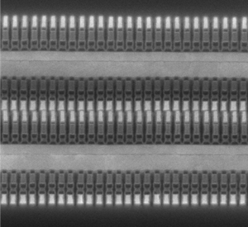
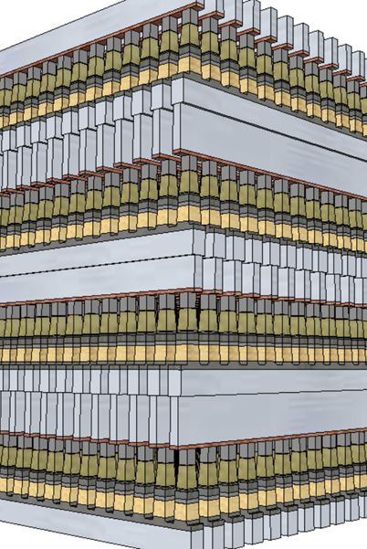
3D XPoint™ Technology Development Evolution
4Kb 200nm feature, 2-Mask Sublitho Heater
Damascene PM Subtractive SD
2003~2006 Santa Clara, CA
64Mb 180nm ½ Pitch 6-Mask Sublitho Heater Damascene PM, Subtractive SD
2007~2009 Santa Clara, CA
64Mb 100nm feature, 2-Mask
Self-Aligned, Subtractive Cell
2010~2011 Agrate, Italy
64Mb 50nm ½ Pitch, 2-Mask
Dual Deck, Self Aligned Subtractive Cell
2012~2013 Agrate, Italy
X-section along ROW
TiAlN
SD
C
W
PM
TiAlN
SD
C
C
SD
TiSiN
PM
Mid Electrodes
TiSiN
PM
SXP cell
SD only
128Gb 20nm ½ Pitch 7-Mask
Dual Deck Self Aligned Subtractive Cell
2013~2018 Boise, ID
256Gb 20nm ½ Pitch 13-Mask
Quad Deck Self Aligned Subtractive Cell
2015~2019 Lehi, UT & Rio Rancho, NM
512Gb 14nm ½ Pitch 13-Mask
Quad Deck Self Aligned Subtractive Cell
2019~2020 Rio Rancho, NM

Slide 3
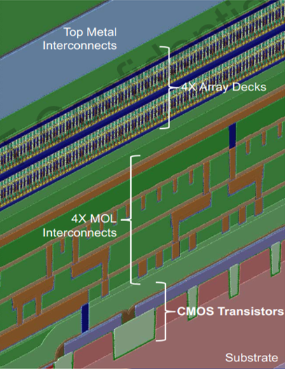
3DXP Process Architecture Overview
3DXP is a back end memory technology. CMOS enabling array access and control logic plus I/O are completed prior to array processing.
Due to properties of the memory materials array processing is done at temperatures consistent with Cu interconnect requirements.
The cross point structures are stacked to achieve higher memory density at a given die size.
The top metal is a final interconnect layer (primarily bussing) and enables cost effective wirebonding.

Slide 4
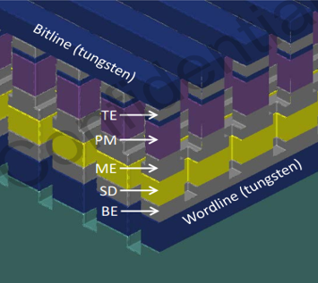
Memory Cell Architecture – High Level
The cross point is created by cutting wordlines in a line/space pattern without the bitline conductor.
Then after gapfill and planarization to expose the top electrode, depositing the bitline conductor and cutting bitlines in a perpendicular line/space pattern stopping above the wordline conductor to leave a square memory cell stack at the intersection and a true 4F² cell size.
Pattern scaling due to a simple line/space pattern moves from spacer based pitch doubling to spacer based pitch quad. No multiple patterning required.

Slide 5
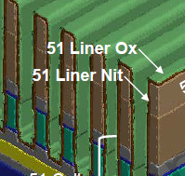
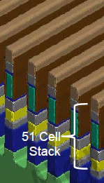
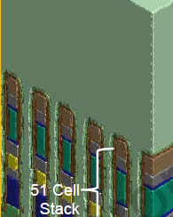
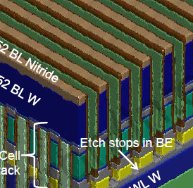
Patterning
The wordline (and bitline) etch process is split in two to avoid cross contaminating the PM and SD as the cross contamination degrades the response of each film. A liner is used to protect the PM during the SD etch and in the case of the wordline – the W etch.
The liner between the first and second “partial” etch processes is a bilayer, nitride is required for adhesion of the oxide liner to the carbon electrodes and the oxide is required for durability through the W etch. A seal film is then applied prior to gap fill to protect both PM and SD.
Gap fill between the array pitch lines requires > 10:1 AR and retrograde capability. Using spin on, need to control thermal energy transfer from a bit being written to the neighboring bits.
Ambient control is used (N2 purge of FOUPs, EFEM) is used to avoid air exposure of PM/SD. The film composition is modified through the etch/clean sequence (undesirable) and this modification is exacerbated by ambient exposure.

Slide 6
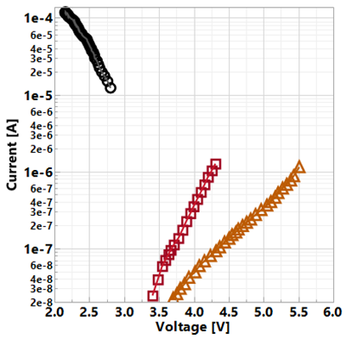
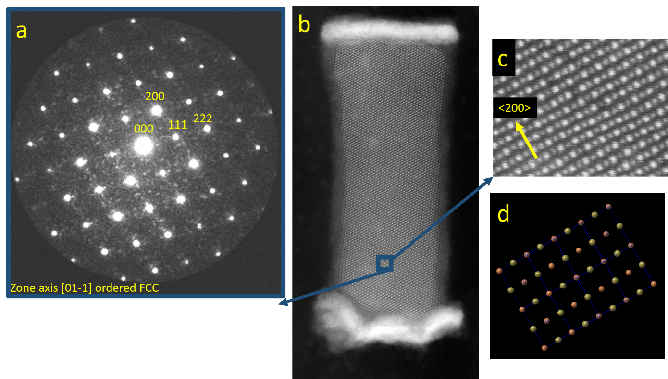
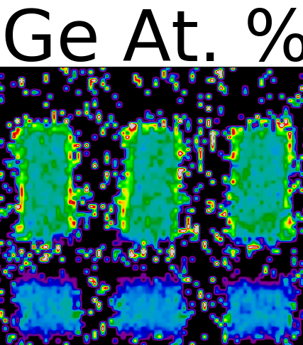
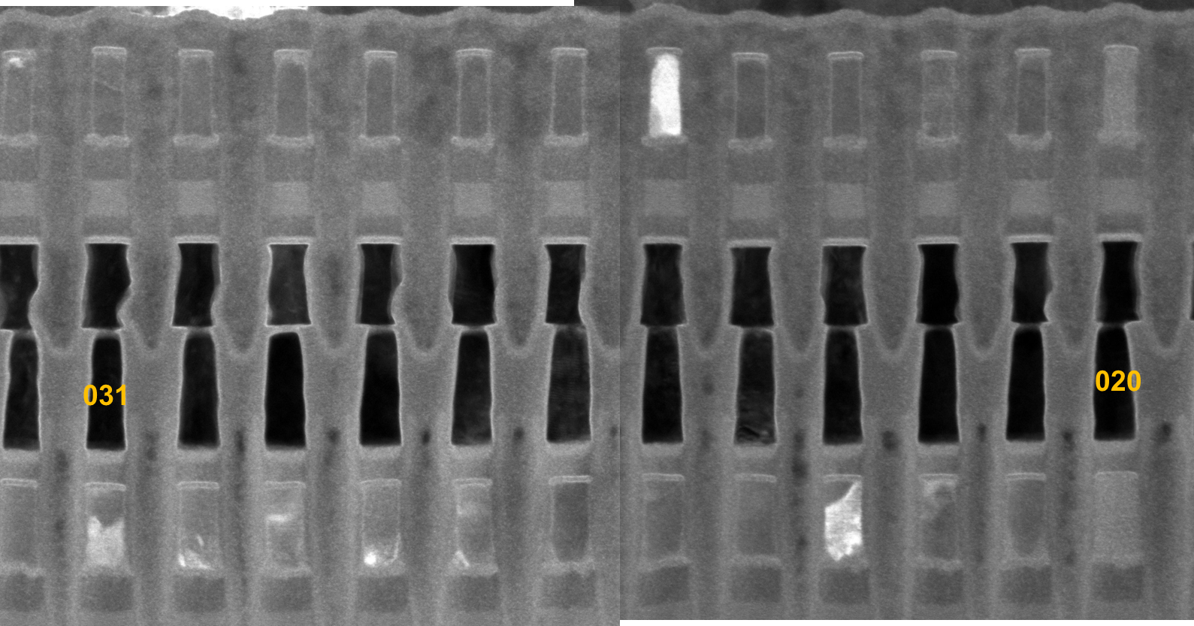
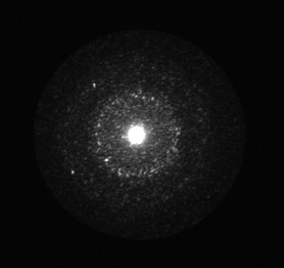
How SXP cell works
Demarcation Read on Quasi-static I-V curves
Set Operations: Solid-state recrystallization to produce crystalline PM / low threshold switching state
Key attributes: I_{SET}, V_{t,SET}, 𝜏_{SET}
On-bias
a.k.a.
Snapback NDR
V_{DM}
SET
State
RST
State
Off-bias
a.k.a.
SubVt
Reset Operations : Melt-quench vitrification to produce glassy PM / high threshold switching state
Key attributes: I_{RESET}, V_{t,RESET}
Fully crystalline (χ≅1)
Amorphous (α)
Amorphous
STEM-ADF: High throughput for χ/α fraction
α corners
(χ ≅ 0.85)
Fully α
(χ ≅ 0)

Slide 7
Components in a 3DXP cell
SD: Selector
PM: Storage
Electrodes: Physical Barrier and Electrical conductor

Slide 8
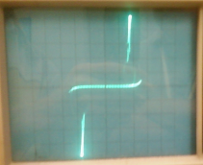
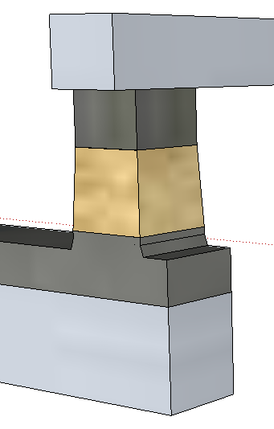
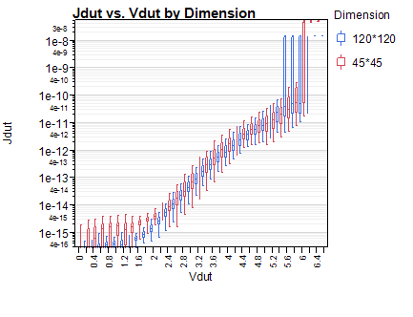
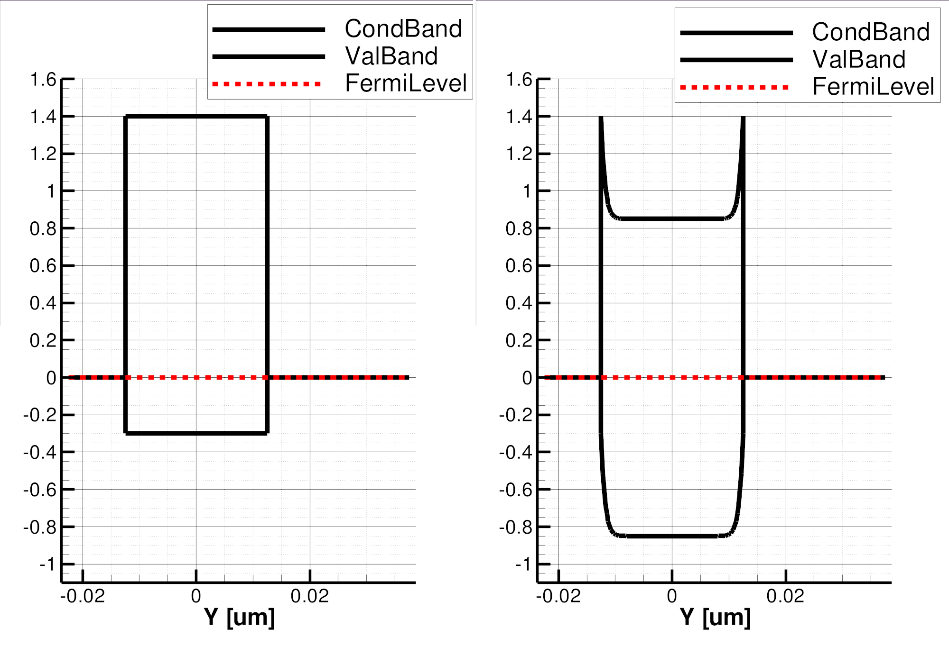
Bi-directional I-V
Ambipolar
On-state
Near Threshold
BE
BE
TE
TE
Top
Electrode
64
J [A/nm²]
(120nm)²
Selector
J [MA/cm²]
(45nm)²
48
Bottom
Electrode
Best Know SD Model
32
Full-STACK
Electrode only
16
φ_{B}=.85eV
3.0eV
4.4eV
V [Volts]
V [Volts]
1.7
1.7eV
E_{F}
BE
TE
BE
BE
SubThreshold
PF conduction
Threshold,
(positive feedback)
Snapback Regime
TE
TE

Slide 9
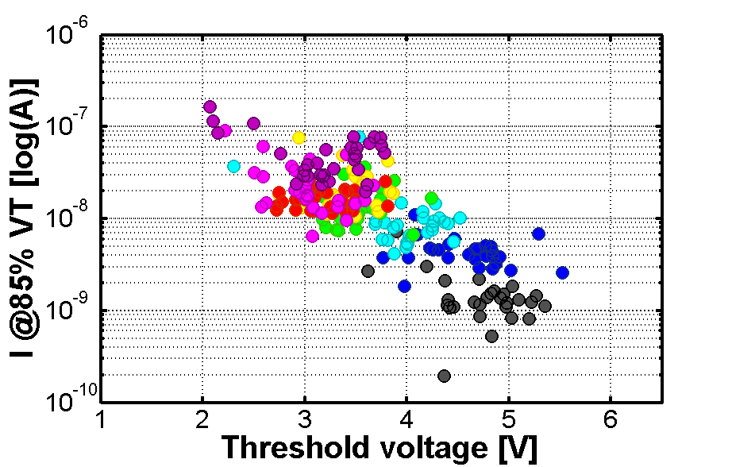
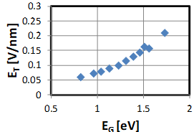
SD Material Exploration
I ~ e ^{- Eg/kT}
SD L0 physical and L1E Electrical success criteria corresponding to DTS (with examples from SDδ experiments)
SD Material system explored include: SD0 (GeAsTe, aka TAG), SD1(GeAsSe, aka SAG), SD2 (POR, SiGeAsSe, aka SiSAG), SD3 (PF including InSAG, GaSAG, doped Ge_{x}Se binary and doped oxide)
Alloy [25 nm] | L0 |  |  | L1E
 | Thermal Stability |  | BG | VT,FF [V] | VT@1E3 cyc [V] | I_{leak} @85%VT [nA] | VT drift (mV/dec) | Bounce [mV/σ]
 | 320C | 375C | Egap [eV] | < 7.9 | > 3.6 | < 30 | < 20 | < 50
goal | no rough. | info
SDdelta.A001 |  |  | 1.95 | 7.15 | 4.6 | 61 | -4.4 | 54.5
SDdelta.B001 |  |  | 1.97 | 6.37 | 4.23 | 14 | -1.9 | 59.7
SDdelta.B002 |  |  | 1.97 | 6.36 | 4.21 | 17 | -5.9 | 69
SDdelta.B003 |  |  | 1.97 | 6.12 | 4.33 | 6 | -5.1 | 67
SDdelta.B004 |  |  | 1.96 | 6.17 | 4.35 | 5 | 4.2 | 70
SDdelta.B005 |  |  | 1.95 | 7.41 | 4.27 | 6 | -8.6 | 68
SDdelta.B006 |  |  | 1.9 | 8.23 | 3.84 | 11 | 8.9 | 102
V_{T@L1E} Vs. E_{Gap@L0}
As₂Te₃ → As₂Se₃
Si → In₂Se₃
Ge

Slide 10
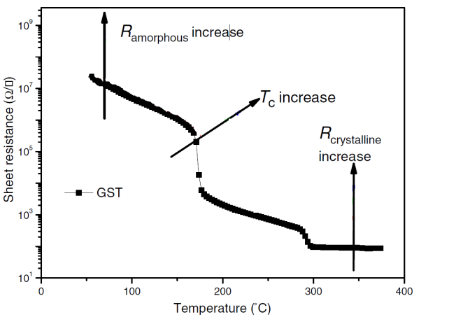
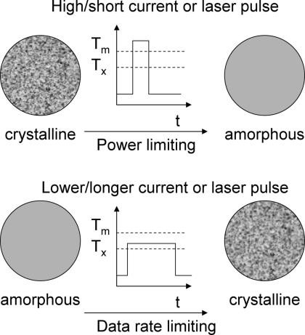
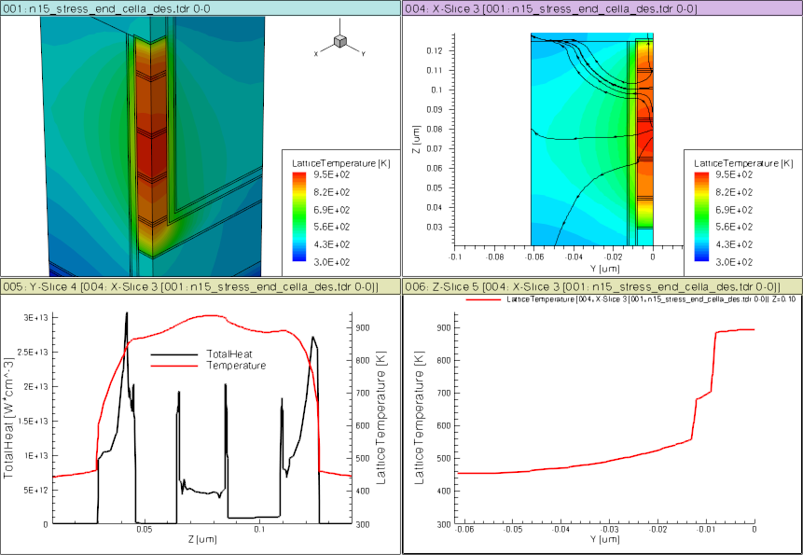
PM: Atomistic Switching Model (Ge₂Sb₂Te₅ example)
E
Te
V
CB
E_{c}
Crystalline
E_{v}
HCP
VB
E_{f}
FCC
10% structural vacancies result in localized states near LP band, exhibiting p-type semiconducting characteristics
E
Te
CB
E_{c}
Amorphous
SD
PM
E_{f}
E_{v}
BE
ME
TE
VB
Over- and under-coordinated Tellurium lead to defects/traps
Glassy PM exhibits threshold switch characteristics

Slide 11
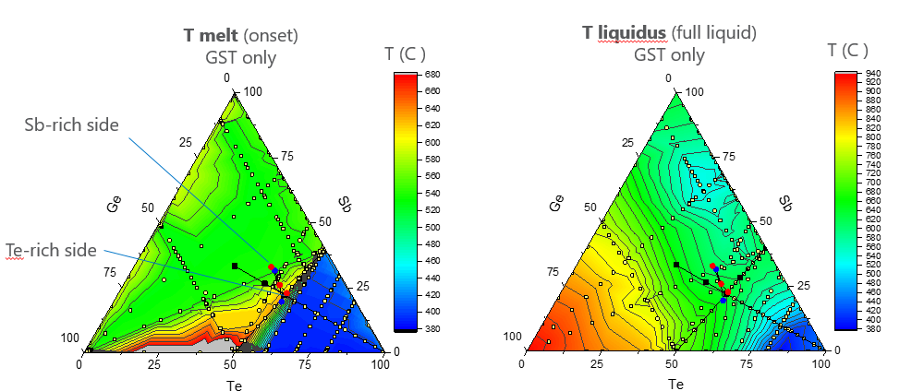
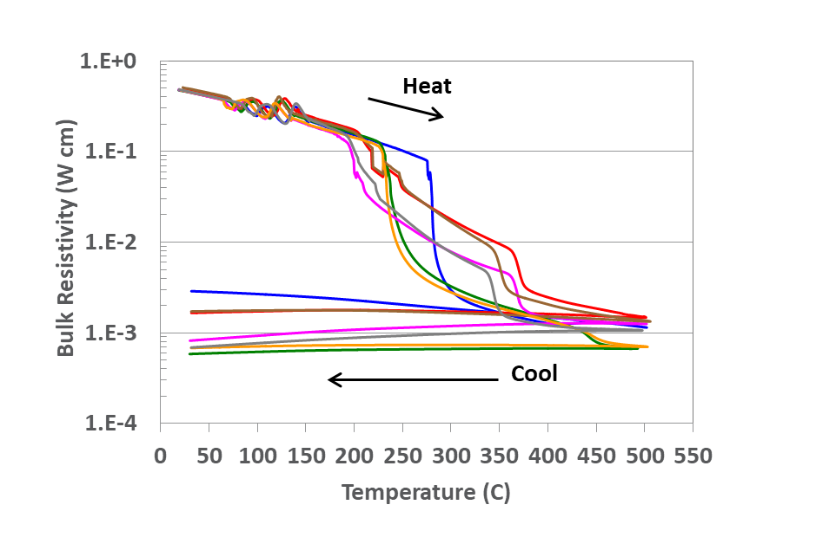
PM Material Exploration
PM L0 physical and L1E Electrical success criteria corresponding to DTS
PM Material system explored PM0(GeSbTe a.k.a. GST), PM1(InSbTe a.k.a. IST), PM2(In doped GST or I-GST) and PM3 (PF including Y-GST, Ga-GST, Sc-GST and doped GeSb at IMI)
Alloy | L0 |  |  | L1E
 | Phase Segr. (XRD) |  | BG | R_{VIR} [KΩ] | R_{SET} [KΩ] | VT [V] | VT@3uA [V] | Set 'speed' [ns]
 | 320C | 375C | Egap [eV]
goal | single | single |  | < 10 | < 4 | info | > 1.2 | < 500ns
PMδ.A001 |  |  |  | 12 | 1.9 | 1.36 | 1.20 | 200
PMδ.A002 |  |  |  | 9.6 | 2 | 1.39 | 1.21 | 200
PMδ.A003 |  |  |  | 10.7 | 2.2 | 1.50 | 1.40 | 200
PMδ.A004 |  |  |  | 13 | 2.2 | 1.45 | 1.50 | 200
PMδ.A005 |  |  | 0.77 | 15.8 | 2.1 | 1.56 | 1.56 | 200
V_{T} [V]
Eg [eV]
speed [ns]
Segregation
(XRD, 375C)

Slide 12
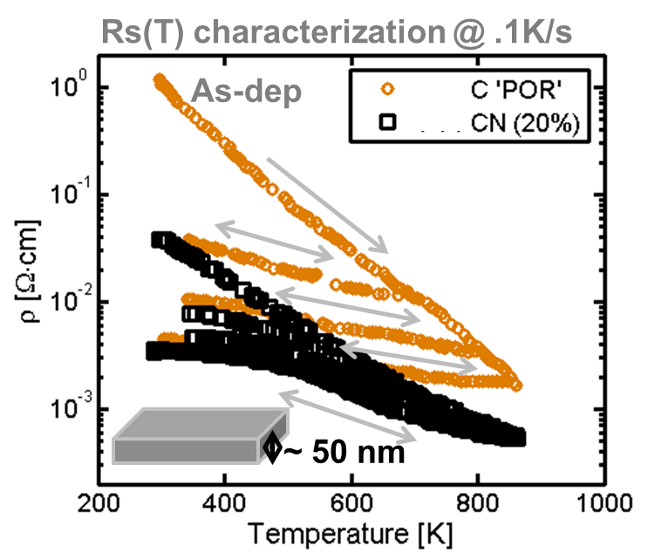
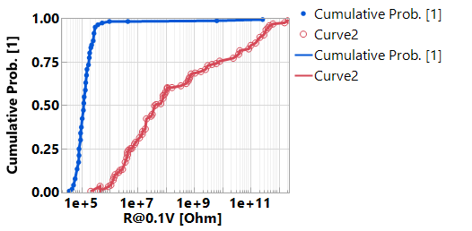
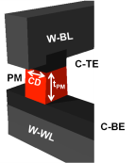
Role of Electrode
Graphitic carbon servers two roles
Physical barriers to eliminate cross contamination between PM, SD and WL/BL metals during manufacturing and product operations
Heating elements for phase change
Irreversible resistance change subject to thermal budget
Electrode Success Criteria
Interfacial liner, W, is needed to improve contact specific resistance to PM.
Component | L0 Spec (mΩ∙cm)
Electrode (El.) Bulk resistivity | As dep | 1~200
 | 300C cycled | 1~30
 | 600C cycled | 1~2.5
E/PM Interface | < 10ΜΩ∙nm²@1μΑ
E/SD Interface | < 100ΜΩ∙nm²@1μΑ
C/PM/W/C
C/PM/C

Slide 13
Roadmap and Pathfinding

Slide 14
3D XPoint™ POR Roadmap
Technology |  | 10s | 20s | P1240 | P1241
½ Pitch [nm] |  | 20.5 | 20.5 | 20.5 | 14
Effective F [nm] |  | 14.5 | 10.25 | 10.25 | 9.8
Immersion layer |  | 7 (4 PD) | 13 (8 PD) | 13 (8 PD) | 13 (8 PQ)
Product |  | S15 | S26 | ALF32 | ATF-64
Platform PRQ |  | Eo’18 | Eo’19 | Eo’20 | Eo’21
Capacity [Gb/die] |  | 128 | 256 | 256 | 512
Read BW [MB/s] |  | 1600 | 1600 | 3200 | 4800
Write BW [MB/s] |  | 550 | 800 | 1100 | 2200
Read E [pJ/b] |  | 71 | 52 | 39 | 28
Write E [pJ/b] |  | 170 | 118 | 92 | 77
Power [W] |  | 0.9 | 0.75 | 1 | 1.15
X8 I/O Interface |  | DDR4 | DDR4 | DDR5/LPDDR5 | LPDDR5+
DDR Rate [MT/s] |  | 1600 | 1600 | 3200 | 4800
Chop | Capacity [Gb/die] |  |  | 128 (2D or 16P) | 256 (2D or 32P)
 | Read BW [MB/s] |  |  | 3200 | 4800
 | Write BW [MB/s] |  |  | 1100 or 550 | 2200 or 1100

Slide 15
P1241+ Scaling Enablers
PM pathfinding:
Need 30% higher $\overset{⃑}{\text{E}\text{TH}}$ due to vertical scaling
Need 50% 𝜏_{nuke} reduction due to lateral scaling
SD pathfinding:
15% 𝜎_{VT} reduction (Empirical)
Exploit Memory window (Empirical)
Seeking opportunity in Drift Reduction (Empirical, SD3 L1E)
Patterning:
Etch/cleans improvements to minimize modification of the PM/SD compositions.
Known improvements by wafer ambient control – minimizing exposure to atmospheric O₂, H₂O with tool modifications
Etch improvements for profile in the multilayer.
Initial work with modified insitu depositions (newer tool configuration) has shown capability at 14nm.
Liner/Seal/Gap Fill:
Improved step coverage of liner/seal. These are currently bilayers (nitride/oxide) to ensure adhesion to cell and durability/mechanical stability.
The oxide is good step coverage (ALD) the nitride is a PECVD (pulsed plasma) film with poor step coverage. Directions we need to explore are halide free, low temperature ALD films.
Improved durability and barrier capabilities of the liner films (H & O)
Replacement of oxide w/ metal oxides (Al, Hf) have shown improved durability, but add significant complexity to etch at 2nd cut.
Lower thermal conductivity gap fill to reduce thermal cross talk
Work with the supplier on modifications to the c-doped oxide SOD, higher C content, was in progress. Mechanical stability and etch impact at 2nd cut are additional risks.

Slide 16
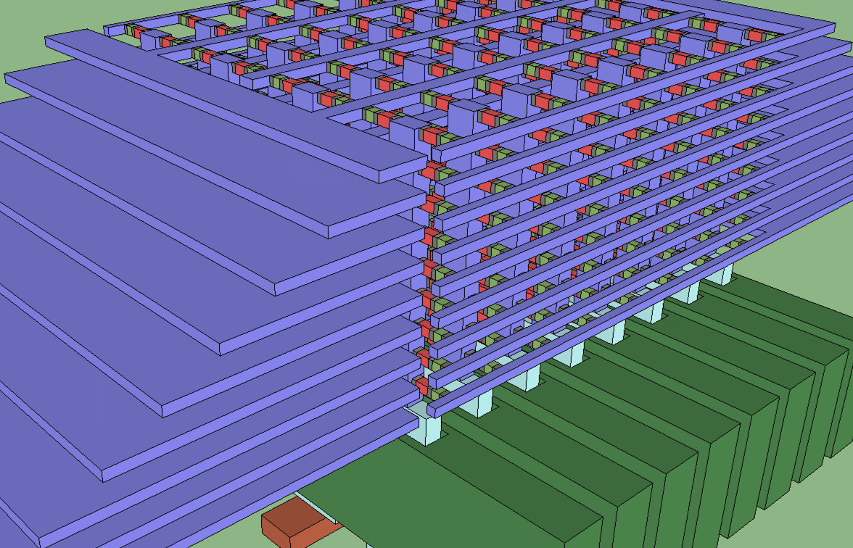
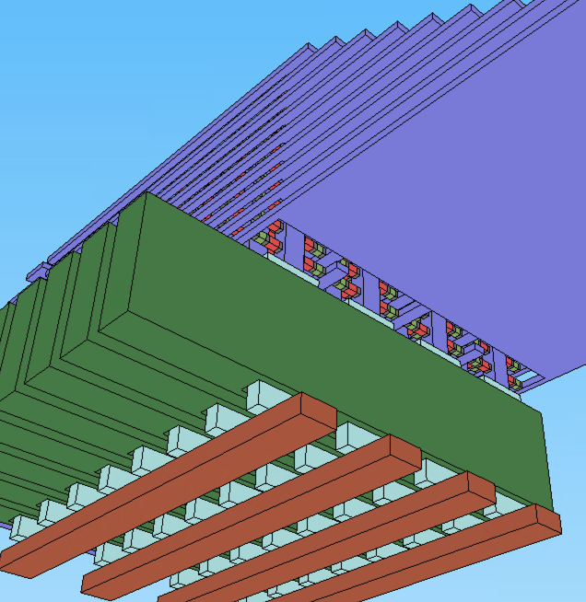
P1242 definition and Beyond
Four options being analyzed
Option-1: 4 Deck Cross Point Array Stack / PQ, F=10.25nm – F_{eff} = 5.125nm
Option-2: 3D Tier w/o TFT ⬅ not scalable ( = dual deck cross point array)
Option-3: 3D Tier with Pillar Select X’tor, 2 bits per pillar each tier (Doublet)
Option-4: 3D Tier with Pillar Select X’tor, 1 bit per pillar each tier (Singlet)
3D Tier Doublet example
Pillar Doublet
2 bits per pillar each tier
WL:
Tier Bias
WL Comb:
2 WL Decoders per Tier
PS: Pillar Select
BL:
Pillar Bias
Pillar Select Transistor

Slide 17
Enabling technology needed for 3D-Tier 3DXP
Pillar Select Transistor
Tier Array Process
5V, 110uA GAA TFT (H_{75nm} , W_{270nm} , T_{42nm} , S_{62nm}), On-Resistance 3KΩ, off leakage < 10nA
Low thermal budget for BEOL integration
Contact resistance (X2) < 300Ω (to BL & pillar)
1st cut is similar to 3D-NAND’s, either replacement vs. subtractive for WL metal
ALD Chal, Carbon & W lamina – maintain composition uniformity at high aspect ratio for chal films
Recess process control: thickness control impacts - sigma in Vt, delta Vt, Iprogram (heaters) ~ endurance/WD
2nd cut etch capable of W lamina removal over entire height of bit (vertical lamina) without chal damage
Replacement Pillar Metals, liner with good good contact to TE carbon and pillar select source/drain and barrier properties for W dep.
PST Success Criteria and Preliminary Survey
Parameter | 3D XP (3D Tier) | Poly-Si | Poly Ge / III-V | Oxide (ZnO; IGZO) | 2D TMD
Ion Lin (uA) @ (Vg-Vt)=4V; Vd = 0.3V | 110 uA
Operating Voltage | 5
Ioff (nA) | <10 (Vg=0)
Contact Resistivity (MΩ.nm²)# | <2
Transistor Lg (nm); W (nm) (GAA) | 75; 600
Transistor EOT (nm)* | 10 |  | HiK | HiK | HiK
Transistor Mobility (cm2.v.sec) | >35
Reliability (BTI, ??) | TBD
Process Compatibility (Max Temp?) | 430 C @ 3mts 300 C @ 1hr |  | High DT ? | H+/O barrier
CMOS | Yes for BiSM |  |  | pTFT poor | No process
# Based on Rcontact ~ 10% of R(total) => 2Rc < 300 ohm
* Based on Si with SiO2 gate dielectric; HiK will likely be lower EOT

Slide 18
BiSM

Slide 19
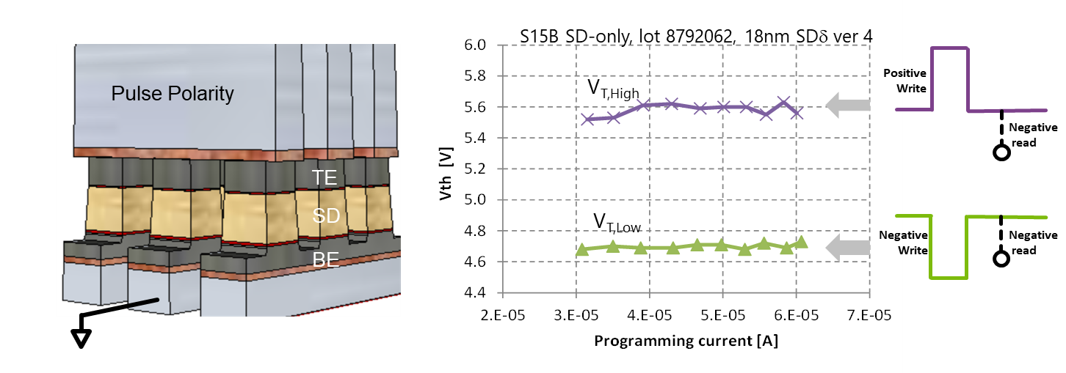
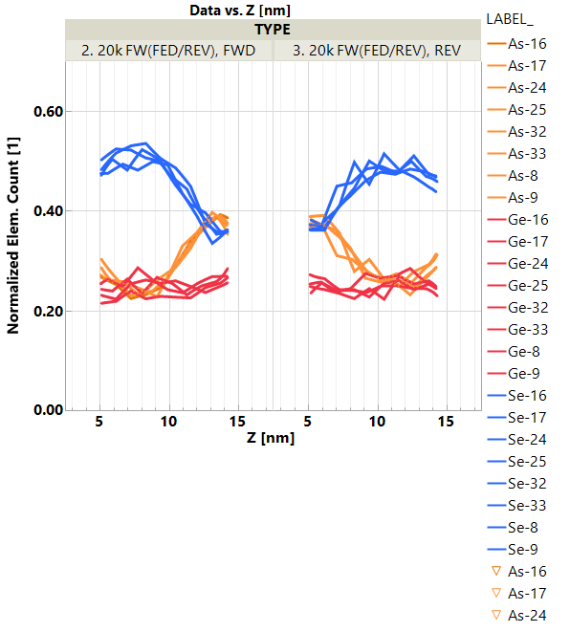
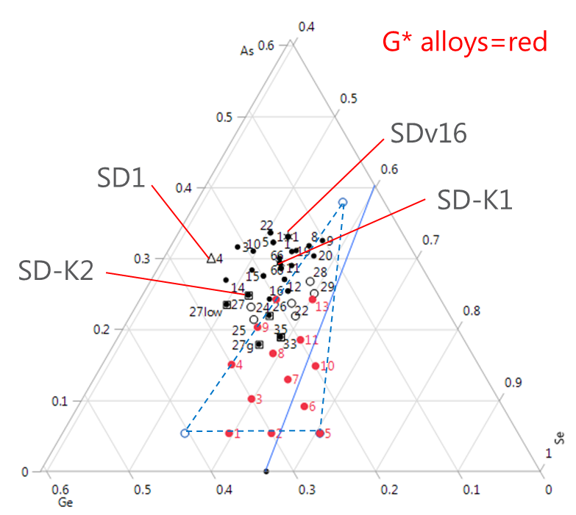
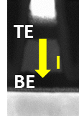
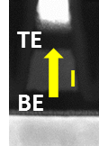
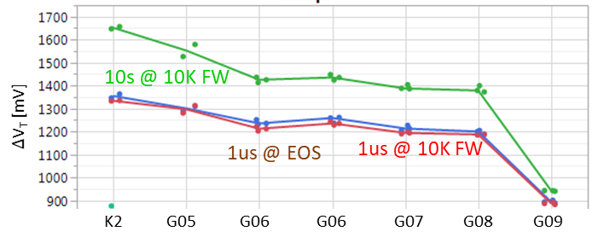
Introduction to atomistic memory switch with Built-in Selector a.k.a. Built-in-Select Memory (BiSM)
Beginning of Life
After 4M cycles
Deck 0
Deck 1
Deck 0
Deck 1
Set
Reset
Set
Reset
Set
Reset
Set
Reset
Sigma of Bit
Sigma of Bit
V_{T} [mV]
V_{T} [mV]
A V_{T} window $(\text{Δ}$V_{T}) is observed by applying programming pulses with opposite polarity
Bipolar memory switching with elemental segregation are observed in wide range of Chalcogenide glasses
SD1 alloy
Conceptually, it is a 3D XPoint™ technology.
Physical construction of BiSM array is BEOL 3D stackable X-Y cross point array comptatible with mainstream CMOS.
Read/Write access deploys threshold selecting one cell while inhibiting the rest of cells in an array with subthreshold bias.
The best known ∆V_{T} physics is an electrochemical potential modulation subject to mass transport by polarity.
TE. BE
TE. BE
Se
As
As₂Se₃
Ge
1.75eV
1.75eV
SD.G09
1.76eV
GeSe₂
SD.G05
1.9eV

Slide 20
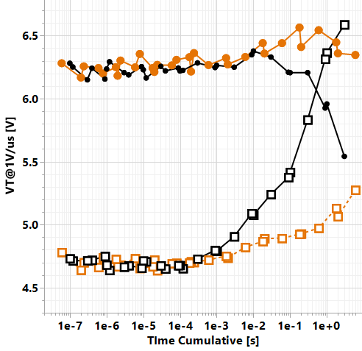
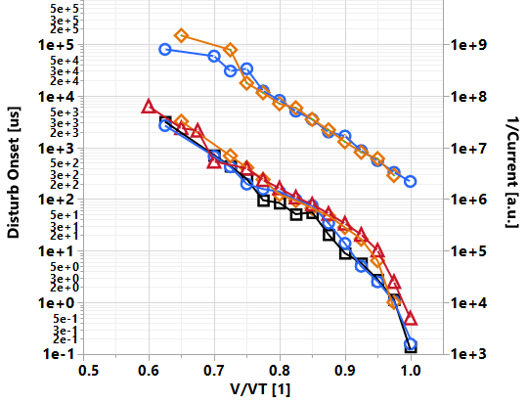

Switching vs. Disturb: Risk and Mitigation
Disturb curve Vs. Duty cycle @V/VT ~0.65
Disturb time Vs. Norm. Stress
Constant ratio of TTF : I_{leakage}⁻¹
suggesting “QBD” mechanism incentivizes for switching physics development
RST
100%
SET
50%
Memory Switching mechanism is also subject to Read/Write inhibiting disturb
Can BiSM hold off cross point disturb w/o a selector
Inverse correction between Time-to-fail and subVt leakage suggests segmentation of underline mechanisms
Seeking BiSM material properties to improve R/W disturb immunity

Slide 21
Supporting Materials

Slide 22
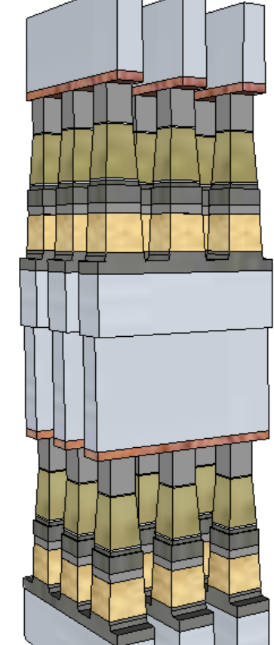
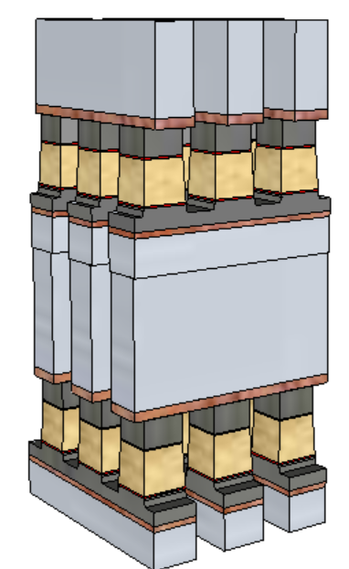
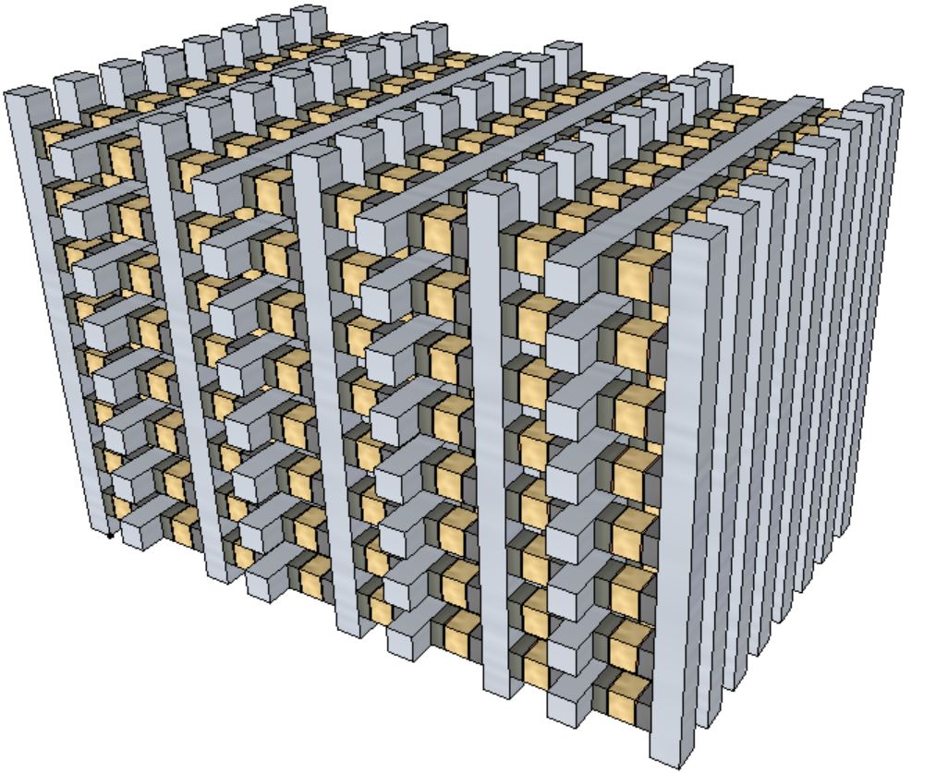
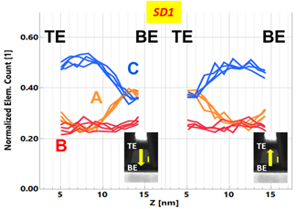
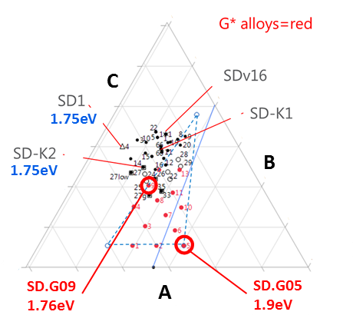
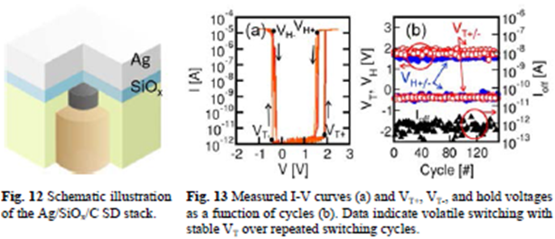
Value Proposition of Built-in-Select Memory Architecture & Motivation
Value Proposition (ref. tech: 3DXP)
No cross-contamination between Memory and Selector materials
Lower cell aspect-ratio (10:1➔ 5:1)
Lower programming current ➔ relaxes metal (WL/BL) requirements and array capacitance
No nucleation required, fast write (40ns) ➔ an opportunity for symmetric memory access (read/set/reset)
Perceived as 3D-Tier integration Friendly
BiSM
3DXP
3D-tier
Motivation
Bipolar memory switching with elemental segregation are observed in wide range of Chalcogenide glasses
Threshold switching characteristics are not limited to Chalcogenide glass. It has been sighted also with other binary oxide, such as NbO_{x}, SiO_{x} and etc.

Slide 23
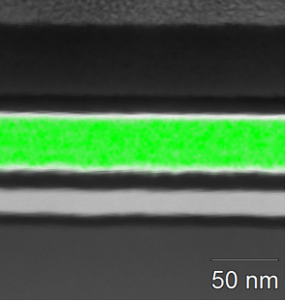
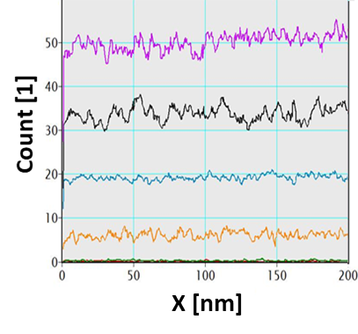
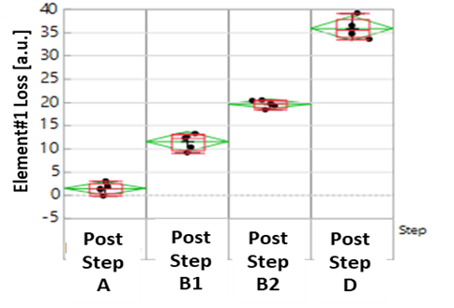
L0/L1D Physical characterization
1. L0: As-deposited film char: Material intrinsic properties
2. L1D ’movies’: Composition transfer function & bit-2-bit
As deposited Elemental mapping
Category | Technique | Metrics (μ, σ)
Avg. Composition | XRF, ICP-OES XRD | Element % Match peak ratio x-wafer
Process Int. compatibility | EDS ‘wrikle’ test (200C-340C) | El % std dev (eq. bit-2-bit) ‘bubbling’ onset
Electrical proxy | Rs Vs T scans [30C-650C] UV-vis spectroscopy TDTR [SC9] | R(post-DT)/R(asdep), E_{A},… Opt. Egap (pre-/post-anneal) Thermal Resistance
Category | Technique | Metrics (m, s)
Cell Health (composition) | XRF, EDS, (XRD) | Element % Stack x-contamination
Cell morphology | STEM | CDx, CDy, thicknesses

Slide 24


L1E/L3 Physical characterization
3. L1E/L3, including EoL & reliability (FM-TEM): Physical root-causing to intercept (i) PE, (ii) PI, and (iii) TD changes
4. Metrology and methodology main gaps and plan
Category | Technique [multi-bit cut] | Metrics (μ, σ) [Automated]
Sample preparation | FIB ‘grounding’ method | Output: Reduce beam sensitivity artifacts on element distrib. ^
Physical Structure | STEM | CDx, CDy, thicknesses
Composition/x-contam. | EDS, (EELS) | Element % vertical/lateral elem. gradients
Crystallinity / (amorphous) | STEM-ADF (coarse resol.) NBD (fine) | Crystalline fraction Phase determination
Atomic resolution | HR-TEM | CDx, CDy, thicknesses Phases location
Gap/Challenge | Comments and current plan
Chal. selector fingerprint (elem. profile, bonding, band align.) Vs. e-stimuli | Collaboration w/ OR-CQN started w.r.t. APT and XPS/IPE Raman also being evaluated (TBD)
Mobile species detection | N/A

Slide 25






Moat isolated Thin Film Device for RRAM/Selector L1E

Slide 26
Connectivity of “Bottom” Electrode
Basic Device Formation
Connectivity below top electrode
DUT load-line, such as Ballast Resistors, MOSTs
Proximity heaters
And other active components
Options including
“C-pad” – 10~100K:1 high “R” ratio
Budding contact to backside
Poor man’s Anti Fuse

Slide 27
DUT examples
TE
TE
To exploit Intel’s CMOS power house for thin film device characterization in 10s nm regime without thin film patterning.
The CMOS base technology is used for DUT loadline, electrical/thermal stimuli and sensing metrology.
Heater
Heater
BE
BE1
BE2
BE3
BE4
TE
TE
TE
TE
Heater
Kelvin
Probe
Heater
Kelvin
Probe
Control
Cntl-P
Cntl-N
Control
Control
GND
“P”
“N”
GND
GND

