Slide 1
Memory CSD 2020
May 18, 2020
CSO 50% check-in

Slide 2
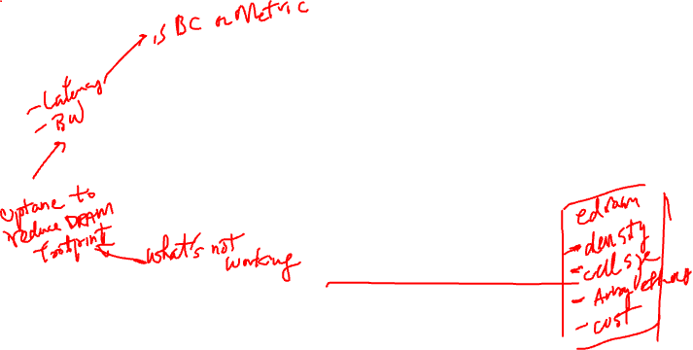
The Plan
1
2
3
4
We are here
Initial Kickoff (wide net cast)
Advisory
ELT discussion / feedback
Technology
Joint WG /
Potential new subteams
Action!
System
Business
Core
Problem Statement Refinement
Strategy Development
Data Collection
Memory issues are business specific – identify issues/solutions per business
Resolve commonality in these issues/solutions
Identify unified Memory industry/technology approach for full Intel weight
Recommend structure/team to empower to drive forward

Slide 3
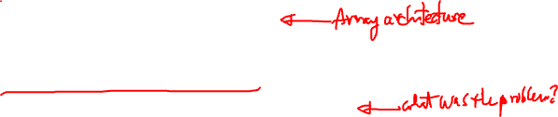
Examples – Why this CSD is Needed
We do not have a good track record for “solving memory” aligned with customer needs and memory realities.
More than a dozen failed IPM attempts – failing late in the game
MTL is the 4th time CCG has rejected 2LM
Apple is shipping OPM without us
We need to use LPDDR for DG1 when customers would like GDDR.
We chose to re-allocate ECC bits, exposing memory failures to end customers.
We do not support 3R interleave up through SPR, limited customer configurations
We added Optane without optimizing for the full hierarchy
Our IPM(HBM) implementation adds unique-to-Intel constraints in power/thermals
Repeated expectations of small volume, low cost, custom memory in a commodity market

Slide 4

What is Different Now?
Today, the environment has changed dramatically w/ DRAM reaching tipping points
Hockey stick growth in core counts accelerating Customer's DRAM cost and pressuring Intel Share of Wallet
End of Dennard scaling leads to competition for power between DRAM and CPU
Minimum DRAM capacity has exceeded Client working set size
For AI/Graphics, memory performance largely determines system performance
Customers have the means and wherewithal to solve things themselves

Slide 5
What we are finding
Challenge with memory is as much a cultural issue as it is technical
Memory can be the bright shiny object, and projects are developed in silos
Memory ecosystem is complicated, and it’s possible to find and use data to support a desired outcome, without addressing confidence or likelihood of the assumptions
Clear case of what's good for Intel isn't always good for the customer.
There isn’t consistent governance across the company
That being said, plenty of smart people in the company that want to solve these challenges
Need to demonstrate inclusive and transparent behavior
Need to base efforts on an objective, data driven assessment of the memory ecosystem realities.
Need to solve for customers, Intel, and memory partners.

Slide 6

Problems to be Solved (Focused)
Data Center Core Count is scaling faster than DRAM bandwidth/capacity/power creating unsustainable increases in our customer’s Capex(cost) and OpEx(power) and decreasing the relevance of Intel’s products
Client Client application needs are increasingly misaligned with DRAM technology, with cost focused platforms paying for more capacity than needed, and performance focused clients suffering low graphics performance due to DRAM bandwidth shortfalls.
Accelerators DC Accelerator: Customers want max BW, max capacity, min power and are prepared to pay for it and so will push the memory technology but hasn’t yet driven memory economies of scale. Consumer Accelerator: High Graphics Performance depends on high memory bandwidth to a small working set (<1 to 10GB) and solutions are cost sensitive.

Slide 7
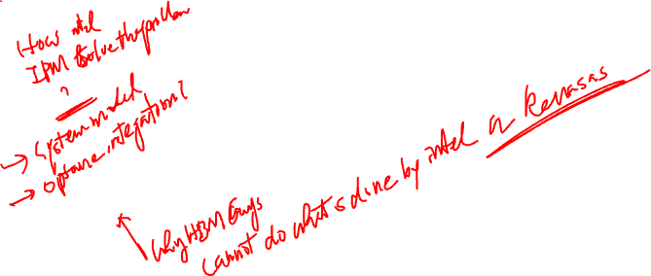
Solve for Customers-Partners-Intel Win-Win-Win
Data Center Customers
CSP customers maintain a fixed core to DRAM capacity and performance ratio
Data scaling 2x in 3 years, DRAM capacity scaling 2x in 4 years
Client Customers
DRAM bandwidth is lagging graphics and AI needs
Minimum DRAM capacities for client are increasing beyond working set size
Accelerator Customers
Still the Wild West
Performance is high memory bandwidth dependent, sometimes cost focused
Customers
Equilateral Triangle
Balance it!
Intel
DC: X% of the DC BOM is DRAM, moving up at y%
Most Client platforms are BOM Cost focused, only high-performance clients will pay more for performance increases
HPC will spend money for performance and capacity, Client focuses on Bandwidth per dollar
Partners
Intel
Memory Partners
DRAM Producers (Samsung, Hynix, Micron) are paid by Capacity (GB) not bandwidth (GB/s)
DRAM capacity scaling slower than
End of Dennard scaling means increasing DRAM performance = increasing power draw; Racks have fixed power limits

Slide 8
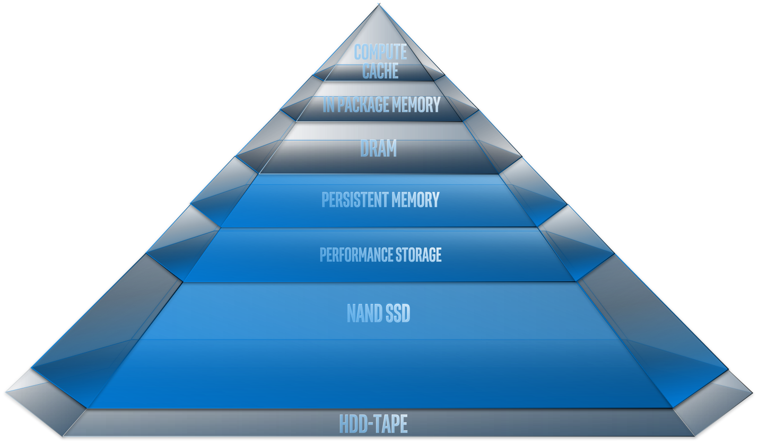

Problems to be Solved (Focused)
Problem statements are focused on DRAM (the incumbent technology)
First identify approaches to solve: business, organizational, technology, systems
Examine the DRAM level solution impact throughout the hierarchy to recommend a full stack solution
SSD to cache
Memory technology to software
Focus these on a small enough set of efforts to succeed
Small number of memory technologies
Small number of systems technologies
Focus on DRAM first
then
Expand answer to complete
Hierarchy

