Slide 1

FERROelectrics review FEB. 2020
Jan Van Houdt on behalf of the ferro team

Slide 2
outline
Introduction: program targets and research vehicles
2019 Plan
Progress made in 2019
Materials and basic understanding
2D FeFET
3D FeFET
What’s new in 2020?
Conclusion

Slide 3
Ferroelectric memory Program targets - 2019
Identify the best materials stack for nonvolatile ferroelectric FETs (currently Hf-based)
Build basic understanding on ferroelectric switching behavior in Hf-based materials and related reliability issues
Demonstrate the best stack in vertical FeFET vehicle and planar FET vehicle

Slide 4
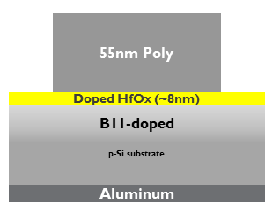
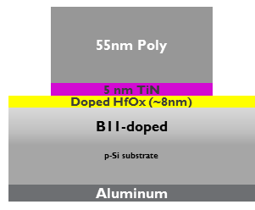
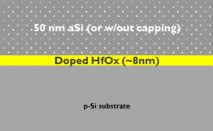
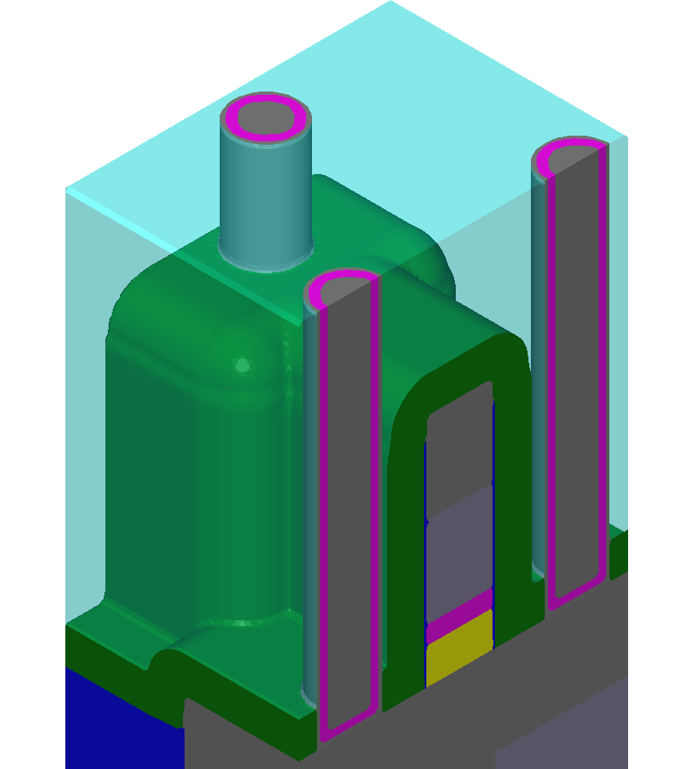
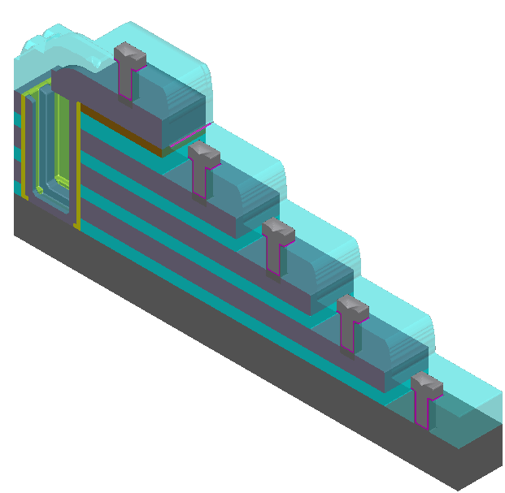
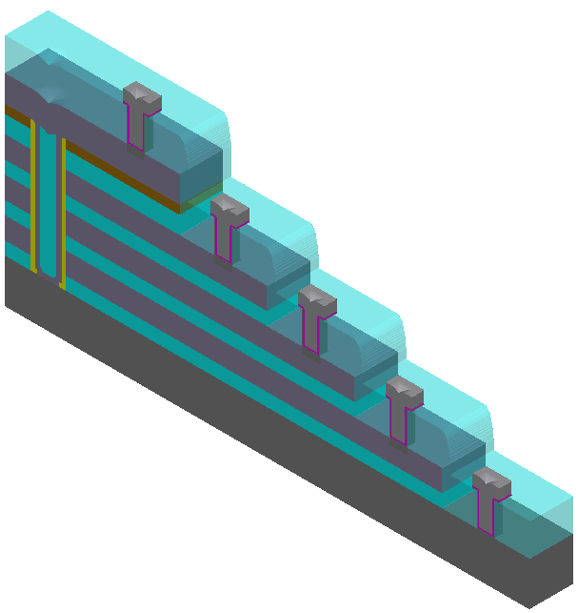
TEST VEHICLES
Blanket test material
CAPATWO 1maskflow (SIS)
CAPATWO 1maskflow (MIS)
SAKKARA 3DFET Trench device
SAKKARA Macaroni (Memhole) device
SALSA3-PLANAR 2DFeFET device

Slide 5
FERRO HLP 2019
Code | Topic Group | Deliverable | Success criteria | Timeline | Status
FF01 | Basic understanding | Ferroelectric modeling | Fundamental study of the wake up effect Analysis of dopant confinement effects Theoretical assessment of nucleation and propagation dynamics | Dec. 2018 April 2019 Oct. 2019 | Nucleation and propagation study showing very fast propagation (nucleation limited switching)
 |  | Material characterization | Continuous material analysis through XRD (phase optimization) | Dec.2019 | XRD phase ratio vs. cycling confirmed on Si-doped films Nanograin ongoing
FF02 | Material study | SIS further exploration and optimization | SIS Material exploration (dopants/dep. conditions) SIS Best known stack delivering 10 years of retention @85C, 100k cycles, <4V operating conditions, in cap flow | April 2019 Oct. 2019 | La: HfO2 film developed and first 2 lots evaluated. La layer ready for integration
 |  | MIS exploration and characterization | MIS Si-doped HfO2 stack available in MIS (>1000C TB, 1yr retention @RT, 100k cycles @<4V) MIS Imprint analysis finalized on Si-doped HfO2 stack | June 2019 Oct. 2019 | MIS imprint ready. New model available.
FF03 | 2DFeFET MIS | Planar FerroelectricFET demonstration | Functional single cell (0.5V MW) Single cell with 1E5 cycles endurance and 1yr retention @RT | April 2019 Oct. 2019 | 2DFeFET pipecleaner ready and working, endurance reached, retention not
FF04 | 3DFeFET SIS | Vertical FerroelectricFET optimization in Memholes and Trench approaches | Plug cell with 1V MW @1k cycles and 10 yrs of retention @RT Trench FeFET 1st electrical results (read current density similar to plug version and 0.5V MW) Trench FeFET Endurance (1k) and 10 yrs retention @ RT | Dec. 2018 April 2019 Oct. 2019 | Trench etch development completed for pipecleaner. First 3D Trench FeFET cells found working. 2nd lot showing good yield and large memory windows (~3V)

Slide 6
Progress (highlights)

Slide 7
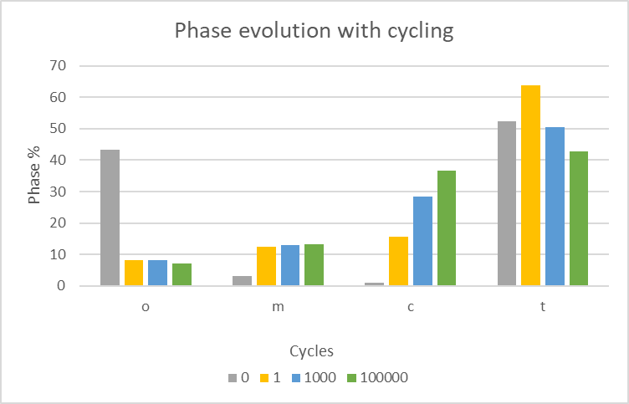
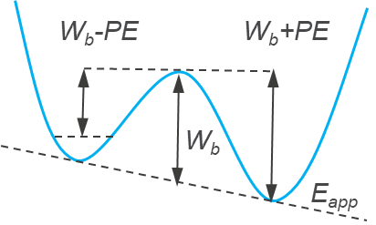
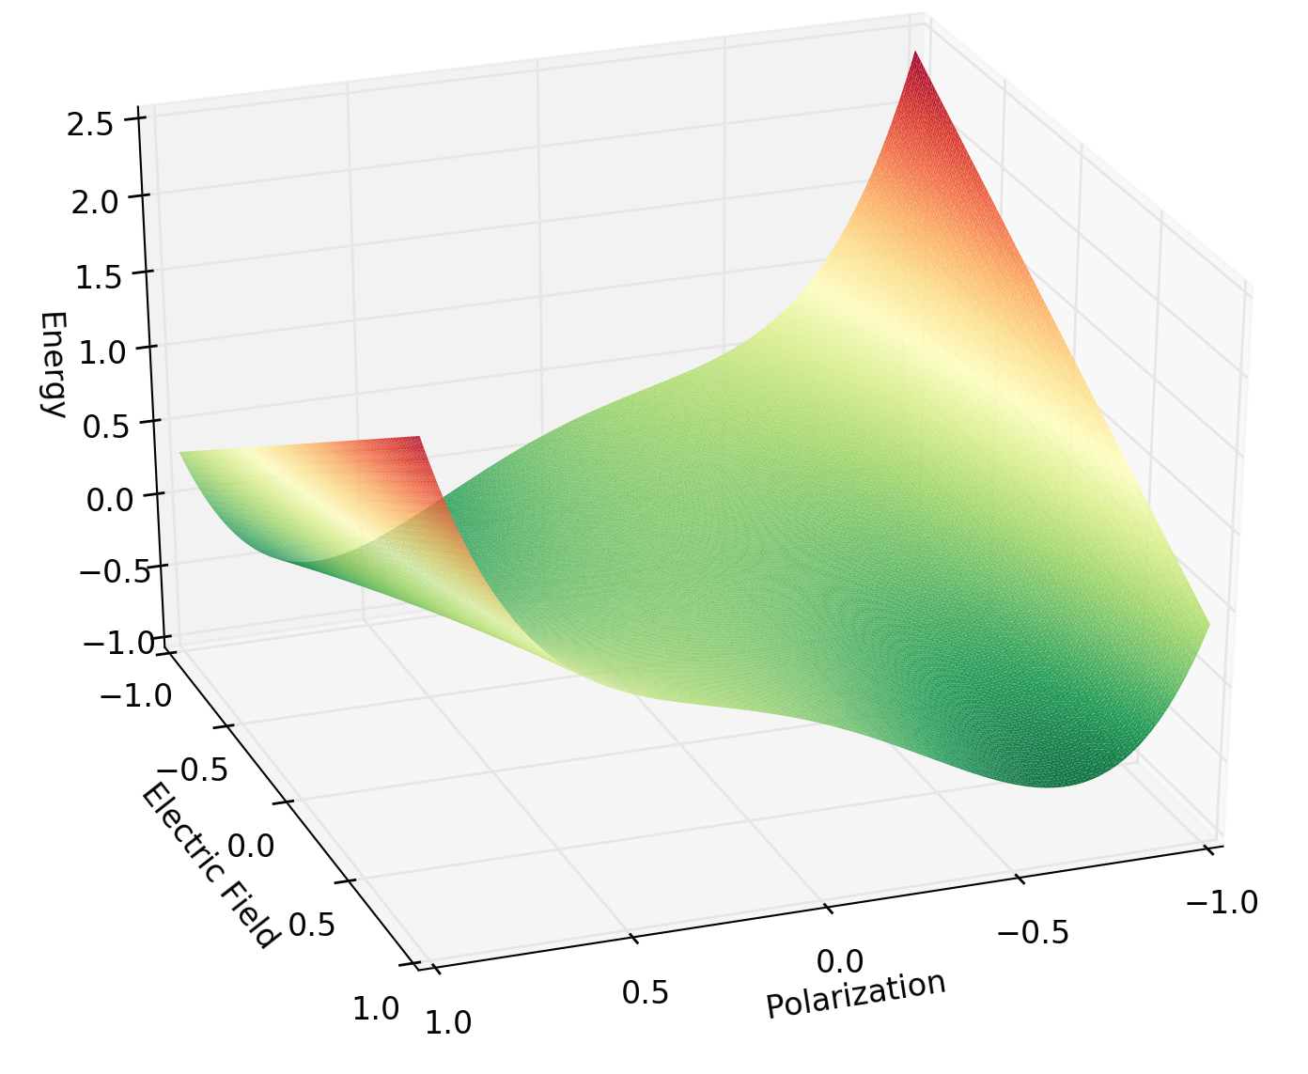
FF01 basic understanding: summary
Ab-initio work shows good progress:
Dopant impact
Nucleation/propagation dynamics
Link to XRD to explain wake-up (phase transformation)
XRD analysis has been helpful to understand phase (ratio) changes
o-content decreases
m-content increase

Slide 8
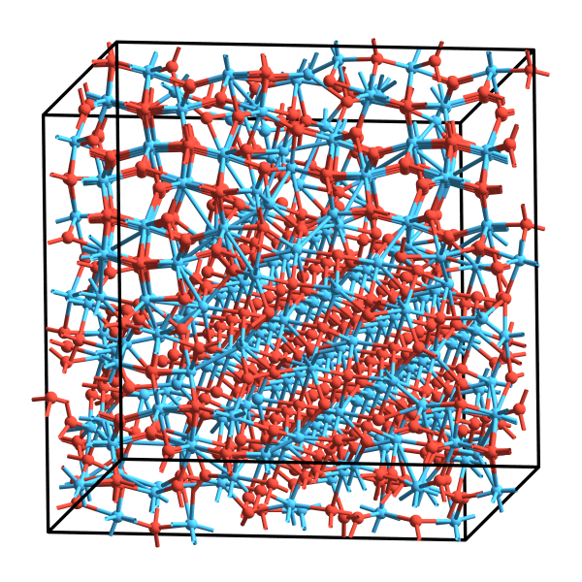
FE HfO₂ – ab initio analysis
Relative energy [eV/atom]
Linear impact of dopant concentration on energetic stability of the ferro phase
Experimental % for FE
G1
5%Al-doping/3.6%Si-doping make ortho-IV, tetra-II and cubic phases accessible

Slide 9
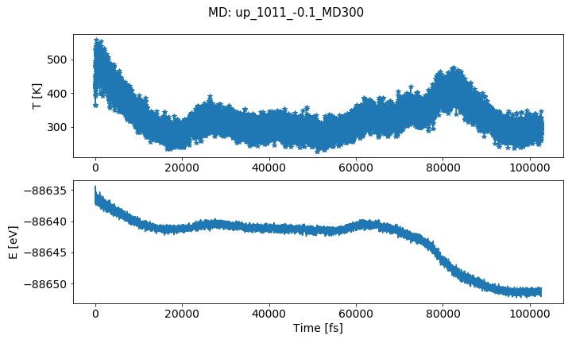
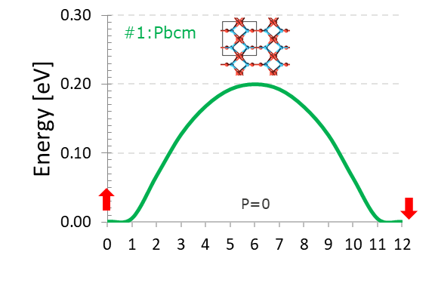
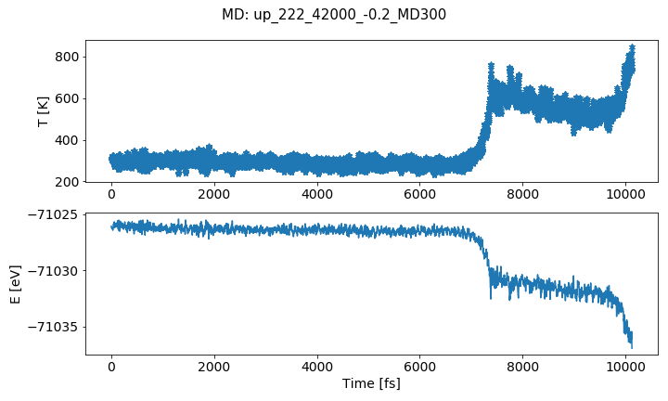
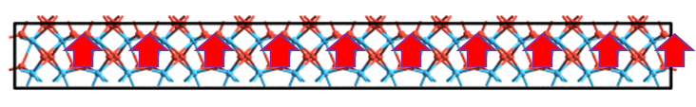
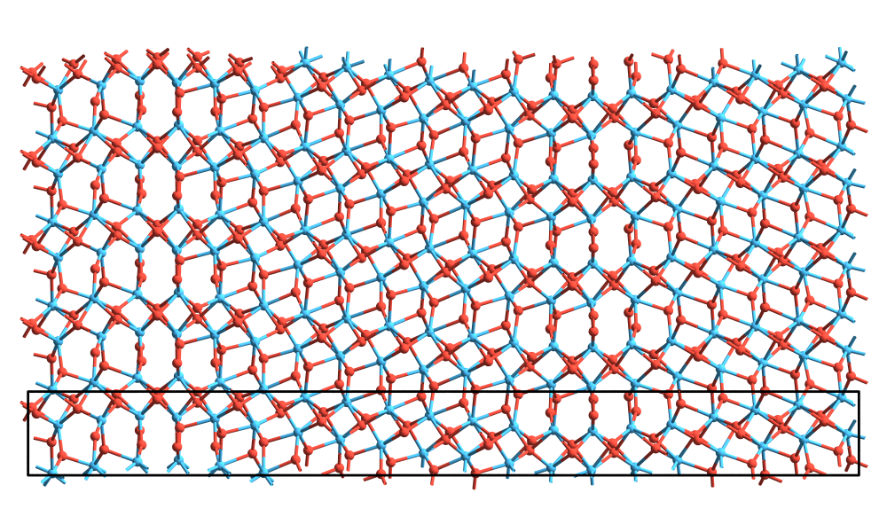
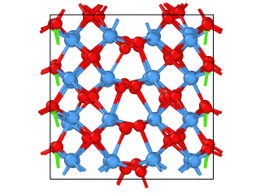
Ab initio study of ferroelectric switching dynamics in HfO₂
Polarization reversal barrier
Domain switching dynamics
Crystal clamping
2nd Nucleation
1st Nucleation
m
Final
m
Final
FE Switching = stochastic process of jumping across a barrier. Barrier is modulated by T, strain, E_{field}, defects, etc.
Un-clamped system ➔ freedom to relax/phase-transform towards lower energy configuration (monoclinic grains)

Slide 10
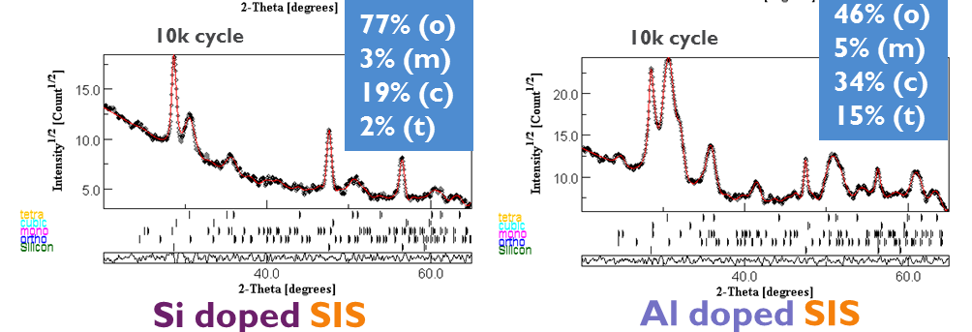
GIXRD for phase ratio analysis
HfO₂ films
Polycrystalline
Poly-phase
Several “doping” atoms
Different phase ratio
Material optimization for different dopants/doping levels done (Si, Al), La underway

Slide 11
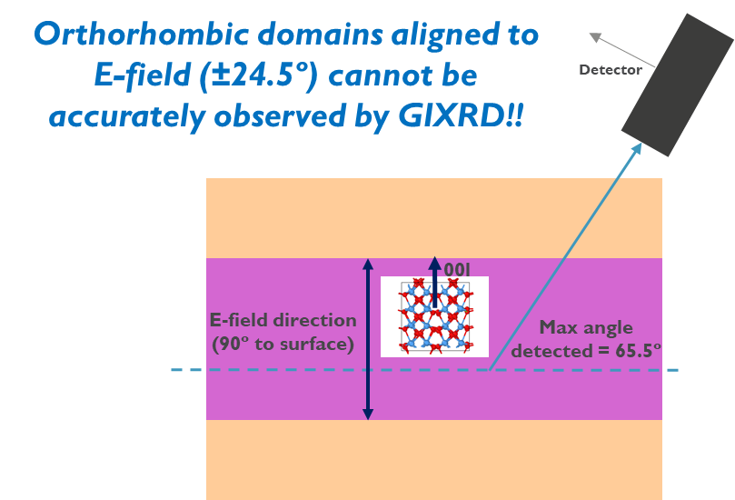
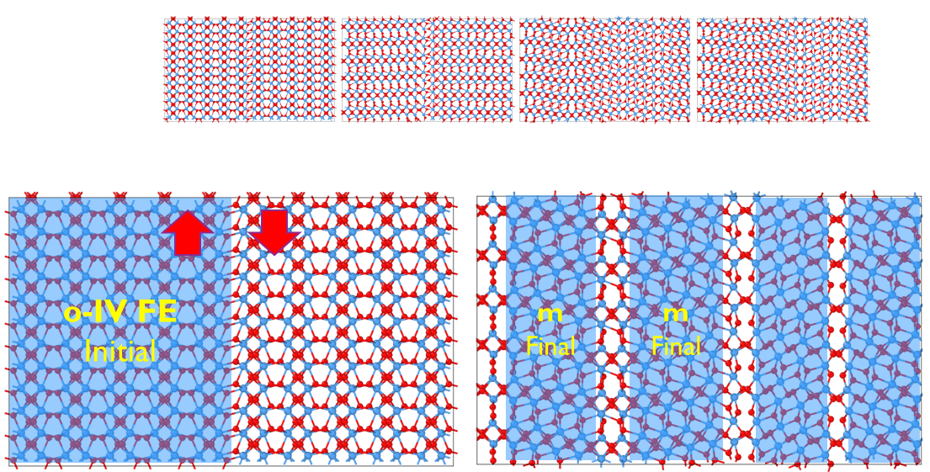
Basic understanding and materials
Grain re-orientation identified as main mechanism for wake up
o-content decreases
m-content increase
90º domain flip to accommodate strain
Grains re-orient to put polarization direction of o-phase parallel to E-field →Pr increase
Measured o-content decreases due to limitation of GIXRD
m-phase is generated to accommodate strain => wake-up mechanism

Slide 12
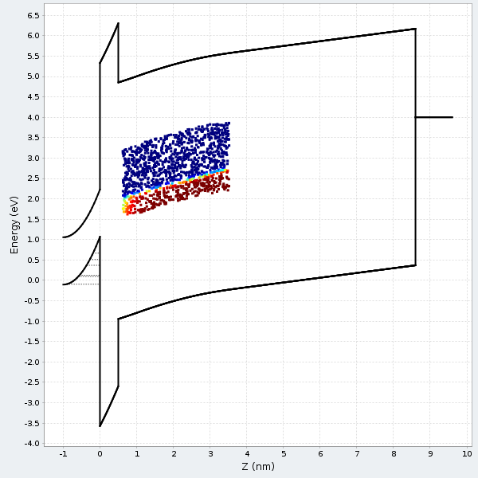
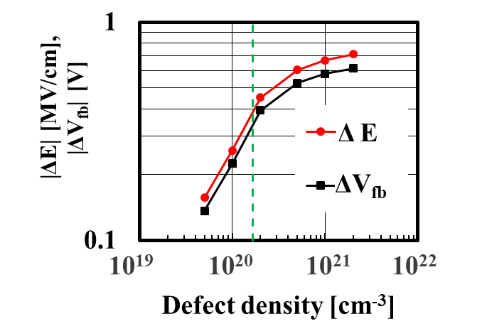
Imprint explained from interaction with traps
defect density corresponding to same effect as polarization charge (8μC/cm²)
+
At high defect density,
charge trapping balanced
by polarization charge
Imprint can be drastically suppressed when impact of defect density becomes lower than that of polarization charge

Slide 13
Charge trap characterization
Comparison ferro vs. non-ferro
9.5 nm HfO₂
9.5 nm Si: HfO₂
1.7 eV from E_{c min}
Sigma 0.087 eV
Nt = 2E19
1.85 eV below E_{c min}
Sigma 0.124
Nt = 2.3E19
Similar defect density for both layers present
E_{t} ~ 2eV below HfO₂ conduction band minimum

Slide 14
Ff02 materials study (caps): summary
Si- and Al-doped stacks delivered with 1E5 cycles and 10 years retention at 85C
La-doped stack almost ready (retention @RT)
MO precursor route explored (not beating Cl-based)
2.5% Si

Slide 15
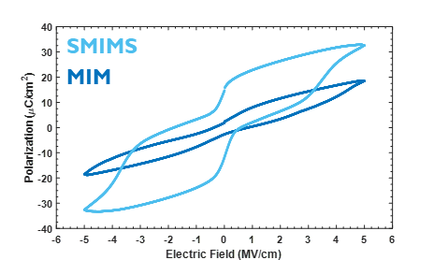
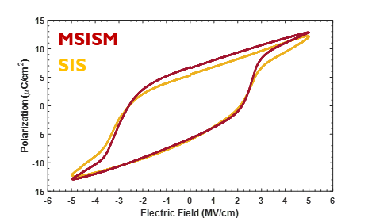


MIM vs SIS
Key role of interfaces!
SIS with TiN interfaces
MIM with Si interfaces
n-type
Si
TiN
Our focus sofar
TiN
Si
HfOx
HfOx
TiN
TiN
p-type
p-type
Pristine
1000 cycles
Pristine
1000 cycles
MIM behavior without opening –
Strong pinning of domains at interface
SIS behavior –
2nm Si interfaces: no need to wake-up

Slide 16
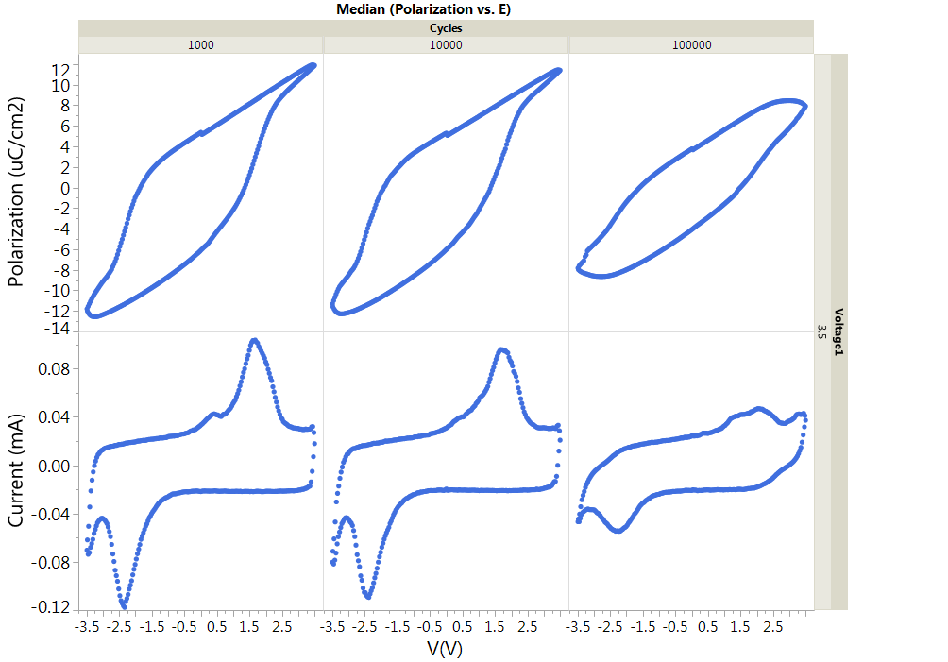
Endurance and Retention on Si:HfO2 SIS caps
2.5% Si
1E5 cycles
4.5MV/cm
SIS stack specifications are reached

Slide 17
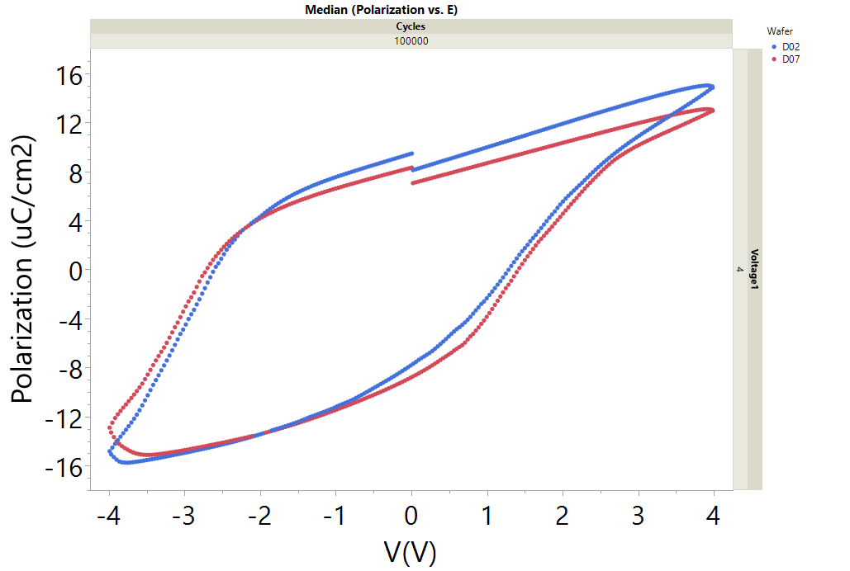
Endurance and retention on Si:HfO₂ MIS caps
Good endurance for both 3.6% and 2.5% Si content wafers
10⁵ cycles - 4V
3.6% Si
2.5% Si
2.5% Si
norm. variation
Similar to the SIS case, low Si dopant concentration in MIS gives better retention

Slide 18
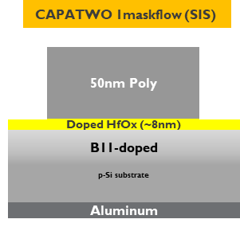
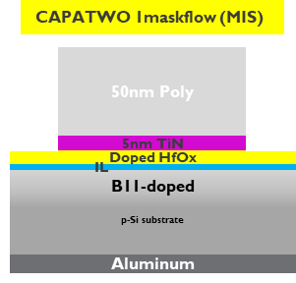
La:HfO₂
Pulse ratios: 14:1-48:1
14-48 pulses
1 pulse
flow
N₂
N₂
N₂
N₂
H
H
O
H
O
H
O
O
TMA
N₂
N₂
TMA
N₂
N₂
HfCl₄
N₂
O₃
LOLA’
O₃
2
2
2
Metal Precursors:
HfCl₄
LOLA’
Oxidant: H₂O
Reactor Temperature: 300ºC
As grown La:HfO₂ films: Amorphous
Hf:La = 14:1 - 48:1
La% = 5.6 – 1.9%
2
Hf cycle
La cycle
Anneal: 700ºC/60s
900ºC/60s
1000ºC/30s
→ Poly Si did not crystallise
18

Slide 19
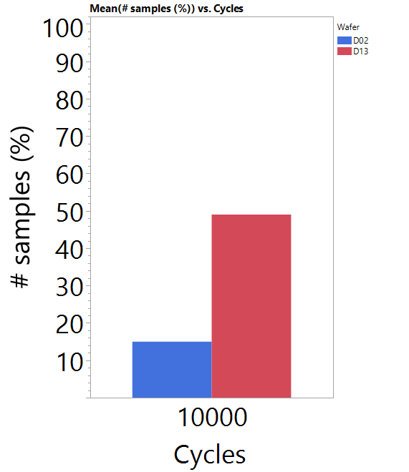
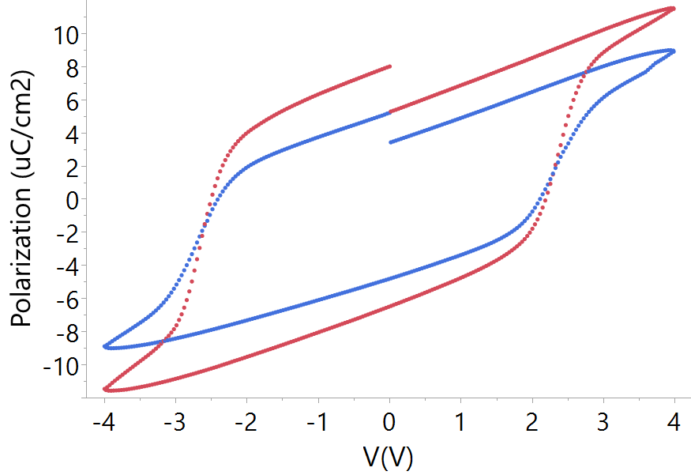
Endurance on La:HfO₂ SIS caps
Retention not met at 85C
best hysteresis loop (higher 2Pr) for 14:1 ratio
10⁴ cycles, 4V bias
1000C 30s
900C 1min
Better endurance (10k) for intermediate PDA temperature (900C 1min)

Slide 20
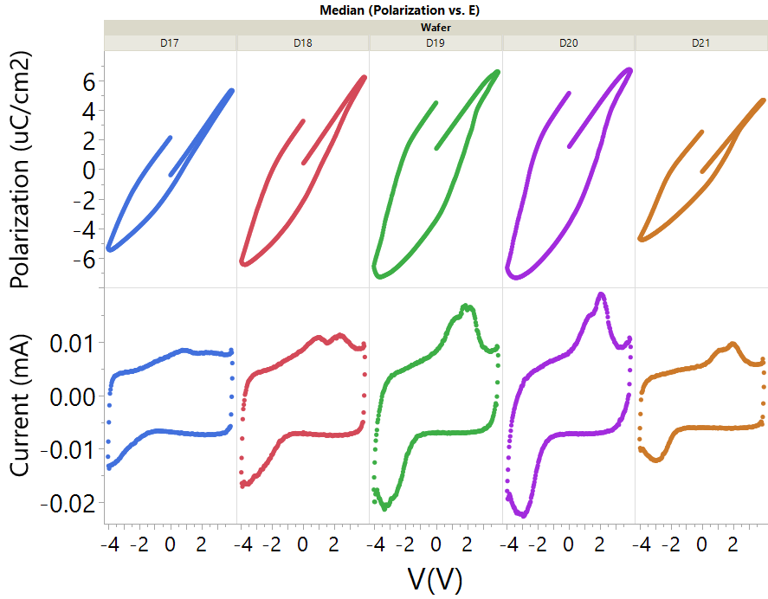
Endurance on La:HfO₂ MIS caps
PDA: 1000C 30s, 1nm SiO₂ (ISSG)
Good endurance at 4V up to 10⁵ cycles
Good RT retention results extrapolated to 1 yr
14:1 20:1 34:1 40:1 48:1
Good endurance and RT retention obtained on La-doped MIS stacks

Slide 21
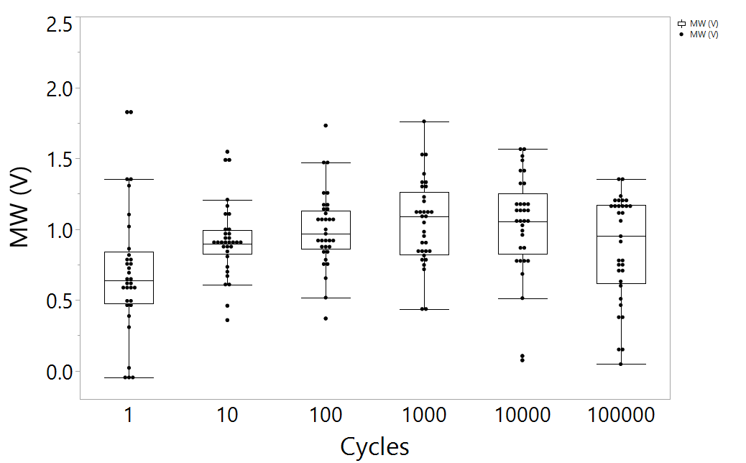
Ff03 planar fet: summary
Working MFIS FET established in Salsa-3 (Si-doped HfO₂)
Si buffer layer between HfO₂ and TiN yields 1E5 cycles
La-doped FET underway (later also Gd and Y)
~0.8V MW @ 1e5cycles

Slide 22
Metal/Insulator/Semiconductor (MIS) FeFET
Reference
Top Electrode Stack:
50 nm CVD Si (Poly-crystalline Gate)
5 nm ALD TiN / 2nm PVD Si (Metal Gate)
Ferroelectric layer:
9.5 nm Si-doped HfO₂
3.6% Si doping
PDA: 1000C, 30s, N₂/O₂
Interfacial Layer:
1 nm SiO₂ (chemical)
Substrate:
p-Si
SALSA3-PLANAR 2DFeFET device
GATE
PG
MG
FERRO
IL
Pwell
SOURCE
p-Si substrate
DRAIN
Aluminum
DOE: MW as function of Si doping, HfO₂ thickness and interfacial layer composition

Slide 23
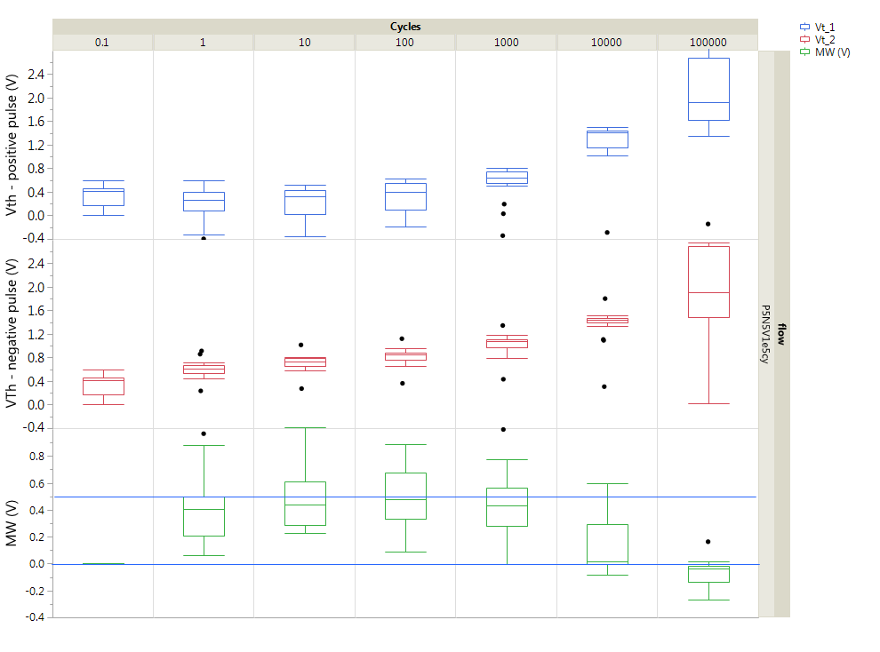
Working 2D FeFET (MFIS)
IL: 1nm SiO₂
Ferro: 9.5nm/3.6% Si
MG: 5ALD-TiN/2PVD-Si
PG: 50CVD-Si
PDA: 1000C,30s,N2/O
April PTW
Vth
init
MW @ 100cycles = 0.5V

Slide 24
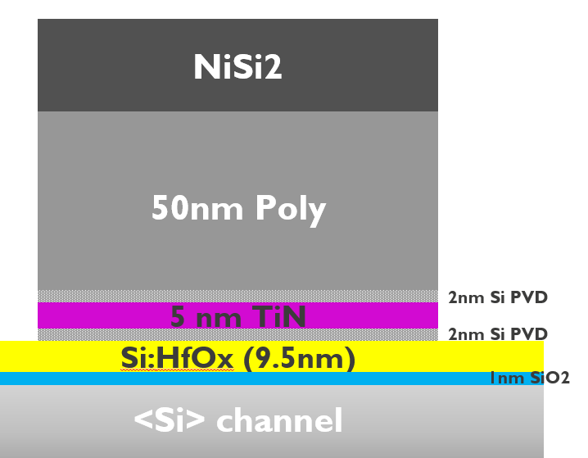
High endurance 2D FeFET
IL: 1nm SiO₂
Ferro: 9.5nm/3.6% Si
MG: 2PVD-Si/5ALD-TiN/2PVD-Si
PG: 50CVD-Si
PDA: 1000C,30s,N2/O
FE MW
Asymmetric pulse +4V / -5V
~0.8V MW @ 1e5cycles
Low Vt level
High Vt level
1E5 endurance and RT retention after 1kcycles obtained on Si-doped 2D Fefets

Slide 25
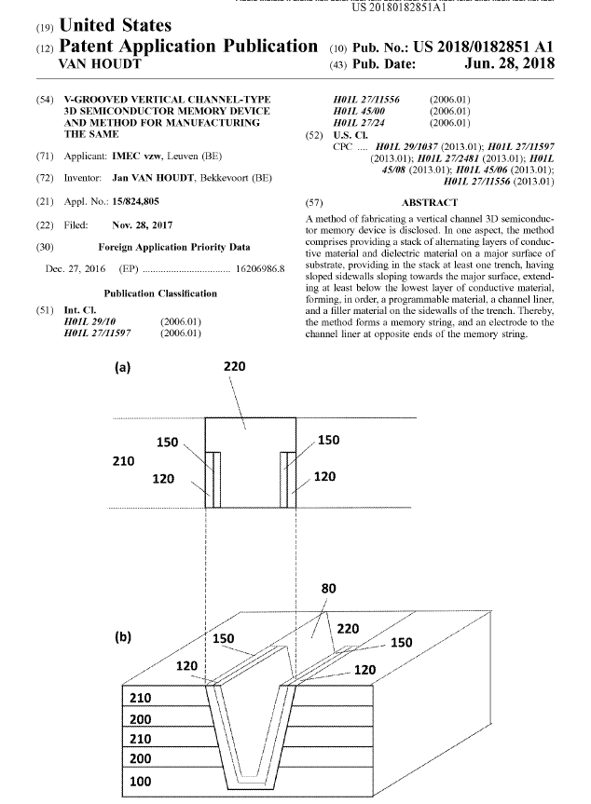
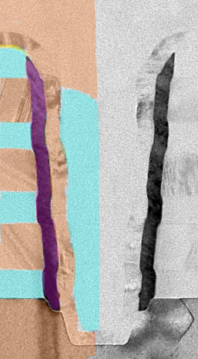
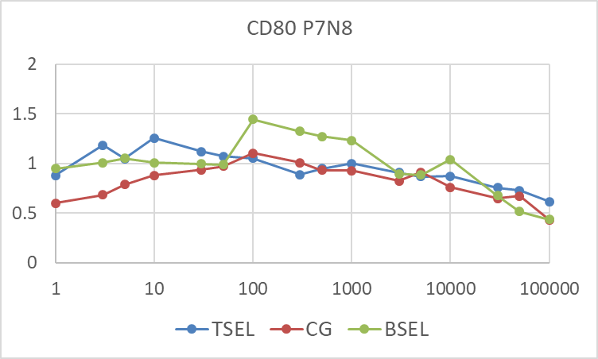
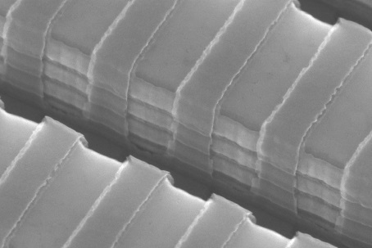
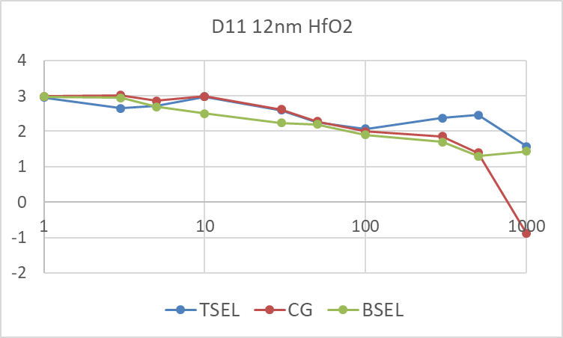
Ff04 3d Fefet: summary
MW
TSEL
CG
BSEL
Plug cell shows 1E5 cycles with good uniformity but limited window (~1V)
3V window!
Trench cell shows large window with good uniformity but limited endurance (1E3)

Slide 26
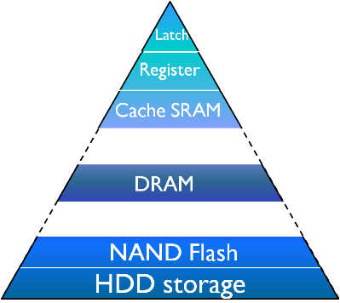
Where could it fit in?
Device for Machine Learning
Legend
On-chip (embedded)
SOT MRAM
STT-MRAM + selector
MRAM
STT-MRAM
STT-MRAM
Emerging/MIM
OXRAM/CBRAM
3D DRAM / IGZO select transistor
eFlash
Slow cache L3/eDRAM
MIMCAP
Ferro
NOR
Disruptive
3D SCM (PCM +selector)
Flash
SCM
Off-chip
(stand-alone)
3D FeFET
Separate offering
3D NAND
Archival
DNA-inspired
Memory insite

Slide 27
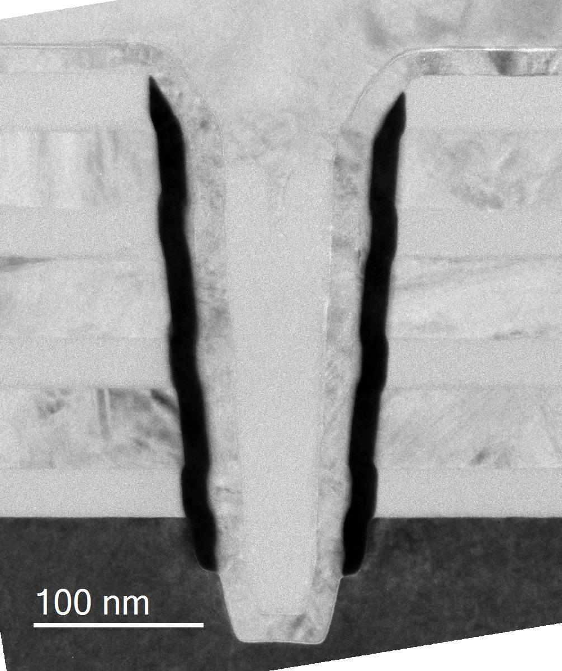
vertical ferroelectric FET
3D NAND scaling limitations :
Vertical pitch: high voltages (O), channel length (P)
Lateral pitch: plug diameter and slits (RMG)
FeFET = 1T
Similar to existing 3D architectures
Higher density possible
Vertical: lower voltages, no lateral charge migration, no interference, shorter channel (thinner EOT)
Lateral: thinner gate stack, relaxed etch, POPO flow allows for fewer (or no) slits
Bonus: low EOT yields higher read current (for same channel quality)
Challenges/solutions
Reduce depolarization/disturbs : POFET concept
Stable ferroelectricity on vertical sidewall : ALD
Statistics of grains and domains: nanograin
oxide
Gate
drain
ferroelectric
gate
Oxide filler
HfO ferro layer
Poly channel
gate
Poly
Cell 1
Cell 2
Oxide
gate
Poly
Oxide
source
Channel liner
Dielectric filler

Slide 28
3D Trench fefet: the rationalE
Main parameters [nm] | Memory option
 | Scaled 3D NAND | Plug FeFET | V-RRAM | Trench-FeFET
Plug diameter /trench width | 60 | 60 | 60 | 60
Dielectric stack | 15 | 8 | 16 | 8
Cell width | 100 | 100 | 50 | 50
Cell length | 20 | 10 | 10 | 10
Intergate spacing | 15 | 8 | 14 | 8
2bpc trench FeFET can be denser than 4bpc NAND because of better lateral and vertical scaling
J. Van Houdt, invited papers at 2017 IMW and VLSI

Slide 29
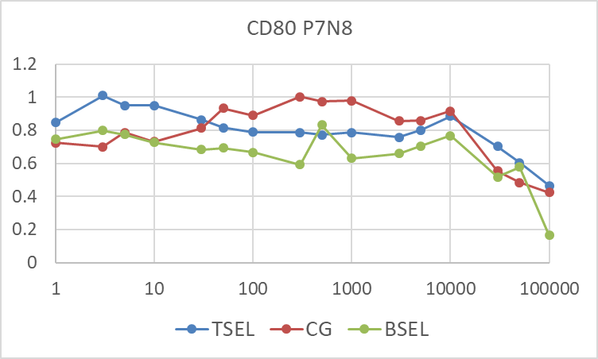
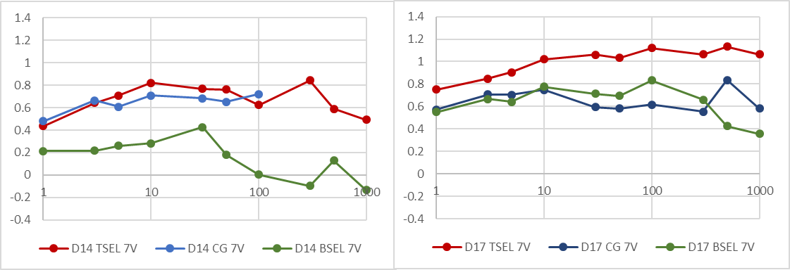
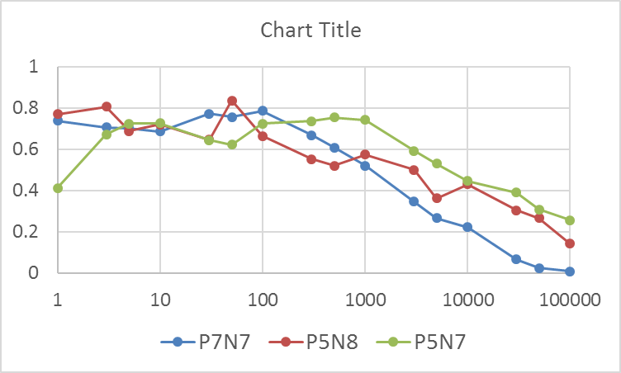
3D FeFET
MW
MW
POR (20nm channel)
MW
11nm channel
TSEL
CG
# cy
# cy
BSEL
MW
Endurance
Thin channel (11nm)
D18 11nm Undoped channel
# cy
Improved MW uniformity between gates with thinner channel
Asymmetric pulses allowed better endurance up to 1E5 cycles

Slide 30
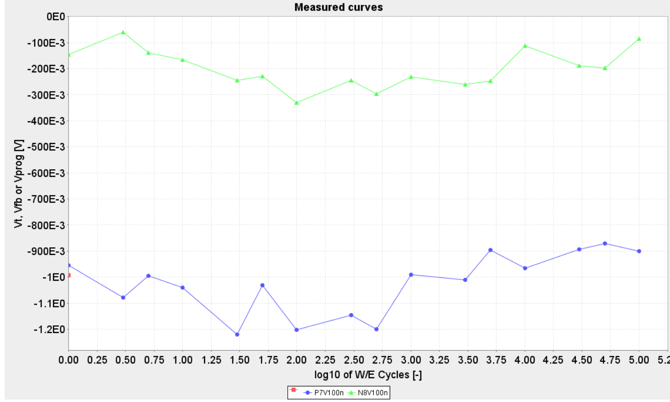
Endurance
TSEL P7N8
0.8
Some cells have large MW after 1E5 cycles

Slide 31
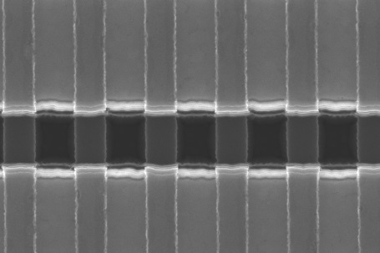
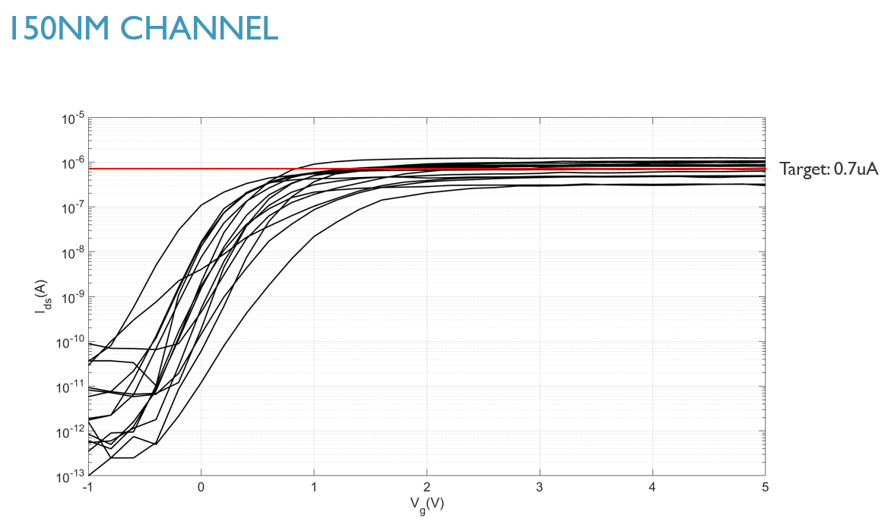
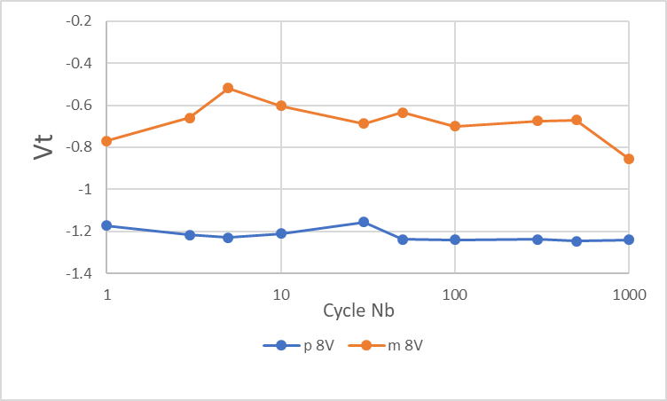
3D trench Fefets
143
Good Id-Vg characteristic
+/-8V 100ns pulses
Vt after -8V pulse
Vt after +8V pulse
0.6V
Vertical trench cells obtained with good Id-Vg characteristic and ferroelectric memory window... But low yield....

Slide 32
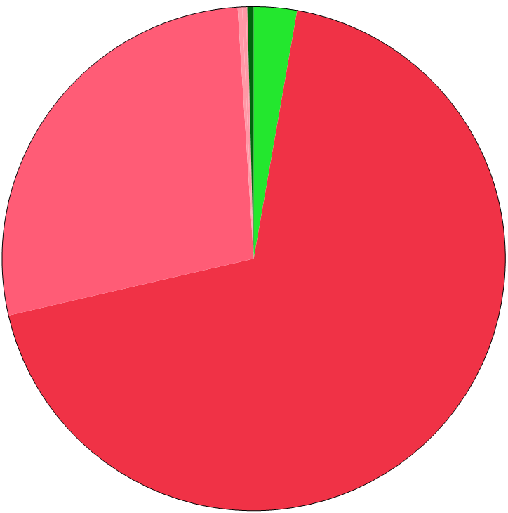
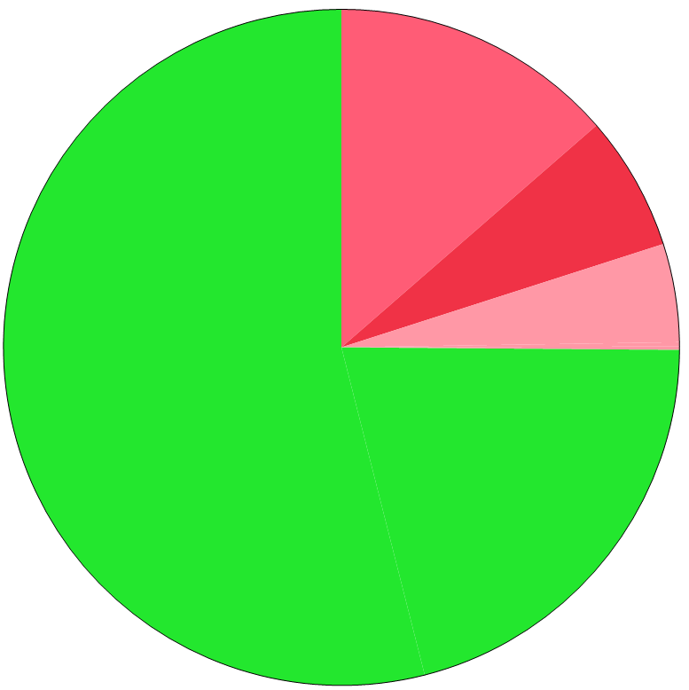
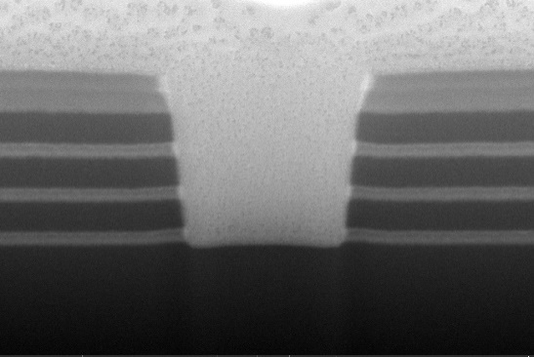



Yield improvement for 3D trench fefets
Working 3%
APF based trench etch
Surface full of pits
SoC based trench etch
Clean surface
333nm
Leakage (other)
12.4%
350nm
Leakage (gate)
17.6%
96.5º
99.5º
Leakage (other)
27.4%
242nm
280nm
Open 5%
Leakage (gate)
68.6%
Working 75%
April 2019: pipecleaner lot
October 2019: LC1
Significant yield improvement with modified trench etch strategy

Slide 33



LARGE Memory window OBTAINED in 3D trench!
Vertical uniformity
Retention
10yrs
3V window!
Neg pulse
Pos pulse
Bias impact
MW larger (up to 3V window)
1k endurance and RT retention
Good uniformity between gates
MLC capability to be checked

Slide 34





longer pulse yields same window for lower Vpp
Case 12nm Si:HfO2 ; P-type gate (D11)
Longer pulse duration of 1us (i.o. 100ns) allows high MW also at 10V bias amplitude.
→ RC delay problem at 100ns
Increasing to 10us does not improve further
→ Max achievable MW for this stack = 3V

Slide 35

Reason for high Vprog
Bias amplitude can be lowered by longer duration pulse (RC delay problem with short pulses)
Root cause is low channel conductivity rather than WL issue:
Strong dependence of MW on channel width
Interfacial layer at drain / channel and source / channel observed in TEM (worse on drain side since Ion @Vd=1V > Ion @Vs=1V)
No difference between n-type and p-type gate
Gates are similar in memhole and trench versions, yet memhole device does not need high Vprog

Slide 36



Cycling with verify
Single pulse P/E
More stable window up to 1E3 cycles
P/E to target [ -1.5 | +1.5V ]
-14V 100ns
+14V 100ns
MW
Verify reduces the memory window variability

Slide 37

Channel width dependence
Sharp Ion decrease, STS variability below 100nm

Slide 38

3D trench : summary

Slide 39


3D FerroFET patents

Slide 40
Highlights - summary
Good understanding of nucleation/propagation effects and their interplay
Explanation for wake-up and cycling-induced phase ratio change in Si:HfO₂
Improved model for imprint in ferrocaps and –fets
Working La-doped HfO₂ layer developed (cap level)
Improved endurance on 2D and 3D GAA FerroFET (1E5 cycles)
Good yield and large memory window (~3V) obtained on 2nd 3D trench FerroFET lot

Slide 41
What’s next?

Slide 42
Ab initio study of ferroelectric switching dynamics in HfO₂
Polarization reversal barrier
Domain switching dynamics
Crystal clamping
2nd Nucleation
1st Nucleation
FE Switching = stochastic process of jumping across a barrier. Barrier is modulated by T, strain, E_{field}, defects, etc.
m
Final
m
Final
2020: trapping-switching interaction study

Slide 43
Basic understanding and materials
Grain re-orientation identified as main mechanism for wake up
o-content decreases
m-content increase
90º domain flip to accommodate strain
2020:
- nanograin exploration for more uniform response
- new dopants Gd/Y in HfO₂
- HfZrO₄ will be revisited in MiM caps (+ doping) as well as alternative ferroelectrics

Slide 44



Nanograin for ferro
Variability and coercive field control through grain size engineering
Requires accurate annealing control
Requires also adequate metrology
Benefit to be proven
Large WiW variation in (single shot) ferro characteristics
Nanograin could provide better control
Yoo et al., IEDM 2017, p481

Slide 45
High endurance 2D FeFET
IL: 1nm SiO₂
Ferro: 9.5nm/3.6% Si
MG: 2PVD-Si/5ALD-TiN/2PVD-Si
PG: 50CVD-Si
PDA: 1000C,30s,N2/O
FE MW
Asymmetric pulse +4V / -5V
~0.8V MW @ 1e5cycles
I_{aft_pos}
I_{aft_neg}
2020: need to improve retention

Slide 46



Further improvements on 3D FeFET planned for 2020
-14V
higher endurance & lower P/E voltage
MW
CG
MW
TSEL
MW
BSEL
MW=2V
+14V
Current MW=1E4
MW
retention
larger window and I_{on}/I_{off} ratio
improved retention
Start MLC study & scale z-pitch

Slide 47
FERROelectrics 2020 HLP and deliverables
Code | Topic Group | Deliverable | Success criteria | Timeline | Status
FF01 | Basic understanding | Ferroelectric modeling | Understanding of the interaction between defects and ferroelectric switching Impact of this interaction on wake-up, imprint and fatigue | Oct. Dec.
 |  | Material characterization | La-doped ferroelectrics benchmarked wrt Si doped Alternative dielectrics screening (literature, simulations) | April April
FF02 | Material study | MIS further exploration and optimization | Optimized La-doped MFIS stack (better than Si-doped case) | Oct.
 |  | MIM exploration of alternative dielectrics (HZO/perovskites...) | Doped and undoped HZO MIMcaps with high endurance (1E9) Choice of alternative (non-Hf) ferroelectric with implementation plan Final benchmarking of dopants in HZO for high endurance | June Oct. April 2021
FF03 | 2DFeFET MIS | Planar Ferroelectric FET demonstration | Optimized 2D MFIS FET with 1E5 cycles and 10yrs retention at 85C | Oct.
FF04 | 3DFeFET SIS | Vertical Ferroelectric FET optimization in Memhole and Trench approaches | Memhole cell with >1.5V MW, 1E5 cycles and 10 yrs retention @85C, incl. first MultiLevel assessment Trench FeFET with sufficient reliability (>1E4 Endurance and 10 yrs retention @ 85C) 2 bpc demonstrated on trench | April Oct. Dec.

Slide 48
ferroelectric Activity ROADMAP
2019 | 2020 | 2021 | 2022 | >2022
Materials research
Nucleation dynamics
Trapping-switching interaction
Basic understanding
Hf-based stacks
High endurance stack
Zr-based stacks
Alternative ferroelectric
2D FeFET
Optimized FET
Hf-based FET
3D FeFET
Reliable plug cell
Vertical plug device
Reliable trench cell
Ultimately scaled cell
Vertical trench device
MLC assessment
1st MLC assessment ready
Other applications
Final report
Steep slope FeFET
In logic program
In-memory computing
In Machine Learning program
Notes:
Materials optimization continued (nanograin); 2D FeFETwork ramped up, 3D plug cell continued but trench is final goal (also MLC analysis)

Slide 49
Key messages
Continued effort on fundamental understanding : variability & reliability
New materials under way (dopants, non-Hf)
MIM capacitor work added
3D FeFET work continued on trench (large window/MLC/vertical scaling)

Slide 51


NAND replacement
?
Benefits
Vertical device: larger FE area => many domains => MLC?
Lower voltages and power
Faster W/E => throughput
Cost (MV, no separate selectors, potentially larger density for trench, no curvature)
Challenges:
Vertical uniformity of FE layer ?
Endurance (memory type) / MLC (storage type) not obvious
Huge market potential, high density entry level...

Slide 52

NOR/AND
?
Benefits
Vertical device: larger FE area => many domains => stability
Lower voltages, power
Faster W/E => throughput
Challenges
Maturity
Enough differentiator wrt floating gate/NROM?
Few NOR players (Cypress, Macronix, Micron)
Smaller market potential, lower density entry level but still (relatively) high entry cost

Slide 53

embedded NVM
?
Benefit
Finfet contains sufficient domains
Lower voltages, power
Faster W/E => throughput
Cheaper than STT
Challenges
High temperature/robustness (automotive)
New market needed (IoT?)
Strong IP confinement (FMC/GF)
9 patent apps
Small-medium market potential, lower density entry level but still high entry cost

Slide 54

machine learning
?
Benefit
Finfet contains sufficient domains
Low power
Strong non-linearity (Ion/Ioff)
Challenges
Accurate analog programming? (not always needed)
Other device options get more traction
Purdue, IEDM18 (see also Notre Dame)
Large market potential, lower density entry level but still high entry cost

Slide 55
FPGA
2 patent apps
FeFET or FeCAP possible
Memory
3
2
3
2
1
1
M
Memory
Regular NMOS
IGZO
FeFET
4
4
5
2T version (PSU patent)
2T1C version (imec patent appl.)
Medium market potential, low density entry level but still high entry cost
Notes:
Defense, military systems, telecom = signal integrity/decoding towers and cablebox at home, finance, medical devices.. FAST and reprogrammable on the fly
Ghz range for processor, but 1 operation at a time (sequential) → FPGA can work in parallel so you can send a lot of data in real time (ex. HDMI)

Slide 56
summary
application | market size | entry cost | main benefit | main issue
NAND | ++ | ++ | NAND-like | density (MLC)
NOR | - | + | more scalable | entry cost
DRAM/SCM | ++ | ++ | lower cost | endurance
Embedded NVM | - | + | lower voltage | high T behavior
Machine learning | + | + | low power | integration
Steep slope logic | +++ | ++ | still a MOSFET | hysteresis
FPGA | - | + | direct boot | cost

