Slide 1
Survey of Bi-polar Base Memory
Tomi (IL/ADR/MAAL)

Slide 2
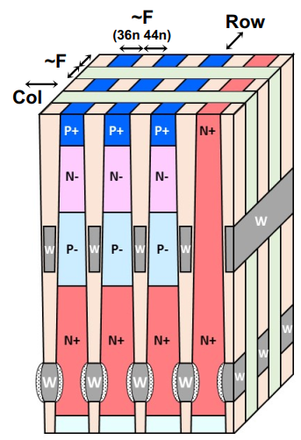
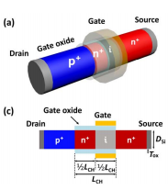
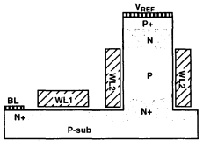
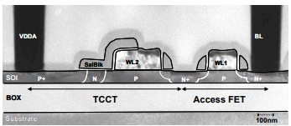
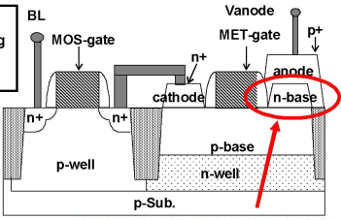
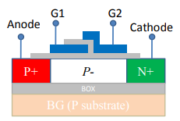
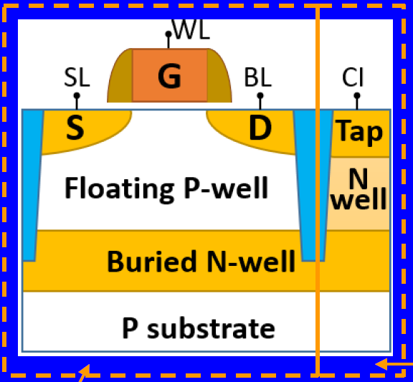
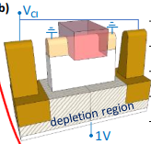
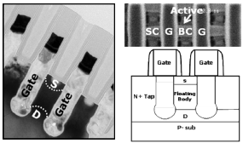
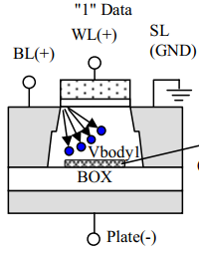
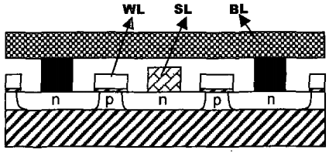
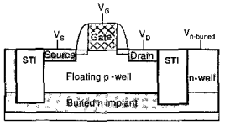
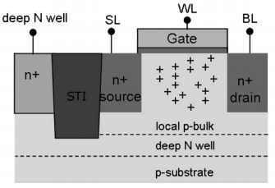
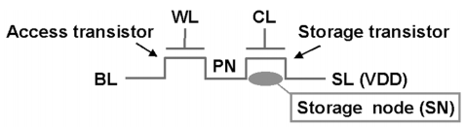
Industry History Overview
GREEN: Bulk + N-well
Orange: SONOS for NV
Thyristor Memory
Kilopass
(MemCon 2016) ^{REF1-5)}
Korean Univ
(TonED 2019) ^{REF1-6)}
Stanford
(IEDM 1999) ^{REF1-1)}
T-RAM
(ISSCC 2006) ^{REF1-2)}
SONY
(IEDM 2007) ^{REF1-3)}
George Mayson Univ
(ISDRS 2011) ^{REF1-4)}
Planer
Trench
Vertical
1T-SRAM
(IS: Innovation Silicon Inc.)
Floating 1T+ Vertical Bi-pola
Floating Body 1T Memory
Zeno
(IEDM 2015) ^{REF3-1)}
Zeno
(IEDM 2018) ^{REF3-2)}
Samsungx
(IEDM 2008) ^{REF2-14)}
TOSHIBA
(IEDM 2007) ^{REF2-9)}
GEN1 came
from STMicro
GEN2 uses Depleted Si
TOSHIBA
(ISSCC 2002) ^{REF2-2)}
TOSHIBA
(ISSCC 2005) ^{REF2-5)}
TOSHIBA
(VLC 2006) ^{REF2-6)}
(IEDM 2006) ^{REF2-7)}
IS & AMD
(ISSCC 2009) ^{REF2-16)}
TOSHIBA
(IEDM 2008) ^{REF2-15)}
TOSHIBA
(VLT 2003) ^{REF2-3)}
IS (Z-RAM)
(IEDM 2007) ^{REF2-10)}
IS
(ISOIC 2001) ^{REF2-1)}
Hynix & IS
(IEDM 2009) ^{REF2-17)}
KAIST
(IEDM 2007) ^{REF2-11)}
KAIST
(VLT 2008) ^{REF2-12)}
(IEDM 2008) ^{REF2-13)}
STMicro
(VLT 2004) ^{REF2-4)}
SK Hynix & IS
(VLT 2010) ^{REF2-20)}
Bulk Fin
IMEC
(IWMTDT 2009) ^{REF2-18)}
(TonCS 2010) ^{REF2-19)}
Renesas
(JSSC 2007) ^{REF2-8)}
Intel
(VLT 2008) ^{REF2-21)}
2000
2005
2010
2015
2020
100nm
90nm
45 ~ 50 ~ 55nm
1. SOI Trend moved from PD to FD 2. Scaling Issue

Slide 3
Reference Papers
Thyristor Memory Papers
1-1) https://ieeexplore.ieee.org/document/824152
1-2) https://ieeexplore.ieee.org/document/1696327
1-3) https://ieeexplore.ieee.org/document/4419105
1-4) https://ieeexplore.ieee.org/document/6135246
1-5) http://virtual-strategy.com/2016/10/11/kilopass-reveals-new-vlt-dram-technology-this-week-at-memcon-csia-iccad/
1-6) https://ieeexplore.ieee.org/document/8556508
FB Memory Papers
2-1) https://ieeexplore.ieee.org/document/958032
2-2) https://ieeexplore.ieee.org/document/992981
2-3) https://ieeexplore.ieee.org/document/1221171
2-4) https://ieeexplore.ieee.org/document/1345433
2-5) https://ieeexplore.ieee.org/document/1494067
2-6) https://ieeexplore.ieee.org/document/1705369
2-7) https://ieeexplore.ieee.org/document/4154265
2-8) https://ieeexplore.ieee.org/document/4362083
2-9) https://ieeexplore.ieee.org/document/4418857
2-10) https://ieeexplore.ieee.org/document/4419103
2-11) https://ieeexplore.ieee.org/document/4419104
2-12) https://ieeexplore.ieee.org/document/4588618
2-13) https://ieeexplore.ieee.org/document/4796658
2-14) https://ieeexplore.ieee.org/document/4796818
2-15) https://ieeexplore.ieee.org/document/4796819
2-16) https://ieeexplore.ieee.org/document/4977507
2-17) https://ieeexplore.ieee.org/document/5200611
2-18) https://ieeexplore.ieee.org/document/5279849
2-19) https://ieeexplore.ieee.org/document/5431014
2-20) https://ieeexplore.ieee.org/document/5556212
2-21) https://ieeexplore.ieee.org/document/4588575
Zeno Papers
3-1) https://ieeexplore.ieee.org/document/7409776
3-2) https://ieeexplore.ieee.org/document/8614555

Slide 4
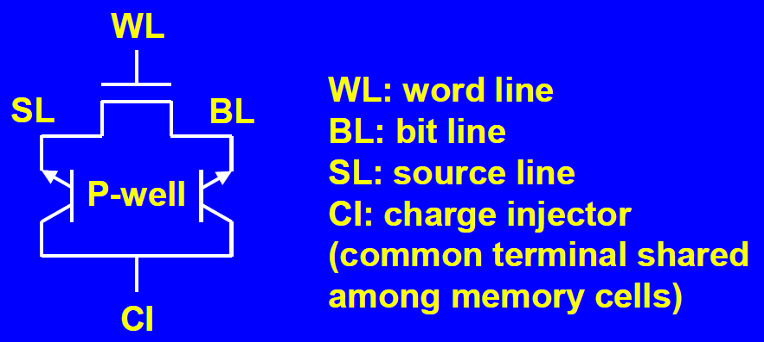
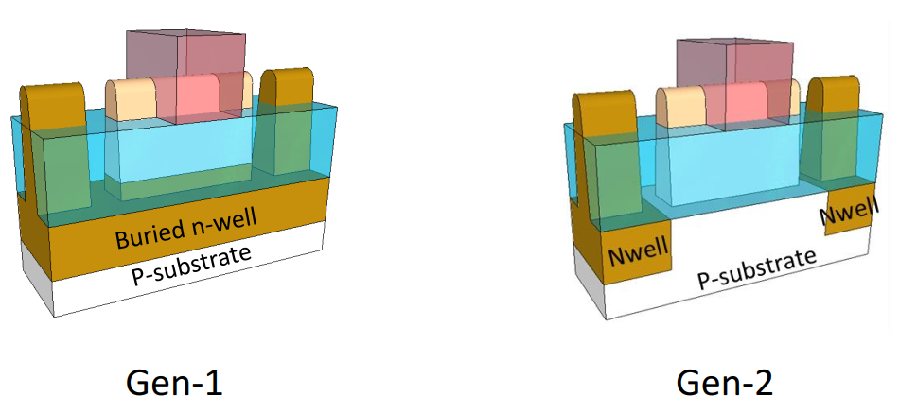
Zeno IEDM 2015 Paper
<Memory Device Structure>
<Device Features>
- The structure is same with STMicro paper (VLT 2004).
- Use the vertical NPN bi-polar aggressively
than STMicro paper.

Slide 5
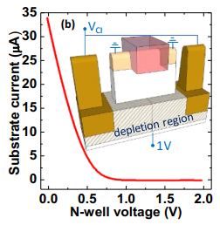
Zeno IEDM 2018 Paper
<Memory Device Structure>
Although the body capacitance would become small,
Junction Leakage would also decrease.

Slide 6
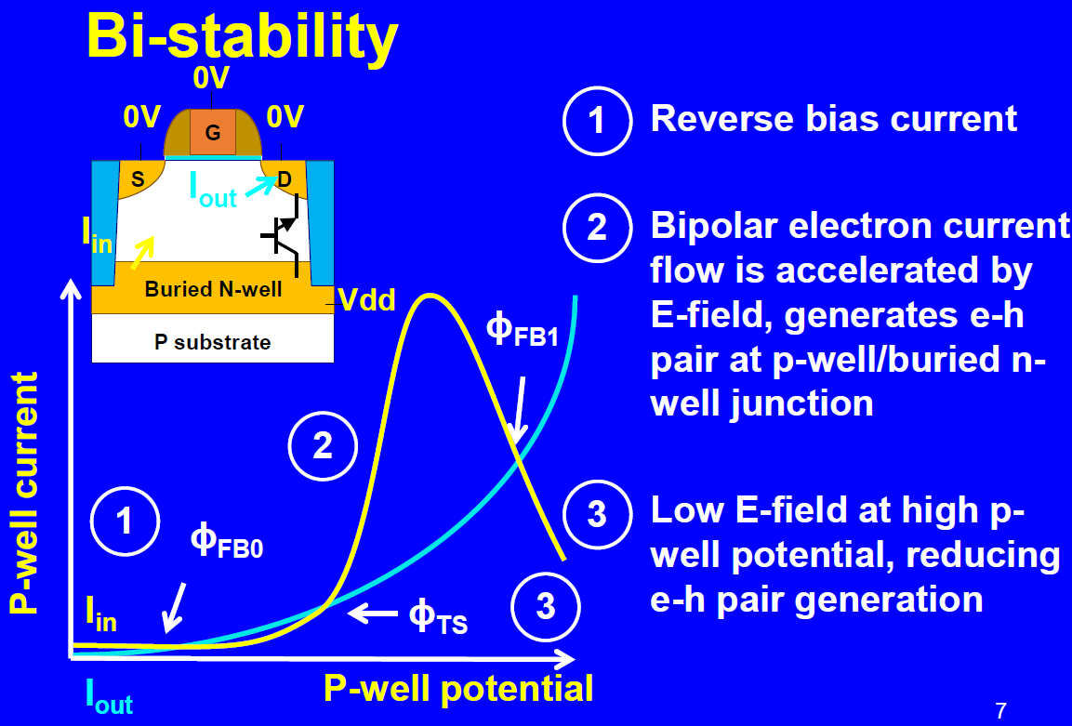
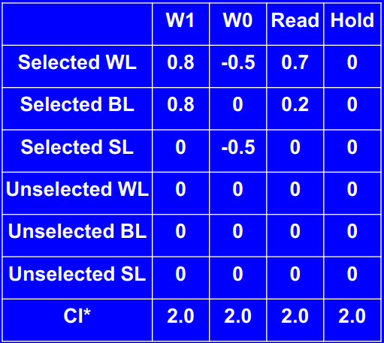
<Potential Structure>
2.0V

Slide 7
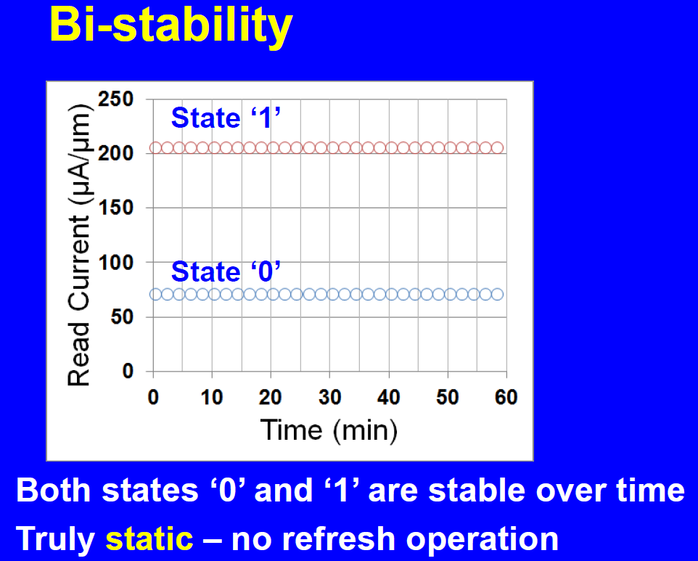
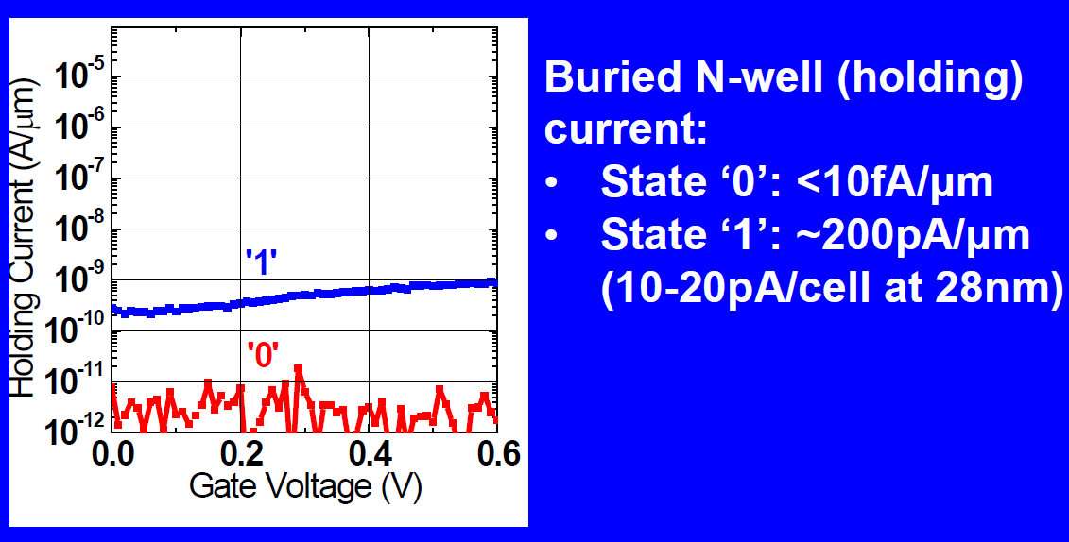
<Data Retention>
B N-well optimization may reduce
The holding current further?

Slide 8
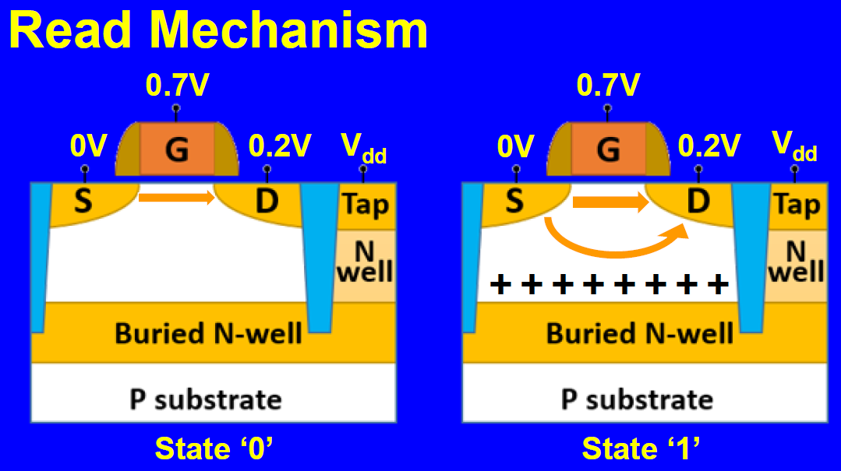
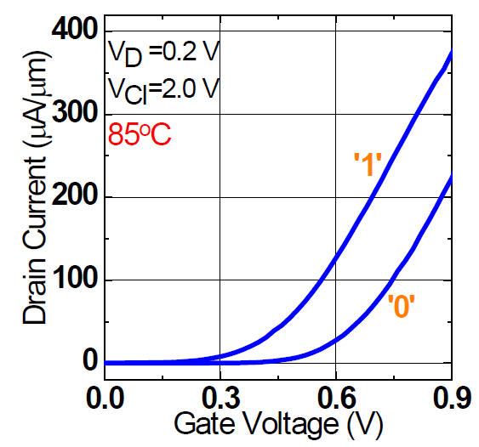
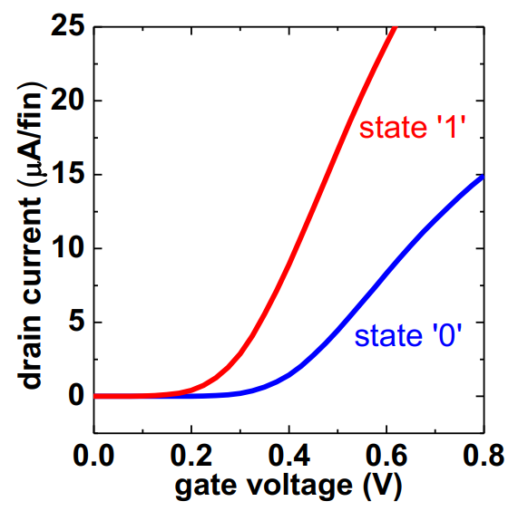
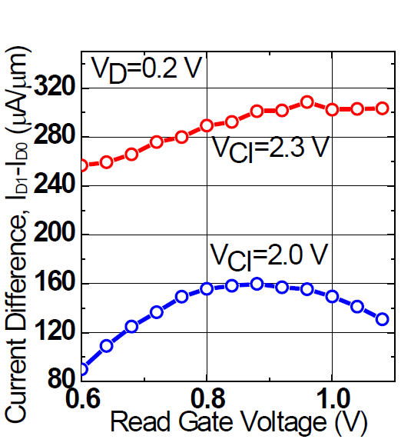
<READ Operation>
GEN1
GEN2
→0.4V (GEN2)
→0.4V (GEN2)
VG=0.7V
2.0V
2.0V
2.0V
2.0V
VG=0.4V
~20uA/cell
~9uA/cell
~8uA/cell
~2uA/cell
VG=0.7V

Slide 9
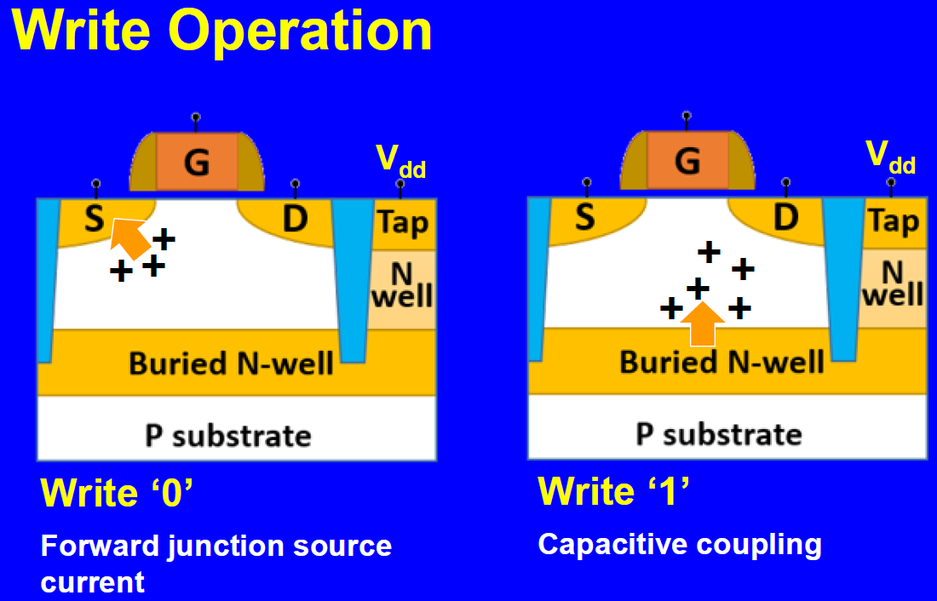
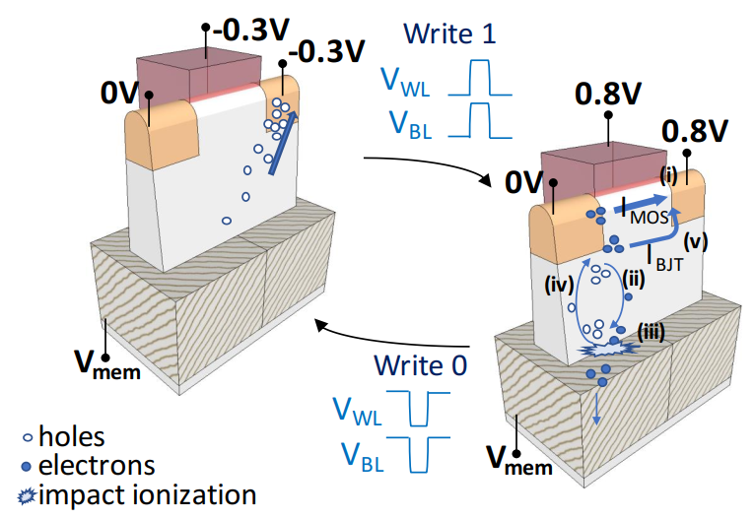
<WRITE Operation>
-0.5V
→-0.3V (GEN2)
0.8V
→-0.3V (GEN2)
2.0V
2.0V
-0.5V
0V
0V
0.8V
(?)
Pull Hole (positive) out from P-body
By Negative voltage
Pull Hole (positive) out from P-body
By Negative voltage

Slide 10
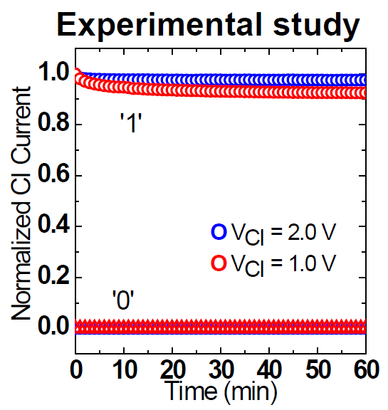
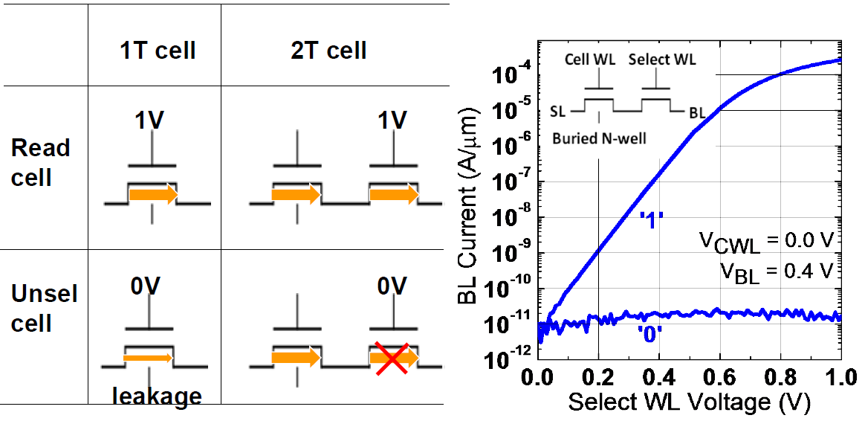
<Leakage Suppression>
2 Leakage paths exist:
- NPN Bi-polar current (Data Holding current).
- Threshold leakage current at half selected.
This is BL leakage/Threshold leakage discussion to cut off.
CI data hold current still remains.
To hold the data, CI is MUST. 10 ~ 20pA/cell at 28nm.
Small CI degrade the retention. (from BLUE to RED)

Slide 11
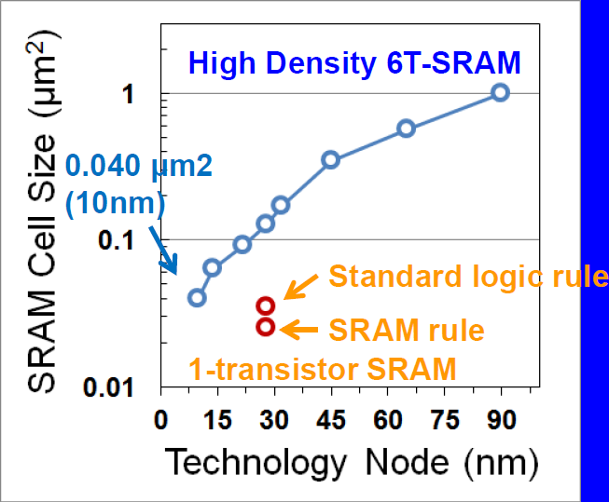
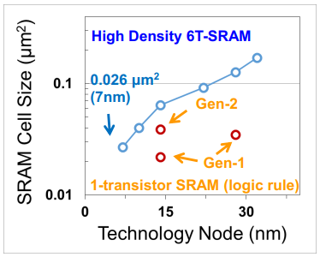
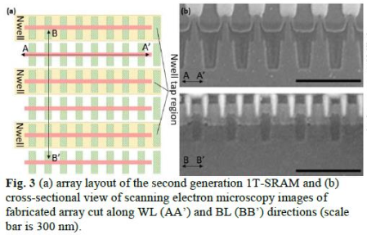
<Scale-down Projection>
Intel 10nm SRAM cell size is
0.030 um2

Slide 12
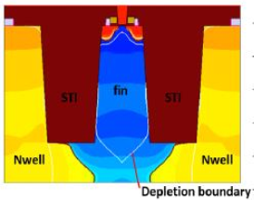
<Cell/Array Arrangement>
The usage of High voltage like ~2.0V
should force large STI separation
Cell
Isolation
Isolation
In IEDM 2018 paper, they deleted any descriptions about VCI (N-Well Voltage).
Still ~2.0V or slightly lower than 2015 paper?

