Slide 1
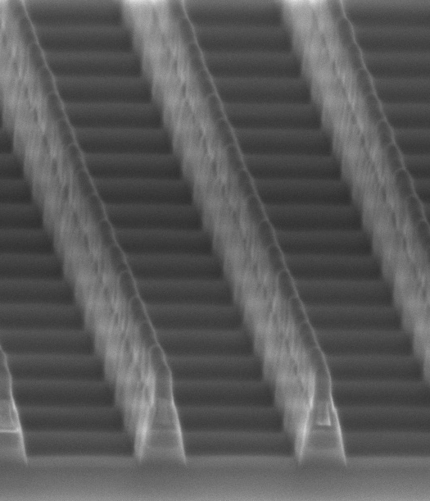
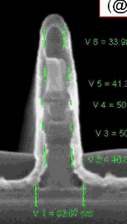
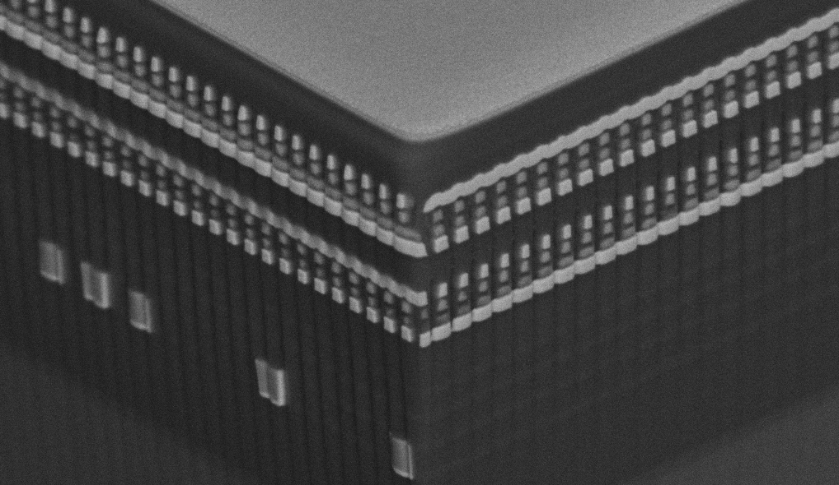
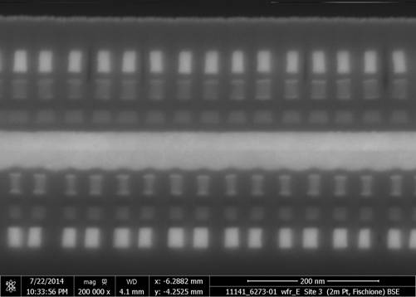
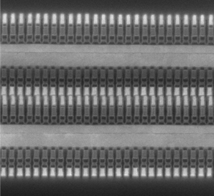
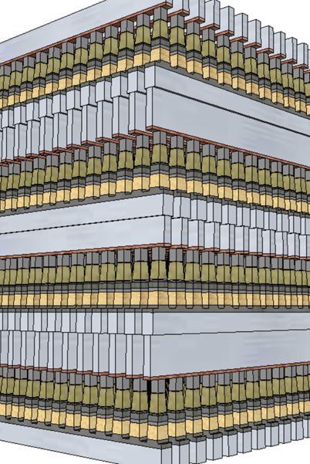
3D XPoint™ technology development evolution
4Kb 200nm feature, 4-mask Sublitho Heater
Damascene PM Subtractive SD
2003~2006 Santa Clara, CA
64Mb 180nm ½ Pitch 6-Mask Sublitho Heater Damascene PM, Subtractive SD
2007~2009 Santa Clara, CA
64Mb 100nm feature, 2-Mask
Self-Aligned, Subtractive Cell
2010~2011 Agrate, Italy
64Mb 50nm ½ Pitch, 2-Mask
Dual Deck, Self Aligned Subtractive Cell
2012~2013 Agrate, Italy
X-section along ROW
TiAlN
SD
C
W
PM
TiAlN
SD
C
C
SD
TiSiN
PM
Mid Electrodes
TiSiN
PM
SXP cell
SD only
128Gb 41nm Pitch
Dual Deck Self Aligned Subtractive Cell
2013-2017 Boise, ID
256Gb 41nm Pitch
Quad Deck Self Aligned Subtractive Cell
2015-2020 Lehi, UT & Rio Rancho, NM
256Gb 33.5nm Pitch
Quad Deck Self Aligned Subtractive Cell
2019~2022 Rio Rancho, NM
10-series: S15
20-series: S26
P1241: Atlantic Falls (ATF)

Slide 2
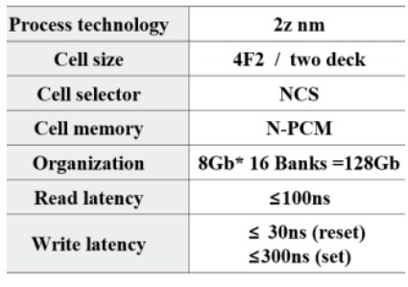
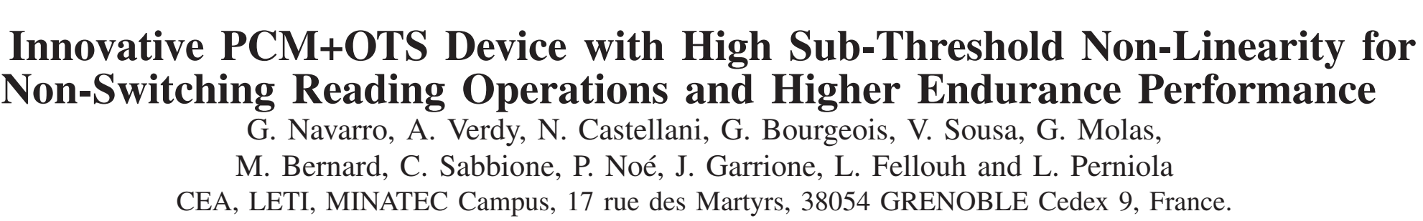
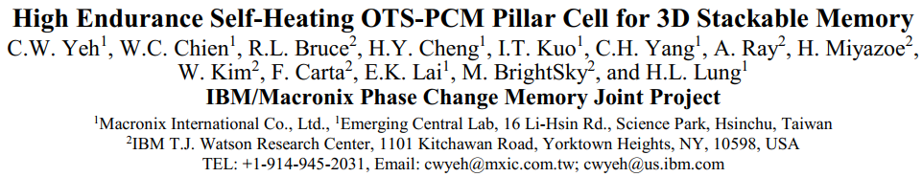
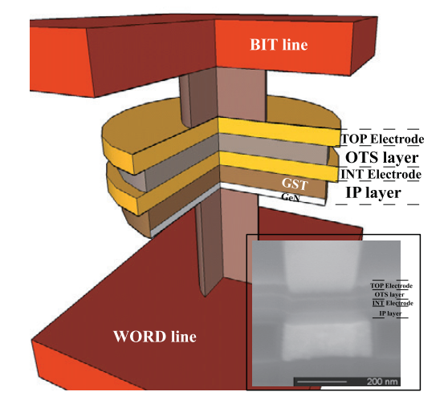
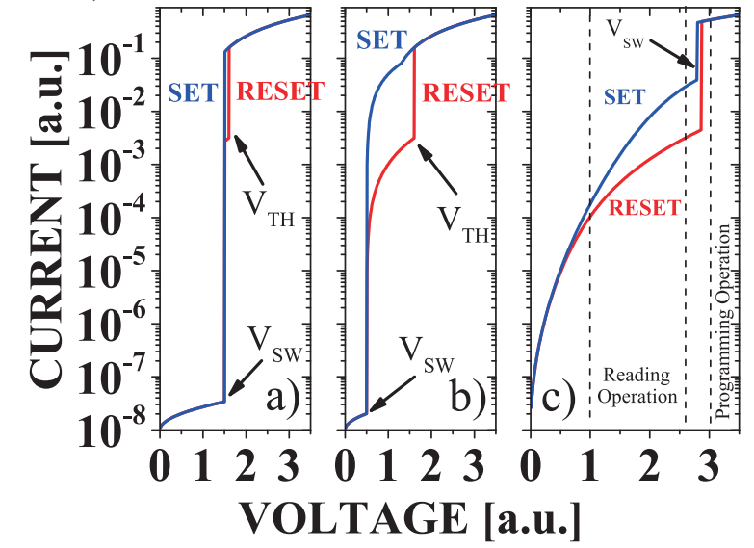
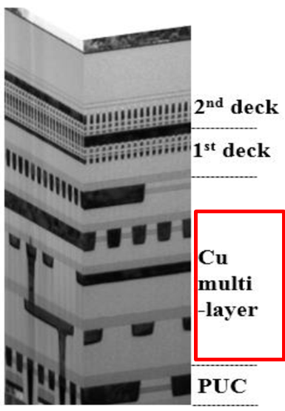
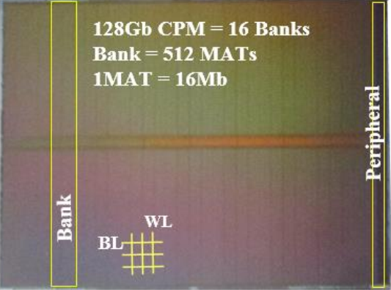
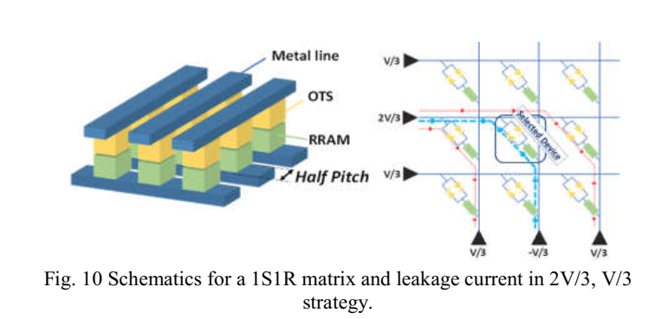
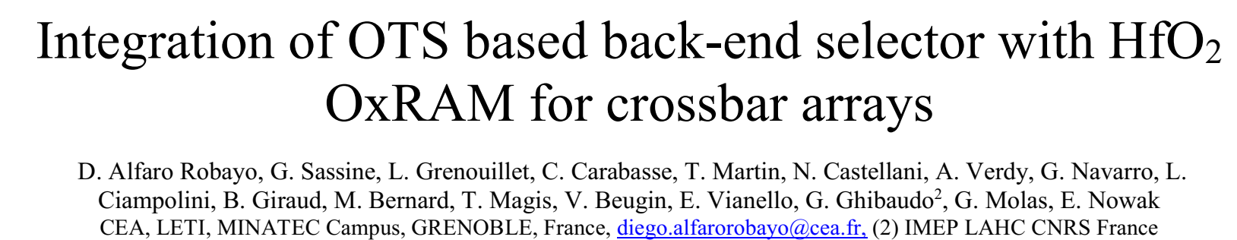
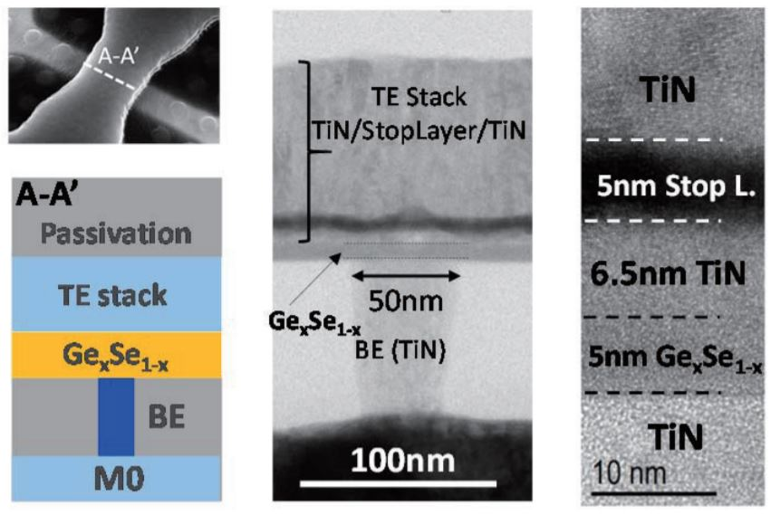
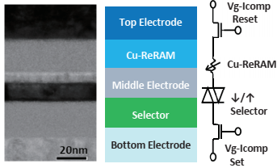
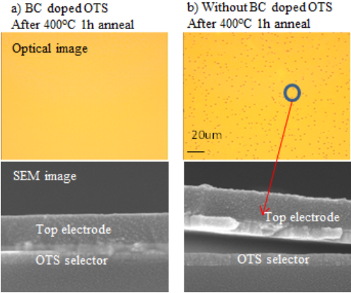
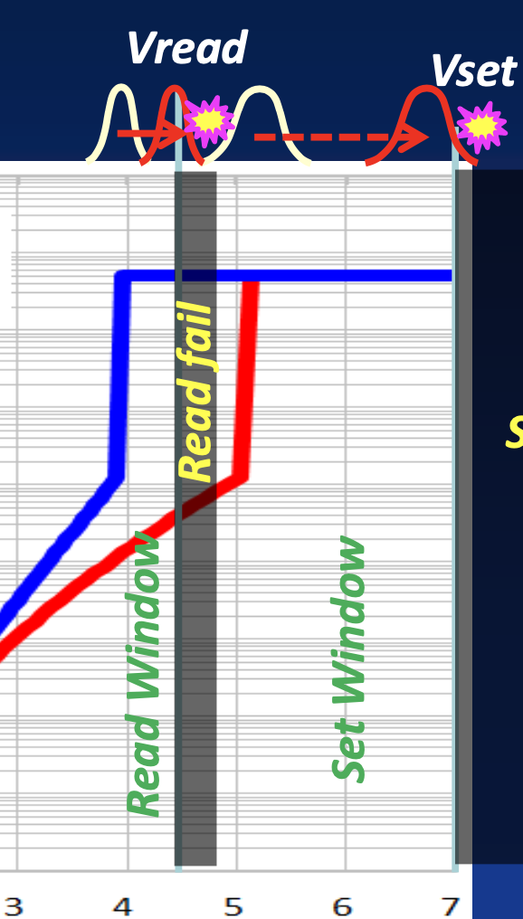
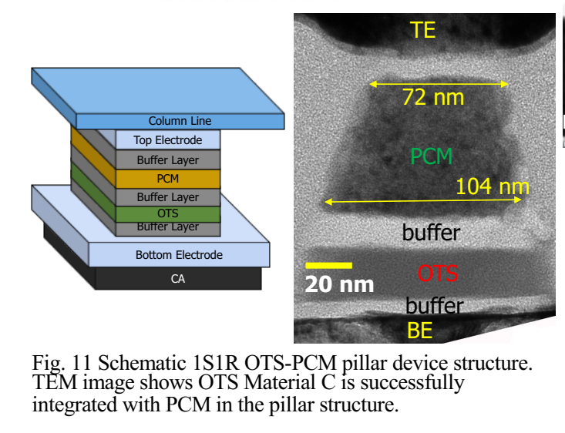
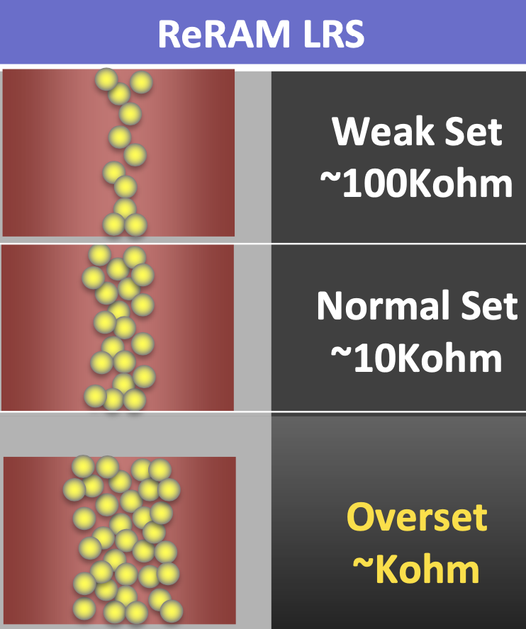
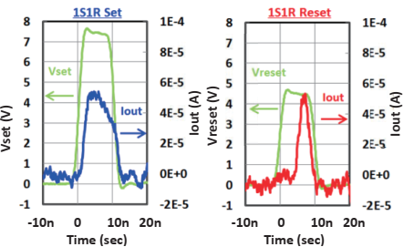
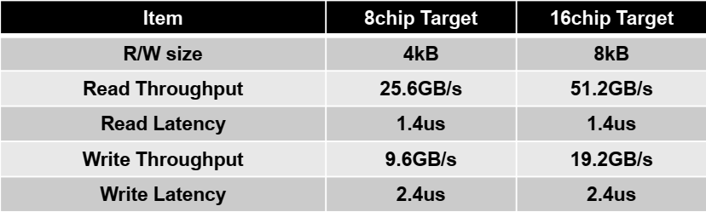
Competitive landscape – chalcogenide selector
IBM/Macronix
SK-Hynix
CEA-LETI
2018 IEDM
2016 +
VLSI 2017
IMW 2019
IMEC
VLSI 2017
Sony
VLSI 2017
IMW 2018
Flash Summit 2019
IEDM 2018; VLSI 2019
PM Summit 2019

