Slide 1
3D XPoint™/Optane™ TD Roadmap
DerChang Kau, WW20.2/2020
Executive Summary
Technology Overview & Process Roadmap
Competitive Landscape
Scaling Challenge & Research Topics

Slide 2
Executive Summary
Overview:
  3D XPoint™ technology is a nonvolatile memory technology.
  Cost close to NAND, performance 2nd to DRAM.
  Two grades for each product – Low-latency storage and persistent memory (Yole estimates >$3B by 2025)
Problem to address: fill the gap between DRAM and storage in cost and performance
The Solution is addressed by 3D XPoint™ technology
  The smallest two terminal memory cell constructed in a x-y array hence cross point memory
  Each cell consists of a selector element and a memory element serially connected at cross point
  It’s a BEOL technology compatible with main steam CMOS technology.
  Multiple layers of memory array are stackable, therefore packing density multiplied.
  The underline mechanism & process control is well developed in house (16 years strong and going).
Technology development
  took near 10 years to graduate from research
  1st gen. demonstrated HVM maturity ➔ predictable scaling roadmap key to business (PRQ 2017)
  2nd gen in PRQ/yield ramp phase ➔ double component density (PRQ Q4/2020)
  3rd gen completes definition phase ➔ Die size: 68%, BW: read 2X, write > 1.4X (PRQ 2022)
  Several candidates in horizon besides geometry shrink

Slide 3
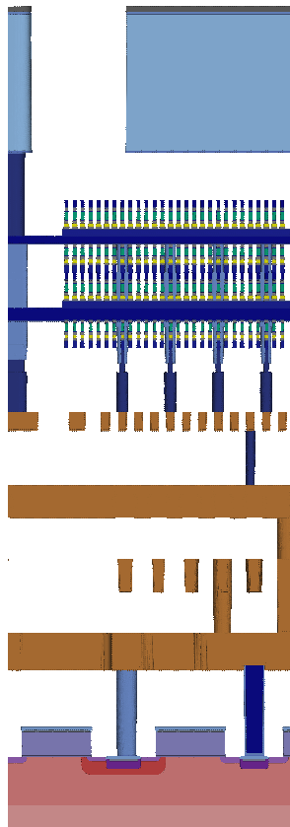
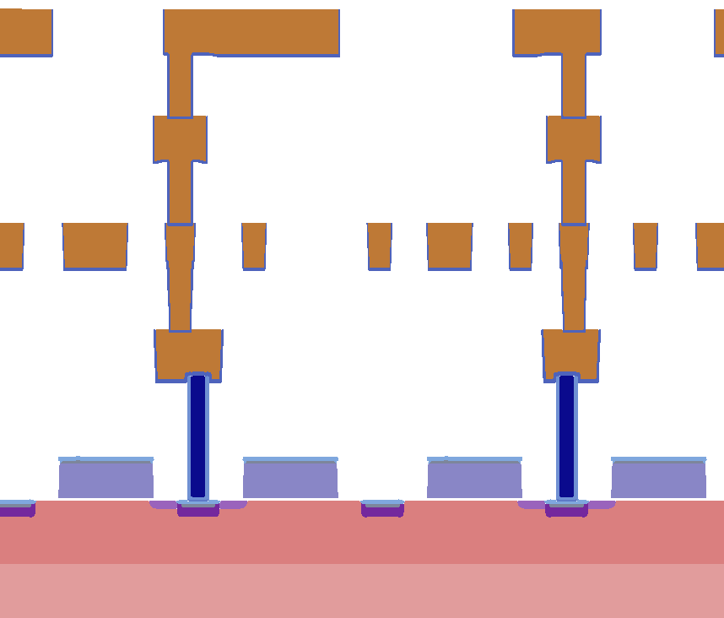
3DXPointTM technology: CMOS Under Array (a.k.a. CUA)
M5: 1000 nm
20 Series
M5: 700 nm
10 Series
V9: 300 nm
(above array)
V7: 300 nm
(above array)
Array Decks:
200nm x 4
Array Decks:
200nm x 2
Total Height Above Wafer: 4020 nm
VA/V4: 360 nm
VA/V4: 360 nm
M4: 160 nm
M4: 160 nm
Total Height Above Wafer: 3620 nm
V3: 230 nm
V3: 230 nm
M3: 160 nm
M3: 160 nm
V2: 230 nm
V2: 230 nm
M2: 160 nm
M2: 160 nm
V1: 230 nm
V1: 230 nm
M1: 160 nm
M1: 160 nm
Con: 320 nm
Con: 320 nm
Gates: 150 nm
Gates: 150 nm
STI: 270 nm
STI: 270 nm
Notes:
Both models are scaled the same.
20 series is slightly taller (400 nm + 300 nm).

Slide 4
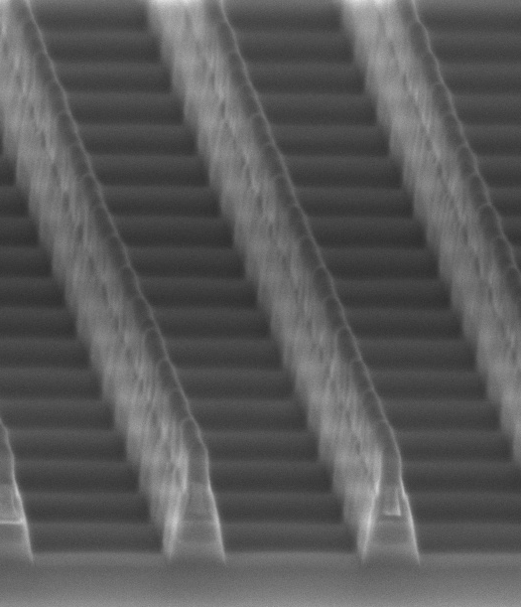
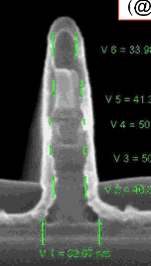
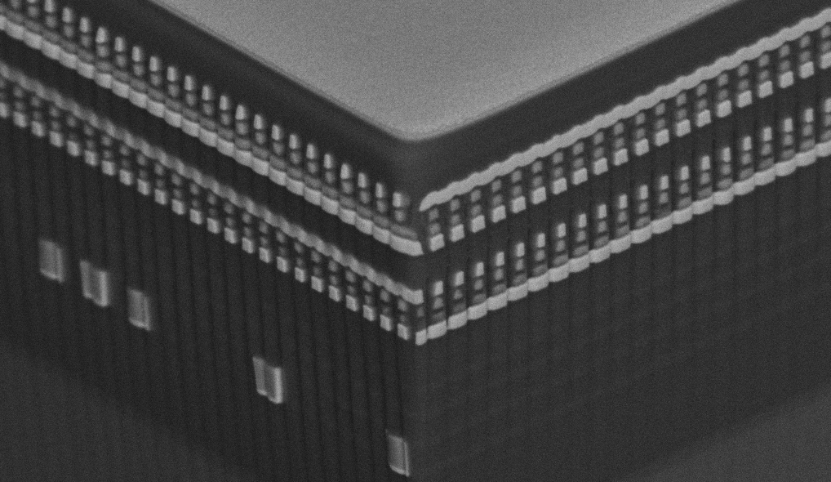
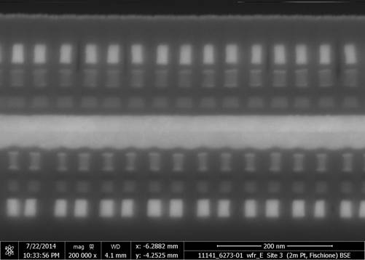
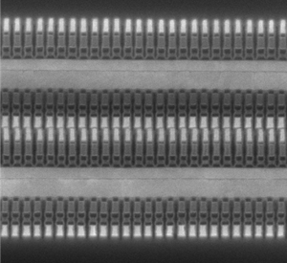
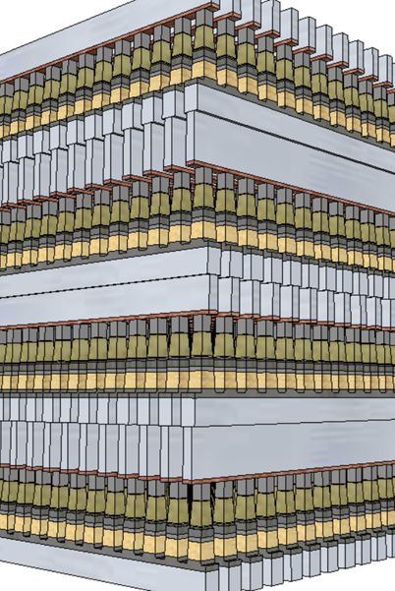
3D XPoint™ technology development evolution
4Kb 200nm feature, 4-mask Sublitho Heater
Damascene PM Subtractive SD
2003~2006 Santa Clara, CA
64Mb 180nm ½ Pitch 6-Mask Sublitho Heater Damascene PM, Subtractive SD
2007~2009 Santa Clara, CA
64Mb 100nm feature, 2-Mask
Self-Aligned, Subtractive Cell
2010~2011 Agrate, Italy
64Mb 50nm ½ Pitch, 2-Mask
Dual Deck, Self Aligned Subtractive Cell
2012~2013 Agrate, Italy
X-section along ROW
TiAlN
SD
C
W
PM
TiAlN
SD
C
C
SD
TiSiN
PM
Mid Electrodes
TiSiN
PM
SXP cell
SD only
128Gb 41nm Pitch
Dual Deck Self Aligned Subtractive Cell
2013-2017 Boise, ID
256Gb 41nm Pitch
Quad Deck Self Aligned Subtractive Cell
2015-2020 Lehi, UT & Rio Rancho, NM
256Gb 33.5nm Pitch
Quad Deck Self Aligned Subtractive Cell
2019~2022 Rio Rancho, NM
10-series: S15
20-series: S26
P1241: Atlantic Falls (ATF)

Slide 5
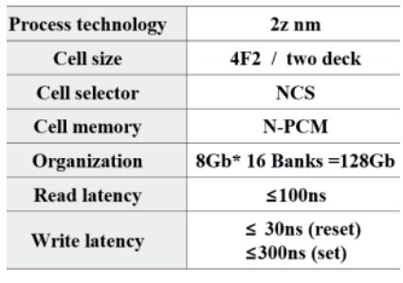
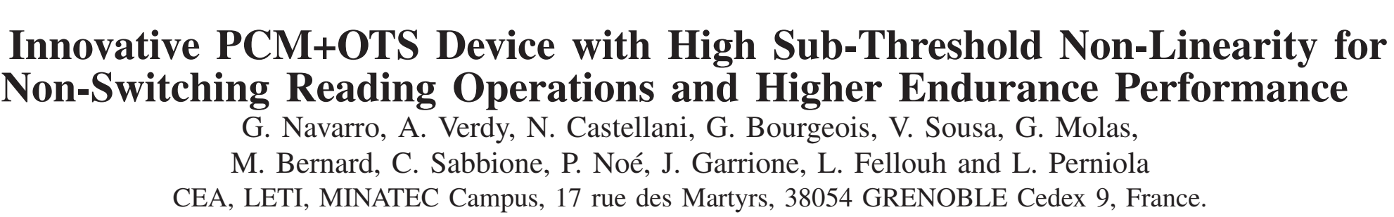
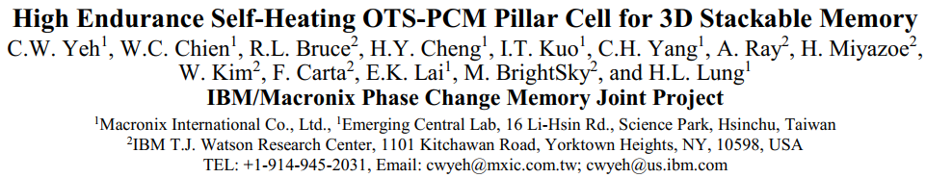
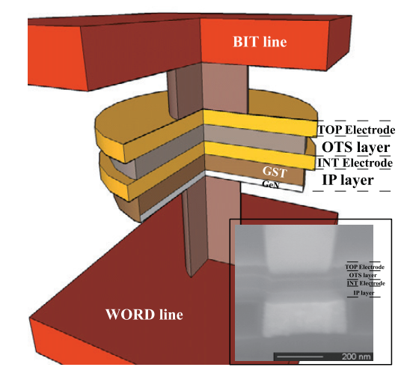
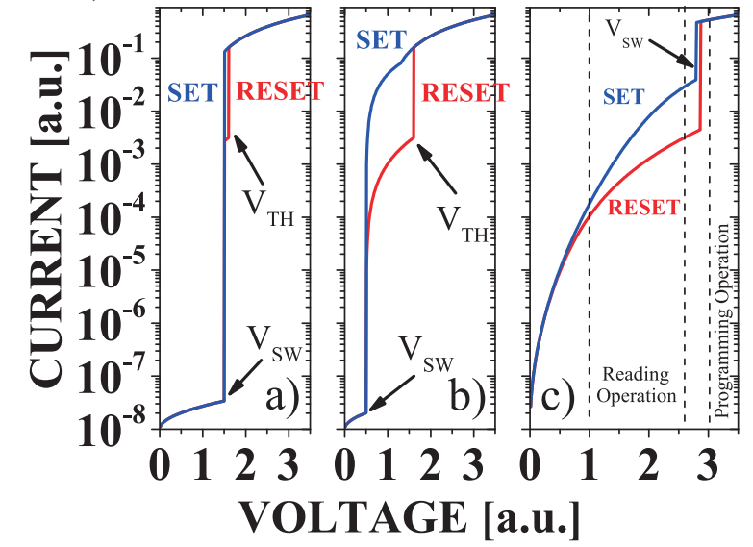
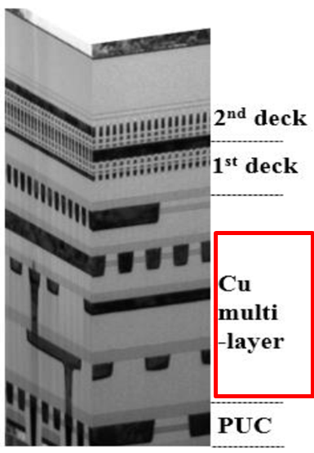
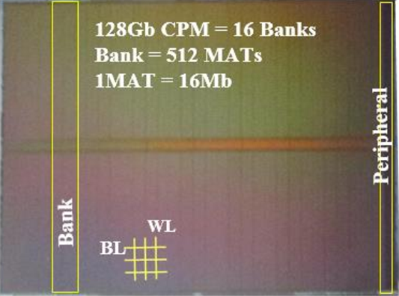
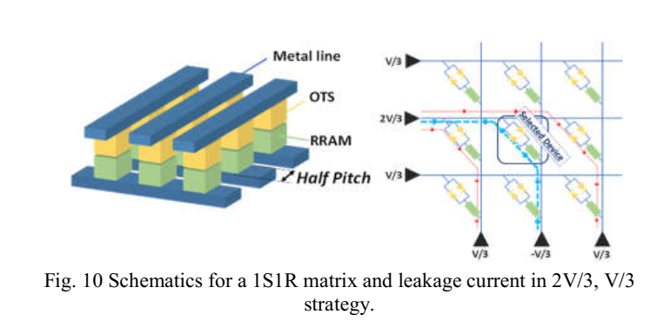
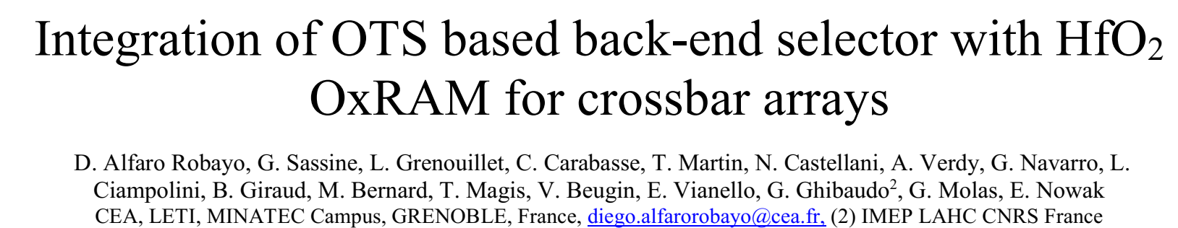
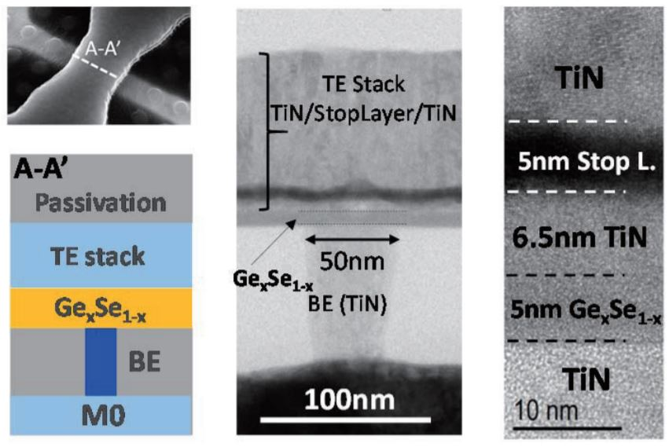
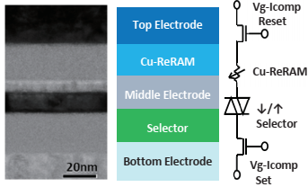
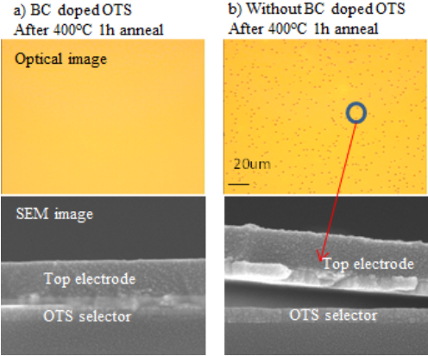
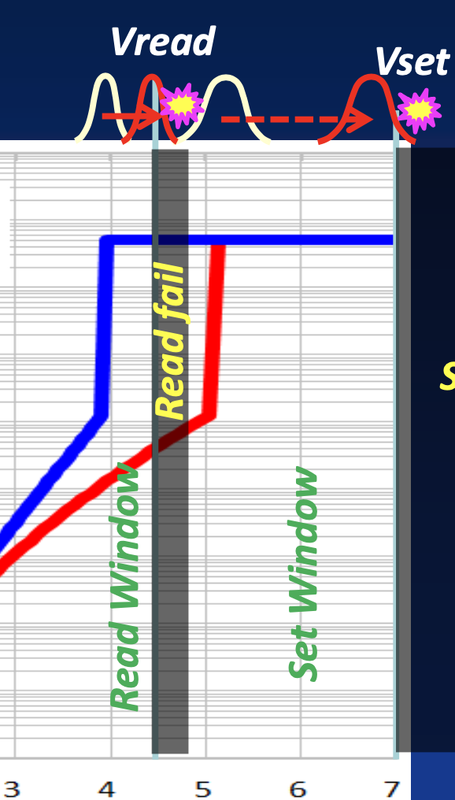
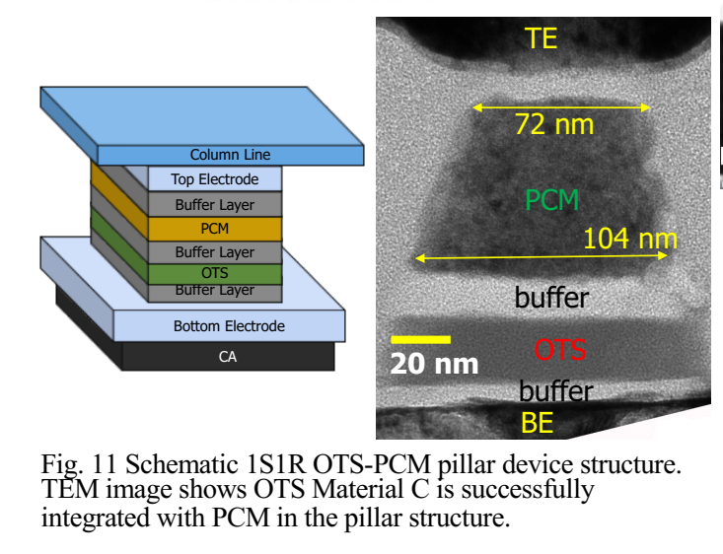
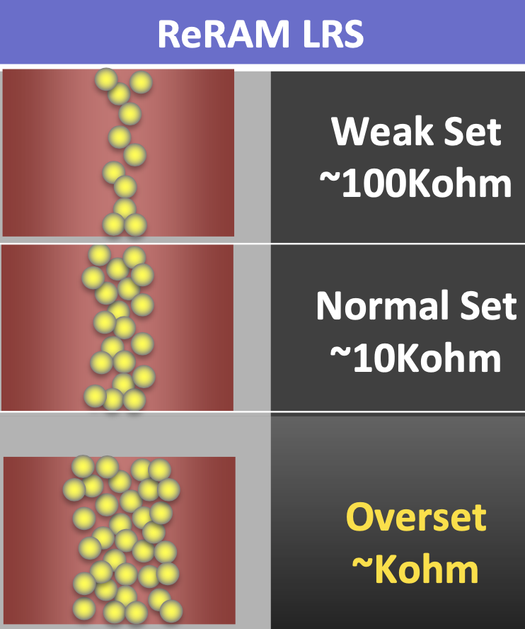
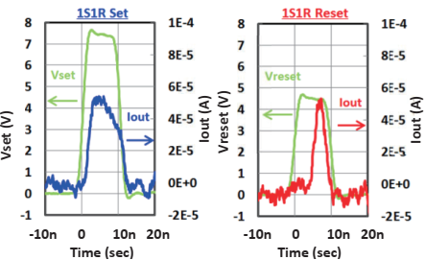
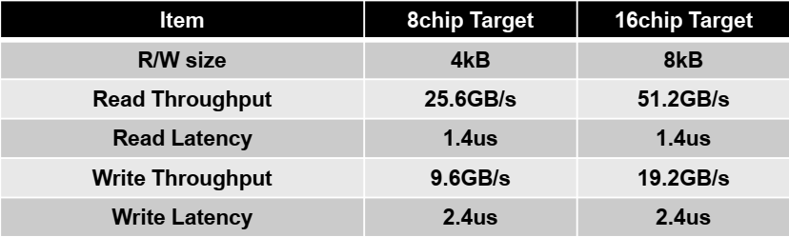
Competitive landscape – chalcogenide selector
IBM/Macronix
SK-Hynix
CEA-LETI
2018 IEDM
2016 +
VLSI 2017
IMW 2019
IMEC
VLSI 2017
Sony
VLSI 2017
IMW 2018
Flash Summit 2019
IEDM 2018; VLSI 2019
PM Summit 2019

Slide 6
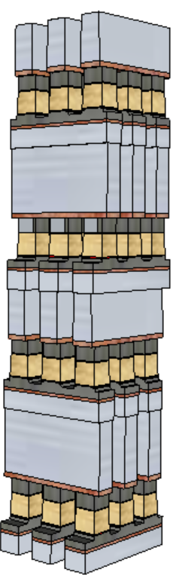
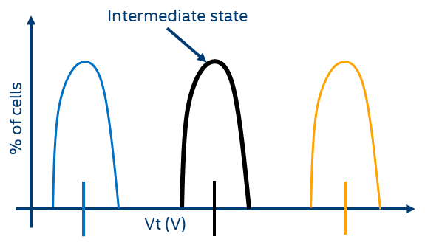
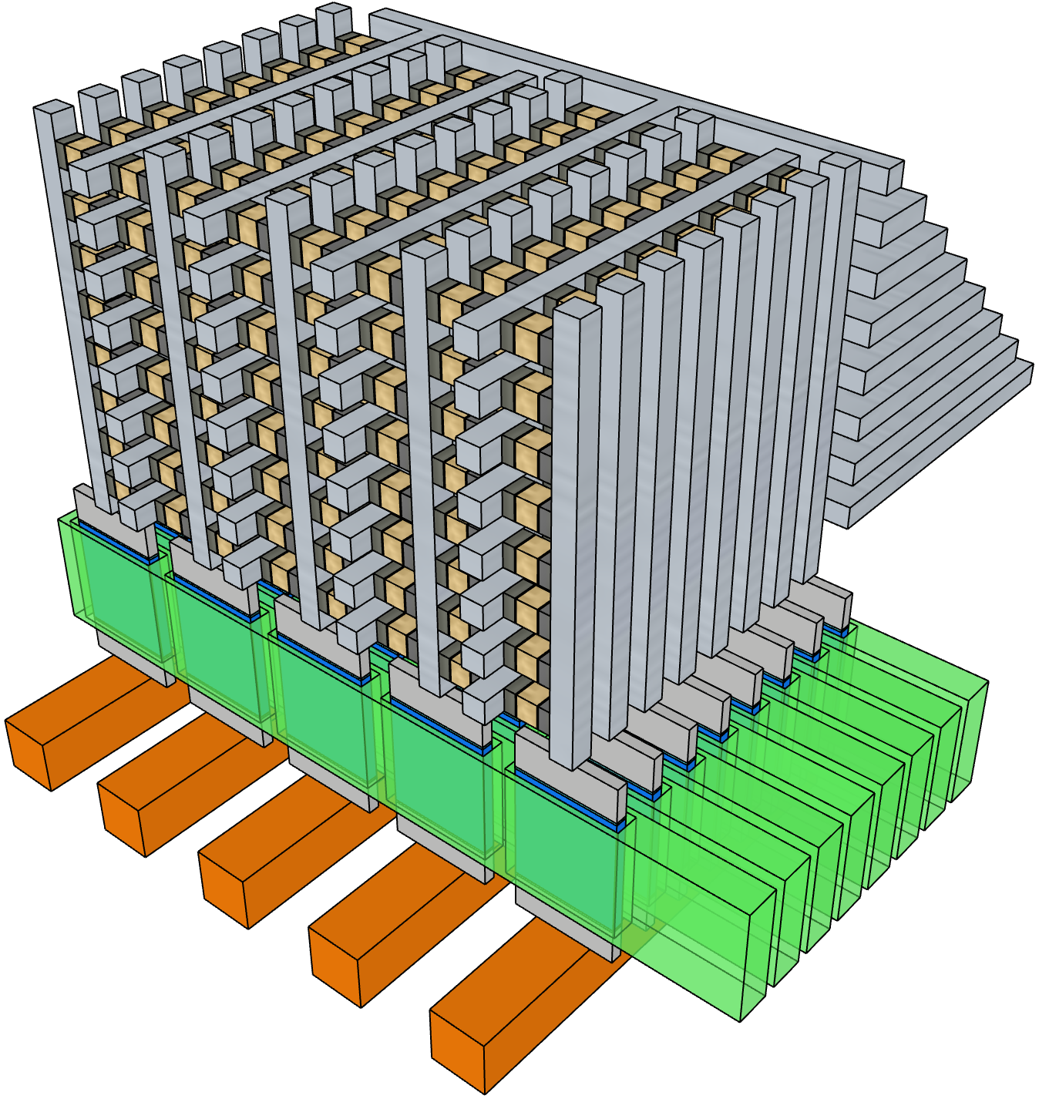
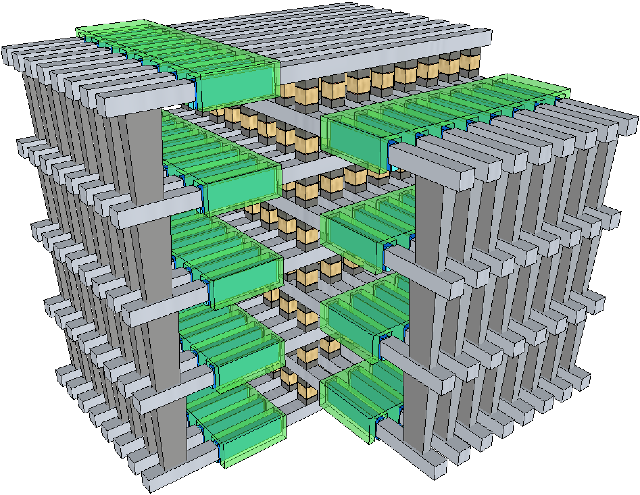
3D XPoint™ roadmap and beyond
Volume Production
PRQ / Early Ramp
Pathfinding → Main Development
128Gb 41nm Pitch
Dual Deck Self Aligned Subtractive Cell
2017 Boise, ID
256Gb 41nm Pitch
Quad Deck Self Aligned Subtractive Cell
2020 Lehi, UT & Rio Rancho, NM
256Gb 33.5nm Pitch
Quad Deck Self Aligned Subtractive Cell
2022 Rio Rancho, NM
10-series: S15
20-series: S26
P1241: Atlantic Falls (ATF)
Die Size: 208mm²
BW: 1600/550 MB/s
Die Size: 199mm²
BW: 1600/800 MB/s
Die Size: 135mm²
BW: 3200/1100~1600 MB/s
Module Definition
Path Validation
Early Research
Concept
26.5p Full Stack
28p Quad Deck BiSM
MLC, 1.5b/c
3D Decoding w/ Pillar Select
3D decoding w/ deck select
Density: 1.4X
Cost: 0.9X
BW: 2X
Density: 1.6X
BW: 1.6X
Density: 1.5X
BW: 1.5X

Slide 7
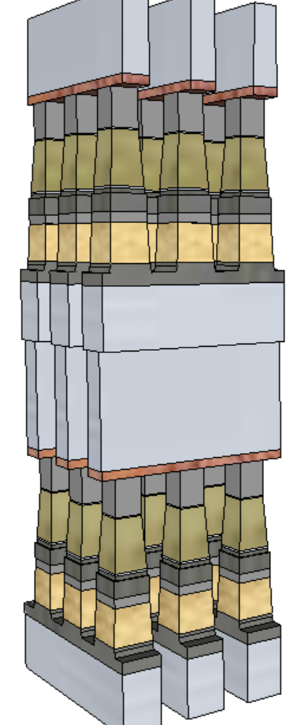
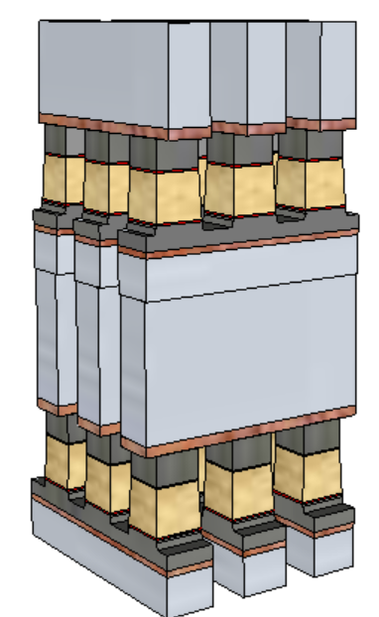
Access cycle time reduction
Problem to solve:
  Write occupancy: limited by crystallization kinetics (~200nsec) + i/o overhead
Solution Space:
  PM material exploration of high speed material; a few candidates in path validation for 30% cycle time reduction.
  Build-in selector Memory, a.k.a. BiSM, expecting 50% reduction of write occupancy initially. Pending scalability results.
  Simplified manufacturing with PM removed
  lower cell aspect-ratio (from 10:1 to 5:1)
  No cross-contamination between Memory and Selector materials
  Improved performance and reliability
  Elimination of PM reliability constraint
  Lower write current to relaxes WL/BL requirements and array capacitance
  Fast write; no crystallization required (from 240ns to 40ns set pulse)
  An opportunity for symmetric memory access (read/set/reset = 40/40/40)
BiSM
3DXP

Slide 8
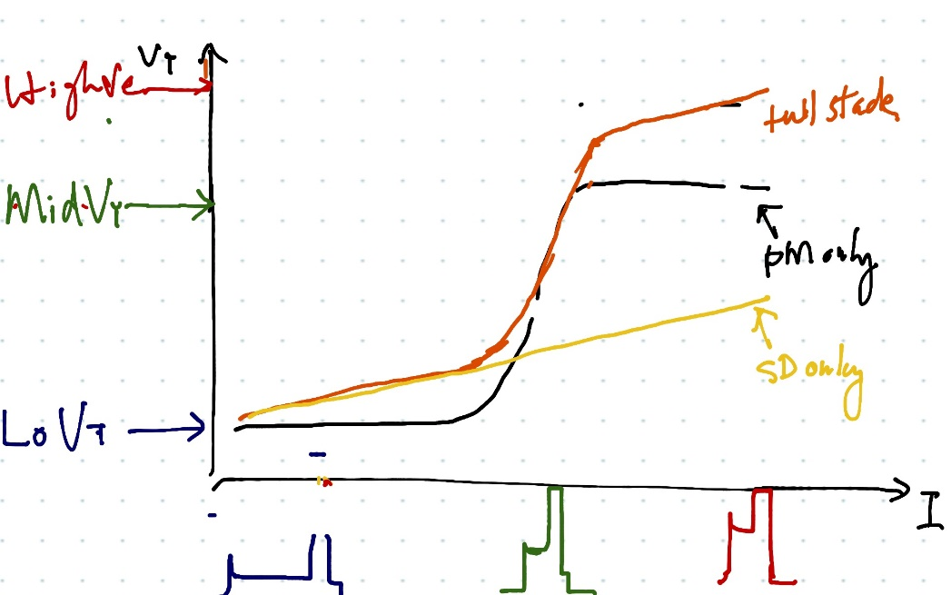
Bandwidth improvement
Bandwidth limited either by (parallelism / cycle time) or (power envelop / access energy)
BiSM is top candidate for cycle time reduction
MLC is in early research stage
1.5 b/c from full stack 3DXP increase 50% BW
1.5b/c, 2b/c or more from BiSM

Slide 9
Density scaling
Density: effective cell size = cell planar size / number of layer
Cell planar size: pitch scaling visibility is 20nm
Number of layer: exploring two early concept 3D architectures with ADM transistor.
Adamantine Deck Select
Adamantine Pillar Selector

Slide 10
Backup Material

Slide 11
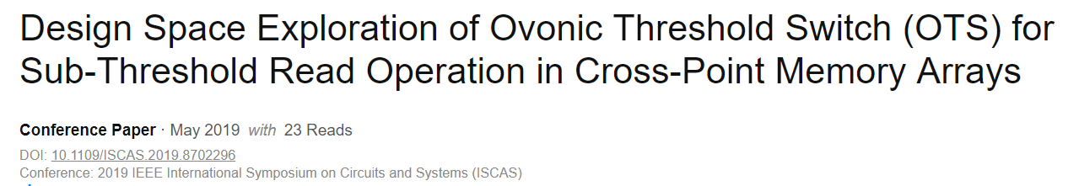
Academic R&D on 3D XP Based on OTS
ASU, 2019
HU, NTU 2019
2019 Electron Devices Technology and Manufacturing Conference (EDTM)
Academic consortium,
Chinese Academy of Sciences
Univ of Grenoble,
MINATECH, France
POSTECH, SK Hynix, Korea

Slide 12
Many Industry Players Pursuing 3DXP Options
(Examples of Non-RRAM Memories)
Company | Memory Type | Memory Mechanism | Pros | Cons?* | R&D Effort
Avalanche | 1S-1MRAM | MRAM with Threshold Selector | Stackable 4f2 ; High NL; Lo Ioff; | Disturb; Operating Window (Variability); | Internal R&D; limited array demo
Sony | 1S-1CBRAM | CBRAM with threshold selector | Stackable 4F2; High NL; Lo Ioff; | “Stuck-at” reliability | Internal R&D
Namlab/Global Foundries | FeFET | HfO2 based FerroFET | High Speed + Low voltage; CMOS compatible | Variability; Endurance; | Univ and Internal R&D; device level
IMEC 3D FeFET | 3D FeFET | HfO2 based FerroFET | High Density 3D NAND like; BE ALD process; | Variability; High Op Voltage; Endurance | Internal R&D; device level
Toshiba | 1FTJ | HfO2 based Ferro tunnel junction | Selector-less; 3D Stackable | Low NL; Variability | Internal R&D; device level
Kilopass / TC Labs | Thyristor (3D) | Vertical thyristor | 3D stackable; high speed; | Epi for abrupt junctions; | Internal R&D; mostly simulations
Sunrise | 3D NOR | NOR | Known Material Base (Silicon) | Large block, Slow Erase (not memory friendly?)
Micron (Intel) | 1X | Self-Select Memory | Process simplicity, low latency | Decoder footprint and access energy | Intel/Micron JDP
MRAM
Based
CBRAM
Based
Ferroelectric Based
T-RAM
NOR
* Perception based on understanding of memory switching mechanism and published data
INTEL CONFIDENTIAL

Slide 13
Many Industry Players Pursuing 3D XP Options
(Select Examples of OTS+PCM & RRAM Based…furthest along)
Company | Memory Type | Memory Mechanism | Pros | Cons* | R&D Effort | Overall Assessment
Hynix | 1S1R | OTS + PCM | 3D stackable; Engineering composition for RW | TBD | Internal R&D; Array demo | Most aggressive publications; Publications closest to Intel capability
IBM / Macronix | 1T1R => 1S1R | OTS+PCM | 3D stackable; Engineering composition for thermal stability | Limited operating window (Variability?) | Internal R&D; Small array demo | Research Level
IMEC/ CEA-LETI | 1S1R 3DXP | OTS+PCM | 3D stackable; Binary alloys based OTS Selectors | Limited operating window (Variability?) | Internal R&D; device level | Research Level
Multiple Univ | 3DXP | OTS + PCM | Materials engineering for Scalability, Reliability, Extendibility | No array data | Device Level | Research Level
OTS + PCM
Company | Memory Type | Memory Mechanism | Pros | Cons* | R&D Effort | Overall Assessment
Sandisk/WD/Unity/Rambus/4DS | 1R (filament / interfacial) | (Non) linear RRAM | Stackable 4f2; 3D RRAM (Selector-less) | Variability(stochastic); High R at scale | University Collab, internal R&D; Limited Array Demo | Dropped
Hynix/HP | 1S1R | SiOx(S)/ ox-RRAM NbOx Selector | 3D RRAM; Scaled (filament) | Variability(stochastic); RRAM compatibility | Internal R&D; Array demo | Dropped
Crossbar/SMIC | 1T-nR; 1S1R | Oxide (S) | Stackable 4f2; High NL; FAAST selector | Disturb; Variability; Integration Compatibility | Internal R&D; Array demo | Deemed Low Probability of Success for 1S1R
Sony (Previously in JDP w/Micron) | 1T1R => 1S1R | OTS(s) + CBRAM | Stackable 4f2; High NL | Complex integration for Cu; Disturb; Variability; | Internal R&D; Array Level | Internal: Low Prop of Success; External: (Yole) Sony plans low-latency drives TB-capacity in 2020
Nantero | 1T-1R; 1R | CNT based RRAM | Selector-less 4F2; High Speed; | Low NL; Inhibit / Disturb; Variability; | Univ and Internal R&D; Limited Array Demo | Internal: Low Prob. of Success; External: Dell venture backed
RRAM
* Perception based on understanding of memory switching mechanism and published data

Slide 14
Pathfinding Stage/Maturity Definitions
(Similar to “POR”, “PrePOR” and “Ideas” in TD program)
Concept: Ideas with first principle / trust-worthy empirical
Early Research: Incumbent identified, competition surveyed, papers studied, landing zone emerging
Path Validation: to validate, quantify, justify for the value proposition and identify execution paths
Module Definition: Critical logistics and infrastructures identified for intercept
Exiting Path-finding: Spec definitions and risk assessment. One step prior to NTI/NPI

Slide 15
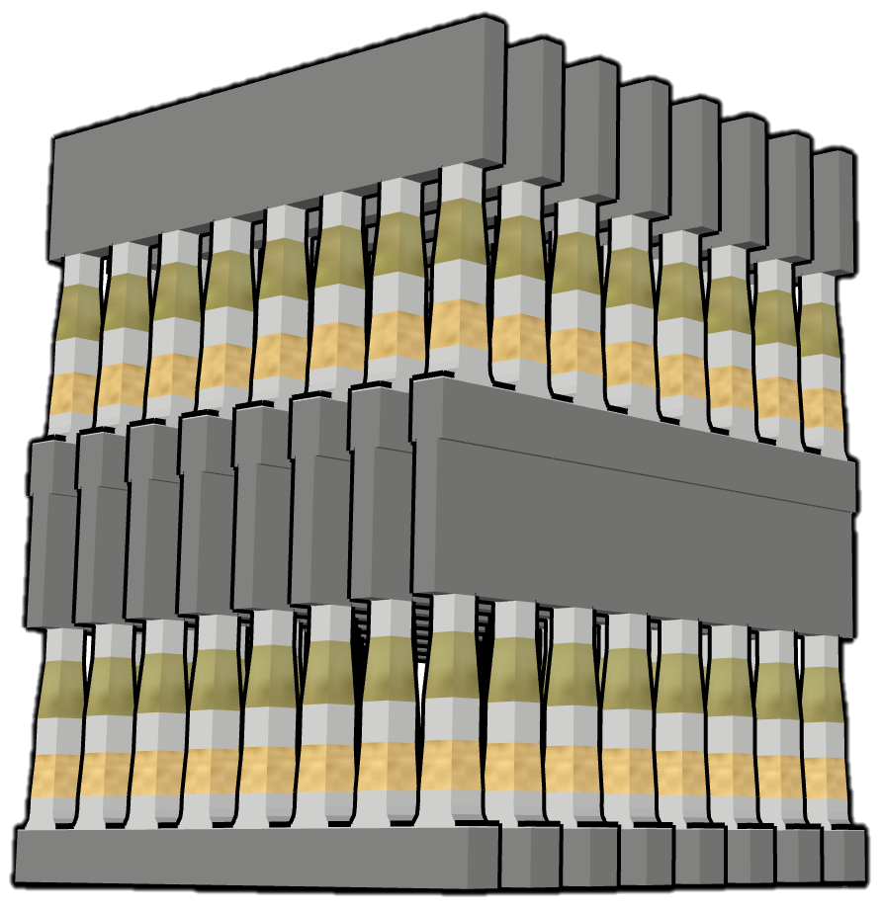
Combining Memory & Storage Hierarchy
Desirable Attributes: Non-volatile, Low Cost, High Performance
Simple scalable structure + 3D technology ➔ Large Memory Capacity
Memory in atomistic state, not electrostatic state ➔ Scalable
Individual Cell Access ➔ Word (small granularity accessible)
Fast switching materials + local low resistance metal interconnect ➔ Immediately Available
Potential Memory Options:
  Magnetic: MRAM, STTM
  Conductive Bridge: CBRAM
  Phase Change: PCM
  Ferroelectric: FTJ
  Interfacial 𝜙: VMCO, CMOx
  Oxygen Vacancy: V_{O}RAM
  Phase Change: PCM
Potential Selector Options:
  Diode (Unidirectional Rectifier)
  Homogenous P/N Jx
  Heterogeneous P/N Jx
  Schottky → Ag/n-ZnO
  Bidirectional
  Mixed Ionic Electronic Conduction
  MiM Tunneling Barrier
  Thin-film chalcogenide selector
Wordlines
Memory & Selector
Bitlines
Wordlines
Challenge: To make this work, need a Selector + Selector & Memory “mated” non-linear I-V

