Slide 1
Proposal for FinFet HV transistor for 3D-XP
Werner Juengling
26-Aug-2019

Slide 2
This proposal is based on using a vertical U-shaped two sided finfet transistor to obtain an alternate HV transistor.
Transistor-1 (4 parallel transistors) Transistor-2 (3 parallel transistors)

Slide 3
This proposal is based on using a vertical U-shaped two sided finfet transistor to obtain an alternate HV transistor.
FIN DIRECTON (Conducting Si orange WL DIRECTION (WL green)
S D S D S
WL (green)
n-channel or p-channel
P-well or N-well
S/D
WL
Transistor boundary for 3 fins

Slide 4
Area and Ion considerations:
A current HV device (W x L) = 8.2ud x 7.ud has a pitch of 10.4ud x 13.12ud and Ion of 560uA.
10.4ud x 13.12ud = 520nm x 656nm = 341120 nm2
The a finfet transistor with fins of 33nm x 33nm (U-shaped) has an Ion of about 13uA. (optimized for Ioff).
Assuming a 100nm pitch (50nm FIN and 50nm GAP) in fin direction and
Assuming a 94nm pitch in WL direction (50nm fin, 44nm WL + GOX).
I can place 25 finfet transistors into the (5 +1) * 94 * (5+1) *100 = 338400 nm2
The current for the 25 transistors is about 13uA * 25 * 50nm/33nm = 541uA (not scaled is the fin thickness).
Parallel to the sidewall transistor there are “brad” devices with about 30uA. 30uA * 25 = 750uA.
This is already 2x the current Isat at 3.3V.
With some tweaking of the vertical finfet the current should increase by 2x to 3x.
Tweaking:
deeper junctions (higher Ion, higher Ioff), high-K dielectric, n-doping of channel. Maybe 3-sided finfet in the “U”
Intrinsic improvements:
better/shorter interconnect, thicker fins and lower contact resistance. Optimized geometry (number of “u”-s along a fin.

Slide 5
Electrical advantages of the FINFET transistor:
No punch through due to gate controlled channel on both sides.
SVTM of about 70 mV/decade
VT of about 350mV.
Good DIBL suppression.
No Vth (VB) dependence
Good mobility due to low channel doping.
No Source or Drain is connected to substrate. Isolation requirements are similar to LV transistors.
Cost and Integration:
Two structure masks needed for fin generation (U-cut and WL).
All periphery HV masks can be eliminated.
Concerns/Risks:
For N+ and P+ contact a N+ or P+ poly liner might be required for good contact. 2 masks.
PMOS data are unknown.
Transistor arrays are very effective due to shared WL contact. Individual transistors need space for WL contact.

Slide 6
Sidewall transistor
Vth 350mV
SVTM 70mV/dec
Ion(3.3v) 13uA (both surfaces) (33nm x 33nm fin)

Slide 7
Shallow BRAD device
Vth 800mV
SVTM 120mV/dec
Ion 30uA (50nm x 50nm)

Slide 8
Deep BRAD device
Vth > 800mV (?)
SVTM 120mV/dec
Ion 30uA (?) (50nm x 50nm)

Slide 12
Physical dimensions of a single transistor:
ST CUT WL-CUT
Shallow Trench WL Trench
STI Trench
50nm 44nm 50nm 44nm 50nm
50nm 44nm 50nm
N+
N+
P-
N+
P-
P-
N+
P-
N+
P-
70nm
50nm
50nm
50nm
70nm
50nm
50nm
50nm
P- PWELL

Slide 14
Description of the next drawing:
RED: STI defines the silicon area in which finfets are created
BLUE: WL defines the area where WL will be formed.
it consists of deep trenches (east-west) and shallow trenches (north south)
GREEN: ST shallow trenches separating source from drain. Later filled with WL
STARS: RED: source and BLU: drain areas. The have to be over ActiveArea.
Not Drawn: Source contact (combine all red stars. Area between green shapes.)
Drain contacts (combine all blue stars. Area between green shapes.)
WL contacts (drawn outside the picture to BLUE over STI (not AA).
For immersion DUV: all features can be about 50nm wide.
For immersion DUV (WL) and dry DUV: WL (east west) are 50nm, others are 70nm (north south)
For dry DUV only : all features are about 70nm wide.

Slide 16
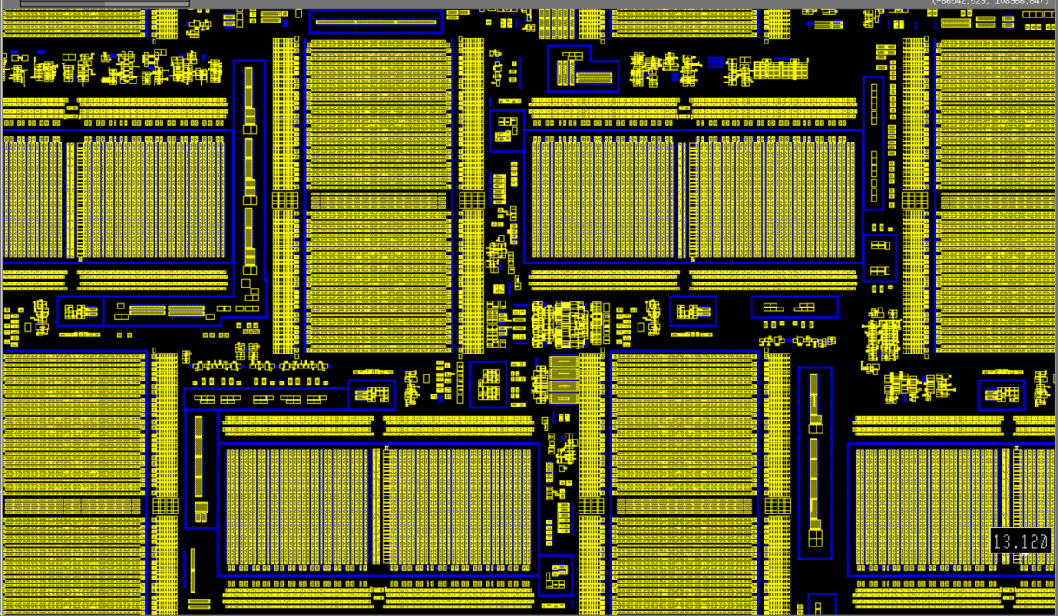

Slide 17
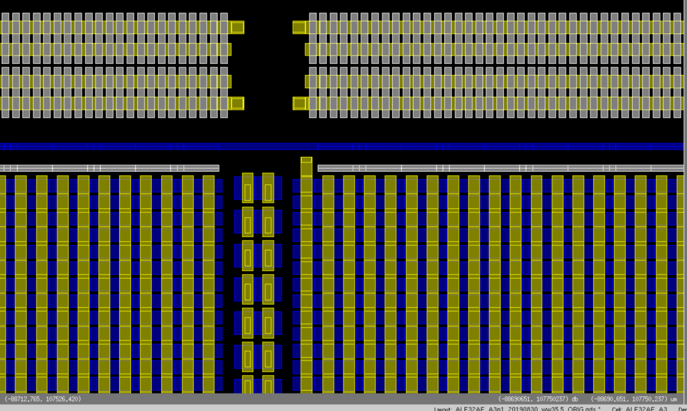

Slide 18
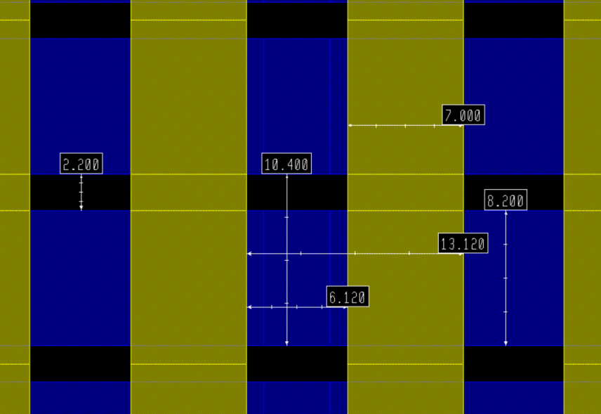
HV transistor layout from ALF32A_A3: L x W = 7000 x 8200 PITCH = 13120 x 10400
350nm x 410nm 656nm x 520nm (~ 7 *90nm * 6 * 90nm)
~ 6*5 or 5*5 finfets

