Slide 1
Transistor Pathfinding for 3DXP Decoder
Team CMOS, WW03.3
3DXP scaling path – ~30% cost reduction every generation (5Q).
Transistor evolution ideas – Starting from planar bulk CMOS
Bulk CMOS geometry augmentation such as Recess Channel and/or Saddle Fin Channel
NSG TCAD assessment on R-FET and SF-FET scaling path
Wideband gap channel enable aggressive channel length scaling
3DIC for die size reduction and parallelism improvement (tile size)
Technologies include Layer Transfer-Si, Poly Si TFT and Adamantine
CR collaboration on LT-Si, Poly-Si TFT and ADM for gap assessment and closure.
Array architect and technologist to complete die size, cost and performance assessment of 3DIC for strategy development
First round of transistor technology benchmark by mid Q1

Slide 2
Si CMOS Geometric Augmentation

Slide 3
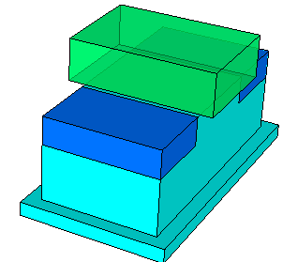
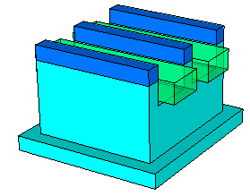
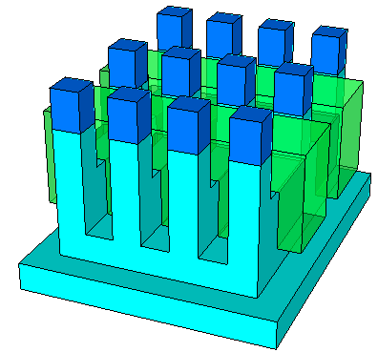
Transistor Active Area Augmentation
P-FET
Planar Channel FET
Z_{Drawn}= 0.41μm
L_{Drawn} = 0.35μm
In 0.5X0.9μm² footprint
R-FET
Recess Channel FET
Z_{Drawn}= 2X 0.41μm
L_{Eff} = 0.35μm
in ~0.5X0.5um² footprint
SF-FET
Saddle-Fin Channel FET
Z_{Eff}= 2X 0.41μm + 2*n*Height_{FIN}
L_{Eff} = 0.35μm
in ~0.5X0.5um² footprint

Slide 4
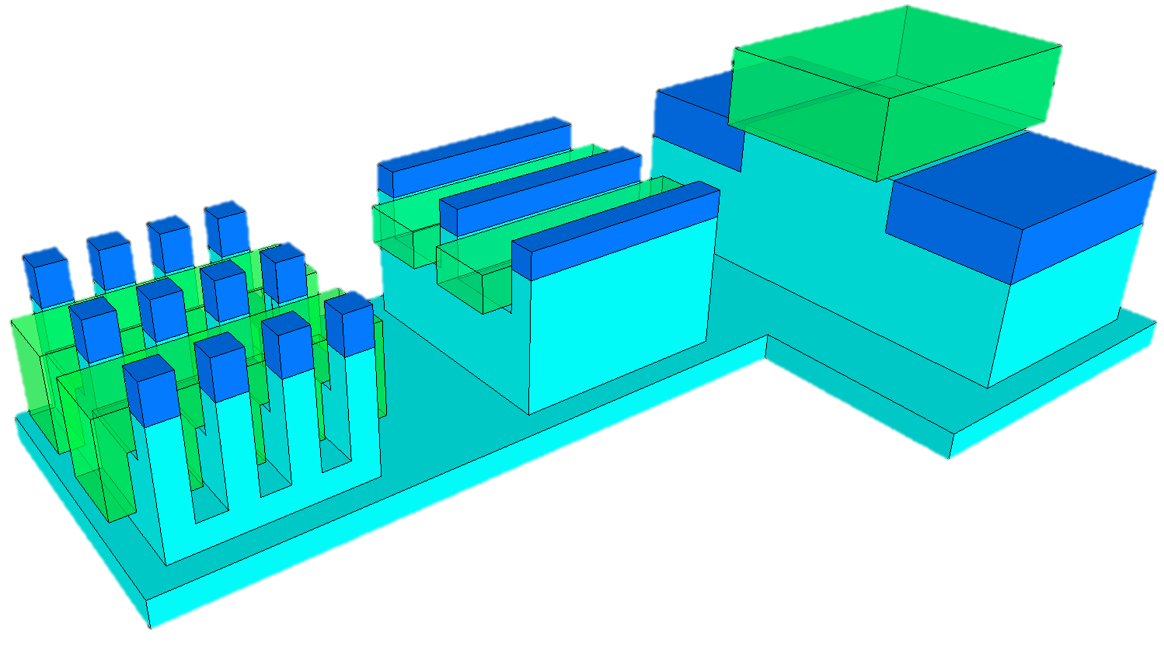
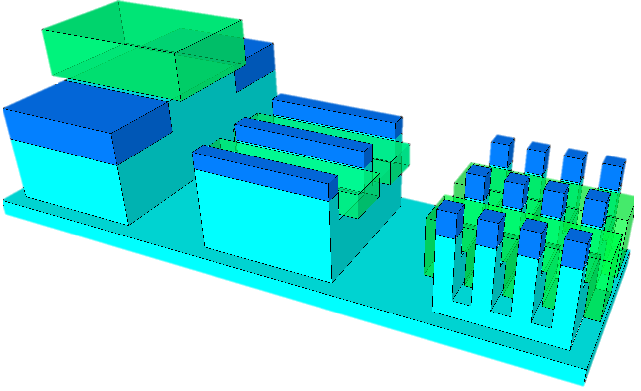
SF-FET
P-FET
R-FET
SF-FET
P-FET
R-FET

Slide 5
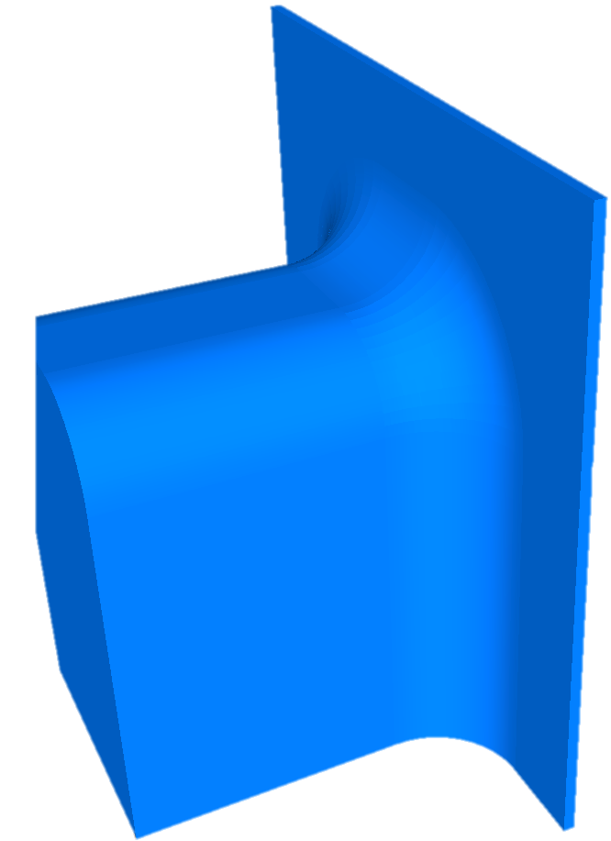
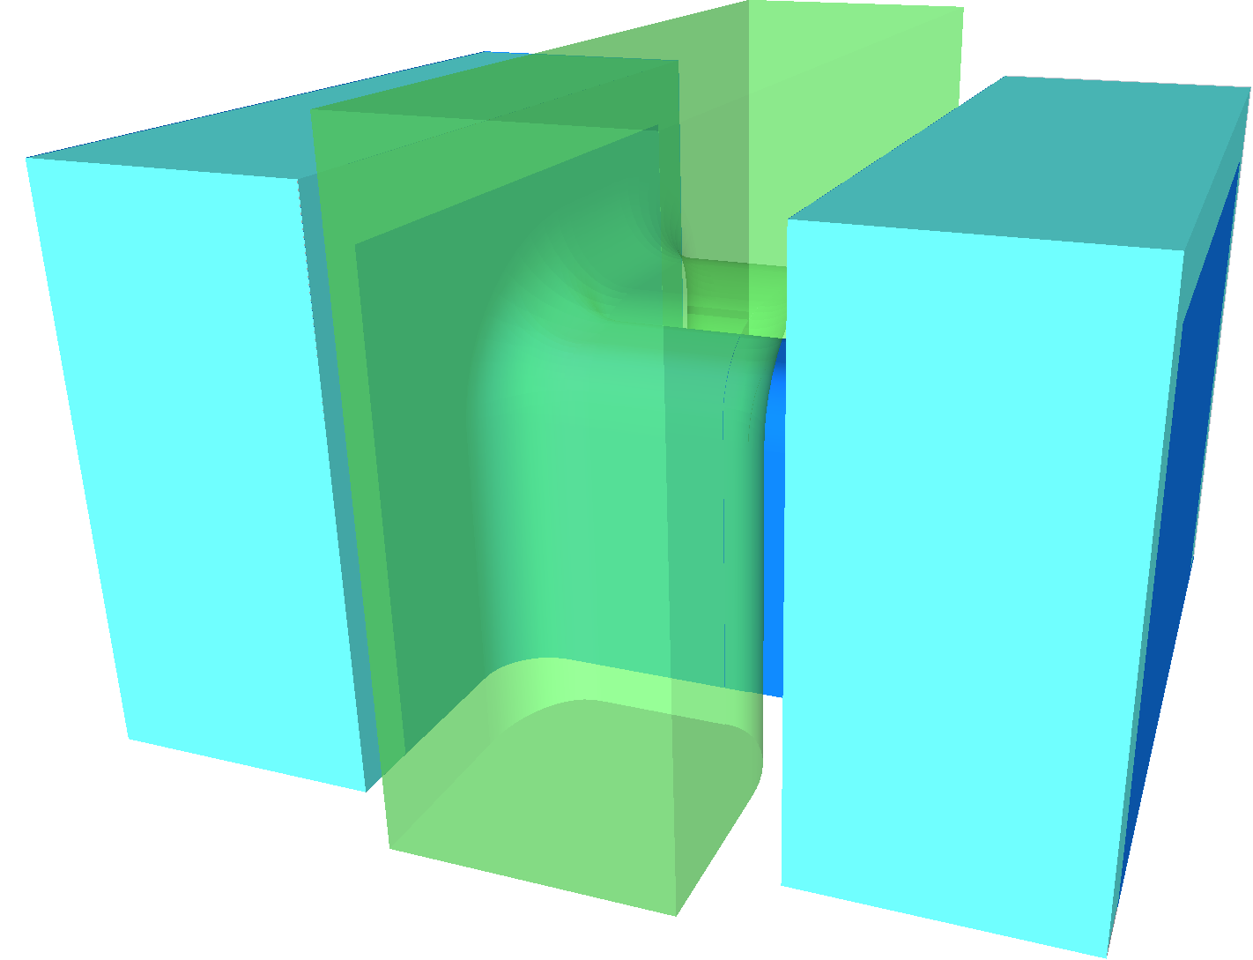
Simplified Lumped Model
SF CAT
Half Channel
Also what was done with Adamantine SF-CAT as an example

Slide 6
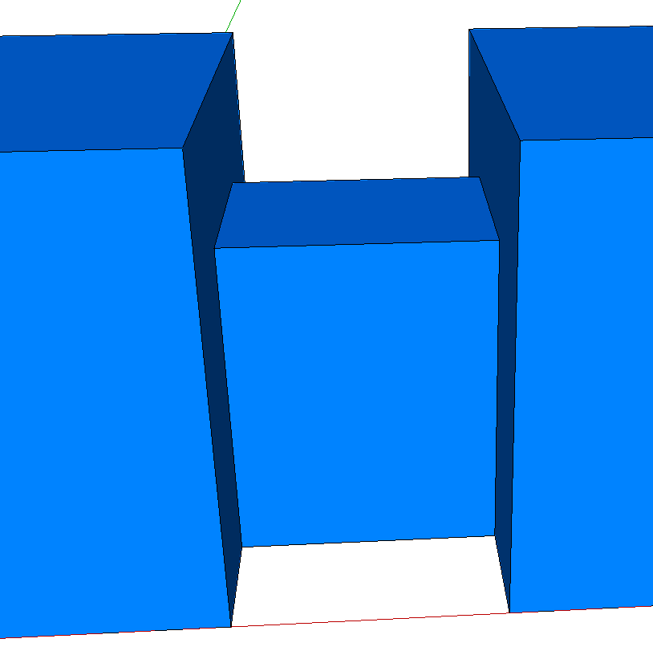
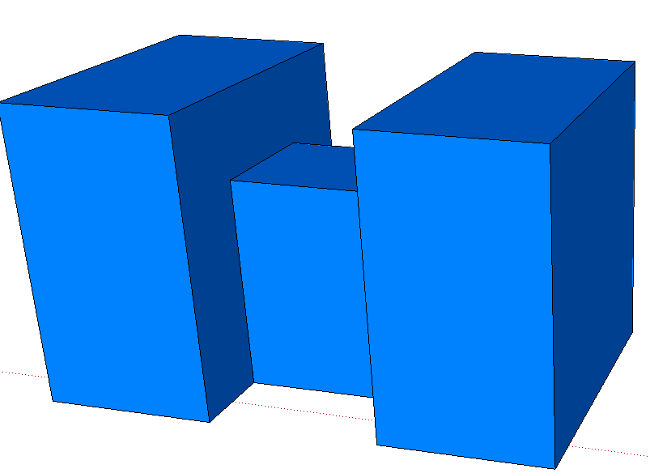
Z, L Design Strategy
Fin height for on-state resistance to optimize t_{sense}
Recess Fin to increase Chanel length to reduce leakage for retention time
S_{Z}
L₁ + 2 · L₂ ≈ L_{min} ;
Z_{2,H} = Z_{1,H} + L₂ ;
Z_{2,W} = Z_{1,W} + 2 · L₂ ;
R_{Ch1}⁻¹ = qµC_{ox}V_{on} · (2 · Z_{2,H} + Z_{2,W} – 4 · L₂) / L₁ ;
R_{Ch2}⁻¹ = qµC_{ox}V_{on} · (2 · Z_{2,H} + Z_{2,w} – 2 · L₂) / L₂ ;
where
V_{on} = V_{P} – V_{T} ;
R_{Ch} = R_{Ch1} + 2· R_{Ch2} ;
Active Design Rule (2 Cells)
Cell Active Pitch = Z_{2W}+ S_{Z} ;
Cell Active Pitch = 3 · L_{SD} + 2 · L₁ + S_{L}
Z_{2,W}
Z_{1,W}
L₁
L₂
Z_{1,H}
Z_{2,H}
L_{SD}
S_{L}
R_{Ch1} = (qµC_{ox}V_{on})⁻¹ · L/W
R_{Ch1}⁻¹ = qµC_{ox}V_{on}· (2·Z_{1,H}+ Z_{1,W})/L_{G1}
R_{Ch2} = (qµC_{ox}V_{on})⁻¹ · L₂/[ ½ ·(Z₁+Z₂)]
R_{Ch2}⁻¹ = qµC_{ox}V_{on}· [Z_{1,H}+ Z_{2,H}+ ½(Z_{1,w}+Z_{2,w})]/L₂

Slide 7
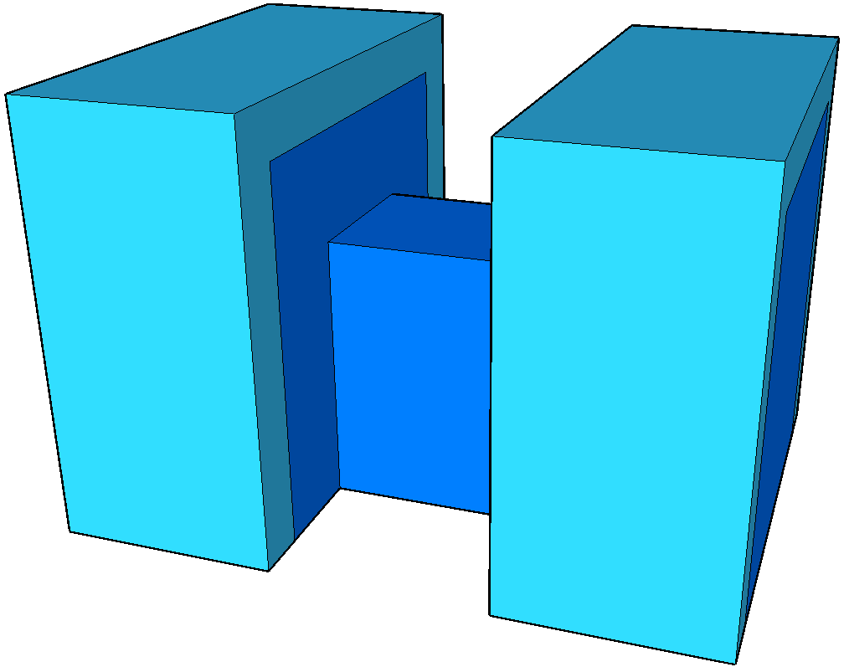
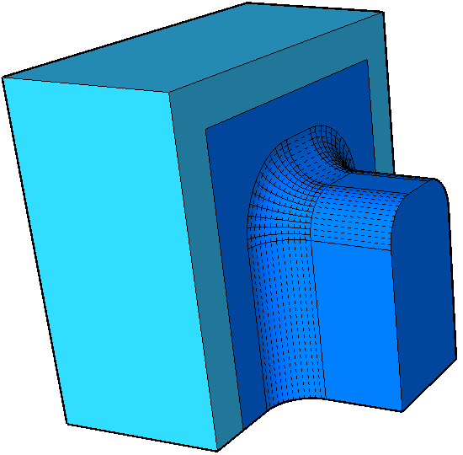
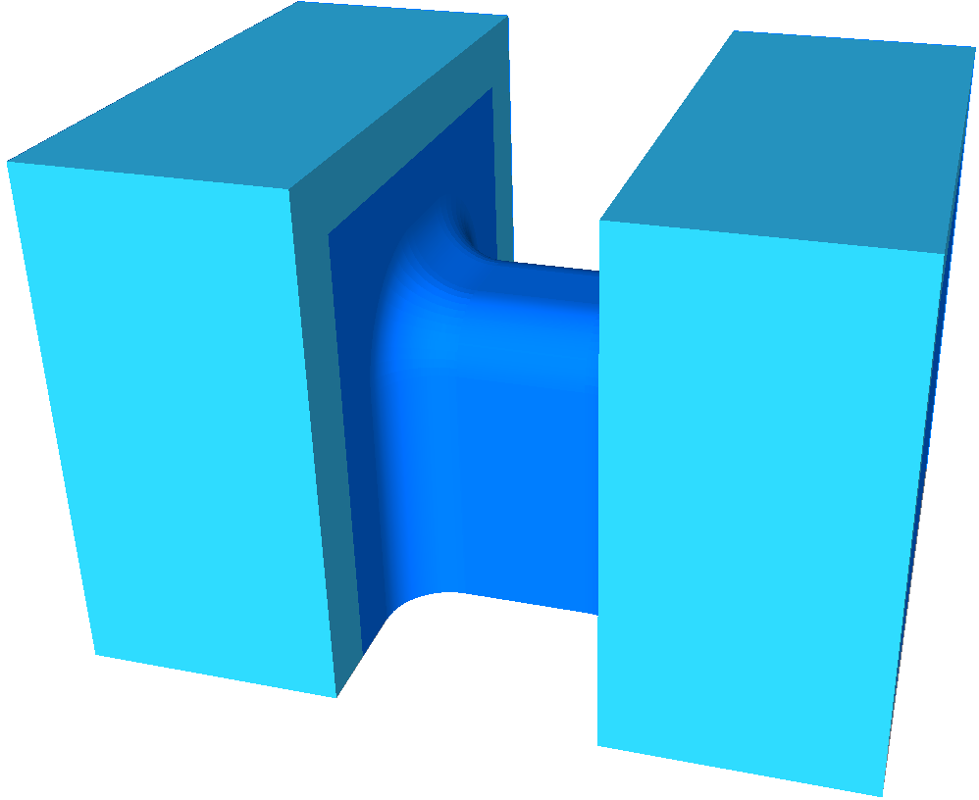
Channel Morphology
Sharp inner corners impede field effectiveness; it degrades I_{off} and R_{on}

Slide 8
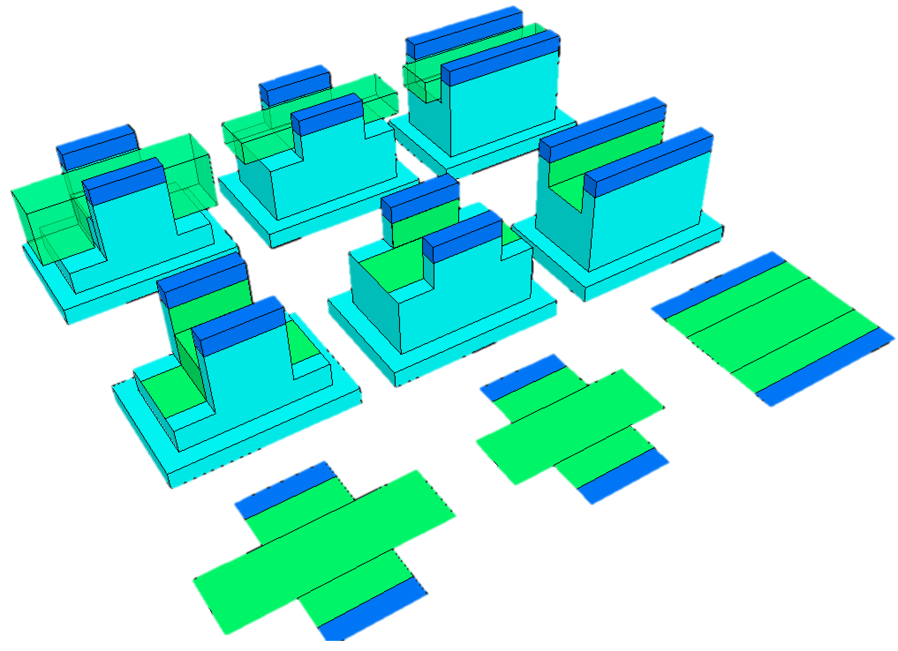
Recess vs. Saddle Fin Channel
L₂
R₁=K·L₁/Z
R₂=K·L₂/Z
R_{H}=K·L₂/(2·H)
L₁
L₂
L₁
Z
x·Z
Z
Z
x·Z
L₂
L₁
H
L₂
L₁
2·L₁+L₂
x·Z
Z
R_{A}
Z
H
L₁
L₁
L₂
R_{B}
x·Z
L₂
R_{A} = 2·R₁ + R₂
= K·(2·L₁+L₂)/Z
Z
Z
R_{C} > 2·R₁/x+(R₂//R_{H})
= 2·R₁/x+R₂·[1–H/(Z+2·H)]
= R_{B}–R₂·[2·H/(Z+2·H)]
= R_{A} + 2·R₁·(1-x)/x
– R₂·[2·H/(Z+2·H)]
L₁
R_{C}
x·Z
L₂
R_{B} > 2·R₁/x + R₂
= K·2·(L₁/x+L₂)/Z
= R_{A} + 2·R₁·(1-x)/x
Where 0 < x < 1
Z+2·H

Slide 9
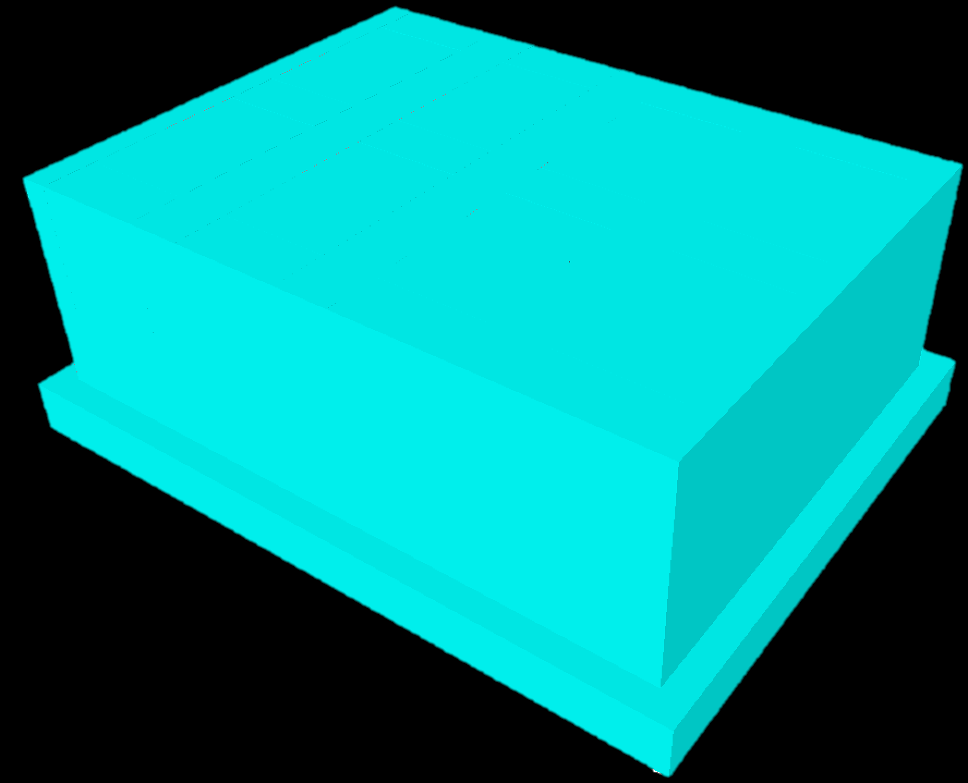
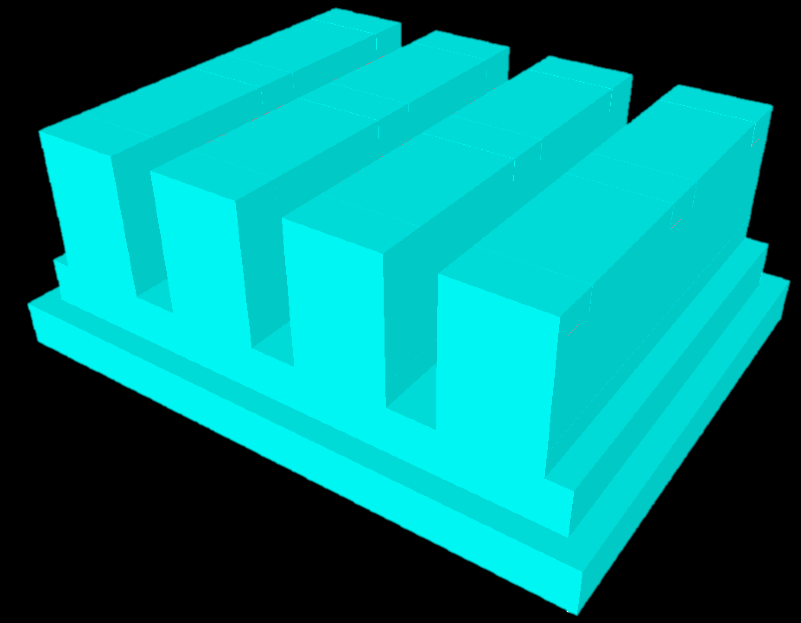
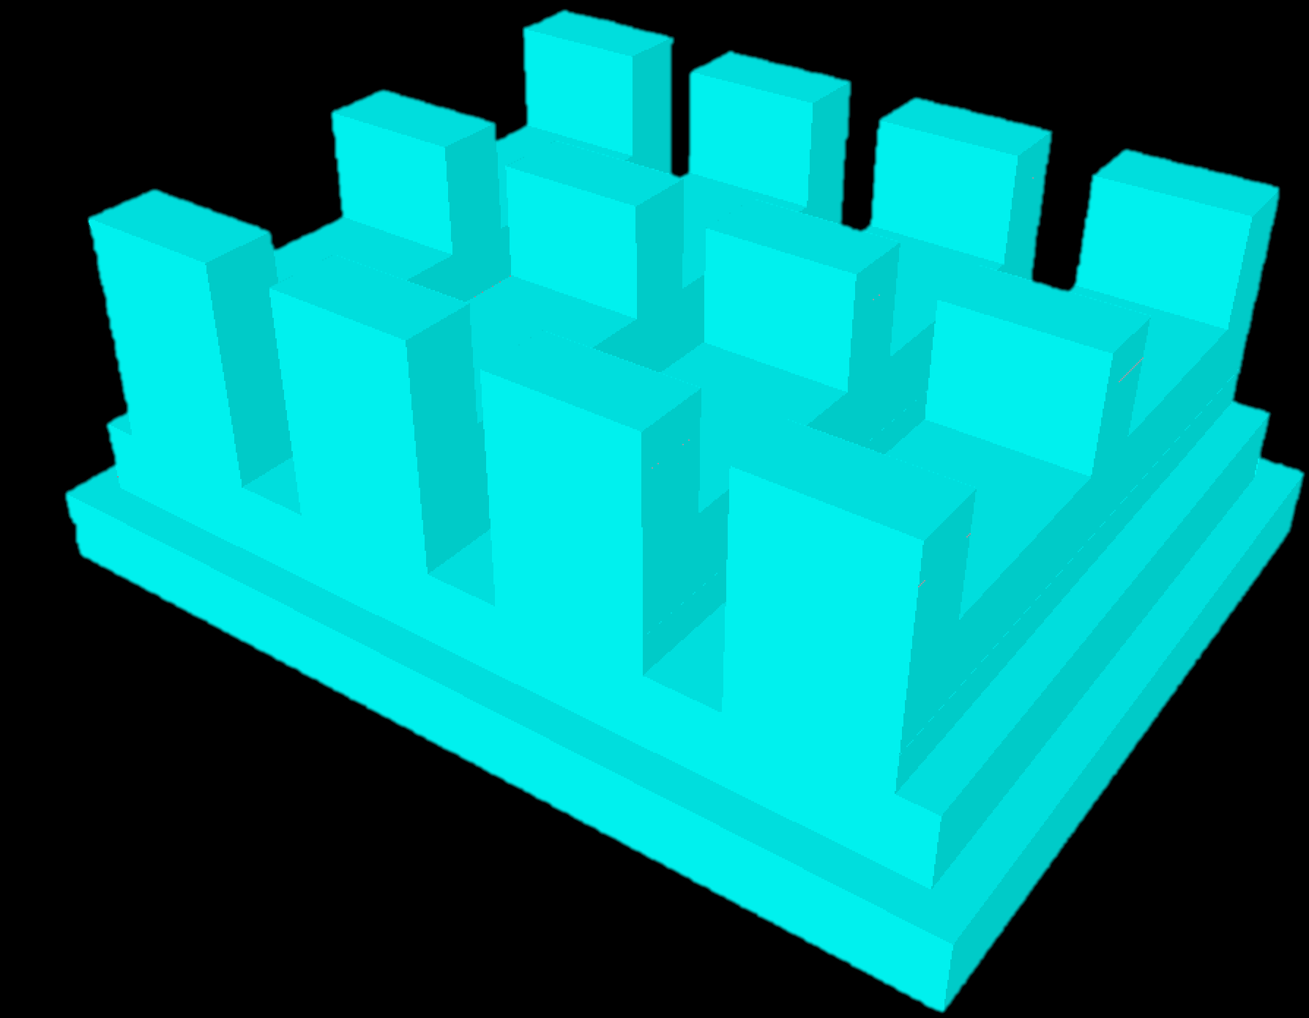
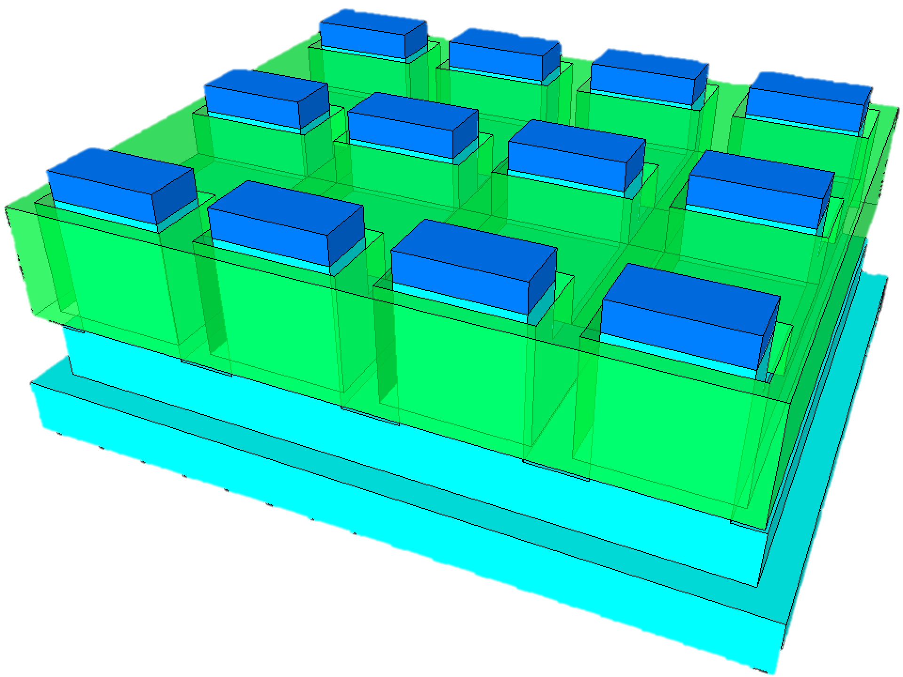
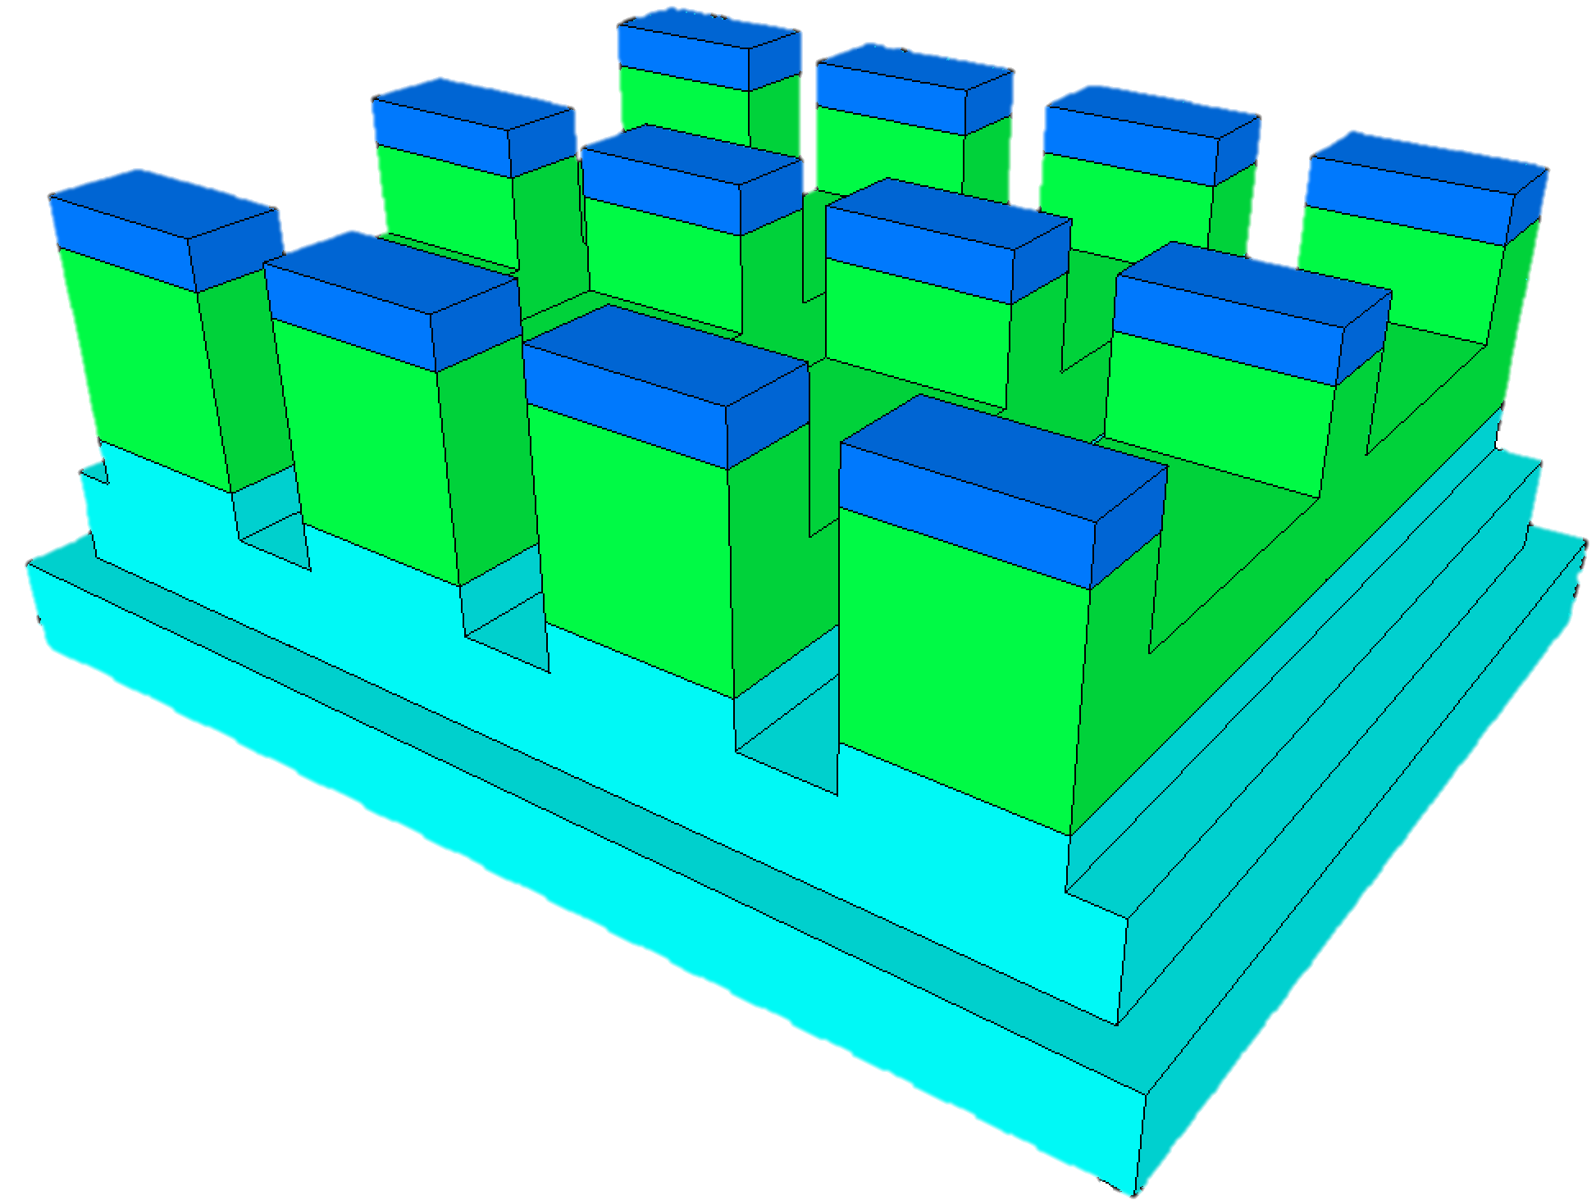
Active Area, Deep Trench
Saddle Gate, Med Trench
Recess Channel, Shallow Trench

