Slide 1
3DXP Decoding Scheme and
4V MOSTs/Switches
Balaji/DerChang
WW44.3

Slide 2
Problem Statement and Solution Space Scope
Decoder Scaling becomes cost inhibitive or performance inhibitive
Solution Spaces
  FinFET/SOI (LVT/HVT on the same substrate)
  Thin Film transistors (3D stacked circuits)
Key questions to guide process direction for 3D stacked circuits–
  Which function block can be replaced by thin film transistor.
  What is connectivity circuits between bulk and thin-film devices.
  Seeking for modularity strategy enabling density and performance scaling roadmap.

Slide 3
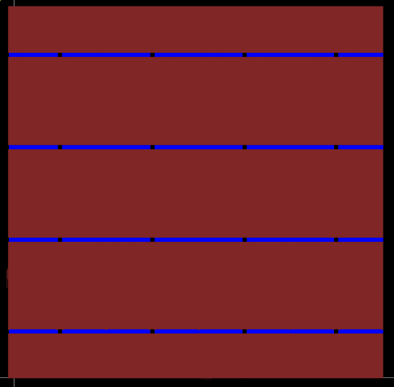
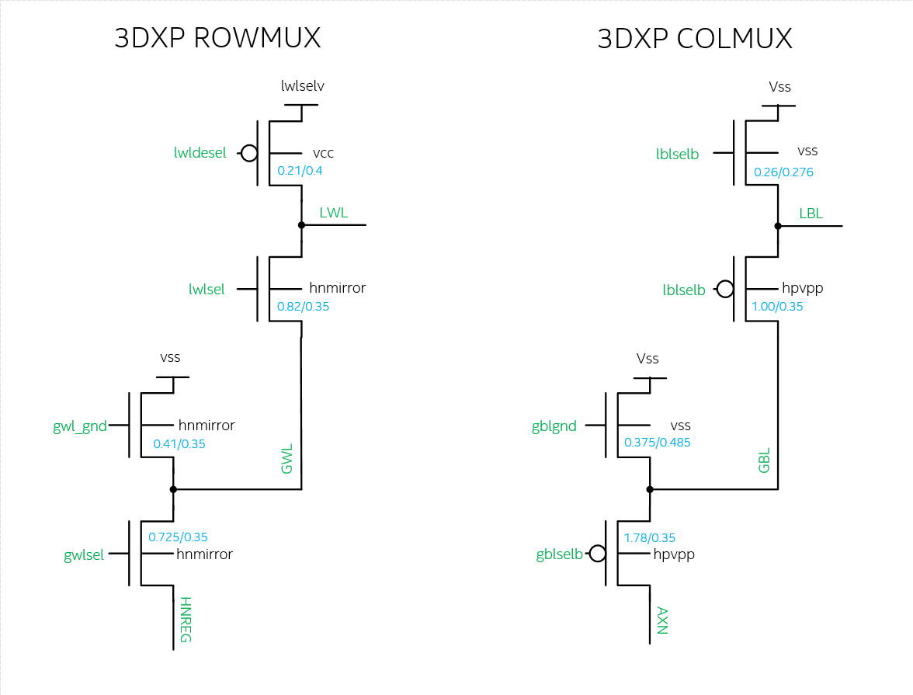
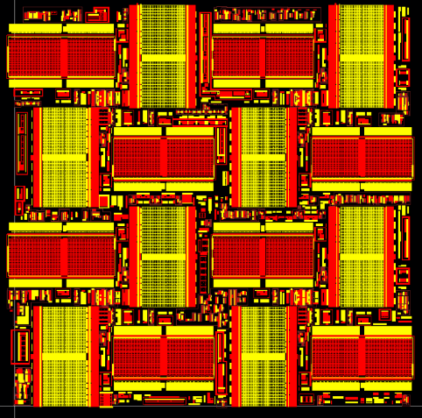
Today’s 3dxp decoder
AM1 & AM23
16k Sel. + 16k Desel. Per tile
4096 tiles/die.
130mm² area for decoders
NDIFF & PDIFF

Slide 4
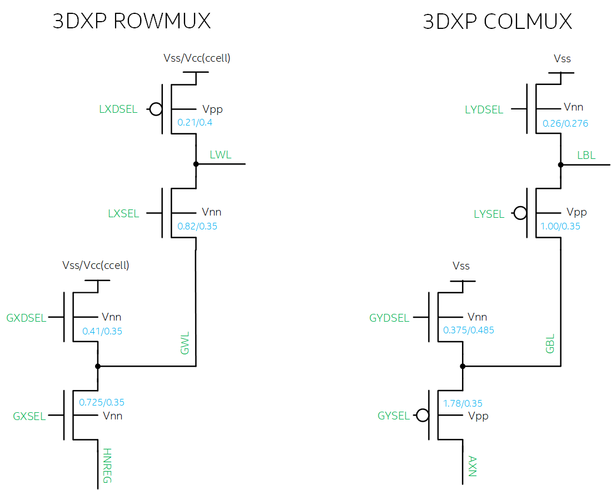

Slide 6

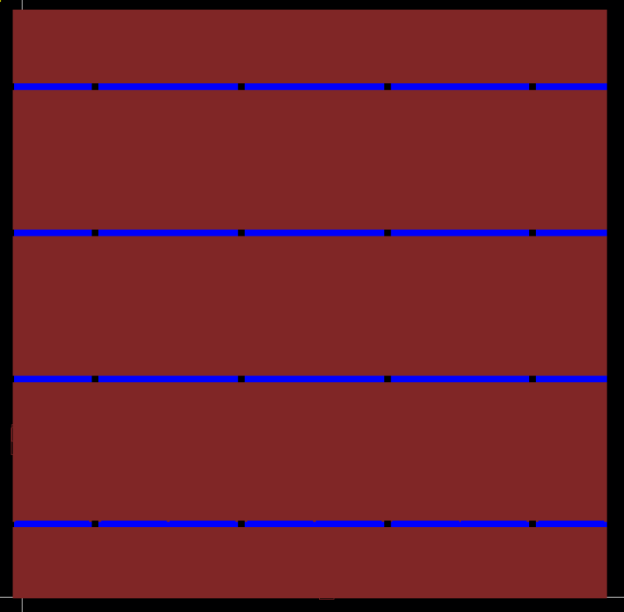
A_TILE
NDIFF & PDIFF
AM1 & AM23

Slide 7
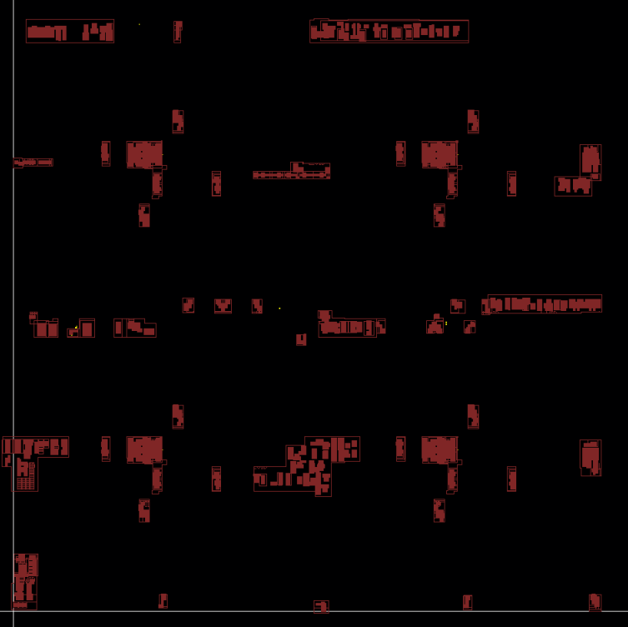
A_TILE
NDIFF & PDIFF
LVID

Slide 9
Modularity
Address Tag
Global MUX
32/Patch
LoZ Paths
Local MUX
1K/Patch LoZ Paths
TM
Array
128/Patch HiZ Paths
M4
Array
Patch footprint is ~[50µm]²
@ 41P node
M3
Command / Data Interface
State Machine
(Instruction)
Analog control
M2
M1
LV / HV MOS
Data Buffer
Read / Write
LVT
Mixed
HVT
TM
TM
Array
Array
Replacement strategy – Which potion of HVT can be replaced by thin film transistor: all, Mux only, or local Mux only
Vertical placement – What is connectivity from circuit in substrate to circuit in thin film: below M1 or below M4 or other multilevel interconnect scheme.
Modularity for scaling such as wafer stacking feasibility
M4
M4
M3
M?
M2
MUX
M1
M?
HVT
M2
LV
M1
LV / HV

Slide 10
Stack transistor Topology
Front Gate
Back Gate
G
S
D
S
D
S
D
S
D
G
Hybrid
S
D
G

Slide 11
Backup Materials

Slide 12
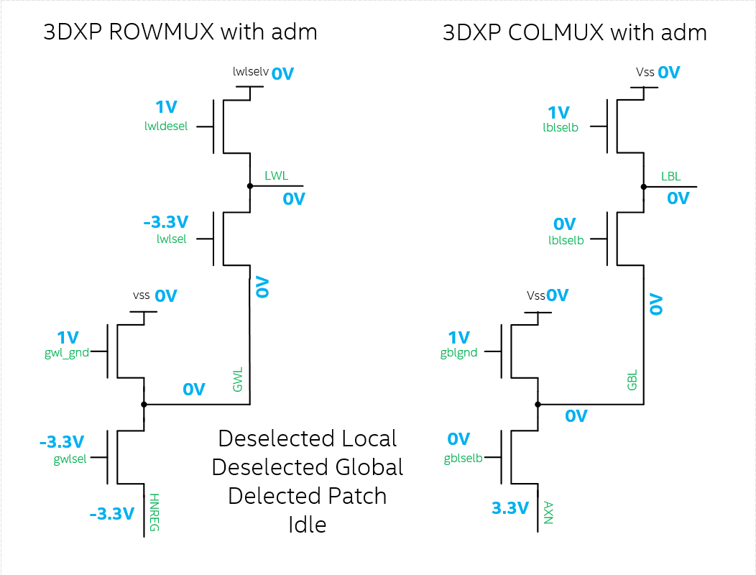
Idle

Slide 13
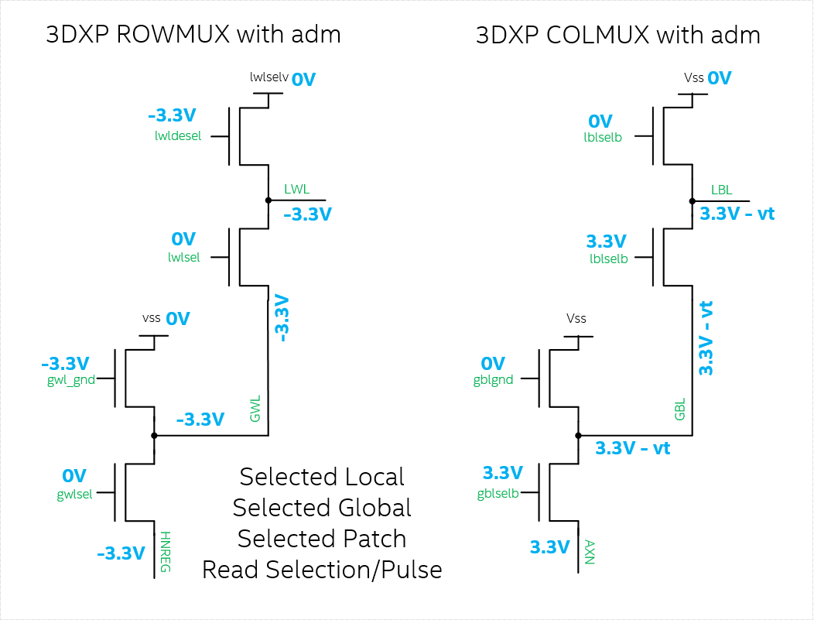
Read Algo SL SG SP
Does this
work?

