Slide 1
3DXP 3DIC Strategy
3DXP Team 3DIC
WW47.3

Slide 2
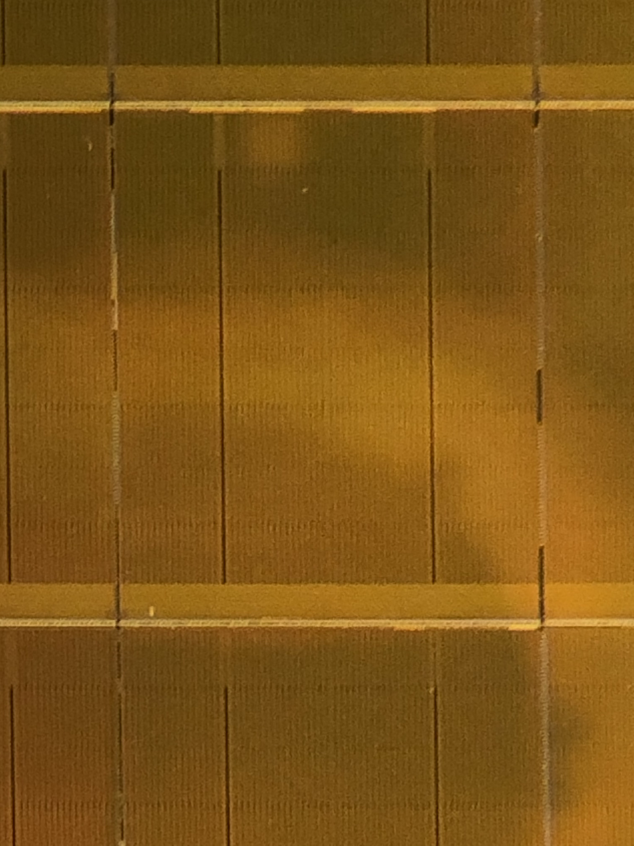
3DXP Component Organization
1/Tile
Array
64Mb/tile
4X4 Patches/Tile
Patch footprint is ~[50µm]²
@ 41P node
Data Buffer
Read / Write
64/Patch
Global MUX
Command /
Data
Interface
Address Tag
Analog / control
32/Patch
64/Patch
Local MUX
State Machine
(Instruction)
1K/Patch
On Pitch Via
HiZ Path
LoZ Path
LVT
Mixed
HVT
Die size = 200mm²
Shaded area is global ~ 17mm²
4KTiles (64K Patches) occupy ~155mm²
Routing takes ~20mm²

Slide 3
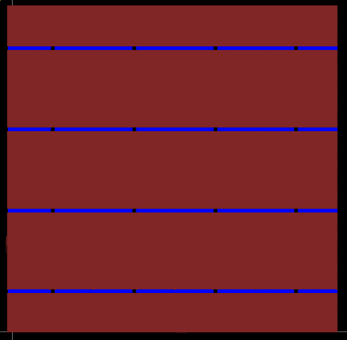
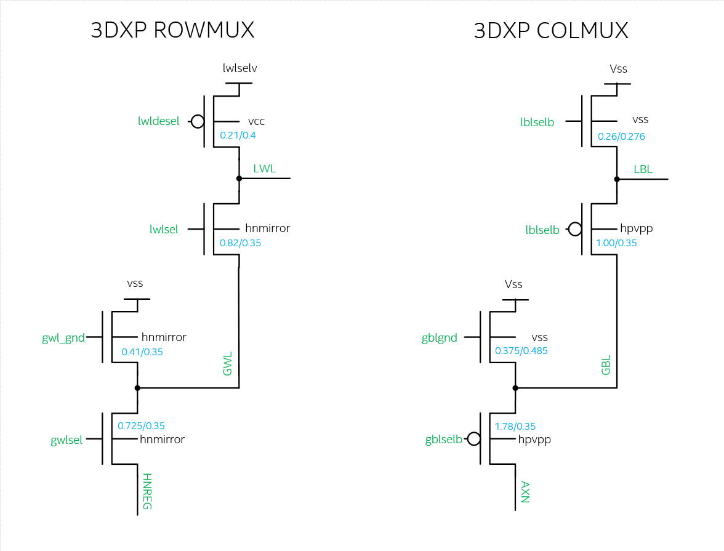
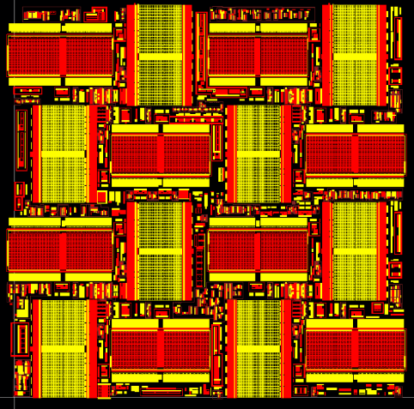
P1240/ALF32 Decoder
One Tile of 3DXP
16k Sel. + 16k Desel. Per tile
4096 tiles/die.
130mm² area for decoders
NDIFF & PDIFF

Slide 4
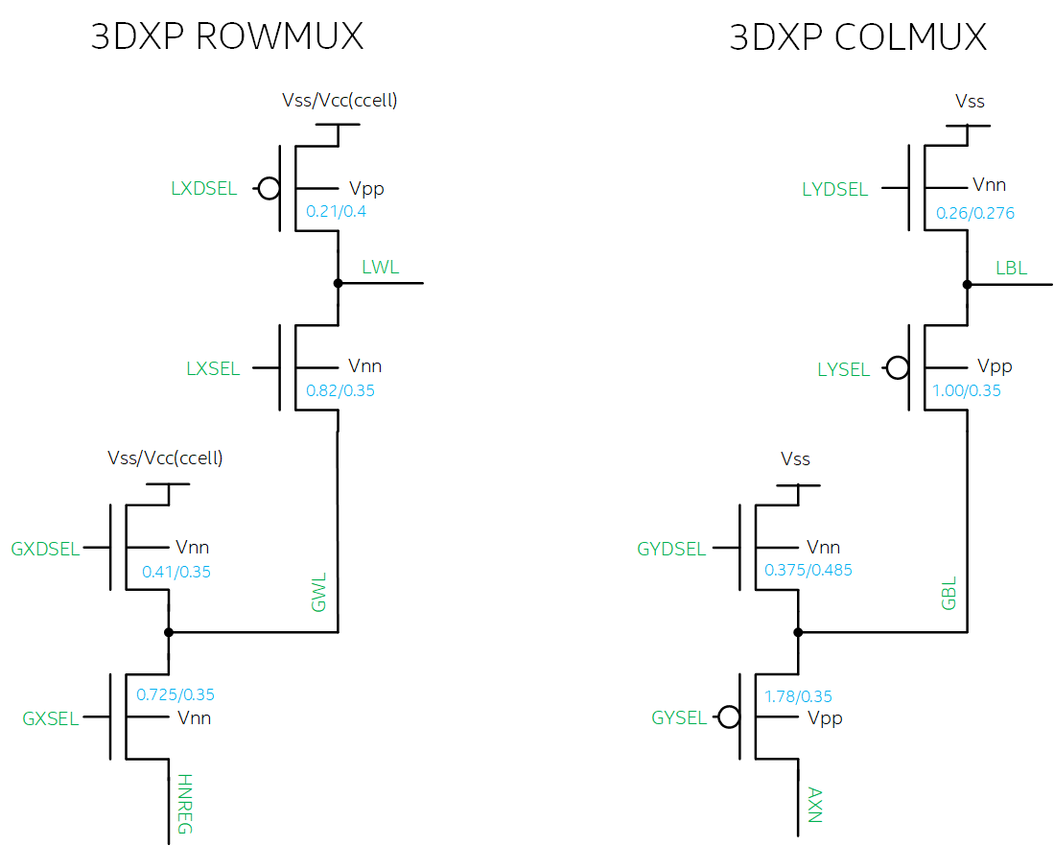

Slide 6
Problem Statement and Solution Space Scope
Decoder Scaling becomes cost inhibitive or performance inhibitive
Solution Spaces
Si Bulk CMOS augmentation – Trench, FinFET, SOI
3D Integrated circuits – monolithic 3D, stacked 3D, wide E_{G} FET
Key questions to guide 3DIC strategy development
Which function block can be replaced by thin film transistor.
What is circuit connectivity between bulk and thin-film devices.
Seeking for modular strategy enabling density and performance scaling roadmap.

Slide 7

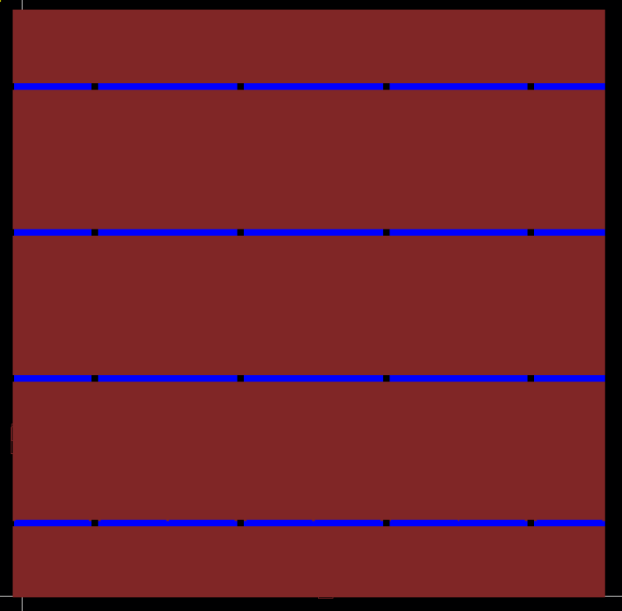
A_TILE
NDIFF & PDIFF
AM1 & AM23

Slide 8
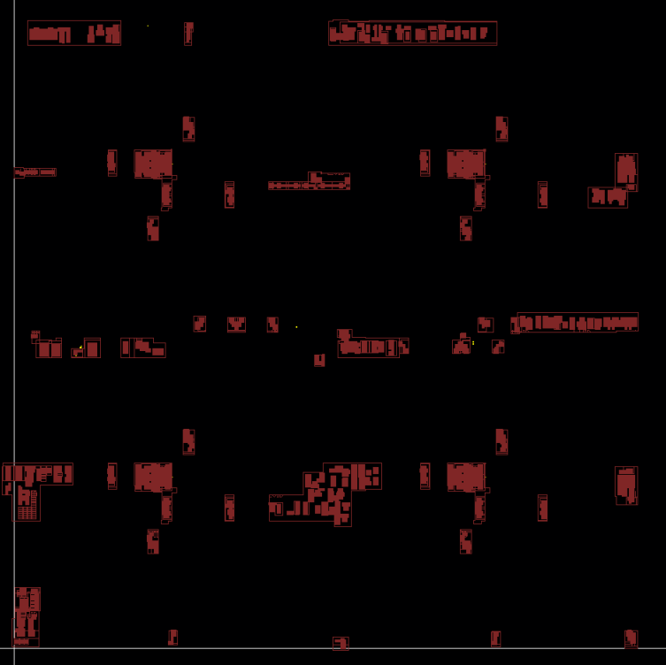
A_TILE
NDIFF & PDIFF
LVID

Slide 9
HVT Success Criteria
The goal is to meet or exceed ALF HVT device target spec
Electrical
NMOS: Idsat ~500uA/um & Ioff ~10pA/um at L=350nm
PMOS: Idsat ~ 300uA/um & Ioff ~ 1nA/um at L=350nm
Reliability (7-year AC lifetime)
TDDB (5.3V stress): <100x increase in gate leakage at 5.57V
BTI (5.3V stress): 10% Idsat degradation at Vd=Vg=5.1V
CHC (WC stress): 10% Idsat degradation at Vd=Vg=5.1V

Slide 11
Modularity
3DIC
Monolithic √
Stacked
Monolithic
Gate oxide division
Function block division
HVT Type √

Slide 12
Modularity for 3DIC
Array
64Mb/tile
4X4 Patches/Tile
Patch footprint is ~[50µm]²
@ 41P node
TM
Data Buffer
Read / Write
1/Tile
Array
64/Patch
Global MUX
M4
Command /
Data
Interface
Address Tag
M3
Analog / control
M2
32/Patch
M1
LV / HV MOS
64/Patch
Local MUX
State Machine
(Instruction)
1K/Patch
On Pitch Via
HiZ Path
LoZ Path
LVT
Mixed
HVT
TM
TM
Array
Array
Replacement strategy – Which potion of HVT can be replaced by thin film transistor: all, Mux only, or local Mux only
Vertical placement – What is connectivity from circuit in substrate to circuit in thin film: below M1 or below M4 or other multilevel interconnect scheme.
Modularity for scaling such as wafer stacking feasibility
M4
M4
M3
M?
M2
MUX
M1
M?
HVT
M2
LV
M1
LV / HV

Slide 13
ATF HIGH LEVEL FLOOR PLAN
Not all of this termination edge fits under the array
PART 31
GBLS DRVR/TERM ANALOG
Tile 127
GWLS DRVR/TERM CAPS
PCL/LBLS & LBLd DRVRS
Tile 0
LWLs/LWLd/PCL CTRL DRVRS
PART 0
PERIPHERY
IO
Tile Circuits: Decoders, VDM source followers, current mirrors, sense amp, mask logic, ..
Partition Circuits: Address drivers, PCL, VDM_DAC, iREF_DAC
PERIPHERY CIRCUITS: PL, Fuses, redundancy matching, HV regulators,..
IO CIRCUITS: PADS, Tx, Rx, DLL,..
Intel Confidential

Slide 14
A_TILE
NDIFF & PDIFF
LVID

Slide 15
BLOCK DIAGRAM
axn
32 Global Selects
1 Global deselect
Global Column mux
32 Local Selects
16 Local deselects
32 GBL’s
IO (PADs, Tx, Rx, DLL,..)
Local Column mux
Address Drivers
(GBL, LBL, GWL, LWL)
BL Tile Circuits
( BL Voltage mux, Mask Logic, Sense Amp)
1024 LBL’s
Periphery Logic
( Command processor, SIPO, PISO,.. )
Partition Control Logic
(Read/Write algo u-controller)
1024 LWL’s
WL Tile Circuits
( WL VDM, Mask Logic, Current Mirrors, Spike mit)
Local Row mux
Partition Analog
( VDM_DAC, iREF_DAC,…)
32 Local Selects
16 Local deselects
HV ( Fuses, redundancy matching, regulators )
32 GWL’s
Global Row mux
32 Global Selects
1 Global deselect
hnreg
IO/Periphery
Partition x32
Tile x128 per partition
Global/Local mux’s x8 per tile
LV + HV
LV + HV
LV + HV
HV

Slide 16
Monolithic thin film transistor topology
Front Gate
Back Gate
G
S
D
S
D
Flip Front Gate
Back Gate II
S
D
G
S
D
Hybrid
S
D
G

Slide 17
Modularity
3DIC
Monolithic √
Stacked
Monolithic
Gate oxide division
Function block division
HVT Type √

Slide 18
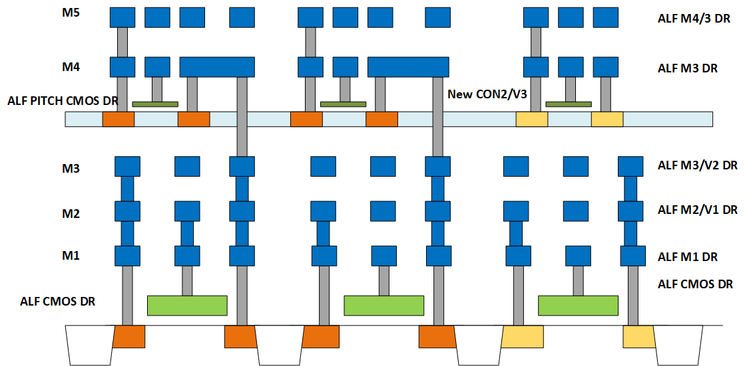
Design Rules for SXP 3DIC
Follow design rules for ALF CMOS for lower and upper deck CMOS.
Upper deck HV only.
Lower Deck HV + LV.
Map metal design rules as shown in the figure.
Introduce new con2/v3 rules
Con2 => same rules as CON, except interacts with upper deck CMOS ONLY. Connects upper decks Diffusion/poly to M4.
Via3 connect M3 directly to M4.
Via3 Size: 2x2, Space 3.0
M3 overlap of V3 1.0.
M4 coverage of V3: 0.50
Via3 Space to upper deck Diff/Poly 2.0.

Slide 19
Backup Materials

Slide 20
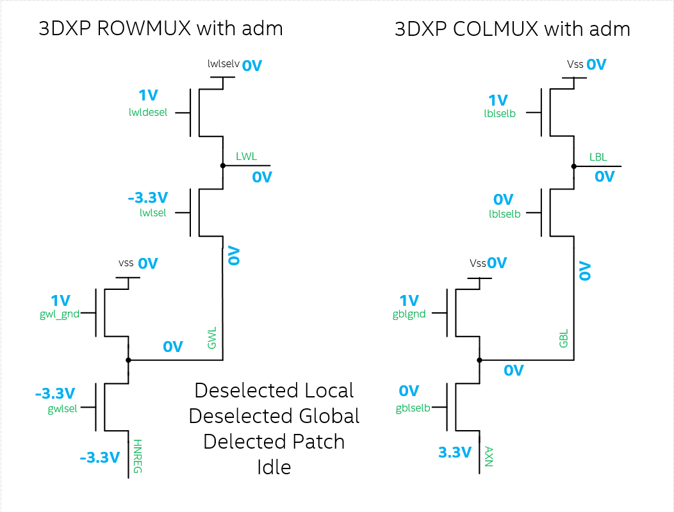
Idle

Slide 21
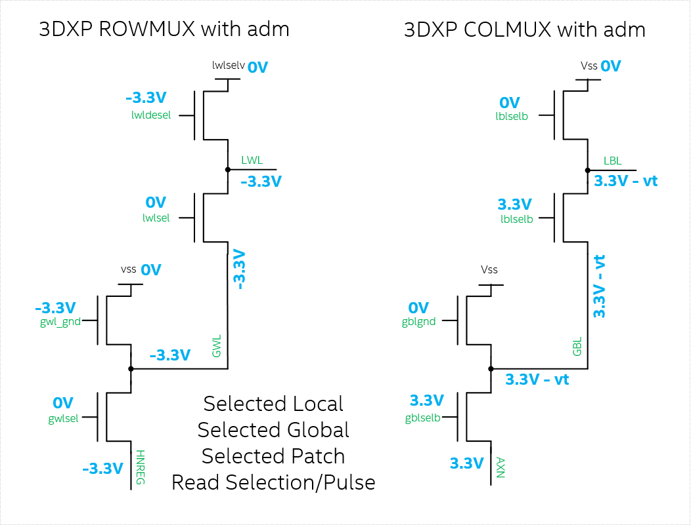
Read Algo SL SG SP
Does this work?

