Slide 1
CXi Initiative Summary
9/22/2021
Rob Munoz on behalf of rest of CXi Team (Jay Desai, Josh Fryman, Dave Kehlet, Tang Lai Guan, Kurt Lender, Ravi Mahajan, Anki Nalamalpu, Peter Onufryk, Gerald Pasdast, Sandeep Sane, Debendra Das Sharma, Tom Stachura, Steve Van Doren, Joe Wu, Swadesh Choudhary, Kemal Aygun, Narasimha Lanka)

Slide 2
7/19/21 TLT Meeting Executive Summary
Chiplets (die interconnected within a package) are used by single vendors today, but no broad scale general purpose chiplet ecosystem exists
HBM is widely deployed, but application specific
A chiplet ecosystem is emerging driven by cloud customers and is key to Intel initiatives
Foundry
Intel products (e.g., Xeon, cloud/edge customers, FPGAs, eASICs, ASICs, and optical transceivers)
Adopted standards and volume attach point are holding back a broad scale chiplet ecosystem
Internal to Intel there are many incompatible chiplet IPs and approaches
Intel is uniquely positioned to drive adoption of broad scale chiplet ecosystem
A number of industry initiatives are underway to jumpstart a chiplet ecosystem and a winner will likely emerge in 12 to 24 months
Objective: Approve the strategy to drive standardization and adoption of a broad scale chipset ecosystem

Slide 3
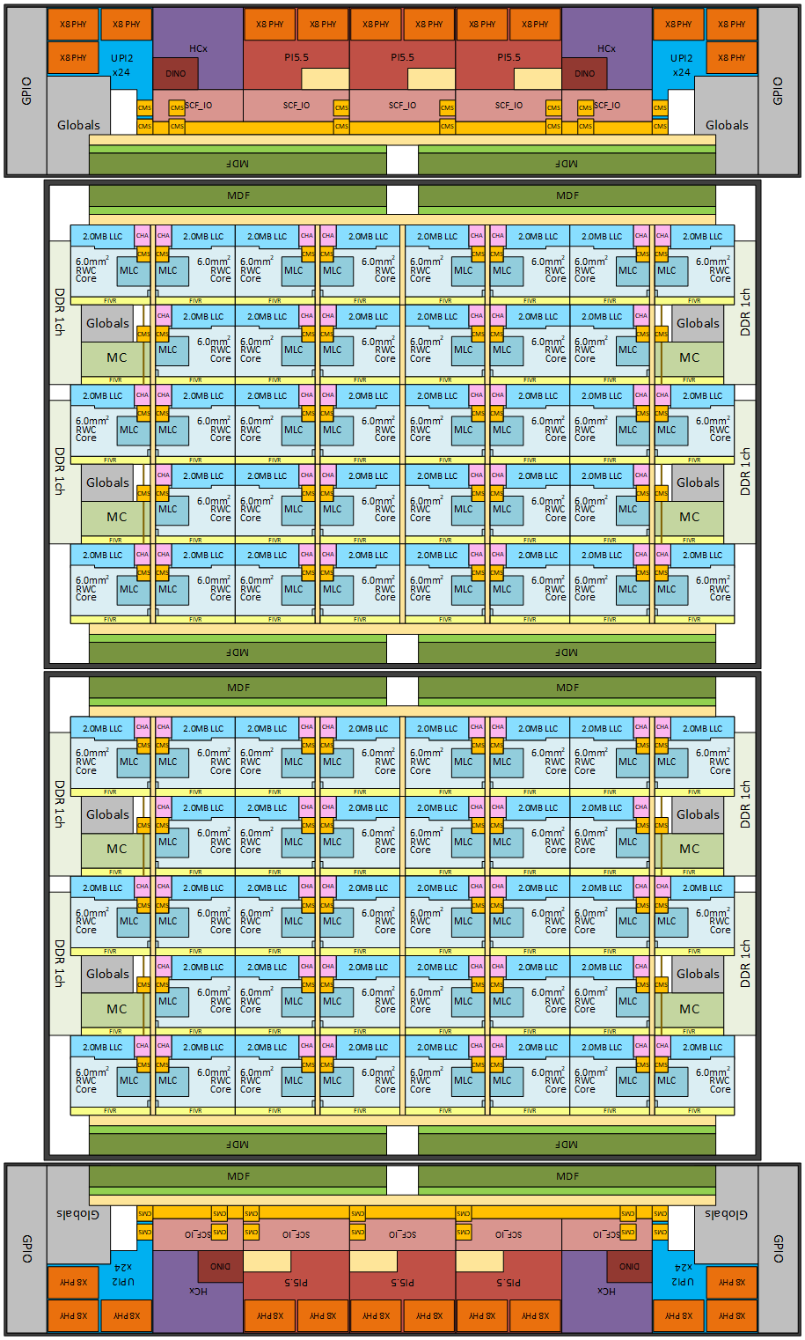
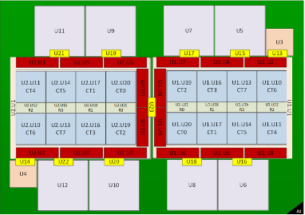
Die-to-Die Use Cases
z
Intel Product Construction
Customer Specific Products
PVC
GNR
Smart NICs for CSPs
(Details Redacted)
Xeon + Chiplets
(e.g., RAN and Cloud)
SoC + Optics
(Details Redacted)
Enables construction of SoCs that exceed maximum reticle size
Reduces time-to-solution (e.g., enables die reuse)
Lowers portfolio cost (both product and project costs)
Enables die to use optimal process technologies
Smaller die (better yield)
Lowers product SKU cost, IP porting costs, etc.
Scales innovation (manufacturing & process-locked IPs)
Enables customers to customize a base product for a specific use
Core technology for Intel foundry
Requires widely adopted, open, and broad general-purpose chiplet ecosystem
The focus of this activity is on how to create a broad scale general-purpose chiplet ecosystem
Intel Top Secret

Slide 4
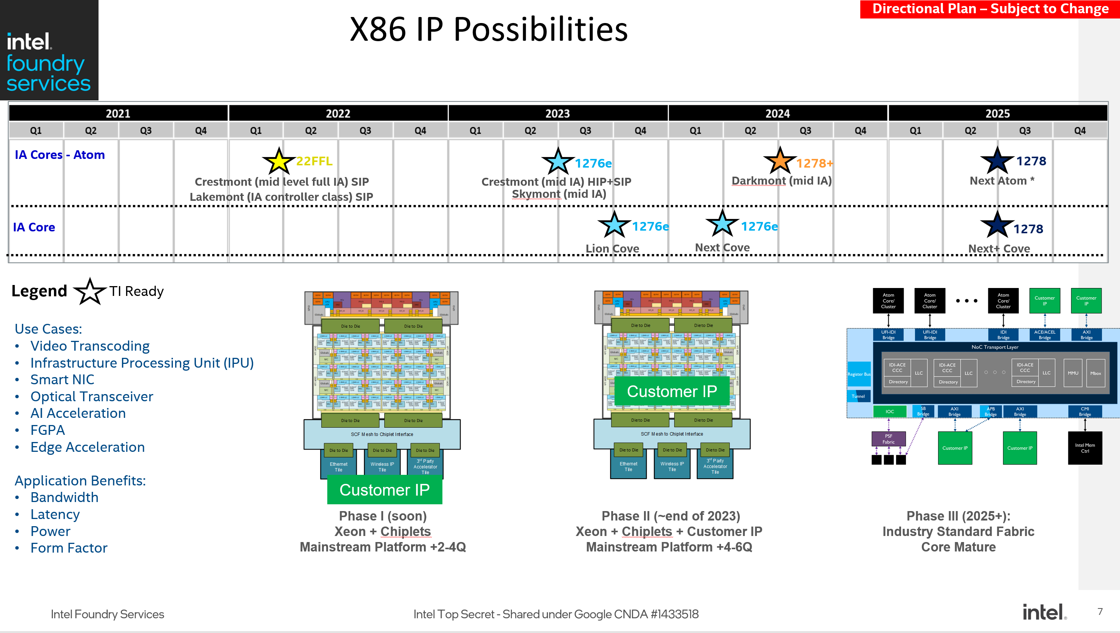
Chiplets and Intel Foundry Services*
* Slide used with permission from IFS (Bob Brennan)
Intel Top Secret

Slide 5
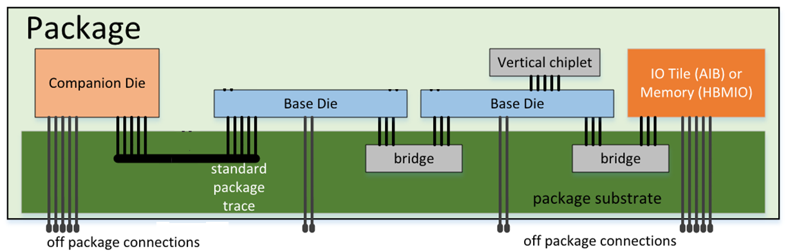
Die to Die Approaches
Packaging Technology
I/O Technology
Package Traces / 2D
Example: Stripline
3D Stacking
Example: Foveros
Many Wires (Parallel)
& Simple I/O
Few Wires (Serial)
& Complex I/O
Advantage
Low latency & power
Simple design
Scales well with future bump pitch
Disadvantage
Die placement constraints
Examples
Intel AIB
Intel MDFI
Advantage
Flexible die placement
Low die shoreline (organic)
Existing standards and IP (OIF)
Disadvantage
High latency
High power
Examples
OIF Very Short Reach (VSR)
OIF Ultra Short Reach (USR)
OIF Extra Short Reach (XSR)
Bridge / 2.xD
Example: EMIB
The initial scope of this activity is on 2D and 2.xD using a many wires & simple I/O approach

Slide 6
Components of Chiplet Interoperability
Chiplet Form Factor
Die size
Bump location
Power delivery
Thermal characteristics
SoC Construction (OSI: Application Layer)
SoC Reset
Initialization (e.g., fuses)
Register access
Security
Die-to-Die Protocols (OSI: Data Link to Presentation Layer)
Link Layer, transaction Layer, etc.
Die-to-Die I/O (OSI: Physical Layer)
Bump arrangement and characteristics
Electrical & thermal characteristics
Substrate or interposer characteristics
Length budget, pJ/bit, bit error rate, …
Reset, clocking, initialization, and data transfer
Test and repair
We need more than a compelling die-to-die I/O for a chiplet ecosystem

Slide 7
Die-to-Die I/O Standards Landscape
 | AIB (Advanced Interface Bus) | BoW (Bunch of Wires) | OpenHBI
Organization | CHIPS Alliance Linux Foundation | Open Domain-Specific Architecture (ODSA) Open Compute Project
Objective | Die-to-Die I/O | Die-to-Die I/O | Die-to-Die I/O Leverage JEDEC HBM Specification
Status | Multiple Published Versions (1.0 & 2.0, draft 2.1) | Work in Progress | Work in Progress
Ecosystem Adoption | ~10 Chiplets with FPGA Powering Up | None | None
Primary Promoter(s) | Intel & US Government | Marvel and Broadcom | Xilinx
Observers | Facebook, Google, Microsoft, AMD
IP Availability | Synopsys, CEVA, Blue Cheetah
Other standardization activities: ODSA Chiplet Marketplace, OpenChiplet specification (Google)

Slide 8
Ingredients for Broad Chiplet Industry Adoption
Broad Market Manufacturing, Packaging and Test
Intel has the pieces necessary to drive a broad scale chiplet ecosystem
Packaging Leadership
Manufacturing and Test with Foundry
Volume Products with Chiplet Attach Points
World class IP
Ability to Drive Industry Standards
Business model
Chiplets &
Chiplet Based
Product Attach
Points
Die-to-Die
Standards
Die-to-Die
IPs

Slide 9
Die-to-Die Strategy Proposal
Create a new die-to-die I/O standard (CXi) that merges the best characteristics of AIB and internal die-to-die approaches
AIB-O (organic), AIB 1.0 and AIB 2.0 continue while preserving interoperability
New die-to-die I/O standard optimized for future KPIs
We need to build a “combo” die-to-die I/O IP that is compatible with new standard and backward compatible with AIB-O, AIB 1.0, and AIB-2.0
The intent is to converge future AIB applications to new die-to-die I/O standard
Standardize die-to-die protocols (initially CXL/PCIe)
Create a die-to-die consortium to drive the above and continue die-to-die standardization
Adopt new die-to-die standard in Intel products as the sole interface for customer visible chiplet attach (e.g., FPGA, optical, and Xeon)
Adopt as the sole die-to-die interface for all customer visible in-package attach

Slide 10
CXi Standardization
Initial Focus
Physical Layer: Die-to-Die I/O with industry leading KPIs
Protocol: CXL/PCIe for near term volume attach
SoC construction issues are addressed since CXL/PCIe is a board-to-board interface
CXL/PCIe addresses common use cases
I/O attach with PCIe/CXL.io
Memory use cases are supported with CXL.mem
Accelerator use cases are supported with CXL.cache
Future
Other protocols
SoC construction (part of other specs)
Chiplet form factor
Chiplet management

Slide 11
CXi Die-to-Die I/O Characteristics
Column1 | Lowest Cost (Organic) D2D I/O | Best KPIs (Advanced Packaging) D2D I/O
Bump Pitch | 100um to 130um | 25um to 55um
Data Rate (Gbps) | 4/8/16/32 | 4/8/12/16/32
BW/shoreline TX + RX (GB/s/mm) | 30.9/61.7/123.4/246.8 | 164/328/492/656/920
BW bump are TX + RX (GB/s/mm^2)* | 22/44/88/125 | 188/375/562/675/940
Energy Efficiency (pJ/b) * | 0.5 (4 GT/s, short reach) 1.0 (≤ 16 GT/s, long reach) 1.25 (32 GT/s, long reach) | 0.5 (≤ 12 GT/s) 0.6 (≥ 16 GT/s)
Raw BER | 1e-27 (≤ 8 GT/s) 1e-15 (> 8 GT/s) | 1e-27 (≤ 12 GT/s) 1e-15 (≥ 16 GT/s)
Latency end-to-end TX + RX (# clocks at GT/s ) * | 12 data rate clocks (1.5ns at 8 GT/s)
Idle entry/exit latency* | 1 cycle (≤ 12 GT/s) 2 cycles (≥ 16 GT/s)
Channel reach | 10mm (short reach) 25mm (long reach) | 2mm
* Representative parameters based on “good” implementation and not specification

Slide 12
Positioning of CXi
Organic
CXi Organic
Advanced Packaging
CXi Advanced Packaging

Slide 13
Possible IP Mapping
Specification
 | D2D I/O Specification
Column1 | Lowest Cost Organic | Best KPIs Advanced Packaging
Bump Pitch | 90um to 130um | 25um to 55um
Data Rate (Gbps) | 4/8/16/32 | 4/8/12/16/32
BW/shoreline (GB/s/mm) | 30.9/61.7/123.4/246.8 | 164/328/492/656/920
BW bump are (GB/s/mm^2) | 22/44/88/125 | 188/375/562/675/940
Energy Efficiency (pJ/b) | 0.5 (4 GT/s, short reach) 1.0 (≤ 16 GT/s, long reach) 1.25 (32 GT/s, long reach) | 0.5 (≤ 12 GT/s) 0.6 (≥ 16 GT/s)
Raw BER | 1e-27 (≤ 8 GT/s) 1e-27 (16 GT/s, short reach) 1e-15 (16 GT/s, long reach) 1e-15 (≥ 32 GT/s) | 1e-27 (≤ 12 GT/s) 1e-15 (≥ 16 GT/s)
Latency end-to-end (# clocks at GT/s ) | 12 data rate clocks (1.5ns at 8 GT/s)
Idle entry/exit latency | 1 cycle (≤ 12 GT/s) 2 cycles (≥ 16 GT/s)
Channel reach | 10mm (short reach) 25mm (long reach) | 2mm
Die-to-Die specification results in multiple potential IP implementations that interoperate
Hard vs Soft IP
Hard IPs for highest KPIs
Soft IPs for simple process porting
Advanced Packaging vs Organic
Organic optimized
Advanced packaging optimized
General purpose organic and advanced packaging support
New D2D optimized vs AIB/AIB-o backward compatibility
IP #1
IP #2
 | General Purpose D2D I/O IP
Column1 | Organic | Advanced Packaging
Bump Pitch | 110um | 45um
Data Rate (Gbps) | 4/8/16/32 | 4/8/12/16/32
BW/shoreline (GB/s/mm) | 30.9/61.7/123.4/246.8 | 164/328/492/656/920
BW bump are (GB/s/mm^2) | 22/44/88/125 | 188/375/562/675/940
Energy Efficiency (pJ/b) | 0.5 (4 GT/s, short reach) 1.0 (≤ 16 GT/s, long reach) 1.25 (32GT/s, long reach) | 0.5 (≤ 12 GT/s) 0.6 (≥ 16 GT/s)
Raw BER | 1e-27 (≤ 8 GT/s) 1e-27 (16 GT/s, short reach) 1e-15 (16 GT/s, long reach) 1e-15 (≥ 32 GT/s) | 1e-27 (≤ 12 GT/s) 1e-15 (≥ 16 GT/s)
Latency end-to-end (# clocks at GT/s ) | 12 data rate clocks (1.5ns at 8 GT/s)
Idle entry/exit latency | 1 cycle (≤ 12 GT/s) 2 cycles (≥ 16 GT/s)
Channel reach | 10mm (short reach) 25mm (long reach) | 2mm
Cost Optimized D2D I/O IP
Column1 | Lowest Cost
Bump Pitch | 110um
Data Rate (Gbps) | 4/8/16/32
BW/shoreline (GB/s/mm) | 30.9/61.7/123.4/246.8
BW bump are (GB/s/mm^2) | 22/44/88/125
Energy Efficiency (pJ/b) | 0.5 (4 GT/s, short reach) 1.0 (≤ 16 GT/s, long reach) 1.25 (32GT/s, long reach)
Raw BER | 1e-27 (≤ 8 GT/s) 1e-27 (16 GT/s, short reach) 1e-15 (16 GT/s, long reach) 1e-15 (≥ 32 GT/s)
Latency end-to-end (# clocks at GT/s ) | 12 data rate clocks (1.5ns at 8 GT/s)
Idle entry/exit latency | 1 cycle (≤ 12 GT/s) 2 cycles (≥ 16 GT/s)
Channel reach | 10mm (short reach) 25mm (long reach)

Slide 14
Possible Future Standardization
Chiplet Form Factor(s)
Die size and bump definition
Power, clocking, reset
Thermal and power management
Management
Interface and protocol (e.g., I3C and MCTP)
“Plug and Play” chiplet discovery and provisioning
Operational and environmental telemetry
Debug
Security (other than that provided by die-to-die protocol)
Attestation
Key management
Other protocols
System buses
Coherency extensions
Ethernet (xMII)
Video (HDMI, DP, MIPI)
Optical (OIF-CEI)
Telcom (OpenRAN)
Memory (SRAM, FLASH, MRAM, ReRAM)

Slide 15
CXi Standards Timeline
 | June |  |  |  | July |  |  |  | August |  |  |  |  | September |  |  |  | October |  |  |  | November |  |  |  |  | December
 | 23 | 24 | 25 | 26 | 27 | 28 | 29 | 30 | 31 | 32 | 33 | 34 | 35 | 36 | 37 | 38 | 39 | 40 | 41 | 42 | 43 | 44 | 45 | 46 | 47 | 48 | 49 | 50 | 51 | 52
D2D TLT Kickoff
D2D I/O High-Level Proposal
D2D I/O Specification |  |  |  |  |  |  |  | 0.3 |  |  | 0.5 |  |  |  | 0.7 |  |  |  |  |  |  |  |  | 1.0
D2D CXL/PCIe Protocol Mapping |  |  |  |  |  |  |  |  |  |  |  | 0.3 |  | 0.5 |  |  | 0.7 |  |  |  |  |  |  | 1.0
Partner* D2D I/O Spec Review
Partner D2D CXL/PCIe Protocol Mapping Review
D2D Consortium Kick Off
Industry Consortium Kick Off
Proposed promoter list ~WW36 (e.g., Intel + two cloud + one semiconductor + one fab + one OSAT )

Slide 16
Summary
Chiplets are not new, but customer pull and industry activities will likely lead to a broad scale chiplet ecosystem in the next 12 to 24 months
Intel is uniquely position to drive a chiplet ecosystem
7/19/21 TLT Asks (approved at meeting with details to be worked offline)
Adopt a single Intel die-to-die interface standard for all Intel customer visible in package applications
Internal name for new interface: Chiplet Express Interconnect (CXi)
We will need to provide a clear public continuity path between AIB and CXi
Approve creation of a die-to-die consortium to drive chiplet standards and ecosystem
Need to align on proposed cooperation model with OCP
Prioritize investment to support adoption across Intel products in a timely manner (e.g., FPGA, optical, and Xeon)

Slide 17
Progress Since 7/16/21 TLT Meeting
Teams Channel has latest details

Slide 18
8/13/21 Update
Workstreams merged
Electrical + Physical
Logical + Protocol + PHY Interface
Teams file structure updated to match
Logical + Protocol + PHY Interface update (see slides for details)
0.5 and 0.7 priority list
Cluster definition: x64 with advanced package, x16 with organic
AIB interoperability requirements documented; working through details (see slides for details)
Electrical + Physical update (see slides for details)
Unidirectional NRZ signaling
Channel reach: 2mm with advanced packaging, 10mm with organic
2 forwarded clock signals per slice allowing independent even/odd phase adjustment
At 32 GT/s may need to tweak some of these decisions
No per-bit clock recovery but per-block clock recovery
Base spec will have DLL and phase adjust in Tx side
Optional Rx DLL/phase adjust for AIB compatibility
2 wire 400-800 MT/s sideband
15V CDM (vs. BoW 50V; industry trending towards 5V and currently at ~35V)
General observation: easier to relax spec later than tighten it so err in that direction

Slide 19
Priority List
List of Rev 0.5 and Rev 0.7
Appendix: AIB interop
0p5
kpi/configs (already there in slide deck)
functionality in PHY box, functionality in logPHY box
Reset/Training flow
Parameters negotiated during link training.
valid framing on main path
BER analysis - flit formats (maybe specific CRC comes in 0p7, for 0p5 just define 1B or 2B)
retry flow
clocking and byte to lane mapping
sideband generic format (details in 0p7)
d2d interface
0p7
PM support (retraining from L1) -- optional but defined.
protocol/framing enhancements beyond PCIe/CXL
link degradation/speed degradation support
lane repair flows
scrambling details (will put placeholders in 0p5)
PHY/logPHY register details, firmware flow for training.
dfx/dft
loopback patterns etc (will put placeholders in 0p5)

Slide 20
Functional Partitioning
CXL protocol shown as an example
D2D logPHY optional features can be bypassed in raw mode (for other protocols)
One Data slice signals per direction :
16 lanes (64 lanes) for organic (advanced packaging)
1 lane of valid1 + lane for background calibration (track)
1 pair of forwarded clock
Sideband/Global slice signals per direction :
2 sideband lanes
Can be shared across multiple Data slices (up to 4)
Fixed speed 400MHz from aux clock (always on)
CXi Specification will define the “Raw D2D Interface” and “Flit Aware D2D Interface”
Simplified interfaces for D2D applications where BER is low
Low overhead CRC/Retry – this is optional because it is not needed when BER is 1e-27
Training flow is contained within the PHY Logic/AFE
Simplifies LSM in D2D logPHY

Slide 21
Cluster Definition
Organic package: x16 Data
Advanced package: x64 Data
More details in electrical spec

Slide 22
ComboPHY proposal for interop with CXi & AIB
Mechanical
Proposed solution would enable 100% wire connectivity with AIB and CXi
40 data wires on advanced package and 14 data wires on organic package when in ComboPHY/AIB mode
64advanced package, 16 organic when in ComboPHY/CXi mode
Proposed solution would allow for 24 channel slice communication with independent clocks
Electrical
First-pass shows SI LOS for 4GT/s interop with AIB2 – will share waveforms next week
Max freq for ComboPHY interop with CXi TBD (at least 4GT/s, looking into higher freqs)
Next steps:
Need to work with PSG KIT team on trending/updated AIB2.0 and AIB-O specs (need BW from that team)
Logical
This shouldn’t cause roadblocks…it can be built

