Slide 1
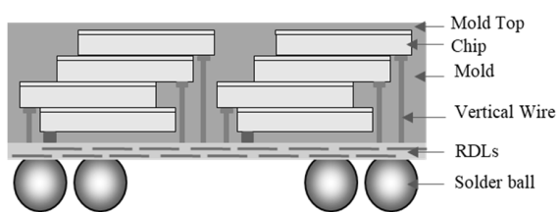
Intel’s Interests in Vertical Fanout Technology A scalable low cost chiplet stacking solutions for TSV+Bump/Bond replacement
DerChang Kau, Intel Fellow
Corporate Planning Group/Global External Manufacturing and Sourcing
Oct, 4, 2023
Features of Interests
Deployment:
Intended market segment, current use cases & roadmap.
Industrial standard compliance & limitations of chip tech.
Capacity: Internal consumption vs. external supply.
Rule of thumb pricing guidance.
Physical:
Module size, stack thickness & breakdown
What is Mold Top? Is backside of top die exposed? Is top die thickness different from other? (like HBM)
How many stacks in one module?
Can two stacks be different in number of die?
Die size and or aspect ratio, roadmap and limiting factors.
Vert. wire & RDL design rule, roadmap and limiting factor.
Can chips be embedded in the layer where RDLs are? If so, what is the connectivity vertically? How many die?
Solder ball design rule. (C4, µB, Pillar and/or other)
Electrical:
R/L/C/S/θ_{th} parameters, design kits, test vehicle validation & roadmap.
Power, Signal and Thermal integrity and design guidance & use case.
Corresponding ESD requirements and scalability.
Process and Test Flow Integration
General stacking process flow – top die first, RDL first or else?
How will it fit to overall packaging, assembly and test flow?
Ki-Jun Sung et.al., EDTM’23 DOI: 10.1109/EDTM55494.2023.10102966

