Slide 1
Thermal Analysis of Embedded SRAM in FO-3D
DerChang Kau, Feb/10,’23
Modeling Methodology
Technology and Design features explored
∆T between chip stack in SPIL’s 25µm pitch FO-3D package
Supporting Materials
Thermal conductivity extraction for µBump & underfill

Slide 2
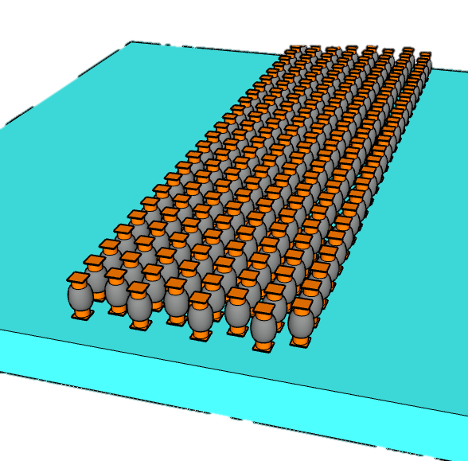
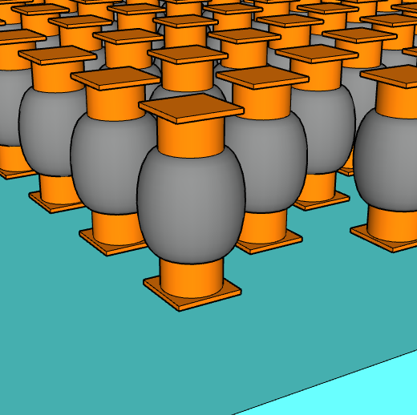
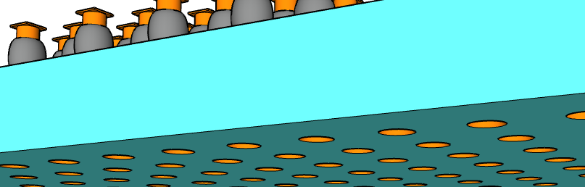
A linear Model: ∆T = Power_{SRAM} · R_{θ,interface}
256MB MSC in 120mm²: 32 channels, Full Duplex @1.6MT/s cacheline access per channel @ 0.3pJ/b, delivering 6.4TB/s @ 16W
Thermal conductivity is based on IBM’s and TSMC’s publication
Κ_{µB}= 8.8 W/°C·m
Κ_{underfill} = 0.55~1.1 W/°C·m
µB physical dimension is based on SPIL’s 25µm technology with HCP layout.
Method and flow for µB dummification as a thermal chimney is yet developed.
Power_{SRAM} = Bandwidth · Energy_{access}
R_{θ,interface} = R_{θ,µB} // R_{θ,underfill}
R_{θ,µB} = R_{θ,IO} // R_{θ,dummy}
Embedded SRAM Chiplet
t_{µB}
25µm Pitch
µBump connect to top die
CD_{µB}
Pitch_{µB}
9µm Pitch
TSVs connect to Substrate

Slide 3
∆T between Embedded SRAM & Top Die
Base Line and experiment explored
Base Line ∆T: Emb. SRAM is < 3˚C higher than Top Die at Full BW
25µm pitch µBump process change
Upto 40% ∆T reduction with thickness, CD and Underfill material change
Layout effects:
Upto 60% ∆T reduction by deploying Thermal Chimney (µBump dummification, method under development)
Lower SRAM density to 1.66MB/mm² (~25%) reduce ∆T by 20%
Other Design impact
½ Transfer Rate, ½ ∆T whereas +20% ∆T with Half Duplex @ constant BW
∆T inversely correlated with channel capacity
µBump Pitch | µBump thicknes | µBump CD | K_{µBump} | K_{UnderFill} | Adding TS PDN Via µBump | Adding Thermal Chimney | SRAM Density | I/O Duplex | Transfer Rate | Capacity
µm | µm | µm | W/°C·m | W/°C·m |  |  | MB/mm² |  | MT/s | MB/ch
25 | 26 | 12 | 8.8 | 0.55 | No | No | 2.25 | Full | 1.6 | 8
 | 25 | 14 |  | 1.1 | Yes | Yes | 1.66 | Half | 0.8~3.2 | 2~16
0.7˚C ∆T (76% reduction) can be achieved with process change and dummification

Slide 4
Thermal Impact DOE
Base Line: CacheLine Access each channel @ 1.6GT/s, 0.2pJ/b; 204.8GB/s@328mW per channel
 | ∆T | ∆T change Ratio | Pitch_{µB} | CD_{µB} | t_{µB} | K_{µB} | K_{UF} | Adding TS PDN Via µBump | Adding Thermal Chimney | Density | IO Duplex | Transfer Rate | Capacity
 | °C |  | µm | µm | µm | W/°C·m | W/°C·m |  |  | MB/mm² |  | GT/s | MB/ch
Control | 2.927 |  | 25 | 12 | 26 | 8.8 | 0.55 | No | No | 2.25 | Full | 1.6 | 8
µBump size changes | 2.516 | -14% | 25 | 14 | 25 | 8.8 | 0.55 | No | No | 2.25 | Full | 1.6 | 8
Double K_{θ,underfill} | 1.774 | -39% | 25 | 12 | 26 | 8.8 | 1.1 | No | No | 2.25 | Full | 1.6 | 8
Adding TS PDN thru µBump | 2.204 | -25% | 25 | 12 | 26 | 8.8 | 0.55 | YES | No | 2.25 | Full | 1.6 | 8
Full Dummification | 1.054 | -64% | 25 | 12 | 26 | 8.8 | 0.55 | No | Yes | 2.25 | Full | 1.6 | 8
All Technology agumentation | 0.701 | -76% | 25 | 14 | 25 | 8.8 | 1.1 | No | Yes | 2.25 | Full | 1.6 | 8
Reduce Memory Density | 2.363 | -19% | 25 | 12 | 26 | 8.8 | 0.55 | No | No | 1.66 | Full | 1.6 | 8
Half Duplex | 3.502 | 20% | 25 | 12 | 26 | 8.8 | 0.55 | No | No | 2.25 | Half | 3.2 | 8
½ Transfer Rate | 1.464 | -50% | 25 | 12 | 26 | 8.8 | 0.55 | No | No | 2.25 | Full | 0.8 | 8
half channel capacity | 4.408 | 51% | 25 | 12 | 26 | 8.8 | 0.55 | No | No | 2.25 | Full | 1.6 | 4
double channel capacity | 1.751 | -40% | 25 | 12 | 26 | 8.8 | 0.55 | No | No | 2.25 | Full | 1.6 | 16
quarter channel capacity | 5.901 | 102% | 25 | 12 | 26 | 8.8 | 0.55 | No | No | 2.25 | Full | 1.6 | 2

Slide 5
Supporting Materials

Slide 6
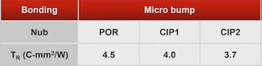
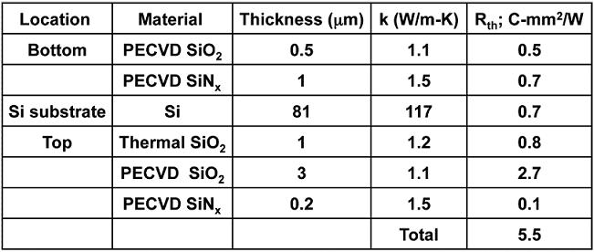
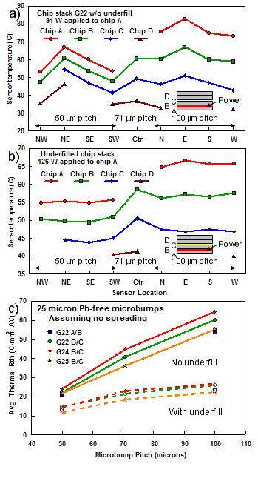
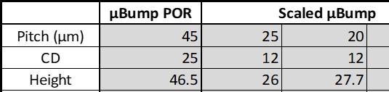
Thermal Conductivity and Underfill
[R1] https://www.electronics-cooling.com/2013/03/measured-thermal-resistance-of-microbumps-in-3d-chip-stacks/
[R2] https://www.anandtech.com/show/16051/3dfabric-the-home-for-tsmc-2-5d-and-3d-stacking-roadmap
Κ_{µbump}: 8.8 W/°C·m ; modeled based on [1]
Κ_{underfill}: 0.55 W/°C·m ^{[1,2]} , 1.1 W/°C·m ^{[2]}
TSMC 25µm pitch µB ^{[2]}: t_{µB} = 15µm, CD_{µB}=16,4 ➔ R­_{θ} = 4.5/4.0 °C·mm²/W @ square/HCP
SPIL reference:
MTS explored:
K_{µBump} | K_{UnderFill} | Pitch_{µBump} | t_{µBump} | CD_{µBump}
W/°C·m | W/°C·m | µm | µm | µm
8.8 | 0.55~1.1 | 25 | 25~26 | 12~14

