Slide 1
CHIPKA: Process Options and Risk Assessment
prashant m .. .for internal discussion with CHIPKOOS …. 12/18/2018

Slide 2
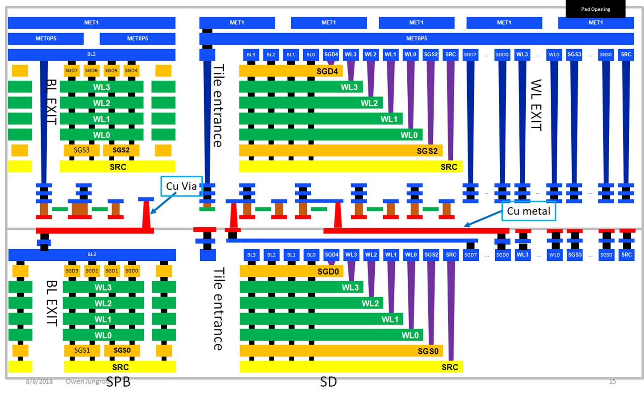
Preferred Approach for Shared CMOS (option d’)
Architecture Overview
Array Operation: CMOS from top wafer drives blocks from both top and bottom wafer (saves CMOS processing steps) → connected BLs, separate string drivers for top and bottom wafers.
New Process: via through the bottom of the CMOS (~5um deep, similar to CON3 dimensions: 600nm pitch, 400nm diameter) is required to connect the bottom array.
Top Wafer (no change): Array + CMOS + top metals
Bottom Wafer: Array + BL metal layer + W0 + Cu1
Performance Impact: 2x reduction in RR IOPS and Seq Write BW
Chip Layout: appears feasible to fit all CMOS in bottom wafer (N39A density)
Total cost savings: 8.1%
INTEL CONFIDENTIAL

Slide 3
2+ Process Options (D), (E), (G) ….
Preferred Structure for Shared CMOS
INTEL CONFIDENTIAL

Slide 4
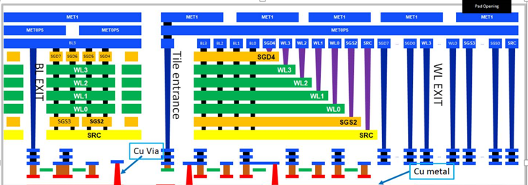
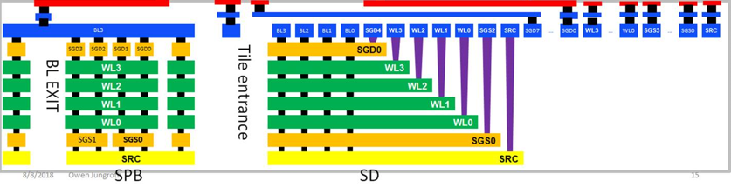
Process Option D: Hybrid Bonding
CMOS+Array (Wafer 1)
Array (wafer 2)
(1)
SiO2
Si
Si
Support Wafer
(2)
Support Wafer
Temp bond support wafer
Hybrid Bonding
Si
(4)
SiO2
(3)
Si
Support Wafer
Support Wafer
+ De-bond Support wafer and expose pads
Via through Thin Si + Metal
Thin Si
INTEL CONFIDENTIAL

Slide 5
Process Option E
Array
SiO2
Si
Si
Perm bond Si wafer
Si
Thin Si,
+CMOS
+Shallow TSV +Array
SiO2
Si
SiO2
Si
INTEL CONFIDENTIAL

Slide 6
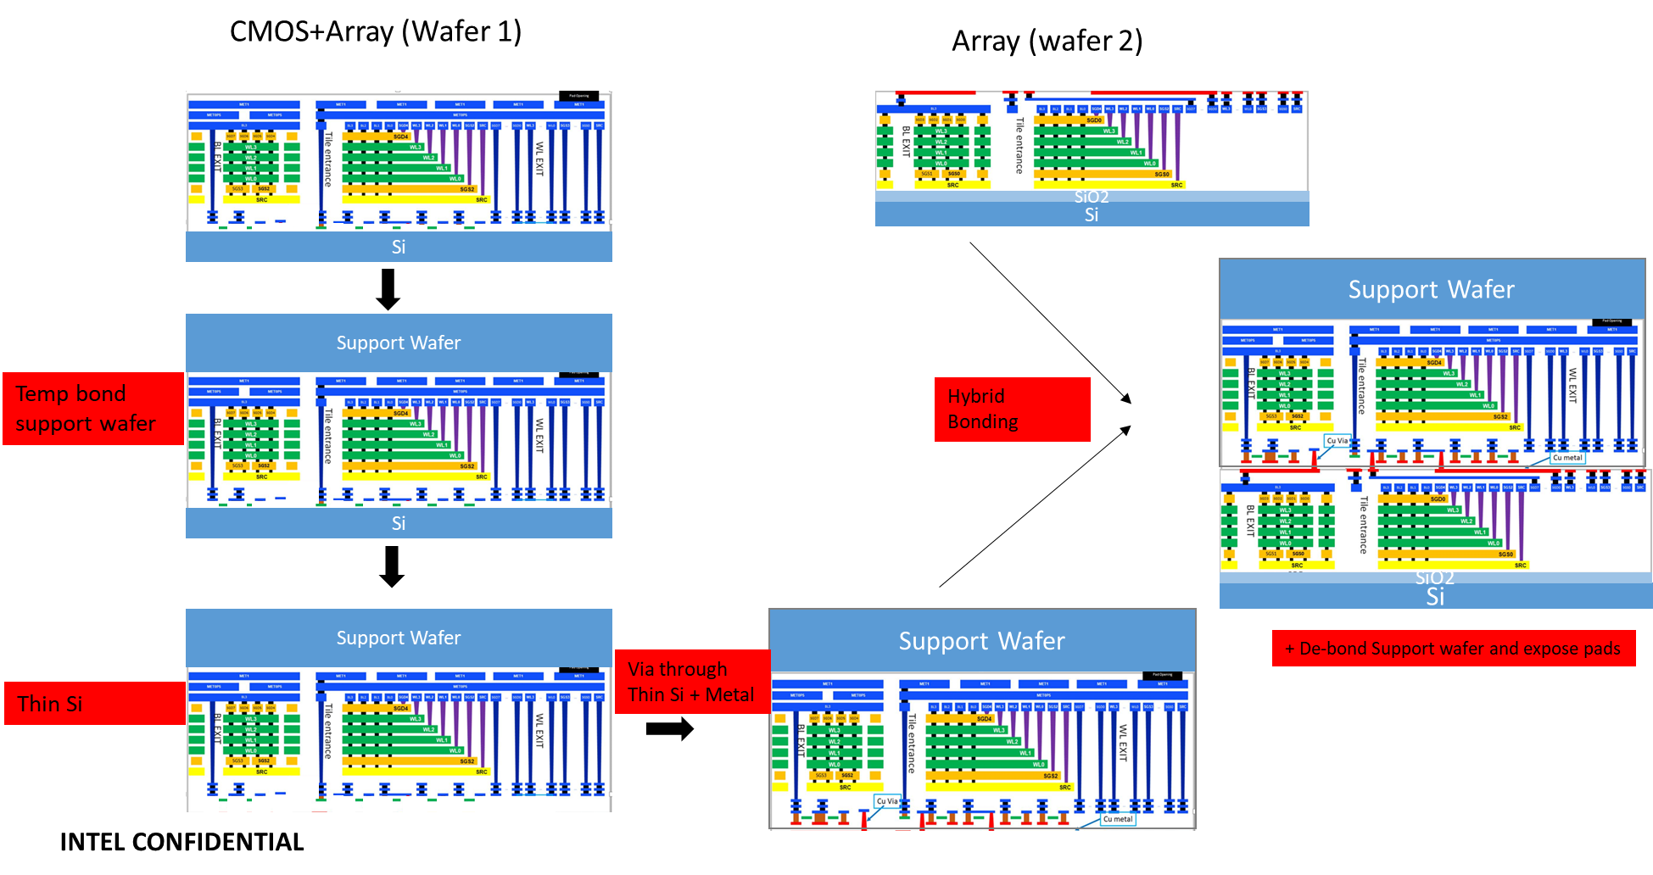
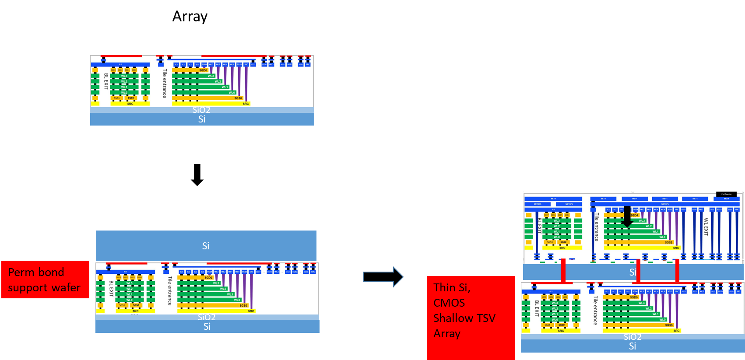
Risks with Options (D) and (E)
D
E
Risk
AR
Risk
AR
Hybrid bonding Alignment Capability Curved wafer Yield | Procure IMEC dedicated HB wafers and work with EVG? Join IMEC-3D program?
Fusion Bonding (Temp/Perm) and de-bond/remove | - EVG/TEL/SUSS demo?
Backside Thinning - Grind / Lap / CMP / Metro | - demo’s (Disco/AMAT) ?
Shallow TSV (Etch / Insulator/ Metallization) | - demo’s (LAM /AMAT)?
??
Hybrid bonding
Fusion (perm) Bonding | EVG/TEL/SUSS demo
Backside Thinning - Grind / Lap / CMP / Metro | - demo’s (Disco/AMAT) ?
Shallow TSV (Etch / Insulator/ Metallization) | - demo’s (LAM/AMAT)
Extra Thermal budget on bottom array | internal assessment
Thinned Si for active transistors | Demo +internal assessment

Slide 7
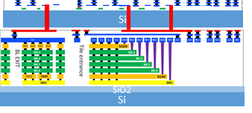
Process Option G
Bottom Array (wfr 1)
CMOS (wfr 2)
[Temp Bond and Backside Thinned]
Top Array (wfr 3)
[Temp Bond and Si Removed]
Temp Bond Carrier
Temp Bond Carrier
oxide
SiO2
oxide
Si
Si (only CMOS / No metals)
oxide
Si (only CMOS / No metals)
Si
SiO2
Si
Bond and transfer CMOS
Shallow TSV + Metals
SiO2
Si
Bond and Transfer Array + CON3 + top metals + Pad
INTEL CONFIDENTIAL

Slide 8
Process Option G (Build)
Bottom Array (wfr 1)
CMOS (wfr 2)
[Temp Bond and Backside Thinned]
Top Array (wfr 3)
[Temp Bond and Si Removed]
Temp Bond Carrier
Temp Bond Carrier
oxide
SiO2
oxide
Si
Si (only CMOS / No metals)
oxide
Si (only CMOS / No metals)
Si
SiO2
Si
Bond and transfer CMOS
Shallow TSV + Metals
SiO2
Si
Bond and Transfer Array + CON3 + top metals + Pad
INTEL CONFIDENTIAL

Slide 9
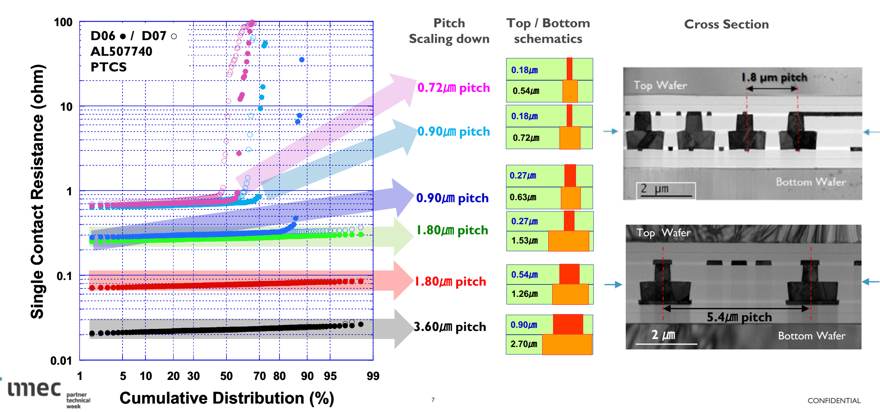
Snapshot of IMEC 3D Hybrid Bonding Test Vehicle

Slide 10
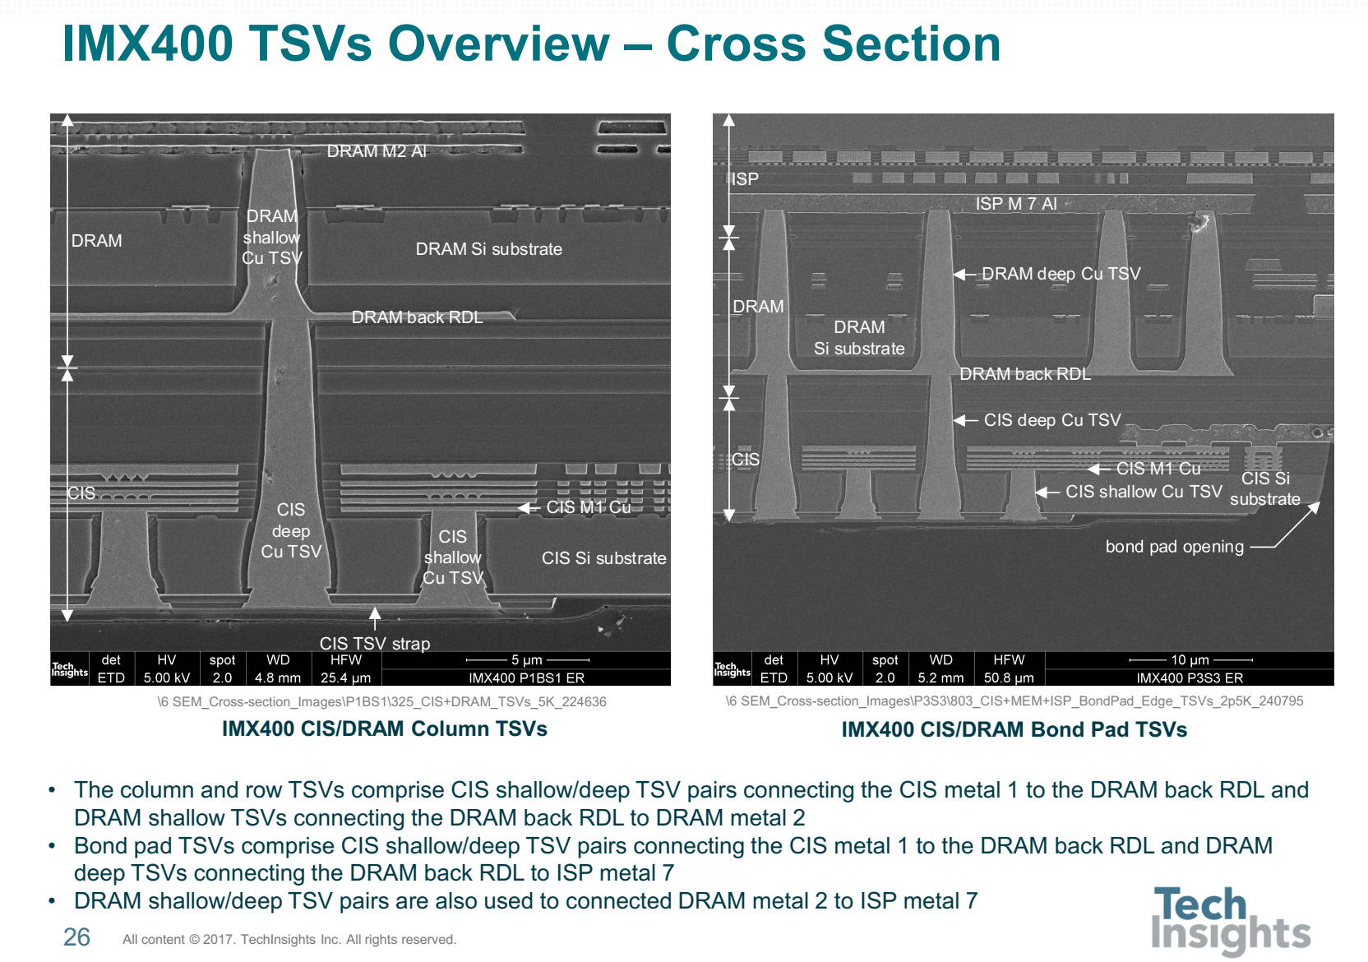
Evidence of TSV Through Fusion Bonded Interface
Bonded interface
(ISP/DRAM)
Bonded interface
(DRAM/CIS)

Slide 11
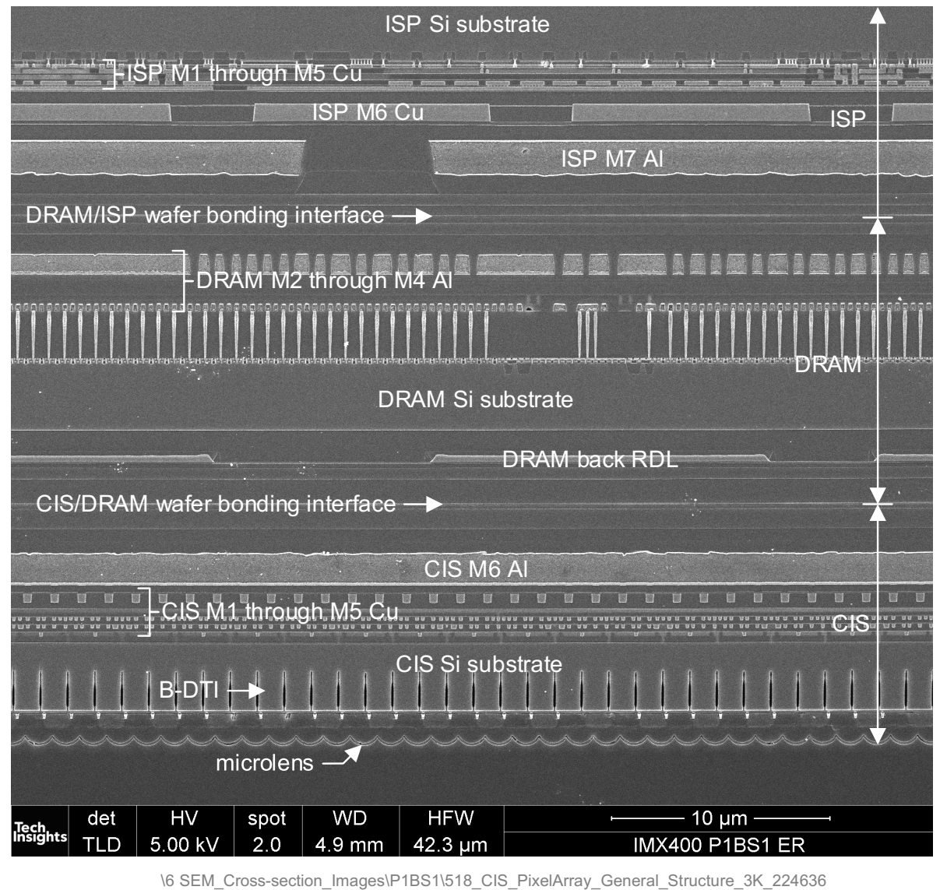
8um

Slide 12
Expected Flow for CIS/DRAM/ISP Integration
ISP backend (Metals/landing pad)
DRAM backend (Metals/landing pads)
CIS backend (Metals/landing pads)
ISP (Si + CMOS)
DRAM (Si + CMOS)
CIS (Si + Metals)

Slide 13
Expected FLOW for CIS/DRAM/ISP Integration
ISP backend (Metals/landing pad)
DRAM backend (Metals/landing pads)
CIS backend (Metals/landing pads)
ISP (Si + CMOS)
DRAM (Si + CMOS)
CIS (Si + Metals)
DRAM backend (Metals/landing pads)
DRAM (Si + CMOS)
ISP backend (Metals/landing pad)
ISP (Si + CMOS)

Slide 14
Expected FLOW for CIS/DRAM/ISP Integration
DRAM backend (Metals/landing pads)
DRAM (Si + CMOS)
DRAM backend (Metals/landing pads)
DRAM backend (Metals/landing pads)
DRAM (Si + CMOS)
DRAM (Si + CMOS)
ISP backend (Metals/landing pad)
ISP backend (Metals/landing pad)
ISP backend (Metals/landing pad)
ISP (Si + CMOS)
ISP (Si + CMOS)
ISP (Si + CMOS)

Slide 15
DRAM backend (Metals/landing pads)
CIS backend (Metals/landing pads)
DRAM (Si + CMOS)
CIS (Si + Metals)
ISP backend (Metals/landing pad)
ISP (Si + CMOS)

Slide 16
DRAM backend (Metals/landing pads)
CIS backend (Metals/landing pads)
DRAM (Si + CMOS)
CIS (Si + Metals)
ISP backend (Metals/landing pad)
ISP (Si + CMOS)
CIS backend (Metals/landing pads)
CIS (Si + Metals)
DRAM backend (Metals/landing pads)
DRAM (Si + CMOS)
ISP backend (Metals/landing pad)
ISP (Si + CMOS)

Slide 17
CIS backend (Metals/landing pads)
CIS (Si + CMOS)
CIS backend (Metals/landing pads)
CIS backend (Metals/landing pads)
CIS
CIS
DRAM backend (Metals/landing pads)
DRAM backend (Metals/landing pads)
DRAM backend (Metals/landing pads)
DRAM (Si + CMOS)
DRAM (Si + CMOS)
DRAM (Si + CMOS)
ISP backend (Metals/landing pad)
ISP backend (Metals/landing pad)
ISP backend (Metals/landing pad)
ISP (Si + CMOS)
ISP (Si + CMOS)
ISP (Si + CMOS)

Slide 18
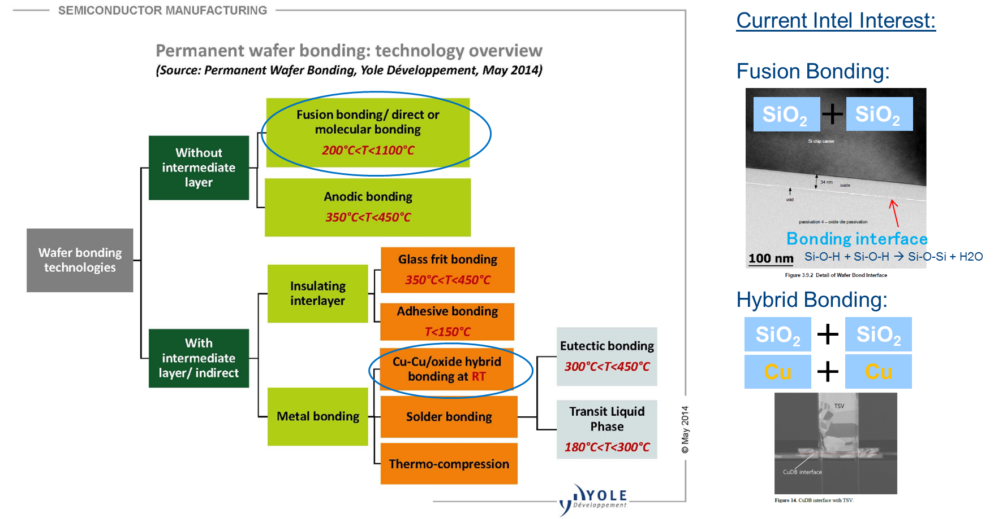
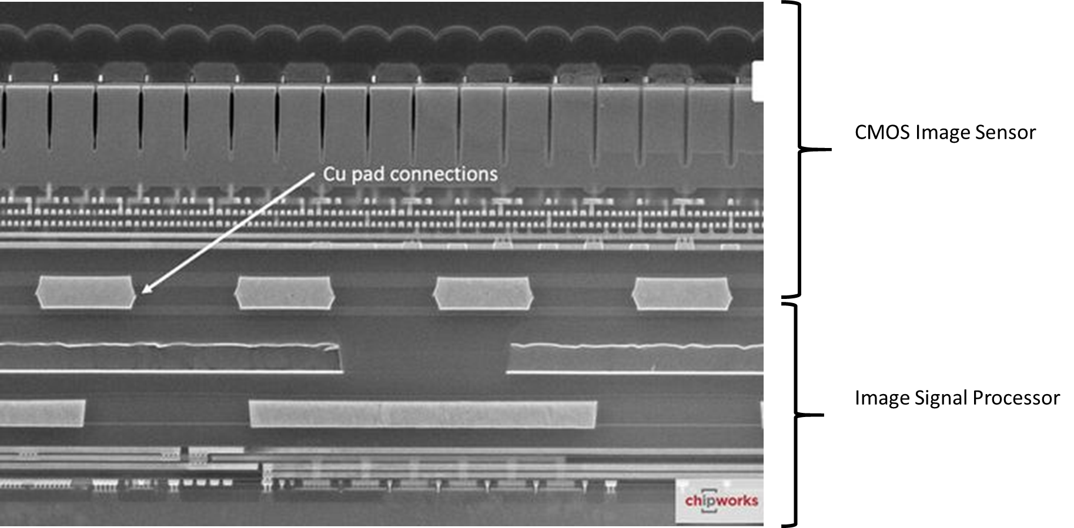
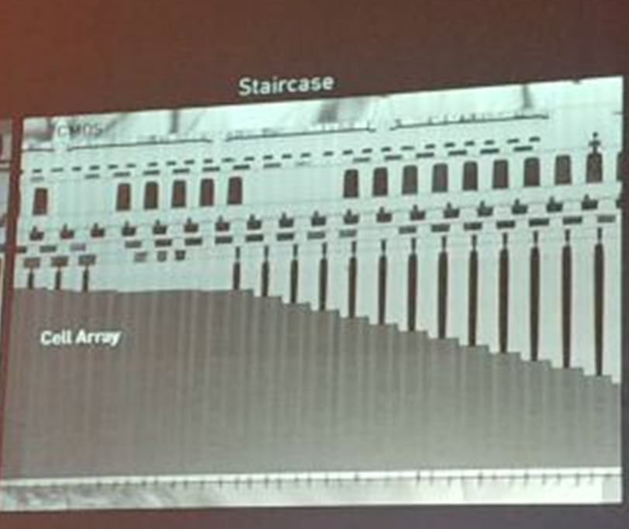
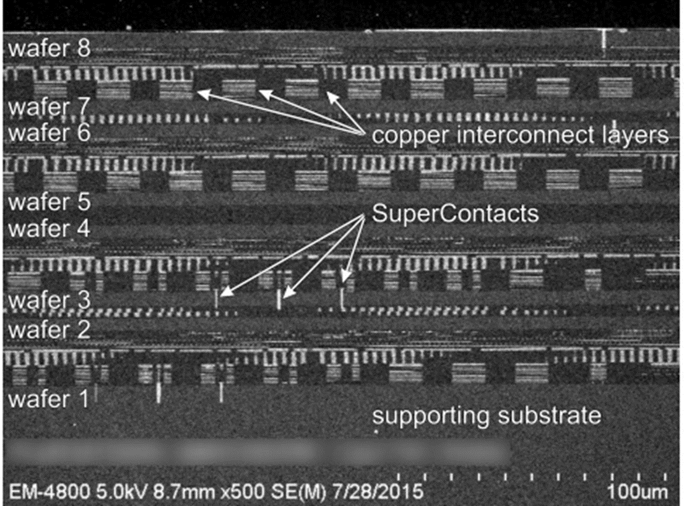
Re-Cap: Hybrid Bonding (Classification and Implementation)
In HVM
Sony Camera in Samsung S7
In R&D
3D NAND
Tezzaron’s 8 wafer stack w/ Hybrid Bonding
YMTC XStacking
CMOS image sensors with DRAM (3 wafer stacking)
Novel 3D integration (monolithic <===> TSV)
Split n Bond (reduce cycle time)
…
Intel Confidential

