Slide 1
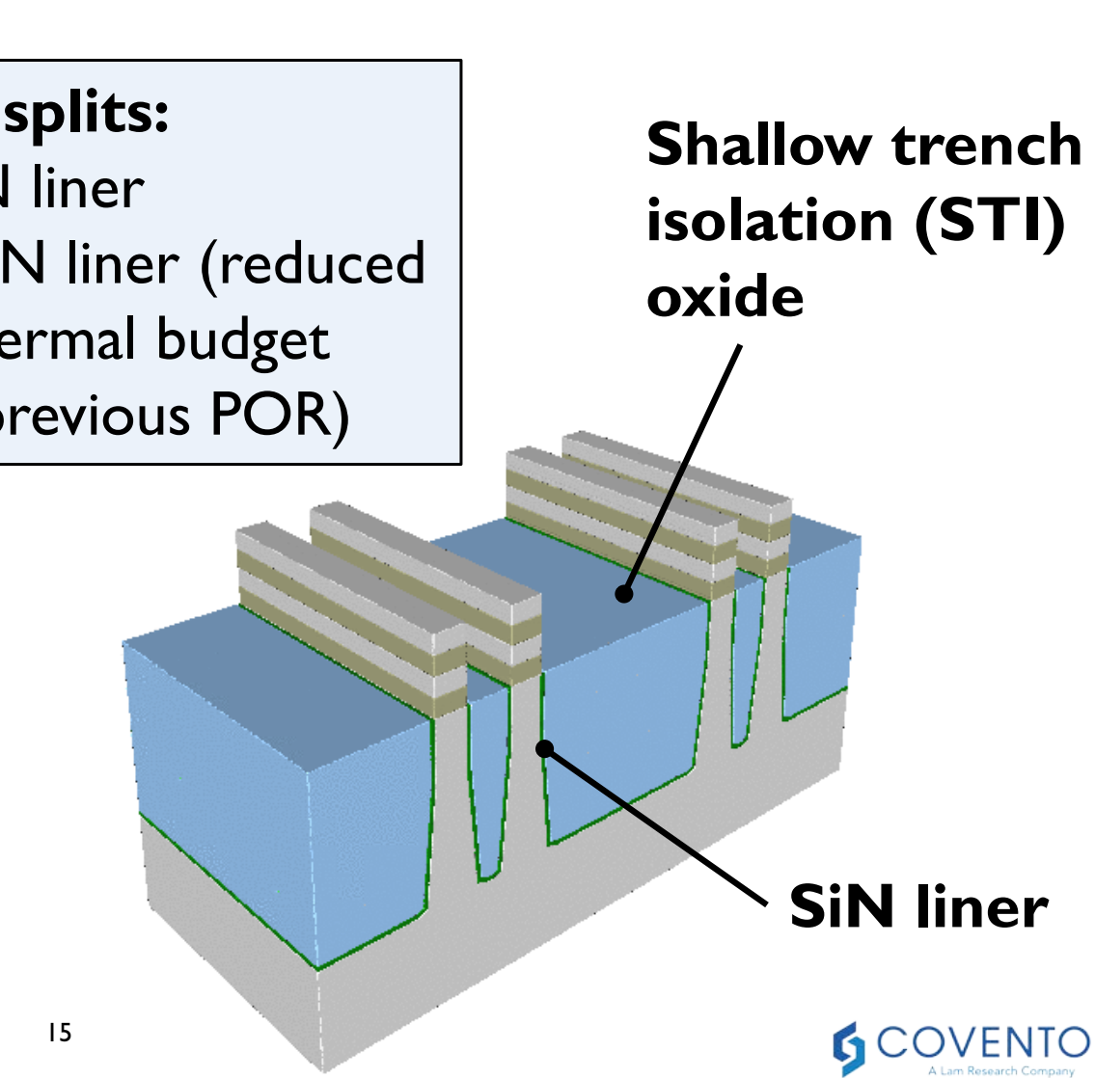
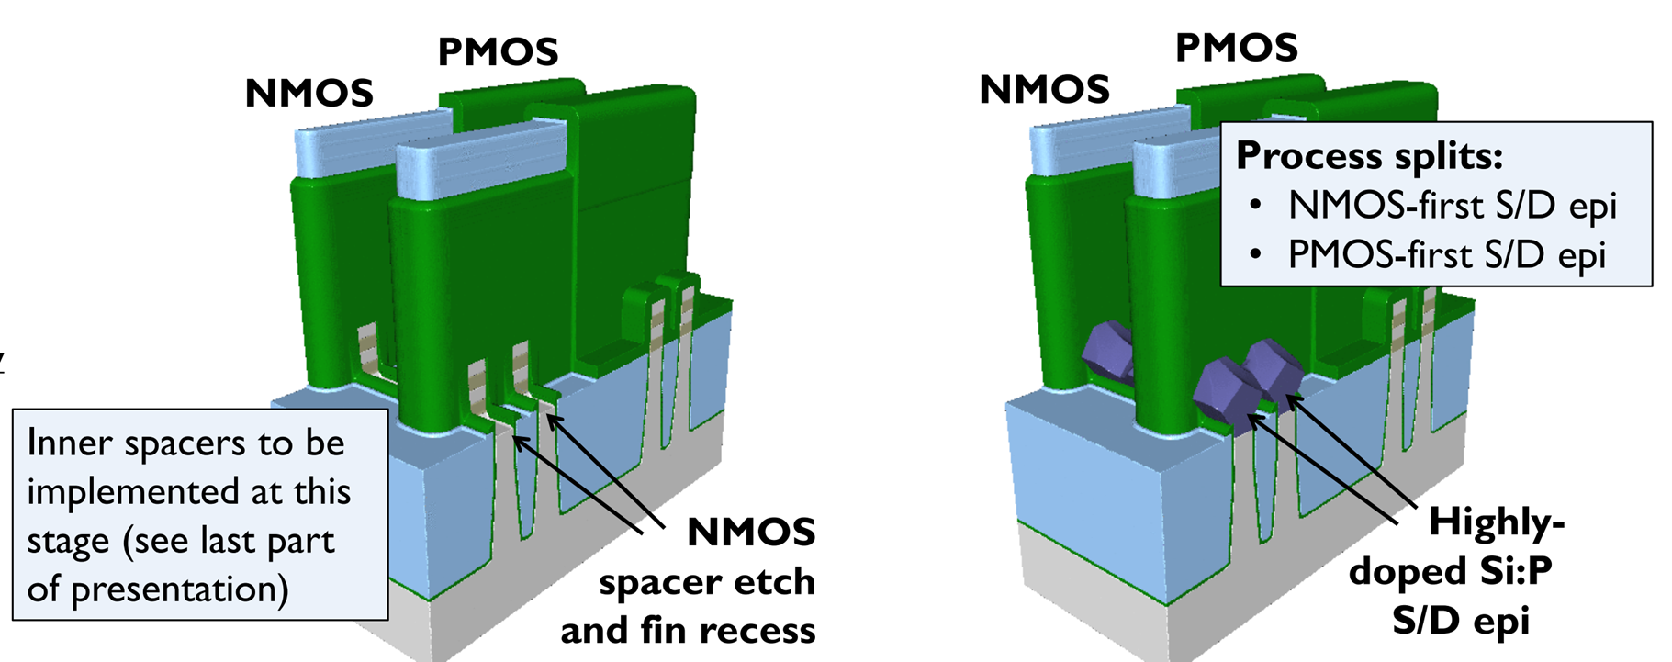
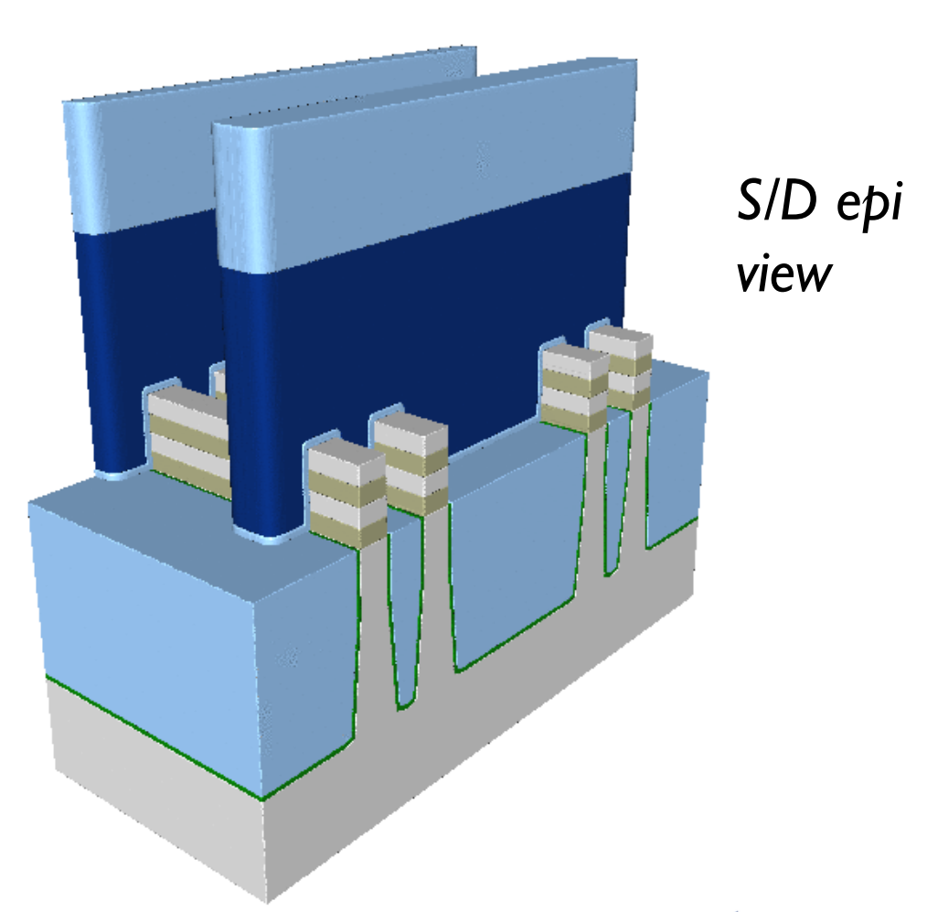
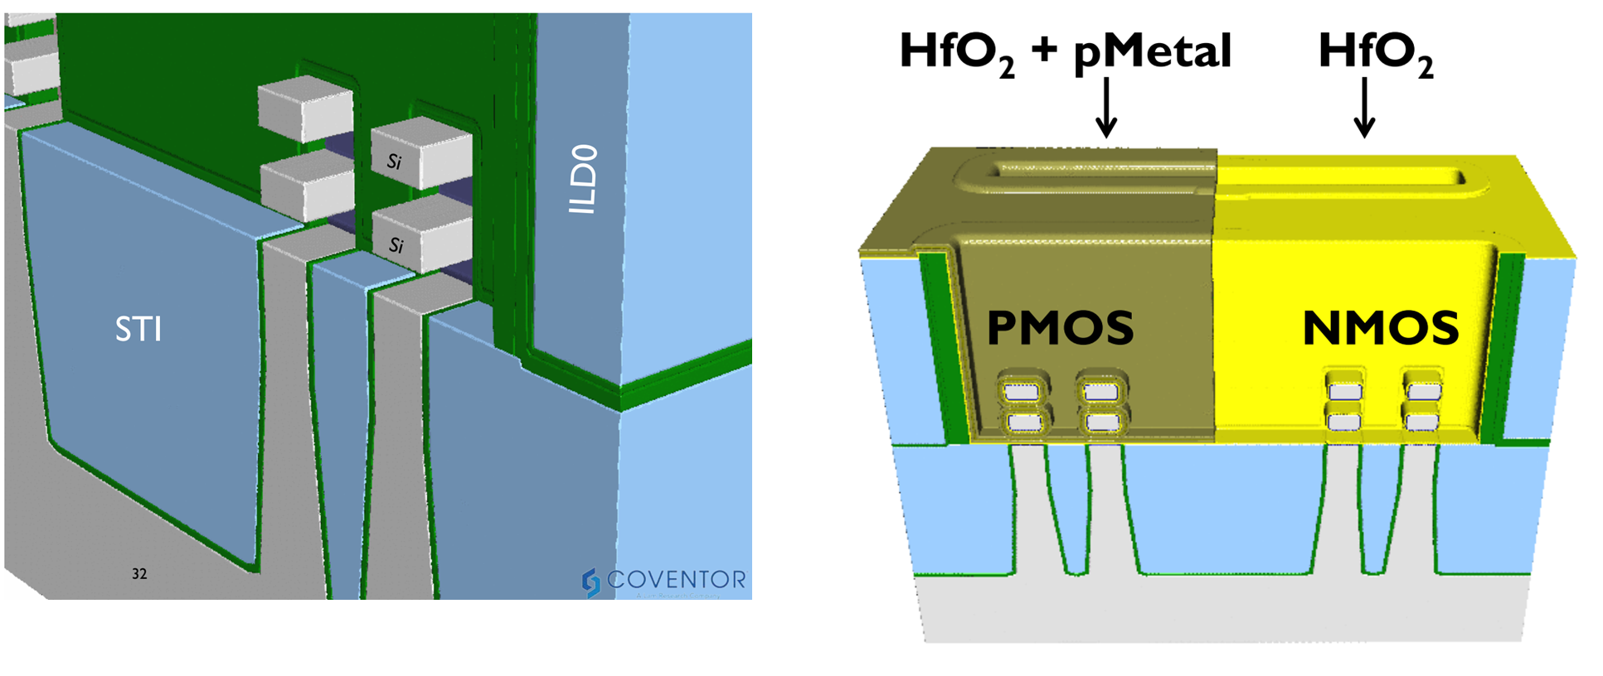
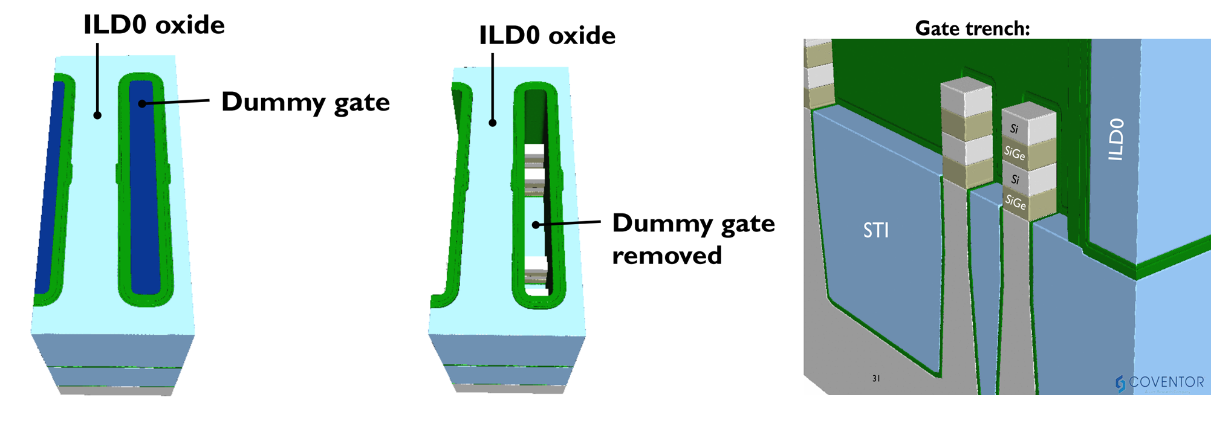
Generic Flow of GAA-NS and Critical Module Challenges
Dummy Gate
Si/SiGe Multilayer

Slide 2
Generic Flow of GAA-NS and Critical Module Challenges
Dummy Gate
Si/SiGe Multilayer
Si/SiGe heterostructure without interdiffusion
Top/Bottom uniformity in inner spacer w/ lowk
eS/D w/o defects and induce channel stress
Channel release
HKMG and Multi Vt; Thick Ox for HV
Channel substrate isolation

Slide 3
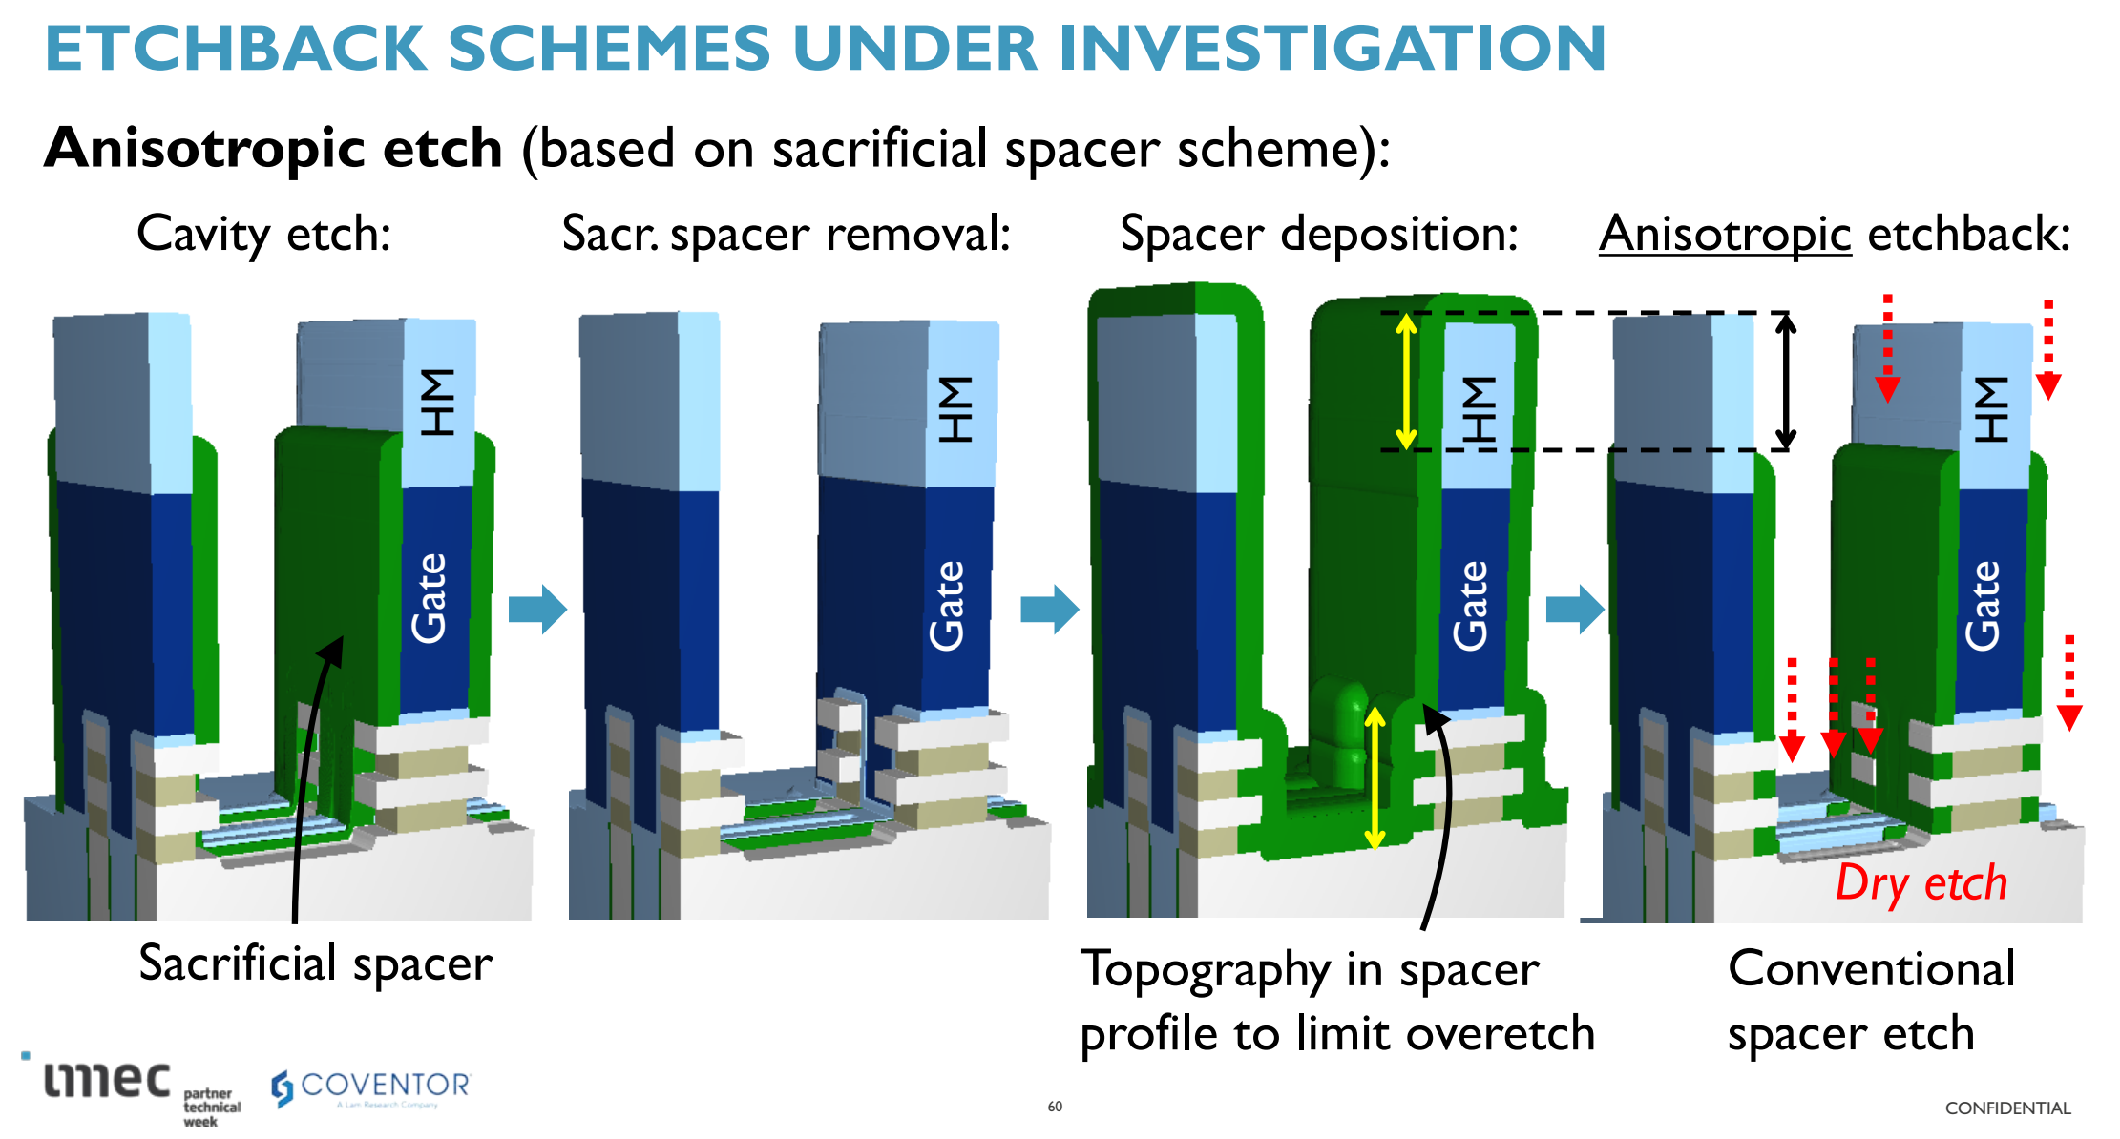
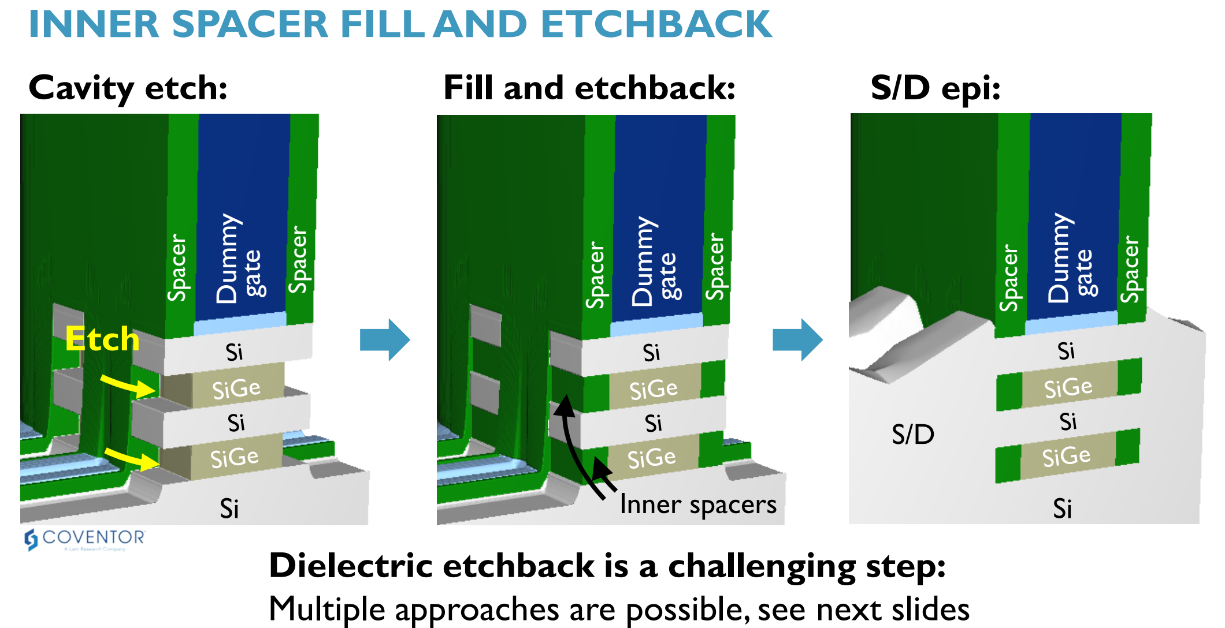
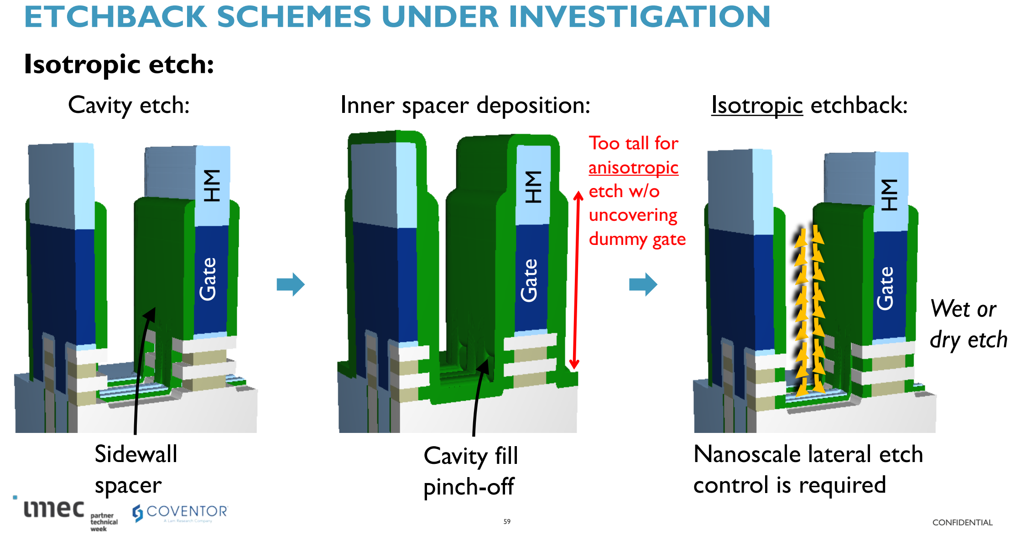
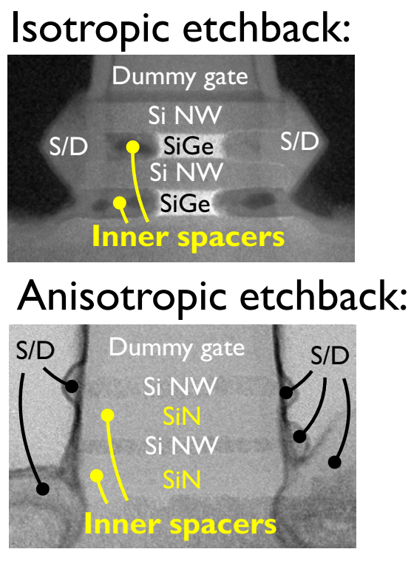
Inner Spacer Challenge

