Slide 1
Problem Statement: Can HBM like multi stack be 3D stacked on XPU?
Typical HBM Stack
HBM* stack scaling w/ bumpless Hybrid Bonding
Potential flow to stack HBM* on XPU in 3D
Collateral info
TSMC SOIC (F2B) for AMD-V Cache
TSMC SOIC F2F in TD
prashant majhi, FTE

Slide 2
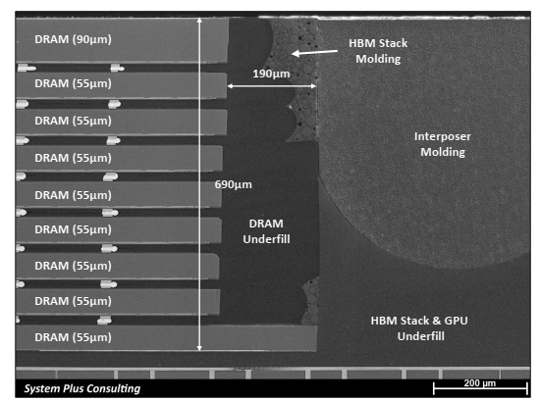
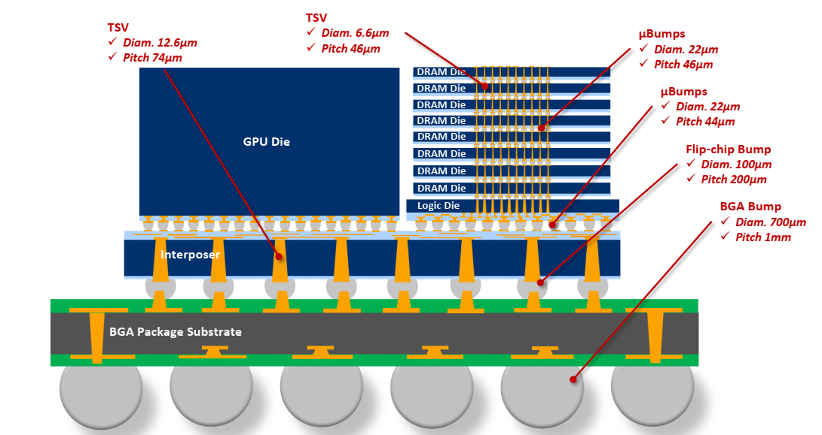
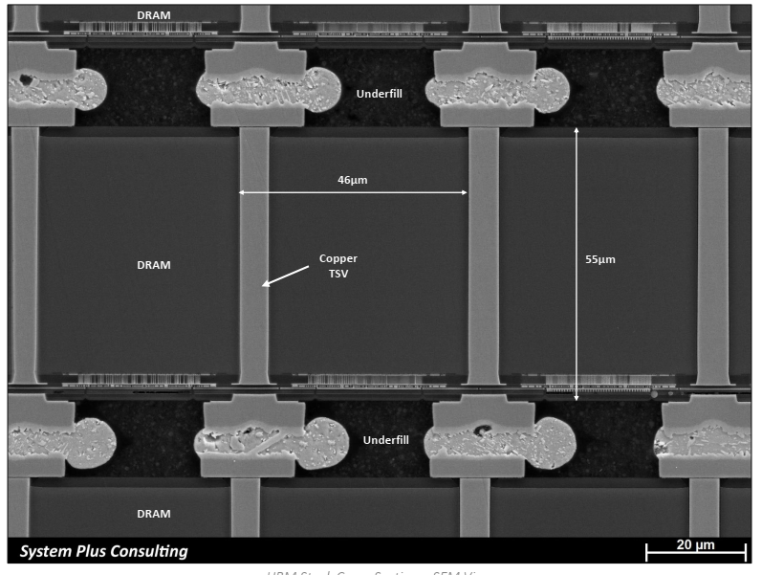
Typical HBM (POR)
AMD Vega Product
prashant majhi, FTE

Slide 3
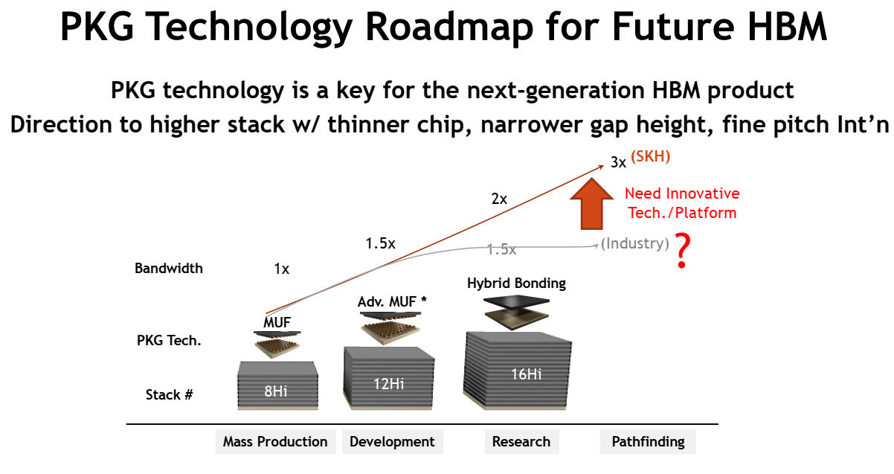
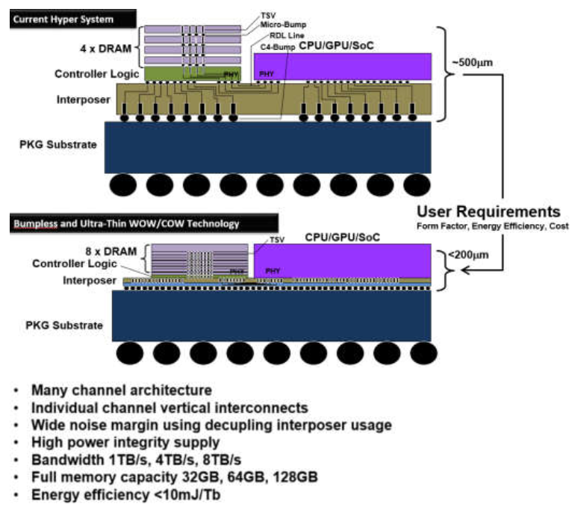
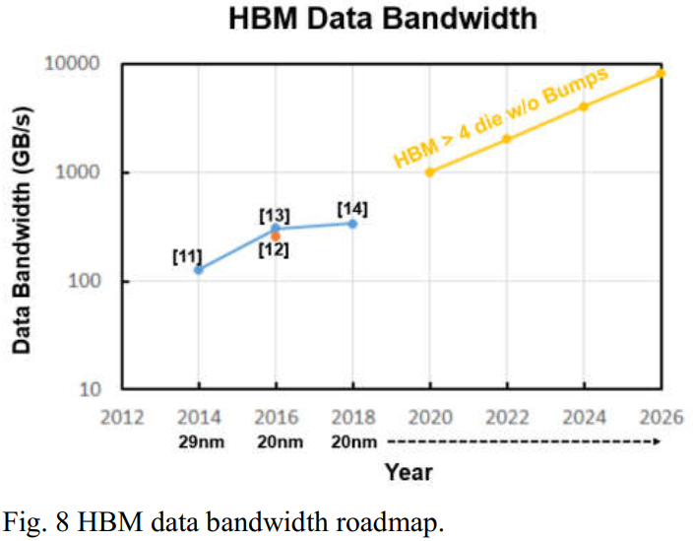
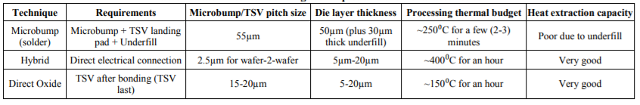
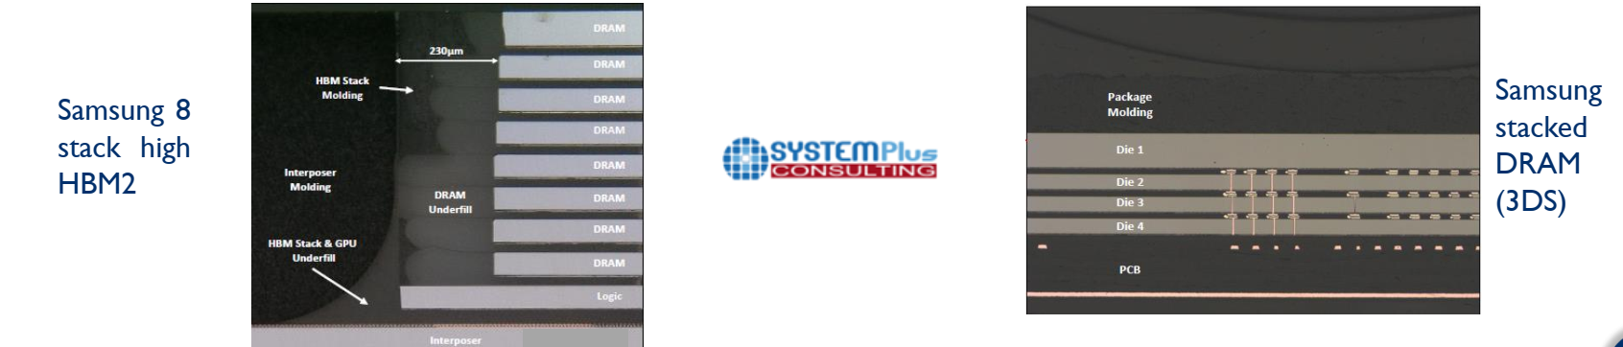
HB for DRAM Stacking [Cube]…… (1/2)
SK Hynix, Samsung
SK Hynix, VLSI 2021
HBM roadmap includes bumpless stacking with Hybrid Bonding
prashant majhi, FTE

Slide 4
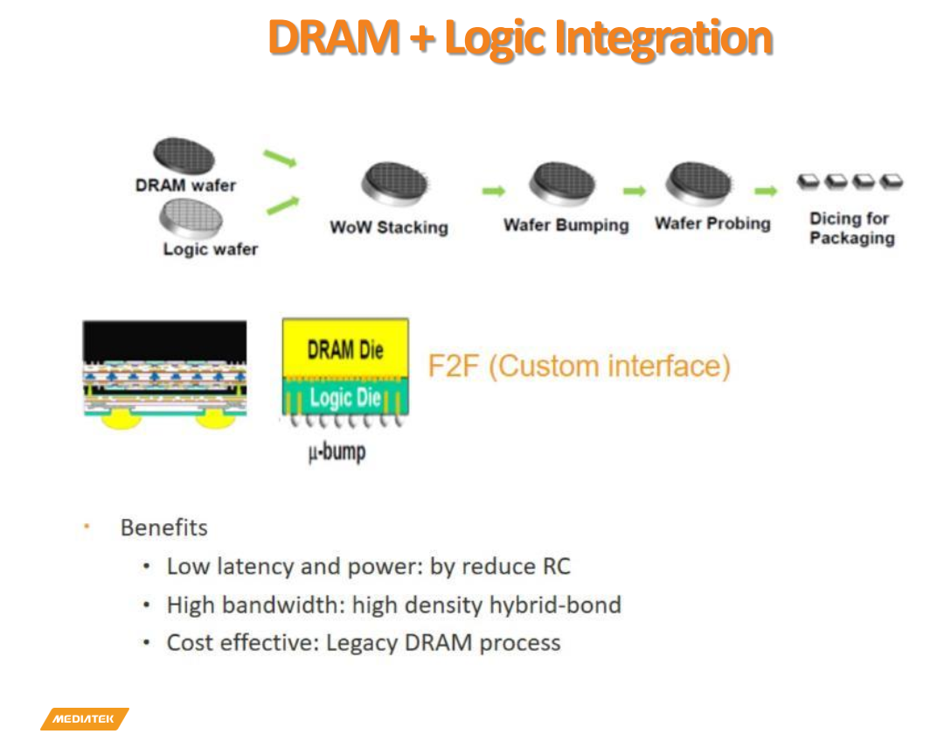
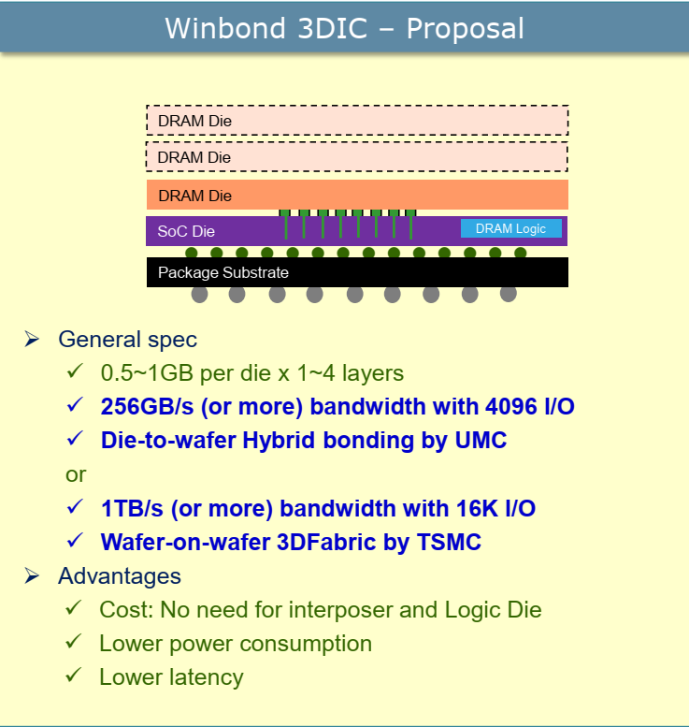
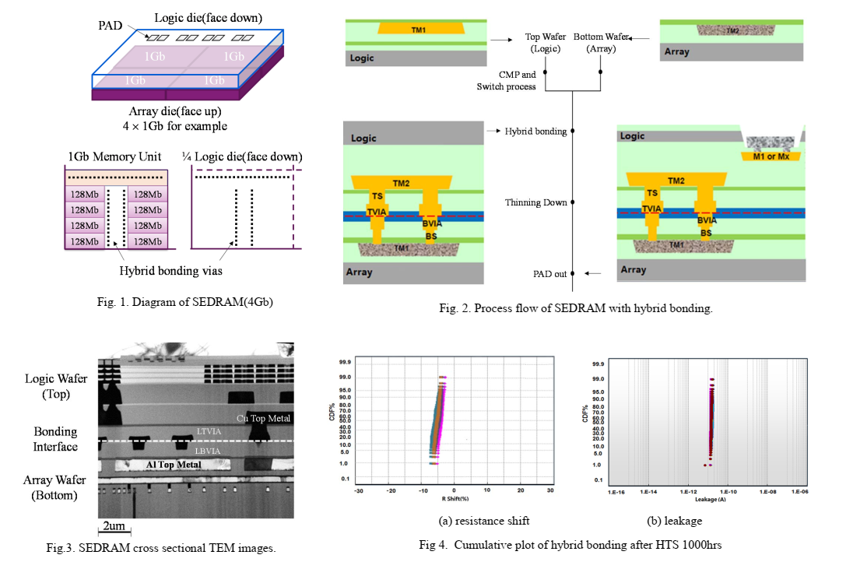
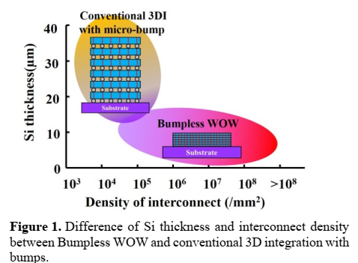
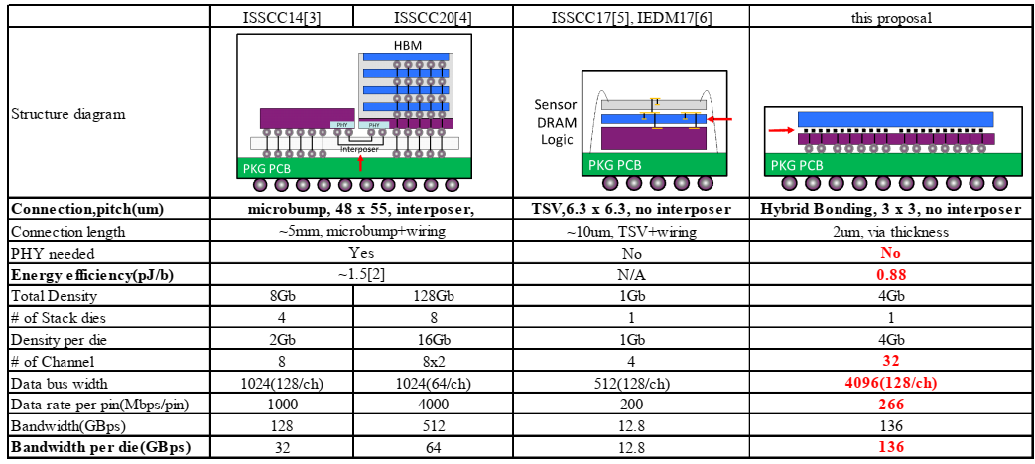
HB for DRAM Stacking [on Logic]…… (2/2)
Xian, Powerchip, IEDM 2020
WoW Alliance + Micron
Mediatek @SRC’2021
Scaling Si thickness and increasing 3DID
HB of 3D stacked DRAM (customized with high I/O) on Logic for optimal bandwidth & power
prashant majhi, FTE

Slide 5
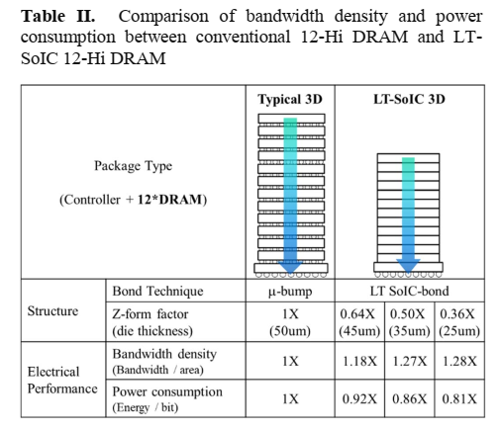
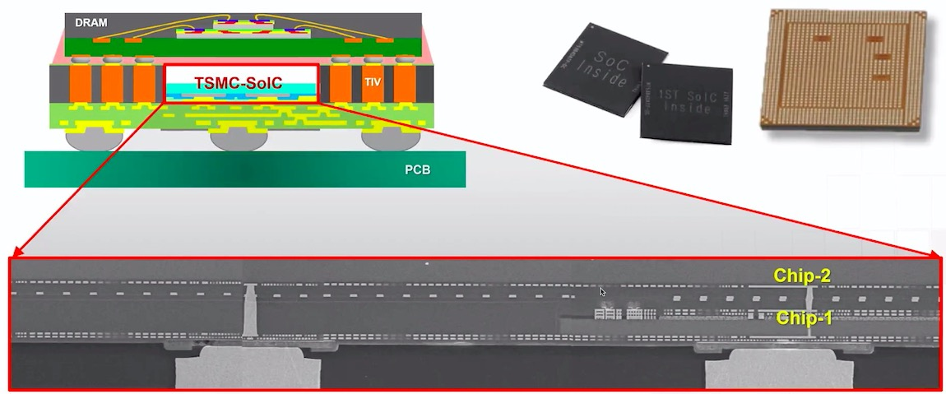
Potential flow to stack HBM* on XPU in 3D
TSCM ECTC 2020
Si (Top):
Transistors
Interconnects
Interconnects
Transistors
Si (Bottom):
Substrate
Chip-2 as Intel CPU and Chip-1 DRAM stack?
INTEL XPU
Stacked DRAM
TSMC Symposium 2020
F2F HB CoW with ODI like connections for Chip-2
Modification of TSMC Symposium 2020
prashant majhi, FTE

Slide 6
Problem Statement: Can HBM like multi stack be 3D stacked on XPU?
Typical HBM Stack
HBM* stack scaling w/ bumpless Hybrid Bonding
Potential flow to stack HBM* on XPU in 3D
Collateral info
TSMC SOIC (F2B) for AMD-V Cache
TSMC SOIC F2F in TD
prashant majhi, FTE

Slide 7
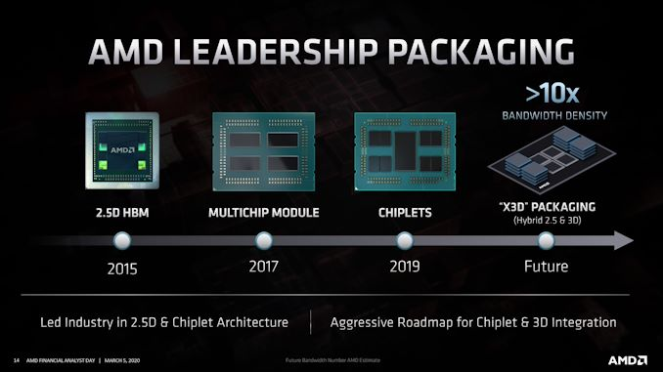
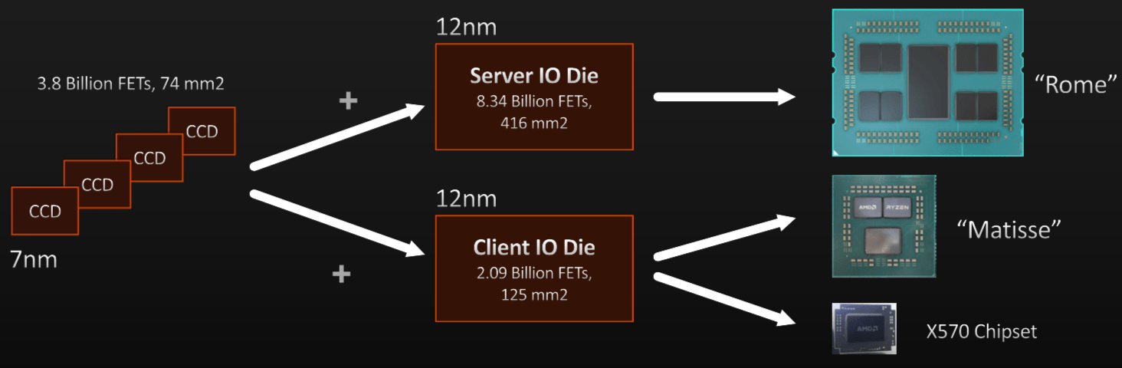
AMD CPU Strategy: Multi Chip ➔ Chiplets ➔ X3D?
7nm ➔ 5nm ➔?
GF12 nm ➔ N6 nm ➔?
Std ➔ Info?
prashant majhi, FTE

Slide 8
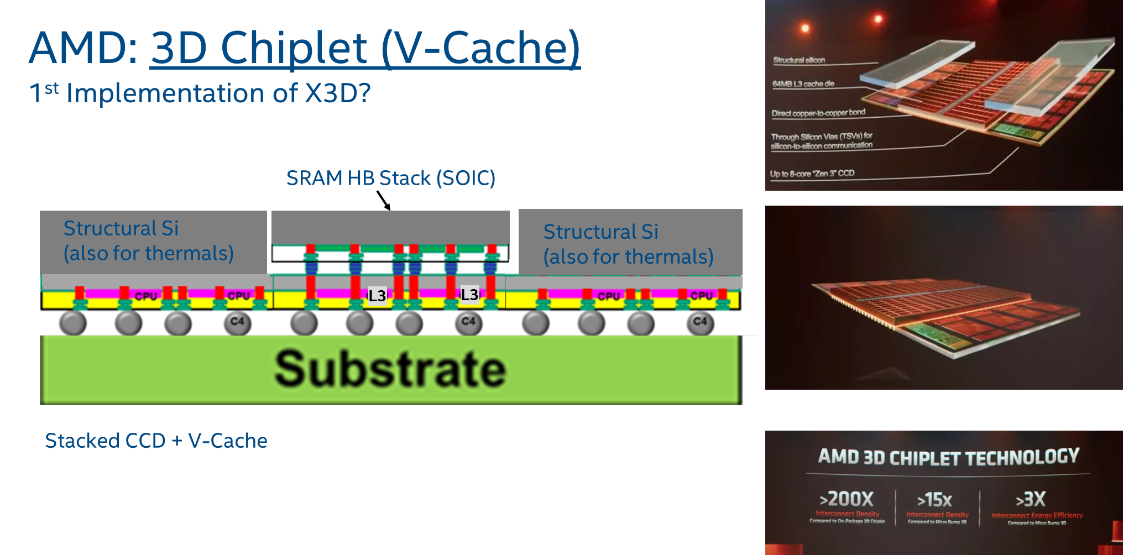
HB for SRAM/Cache on Logic: AMD/TSMC 1/3
Speculative CoW Flow
prashant majhi

Slide 9
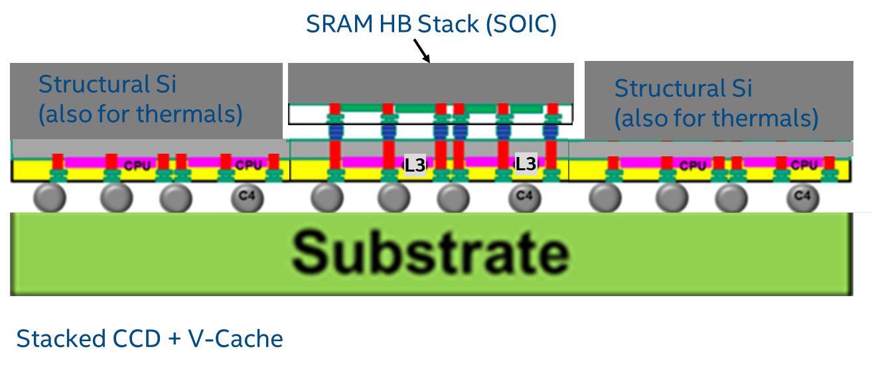
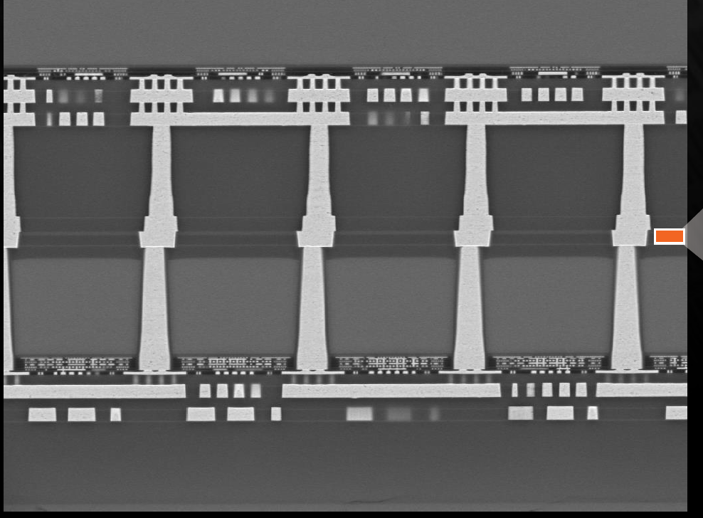
HB for SRAM/Cache on Logic: AMD/TSMC 2/3
Top: SRAM
Bottom: CCD XPU
SRAM [V-Cache]
SiO2
Bonding Oxide Stack
~6um
~9um
CCD [Face Down]
Speculative CoW Flow
AMD @ HotChips ‘21
prashant majhi, FTE

Slide 10
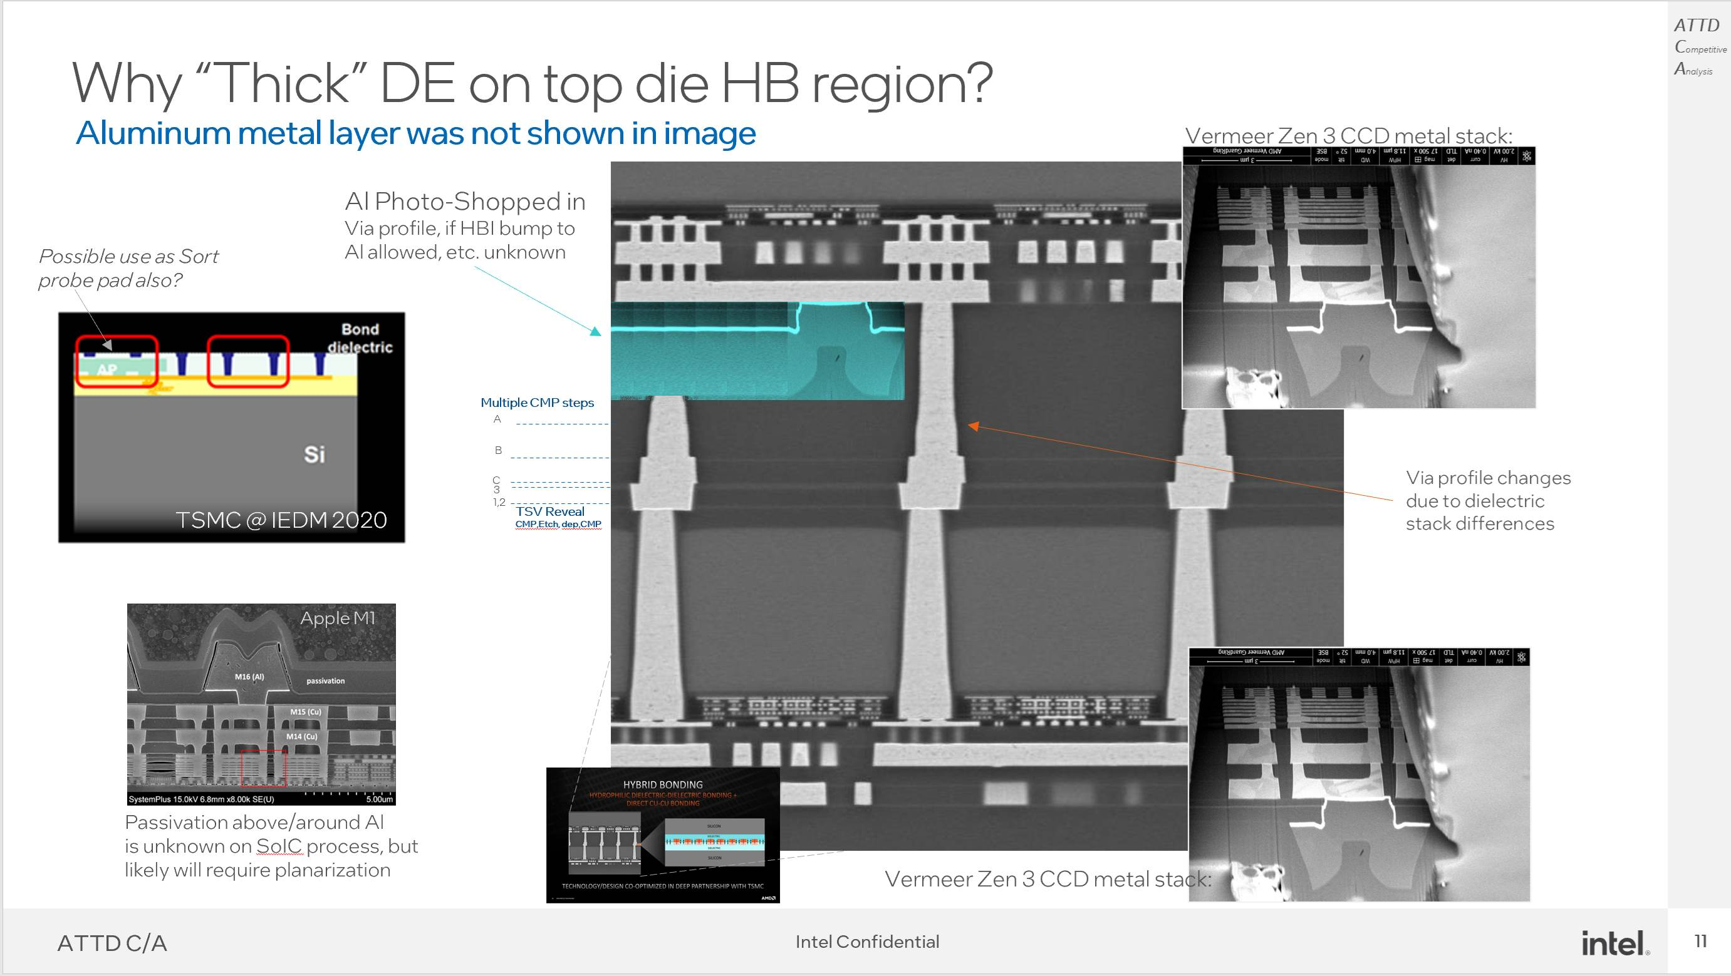
Tom DeBonis

Slide 11
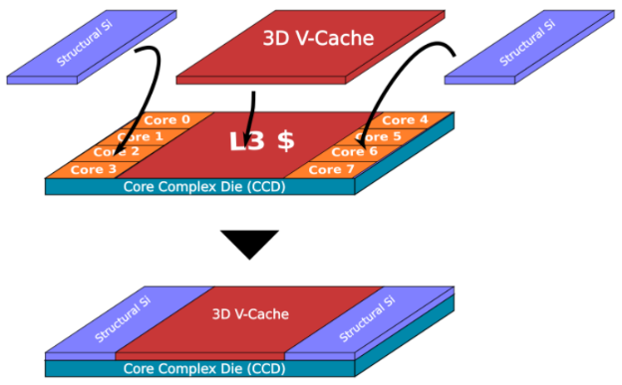

V-Cache + Fusion Bond results in “Monolithic-like” Blocks
AMD/TSMC V-Cache
BSM
Structural Silicon 2
~750um
Oxide Fusion Bond
Oxide Fill
Str. Silicon
Top Memory Die
Str. Silicon
15um
Cu:Cu /Ox:Ox Hybrid Bond
5um
Micro TSVs
Logic Die
10um
Expected TSMC SoIC Process for AMD Zen 3 V-cache
Top Cache Die
& Structural Si
Std Process
HB Pad Surface Prep
Plasma Singulation on frame
C2W Bond (20um die)
PECVD SiOx Gap Fill, Backgrind
Std Process + TSV & Sort
Passiv/Bond /TSVReveal/ HB pads, CMP
Finish Std Process: Bumps, etc.
Fusion Bond Structural Silicon 2
CCD Base Wafer
Tom DeBonis

Slide 12
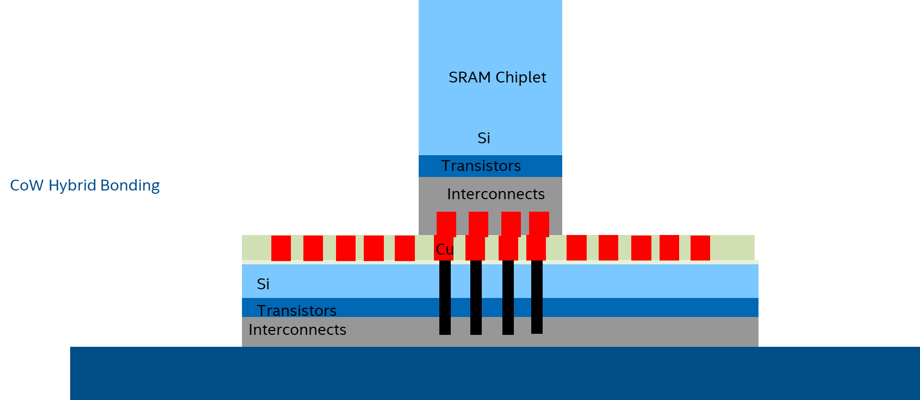
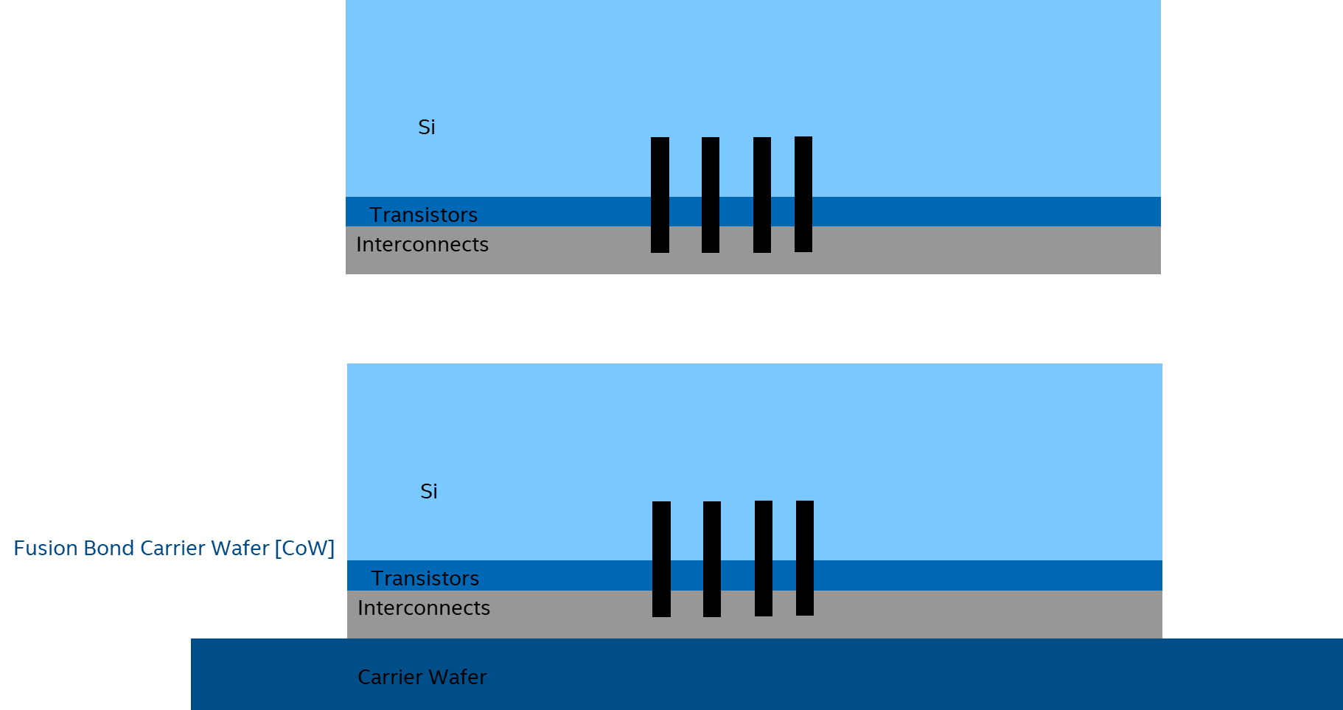
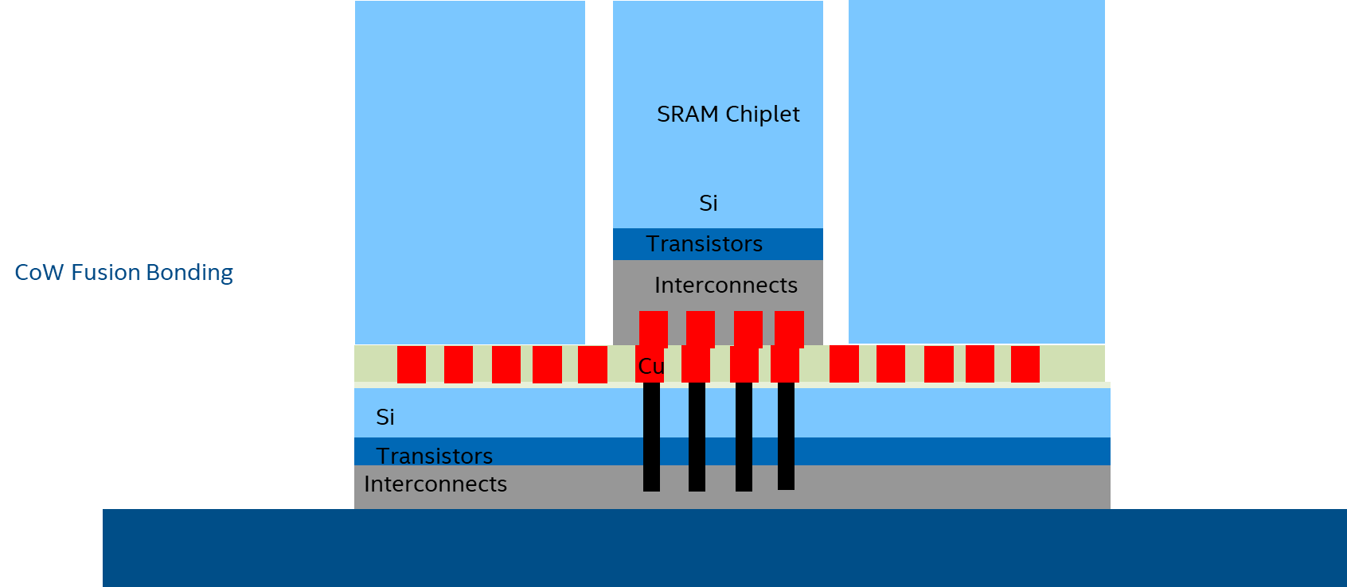
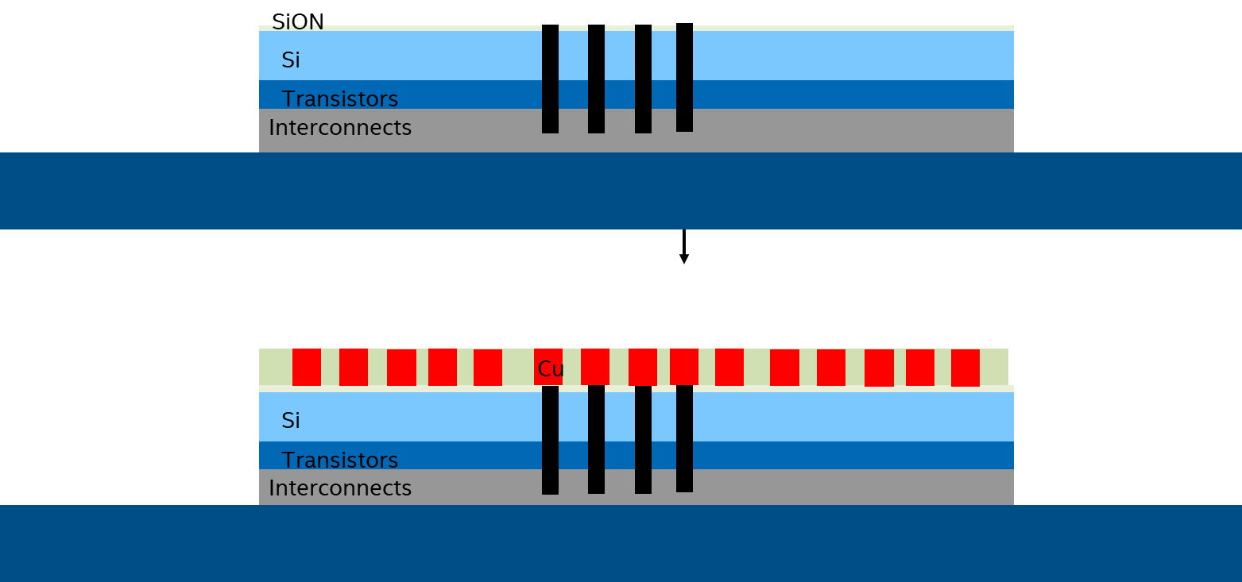
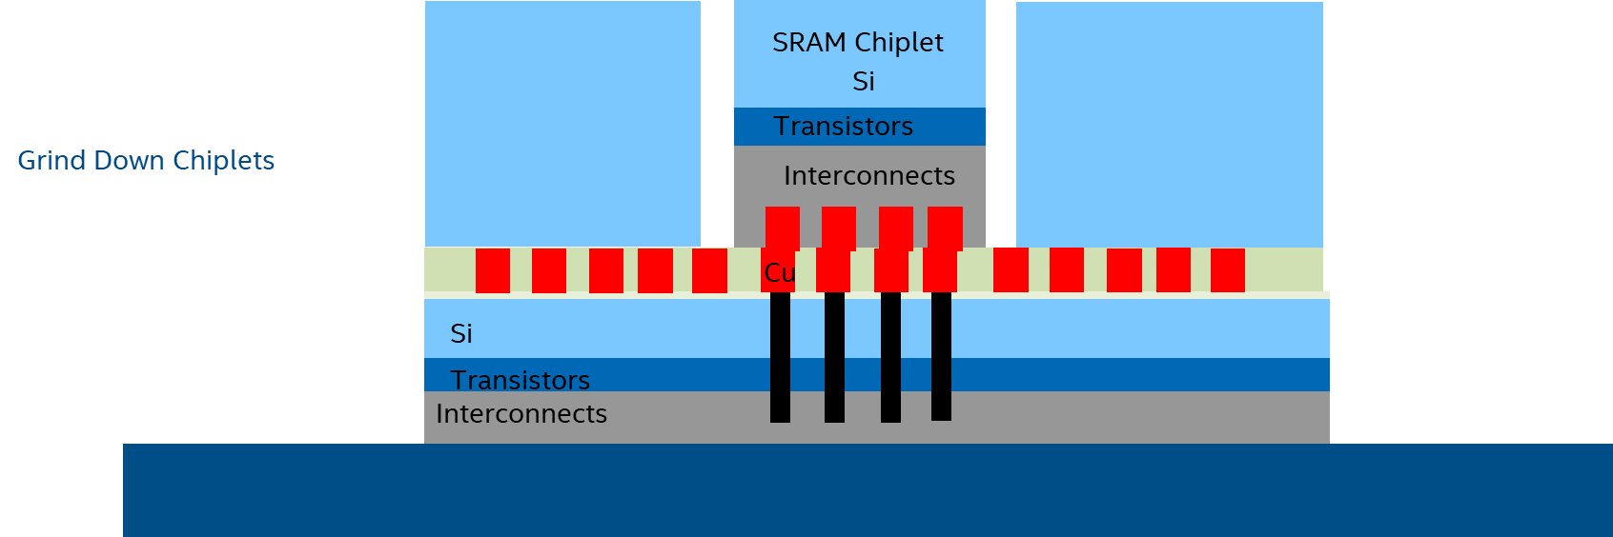
Flow for V-cache [speculation]
Multiple CoW to fill Wafer
Grind/Expose TSV
Stack Si structural support wafer on back to expose base die Al-pad and C4 bump;
Std A&T after that
Cu Hybrid Bond Pads
prashant majhi, FTE
prashant majhi

Slide 13
Flow for V-cache [speculation]
Multiple CoW to fill Wafer
Grind/Expose TSV
Cu Hybrid Bond Pads
prashant majhi, FTE
prashant majhi

Slide 14
SRAM Chiplet
SRAM Chiplet (Cube)
SRAM Chiplet
Si
Si
Si
CoW Hybrid Bonding
Interconnects
1x SRAM Stack
[CoW]
4x SRAM Stack
[WoW + CoW]
Cu
Si
Transistors
Interconnects
prashant majhi

Slide 15
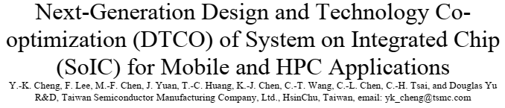
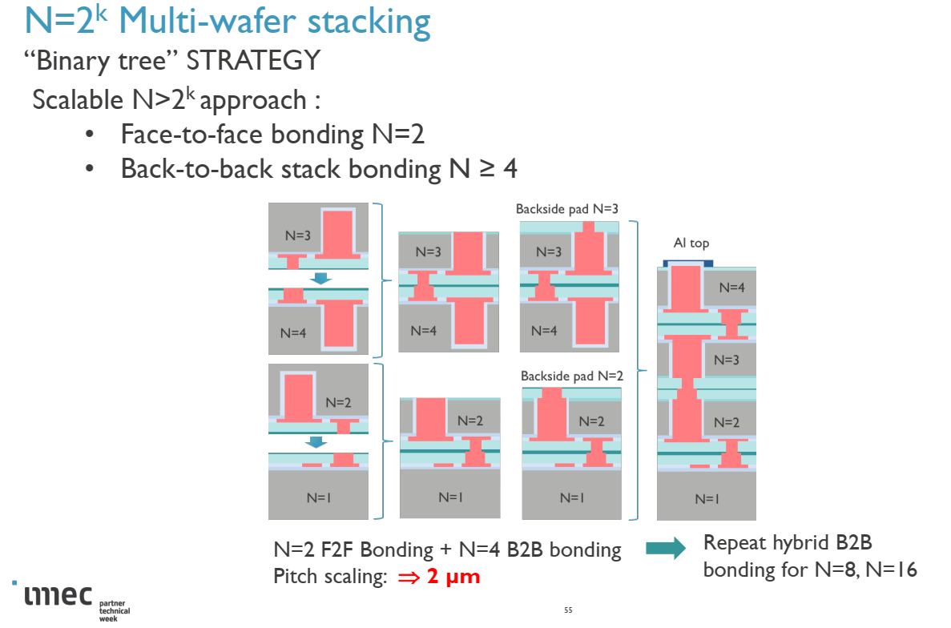
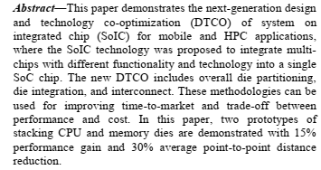
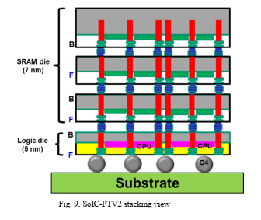
AMD V-Cache: Future?
HB for SRAM/Cache on Logic: AMD/TSMC 2/3
Epyc BIOS with #N Stack
Speculative CoW Flow
TSMC IEDM ‘20
prashant majhi, FTE

Slide 16
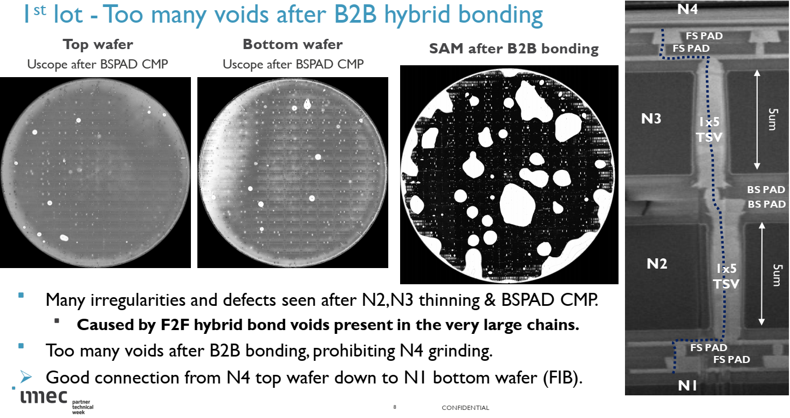
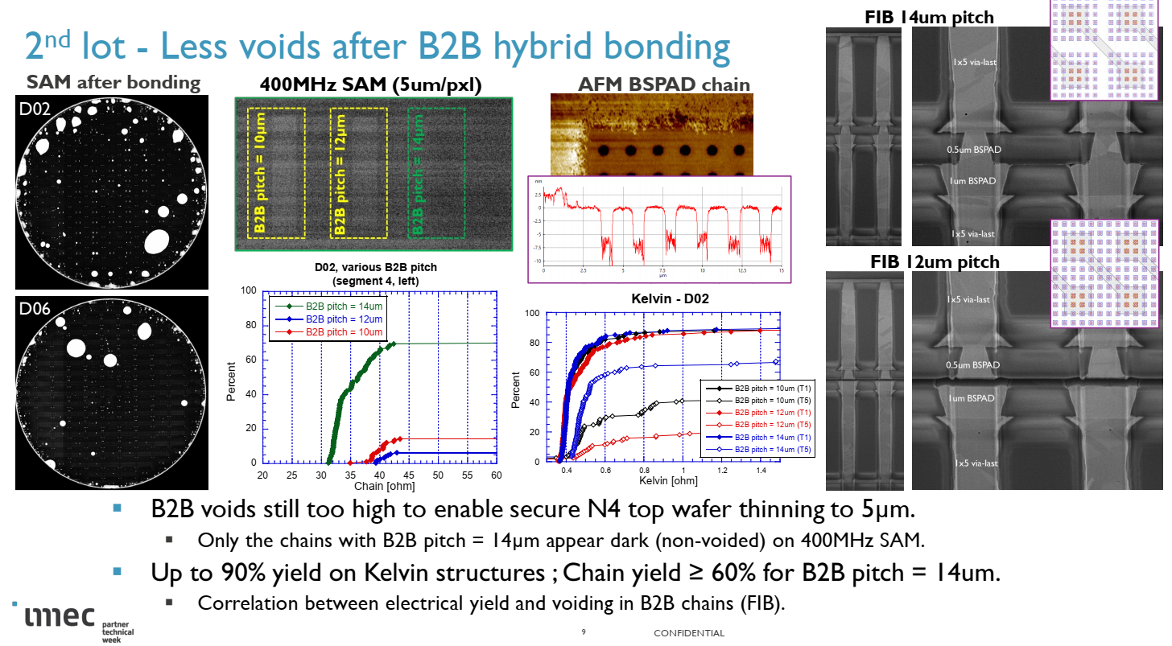
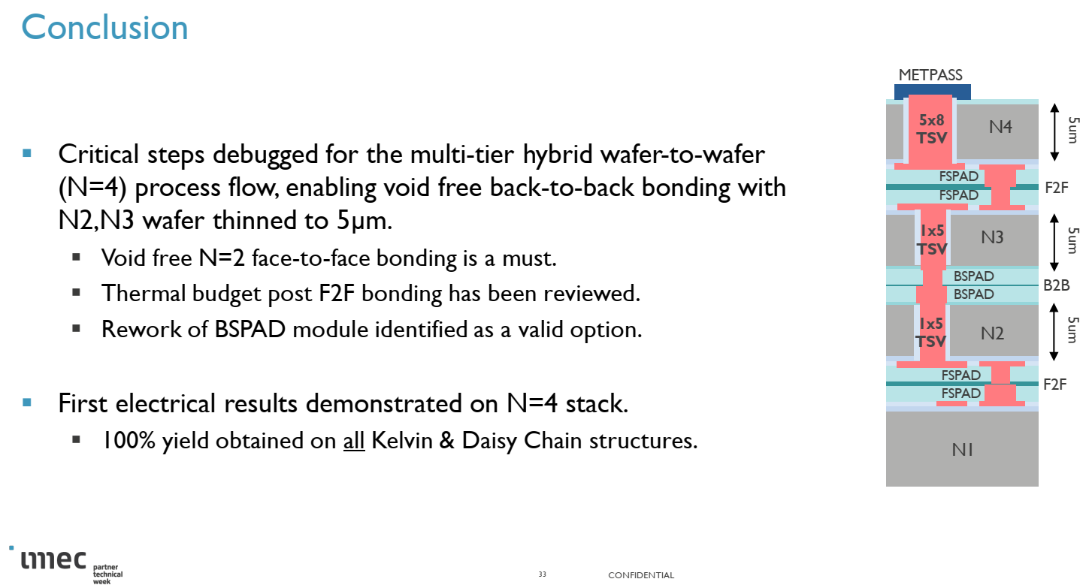


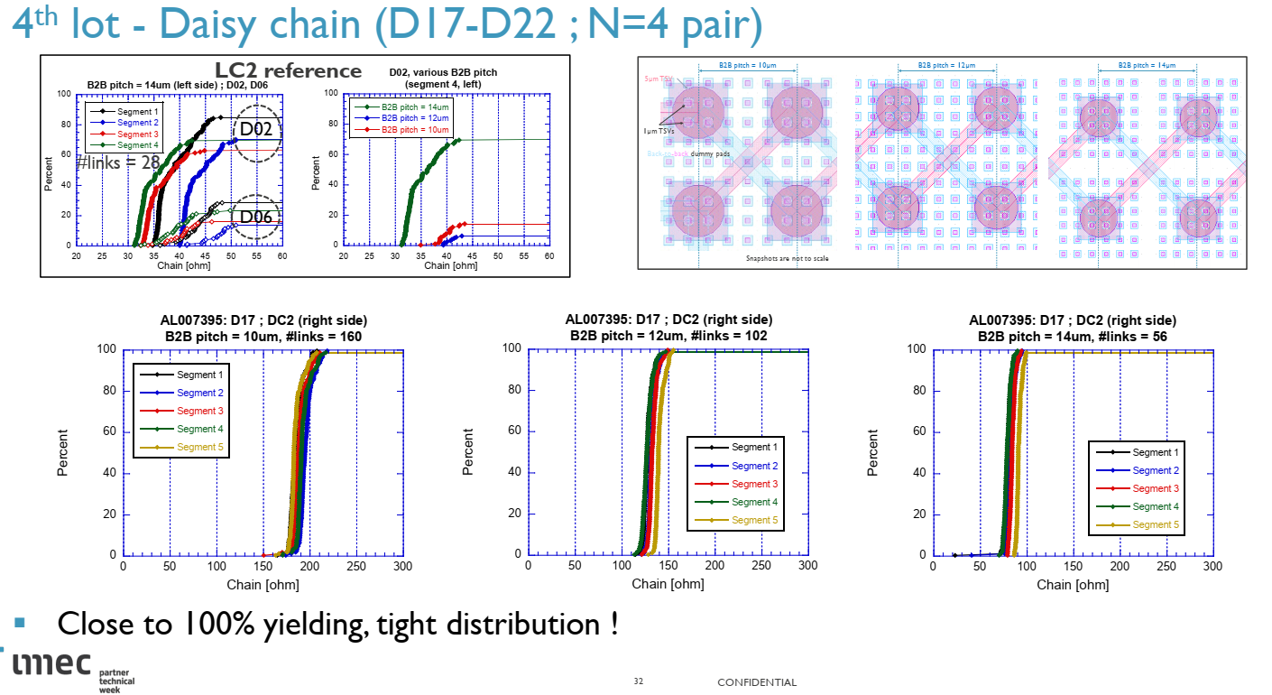
IMEC Process Dev/Learnings with WoW (N=4)

Slide 17
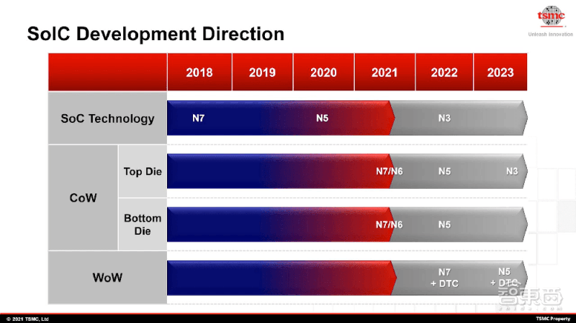
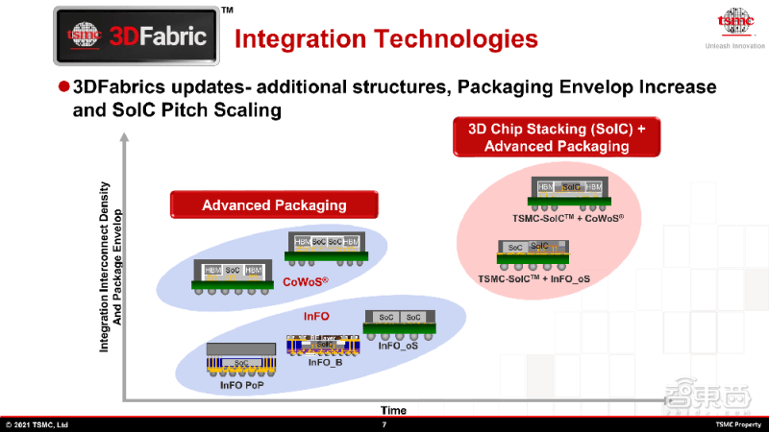
3D Chip Stacking + Adv Packaging
https://min.news/en/economy/64f15e0861b4f16760f4ef7b43873b92.html
prashant majhi, FTE

Slide 18
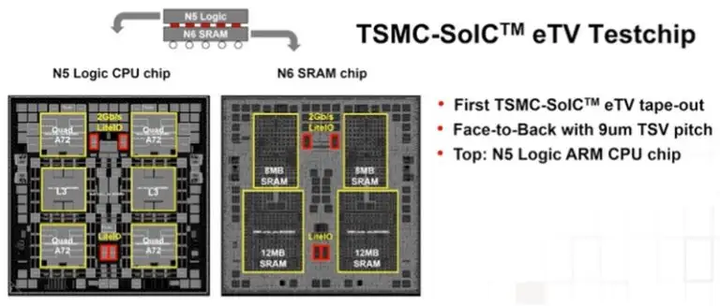
TSMC OIP 2021: eTV with Logic on Top
https://semiwiki.com/semiconductor-manufacturers/tsmc/304612-update-on-tsmcs-3d-fabric-technology/
prashant majhi, FTE

Slide 19
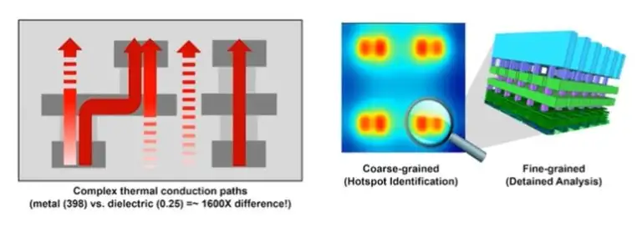
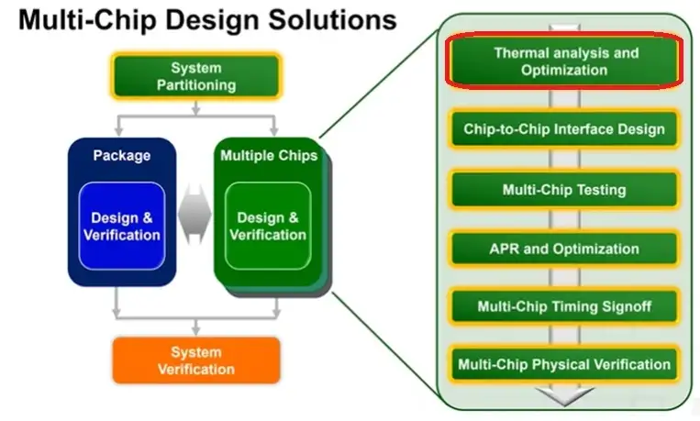
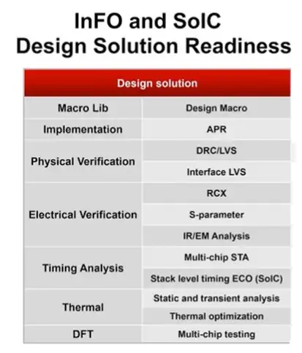
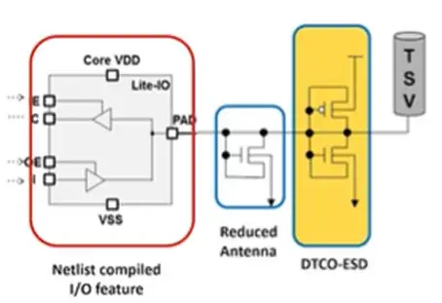
TSMC OIP 2021: eTV and eco-system for 3DIC
https://semiwiki.com/semiconductor-manufacturers/tsmc/304612-update-on-tsmcs-3d-fabric-technology/
prashant majhi, FTE

Slide 20
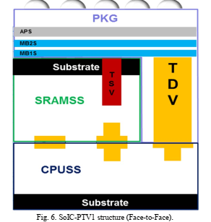
Test Chip #1
Test Chip #2
Wrote About 2 Prototypes TV but only presented one (PTV1)!
TSMC SoIC @ IEDM 2020 “Abstract”
prashant majhi, FTE

Slide 21
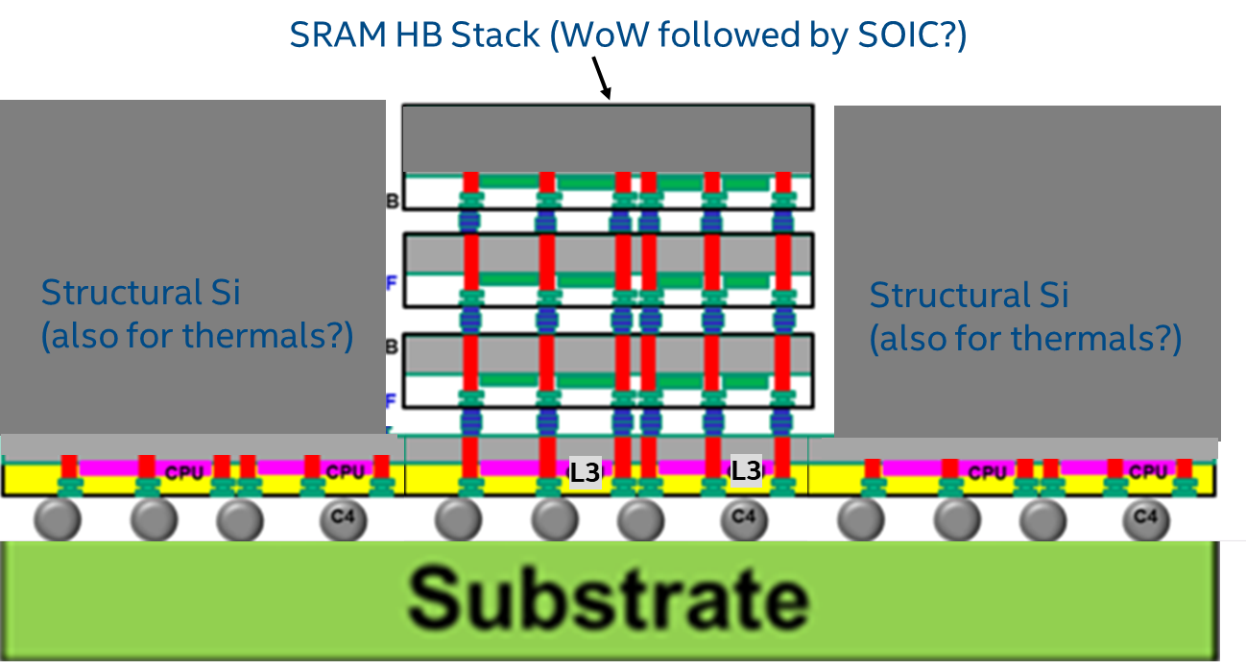
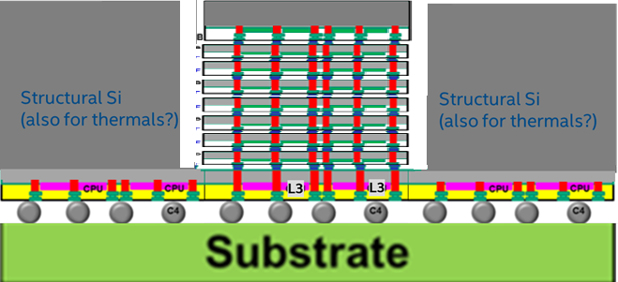
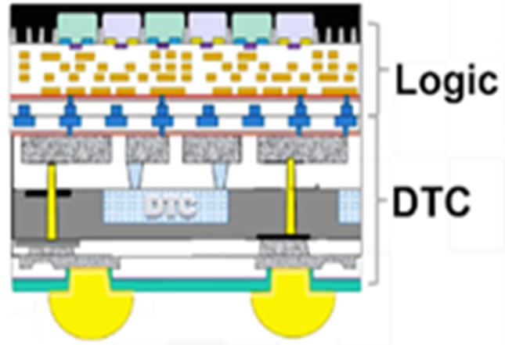

AMD Future 3DIC With Hybrid/Fusion Bonding?
SOIC Multistack SRAM [CCD ⬄ SRAM x N]
WoW Deep Trench Cap for high Cap Density [PI for I/O , CCD ?]
ISMC for Thermals
SOIC [V-Cache] + HBI interposer [CCD⬄CCD… Graphics?]
Logic/DRAM Stack?
WoW Logic + DeepTrenchCap
High MIM Cap Density for Droop and Structural Si support?
Structural Si Also as LSI Interposer
prashant majhi, FTE

Slide 22
F2F(Std)
F2B(std)
F2F (ODI)
F2B (ODI)
F2F (BS-PDN)
RDL like Routing to HB pads
Si (Top):
Si (Top):
Si (Top):
Si (Top):
Socket T
Transistors
Si (Top):
Interconnects
Transistors
Transistors
Transistors
Socket B
Interconnects
Interconnects
Transistors
Interconnects
Interconnects
Interconnects
Interconnects
Transistors
Interconnects
Transistors
Si (Bottom):
Transistors
Si (Bottom):
Transistors
Si (Bottom):
Transistors
Si (Bottom):
Interconnects
Interconnects
Socket B-S
Substrate
Substrate
Substrate
Substrate
Substrate
Feature | F2F (std) | F2B (std) | F2F (ODI) | F2B (ODI) | F2F (BS-PDN)
Socket T | Bump/Pad [R,L,C] | Bump/Pad [R,L,C] | Bump/Pad [R,L,C] | Bump/Pad [R,L,C] | Bump/Pad [R,L,C]
Adaptor T-B | --NA-- | TSV (B): micro-TSV | --NA-- | TSV (B): micro-TSV | --NA--
Socket B | Bump/Pad [R,L,C] | Bump/Pad [R,L,C] | Bump/Pad [R,L,C] | Bump/Pad [R,L,C] | Bump/Pad [R,L,C]
Additional routing T-S | TSV (B) | TSV (B) | TMV | TMV | nano-TSV(B) + IC(B)
Adaptor B-S | TSV (B) | --NA-- | TSV (B) | --NA-- | nano-TSV (B)
Socket B-S | C4 bump | C4 bump | C4 bump | C4 bump | C4 bump
prashant majhi, FTE

Slide 23
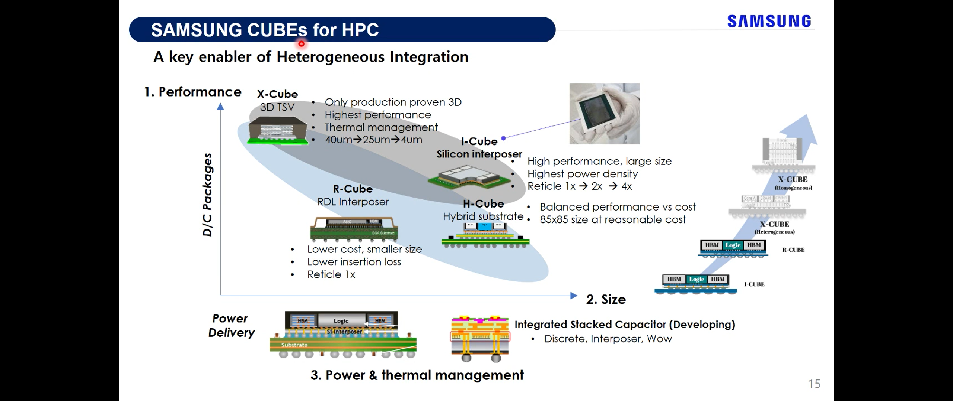
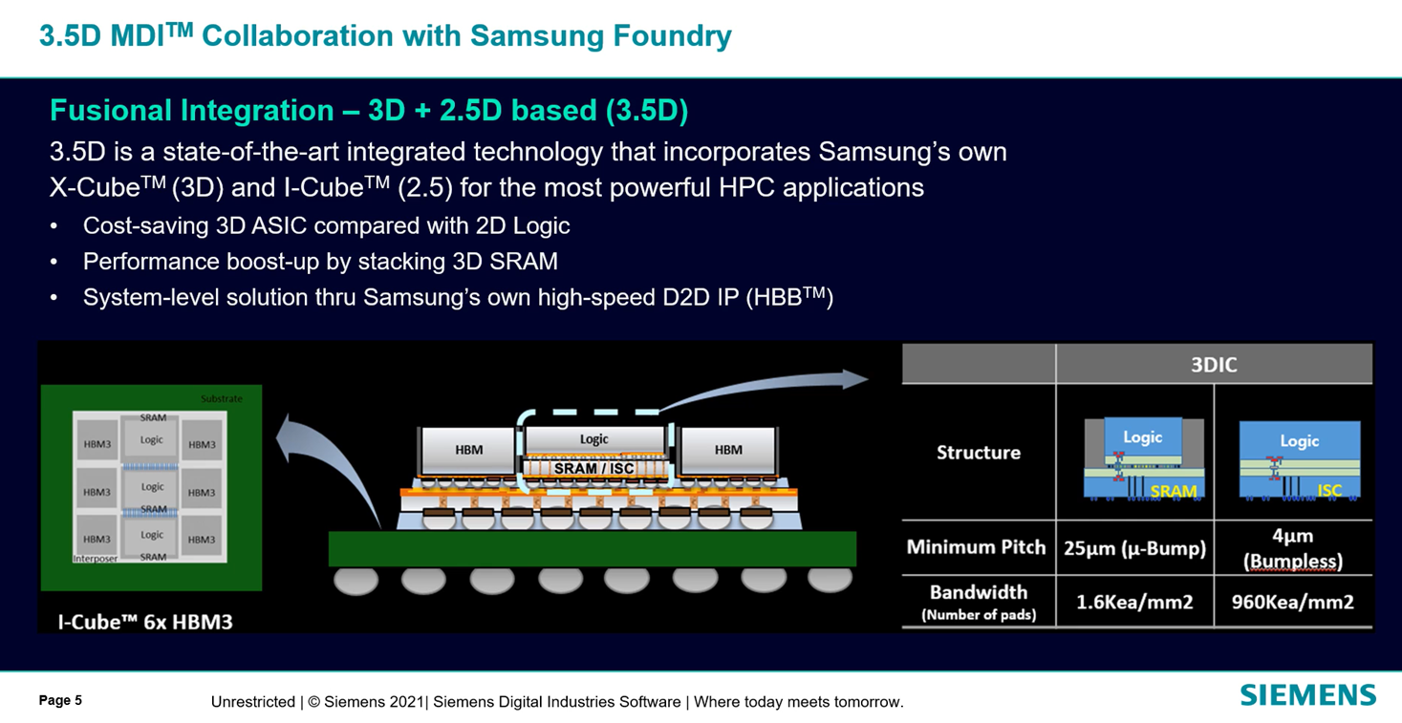
Samsung @ SAFE 2021
prashant majhi, FTE

Slide 24
Samsung @ SAFE 2021… HB Stacking DRAM?!!
prashant majhi, FTE

