Slide 1
Co-optimization Pipeline 3-5 year horizon
Q1’20 TD BU Update
Ramune Nagisetty, Vivek Rajan, Nick Kuhlman
Ying Zhang, Gary Patton
Ack: Adel Elsherbini, Shawna Liff, Debendra Mallik
Lalitha Immaneni, Sujit Sharan, Ravi Mahajan
Wilfred Gomes, Scott Siers, Sanjay Thodupunuri, Chris Mozak
Doug Ingerly, Ben Sell, Fatih Hamzaoglu
Eric Fetzer, Srinivas Chennupaty, Pushkar Ranade, Ajat Hukkoo
March 27, 2020

Slide 2
Outline: Co-op Quarterly Update
Timeline | Primary Focus
Sept 2019: Power Delivery | FIVR scaling challenges Stacked 1222 and GaN power delivery chiplets
Dec 2019: Tightly Coupled Memory | ADM roadmap and future capacity requirements > drives multi-die stacking Need to stay in tune with external ecosystem options
March 2020: 3DIC Reference Design (Testchip) and Platform (TFM) | Problem statement and specific examples Competition Recommendation Establish new 3DIC testchip swimlane and roadmap Two areas: 1) Near term TFM and 2) development for hybrid bonding Supported by TD Design Enablement & IPSG PESG and Testchip Engineering
3DIC is a common theme
Notes:
IPSG: PESG and Testchip engineering
XSI (codesign) has been aligned to MTL. Kalyan is sponsoring. Next week will be a review on that.

Slide 3
Q1 Co-Op Focus Areas & Key Messages
Area | Topics (Jan-Mar’20) | Key Messages
Process Technology | 1280 update | Emerald Tyche is a promising scaling path.
Physical Integration | Foveros-TS, Active EMIB, ODI | Stacking 4 high would require new tooling Foveros-TS is an option that offers more flexibility between top and bottom die and could be available sooner than ODI Would need to singulate die in the base wafer in order to provide similar test coverage for top and bottom dies 1x2 reticle passive interposer is uncommitted
Memory & IO | Co-packaged Photonics | Evolution towards copackaged optics with ring modulators in 2024. Asking for feedback on integration concepts.
Product/Arch | MTL ADM Update Lion Cove GNR Passive vs Active EMIB Decision | MTL: tighter ubump pitches and ODI could reduce die2die interconnect overhead and improve power delivery to the top die. LNC: industry standard TFM and process-agnostic design style
Common theme: 3DIC and Packaging Technologies
Notes:
Silicon hotspot mitigation can be done through improved floor planning. The HEAT tool can provide quick turn analysis for the TR phase and also be used to provide u-arch and SOC design guidelines. GNR will pilot this tool to highlight SKUs that violate the design guidelines. Need help to formalize the use of this tool among design teams.

Slide 4
Problem Statement & Examples
TFM | Validation | Technology Development | Design and Architecture
Products are pipe cleaners for TFM issues, causing delays in execution. No common 3DIC silicon/package/board co-design tool across product teams. | IPs are unproven in stacked die configurations and could slow down post-silicon validation. | Need product benefit/tradeoffs/risks in order to justify significant investment and to align timing of HVM readiness. | Products need to gain confidence in unproven capabilities, and need to experiment with new concepts.
Lack of industry standard model enabling hinders EoU. TSV as hard IP instead of TSV-as-a-Via in LKF and PVC caused base die routing congestion and poor utilization. | Power delivery IPs that are the long pole in the tent for validation are untested in 3DIC configurations. Adds risk for VR implementations. Connectivity on CPX4 | Late requirements: MTL asking for an increase in # of metal layers for ADM base die. Additional RDL layers needed for MTL to remove TSV-PSB landing requirement. | IP placement and readiness with respect to C4 vs uBump pitch mapping. PVC Learnings: Blocks that are rotated and flipped need to align with TSV and PSBs. Could have used additional RDL.
General Problem
Specific Examples
1. Pre-execution preparation
2. Longer horizon exploration
Dramatic improvement required

Slide 5
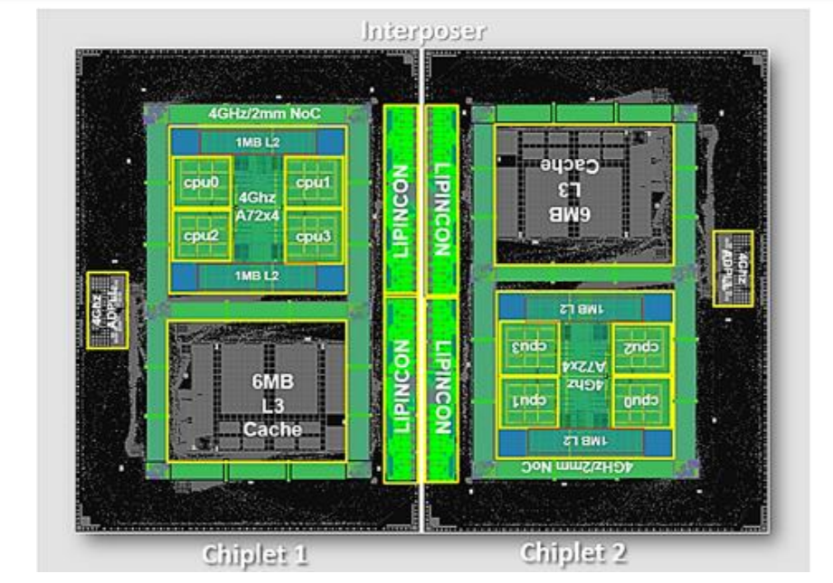
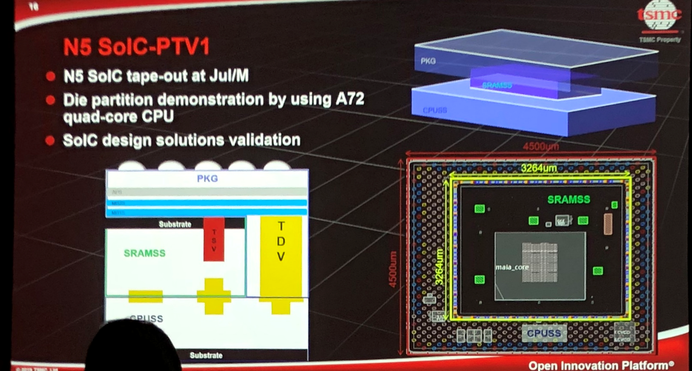
Competition- Design ARM/TSMC test vehicle examples
1. Pre-execution preparation
2. Longer horizon exploration
ARM 4 GHz SoC on on silicon interposer with LIPINCON die2die PHY, Sept 2019.
IP readiness for 3DIC
0.56pJ/bit power efficiency at 8 GT/s.
1.6Tb/s/mm2 bandwidth density.
ARM/TSMC Hybrid Bonding with TDV in mid-2020
Test vehicle with stacked CPU and SRAM test vehicle
Hybrid bonding improves encroachment.
TDV allows smaller bottom die- better for PD, HSIO.
PHY HIPs can keep C4 bump pitch.
Notes:
Is this an internal TSMC team? I do not know, but I suspect. Add another example ARM plus LIPINCON die2die PHY on COWOS. Our strategy should be, take the Atom CPU core, pick a generic fabric like GNR, and build something to prove the concepts out. Minimizing the explicit IP creation. Allows us to explore the concepts of the max number of cores, etc. We may also realize that there are design side changes that are needed.
Our flows have become 3D capable. No silicon escapes on LKF. Expect no escapes on PVC.
Start with a passive/continuity TV to explore the DR space.
The SRAM TV doesn’t have any high speed circuits. Ask Adel for this content.
https://www.tsmc.com/tsmcdotcom/PRListingNewsArchivesAction.do?action=detail&newsid=THWQSTTHTH&language=E
This single proof-of-concept chiplet system successfully demonstrates the key technologies for building an HPC System-On-Chip (SoC) with Arm-based cores operating at 4GHz in a 7nm FinFET process. The chiplet system also demonstrates for SoC designers an on-die, bi-directional interconnect mesh bus operating at 4GHz, and a chiplet design methodology connected by an 8Gb/s inter-chiplet interconnect over a TSMC CoWoS interposer.
Rather than the traditional SoC approach of combining every system component onto a single die, chiplet designs are optimized for modern HPC processors which partition large multi-core designs into smaller chipsets. This efficient approach enables functions to be split into smaller, separate dies which provide for the flexibility of producing each chiplet on different process technologies, as well as delivering better yields and overall cost effectiveness. And to ensure the highest levels of performance, chiplets must communicate with each other through dense, high-speed, high-bandwidth connections. To address this challenge, this chiplet system features a unique Low-voltage-IN-Package-INterCONnect (LIPINCONTM) developed by TSMC which has reached data rates of 8Gb/s per pin with excellent power efficiency results.
Chiplet System Details The chiplet system is comprised of a dual-chiplet CoWoS implemented in 7nm, with each chiplet containing four Arm Cortex®-A72 processors and an on-die interconnect mesh bus. The die-to-die inter-chiplet connection features scalable 0.56pJ/bit (pico-Joules per bit) power efficiency, 1.6Tb/s/mm2 (terabits per second per square millimeter) bandwidth density, and 0.3V LIPINCON low-voltage interface achieving 8GT/s (Giga Transactions per second) and 320GB/s bandwidth. The chiplet system was taped out in December 2018, and produced in April 2019.
“This latest proof-of-concept with our longtime partner TSMC is an excellent foundation for future production-ready infrastructure SoC solutions which will integrate TSMC’s innovative advanced packaging technology with the unmatched flexibility and scalability of the Arm architecture,” said Drew Henry, Senior Vice President and General Manager of Arm’s Infrastructure Line of Business.
“This demonstration chip is an excellent showcase of the system integration capabilities we offer to our customers,” said Dr. Cliff Hou, Vice President of Technology Development for TSMC. “TSMC’s CoWoS advanced packaging technology and LIPINCON inter-chiplet interface enable customers to partition large multi-core designs into smaller chiplets that deliver better yield and better economics. This Arm and TSMC collaboration further unleashes our customers’ innovations in high-performance SoC design for cloud-to-edge infrastructure applications.”

Slide 6
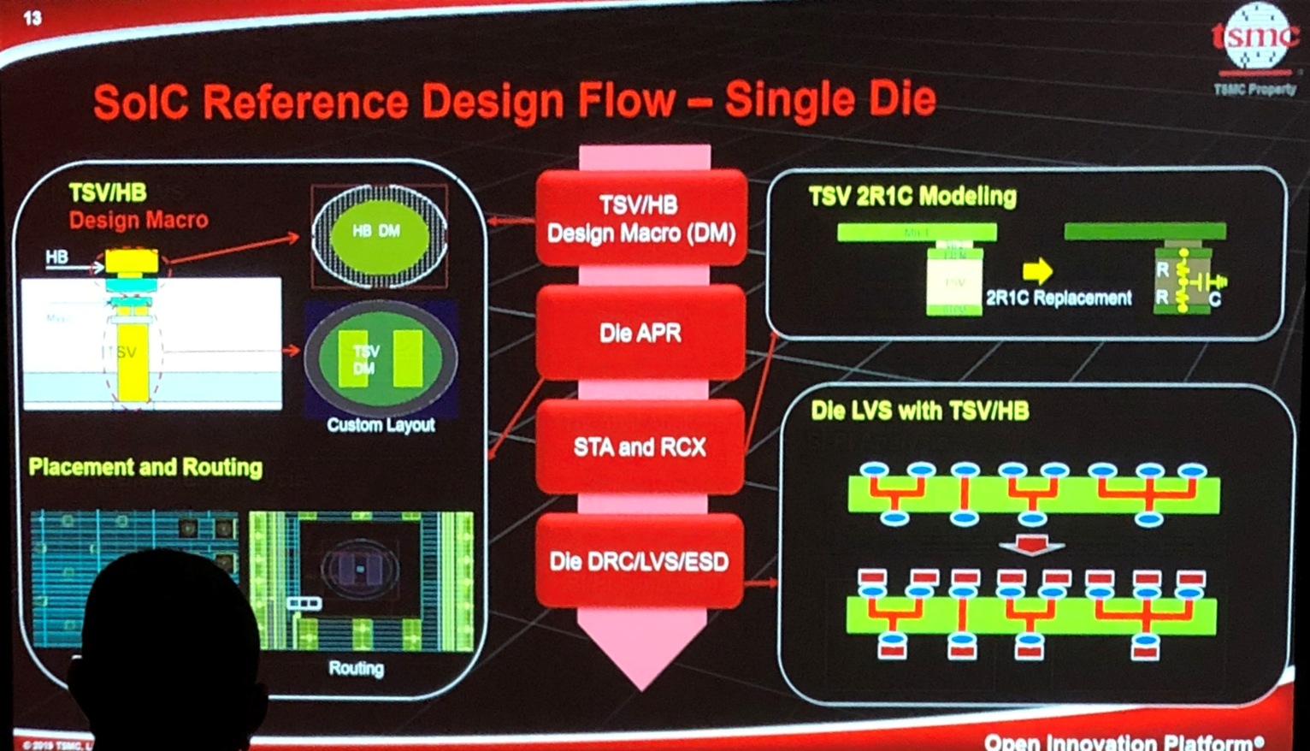
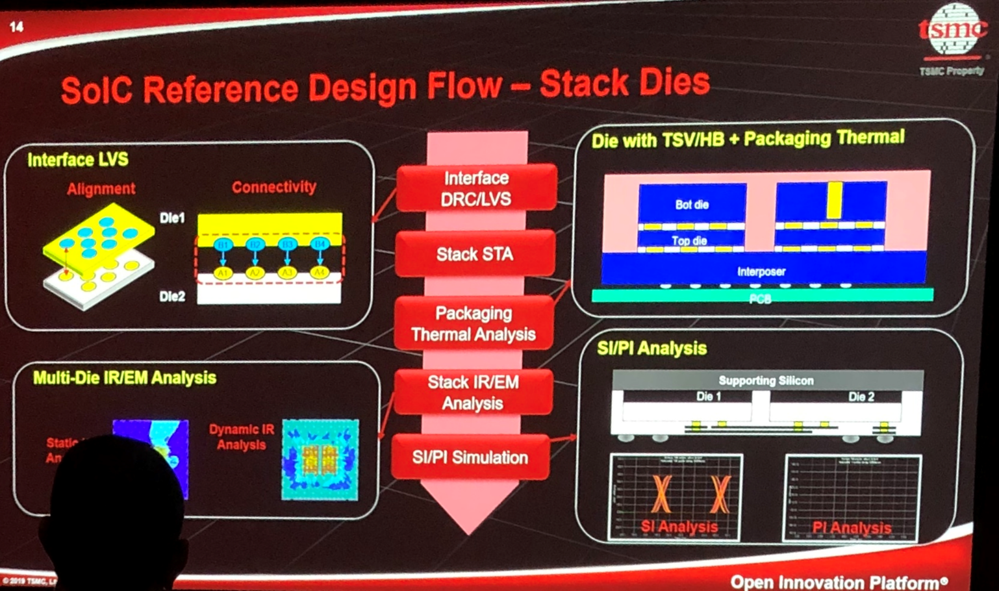
Competition- TFM
STA- static timing analysis
RCX- RC extraction
HB- bump
Macro- physical representation turning into a linear model or RLC element. (2R1C replacement for TSV)
TSV guard ring
SI/PI signal and power integrity
IR/EM- heat map and electromigration
Competition has single die and stacked die reference design flows.
Design Enablement should share productizable reference flows
Notes:
Charter for reference flow would be in PESG
General shuttles focused on IP development, not for 3D learnings
How do you plan a reticle so a die can be converted for 3D
Reference flow used to be offered to ICF customers. Do not have a good TFM for a stacked die. Have not worked closely with EDA. From project to project we learn from each other. Need to prioritize and resource this.

Slide 7
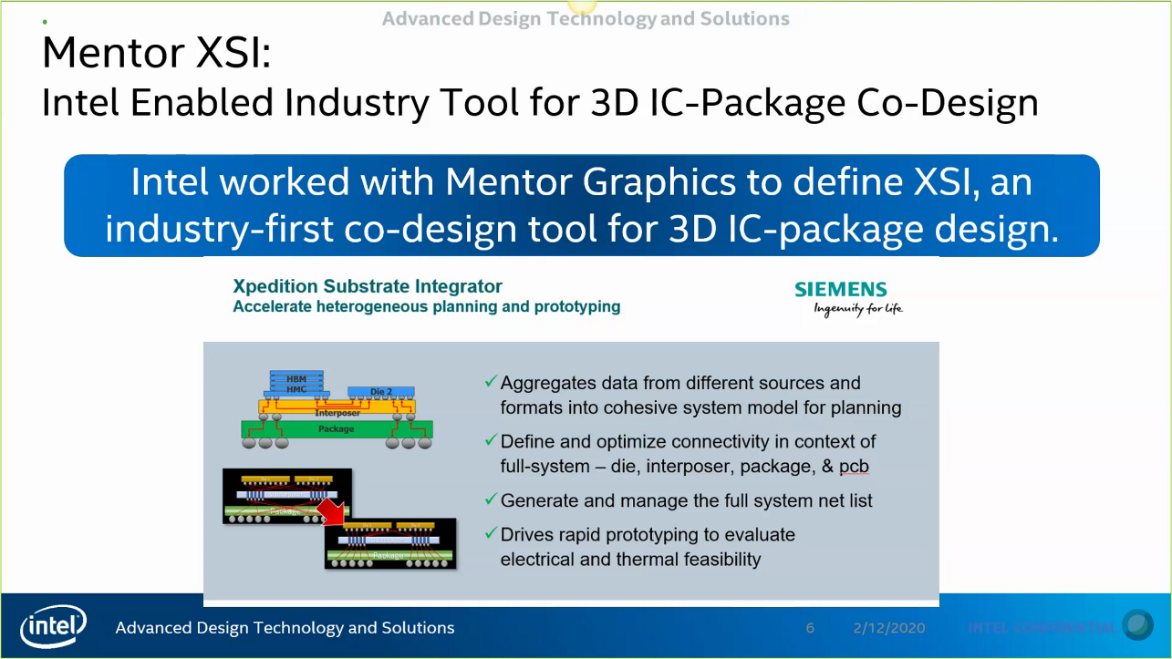
State of TFM at Intel
Non-industry-standard HIP-based TSV exists for LKF and PVC
Industry standard TSV-as-a-Via and 3DIC TFM being enabled for MTL as 1st intercept
Most tools have extended from monolithic to 3D capable
Timing, characterization, ESD, construction, place and route, signoff
TSV-as-a-Via supports EOU and industry automation (RDL automated routing, no tricks in signoff)
Co-design opportunity identified for 3DIC TFM improvements (Kalyan, Lalitha)
Mentor XSI silicon-package-board codesign cockpit
End to End connectivity verification
POR for IOTG Oyster Bay
Aligning with MTL and GNR
Notes:
add Oyster Bay as intercept for IOTG
End to End connectivity verification (avoid CPX4 issue) on XSI deployment on track for WW13
Do you want me to send AMD / Qualcomm example?

Slide 8
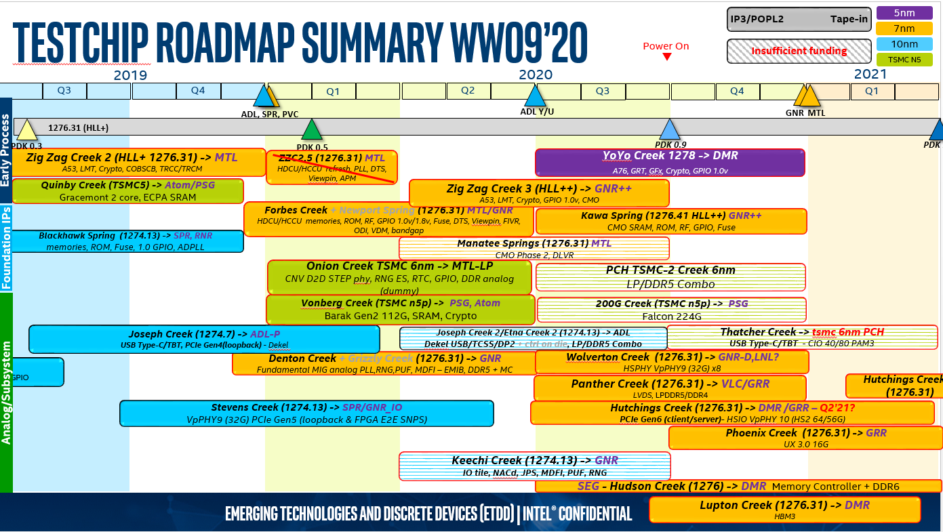
Proposal: Add a 4th Shuttle Swimlane
Early Process Technology
Foundational IP
Analog Subsystem
New swimlane: 3DIC Technology
Focus on 3DIC technology development, packaging, co-design exploration, PDK, and TFM readiness
Should be owned by IPSG Testchip Engineering and TD Design Enablement

Slide 9
1) A 3DIC Reference Platform Model for pre-execution readiness
Tech Readiness
(Application Team)
SOC #1
SOC #1
Design Enablement
Tech Readiness
(Application Team)
SOC #2
Design Enablement
3DIC Reference Platform
DE + IPSG + EDA Vendors
(Application Team)
SOC #2
Tech Readiness
(Application Team)
SOC #3
SOC #3
Current
Proposed
Proposal
Build a complete reference design, along with application notes that is directly leveraged by products teams
In this case, 3DIC Reference design is built by joint collaboration between DE + IPSG + EDA vendors
Create shuttle program that is 3DIC friendly (seat and frame size compatible for stacking)
Benefits to the product execution teams
Proven TFM and Collateral (PDK) support for new technology (Example: TSV)
A reference design (example implementation and good documentation) jump-starts product implementation
Net outcome is predictable product execution and schedule

Slide 10
2) A 3DIC exploration roadmap to inform technology development and architecture directions with focus on hybrid bonding and advanced ODI capabilities
In flight:
ATTD/CR/LTD 3DIC hybrid bonding testchip with 1222 SRAM on 10 nm SRAM
Results expected by Q1’2021
Pre-tape out learnings:
Top metal design rules required changes to support 10 um pitch
Need a fine pitch conversion flow
Need a flow for checking die stacking nets/design rules. Teams have been using custom scripts.
Future proposals:
Multiple Atom or ARM cores instantiated on SRAM or ADM
like TSMC N5 test vehicle
Multi-high SRAM or ADM stacking
Face to face versus face to back, thermal explorations
Speculative: core folding, FPGA folding, topside power, DMR disagg
SRAM on SRAM
HBI
4 1222 SRAM chiplets on 10 nm FOV SRAM
Cores on SRAM
HBI + ODI
Similar to TSMC testchip with
ARM cores on SRAM
Notes:
Piece that is missing: who sets the design rules. Scratch PDK -.1 for early use. OPC, litho, fab support, etc. Doug: Need resourcing from LTD as well. Currently this is a secondary item. Not in the key deliverables to deliver to product.
Design wants to be able to ignore this, focus on the important part of the design, want all the other connections to not get in the way. They want tight pitch because they think it won’t impact the IP.
FLI design rules:
Current top metals design rules does not allow 10 um pitch. We worked with PTD to enable those and verified that they can be fabricated through our passive test chips.
However, those will need to be qualified for production (i.e. reliability, yield, ROI etc.)
PTD helped us develop an initial validation runset for these design rules that were used for validating the passive test chip.
Similar design rules are used for the active test chip (slightly more aggressive)
Fine pitch conversion flow:
None available. I could not find an existing automation tool that allows inputting the coarse pitch design and getting the fine pitch design in a meaningful manner (just arraying the bump pattern does not work).
I developed my own tool that does that (it even worked for another EMIB design with relatively small modifications). I don’t think there is a commercial tool that does that either.
Some design details (through previous analysis or active test chip):
Power traces away from D2D IO IPs are wide and do not benefit much from fine pitch but they benefit from hybrid bonding due to higher Imax per bump and lower bump resistance.
Lead-way routing gets significantly shorter with fine pitch (and thus lower power). This makes the ESD contribution more significant as the pitch gets smaller.
There is no flow for checking die stacking nets/design rules (based on discussions with LKF teams and with SRAM XCHIP designers). Both teams used custom scripts. This is our plan as well for the scaled SRAM XCHIP.

Slide 11
Strawman Recommendation for Discussion
DE and IPSG build a Dedicated 3DIC Design Team
Design Enablement Group | 5 HC for near term TFM on Passive or Memory Interposer, PDK and integration testing with Reference flow
 | 5 HC for Strategic tech, HB, etc. in parallel, catch up to TSMC offering
IPSG Testchip Engineering Group | 10 HC - ZZC style TC on top, validation, drive board & PKG and post-Si lab testing class sort 2x TC per year, +2 minor steppings
 | 9 HC + $500k BTI/year Post-Si debug, board, packaging, TIU, HVM (assuming no new debug tech)
Staffing Portfolio | 1/3 High cost geos, 2/3 Low cost geos 25% external hire, look for experience with 3DIC integration LTD backend integration support required as well
Initial Estimates
Strawman 3DIC Platform Roadmap with staggering between near term TFM and strategic tech
2020 H1
2020 H2
2021 H1
2021 H2
2022 H1
2022 H2
Steering Committee
DE, IPSG, LTD, ATTD, CR, IAGS, SEG
Decision Making Forum: tbd
Decision Maker: tbd
Team Onboarding^
3DIC Reference Design 1.0^
3DIC Reference Design 2.0^
1st 3DIC Test Chip Tape-In^
2nd 3DIC Test Chip Tape-In^
ATTD/CR 3DIC hybrid bonding test-chip ^
3DIC 1278 hybrid bonding Test Chip ^
Long range 3DIC New Technology Test Chip ^
Notes:
ATTD testchipThe passive test chip (testing the FLI) is designed, taped out and fabricated. We are waiting on one last fabrication step before it can be assembled (special dicing).
I completed the initial design of the active test chip (device + ILD + FLI test) for both the top & bottom dies (p1222/p1274 dies) but we are waiting on the tape-out process (validation, mask fracturing, approval of additional layers for dicing/test etc.).
Johanna and Shawna have the detailed timeline for the assembly. The high-level view is to have the active testing completed by Q1’21.

Slide 12
TDBU Feedback
3/27/2020 3DIC Reference Design and Platform Proposal from the Co-optimization Pipeline
Attendees: Murthy, Jim, Raja, Mike, Daaman, Gary, Ying, Babak, Ajat, Vivek, Nick, John, Scott, Ramune
Feedback:
Raja: Need to get all the PVC issues from Balaji. From the Powerpoints it had seemed that a lot more work had been done in advance of execution than actually had been done.
Jim: We are not doing enough to comprehend that IPs actually have to be redesigned for 3DIC.
Mike: We focus too much on the technology, but not enough on enabling and design.
Raja: We will do logic on logic, logic on interposer, logic on memory, etc- all of these approaches will be used.
Daaman: What do we need to do to get ahead of MTL? Nick: IP timelines, resources, shuttle timelines need to align.
Mike: MTL TFM could be validated without actually building the silicon. Vivek: We are developing a presilicon reference design and doing a mock tape in for MTL.
Babak: We will have the capability to ramp HBI in 2023. Competitors may have products in mid-2022.
Murthy: Some things will only be found in product execution, but we still need to be as well prepared as possible. This is a logical and sensible direction. Need to get from here to a roadmap.
Outcome: Agreement that this is the right thing to do. Come back within a few weeks with a roadmap.

Slide 13
Backup

Slide 14
Testchip Table
Testchip Name | Owner/Org | Description | Purpose: TFM/ Validation/ Technology Development/ Design and Arch Direction | Expected impact and timeframe: Pipecleaner, Technology DRs, PDK | Dates: Tape in/ Assembly/ Analysis and Report out
1xCRBB ATTD/CR/LTD 3DIC daisy chain with next-gen solder (NGS) and hybrid bonding interconnect (HBI) | Adel Elsherbini, Johanna Swan (CR) Shawna Liff (ATTD) | Up to 8 passive chiplets stacked on base die (modular design) Utilizing 10 and 20 um pitch NGS and HBI | Develop assembly and fab process for NGS and HBI and characterize FLI performance. | Characterize solder limits and motives to switch to HBI. Fab & Assembly DRs for active HBI test chip. | Tape-in: Q1’19 Process Development: Q2’19-Q2’20 Assembly: NGS: Q3’19, HBI: Q3’20 Analysis and Report out: Q4’20
X74H-HBI* ATTD/CR/LTD 3DIC Stacked SRAM with hybrid bonding interconnect (HBI) | Adel Elsherbini, Johanna Swan (CR) Shawna Liff (ATTD) | 4 1222 SRAM chiplets stacked on 10 nm FV SRAM base die Utilizing 9 um pitch HBI | Prove HBI with active circuits and IP | DRs and TFM for 2023 product intercepts | Tape-in: Q2’20 Assembly: Q4’20 Analysis and Report out: Q4’20-Q1’21
(*) Tentative name

Slide 15
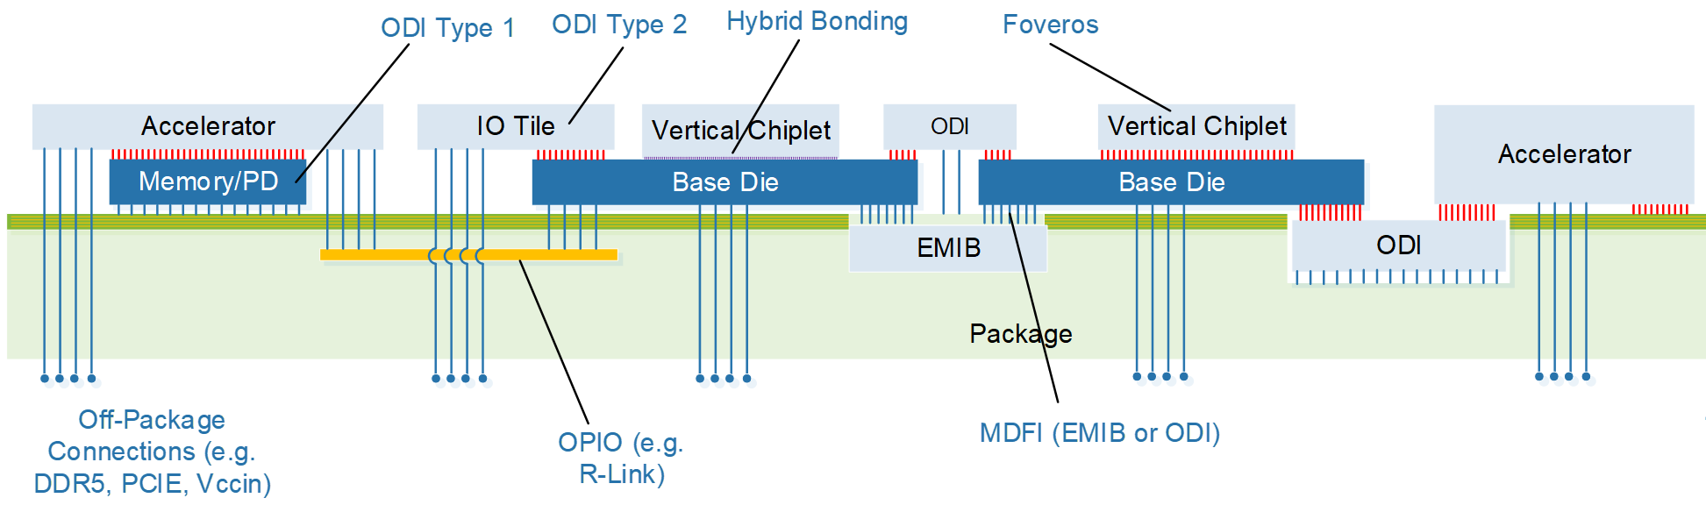
ODI and hybrid bonding
Adel Elsherbini
ODI cantilevered approach could help with power delivery, HSIO, and thermals
Base die size independent of top die, alleviate ADM capacity issues
Base die could be reused across products

Slide 16
Propose to define a 3DIC reference platform
SOC #1
Tech Readiness
(Application Team)
SOC #1
TSMC
TSMC + TFM + Vendors
(Application Team)
SOC #2
Intel TD
Tech Readiness
(Application Team)
SOC #2
SOC #3
Tech Readiness
(Application Team)
SOC #3
See this link: https://news.synopsys.com/2018-10-03-Synopsys-Design-Platform-Enabled-for-TSMCs-Multi-die-3D-IC-Advanced-Packaging-Technologies
This is Industry approach (TSMC specifically) on how to introduce and advance core technology with Silicon design (product) teams
In short the TSMC approach is:
Build a complete reference design, along with application notes that is directly leveraged by products teams
In this case, 3DIC Reference design is built by joint collaboration between TSMC and SNPS
Benefits to the Product teams
Tools and flows native supports new technology (Example: TSV) for all aspects of the flows
A reference design (example implementation and good documentation) directly jump-starts Product implementation
In other words, no need for “TR” by each of the product teams. Net outcome: predictable product execution and schedule
Vivek Rajan

Slide 17
3DIC Platform Proposal
Research Vectors
Design Rules
3DIC Technology
PDK
Foundation IP
Packaging
EDA / Standards
Tools / Flows
3DIC Test Chips
(Assembly, Sort, Post-Silicon Feedback)
Pre-Silicon Reference Design Kits
(Multiple Test Configurations, Full IMPL)
Product / IP Design Environment
CoDesign
(Thermals, Power Delivery, Disaggregation, …)
Design Execution

Slide 18
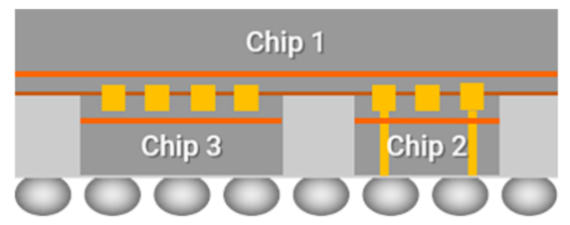
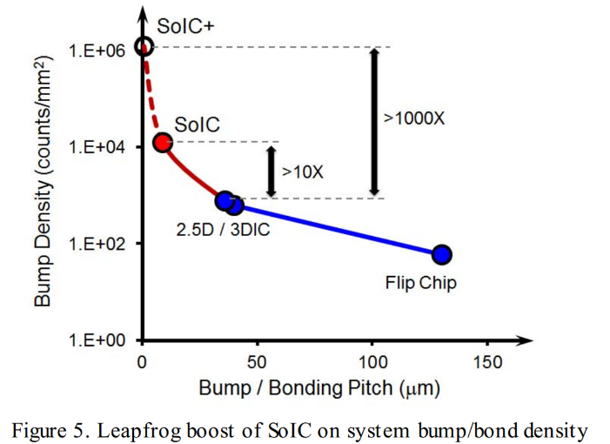
Hybrid Bonding Environmental Scan
Environmental Scan
TSMC (and to a lesser extent GF) have in recent months announced availability of fine pitch (<10 um pitch) interconnects (TSMC target production 2021)
Potential applications include
AI SoC (Huawei)
DRAM Integration (TSMC)
SRAM stacks replacing HBM (Global Foundries)
Intel Status
(CR + ATTD) have a program in place to define similar capability with a target intercept of ~EO 2023
To date we have ID’ed one potential application working with Pradeep Dubey’s group that can use aggressive pitches
Open Questions/Help Needed
Are we missing something i.e. are there other architectures that can benefit from fine pitch stacks? Will we have more than a perception problem to deal with if competitors come up with something that we missed and have to scramble?
Detailed vetting/co-optimization of 1+ archs.
Identify potential products/architecture
Define Key D/R, Pkg/Die Interconnects, Power Delivery, On-pkg & Off-pkg Signaling and Thermals
(Quickly) Identify a small team of key product architects and technologists to do a deeper dive on product arch/process co-optimization
SoIC
Hybrid Bond
(Cu-Cu &
Oxide-Oxide)
[Ref] : TSMC
[Ref] : ECTC 2019, TSMC
Debendra Mallik

Slide 19

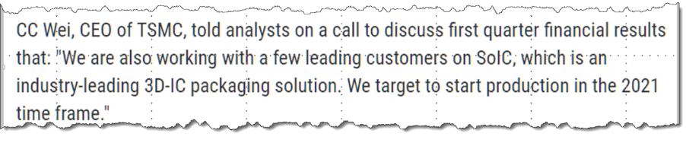

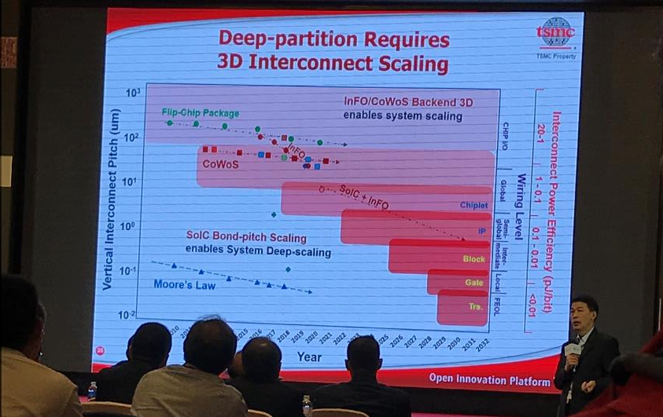
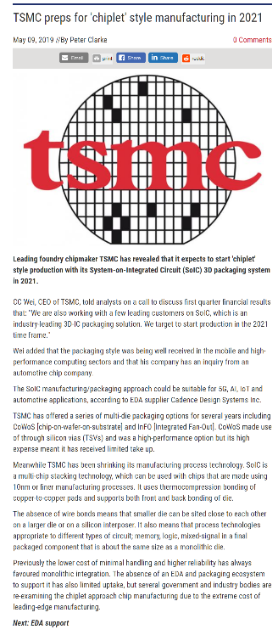
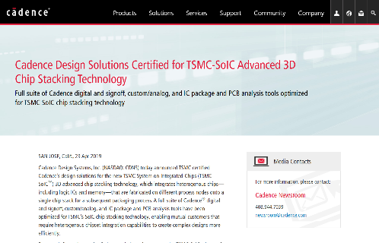
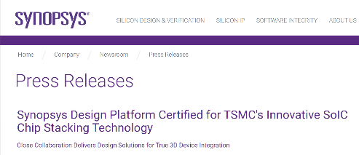
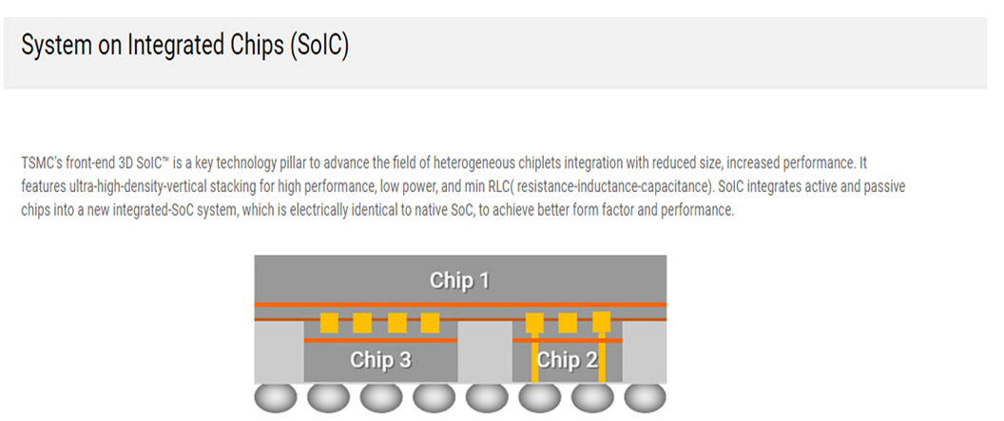
TSMC Target: Start SoIC Production in 2021 Time Frame
“ ’First commercial product expected eo2020 ’ ”
“ ’…could stack 6x7mm DRAM on logic’ ”.

Slide 20
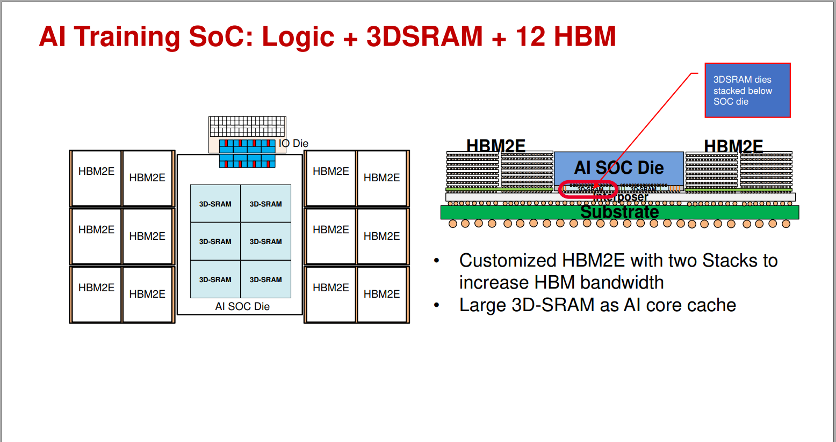
Ref: Huawei 7/2019

Slide 21
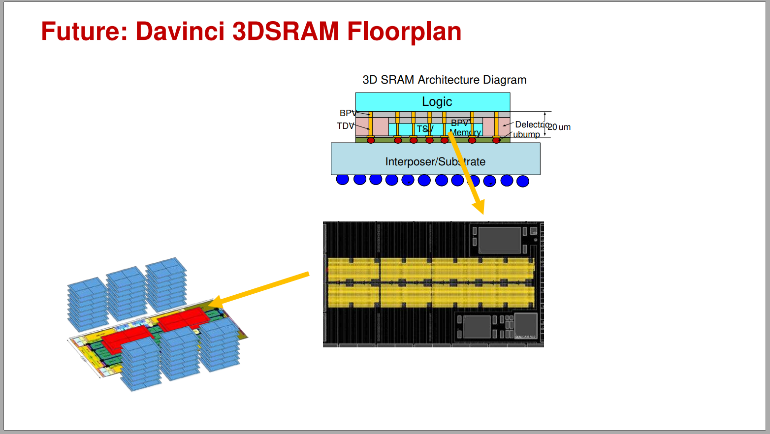
[Ref]: Huawei 7/2019

Slide 22
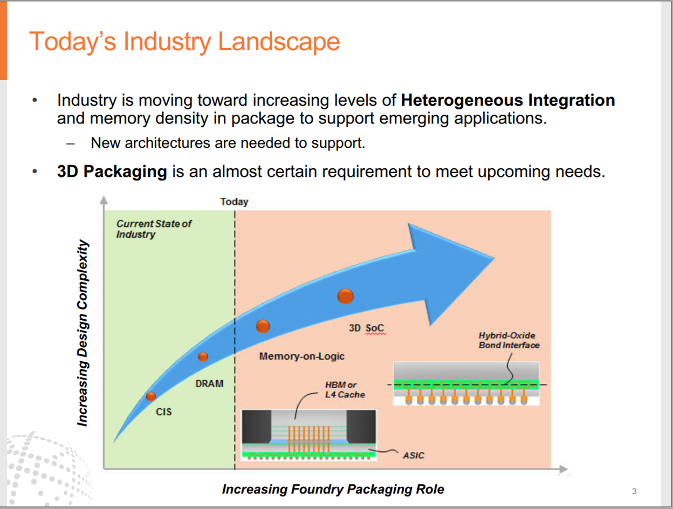
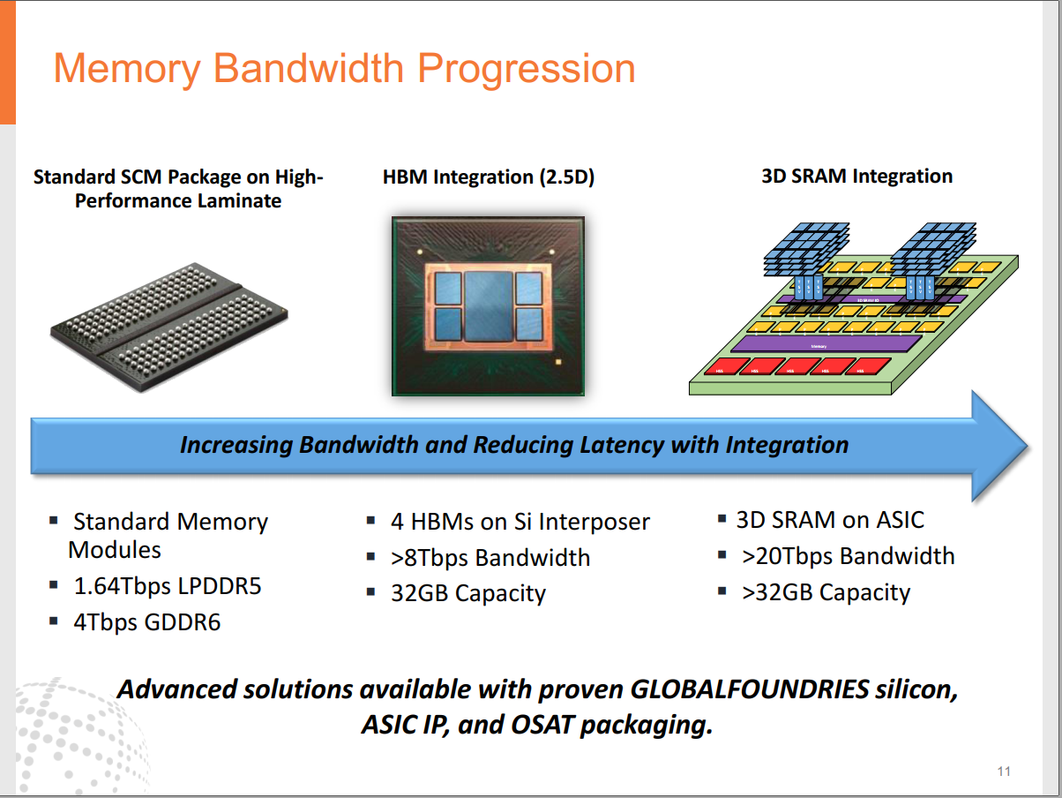
[Ref] : Global Foundries

Slide 23
Graphics/AI Processor Roadmap for IPM
PRQ → | 2021 | 2022 | 2023?
Product | PVC1 | PVC2 | PVC-NG
AI FLOPS | ~400 TF | ~400 TF | ~800 TF + Sparsity
Top Die | i7 | N3? SRAM = ~32-128 MB tbd @ 6TB/s @ 1.5 GHz | N3? SRAM tbd Capacity & BW
Base Die | 10nm SRAM (~240 MB @ 6 TB/s (@1.5 GHz) | ADM (~1.2 GB @ ~2.5-3 TB/s) | ADM STACK (~64 GB @~16 TB/s)
HBM (w/ EMIB) | 4x HBM2 | 4x HBM3 | (n/a)
Potential need for
Hybrid Bonding to create
ADM Stack – Needs Scoping and Co-optimization

