Slide 1
Co-Optimization Pipeline Quarterly Update
tdbu
July 21, 2020
3DIC Reference Design & Test Chip Roadmap
➔HBI-C for Memory Stacking
Ramune Nagisetty, Randy Osborne, Fatih Hamzaoglu, Vivek Rajan, Nick Kuhlman, Lalitha Immaneni, Adel Elsherbini, Shawna Liff, Sonia Leon, Debendra Mallik, Wilfred Gomes, Ben Sell, Srinivas Chennupaty

Slide 2
Evolution over last 12 months ➔ STCO
3DIC Reference Design and Testchip Proposal: HBI-A and HBI-B
3/2020
Tightly Coupled In-Package Memory:
ADM Roadmap & Requirements
Today
12/2019
3DIC Reference Design and Testchip Roadmap:
HBI-C for memory stacking
Power Delivery:
FIVR chiplets, GaN
9/2019
Coop Kickoff & Scope:
3-5 year pre-roadmap horizon
6/2019
STCO = System Technology Co-Optimization
Notes:
July 2019: Kickoff and scope
3-5 year pre-roadmap horizon
Sept 2019: Power Delivery, FIVR Chiplets, GaN
Dec 2019: Tightly Coupled In Package Memory
Mar 2020: 3DIC Reference Design & Test Chip Proposal
2020 1H: HBI-A (Foveros style)
2021 1H: HBI-B (ODI style)
Today: 3DIC Reference Design & Test Chip Roadmap
2021 2H: HBI-C ADM memory stack with power delivery solution

Slide 3
Outline
Intel Differentiating Opportunity
IDM Advantage through Tightly Coupled Logic/Memory
IDM Advantage through Tightly Coupled Logic/Memory
Ingredients
Memory
Requirements/Technologies
Memory/Logic/Power/Packaging
Integration Challenges
In-Package Memory
Memory/Logic Integration
Finding the Optimum Solution
System-Technology Co-Optimization
Proposal
Accurate/Agile Pathfinding
3DIC Reference Design
Accurate/Agile Pathfinding
3DIC Reference Design
Technology Development/Validation
3DIC Test Chip

Slide 4
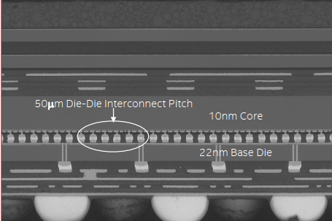
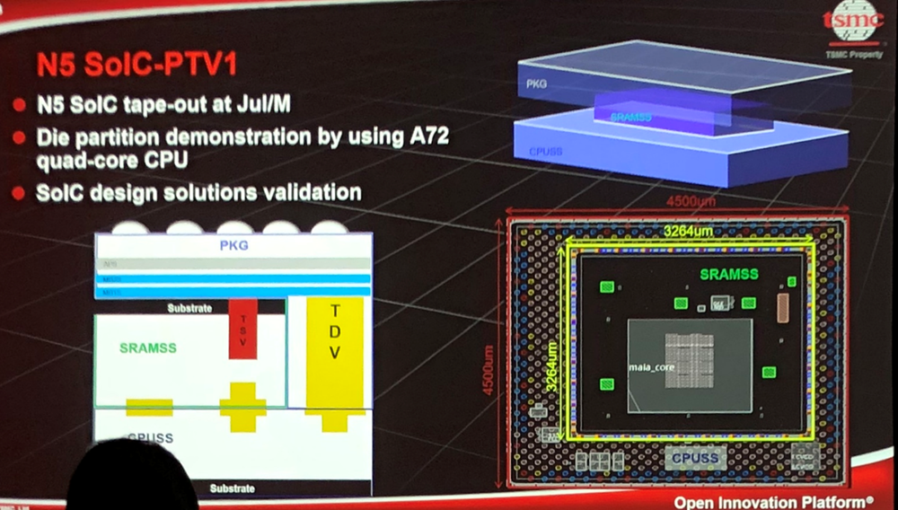
Tightly coupled IPM plays to IDM advantage
 | IDM/ Intel | Fabless/ Foundry | Memory Vendor
In Package Memory Technology (eg 1222 ADM) | ✓ | ? | ?
Advanced Packaging Technologies (eg, EMIB, Foveros, ODI, HBI at Intel; SOIC at TSMC, HBI at memory vendor) | ✓ | ✓ | ✓
Logic Technologies (eg 1274, 1276, 1278) | ✓ | ✓ | ✓
Power Delivery Technologies (eg 1222 FIVR, GaN) | ✓ | ✓ | ✓
Thermal Solution | ✓ | ✓ | ✓
Test for known good die (SDX) | ✓ | ? | ✓
Chiplet partitioning and design | ✓ | ✓ | ✓
System-Technology Co-optimization | ✓ | ✓ | ✓
Flexibility | ✓ | ✓ | ✓
Cost vs Price to Intel | ✓ | ✓ | ✓
Lakefield
Foveros
TSMC hybrid bonding memory + logic
An IDM can co-optimize across memory and logic technologies, packaging architectures, power delivery & thermals, test, chiplet partitioning and design
Benefit ➔ System-Technology Co-optimization, Flexibility, Cost vs Price
Notes:
Die on wafer is the first intercept for memory stacking.

Slide 5
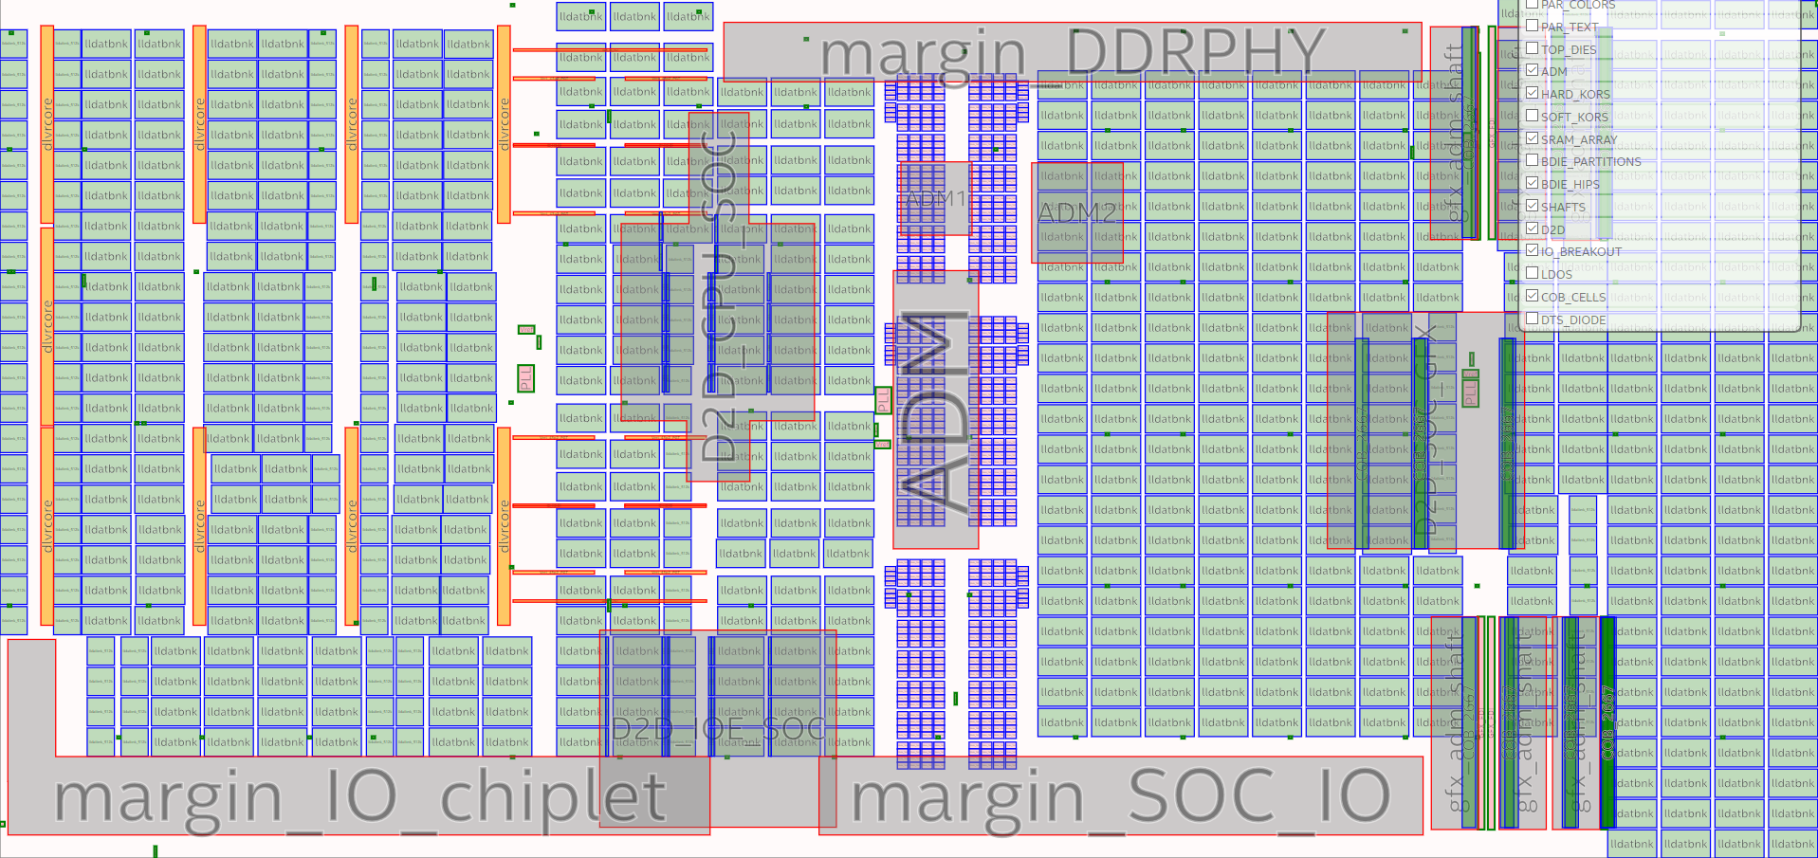
STCO: Areas for Improvement for IPM
MTL base die floor plan
Die to die interconnect microbump fields
Memory capacity erosion due to
Top die power delivery TSVs
Die-to-die interconnect
Top die IO feedthroughs
4.5MB/mm2 => 2MB/mm2
Codependence between
Top & bottom die
Die & package
Hard IPs
Result
Brittle floor plans
Lower base die utilization
Reduced ROI
DLVR TSVs
IO feedthroughs
Co-optimization parameters include chiplet partitioning, packaging architectures (ODI, HBI), TSV-RDL-metal stack, MIM, memory array architecture, power delivery, thermal solutions, sort test requirements
IPM = In Package Memory
Notes:
Note: If any of these chiplets had std interfaces would they be reusable beyond MTL? Probably not.

Slide 6
Memory Solutions & Workload Mapping
Bandwidth (GB/s) vs Capacity (GB)
Challenges:
HBM
huge capacity
cost ~$6.5/GB, price ~$13/GB
minimum price ~$100
power < 4 pJ/bit
GDDR
large PHY & board footprint
cost ~$2/GB, price ~$4/GB
power ~14 pJ/bit
ADM
custom BW and capacity
can scale above 6 TB/s
cost $10-12/GB (Gen2)
power < 2 pJ/bit
SRAM
high cost
high leakage power
SRAM
New hierarchy for high BW/W
ADM Gen2
ADM
Gen2
4 hi stack
HBM3
1, 4, 6 stacks
ADM Gen1
GDDR6
1, 12 channels
DDR and LPDDR
DL inferencing
DL training
3D Graphics
Client 2LM
DL training
HPC
WORKLOADS
Memory BW, capacity, cost data 7/20: Percy Soto, Kuljit Bains
Notes:
Fatih: assume 6TB/s/GB is the slope for ADM
3D graphics: integrated need 1GB, 500GB/s; discrete need 1-2GB, 4TB/s
DL training: need 20-30GB, 4-8X HBM
Client 2LM: need 4-8GB, 300GB/s
The BW for the WLs spans a large range. I think it is better to show it as a rectangle up to 4TB/s for HPC, up to 1TB/s for 3D dgfx. For DL, the BW is actually very high for small capacity and then reduces for larger capacity – but still need HBM BW at large capacity
Slide 6:
All these solution rectangles can extend down to .1GB i.e. anything of less than 1GB also fits in a 1GB memory
Slice 7:
The stacked ADM needs to overlap with DL training and HPC rectangles… otherwise it falls in valley of death where it is not solving a problem. This will be easier to show if slide 5 shows a BW vs capacity rectangle that goes from .1GB to whatever, .1GB to 100GB in case of HPC and DL training

Slide 7
Different Options Pros/Cons
HBM: high cost, overprovisioned capacity for GFX and client 2LM
GDDR: high power
SRAM: high cost, very low capacity
High BW fine-grained DRAM
- not available, no information
ADM: need more capacity, 4 to 6 GB for Client 2LM & datacenter accelerators
+ customize capacity with stacking
+ System Technology Co-Optimization favors Intel’s strength
➔ Recommend pursuing HBI-C stacked ADM reference design and testchip
Notes:
3 columns, external, in package, tightly coupled

Slide 8
Outline
Intel Differentiating Opportunity
IDM Advantage through Tightly Coupled Logic/Memory
IDM Advantage through Tightly Coupled Logic/Memory
Ingredients
Memory
Requirements/Technologies
Memory/Logic/Power/Packaging Integration Challenges
In-Package Memory
Memory/Logic Integration
Finding the Optimum Solution
System-Technology Co-Optimization
Proposal
Accurate/Agile Pathfinding
3DIC Reference Design
Accurate/Agile Pathfinding
3DIC Reference Design
Technology Development/Validation
3DIC Test Chip

Slide 9
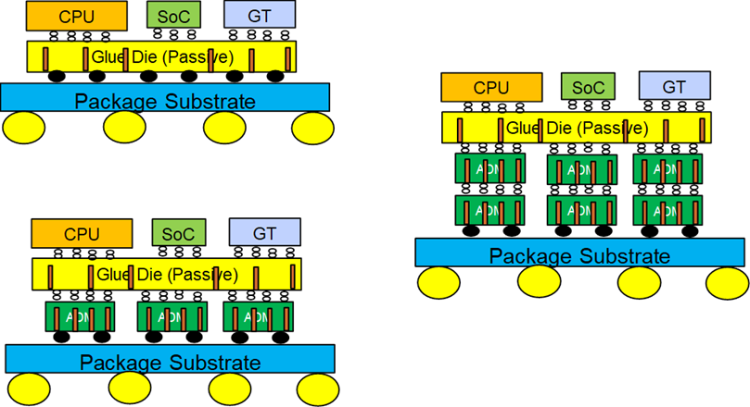
3DIC Solution Space for STCO Exploration
Middle interposer
Problem or requirements | Possible solution
Power delivery and HSIO feedthroughs | ODI with copper pillars (similar to SOIC TDVs) FIVR chiplets where applicable
Routing flexibility, MIM | Middle interposer
Memory capacity | ADM scaling roadmap and multi-die HBI stacks
Thermals | Cold spray (Research)
Sort test, debug | Sacrificial RDL (Research)
Standardized die-to-die interfaces | Synthesis and compilers
Notes:
For super thin layers, wafer to wafer bonding would be better. Temp limits have to be managed.
What would we have exercised for MTL for a reference design that would have surfaced. If this Testchip would have been built, we would have saved x, y, z, etc. Deliberately degrade and measure some of these parameters. What is the actual impact of crappy power delivery.
Propose topside power delivery as a research direction.

Slide 10
3DIC Sandbox, Reference Design & Flow, Testchip Deliverables
STCO: select/adjust technologies based on reference flow feedback
Down-selection to a specific implementation
Sandbox of key ingredients for STCO
Technologies and experimental PDKs
3DIC: Packaging architectures (Foveros, ODI, HBI), TSVs, RDL
Silicon technologies (Logic, memory, interposer)
IPs
3DIC die2die: FDI, DSI
Compute: Atom, ARM cores
Memory HIP
Power delivery: DLVR, FIVR
HSIO: PCIe, DDR
Reference Design & Flow
Tools, flows, methods
  3DIC Project Moore Cockpit
Evaluate overall subsystem/system performance & interactions
Rapid exploration and learning
Test Chip
Full technology and TFM validation
ROI:
Iron out inter-dependencies
Path clearing for PDK and tools, flows, methods (TFM)
Proven reference design (scripts, collateral, docs) to bootstrap projects
De-risk execution
Shift towards capabilities in support of product and technology portfolio
Notes:
Convert MTL to a shell only reference design
path clearing PDK/TFM/etc.?
prototyping 3DIC configurations (like fine-pitch ubumps, 3 levels of stacking, …)
provide a “sandbox” of IPs for 3DIC system technology cooptimization studies
provide design test-case to bring-up new capabilities in (design, tools, packaging, sign-off methods, …)
For the cross-org structure and roles and responsibilities, can you, together with Sonia and Nick put this together? We should put it together and review it with a different set of managers (Gary Patton, Daaman?, Ahmad?, etc).
Thanks,
Ramune
From: Rajan, Vivek K <vivek.k.rajan@intel.com>
Sent: Friday, July 17, 2020 9:31 AM
To: Nagisetty, Ramune <ramune.nagisetty@intel.com>
Cc: Kuhlman, Nick <nick.kuhlman@intel.com>; Elsherbini, Adel A <adel.a.elsherbini@intel.com>
Subject: RE: TDBU Coop slide review
Hi Ramune –
Thanks for driving 3DIC Reference Design and TC TDBU Proposal.
Few suggestions for the proposal:
It would be good to include 1-2 slides on following:
What key aspects of “design enablement” will reference design and TC (each) focus on
What exactly does design enablement mean in this context?
Example: is it path clearing PDK/TFM/etc.?
Example: is it prototyping 3DIC configurations (like fine-pitch ubumps, 3 levels of stacking, …)
Example: is it going to provide a “sandbox” to IPs to validate their 3DIC Integration readiness
Example: is it going to provide design test-case to bring-up new capabilities in (design, tools, packaging, sign-off methods, …)
….
Also, it would be good to propose a structure to make this successful
What kind of structural support do we need to make this jump-start and successful with BU teams
Such a capability (3DIC reference design and TC, being integration vehicles) are essential from a portfolio aspects
What support and structures do we need for portfolio level of engagement
For example: at Intel PDK is successful because of its Portfolio role. Earlier every BU had its own Library development, funding, etc., and now there is a well-organized structure to make PDK successful at Intel on numerous processes
Similarly, it would be good to propose a structure for 3DIC Reference Design and TC, including R&R
A slide or two, that pictorially shows all the building blocks for this this proposal
What already exists (green-color), what capabilities can be integrated quickly (orange-color), what would need new development/enabling, etc ..
Something that should a development cadence and structural process

Slide 11
3DIC Test Chip Roadmap
1H’20: HBI-A Foveros style 1222/10 nm SRAM stacks
  Already taped out
1H’21: HBI-B ODI with 1276+ HSIO on passive interposer
  Slated to be Panther Creek derivative in Q4’20
    Far backend DRs aren’t ready, slip to Q1’21, Wolverton Creek
2H’21: HBI-C ADM memory stack
  Die on wafer (for > 2 um pitch, > 30 mm2 die)
  Wafer on wafer (for < 2 um pitch, < 30 mm2 die)
  Memory stacking, scalable solution
  System technology co-optimization with power delivery, thermal solution, test
Notes:
1H’20: HBI-A Stacked SRAM 10 nm on 1222, already taped out.
1H’21: HBI-B with ODI, was slated to be Panther Creek derivative in Q4’20, but since design rules aren’t ready it will slip to Q1’21
2H’21: HBI-C ADM stacking using die to wafer HBI. The primary goal is to do a strawman design that includes STCO.
Pitches less than 2 um would be wafer to wafer. And then have to do something with yield loss.
Talk to sriram.srinivasan@intel.com about DRM ADM stacks.

Slide 12
Next Steps
Build the 3DIC reference design STCO sandbox
  Utilize MTL architecture as starting point
  Utilize IPs from shuttles (power delivery, HSIO, Die2Die IO)
Establish cross-org roles and responsibilities
  TD: DE, LTD, ATTD, CR
  IPSG: PESG, IP Testchips
Resources for Plan 2021
  + DE allocating 5 HC
  - Need resource allocation for IPSG 3DIC testchip swimlane
Notes:
Need a Testchip roadmap that defines the technology path, rather than a product roadmap that defines just in time testchips.

Slide 13
Backup

Slide 14
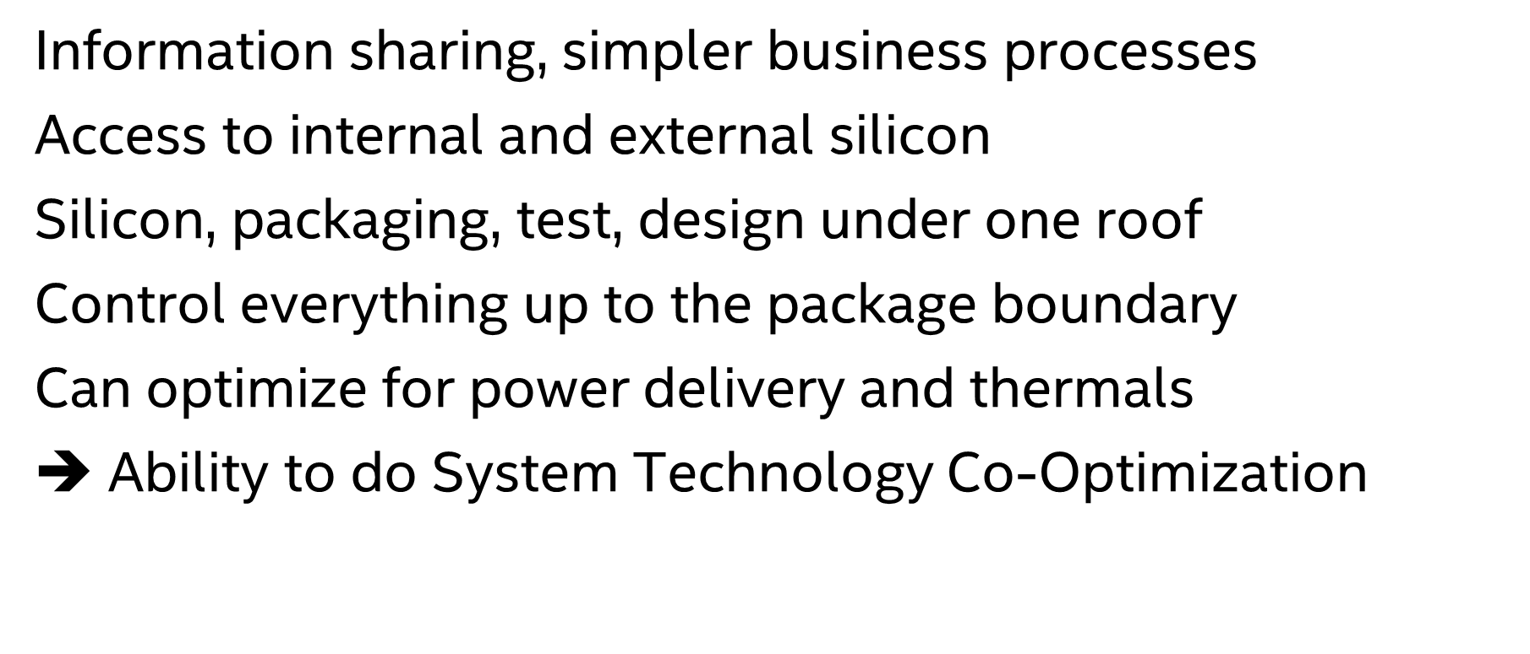
IDM Advantage
Information sharing, simpler business processes
Access to internal and external silicon
Silicon, packaging, test, design under one roof
Control everything up to the package boundary
Can optimize for power delivery and thermals
$➔$ Ability to do System Technology Co-Optimization

Slide 15
Key direction: New memory focused on high BW
Slope is BW/capacity ratio
SRAM
ULTRA HIGH BW
New form of memory solution for 10s of TB/s, 10s of GB
GDDR7 8Gb, EOL (optimistic)
ADM
NEW BW FOCUSED MEMORY
GDDR6 8Gb, EOL
TRADITIONAL CAPACITY FOCUSED DRAM
HBM3 8hi, EOL
HBM2e 4hi, EOL
GDDR6 16Gb, EOL
LP5

Slide 16
Memory Solutions
Challenges:
HBM
huge capacity
cost ~$6.5/GB, price ~$13/GB
minimum price ~$100
power < 4 pJ/bit
GDDR
large PHY & board footprint
cost ~$2/GB, price ~$4/GB
power ~14 pJ/bit
ADM
custom BW and capacity
can scale above 6 TB/s
cost $10-12/GB (Gen2)
power < 2 pJ/bit
SRAM
high cost
high leakage power
Bandwidth (GB/s) vs Capacity (GB)
SRAM
New hierarchy for high BW/W
$44
ADM Gen2
4 stack
~4 GB
ADM Gen2
ADM
Gen2
4 hi stack
HBM3
1, 4, 6 stacks
ADM Gen1
$100
HBM3
8 GB
$24-48
GDDR
6 to 12 GB
$7
ADM Gen1
~.0.5 GB
GDDR6
1, 12 channels
DDR and LPDDR
DL inferencing
DL training
3D Graphics
Client 2LM
DL training
HPC
WORKLOADS
Memory BW, capacity, cost data 7/20: Percy Soto, Kuljit Bains
Notes:
Fatih: assume 6TB/s/GB is the slope for ADM
3D graphics: integrated need 1GB, 500GB/s; discrete need 1-2GB, 4TB/s
DL training: need 20-30GB, 4-8X HBM
Client 2LM: need 4-8GB, 300GB/s
The BW for the WLs spans a large range. I think it is better to show it as a rectangle up to 4TB/s for HPC, up to 1TB/s for 3D dgfx. For DL, the BW is actually very high for small capacity and then reduces for larger capacity – but still need HBM BW at large capacity
Slide 6:
All these solution rectangles can extend down to .1GB i.e. anything of less than 1GB also fits in a 1GB memory
Slice 7:
The stacked ADM needs to overlap with DL training and HPC rectangles… otherwise it falls in valley of death where it is not solving a problem. This will be easier to show if slide 5 shows a BW vs capacity rectangle that goes from .1GB to whatever, .1GB to 100GB in case of HPC and DL training

Slide 17
Memory Requirements
Input from DL memory WG
BW
HPC
DL training
DL inference
Capacity is function of
compute assumption
Need to fill machine
DL training
3D discrete GFX
3D int GFX
Client 2LM
capacity

Slide 18
Physics and Technology Trends
Slowing scaling trend for logic and memory
Rise of accelerators
Range of DL architectures and workloads
  Inference, training, HPC/DL
Range of memory requirements
Range of memory solutions

