Slide 1

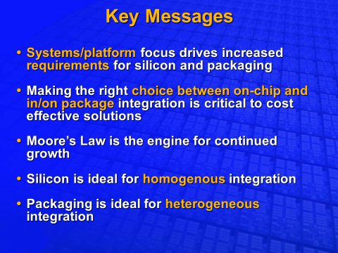
Advanced Packaging for Heterogeneous Integration
Fellows Forum – October 29-30, 2018
Ravi Mahajan, Bob Sankman
Acknowledgments: Chris Baldwin, Luke Garner, Pat Stover, Ram Viswanath, Sriram Srinivasan, Eugene Scuteri, Raj Varada, Randy Osborne, Wilfred Gomes, Jeff Howard, Suresh Chittor, Shawna Liff, Jose Cardona, Rob Nickerson, Mitul Modi, Ken Brown, Sri Nimmagadda, Surhud Khare, Pilin Liu, Deepak Goyal

Slide 2

Key Messages
Multi-Chip Packages (MCPs) have been used @ Intel for TTM and enhanced performance for many years
Increasing demand for on-package bandwidth has driven revolutionary changes in package architectures¹ (e.g. EMIB, Foveros)
TTM, Heterogeneous IP Integration and Die Yield continue to drive on-package interconnect density for joining multiple chips in increasingly complex packaging architectures
Resources required to develop these advanced architectures are significant
Early planning & Cross-organization collaboration need to select the optimal packaging strategy since Package Architecture Development is a highly Integrated Effort
1. Today’s Focus entirely on-package Interconnects. MCP technology envelopes needed to meet off-package signaling, power delivery and thermal needs not covered today

Slide 3
Some Definitional Stage Setting………
Heterogeneous Integration¹ (HI) refers to the integration of separately manufactured components into a higher level assembly (SiP) that, in the aggregate, provides enhanced functionality and improved operating characteristics
In this definition, components should be taken to mean any unit whether individual die, MEMS device, passive component and assembled package or sub-system that are integrated into a single package. The operating characteristics should also be taken in its broadest meaning including characteristics such as system level performance and cost of ownership
SiP or System-in-Package² refers to package (such as a SO, QFP, BGA, CSP, LGA) that has multiple die (Si, GaAs, SiGe and/or SOI) plus optional passives integrated together
The term “Multi-Chip Package (MCP)” is used in this presentation to cover all Multi-Component Packaging
William Chen (ASE), Chair : IEEE Heterogeneous Integration Roadmap Leader
Prismark Partners LLC, - June 2018

Slide 4
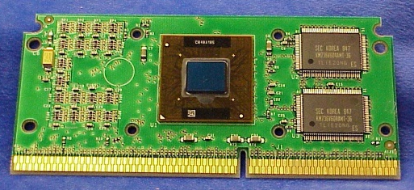
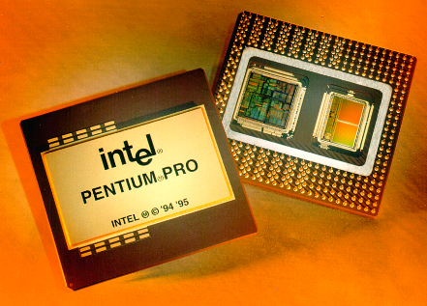
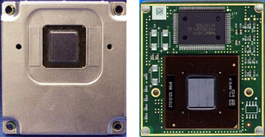
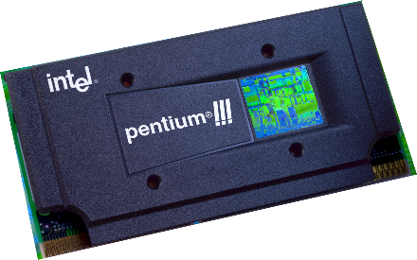
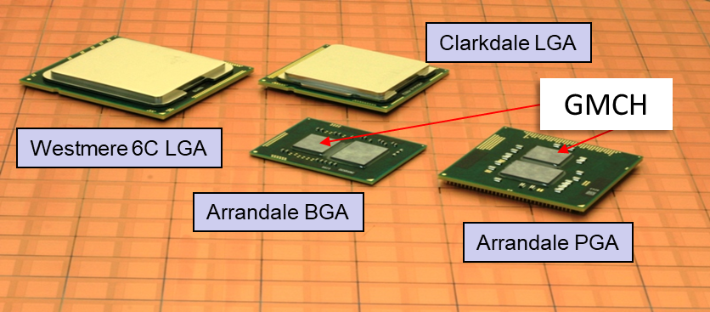
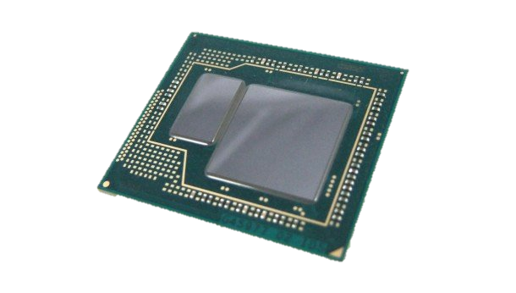
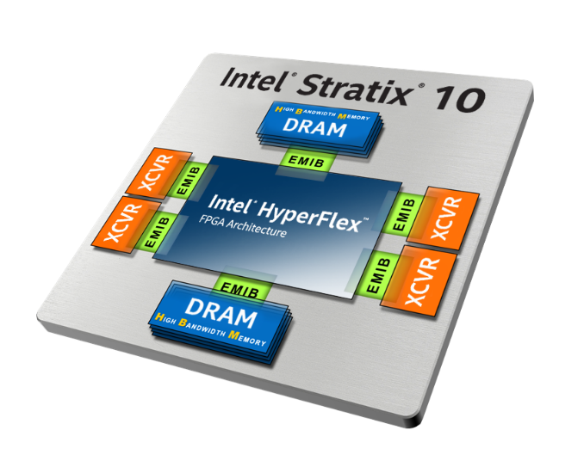
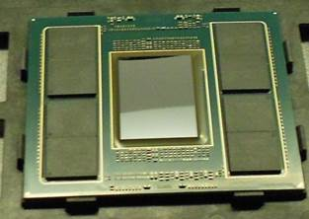
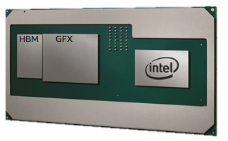
Intel has a long history of MCPs for TTM & Performance….
SRAM Integration
(G)MCH Integration
MC-DRAM
eDRAM
CPU
I7 Iris Pro
Core i7
Kaby Lake G
Knights Landing
DRAM Integration

Slide 5
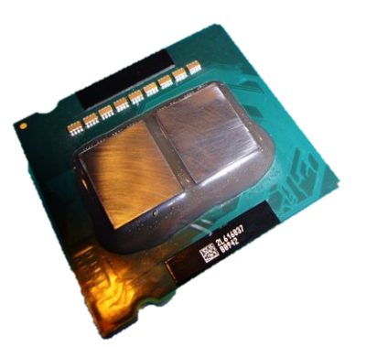
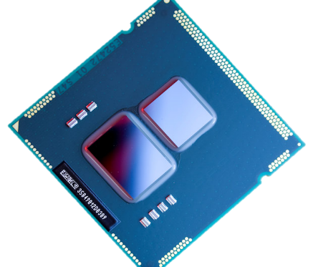
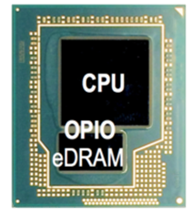

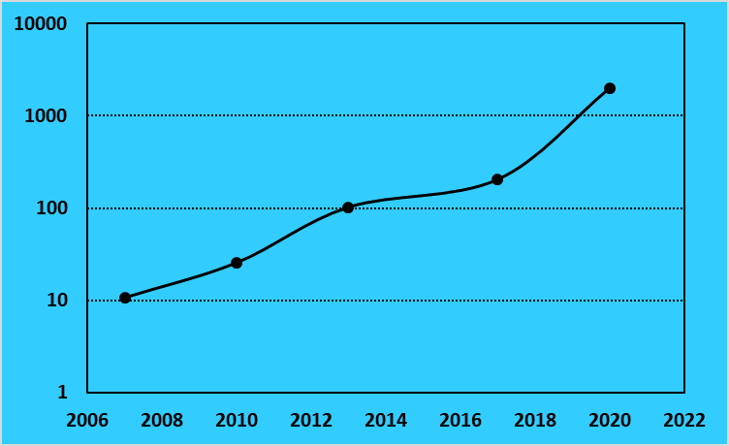
Dense MCPs to meet On-Package BW Demand
HBM drove EMIB adoption
RAMBO is driving investigations in SRAM Stacking & Foveros Design Rules
Year | 2007 | 2010 | 2013 | 2017 | 2020+ Discrete Graphics¹
Product | Xeon | Core | 4th gen core | 8th gen core | TBD
I/O Bus | Front side bus (FSB) | QPI | OPIO | HBM | CPU-SRAM
# of signals (data) | 64 | 32 (differential) | 128 | 1024 | TBD
Signaling rate (Gb/s) | 1.333 | 6.4 | 6.4 | 1.6 | TBD
BW (GB/s) | 10.7 | 25.6 | 102.4 | 204.8 | 2TB/s
BW Demand Growth – 2X every 2 Years
GB/s
Year
High BW Demand has Spurred Recent Interest in Dense MCPs²
Speculative Projections based on RAMBO (Random Access Memory Bandwidth Optimized) Memory Configuration (Ack: Wilfred Gomes)
Dense MCP demand also driven by need for parallel, power efficient interconnects (Power Efficiency not specifically covered today)

Slide 6
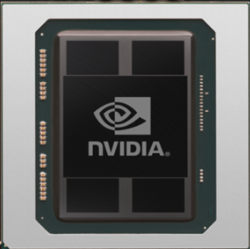
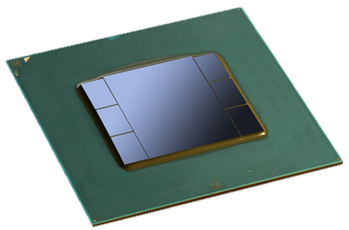
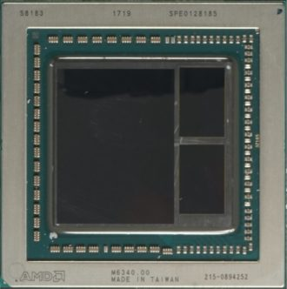
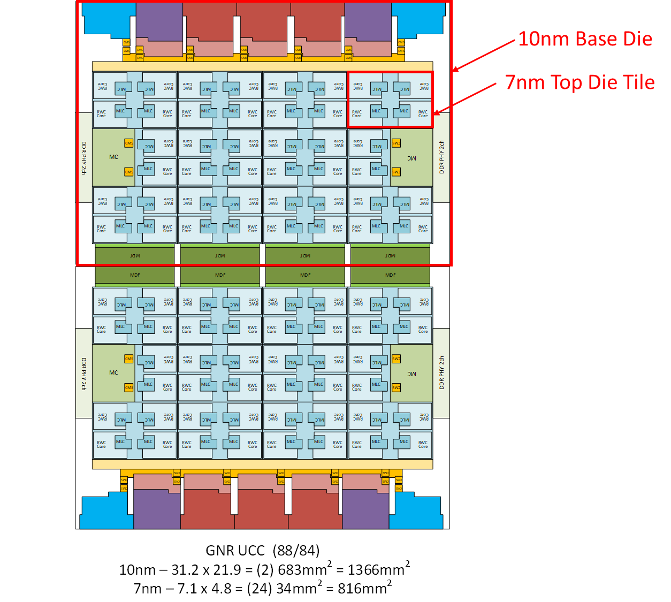

Dense MCPs are here to stay…..
NVidia Tesla P100
4 HBM + GPU
AMD Vega 10
2 HBM + GPU
Intel Stratix 10
6 Xcvr + FPGA
For TTM and Heterogeneous IP Integration
SPR (Xeon-SP)
10nm Silicon
XCC: Quad-tile w/ 10 EMIB’s
For Die Yield Resiliency
56.5mm
$$Die Yield≈exp[−\left(Die Area x \frac{Process Defects}{Area}\right)]$$
20.6x21mm
GLC
77.5mm

Slide 7
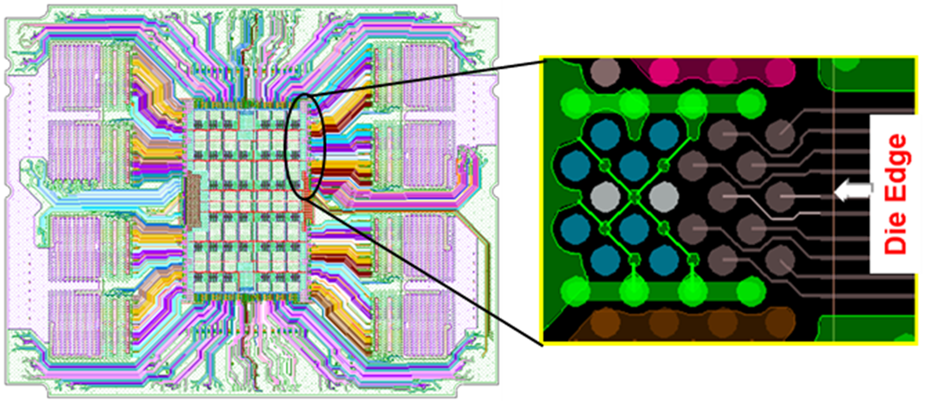
Interconnects in Multi-Chip Packaging : Density Metrics
Key Package Interconnect Density Metrics:
IO¹/mm/Layer (Escape Density)
IO/mm² (Die Area)
IO refers to physical wires and bumps

Slide 8
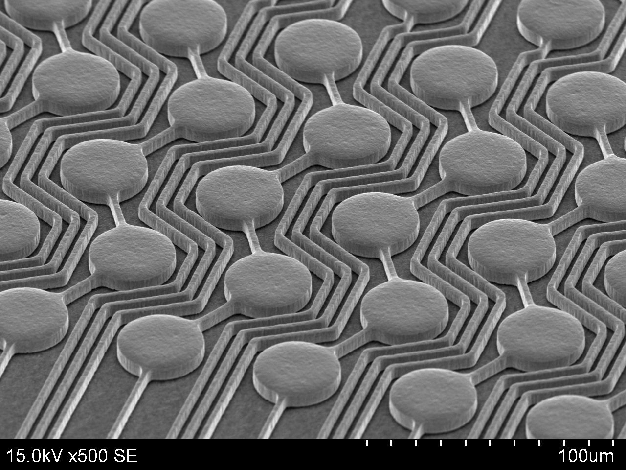
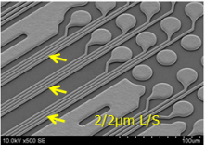
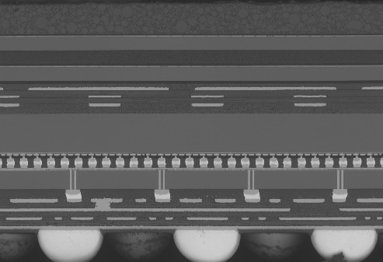
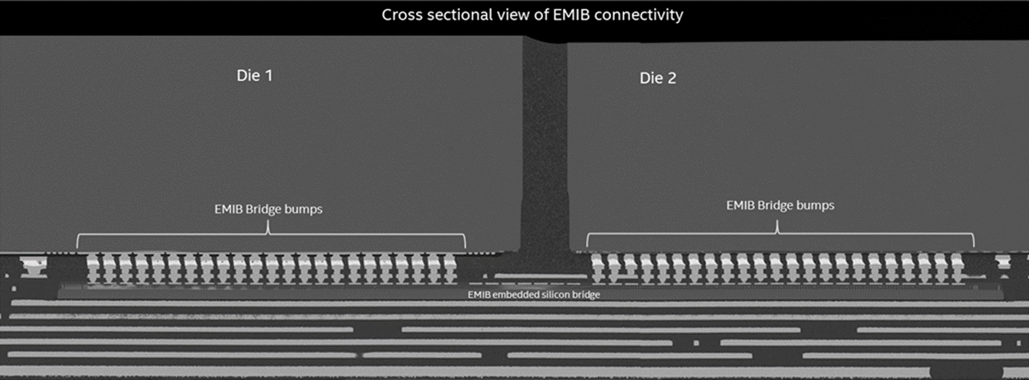
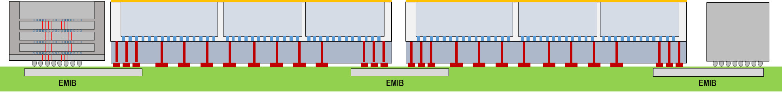

Today’s MCP Technology Landscape¹
3/3 L/S
10nm Core
P1222 Base
Standard MCP
HDI Organic Interposer
EmIB
Passive Si Interposer (CoWOS)
Gen 1 - Foveros
Gen 2 - (Foveros + EMIB)
IO/mm/lyr = 28-34
IO/mm² = 83-123
Bump Pitch = 110-90µm
IO/mm/lyr = 103-150
IO/mm² = 331
Bump Pitch = 55µm
IO/mm/lyr ≥ 250
IO/mm² = 331
Bump Pitch = 55µm
IO/mm/lyr ≥ 250
IO/mm² ≥ 625
Bump Pitch ≤ 40µm
IO/mm/lyr = NA
IO/mm² = 400
Bump Pitch =50µm
IO/mm/lyr = NA
IO/mm² = 772
Bump Pitch =36µm
Organic FCXGA – Industry Workhorse
Nascent Technology : ATTD has an internal Pathfinding and Monitors Industry Pulse
Intel Unique Technology
Stratix – 10, Kaby-Lake G in production; more products in pipeline
Industry Solution for Dense MCPs (NVidia Tesla, AMD Fury, Xilinx)
POR for Lakefield
GNR Working POR
Broad Spectrum of Dense MCP Technologies in Development & Pathfinding Today
1. Multi-Die Stack technologies not shown. Primarily used today in High Bandwidth Memory (HBM)

Slide 9
2D Dense MCPs - Current and Planned Deployments

Slide 10
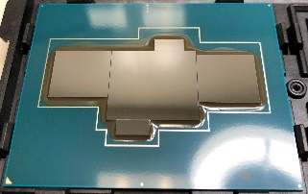
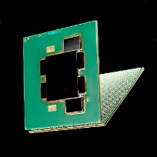
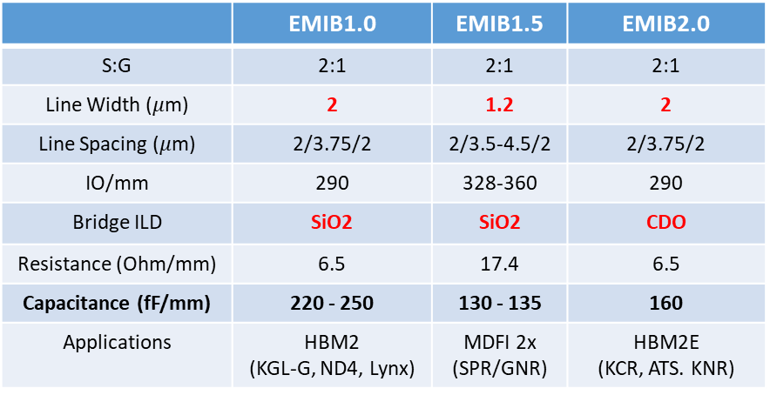
EMIB Roadmap
Right side of box represents tech cert
Stars represent lead product power-on and PRQ
H2’18
H1’19
H2’19
H1’20
H2’20
H1’21
10nm Wave 1 (Sequoia Acres, Falcon Mesa 3-8)
Maximum 6 bridges
Up to 55x70mm BGA
Sequoia Acres
FPGA + ASICS + XCVRs
Falcon Mesa
FPGA + XCVRs + HBM2/2E
10nm EMIB Tiling (Sapphire Rapids, Arctic Sound)
Maximum 12 bridges
Up to 80mm BGA and 77.5x56.5mm LGA
Arctic Sound
GPU tiling + HBM2/2E
Sapphire Rapids
CPU tiling
TSMC 7nm on EMIB (Rivercrest, Knights Run)
External silicon qual, Maximum 15 bridges
Up to 80mm BGA
Knights Run
Hetero logic tiling + HBM2/2E
Rivercrest
Logic tiling + HBM2/2E
EMIB Development Focus : Package Size & Bridge Count Increases, Improved Signaling in Bridge

Slide 11
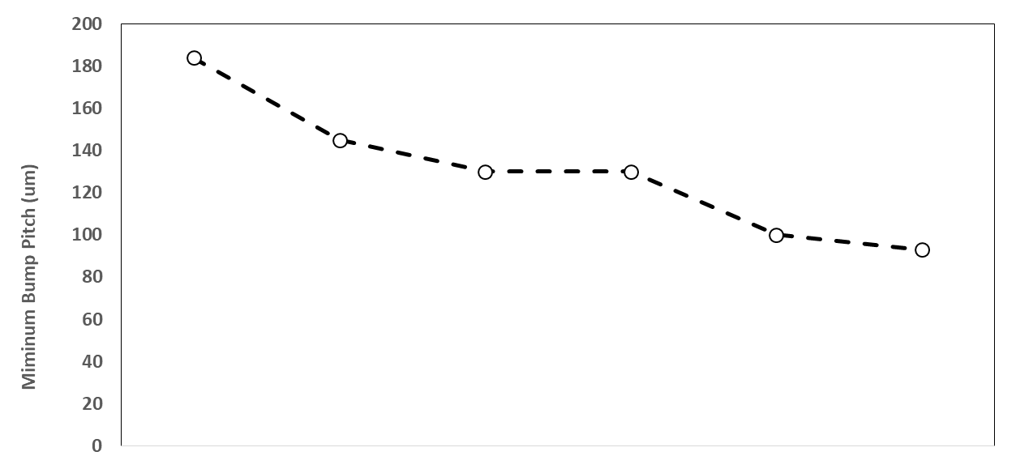
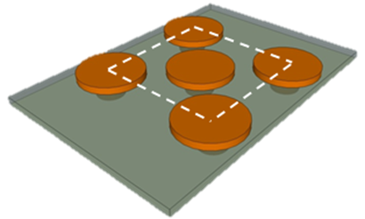
Scaling MCP Bump Pitch at Intel
Bump Density - 5X Increase over 6 nodes
Intel Conventional FCXGA
Minimum Bump Interconnect Pitch (um)
~7X Increase Over Conventional FCxGA
Advanced Packaging
Mature Current Future
What Does it Hit these Targets?

Slide 12

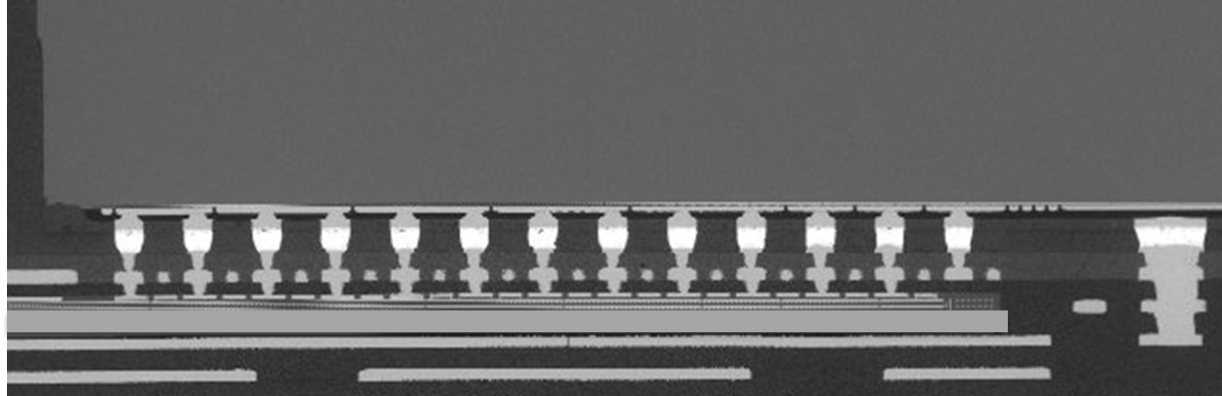
EMIB Pitch Scaling
Via Scaling requires improved alignment, test capability, new materials & equipment in Package Manufacturing
55μm EMIB Interconnect Pitch
EMIB 55μm Today
Substrate
Up to 10 bridges per substrate
OST @ 55μm on substrate bumps
Laser via: 23μm dia; ±9.5μm alignment
Silicon Bridge
5:1 aspect ratio
Wafer level OST @ 55μm
Assembly
NGWP
TCB/CUF
EMIB 45μm
Substrate
Up to 14 bridges per substrate
New OST @ 45μm pitch on substrate
New UV Laser via: 20μm dia; ±9.5μm alignment
New Planarization Tools
Silicon Bridge
7:1 aspect ratio
Wafer level OST at 45μm pitch
Assembly
NGWP
TCB/CUF
EMIB 30μm
Substrate
Up to 14 bridges per substrate
New OST @30μm pitch on substrate
PID or LIV via: ~6μm dia; alignment TBD
Silicon Bridge
7:1 aspect ratio
Wafer level OST at 30μm pitch
Assembly
TCB/Underfill : Significant effort (Invention?) Required
>98% Assy Yield Today!
Pitch Scaling Requires Significant Resources & Building Block Development
OST – Open Short Testing

Slide 13
3D Stacking - Current and Planned Deployments

Slide 14
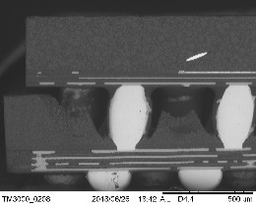
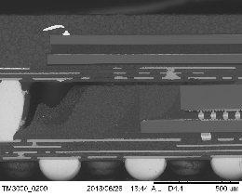
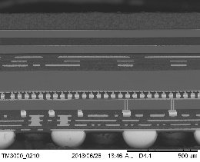
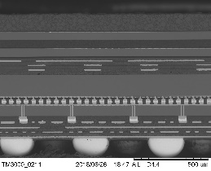
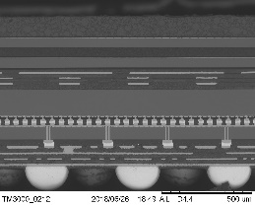
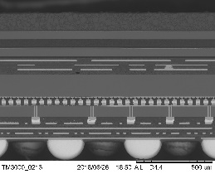
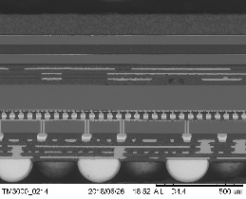
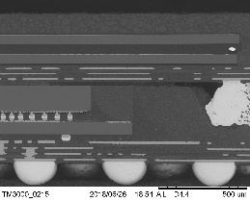
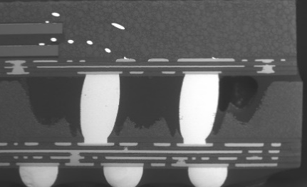
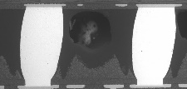

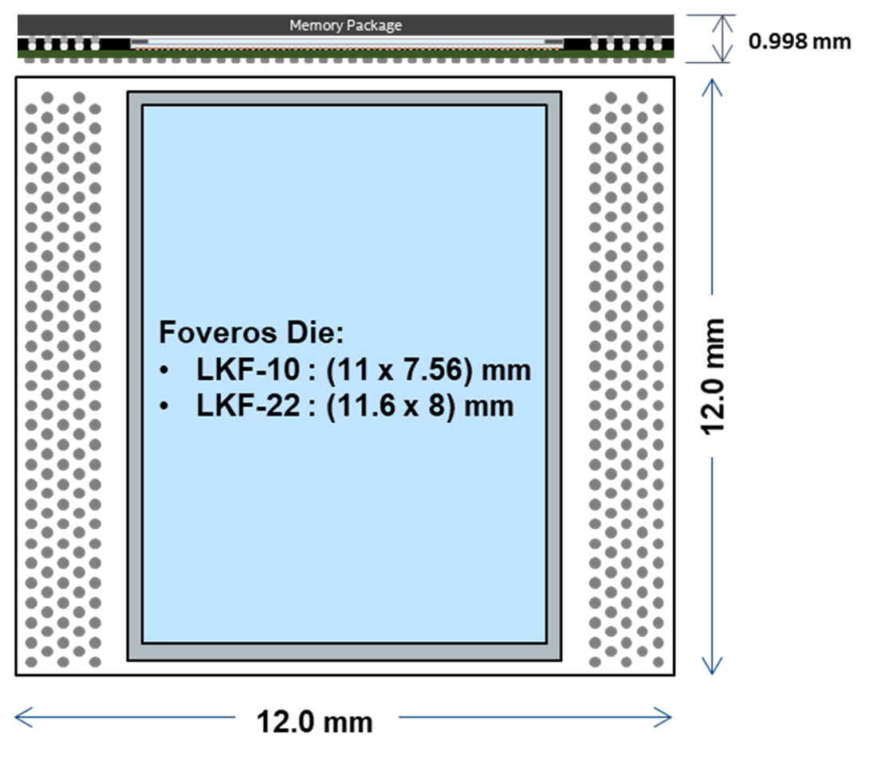
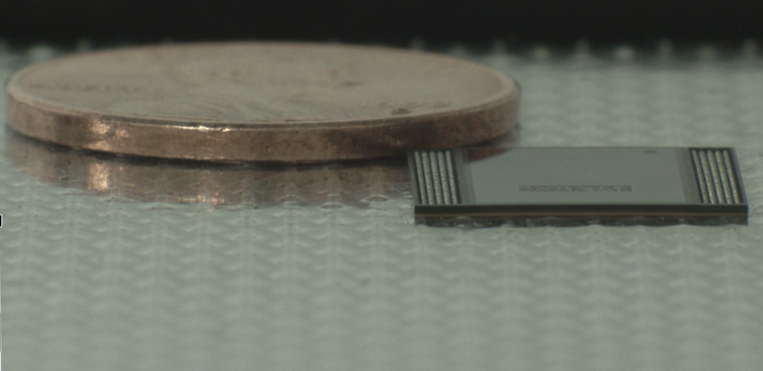
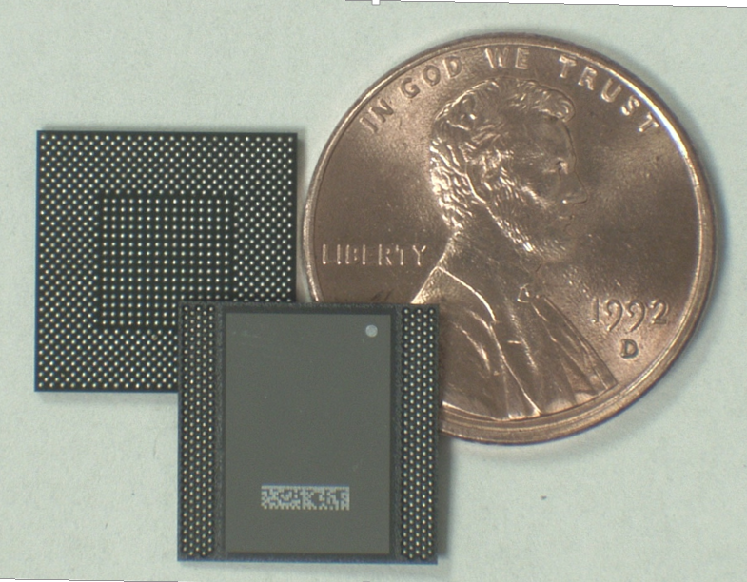
Foveros Generation 1 : Lakefield
50μm Die-Die Interconnect Pitch
10nm Core
P1222 Base Die
Yields on-track to Forecast Roadmap (Assembly Certification EO’18). Lakefield Sample Shipping

Slide 15
Generation 2 : (Foveros + EMIB) aka Co-EMIB
Multiple Top Die Tiles
(7nm & 10nm)
Backside Metallization for Solder TIM
36μm Die-Die Interconnect Pitch
HBM
Companion Die
EMIB
EMIB
EMIB
10nm Base Die or Passive Interposer
Generation 2 Envelope covers Multiple Core Tiles Stacked on (Passive or Active) Silicon Interposers with EMIB Connections between Stacks & Peripherals

Slide 16
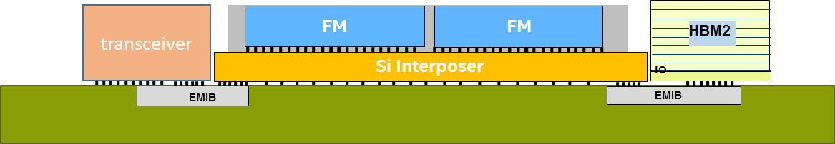
(Foveros + EMIB) – Product Configurations
Granite Rapids
Ponte Vecchio
Falcon Mesa 11/ASIC
10nm –
MCDDR
7nm –
Core Tile
G
Rambo
G
HBM2e
P1222 vs 10FV-
P1222 vs 10FV-
EMIB Substrate
EMIB
EMIB
Si: 10nm on Passive Si Interposer
Base die: 1000-1600 mm²
# of Chiplets: 3
# of Base die: 1
(Foveros + EMIB) @ 75μm Or Full Silicon Interposer
EMIB Count: 7
Si: (7nm + 10nm) on 10FV
Base die: 600-700 mm²
# of Chiplets: 8-10
# of Base die: 2
EMIB Pitch : 55μm
EMIB Count: 4
Si: (7nm + 10nm) on 10FV
Base die: 312-624 mm²
# of Chiplets: 6
# of Base die: 4
EMIB Pitch : 55μm
EMIB Count: 14
Complex Architectures with plenty of Yield, Assembly, Test and Reliability challenges. Technology Envelopes are being actively negotiated with Product Architects

Slide 17
(Foveros + EMIB) : Flavor of the Key Technical Challenge Areas
Existing EMIB Building Blocks
Fab: Mixed Pitch & Mixed CD Bump Plating
Assembly: Fine Pitch Chip Attach Process
Test: Fine Pitch Sort @ 110μm pitch
Substrate: Bridge Embedding & Substrate Test
Existing Foveros Building Blocks
Fab: TSV Process
Fab: > 36μm pitch bump plating
Assembly: TCB die stacking on wafer >36um pitch
Assembly: Wafer mold and Grinding
Assembly: TCB stacked die to substrate
Test: Fine Pitch Sort @ 72μm pitch
Fab or Assembly: Backside Metal Sputter to enable STIM (planned)
New Required (Foveros + EMIB) Building Blocks
Fab: Mixed Pitch & CD PSB Bumps on Stacked Die Wafer
Fab: Via Reveal on “thick” stacked die wafer
Assembly: NGWP process on stacked die wafer
Assembly: TCB stacked die to EMIB substrate at ≤ 55μm pitch
Plan is to Leverage & Extend All Existing Building Blocks

Slide 18
What is Being Explored?

Slide 19

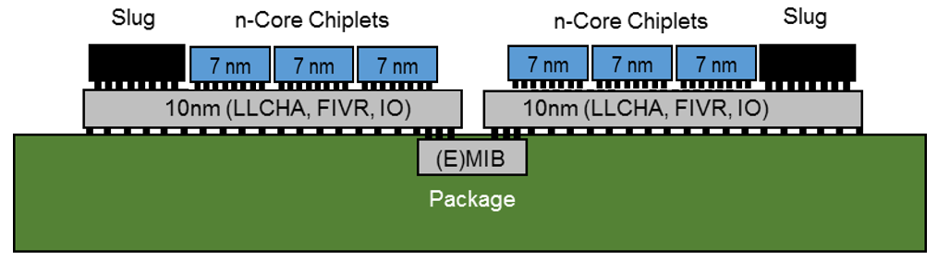
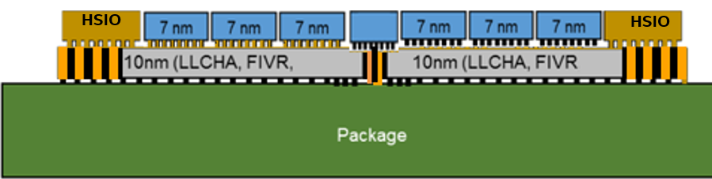
Omni-Directional Interconnect (ODI)
Ack: Shawna Liff, Adel Elsherbini & Johanna Swan
(Foveros + EMIB)
ODI
Improved Thermals
500μm Pencil Core
No TSVs in IO Die
Foveros Base Die Thickness
A4 Paper Sheet Thickness
Significantly Reduced Parasitics + Dense Interconnect
ODI is a Novel Architectural Concept Currently Under Exploration

Slide 20
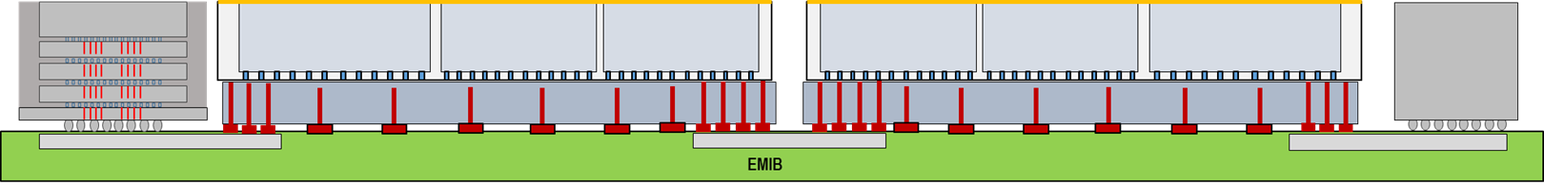
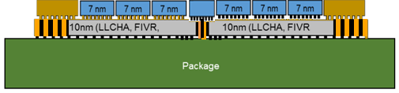
Dense MCP Scaling Vectors
Bump Pitch
Bridge Count & Size
Active Bridge
EMIB
Die-Die & Die-Package Bump Pitches
Tile Count
Foveros + EMIB
Die-Die & Die-Package Bump Pitches
Tile Count
ODI

Slide 21

Dense MCP Scaling Directions……….
Scale 3D Stacking?
Scale EMIB?
Invest in New Technologies
ODI?
Si Interposer?
Glass?
Strategic, Cross-Organizational Approach Needed to Set Directions & Invest in Key Technologies

Slide 22
Back-up

Slide 23

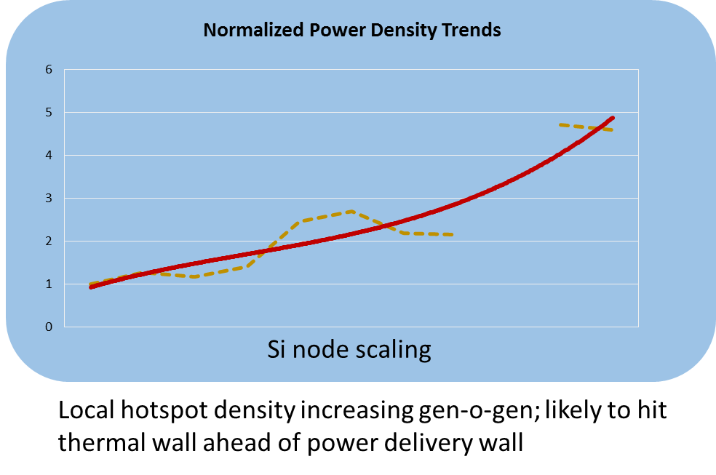
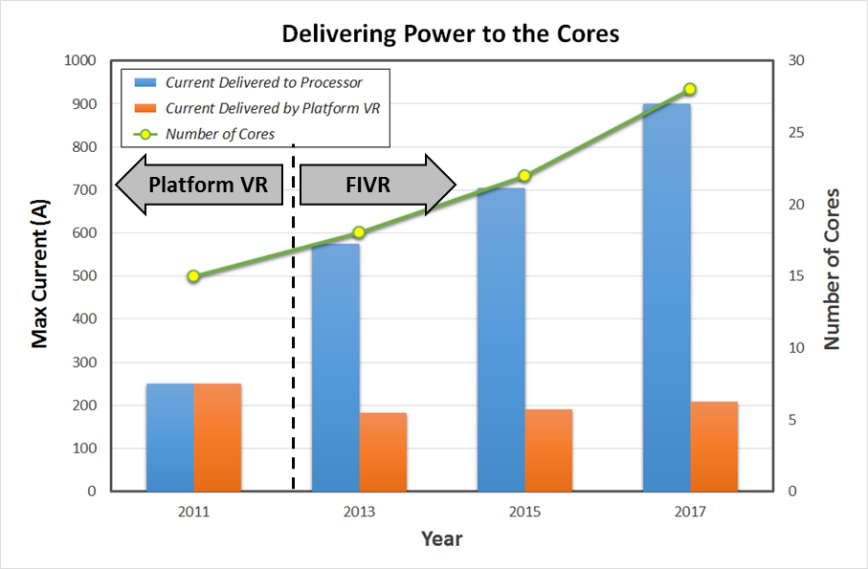



Multi-Chip Packages will have to address other challenges
Technologies for high Bandwidth, Off-Package Electrical & Optical Signaling Needed
Introduction of FIVR with package inductors helps current demand
Improved Inductors Needed
Improved Thermal Interface Materials (TIMs) and Interface Control Needed for MCPs

Slide 24

Multi-Die Stacking
Global Foundries Presentation from Stanford System X Workshop, May 2018
3-D Stacking
IO/mm = N/A
IO/mm² ≥ 625
Bump Pitch ≤ 40µm
Primarily used for Memory Stacking (HBM)
Multi-Die Stacking Primarily Used Today for Memory Stacking

Slide 25






Dense MCP : Competitive Analysis
 | AMD Fury R9X | Tesla P100 | AMD Vega 10 | Xilinx VU9P | HiSilicon 1610 FOCoS | Stratix 10 GX2800
Image |  |  |  | image cropped/IHS removed
Package Size | 55x55mm | 55x55mm | 47.5 x 47.5 | 47.5x47.5 or 52.5x52.5 | 42.5x42.5mm | 55x55mm
HBM Supplier | SKHynix HBM1 | Samsung HBM2 | Samsung HBM2 | n/a | n/a | n/a
HBM-Interposer μBump Pitch Min | 55μm | 55μm | 55μm | n/a | n/a | n/a
HBM Top Die Thickness | 200um | 400um | 363um | n/a | n/a | n/a
xPU-Interposer μBump Pitch Min | 45μm | 55μm | 45μm | 40μm | 40μm | 55μm (EMIB), 130μm (pkg)
xPU Die Thickness | 511μm | 700μm | 652μm | 489μm | 647μm | 750μm
xPU die XY | 26.25x22.25 | 22.5x27.5mm | 19x25.6mm | 25.66x11.44 (x3) | 16.2x6.2,15.7x8.6 | 20.3x28.3mm
Interposer Size XYZ | 32.9 x 26 x .01mm | 40 x 28.9 x .01 | 27 x 29 x 0.11mm | 35.61x27.19x.01mm | 17.7x16.6mm | 3.1x8.4mm EMIB
Interposer Top Metal Layers | 3 Cu | 1 Cu + 1 Al | 4 Cu | 3 Cu + 1 Al | 3 Cu RDL + Pad | 4 Cu + 1 Cu Pad
Interposer Routing Min L/S | 1 / 1μm | 1.1 / 1.6 μm | 1 / 0.5μm | 0. 5/ 0.3 μm | 2.5 / 3.5μm | 2.1 / 1.9 μm
Min FLI Pitch | 200μm | 180μm | 150μm | 180μm | 200μm | 130μm (non EMIB)
D2D Interconnect Process | OSAT CoS,CoC | TSMC CoWoS | OSAT CoC, CoW-L | TSMC CoWoS | ASE FOCoS | EMIB

Slide 26
Package Technology Announcement | Technology Claims | Applications | Intel Interpretation and Competing Package Technology
TSMC’s InFO extensions < L/S < Bump Pitch < BGA Pitch NEW Backside RDL | TSMC claimed improvements vs conventional FCCSP: 0.8 x thickness 0.9x footprint 0.85x thermal resistance 1.1x performance Finer features extend InFO into medium-high density die-to-die interconnect applications. | MUST: InFO_PoP Modem + LPDDRx in InFO. 6mm x 5mmm footprint, 0.6mm Z-ht. 40um FLI. TSMC will package/stack consigned DRAM wafers (rumored for Apple). InFO_AIP: mmW RF FEM with and IPDs and antennas on backside RDL. 12x12, 0.9mm z-ht, 2 layer RDL InFO_oS/InFO_MS: Connecting 2 or more die in with fine pitch InFO in lieu of silicon interposer then attached to organic substrate up to 65x65mm size. 830mm² reticle, 2um L/S RDL, 40um bump pitch Customers claimed: AMD, Broadcom, eSilicon, GUC, HP Enterprise, Mediatek, Xilinx, NVIDIA Mediatek/Nephos network storage product (Q3’18) | Intel Pathfinding has Modem solution with RDL LPDDR die flip-chip connected to substrate standoffs & achieves similar Z-height and footprint. Intel is currently pursuing mmW packages with conventional materials and processes that we believe will meet product performance requirements more cost effectively. Intel’s EMIB technology offers similar interconnect capabilities to InFO_oS and InFO_MS, with slightly larger bump pitch. InFO_OS is analogous to ASE’s FoCoS now in production for HiSilicon 1610 networking product.
Wafer to Wafer Stacking w/Hybrid Bonding | GF: F2B Hybrid Bonding of multi-high stacked wafers @ 7.5um pitch, 2-5um TSVs, qualed on 14nm. TSMC WoW: Wafer on Wafer bonding: F2F, F2F2B @ 10um pitch w/TSVs | GF: 3D SRAM cube with >15Tb/s bandwidth for fast access. TSMC WoW: No product alignment stated. Rumored for GPU stacking. | Intel Foveros technology will compete with 2-die stack; Client/DC applications do not demand the tighter bump although bump pitch is ~4X higher in the initial 7nm version. Intel Components Research demonstrated functioning SRAMs with wafer to wafer stacking at 3-5um pitch; work was halted due to lack of a product application. Requires very high D/W Debug difficult on 3 die stack Thermal issues.
Die to Wafer Stacking | GF: Micropillar Mass Reflow TSMC SoIC - System on Integrated Chip → 3D stacking with <10um CoW bonding process, TSVs and Thru-Dielectric Vias | GF: 2 3D-SRAM L4 Cache cubes stacked on top of ASIC >20Tbps Bandwidth, 32GB Capacity (test vehicle) for Machine Learning applications. TSMC SoIC: “Simplest bond structure & minimum parasitic for better performance. Compatible with many package types for various applications.” | SoIC architecture is similar to Foveros w/ODI. Intel Foveros technology will compete with but bump pitch is ~4X higher in the initial 7nm version. Design for Sort at ultra fine bump pitch

Slide 27










Advertised Derivatives of Base Technologies
INFO - POP
Smaller Form Factor Stacked Package
Added
Topside RDL
RF coils & Patch Antennas in RDL
Copper Pillar Through Mold Interconnect
Die Embedded in Epoxy Mold Reconstituted Wafer
Add Topside RDL
Finer L/S
Tighter Via Pitch
MUST
InFO_AIP
RDL Layers
Eliminate Silicon Interposer
Incorporate HBM-like Die Stacks
CoWoS/2.5D
InFO_oS / InFO_MS
Epoxy Molded Stacked Die Wafer with Planarized Surface
Die to Wafer Flipchip Attach
Active Interposer
Tighter Bump Pitch
Hybrid Bond
Silicon Interposer
WoW (Wafer on Wafer)
SoIC (Silicon on Integrated Chip)
Transition from 40um pitch solder interconnect to 10um pitch Cu-Cu direct bond, and active-to-active face to face die bonding

Slide 28



Die-to-Die Interconnect Comparison
Intel EMIB
4 Layer, 2um L/S
UniMicron Silicon Interposer
TSMC CoWoS Silicon Interposer
Up to 55x55mm package
2L routing w/ guard trace + 2 Shield Layers
AMD Fury R9X
3 Layer 1um L/S
Xylinx VU9P
3 Routing Layer 0.5um L/0.3um Sp
6.9um 2 signals
23x36mm Interposer/55mm pkg
35.6x27.2mm Interposer/47.5x47.5mm pkg
2L routing w/ guard trace + Shield Layer
Min: 1um L, 1um S, T=1.1um, 48um Die Via Pitch
3L routing w/guard traces +Al Bump Pad
Min 0.49um L, 0.3um S, T=0.85um, 40um Die Via Pitch
6.5 Ω/mm
6um 2 signals
21 Ω/mm
6um ~9 signals
60 Ω/mm
Al RDL
Signal Ground
ASE FOCoS
HiSilicon 1610
3L Fan Out ~3um L/Sp
AMD Vega 10
4 Layer, 1um L/0.5um Sp
Nvidia Tesla P100
1 Routing Layer 1um L/2um Sp
27x29mm Interposer/47.5x47.5mm pkg
29x40mm Interposer/55x55mm pkg
16.6x17.7mm Pseudo Die 42.5x42.5mm pkg
2L redundant routing w/ guard trace + 2 Shield Layers
Min: 0.95um L, 0.5um S, T=1.15um, 45um Die Via Pitch
1L routing w/ no guard trace +Al RDL/Shield Layer
Min: 1um L, 2um S, T=1.6um, 55um Die Via Pitch
L1 & L3 routing w/ no guard trace, L2=power/ground
Min: ~3um L, ~3um S, T=4-5.5um, 40um Die Via Pitch
6um 2 signals
10 Ω/mm
6um 2 signals
16 Ω/mm
6um 2 signals
1.5 Ω/mm
RDL X-section images are approximately to scale

Slide 29





TSMC CoWoS Today:
1.75x Reticle, 40um uPGA, 0.8um RDL pitch, >98% Yield
> 2Mu/Qtr output, Adding Capacity
Growing # of Tape outs
CoWoS Future:
Deep Trench Capacitor
Embedded Inductor
★
VU
★
P100
★
V100
Beyond CoWoS:

