Slide 1
Fan-Out Si Bridge Enabling Project
FTE EPAE
Alois Nitsch / David O’Sullivan / Evelyn Chen / Andreas Dost / Hans-Gerd Jetten /
Thomas Huber
2021-Oct

Slide 2
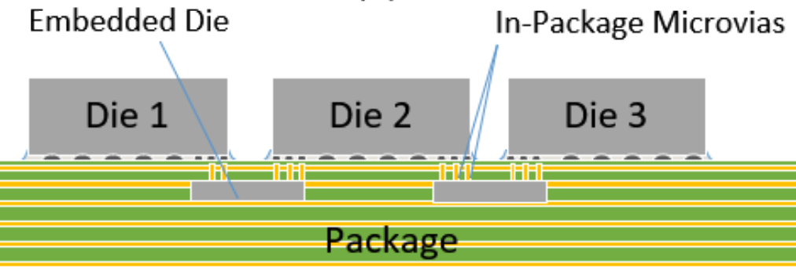
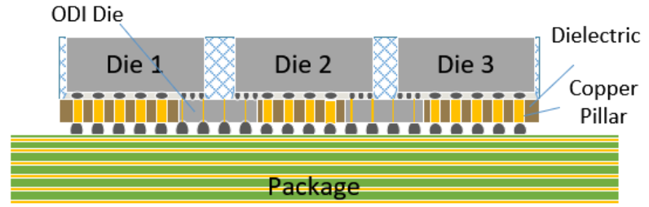


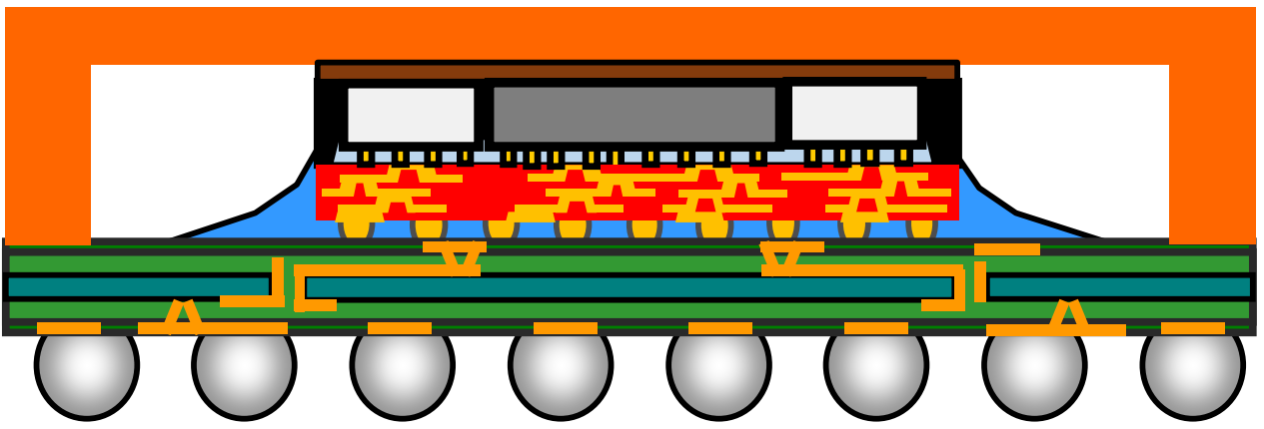
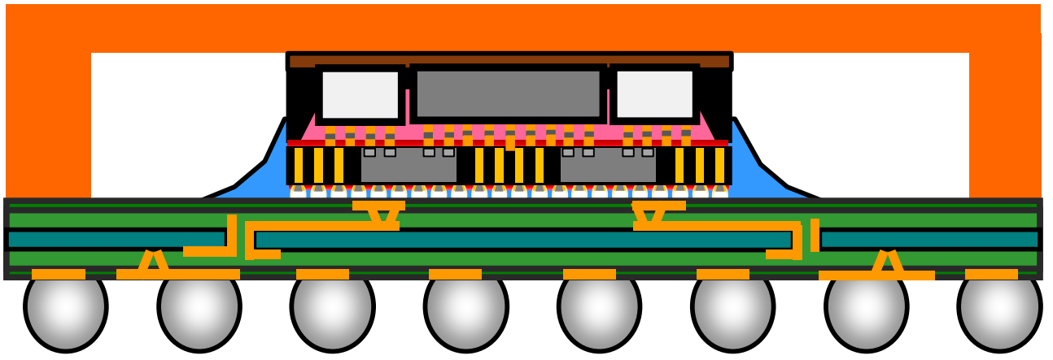
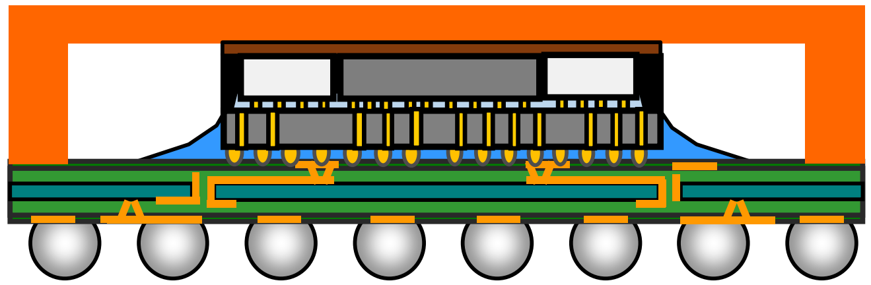
2.xD Packaging Technology Milestone
EMIB
Si bridge in substrate
2017 first product shipment
ODI
In development
2017
2024
2012
2020
2021
Today
Si interposer (2.5D)
tsmc CoWoS first product shipment
RDL interposer (2.3D)
SPIL FO-MCM production
Fan-out Si bridge
SPIL FO-EB production
(1ASIC+4HBM)*2, AMD GPU
Same Si bridge concept with EMIB/ODI:
Plug-and-play complementary solution for Intel?
Notes:
EMIB: embedded multi-die interconnect bridge
ODI, Omni Directional Interconnect

Slide 3
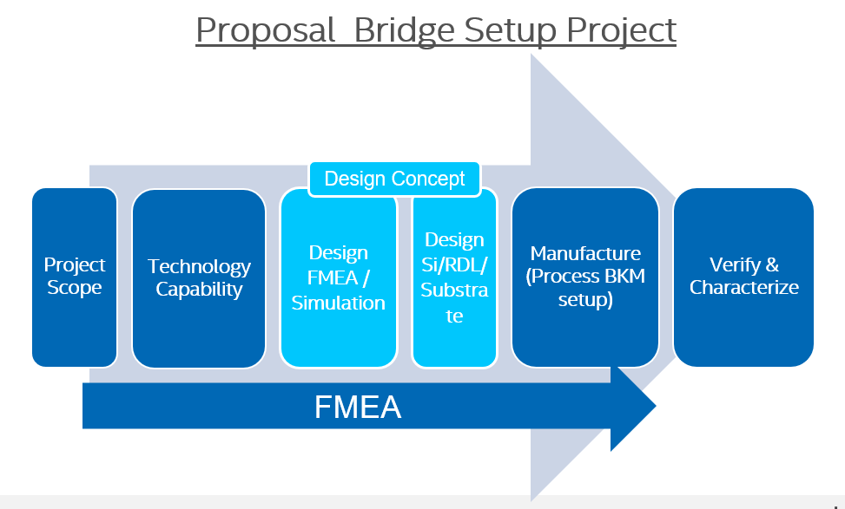
Project Target:
Enable external fan-out Si bridge technology:
Provide a complementary solution for EMIB/ODI for any internal capacity issue.
Plug-and-play solution —no Silicon redesign, minimum design modification effort on RDL/substrate. Use Silicon/substrate of Emarald Rapids.
Better electrical performance in PDN expected compared to 2.3D
Potential cost down. Ex: opportunity to reduce substrate layers.
Potential option for IFS-Customers
Current Phase : Technology Capability

Slide 4
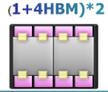
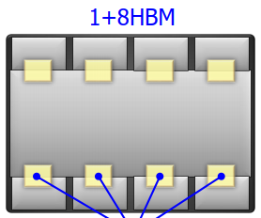
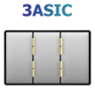
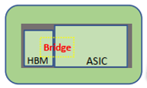
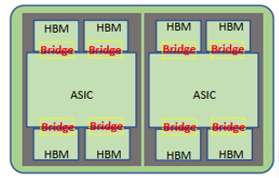
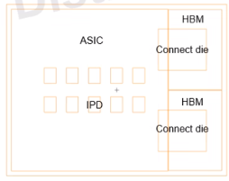
OSAT capability evaluation
              SPIL has most development experience and product in production.
Product feature | Emerald Rapids | OSAT experience
 |  | SPIL LVM experience | ASE Qualified | AMKOR Engineering/Development
Top die qty​ | 2 ASIC | (1+1HBM) in LVM (1ASIC+4HBM)*2 in LVM 1+8HBM in qualification 3 ASIC in dev | (1ASIC+1HBM) qualified (1ASIC+4HBM)*2 in qualification – 2022Q1 | (1ASIC+2HBM) in engineering
Bridge die qty​ | 3 | 4 | 1 | 2
ASIC die size​ | 858 mm2 (26x33) | 725mm2 | 235mm2 (17.6x13.4)​ | 566mm2 (23.4X24.2)
Die to Die Distance | 100um | 140um Eng experience 118um | 70um | TBD
Si bridge size​ | 16.2mm2 (2.7x 6) 32.4mm2 (2.7 x12) | 37mm2 (~1:1 ratio) | 35mm2 (5.6x6.3)​ | 46mm2 (7.3x6.3)
Molding interposer size | NA | 1460mm2 2x reticle | 404mm2 (27.3x14.8)​ 1x reticle | 836(32.8x25.5) 1x reticle
Package size​ | 4640mm² (80mmx58mm) | 5600mm2 | 1271mm2 (41x31)​ | 4556mm2 (67.5x67.5)
top die bump pitch | 55/100/130um | 45um * No mixed bump experience | 55um *No mixed bump experience * core bump/ubump diameter ratio <2 | 50um * No mixed bump experience
Bump out pitch to substrate​ | Top die core bump 100/130um | Molding interposer min 150um 2024 roadmap 90um | Molding interposer min 150um | TBD
No gap
Gap

Slide 5
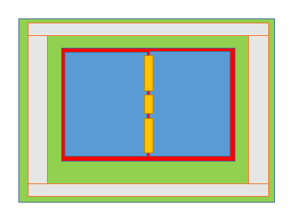



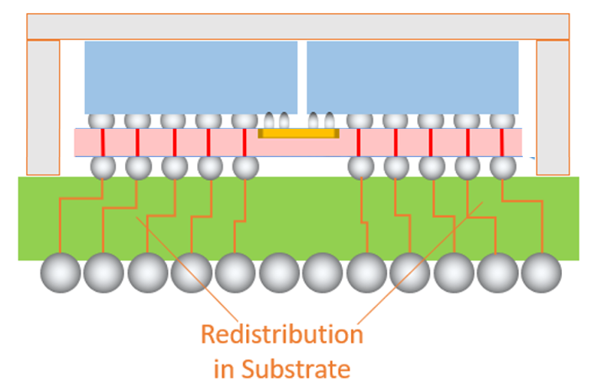
Product Concept Study – Emerald Rapids
EMIB
core bump 100/130um pitch
Top die: Intel Silicon
Bridge die: Intel Silicon, embedded in substrate
ubump 55um pitch
External
Si Bridge
Tall Cu pillar in molding interposer
Bridge die embedded in molding interposer
Key to project success:
Retain form factor. Keep same pitch to substrate.

Slide 6
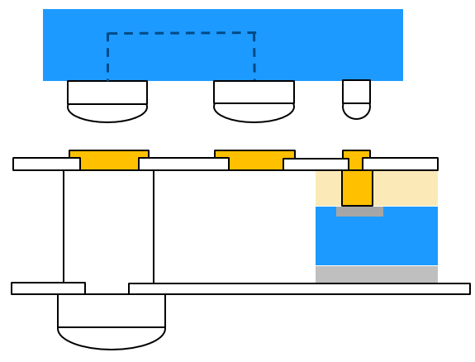
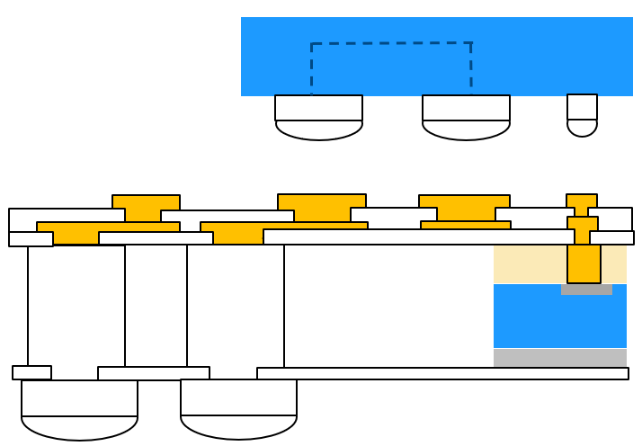
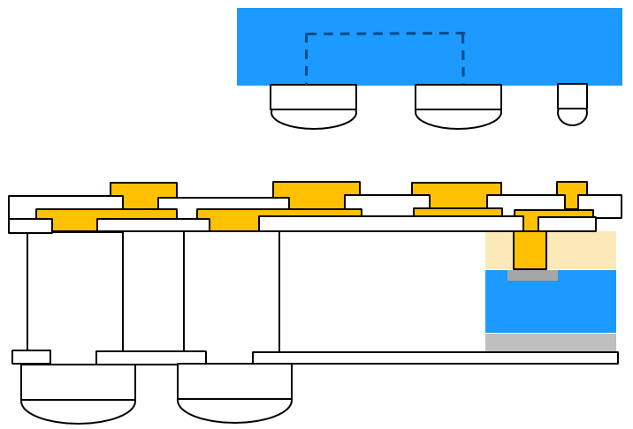
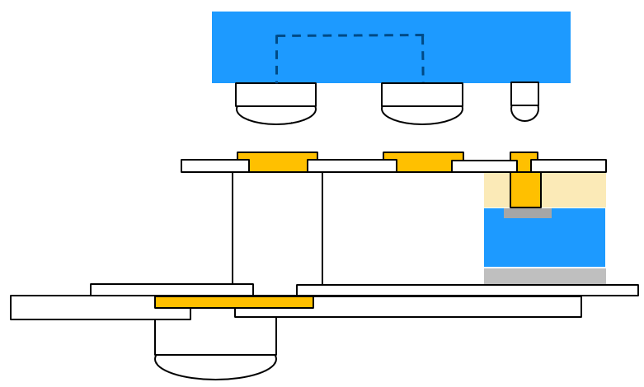
Design Options— Redistribution Layer (RDL)
SPIL lesson learnt: REL failure is observed at direct vertical connection between top die & molding interposer.
  Option A ranks highest – best choice in design, electrical performance, cost
  OSAT has experience of option C. Lowest concern in REL – relaxed design rule needed
  Plan to have option A/ option C go in parallel
Topic | A. No RDL | B. Top RDL | C. Top RDL | D. Bottom RDL
Design feature | No RDL | Die to interposer →Core bump: RDL →ubump: stacking via | Die to interposer →Core bump: RDL →ubump: RDL | interposer to sub →RDL
Min design effort | *** | ** | ** | **
Low REL concern | ** direct vertical connection | ** direct vertical connection | *** OSAT experience | ** direct vertical connection
Electrical performance | *** | ** | ** | **
Low cost | *** | ** | ** | **

Slide 7
Next Steps
What has been done
OSAT capability evaluation
Defined Project target & scope
Work Packages
Design rule review and design option decision. [Ongoing, Dec]
OSAT selection [Ongoing, Dec]
Bond and communicate with BU. [Dec]
Establish detail plan. Resource needed from BU/FTE/OSAT. [Ongoing, Dec]

