Slide 1
Advanced Packaging Solutions Emerald Rapid in 2.3D The FIVR –PDN Analysis
Nov 15th 2021 / Andreas Dost

Slide 2
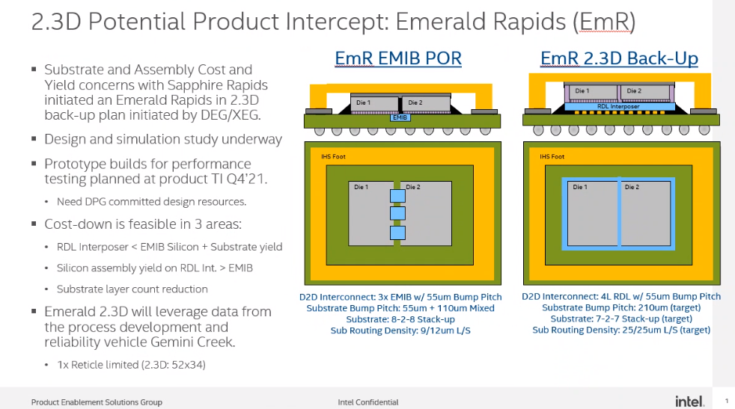
130um
BE CAREFUL!!! IS THIS THE LATEST

Slide 3
Common Project
Business Unit: Server Group DCG / PHED
Ted Burton
Business Unit: DCG / PHED
SI/PI Julio Cinco Galicia
Emerald Rapid / EMIB Alternatives in 2.3D
TEG:
Carlton Hanna / ProjectMgr
Bernd Waidhas/ SystemArchitect
Abdallah Bacha/ Layout
StefanReif / DesignSystem
Cindy Muir / Simulation
Friedrich Rosenbauer / DesignSystem
FTE:
David O‘Sullivan / PlatformMgr
Dwight Lee / ProcessExpert-OSAT
Andreas Dost / Layout
Big opportunity to contribute in a common project work

Slide 4
Content of Work
Emerald Rapid / EMIB Alternatives in 2.3D
TEG:
Carlton Hanna /ProjectMgr
Bernd Waidhas/SystemArchitect
Abdallah Bacha/Layout
Cindy Muir/Simulation
FTE:
Andreas Dost / Layout
Workpackges completed: so far
Layouting the EMIB-Bridge in 2.3D / done
Signal Integrity-Simulation for EMIB replacement / done / pass
Layout the 2.3D-PowerDeliveryNetwork for the cores/ done
PDN-Analysis for 2.3D-core supply (FIVR-Network)
Layout EMIB-PDN / Simulate the EMIB-PDN (ongoing)
critical item:

Slide 5
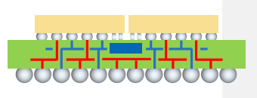
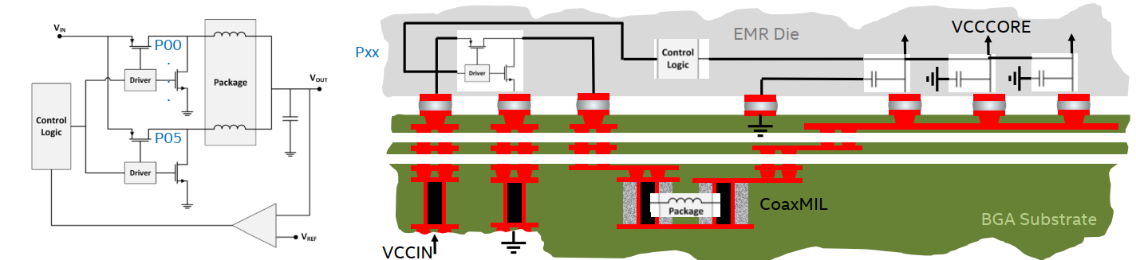
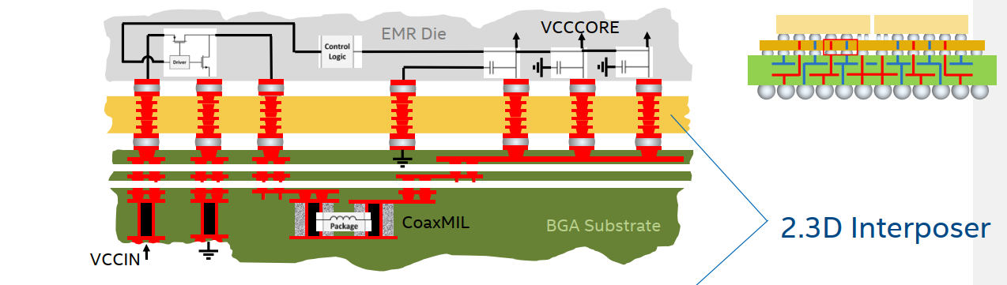
FIVR: EMIB vs 2.3D Interposer
FIVR: Fully Integrated Voltage Regulator
EMIB
no Interposer
Organic interposer with 4L RDL
Added resistance to PDN / Risk

Slide 6
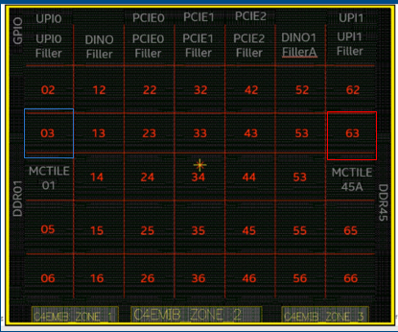
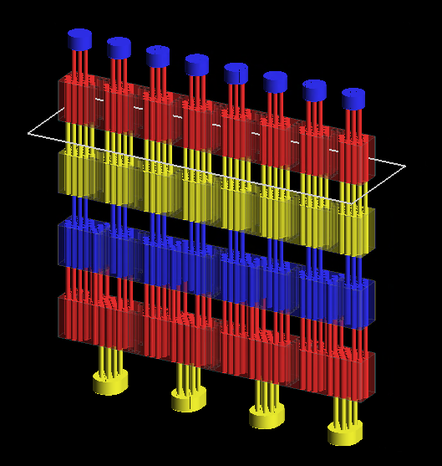
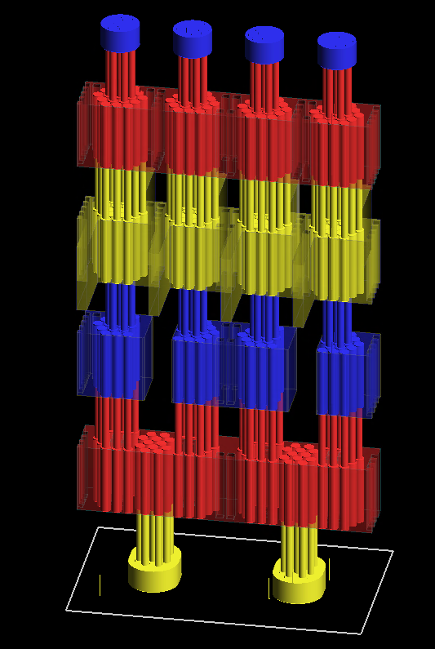
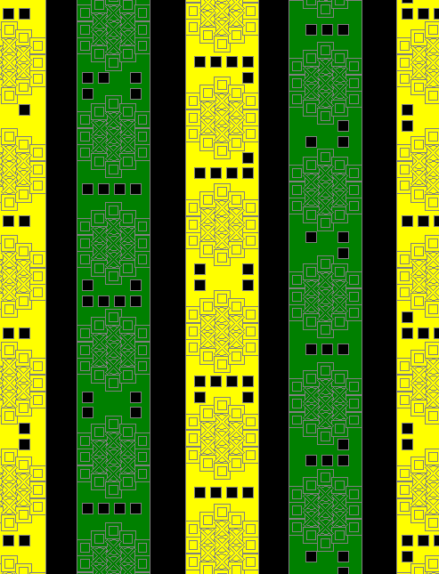
Many Cores / several Layout studies in RDL
To minimize Resistance Path in 2.3D Interposer / optimizing interposer design rules design
Via arrays
Stacked vias / Staggered vias
Traces/Metal density ...
VXBR Pattern
Top Level Die
Output Pattern

Slide 7
Combined Simulation Die/2.3D/Substrate
Simulation Judgement Table
R-Extraction
L-Extraction
Bode/Phase Diagram
Impedance Plot
Transient Simulation
Efficiency
Imax Current
BU- Die model
Graphics & Data taken from
Julio Cinco / DCG /PHED
BU- Substrate model
TEG
2.3D interposer
model

Slide 8
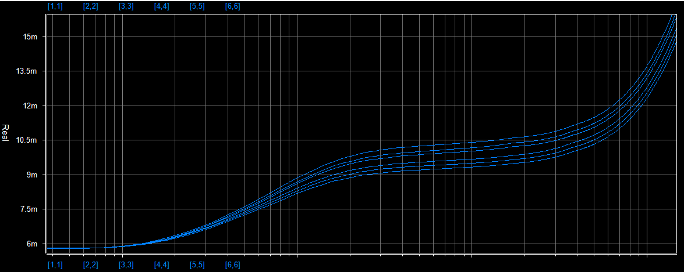
Findings in Simulation: R Extraction vs Freq of VXBR
Graphics & Data taken from
Julio Cinco / DCG /PHED
R (ohm)
Fsw= 90MHz
VXBR Pattern
Simulation Judgement Table1
L-Extraction | Small effect compared to inductor
Bode/Phase Diagram | No impact
Impedance Plot | still ok
Transient Simulation | Ok
R-Extraction | Higher/ Risk
Extra 9-10mOhm of Rac @ Fsw = 90Mhz per VXBR.
This will increase DC/AC losses that contribute to efficiency.

Slide 9
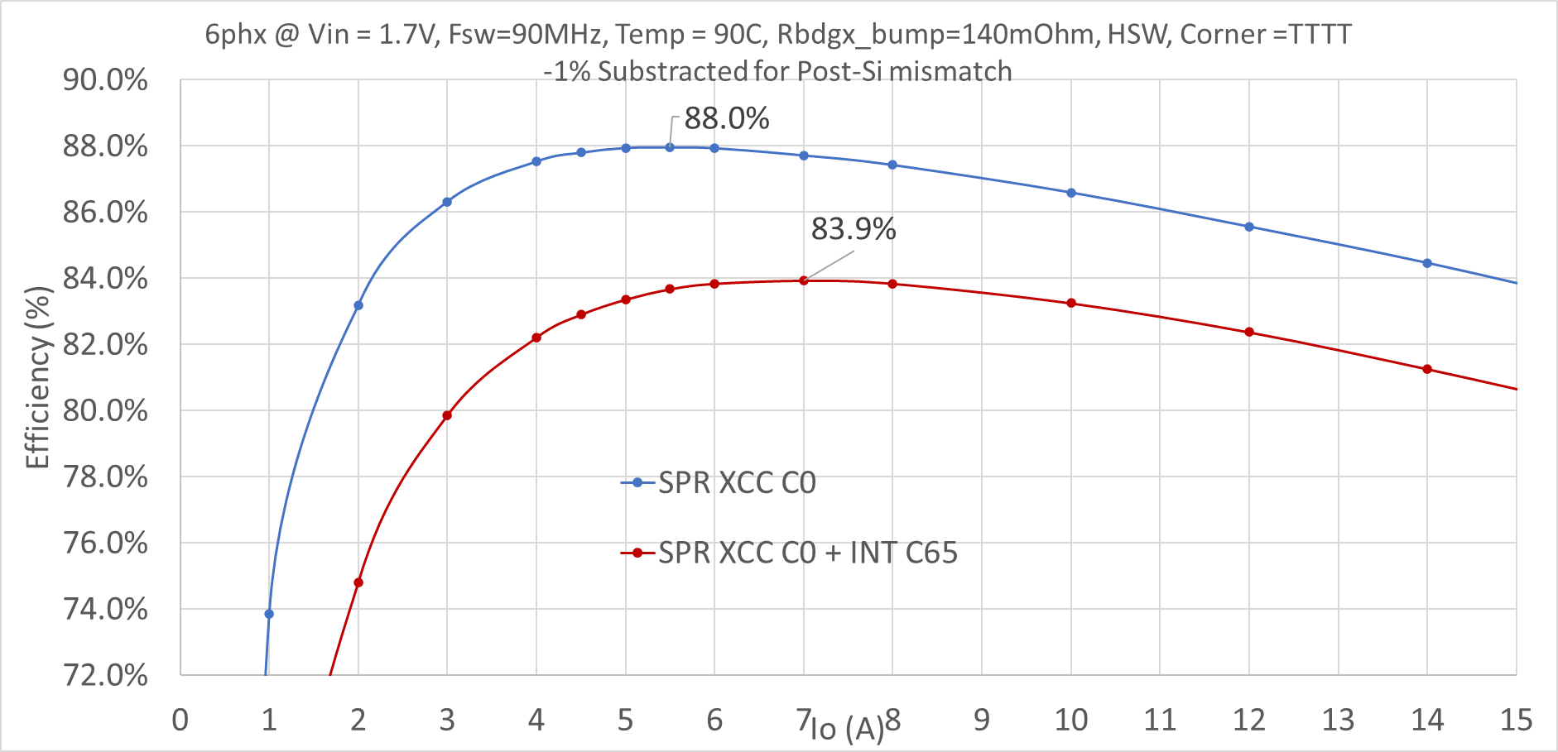
Efficiency: Potential Show Stopper for 2.3D
Simulation Judgement Table
Efficiency | -4%
Extra losses of Interposer reduces efficiency by 4%. This is high risk

Slide 10
How to deal with this Result?
Rule of thumb calculation for stacked vias by Bernd
Compare to DC-simulation for the stacked-via set from Cindy
Detailed confirmation of simulation condition Cindy/Julio (PVT+stackup+solder joint confirmation)
Comparing simulation tools (Ansys Q3D vs Cadence Sigrity™)
Julio did re-simulation with Cindy’s DC-simulation setup

Slide 11
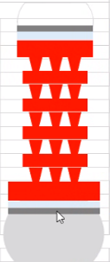
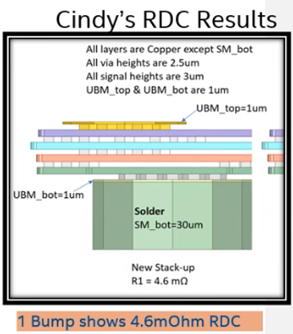
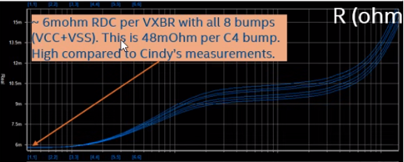
Problem: -4% risk in FIVR efficiency DC-resistance comparision for one via-stack
Rule of thumb gives 2mOhm
Cindy‘s sim: 4.6mOhm
Julio‘s result: 48mOhm
Bernd :Rule-of-thumb result: 2mOhm
2.
Clear mismatch:
Resistance ~10x
higher than expected

Slide 12
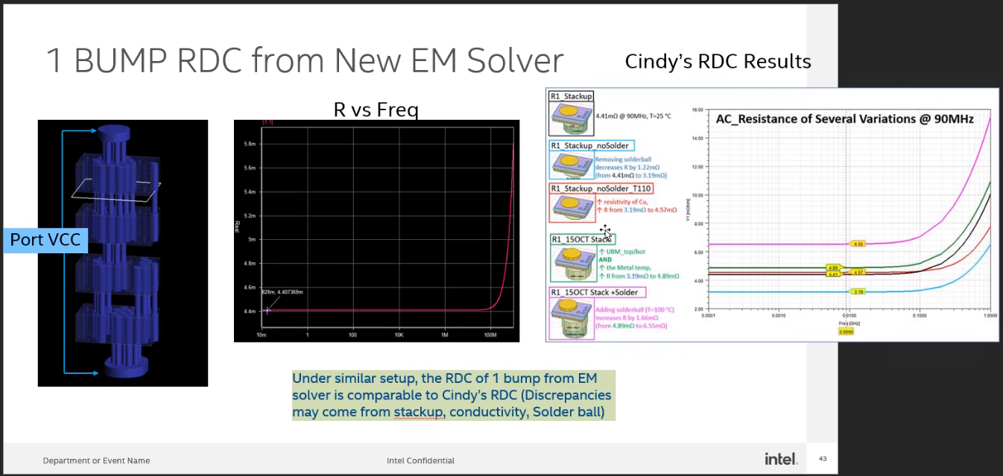
Next: Confirm Julio‘s setup with simplified Layout and new EM-SOLVER
Now the simulation is matching the simplifed setup

Slide 13
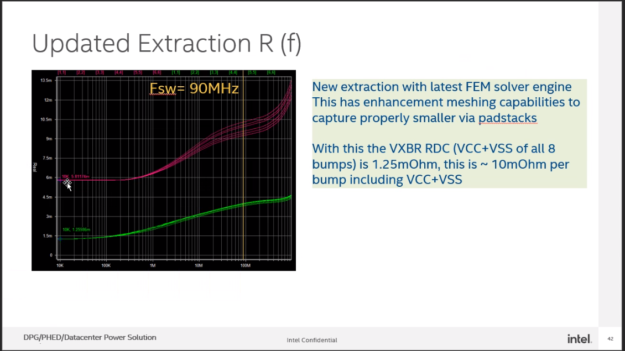
New EM-Solver (by Julio): full PDN-Simulation again
Simulation Judgement Table
R-Extraction | Only slightly higher
L-Extraction | Small effect compared to inductor
Bode/Phase Diagram | No impact
Impedance Plot | Ok
Transient Simulation | Ok

Slide 14
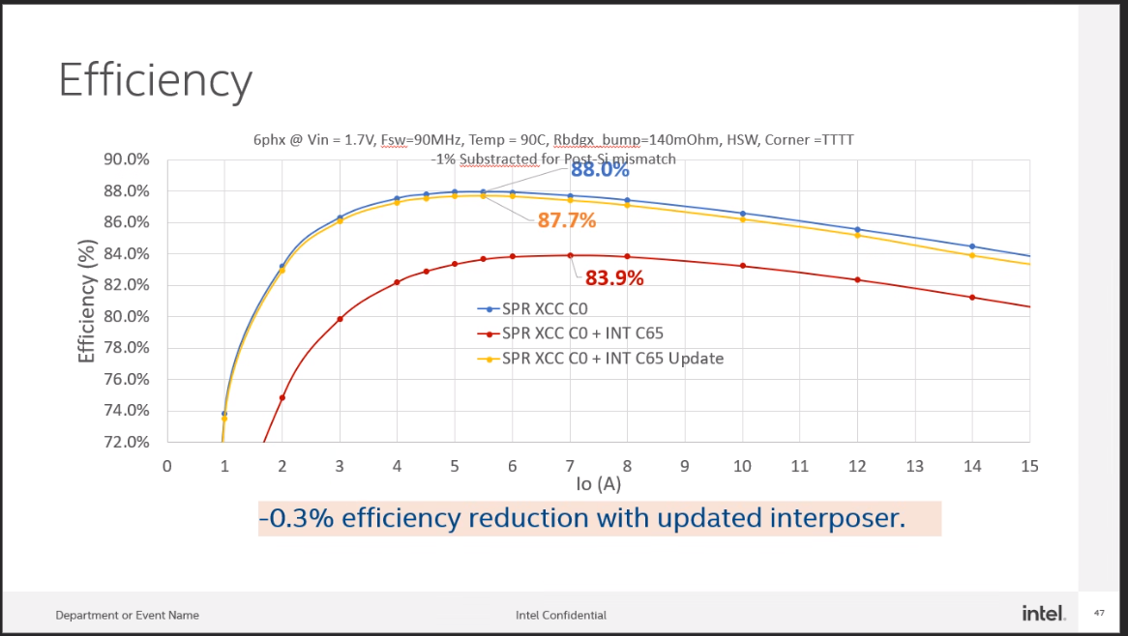
New EM-Solver (by Julio)
87.7%! Show Stopper is removed

Slide 15
ONE

