Slide 3
Future Memory Direction

Slide 4
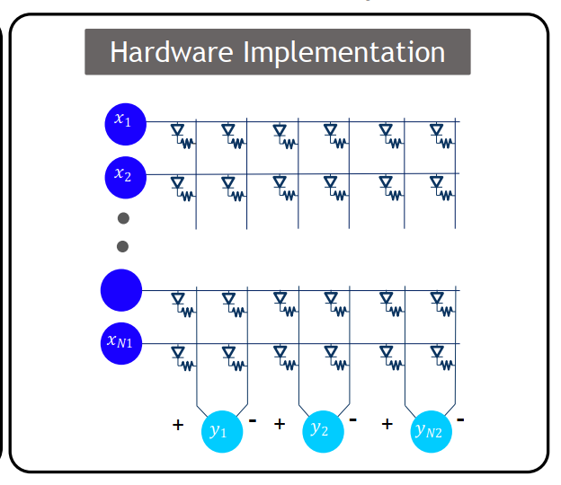

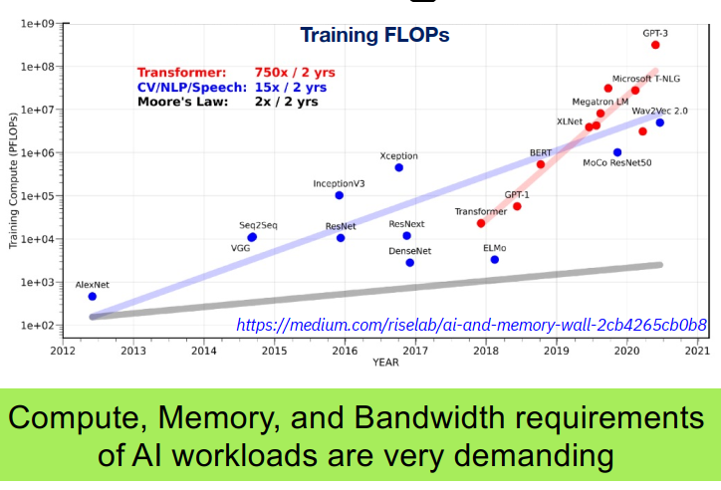
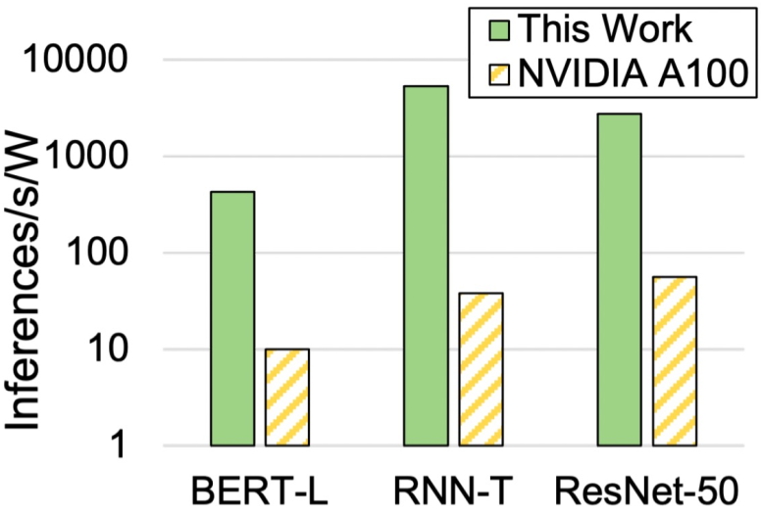

Slide 5
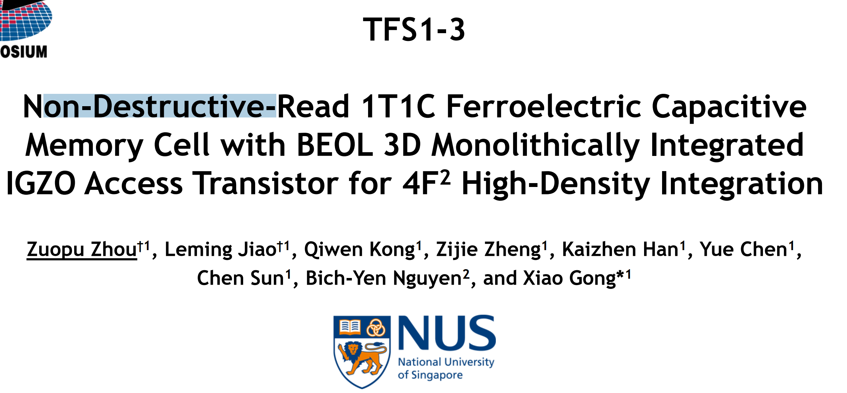
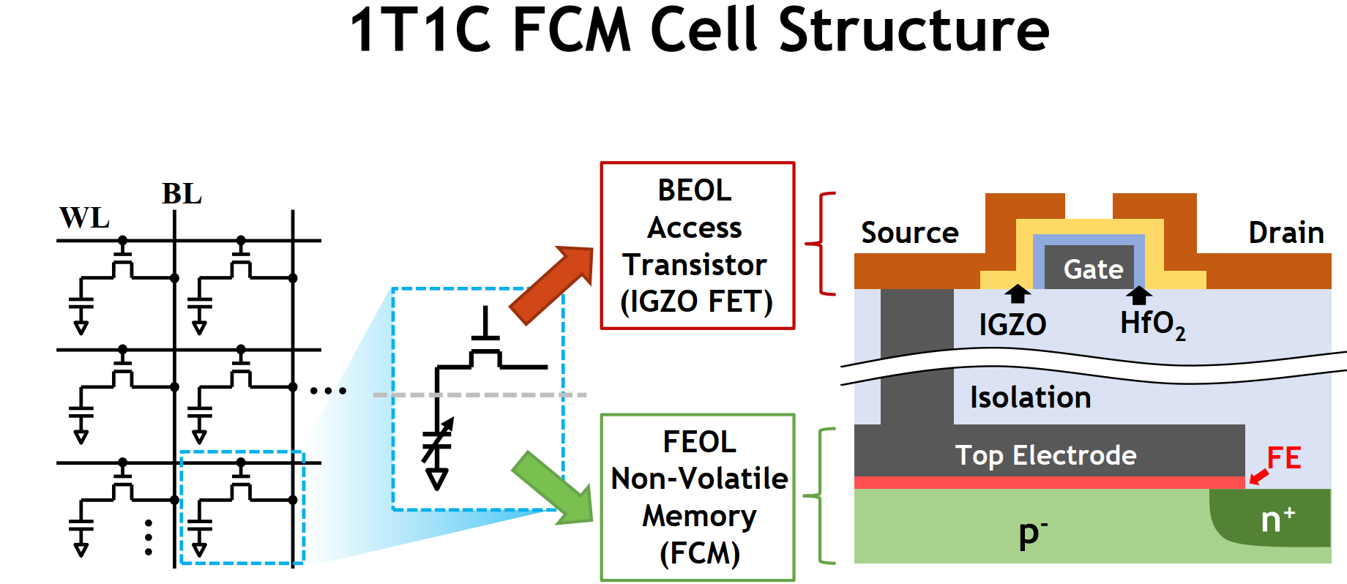
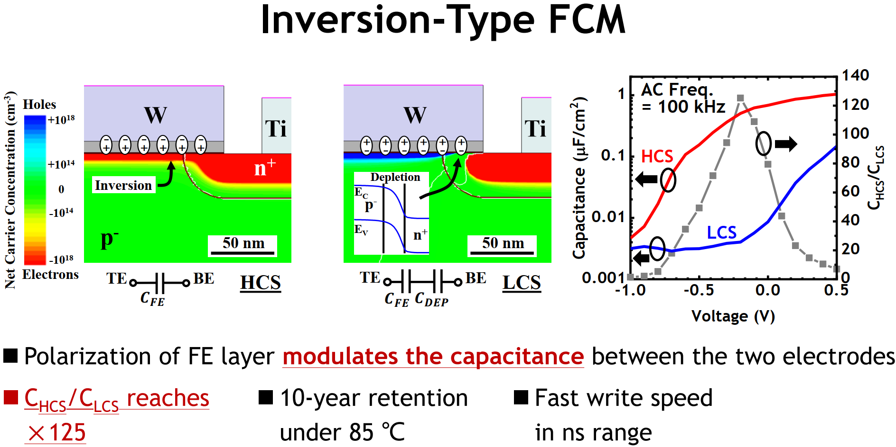
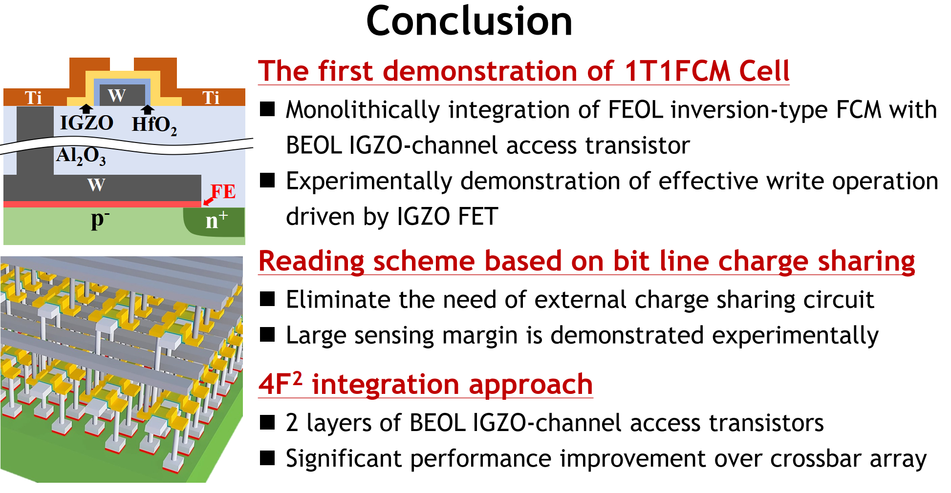
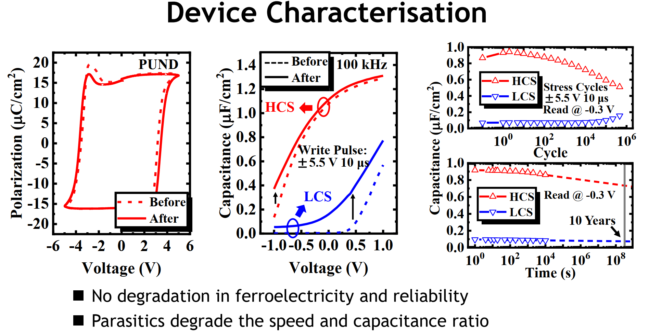

Slide 6
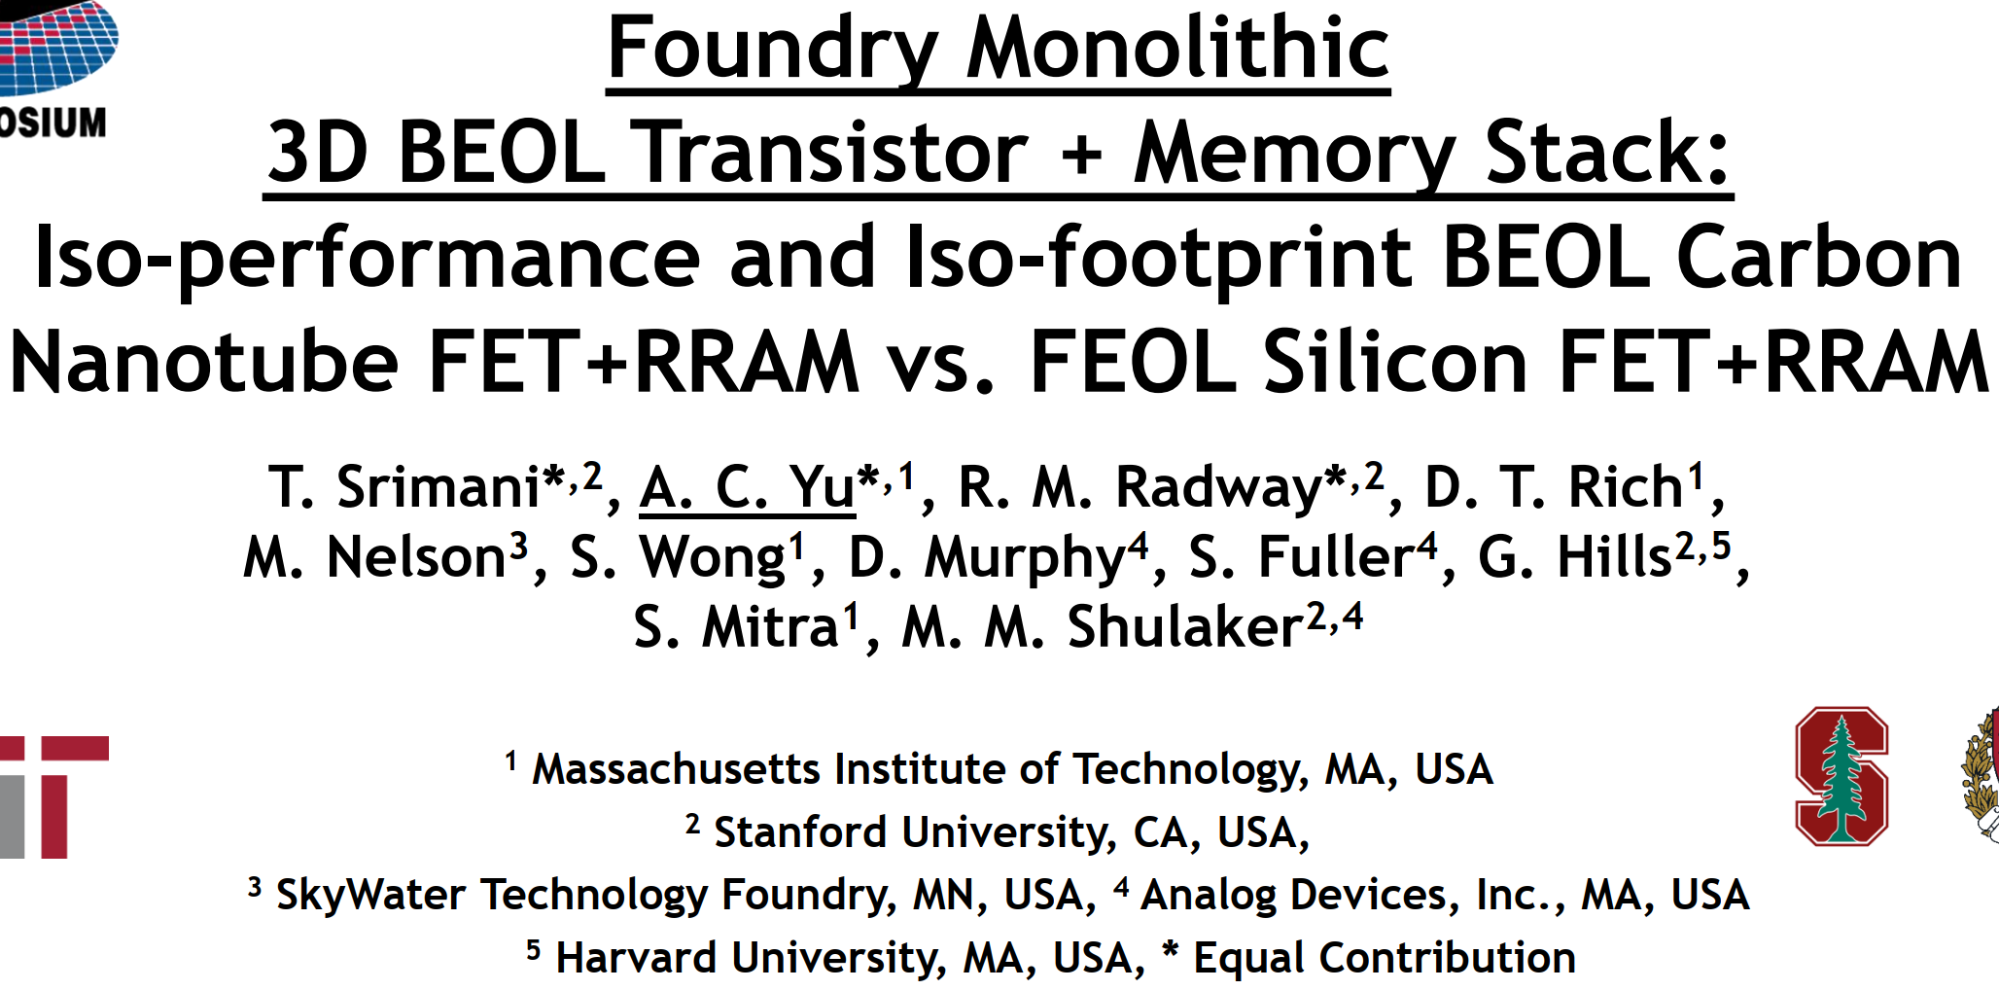
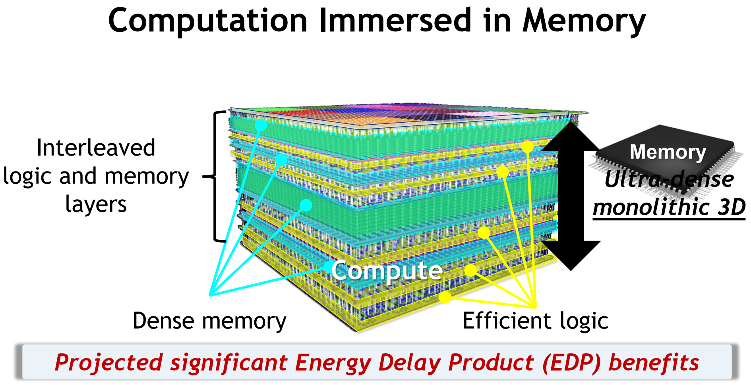
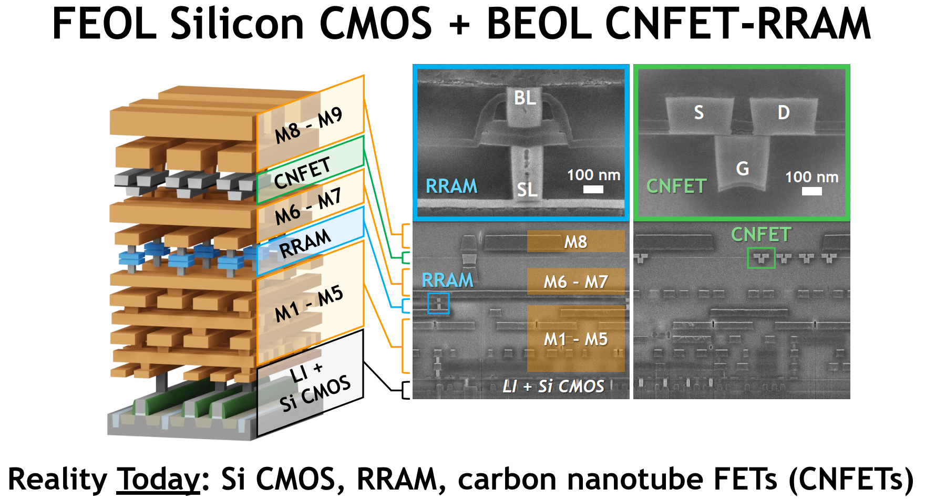
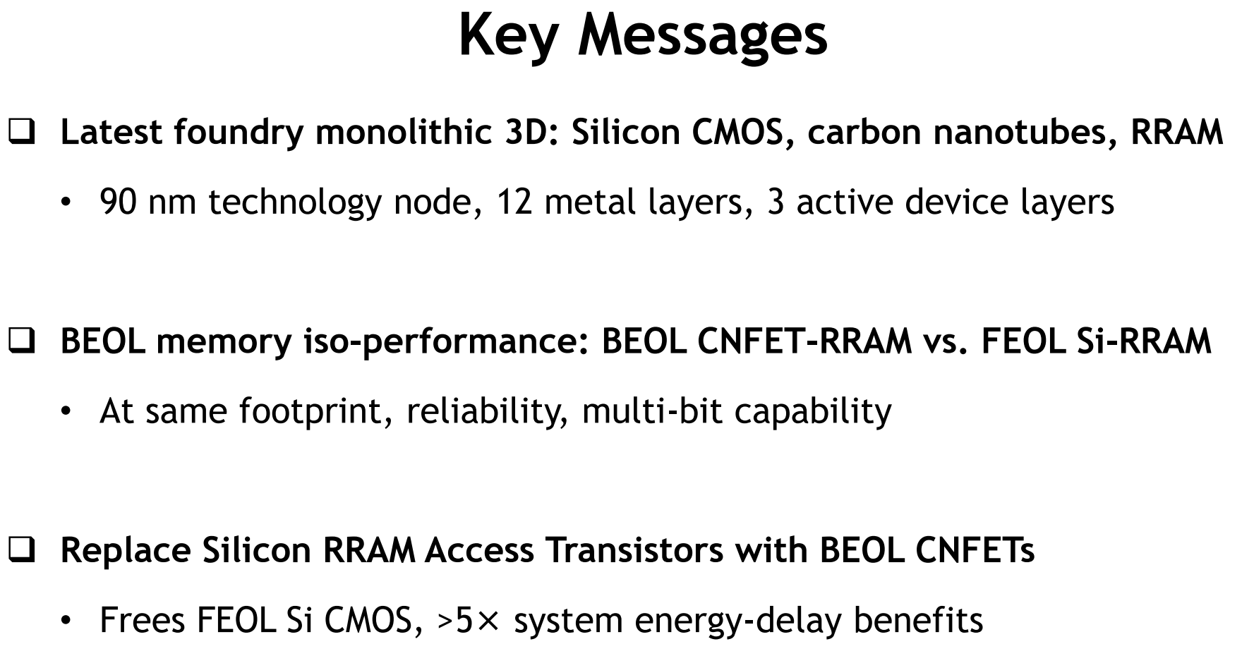
TFS1-4

Slide 7
3D NAND

Slide 8
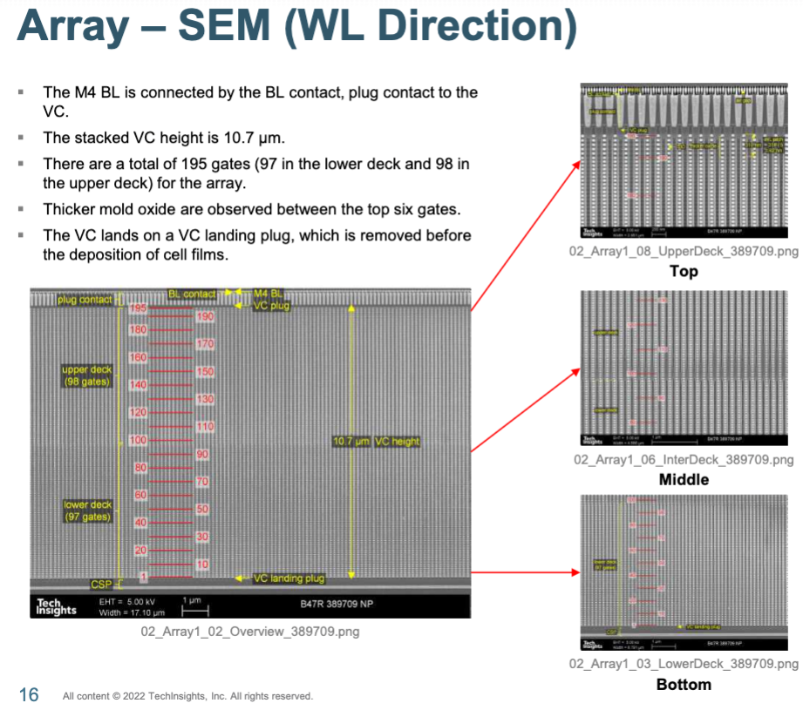
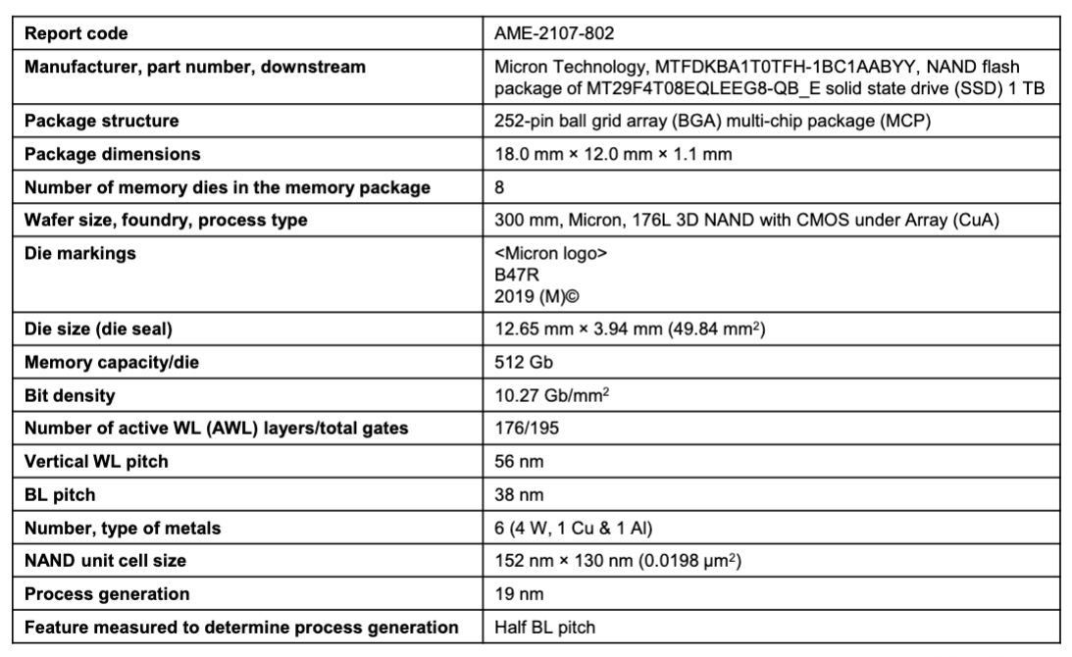
Micron 3D-NAND 176-layer 19nm 512Gb QLC

Slide 9
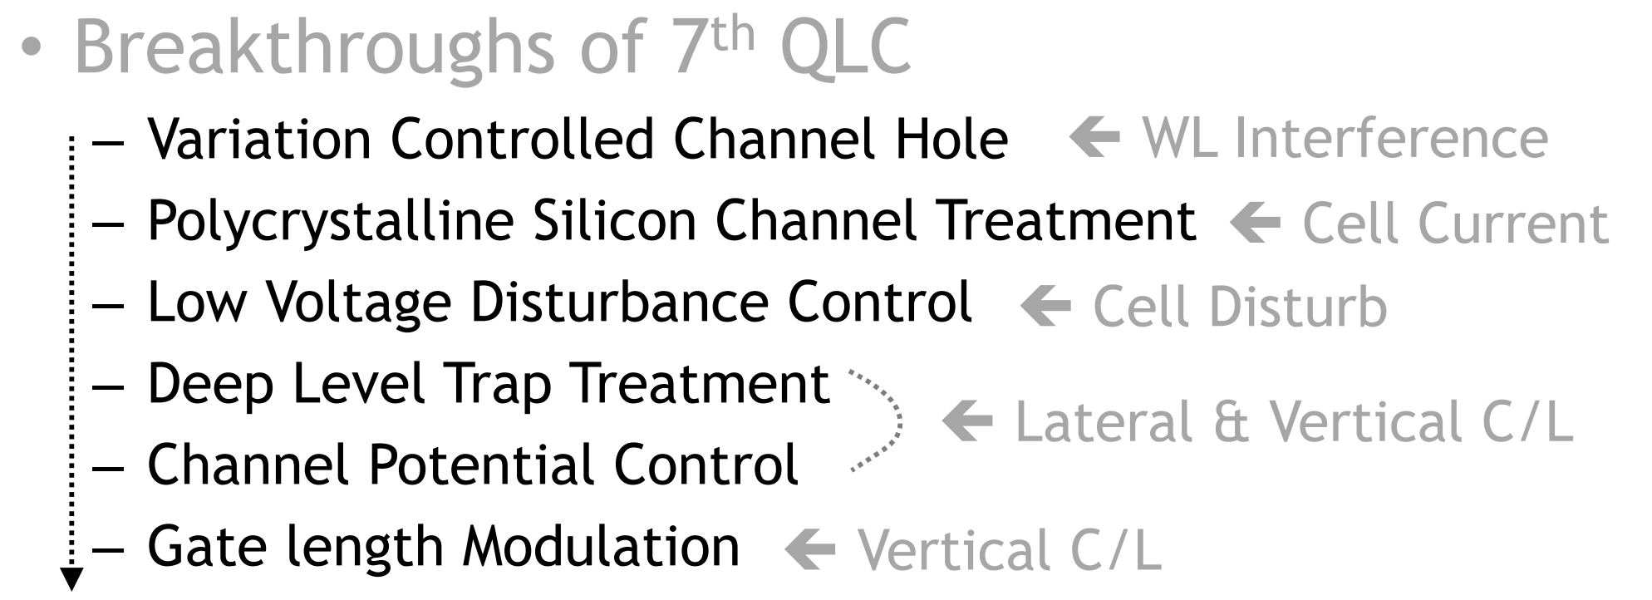
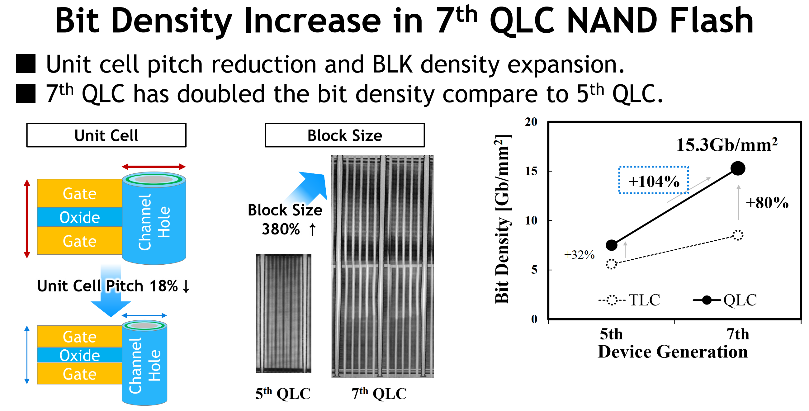
T3-4 Samsung 7thGen 1Tb 3D NAND QLC
92 Layers
1 deck
176 Layers
2 decks

Slide 10
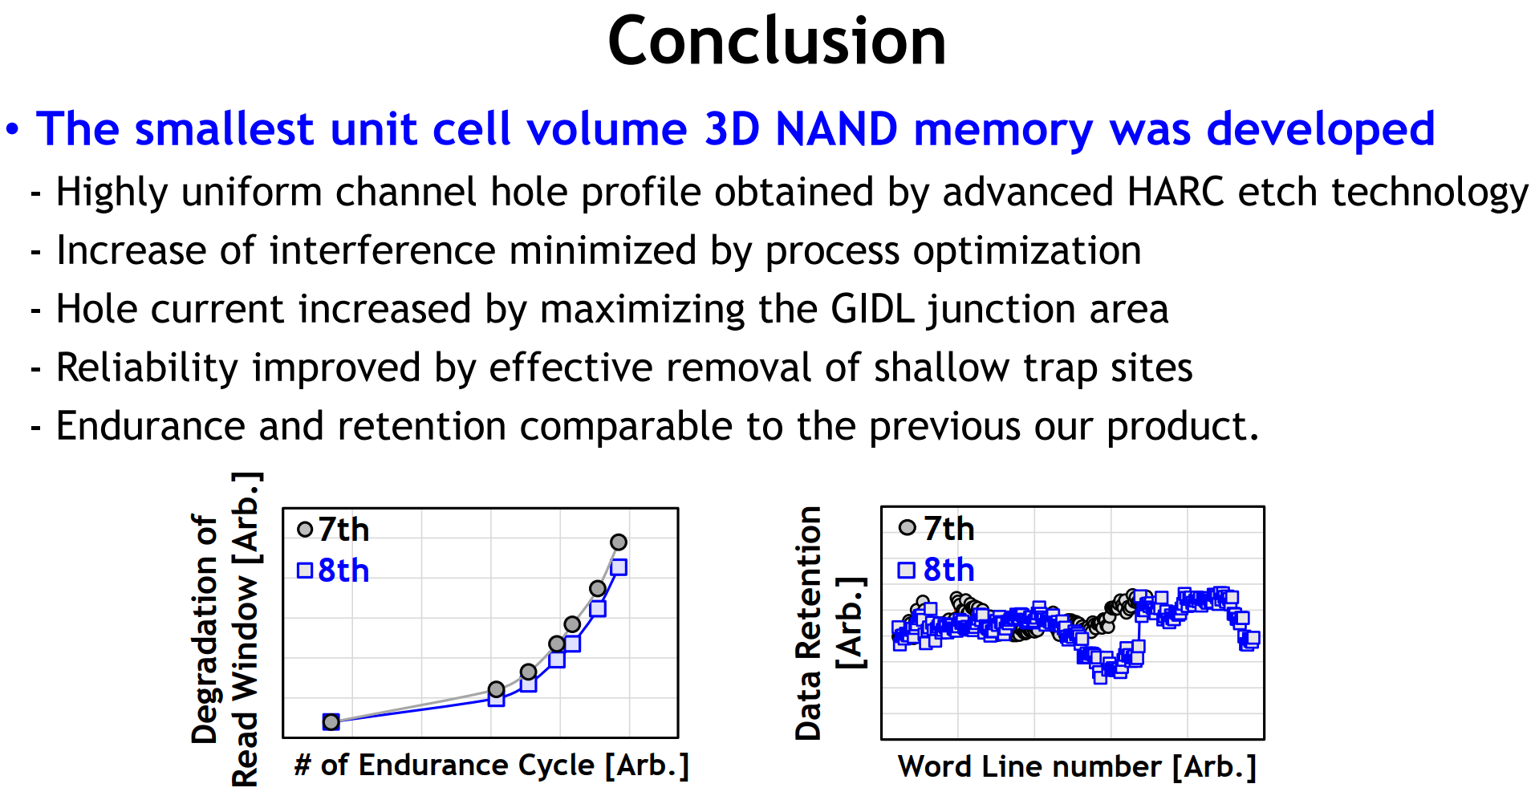
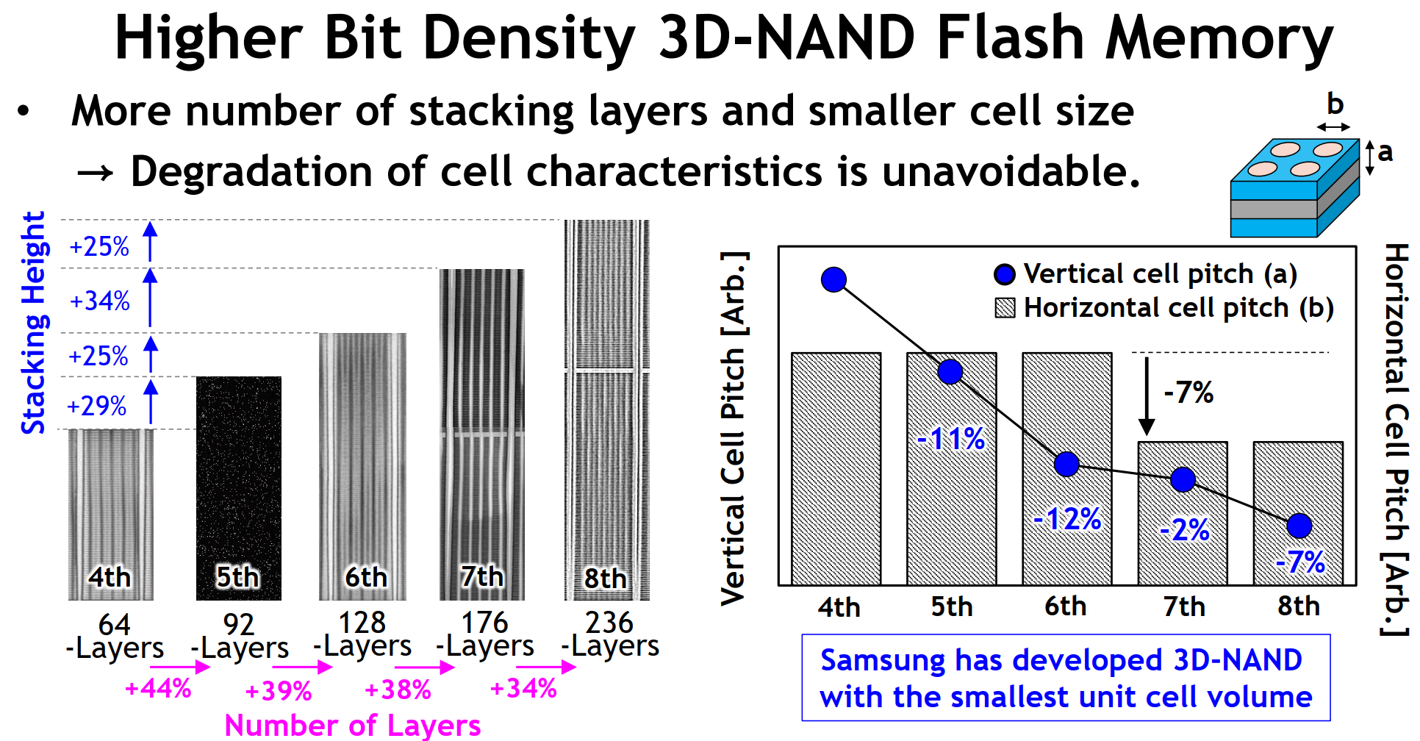
T3-1 Samsung 8thGen 1Tb 3D NAND QLC

Slide 11
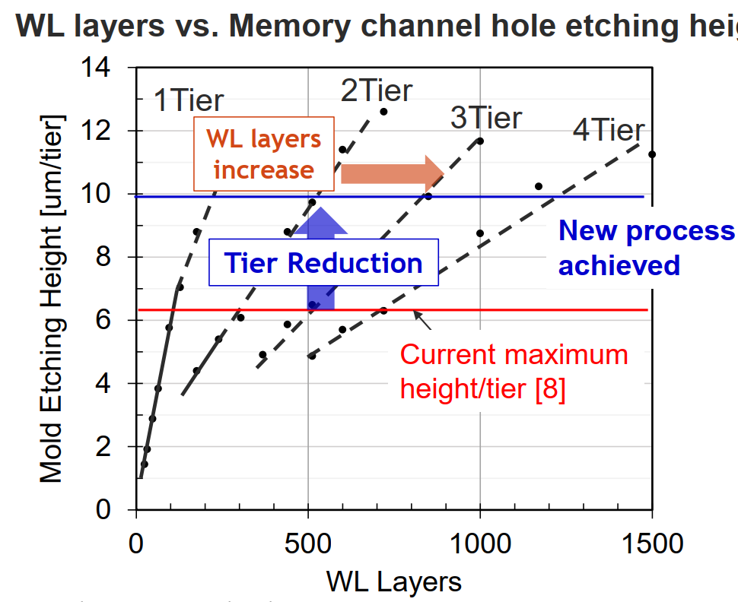

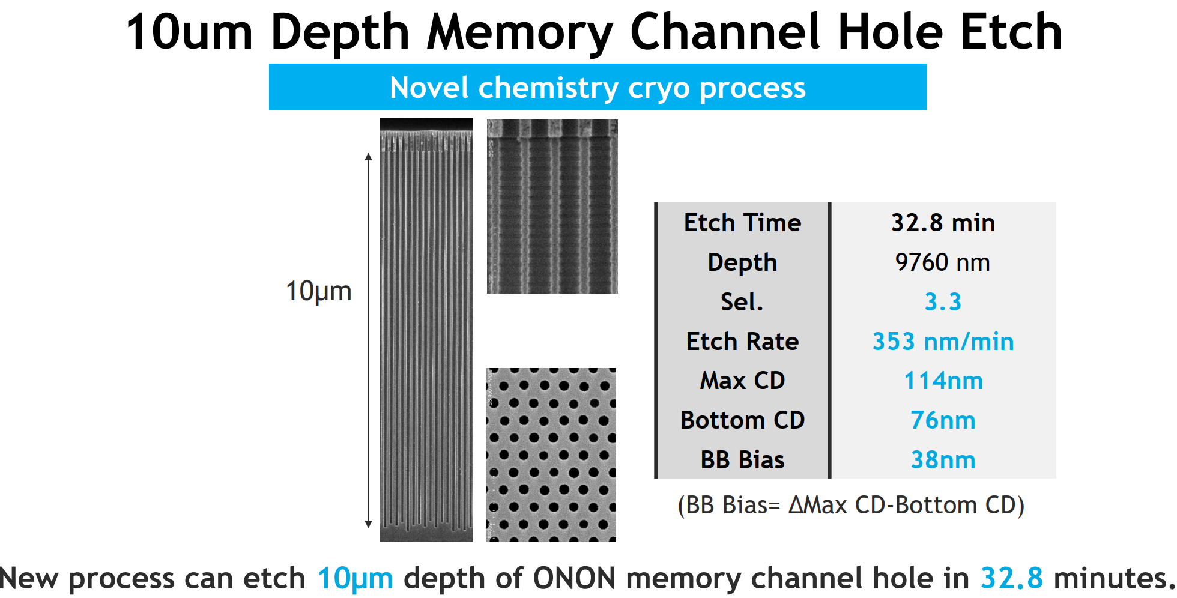
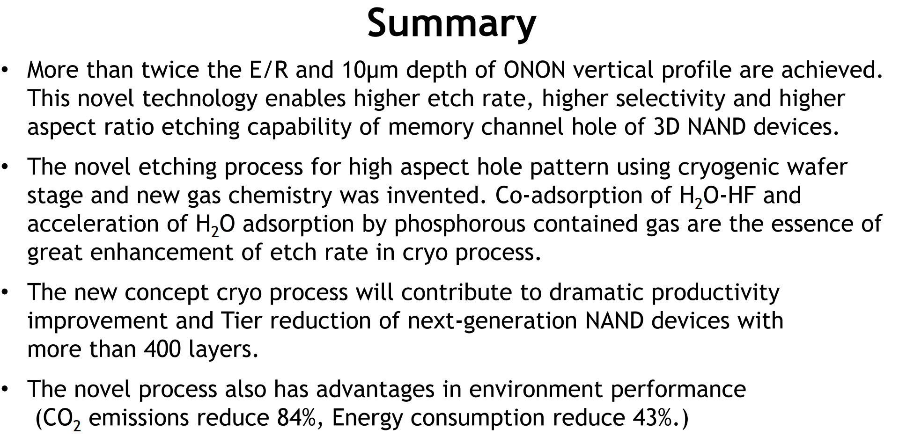
T3-2

Slide 12
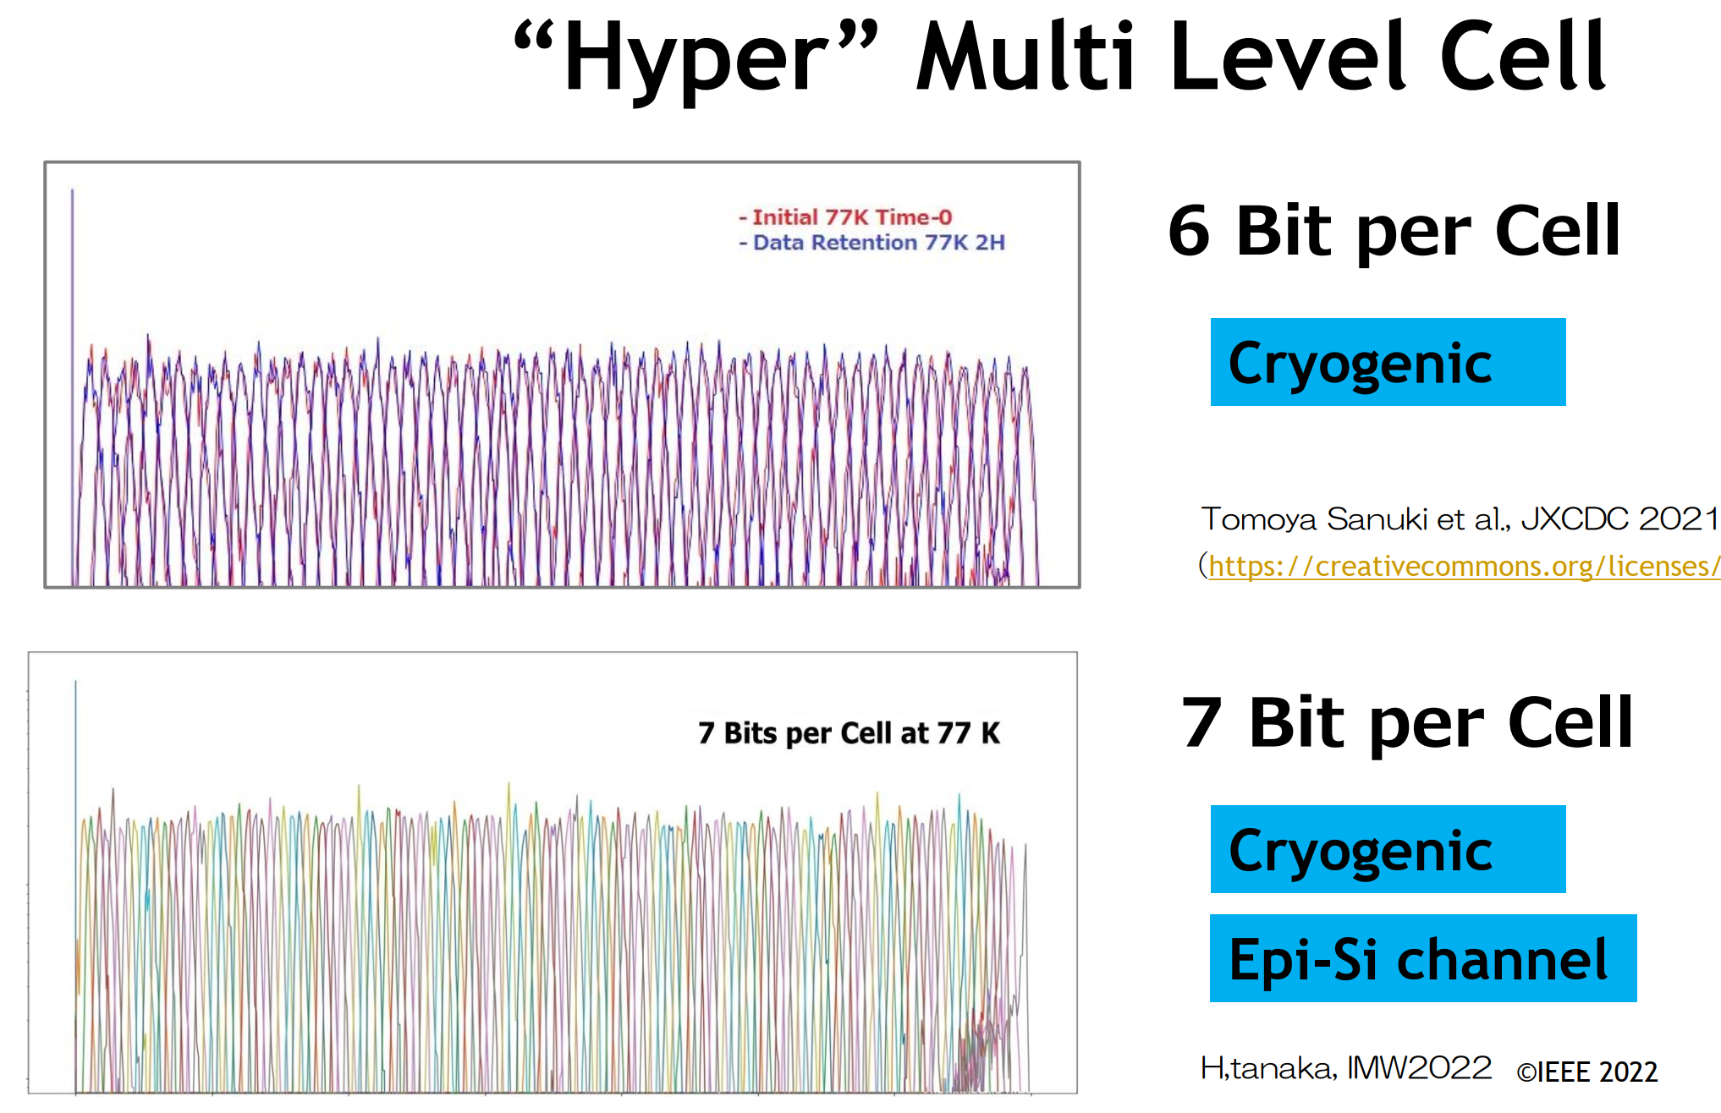
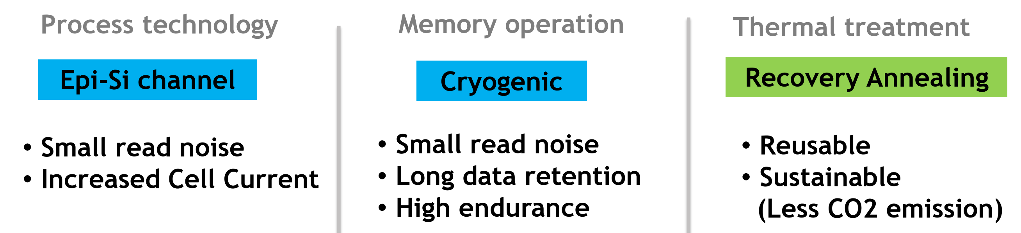
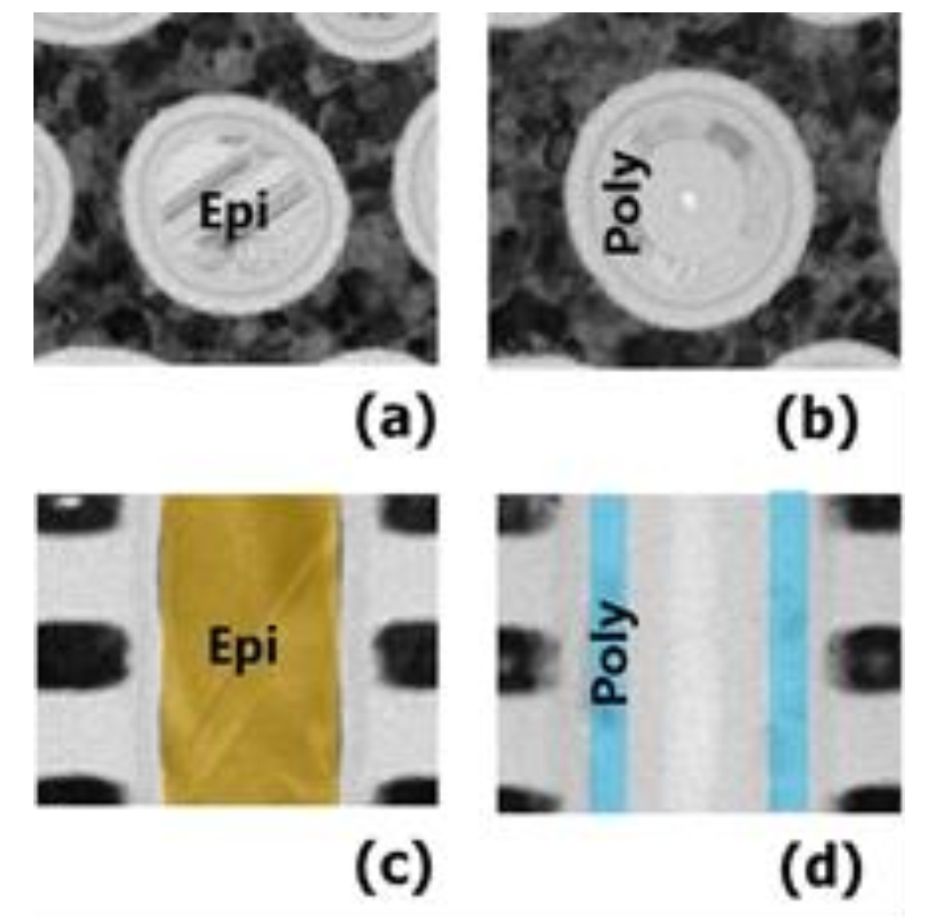
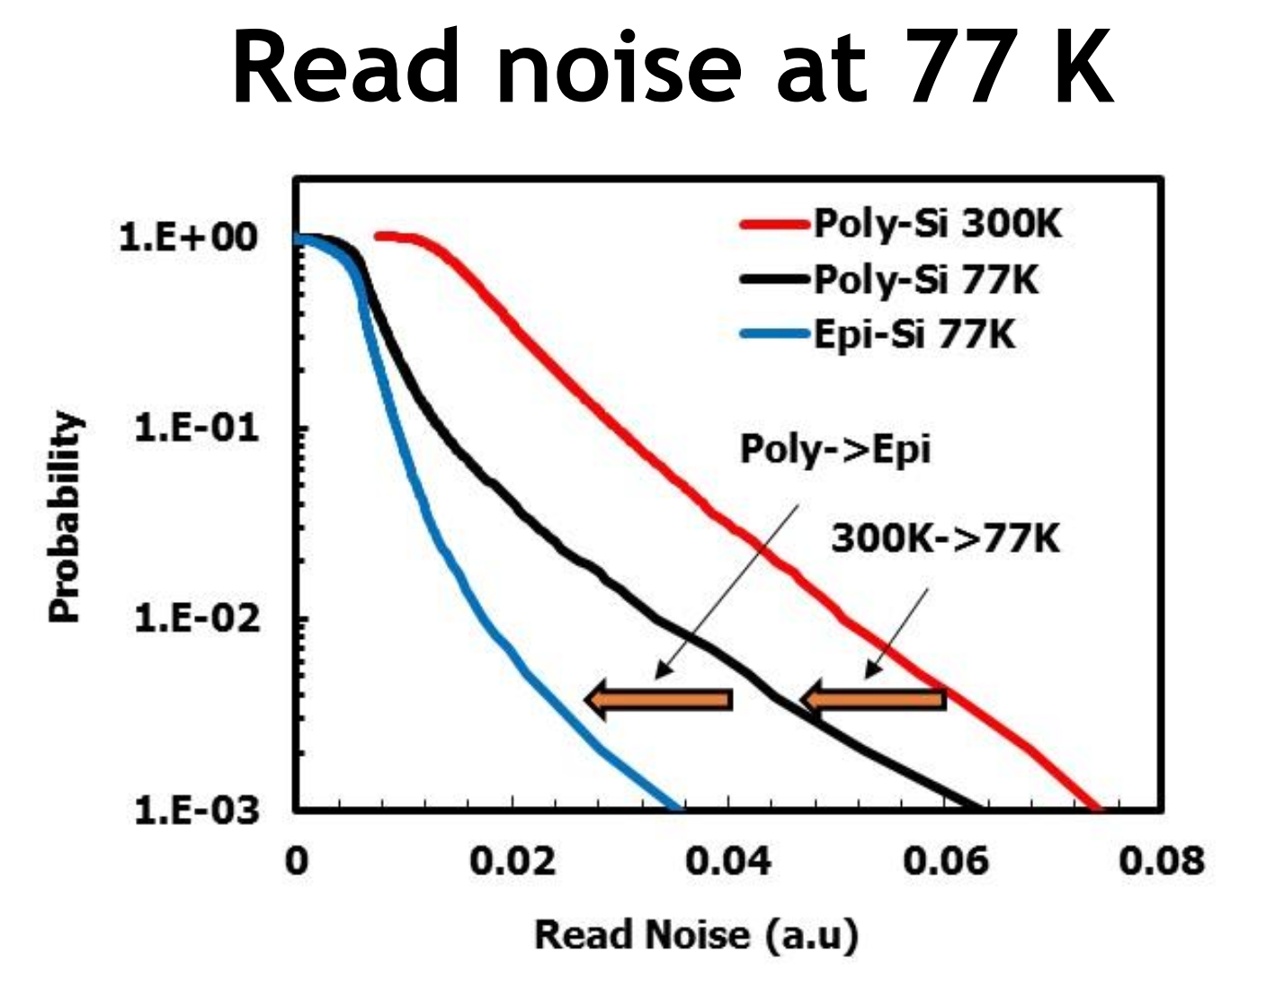
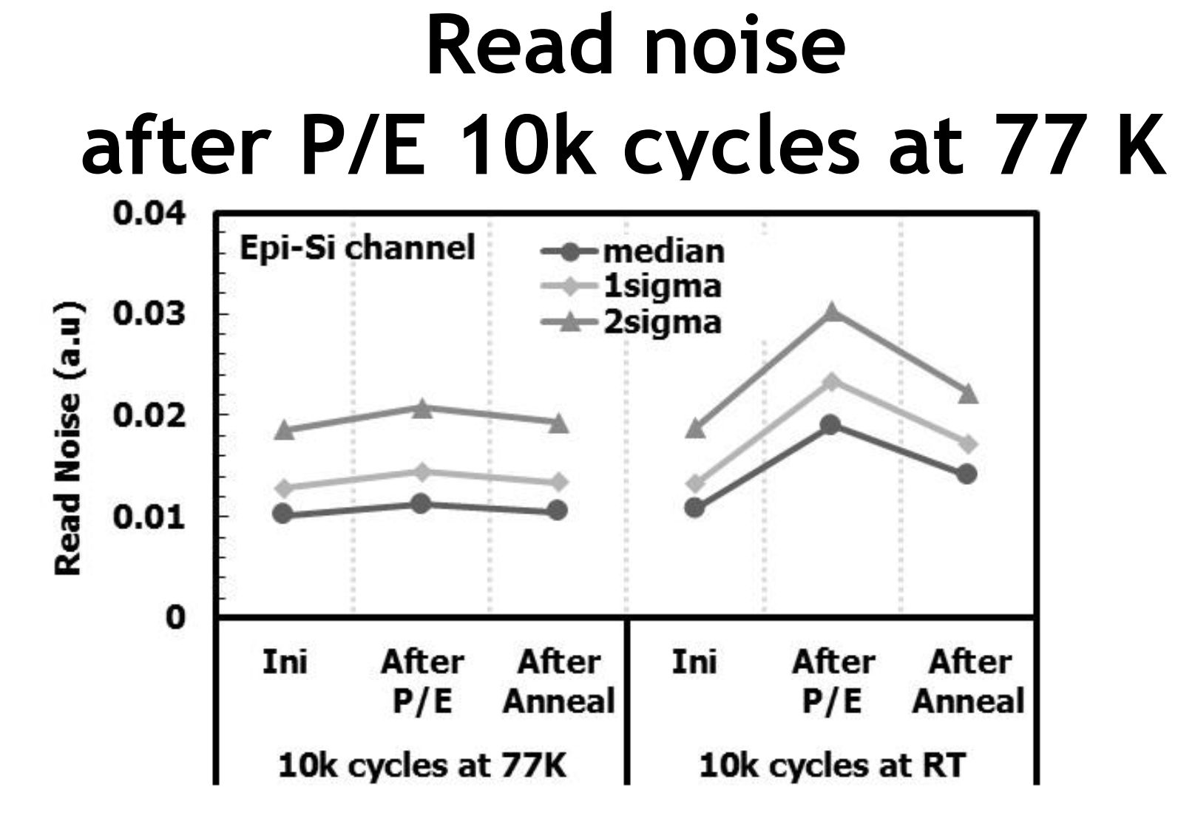
T3-3 Kioxia’s Recovery Anneal on
7-bits/cell Cryo Flash

Slide 13
Ferroelectricity

Slide 14
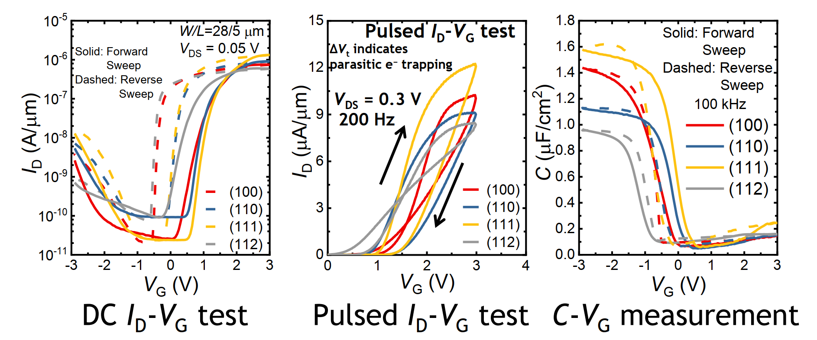
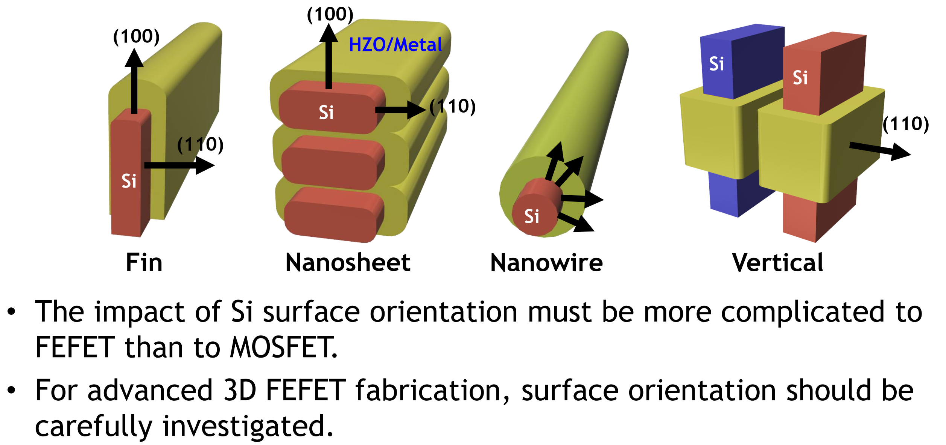
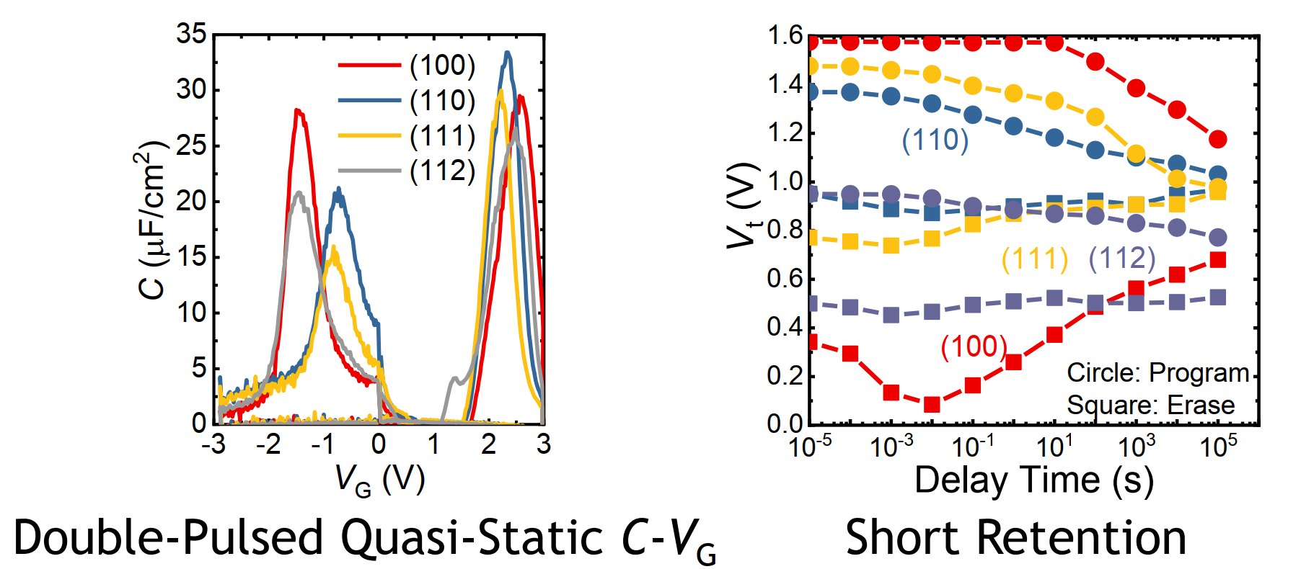
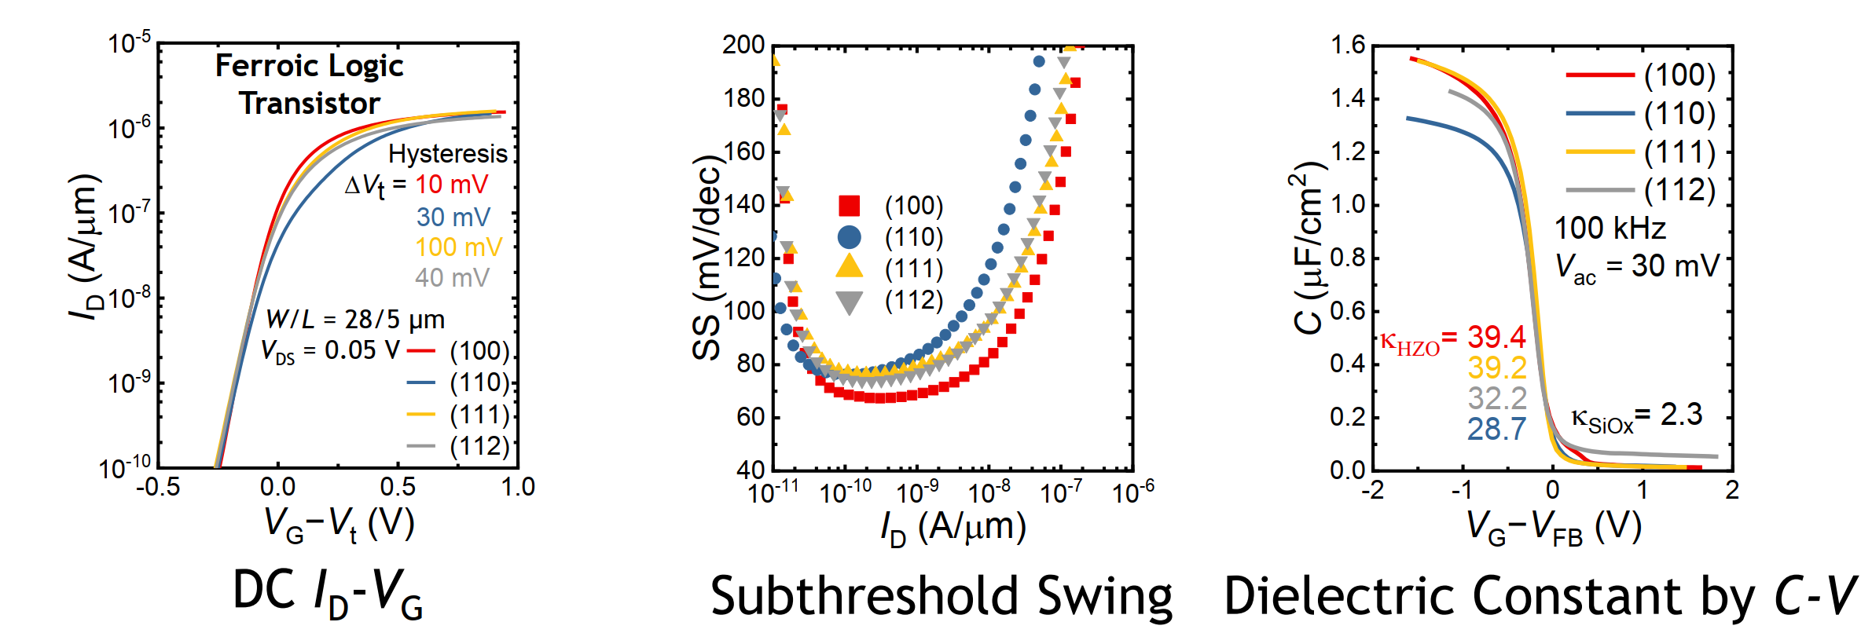
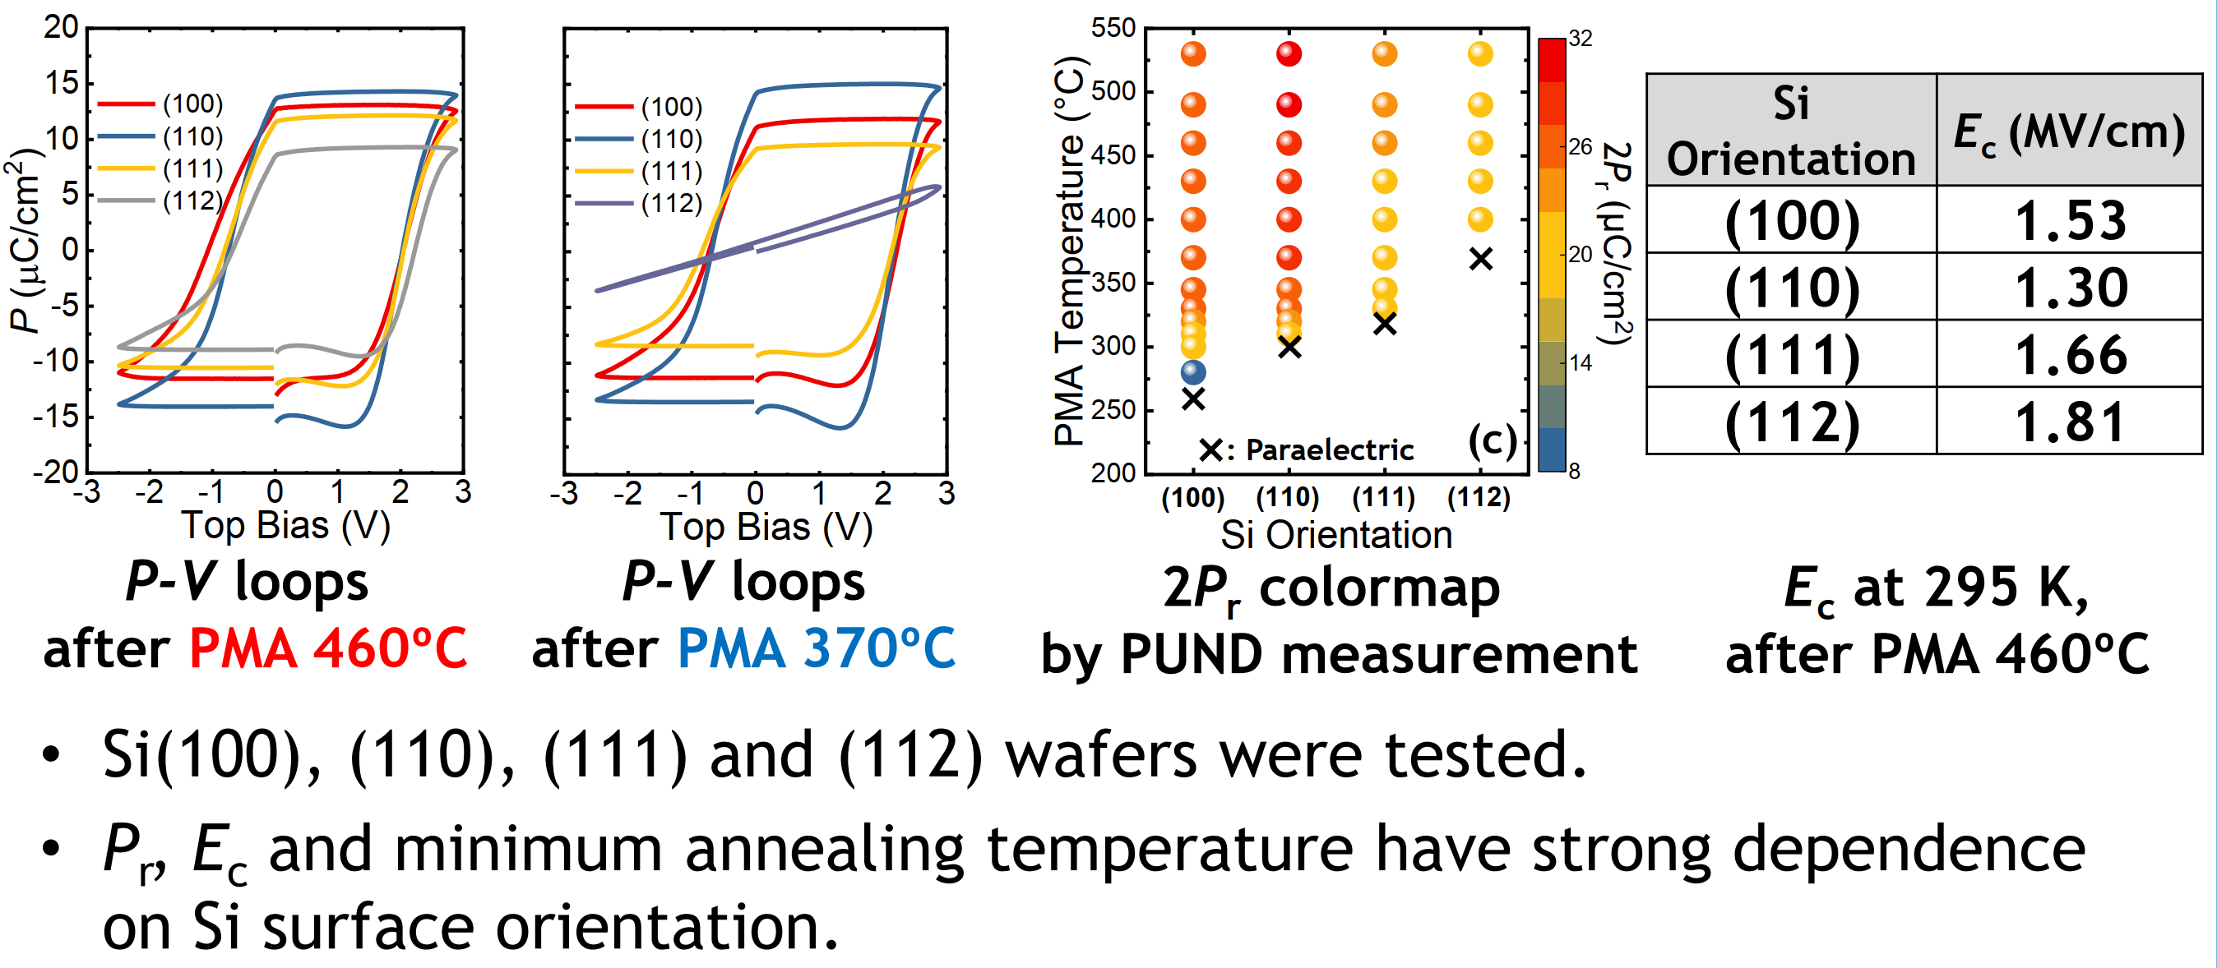
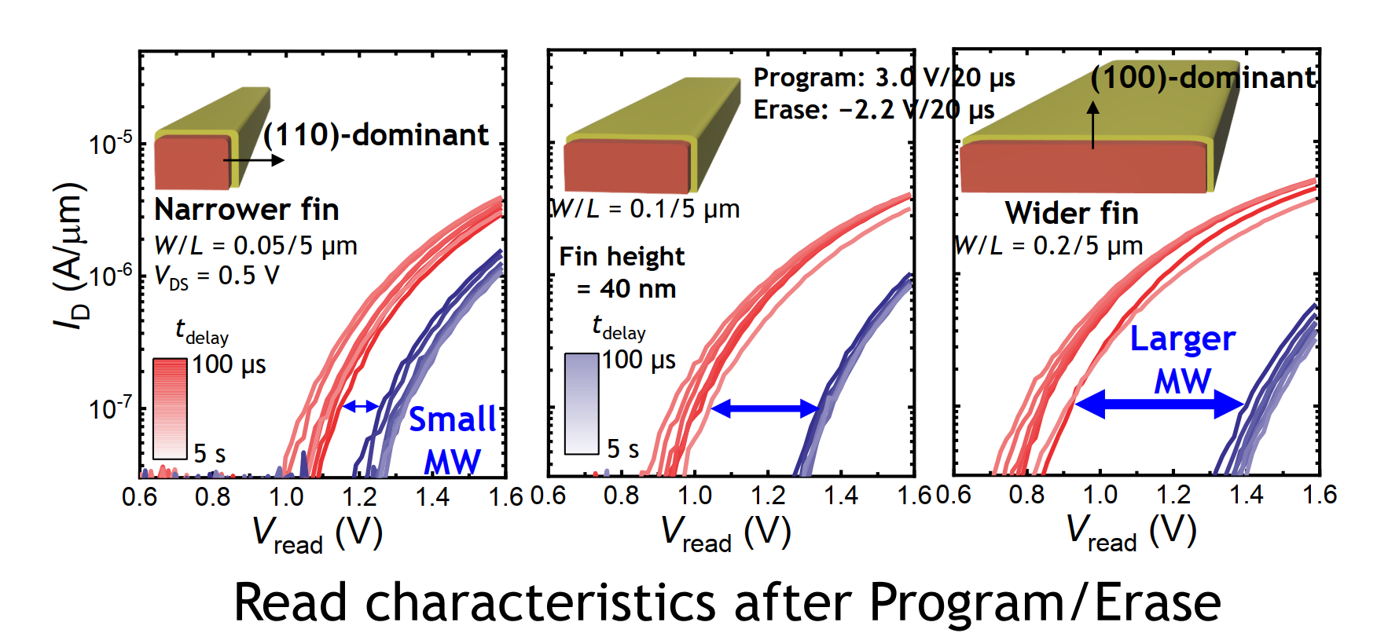
T5-1 KAIST/KIST on 3D FE-FET orientation charx

Slide 15
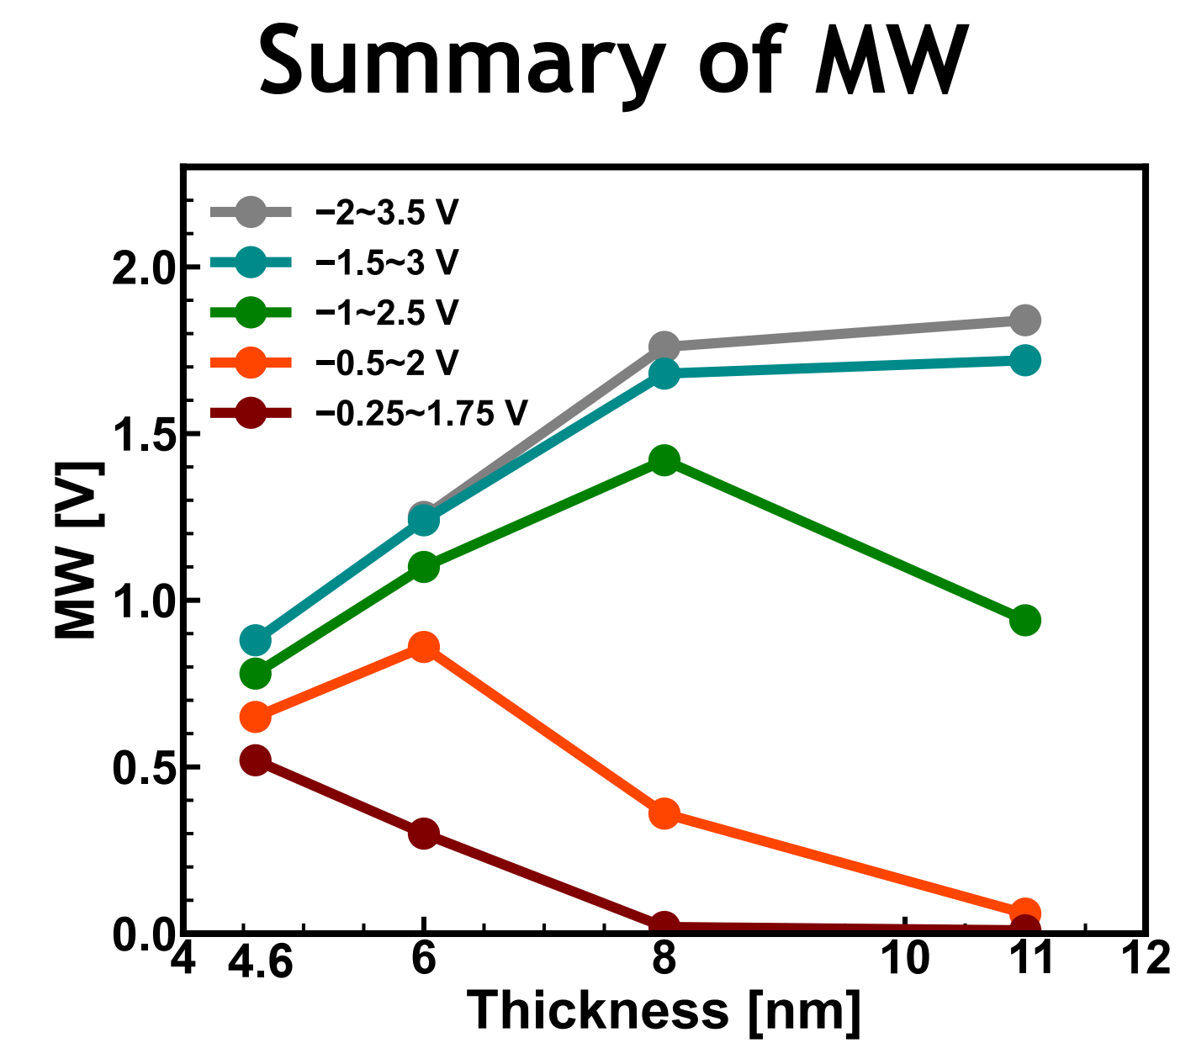
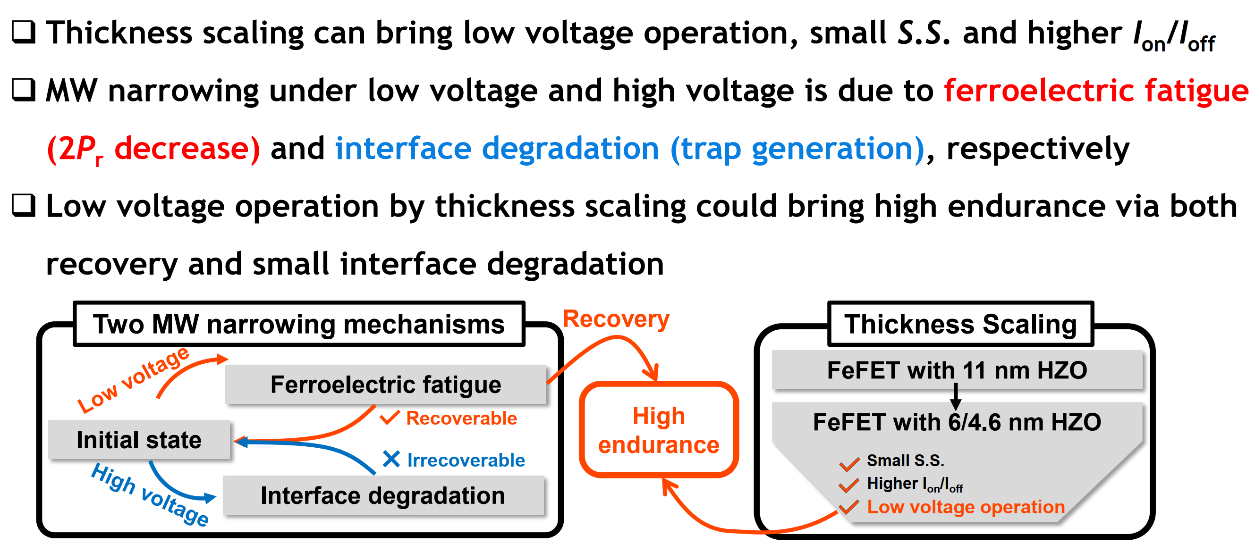
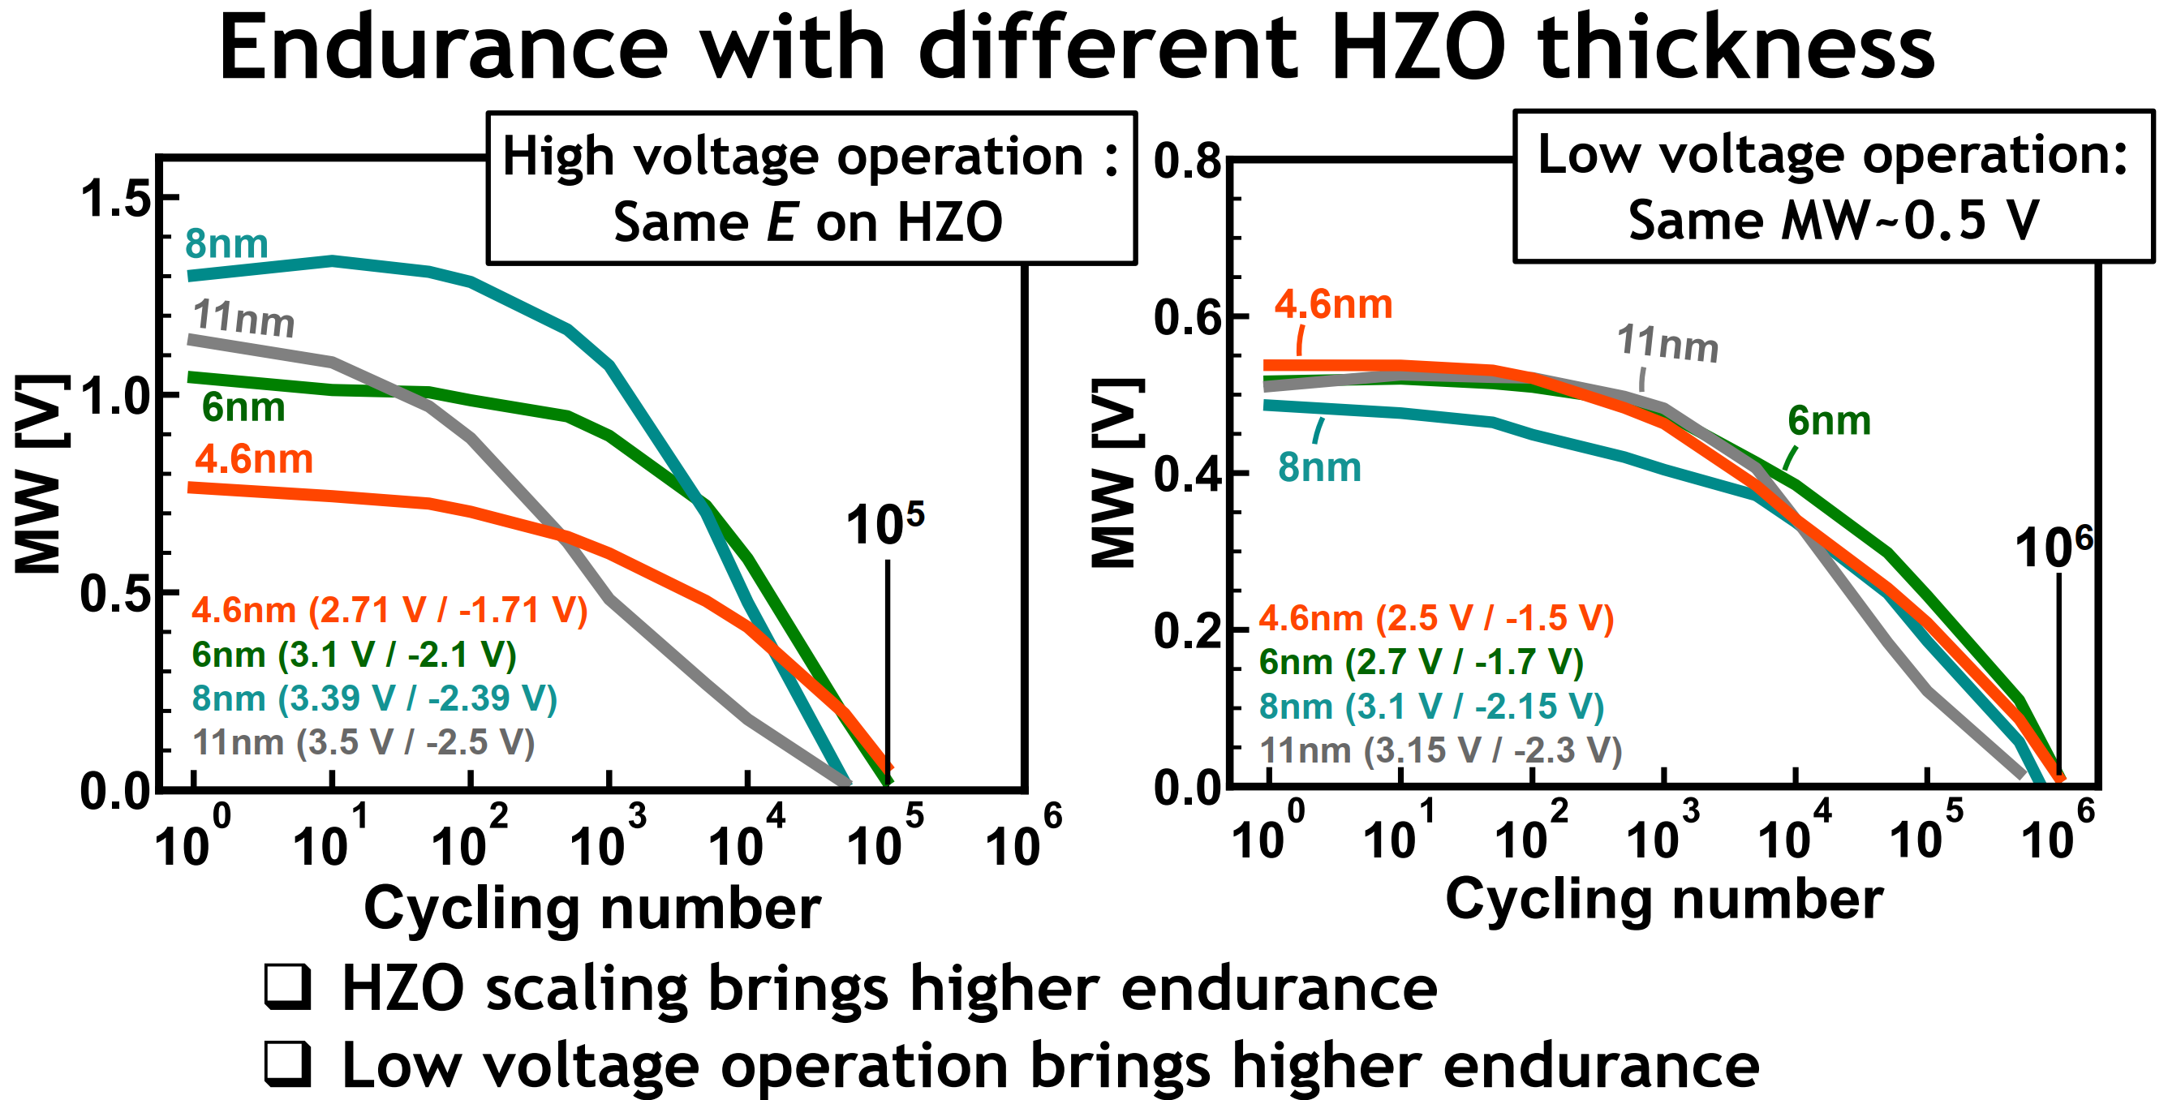
T5-2 Uo Tokyo on T_{HZO} Characterization and Cycling Endurance

Slide 16
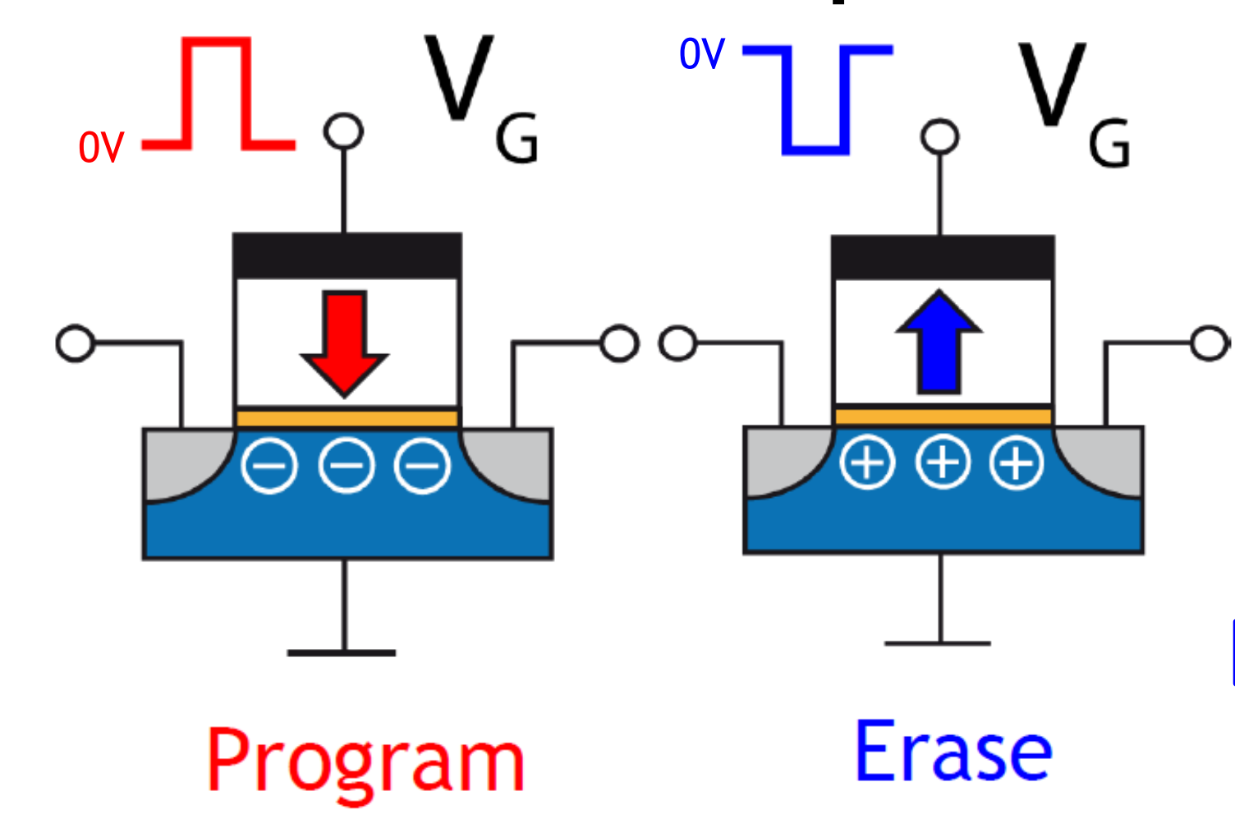
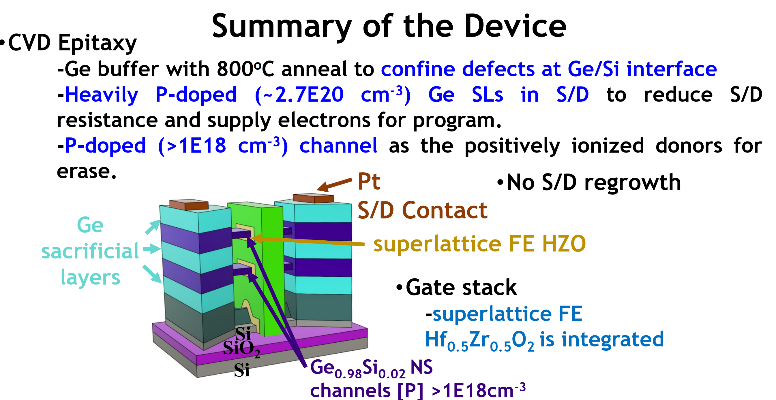
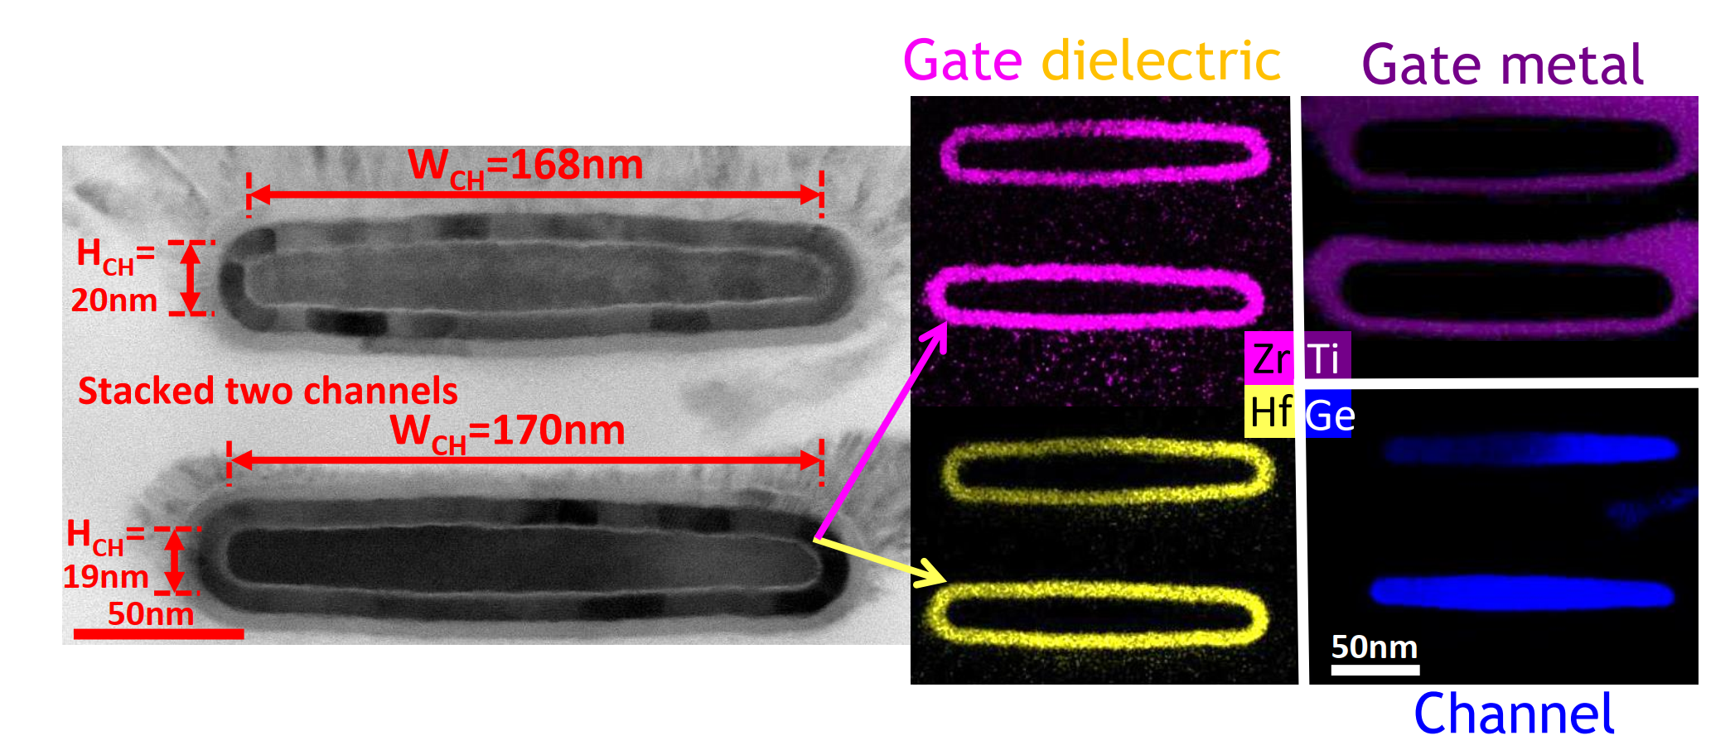
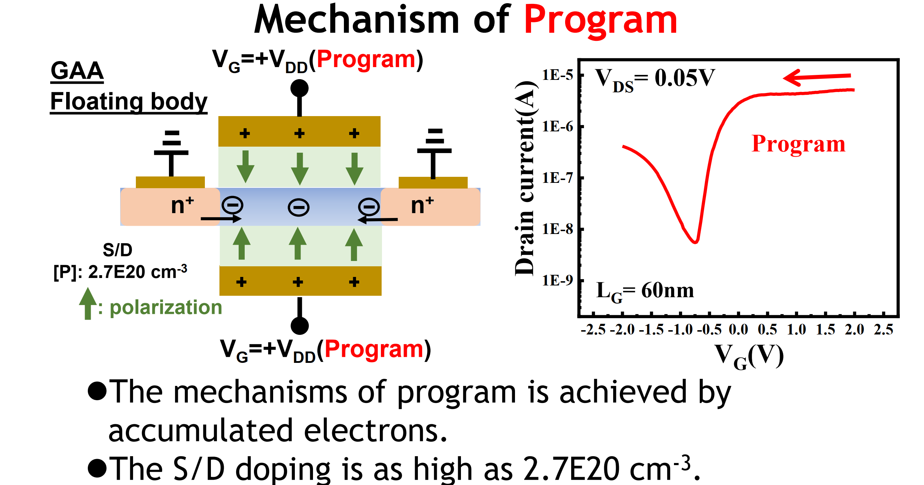
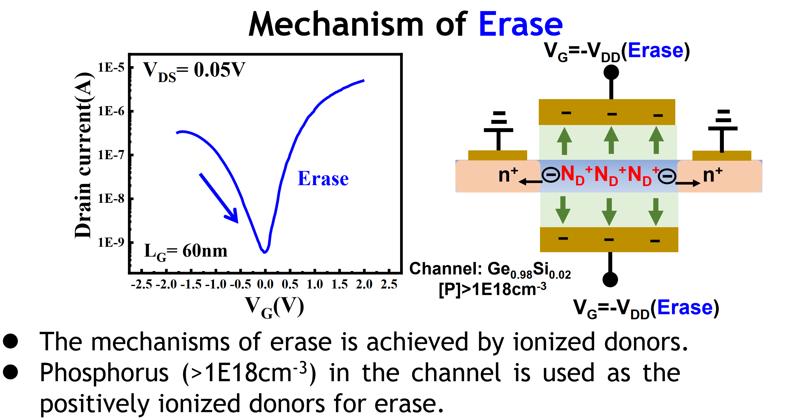
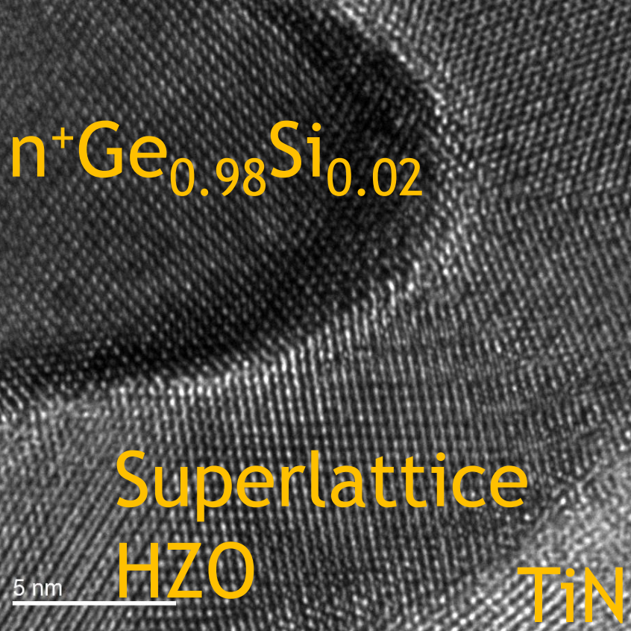
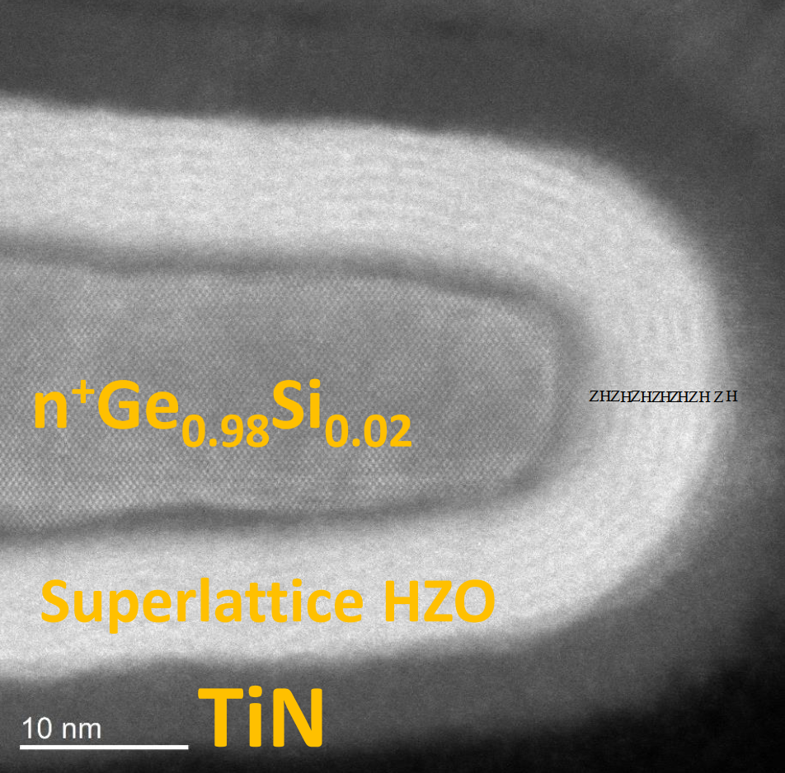
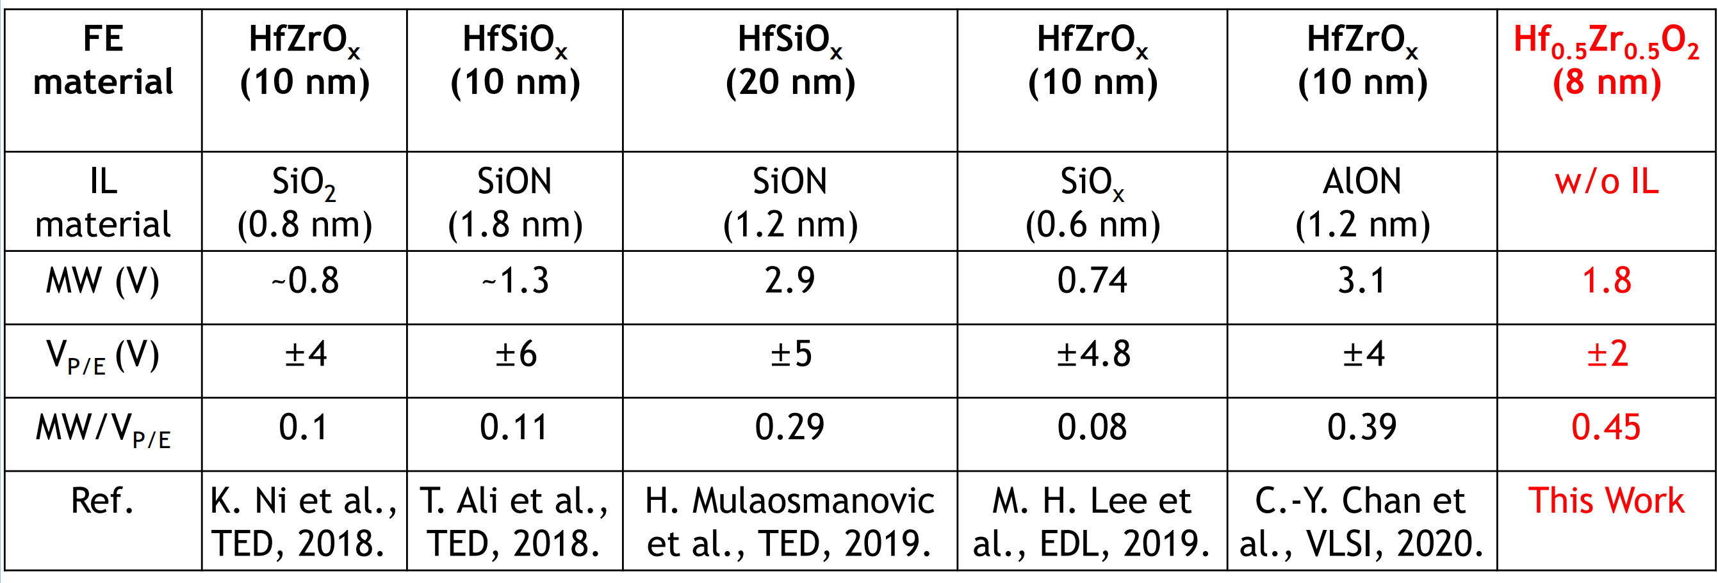
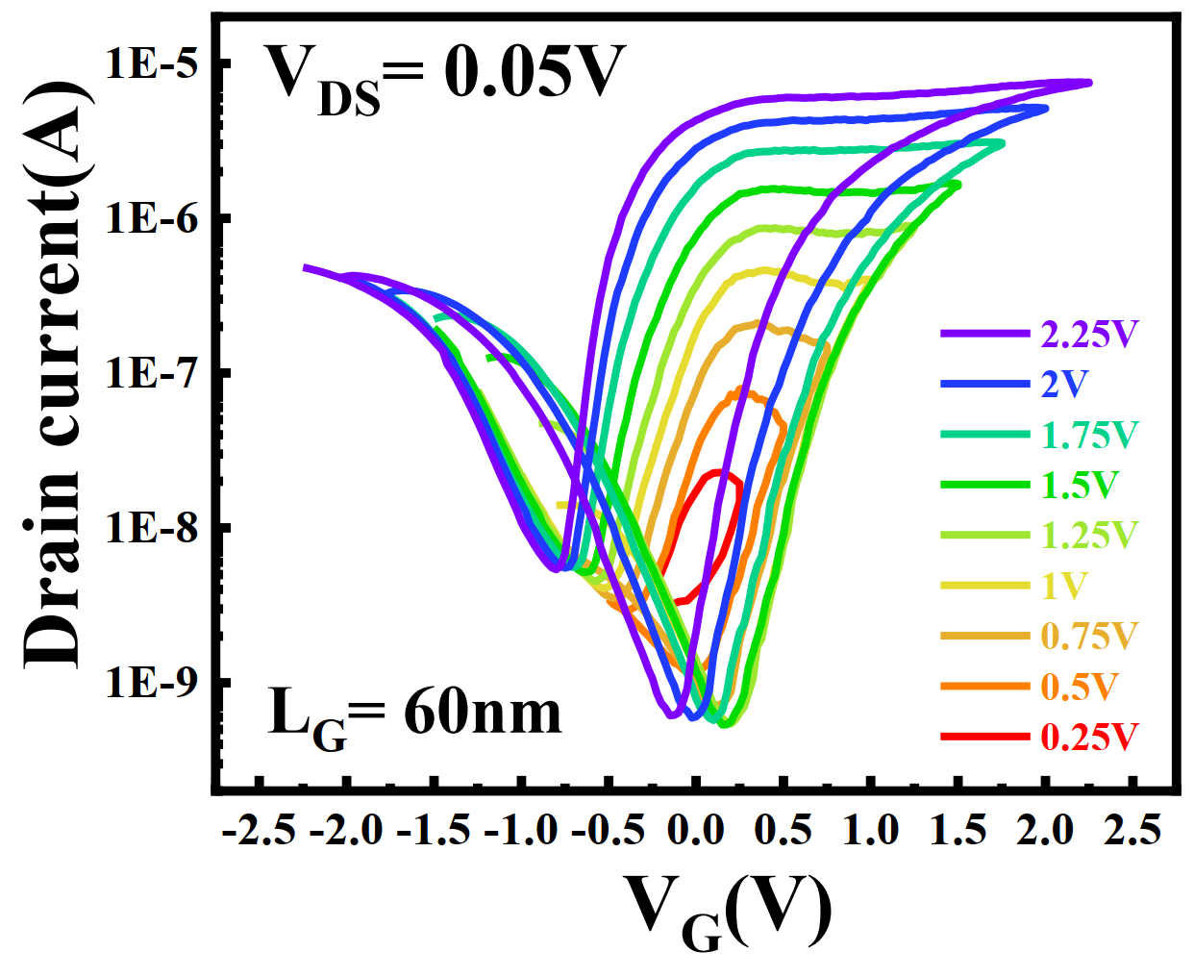
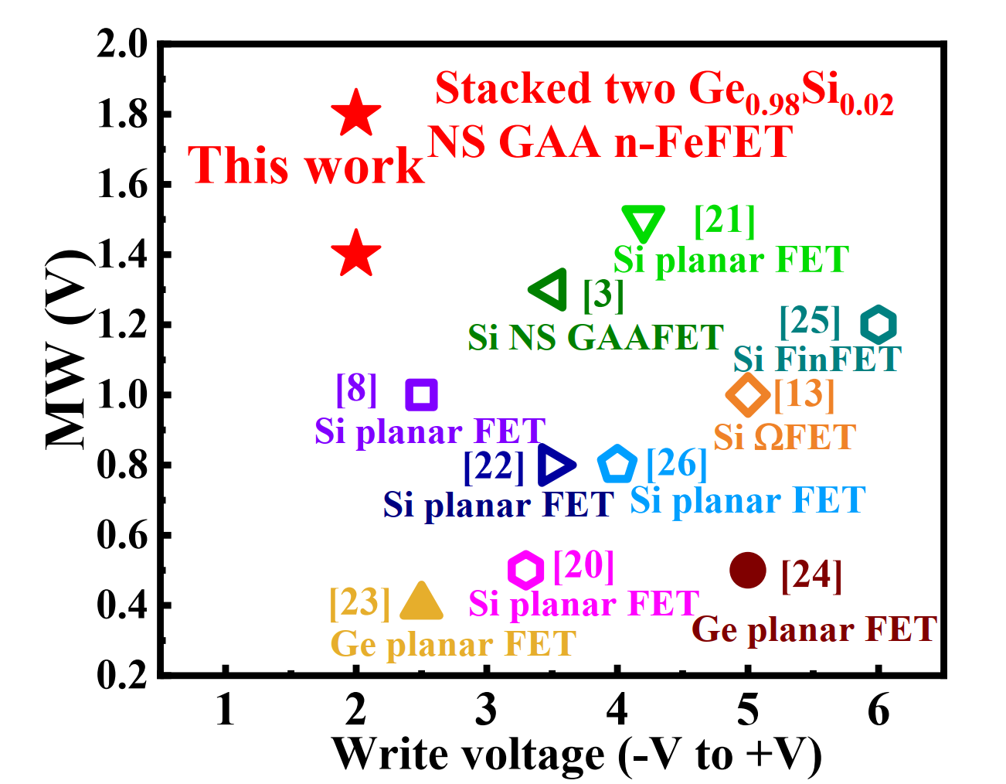
T5-3 N. Taiwan U on NS FeFET

Slide 17
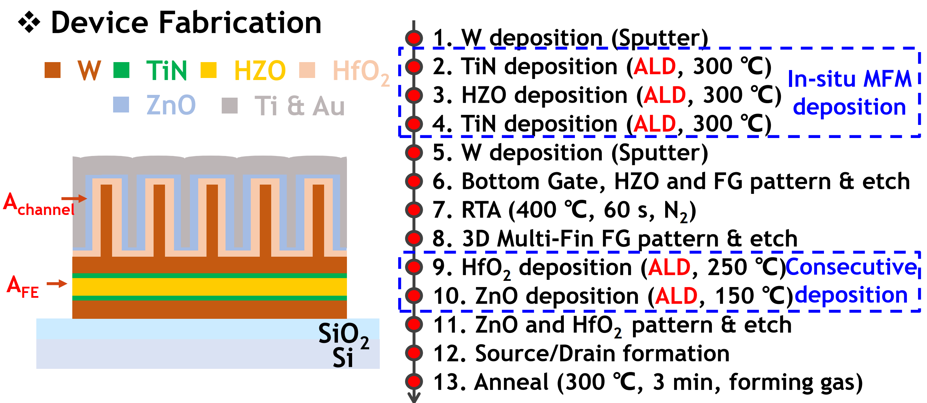
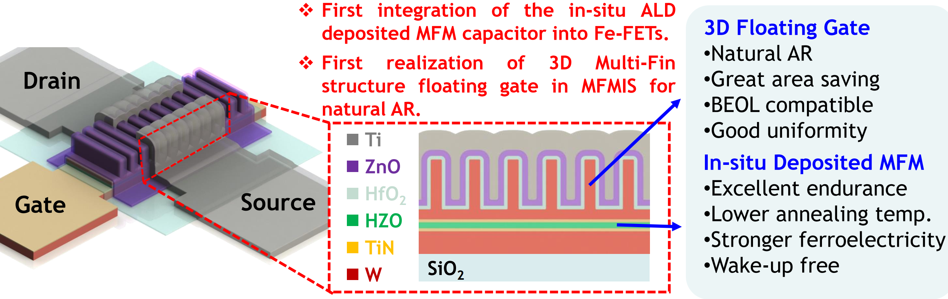
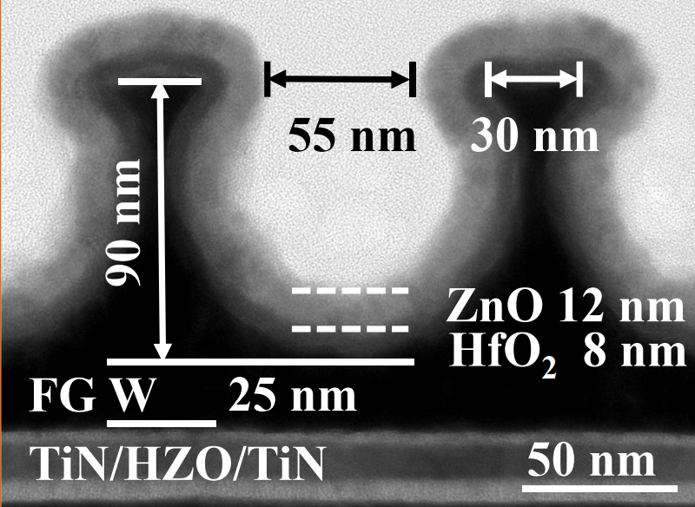
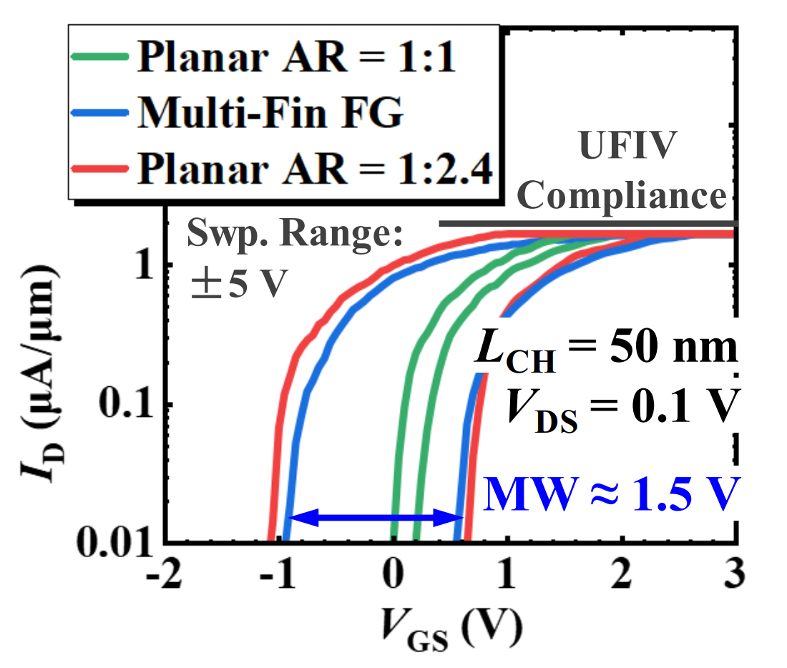
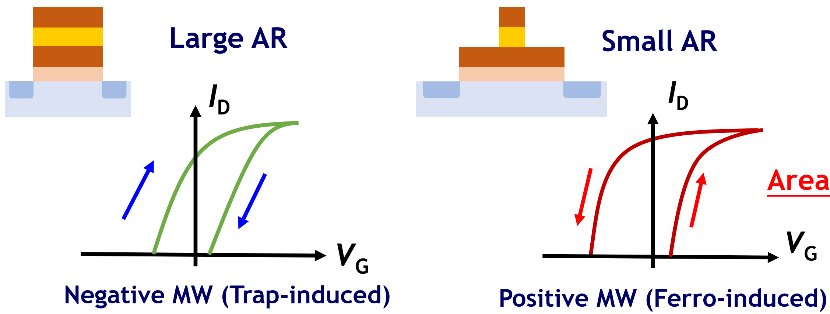



Slide 18-27
T5-4 NUo Singapore on M-I_{FE}-M-FinFET @50nm L_{G} NVM
OR W⇩︎

Slide 18

T10-1 Chinese AoS. Design Methodology of 128Kb 1T1C FeRAM

Slide 19



T10-2 GSAT, N Taiwan U on stackable vertical Bilayer MiM FTJ

Slide 20






T10-3 KAIST on Bilayer MiS FTJ (MFIS)

Slide 21




T10-4 NUo Singapore on Back-Gated FE-FET+ Schottky Source

Slide 22





T12-2 NUo Singapore on M-I_{FE}-M-FinFET @41nm L_{G} HZO AFeFET

Slide 23


T12-3 UC Berkeley on High Gm HZH superlattice
Replacement gate flow HKMG FTe

Slide 24


T12-4 N Taiwan U on Epi FeHZO
Background –
Theoretical limit of 2Pr (remanent polarization) of piezoelectric material is in the range of 1000s µC/cm²
PZT (Lead Zirconate Titanate) and BaTiO3 (Barium Titanate) reported 2Pr from 100s to 1000s µC/cm²

Slide 25





T7-1 Kioxia’s MILC for 14µm/300 layers 3D NAND

Slide 26





T7-2 Hynix’s QLC 3D FeNAND

Slide 27




T7-3 Stanford’s record remanent polarization
﻿
First Observation of Ultra-high Polarization
(~ 108 μC/cm2) in Nanometer Scaled High
Performance Ferroelectric HZO Capacitors
with Mo Electrodes

Slide 28
➡︎

Slide 29






‘20 iedm 11.4 TSMC on 16nm eMRAM
‘19 isscc 13.3 Intel on 22nm eMRAM
T18-4 Samsung on 14nm eMRAM
and scaling in sub 10nm

Slide 30

T18-4 ﻿ 交通大學 on Unipolar MRAM

