Slide 1






VLSI-23 debriefing on Memory Technologies
Dany Ly-Gagnon, Hank Wang and DerChang Kau, July/17/23
Mainstream Memory Technologies
Flash (DerChang)
DRAM (Dany)
SRAM (Dany)
Niche Memory Technologies
MRAM (DerChang)
Disruptive Memory Technologies
Gate: Ferroelectric Cap/FET (DerChang)
Channel: Oxide for 3D memory (Hank)
RRAM, PCM and TF Diode for SCM (Dany)
U-MRAM (DerChang)
It’s the Memory, Stupid!
…Processor Speed Has Outstripped Memory … today’s chips are largely able to execute code faster than we can feed them with instructions and data. There are no longer performance bottlenecks in the floating- point. ...The real design action is in memory subsystems, caches,buses, bandwidth, and latency…I expect that over the coming decade memory subsystem design will be the only important design issue for microprocessors.
Architects Look to Processors of Future,
Microprocessor Report, V10, N10, Aug/5/1996
Dick Sites, Digital Equipment Corp
Capacity, Latency
Bandwidth, Cost

Slide 2
Mainstream Memory Technologies
3D-NAND
DRAM
SRAM

Slide 3
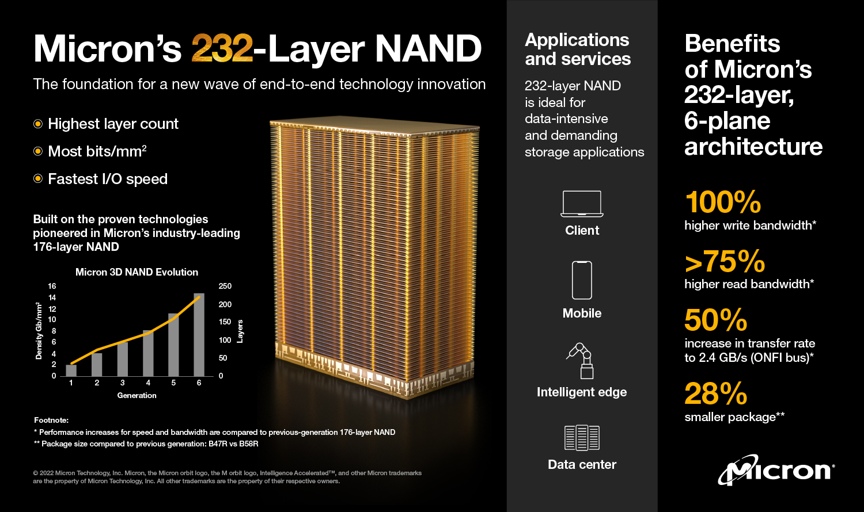
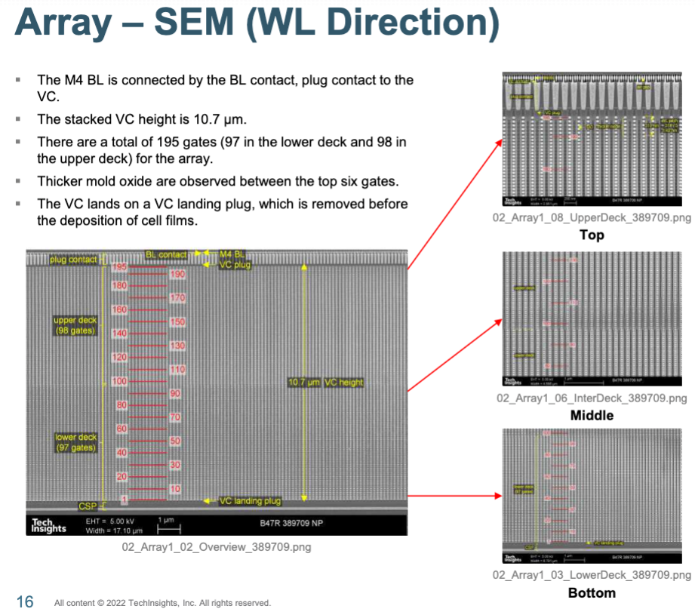
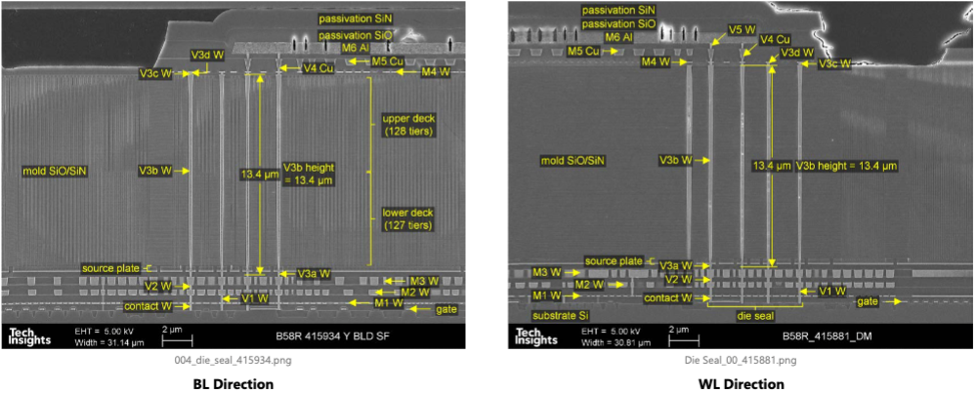
3D NAND Leadership
2020 Micron QLC 3D-NAND 176-layer 19nm 512Gb 10.27Gb/mm^{2,} cell size: 56_{v}x152x130nm³
2022
https://www.micron.com/products/nand-flash/232-layer-nand

Slide 4
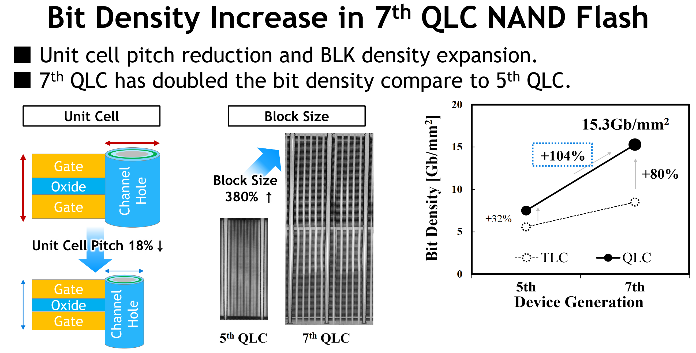
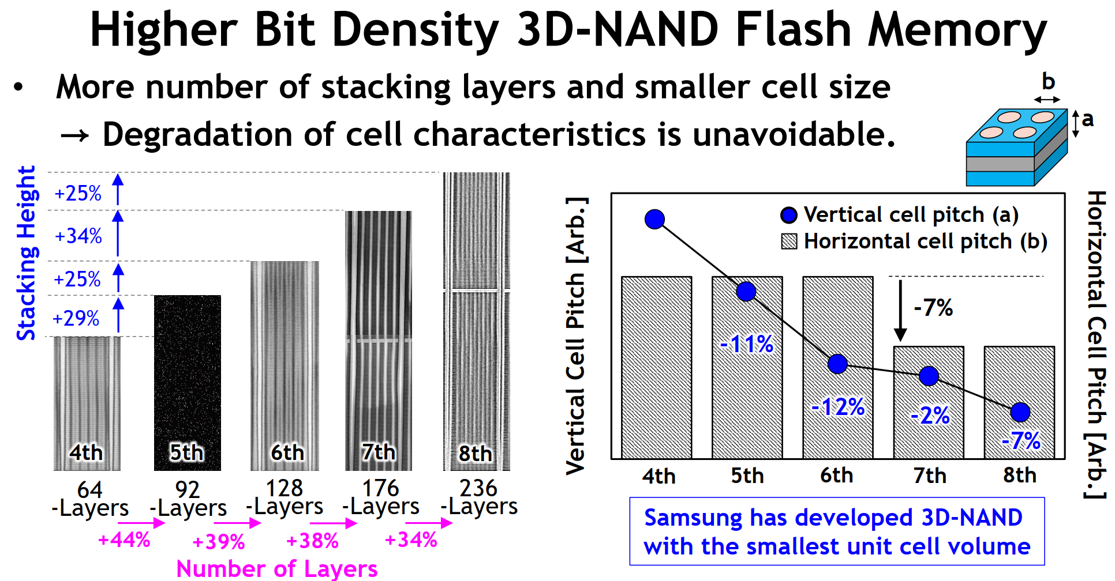
3D NAND Product
T3-4 Samsung 7thGen 1Tb 3D NAND QLC
T3-1 Samsung 8thGen 1Tb 3D NAND QLC

Slide 5
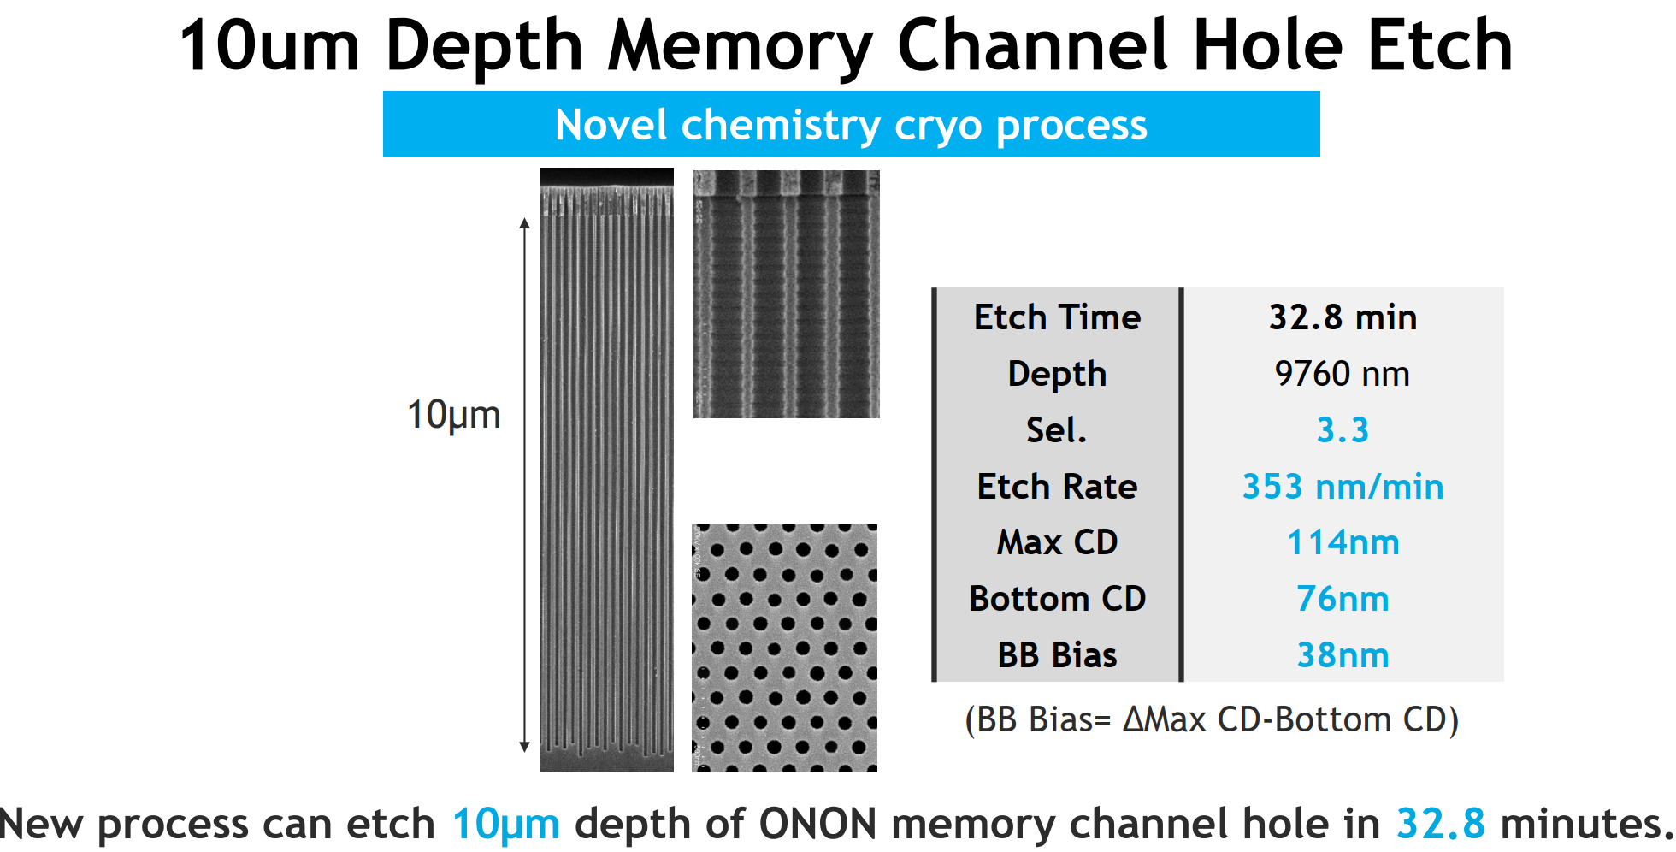
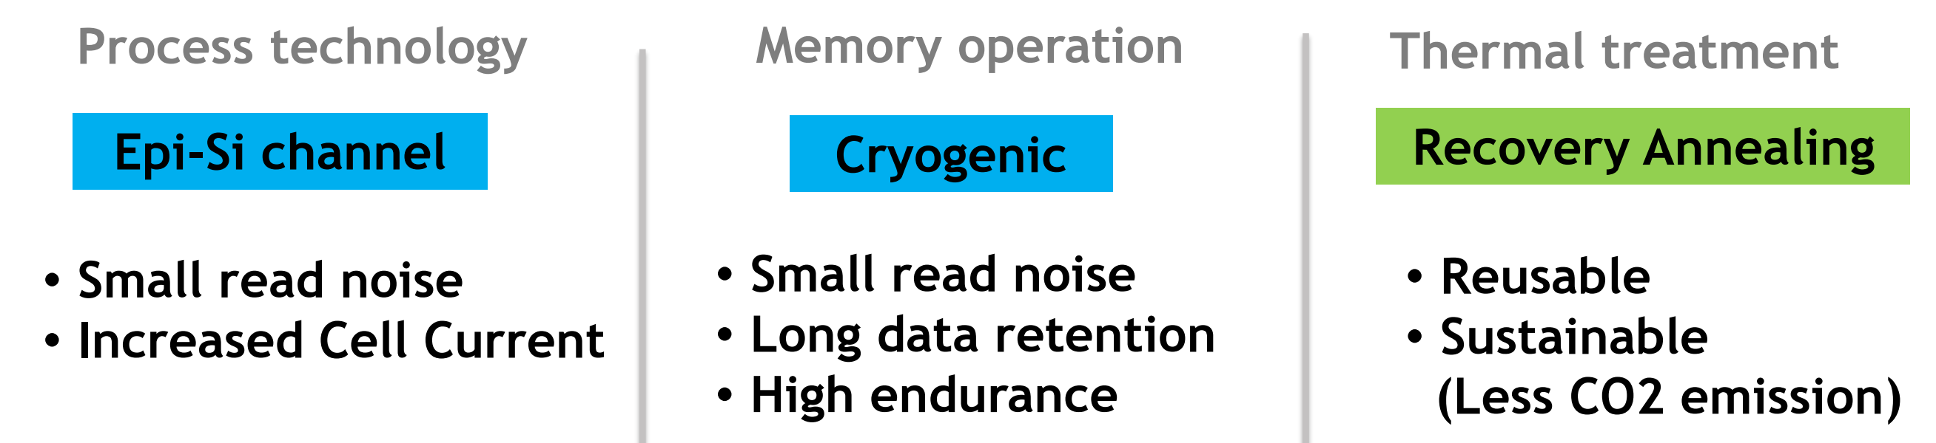
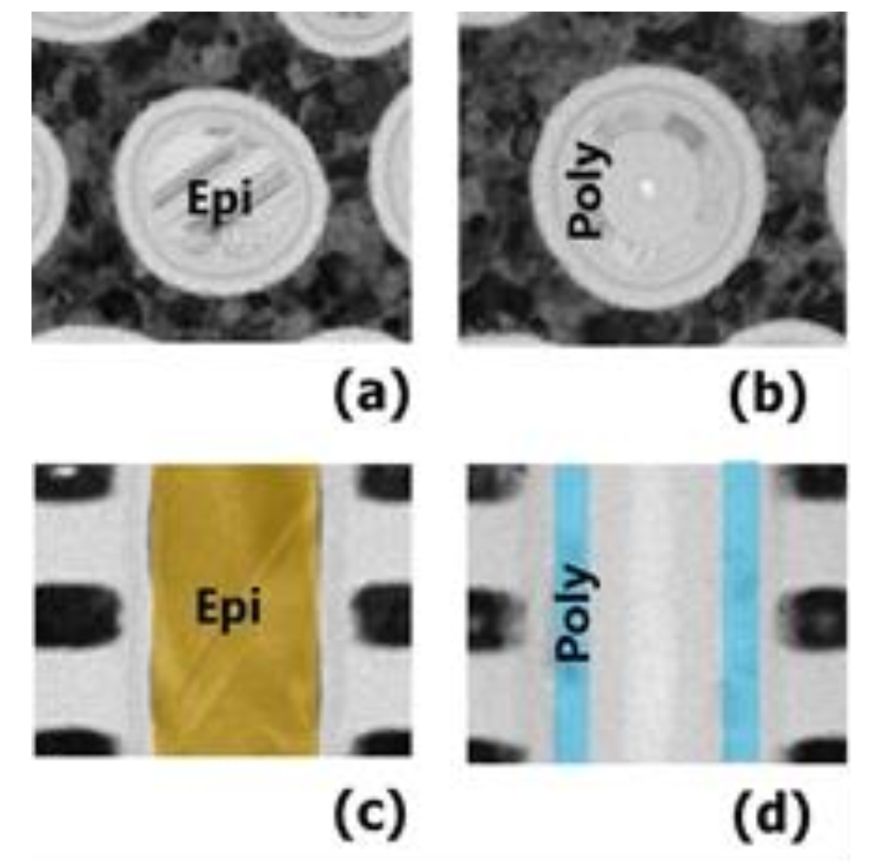
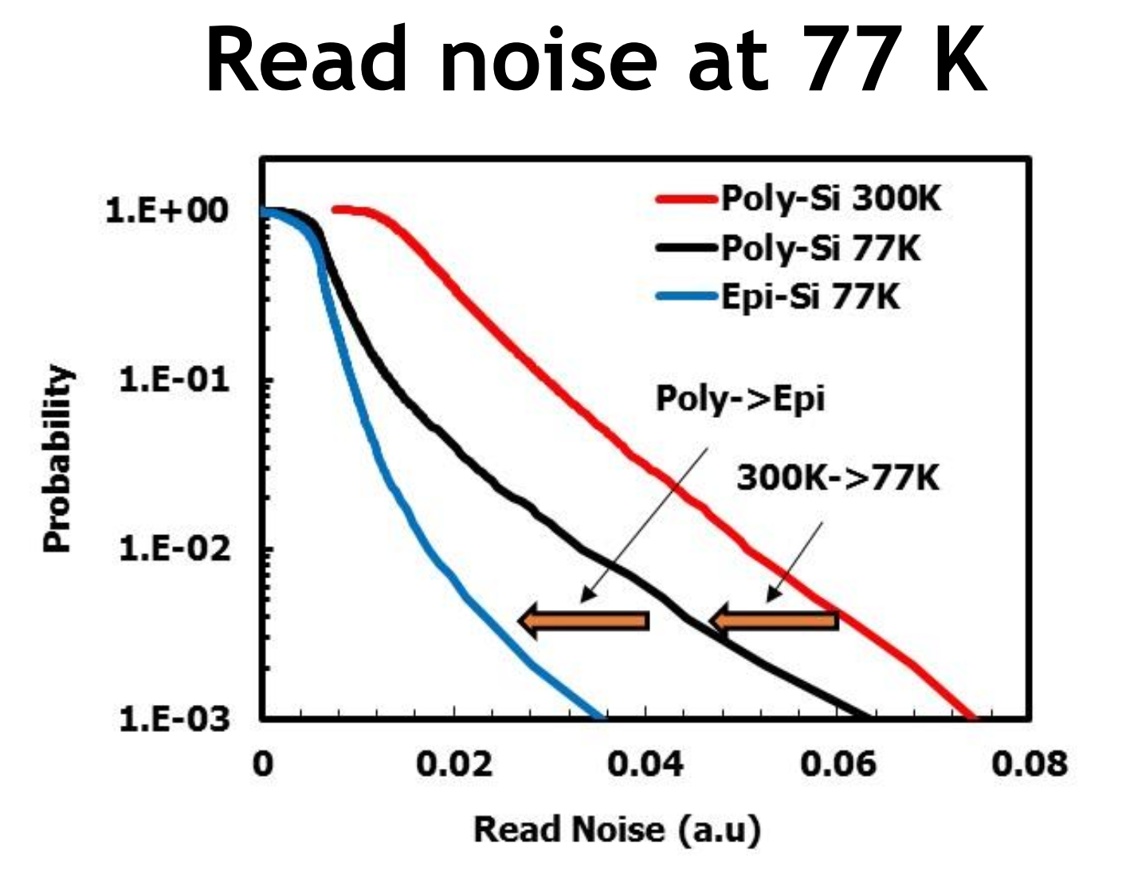
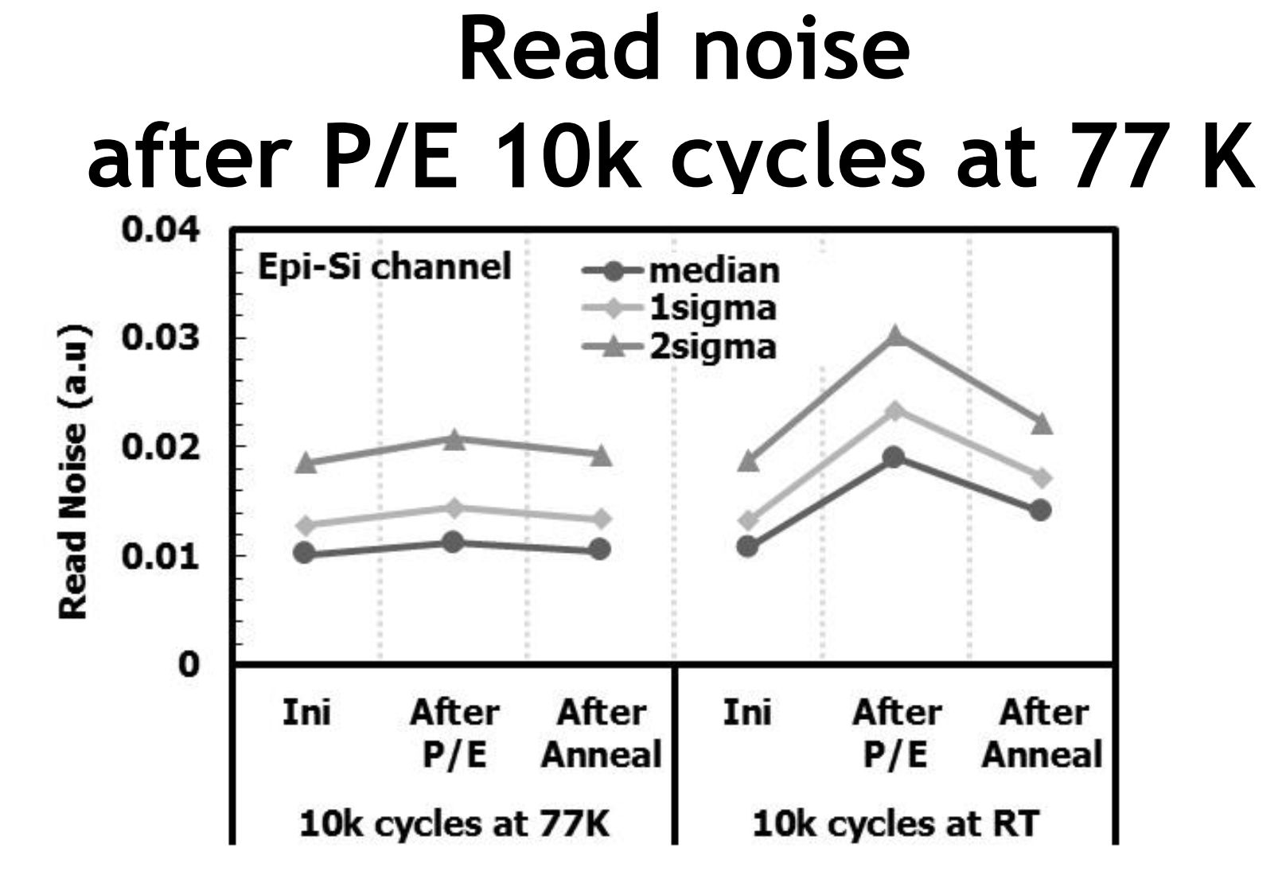
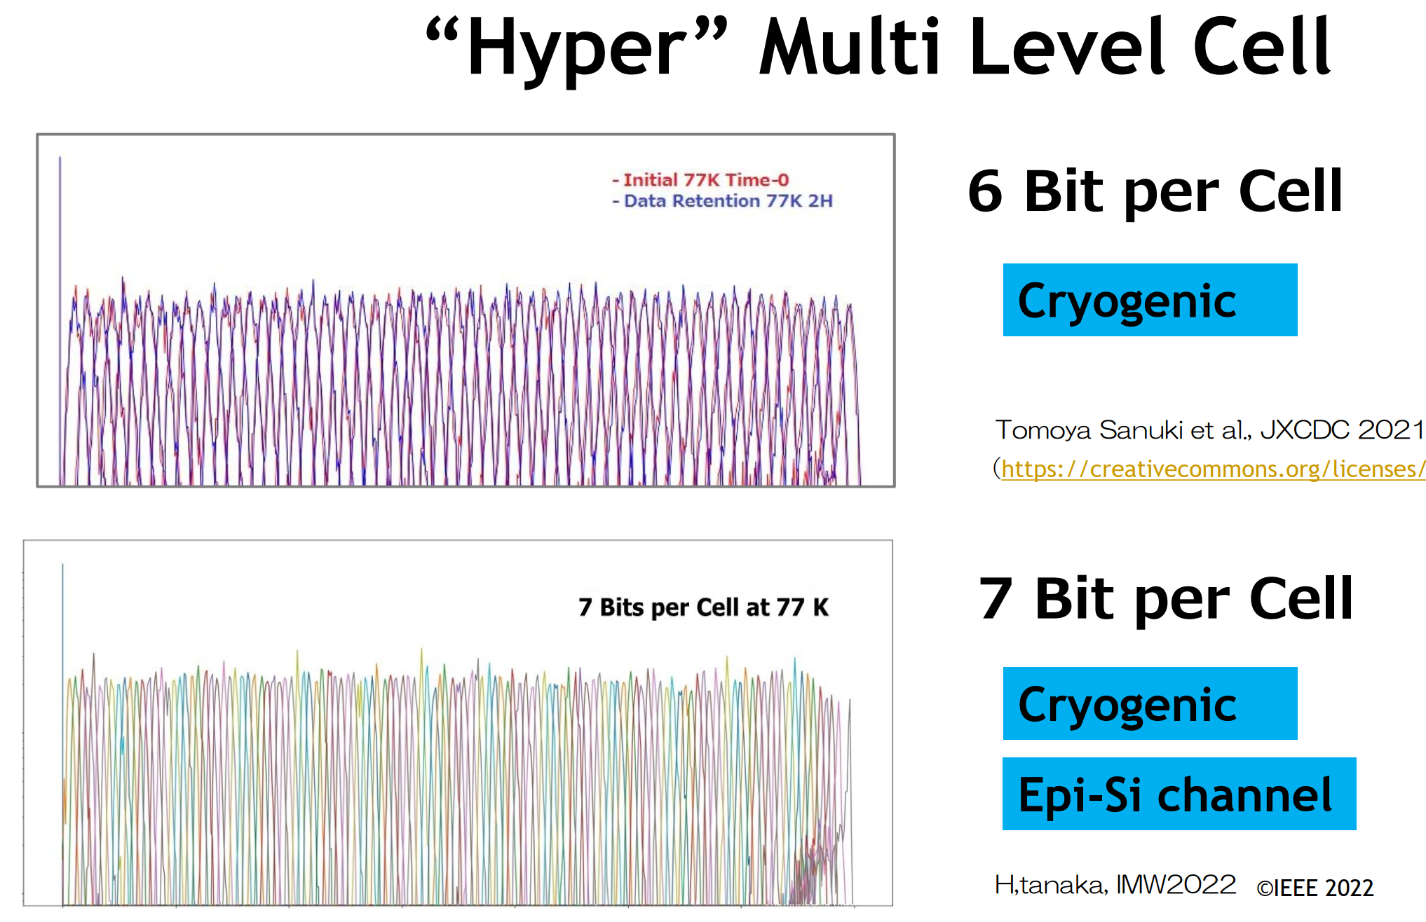
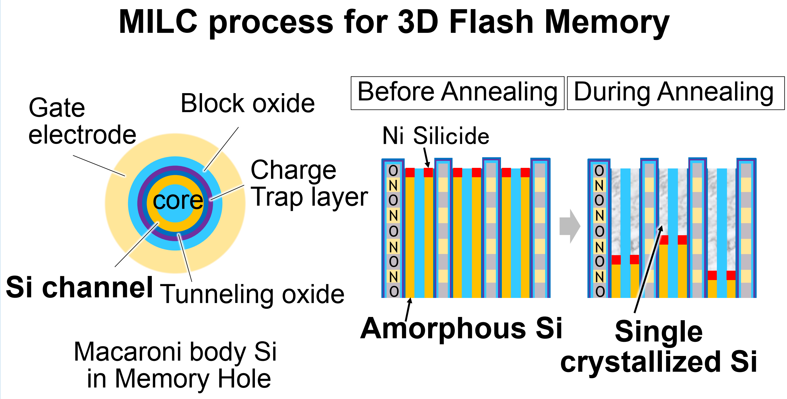
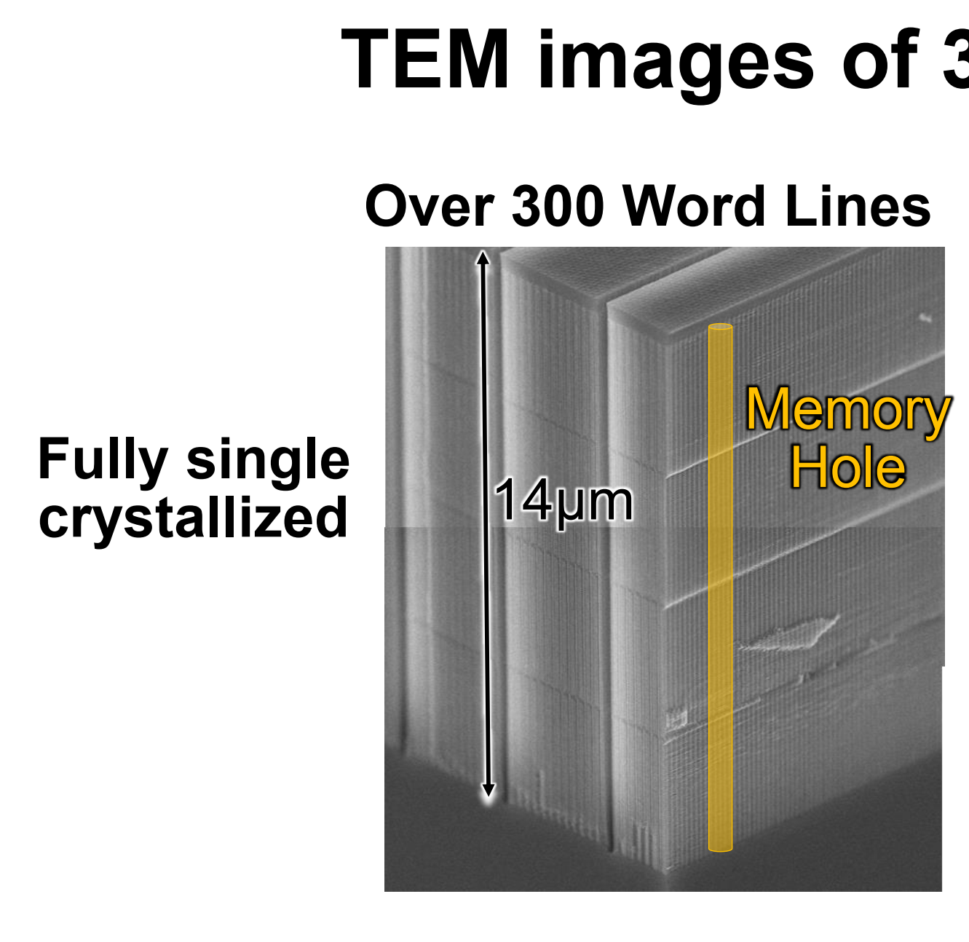
3D NAND Scaling direction
T3-3 Kioxia’s Recovery Anneal on 7b/cell Cryo Flash
T3-2 TEL’s HAR (>100) etch for > 10µm/400 ONON layers
T7-1 Kioxia’s MILC for 14µm/300 layers 3D NAND

Slide 6
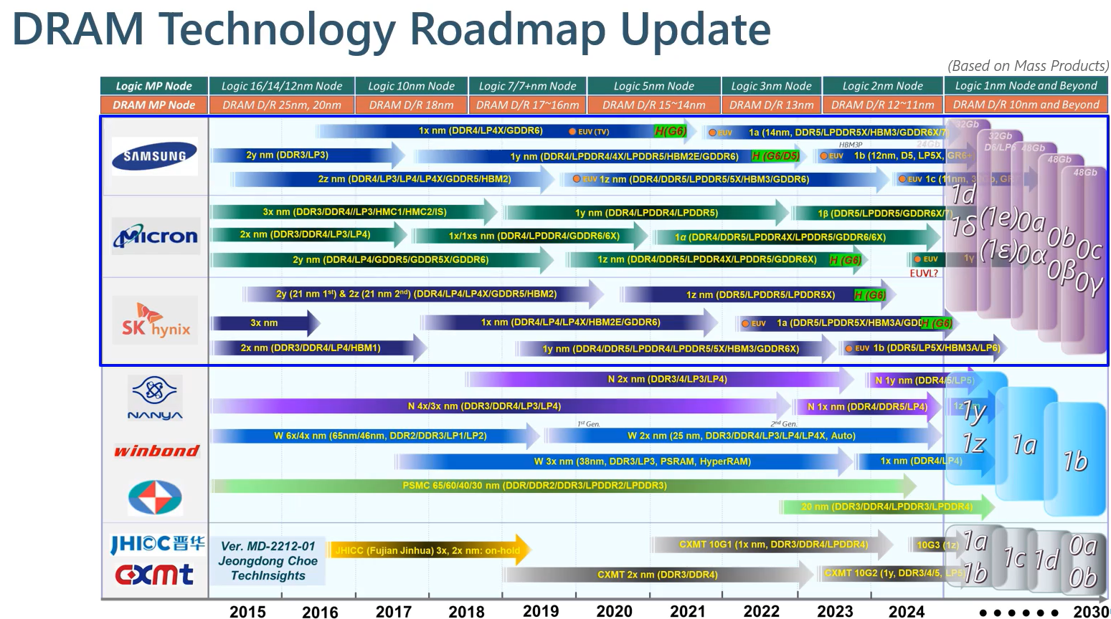
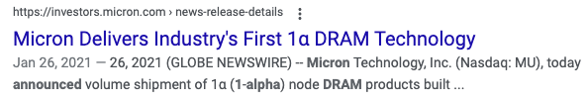
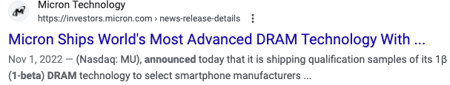
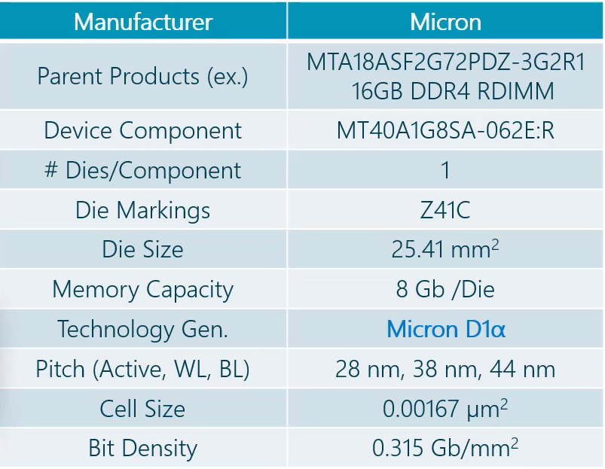
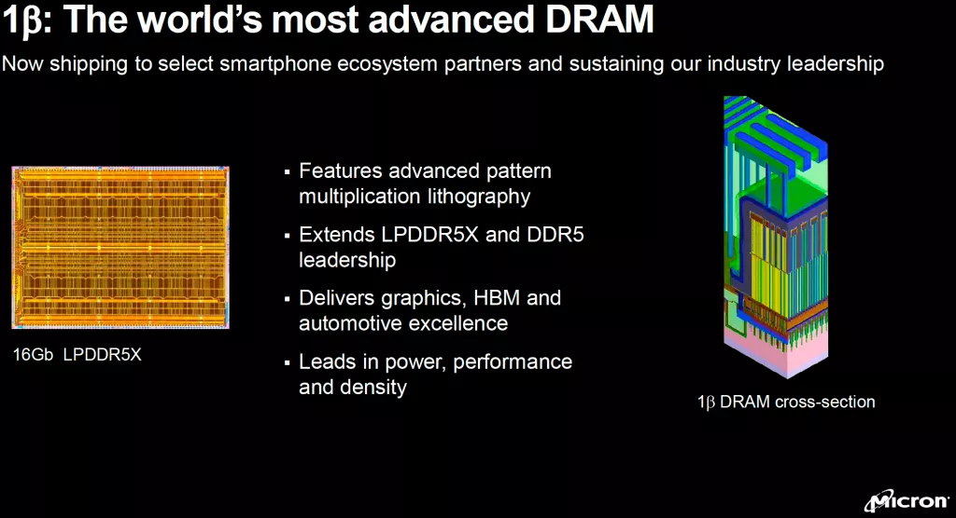
DRAM – Recent generations
EUV deployment
12nm ½Pitch
Estimated
(1.35x density improvement)
DRAM Leadership
14nm ½Pitch

Slide 7
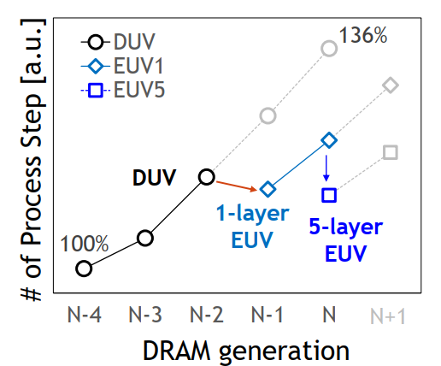
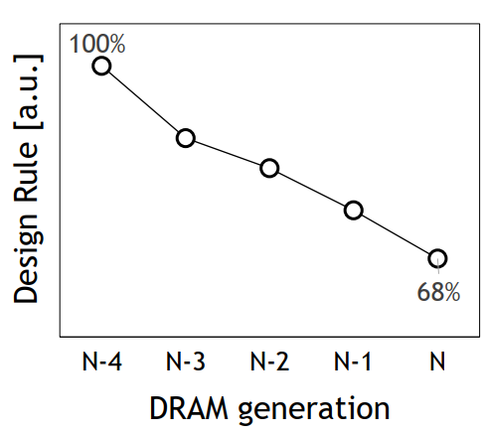
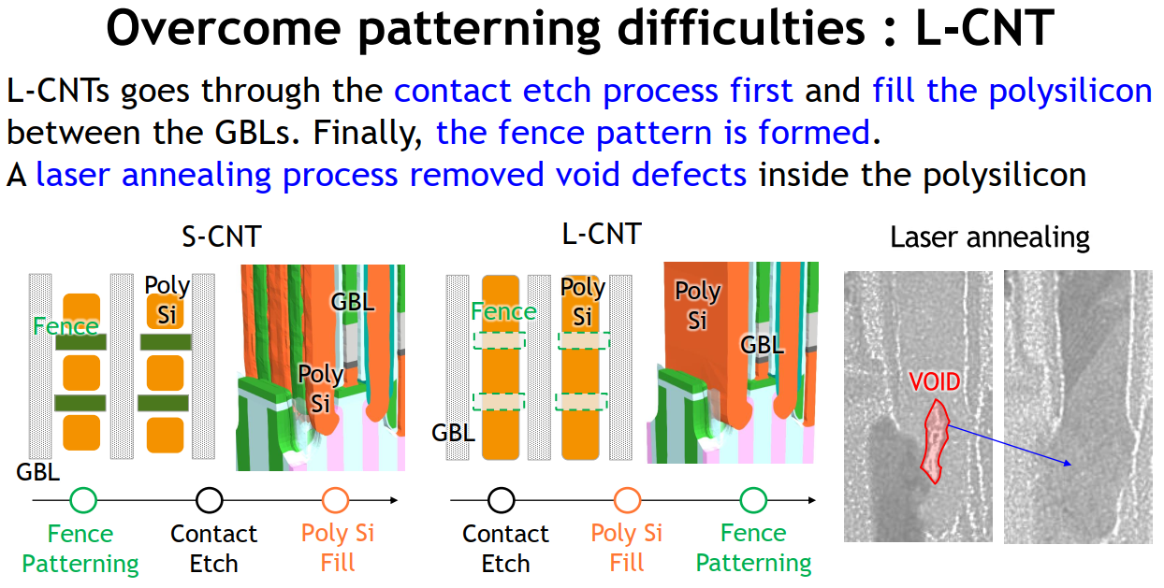
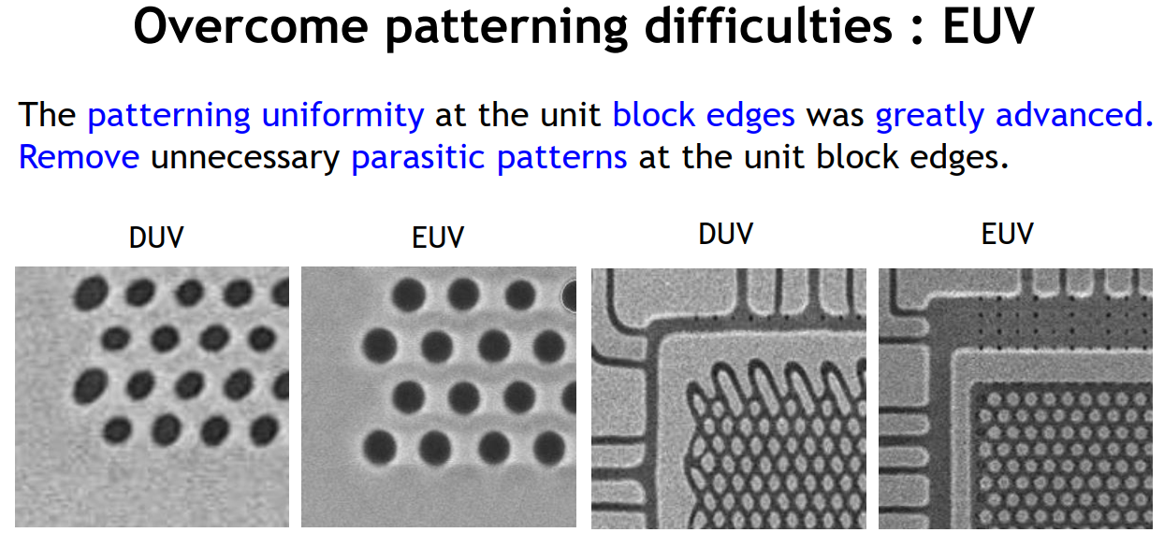
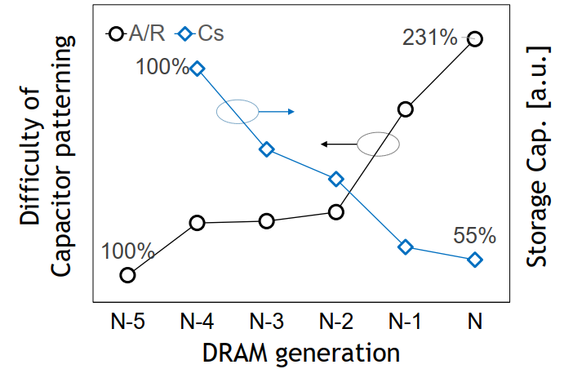
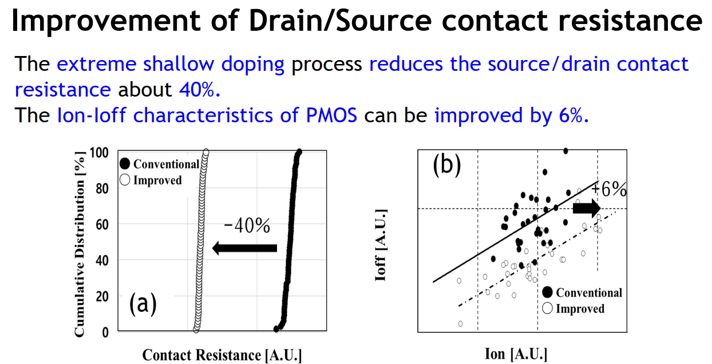
DRAM
T18-1 Samsung 14nm w/ 5 layer EUV
1z
1a
DRAM generation

Slide 8
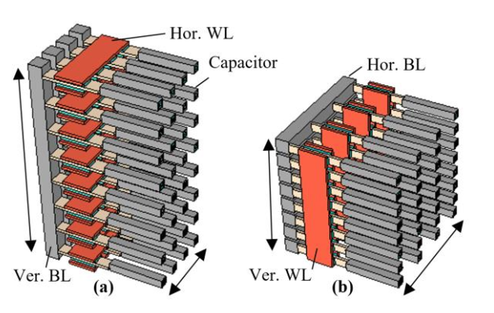
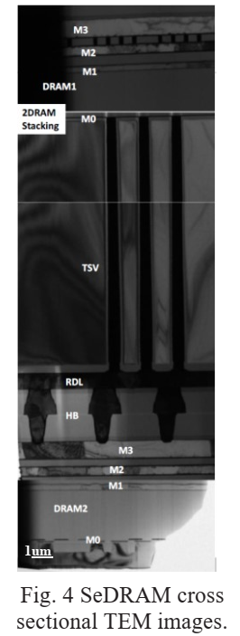
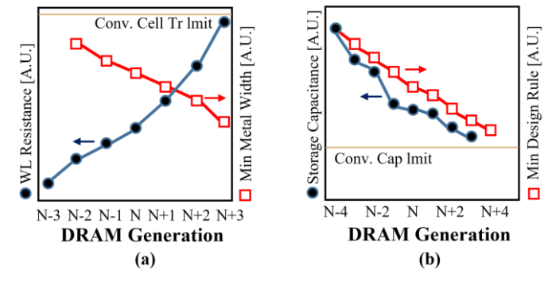
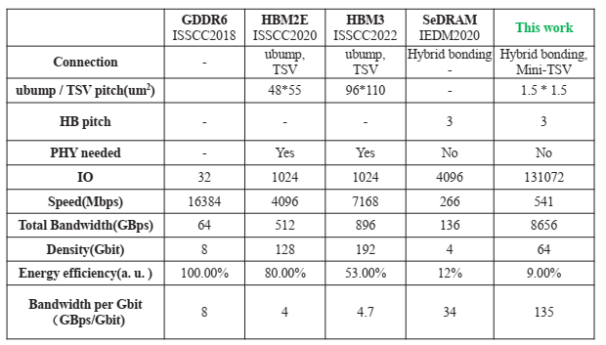
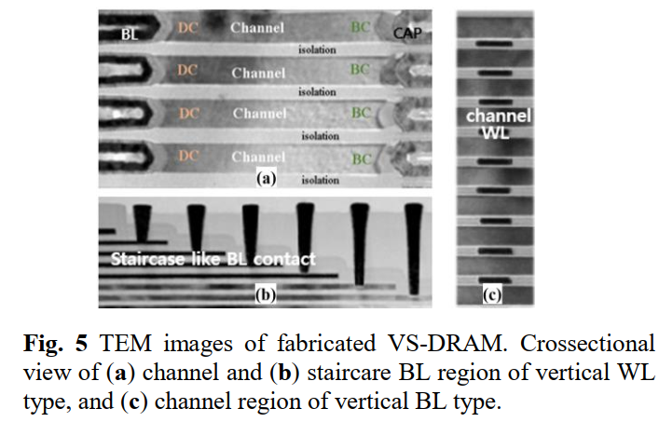
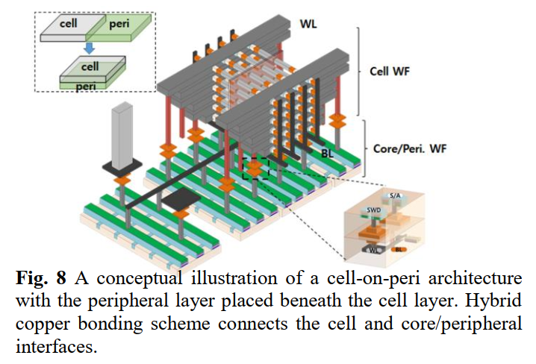
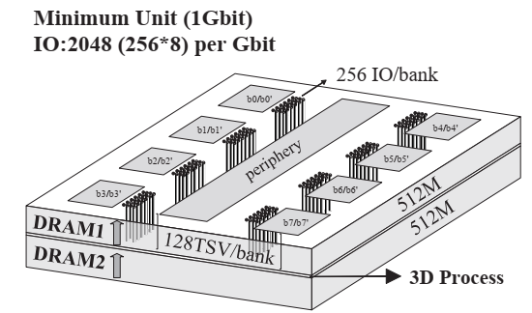
3D-DRAM directions
TFS-1 Vertically scaled DRAM (Samsung)
T18-2 HBI + mini-TSV for DRAM (UniIC + Wuhan Xinxin)
(invited talk)
135GBps / 1Gb mem ; 0.66pJ/bit
Wafer-to-wafer HBI

Slide 9
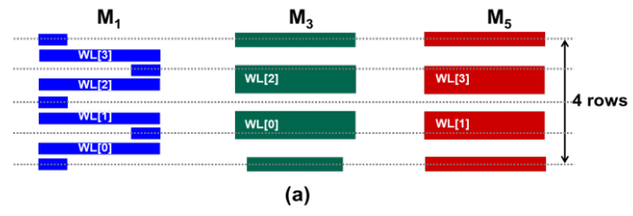
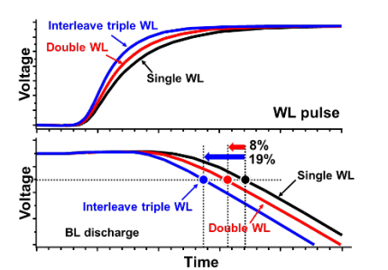
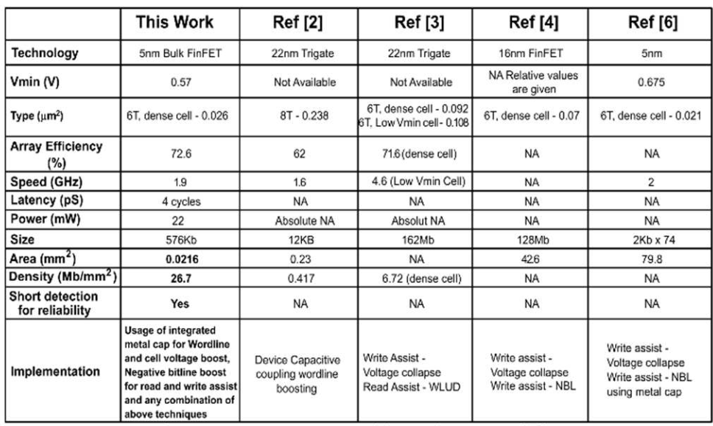
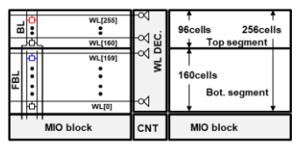
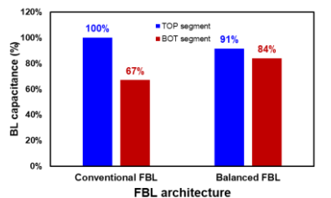
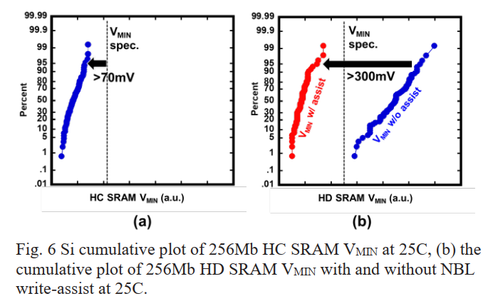
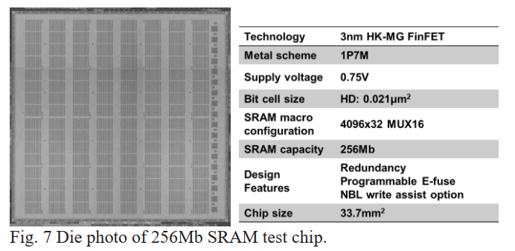
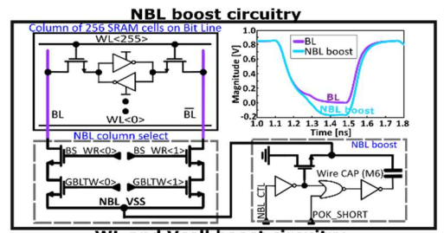
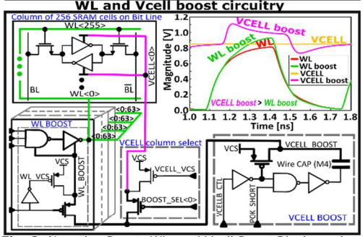
SRAM design
C9-1 / 3nm 256Mb SRAM with interleaved triple WL (TSMC)
C9-2 / 576kb SRAM with 1.9GHz (1.1V) / 0.57V Vmin in 5nm (IBM)
M1//M3 or M1//M5 strapping
Rebalance array for FBL

Slide 10
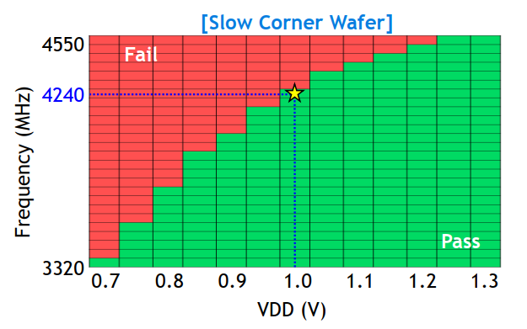
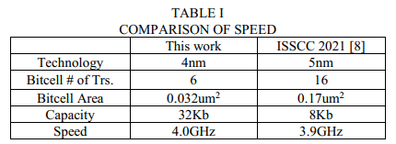
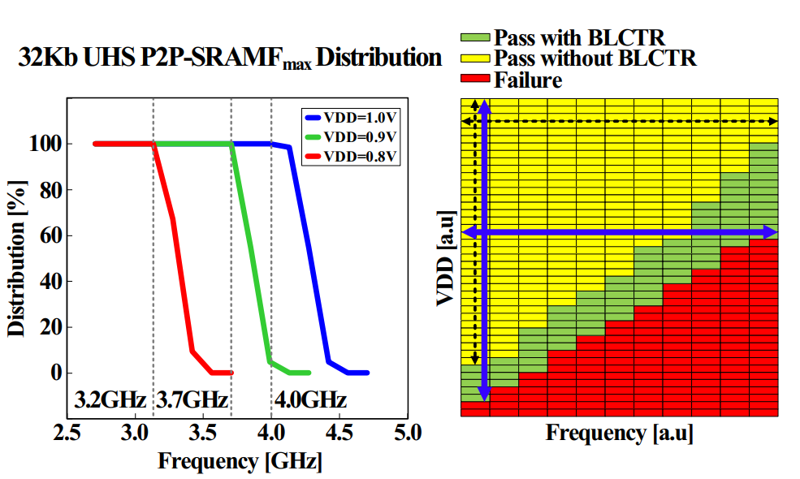
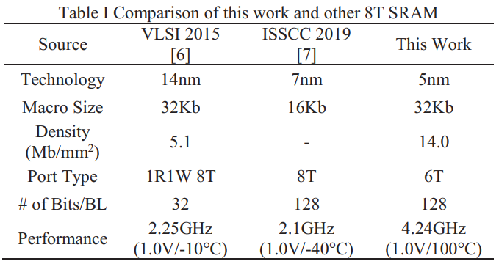
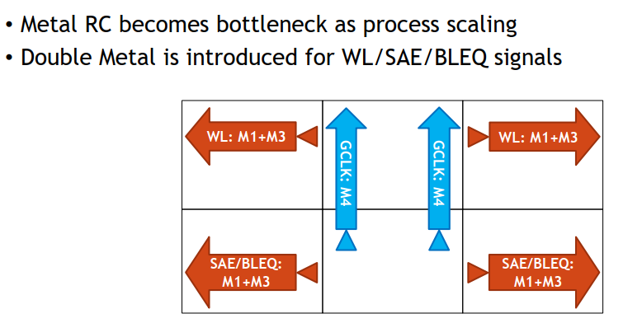
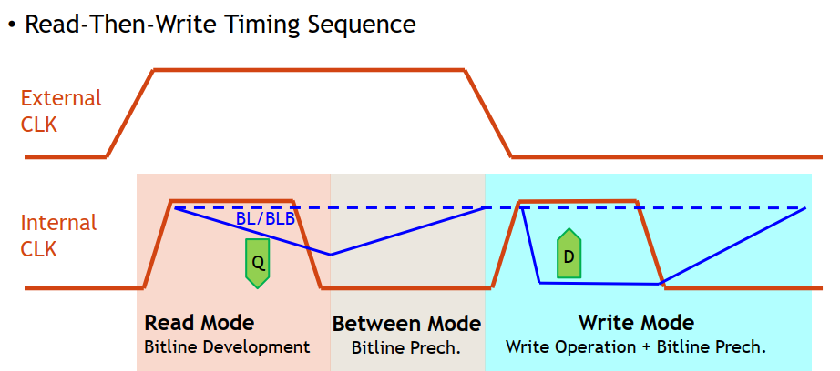
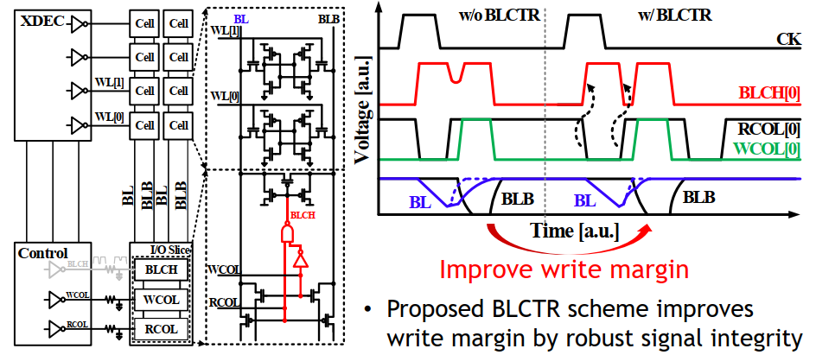
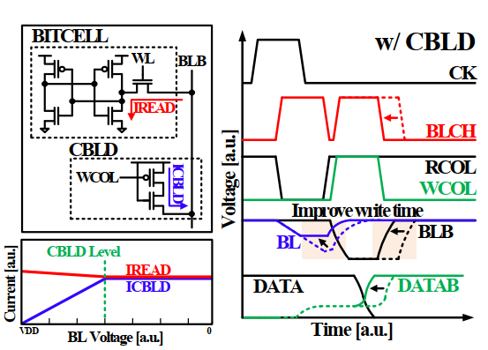
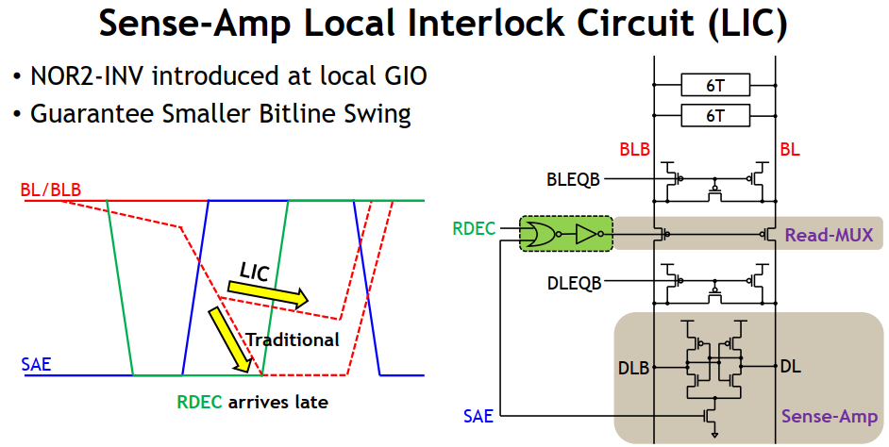
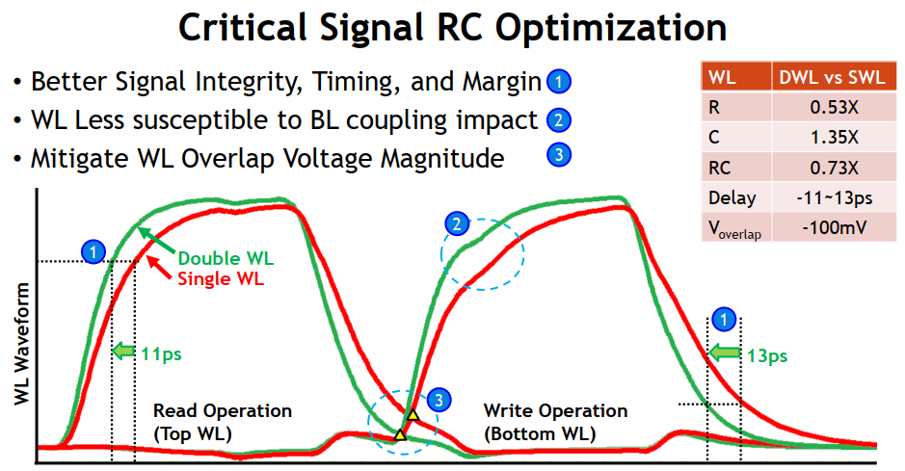

SRAM design
C9-3 / 4.0GHz 2-port 6T SRAM in 4nm (Samsung)
C9-4 / 4.24GHz 2-port 6T SRAM in 5nm (TSMC)
Bit-Line Charge Time Reduction
Clamped Bit-Line Discharge
Flying word-line

Slide 11
Niche Memory Technologies
MRAM

Slide 12









SoA MRAM and Application
iedm’21 Samsung on 28nm MRAM
for Frame Buffer Memory in CIS
May’23 Everspin
NXP, TSMC bring embedded MRAM to
automotive MCUs, May 16, 2023
Isscc-19
13.3 Intel on 22nm eMRAM
Iedm-20
11.4 TSMC on 16nm eMRAM
vlsi-23 T18-4 Samsung on 14nm eMRAM and beyond (10nm)
vlsi-23 C2-2 Samsung’s 14nm 128Mb@0.64V/12.5ns/18.1Mb/mm²
15.2~18.1 Mb/mm²

Slide 13
Disruptive Memory Technologies
Scalable Ferroelectric Devices
Oxide TFT for 3D memory
PCM/RRAM/Threshold Switching Devices
Unipolar STT-MRAM

Slide 14





FE-Cap
Background –
Theoretical limit of 2Pr (remanent polarization) of piezoelectric material is in the range of 1000s µC/cm²
PZT (Lead Zirconate Titanate) and BaTiO3 (Barium Titanate) reported 2Pr from 100s to 1000s µC/cm²
T12-4 N Taiwan U’s experimental validation 2P_{r,max} : Ti/EpiHZO/n+Si 84µC/cm² or Ti/EpiHZO/n+Ge 73µC/cm²
T7-3 Stanford’s record remanent polarization @ 108 μC/cm² Mo/HZO/Mo

Slide 15














FE-FET
T5-1 KAIST/KIST on 3D FE-FET orientation charx
T5-3 N. Taiwan U on NS FE-FET, MW=1.8V, V_{p}=±2V
T7-2 Hynix’s QLC 3D Fe NAND
T5-2 U.Tokyo on T_{HZO} Characterization and Cycling Endurance

Slide 16










Alternative capacitive FE devices
T10-1 Chinese AoS. 128Kb 1T1C FeRAM
T5-4 NUo Singapore on M-I_{FE}-M-FinFET @50nm L_{G}
T10-4 NUo Singapore on BG FE-FET+ Diode Source
T12-2 NUo Singapore on M-I_{FE}-M-FET @41nm L_{G}

Slide 17






FTJ
T10-2 GSAT, N Taiwan U on 3D M-i-FE-M FTJ
T10-3 KAIST on Bilayer M-i-FE-S FTJ

Slide 18







VLSI’23 Oxide TFT – BEOL compatible 3D Memory (1/2)
Background: Oxide semiconductor (In₂O₃, ITO, IGZO, IZO, ...)
Material Basics
BEOL compatible T < 400 °C
Relatively high µ_{e} : 40~100 cm² / V*s (Si: ~1400)
Wide E_{g} 2.5~3.5 eV => low I_{off}
Drawback: lack of reliable dopant, especially for P
Application: Display(mature), DRAM, 3DNAND
Research Trend: (1). Device scaling w/ advances in dep method. (2). Device optimization for gain cell.
T17-2 Purdue on scaled ALD a-IGZO TFT
T11-2 NUoSingapore on thickness eng. of a-ITO TFT
T14-1
Notes:
T11-2: ITO vt tuning w/ thinner film, together with mobility degradation. SCE still dominates T17-2: how is Ion in Ion-off ratio defined?

Slide 19











VLSI’23 Oxide TFT – BEOL compatible 3D Memory (2/2)
T14-2 NYCU/TSMC demo’ed L_{CH} = 8 nm ALD a-IZO TFT w/ controlled SCE & G_{m} ~ 802 µS/µm
T17-4 Hynix PVD c-IGZO TFT w/ high thermal budget
PBTI
T11-4 Stanford/UoTokyo on gain cell optimization through ITO TFT device engineering
T17-5 imec on IGZO patterning for 2T0C DRAM
Notes:
T17-4: high thermal budget for memory application
Is GAA IGZO worth reporting?

Slide 20






Long gestation of Disruptive Memory Technologies
2nd Production Generation
PoC: Cell and Array
Research Graduation
64Mb
180nm ½ Pitch
6-Mask
Sublitho Heater
Damascene “M”,
Subtractive “S”
64Mb
50nm ½ Pitch,
2-Mask
One Deck,
Self Aligned
Subtractive Cell
256Gb
41nm Pitch
Quad Deck
Self Aligned
Subtractive Cell
Ideation
2007
2012
2015
1970
2003
2010
2013
2019
4Kb
200nm feature,
4-mask
Sublitho Heater
Damascene “M “
Subtractive “S”
128Gb
41nm Pitch
Dual Deck
Self Aligned Subtractive Cell
64Mb
100nm feature
2-Mask
Self-Aligned,
Subtractive Cell
Scaled
Line/Space
3rd Production Generation
PoC: Process Architecture
1st Production Generation
PoC: Electron Devices
Contains or derived from supplier Confidential Information

Slide 21








PCM / chalcogenides
T9-1 Selector-only memory for XPA (Hynix)
T9-2 In-Te OTS for 3D-XPA (Hynix)
Issues with OTS+PCM:
Program window
Endurance
Thermal disturb
Aspect ratio

Slide 22





3D RRAM
T9-3 3D RRAM (Ch. Acad of Sci.)

Slide 23







T18-5 Unipolar MRAM
Bipolar MRAM

