Slide 1
SMG Tech Community Update –
Expected Actions in the PE/Sr. PE nominations process after the rewards pause is lifted
Sourav Chakravarty, TLP Chair and Sr. Principal Engineer, Corporate Planning Group
Eric Mentzer, Tech Council Chair, DCAI

Slide 2
Calendar/Key Milestones: 2022
Milestone | Due Date | Notes | Owner
Check In with Leads | May 25th | Status Update and Help Needed (5min per group to give a status update on TLP Pipeline assessments and any help needed) *Josh to send current pipeline tracker in email | PM
Pipeline Talent Matrix Assessments Complete | July 1st (end of Q2) | (list of candidates for Pipeline(new/removed) | Leads/HRM
Request to all managers to Declare Intent to Nominate a PE, Sr PE | July 8th, 2022 | Candidate to already be in the program, unless there is an exception. Managers need to make sure to check with Staff sponsor and HRM on budget | Leads/HRM
Managers Declare Intent to Nominate a PE or Sr. PE | July 29, 2022 | Request will be emailed to all managers of eligible TLPers by July 8, giving them 3 weeks to respond. | TLP Chair/PM
SMG Staff GMs Approve Their List of Candidates | August 12, 2022 | Budget Availability determined by Staff GMs with guidance from Staff Sponsor | BU Staff sponsor/GM
Assign PE Coaches to Candidates | September 2, 2022 | By September 2nd we will have coaches assigned for those who have requested it | TLP Chair/PM
Round 1 Nomination Forms Complete | September 30, 2022 | Nomination and Reference forms complete | Manager/Candidate to send to PM/TLP Chair
Round 1 Committee Review with Coaches | October 21st, 2022 | Review and feedback given to management | TLP Chair/PM/Committee Members
Final Round Nomination Packages Complete | November 7, 2022 | Gives them 4 weeks from round 1 results notification | TLP Chair/PM/Committee Members
Final Round Manager Presentation to Committee | November 14, 2022 | Could shift based on committee availability (days not weeks) | TLP Chair/PM/Committee Members
Assumed date SMG Staff Needs Promo Recommendations from Committee | November 21, 2022 | Waiting on Rewards calendar from HR | TLP Chair/PM to send recommendation to Christoph
Remainder of dates pending Rewards calendar from HR
This is where we left off in 2022

Slide 3
2023 SMG PE/Sr. PE Nomination Process for Exec Sponsors
22 Nominations in 2022 | Expected Actions after the Pause is Lifted | Comments
12 Nominations that made it to the final round in 2022 | The 12 will automatically enter the final round of nominations whenever the pause is lifted. Voluntary withdrawals, employees who have left Intel or SMG etc. are a few ways in which this pool of 12 will reduce in #. AR: PE Lead for each group needs to confirm that these 12 candidates are valid entries at the time the pause is lifted. They are expected to have their nomination packages updated with the committee feedback that was provided in Q3 of 2022 by the SMG TLP chair It is expected that each SMG group will honor and support the respective PE/Sr. PE promotions from a budget standpoint for the candidates who make it through the final round. AR: SMG Staff sponsors to confirm.
10 nominations who did not make it to the final round in 2022 | 10 candidates who did not make it to the final round will be added back into the nomination pool when the pause is lifted assuming they are approved by the SMG Staff Sponsors for each SMG group. AR: PE Lead for each group needs to validate their respective candidates from the pool of 10. Expectation from each candidate/manager/mentor/coach is that the detailed feedback provided in Q3 2022 by the SMG TLP chair has been leveraged fully to improve the nomination package The SMG PE/Sr. PE committee will be called to action again by the SMG TLP chair once the pause is lifted to review these 10 candidates Based on committee feedback, the SMG TLP chair will score and decide on who amongst the 10 candidates will go into the final round The subset of 10 candidates who go into the final round will be reviewed with the SMG Group Exec Sponsors to make sure they have the budget to support these promotions
New nominations entering the pool in 2023 | Yes, if there is budget in that SMG group which will be determined by the respective group’s executive sponsors The final pool of 12 is already 2X of 2021 so we expect these new additions in 2023 to be limited in number For candidates seeking the designation/title change without a budget change, the respective SMG group’s executive sponsor can decide on their addition to the pool

Slide 4
Calendar/Key Milestones: 2023
Milestone | Due Date | Notes | Owner
Request to all managers to Declare Intent to Nominate a PE, Sr PE | July 15th , 2023 | Candidate to already be in the TLP, unless there is an exception. Managers could have candidates already in the final round from 2022 or candidates who did not make it to final round in 2022. Managers need to make sure to check with Staff sponsor and HRM on budget. | Leads/HRM
Managers Declare Intent to Nominate a PE or Sr. PE | August 4th , 2023 | Request will be emailed to all managers of eligible TLPers by July 15th, giving them 3 weeks to respond. | TLP Chair/PM
SMG Staff GMs Approve Their List of Candidates | August 19th, 2023 | Budget Availability determined by Staff GMs with guidance from Staff Sponsor. From the list of 10 candidates who did not make it to final round and add new candidates to the pool. | BU Staff sponsor/GM
Assign PE Coaches to Candidates | September 9th, 2023 | By September 9th we will have coaches assigned for those who have requested it | TLP Chair/PM
Round 1 Nomination Forms Complete | October 2nd , 2023 | Nomination and Reference forms complete | Manager/Candidate to send to PM/TLP Chair
Round 1 Committee Review | October 23rd, 2023 | Review and feedback given to management | TLP Chair/PM/Committee Members
Final Round Nomination Packages Complete | November 22nd, 2023 | Gives them 4 weeks from round 1 results notification | TLP Chair/PM/Committee Members
Final Round Manager/Candidate Presentation to Committee | December 4th to 8th, 2023 | Could shift based on committee availability (days not weeks) | TLP Chair/PM/Committee Members
Assumed date SMG Staff Needs Promo Recommendations from Committee | December 14th , 2023 | Waiting on Rewards calendar from HR | TLP Chair/PM to send recommendation to Christoph
Remainder of dates pending Rewards calendar from HR
This is where we are presently

Slide 5
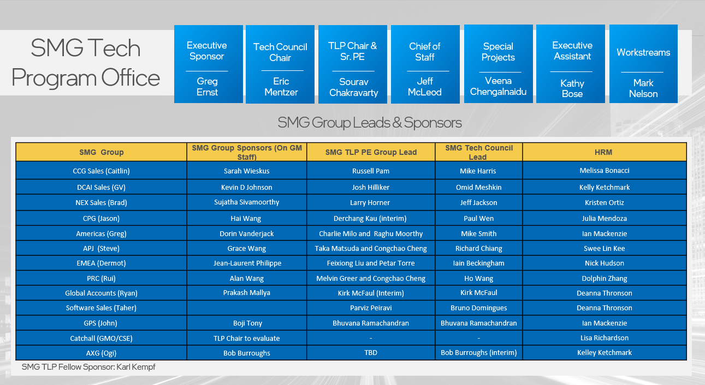

Slide 6
2023 SMG Nomination Committee
SMG PE & Sr. PE Nomination Process Review Committee
SMG Members | BU Members
Sourav Chakravarty - Sr. PE & Committee Chair | Karl G. Kempf - Sr. Fellow, DPG
Melvin Greer - Fellow, US Sales | Mohan J. Kumar - Fellow, DPG
Xiaorong Xiong – PE, CPG | Prashant Sethi - Fellow, IAGS
Tiffany Sargent - Sr. PE DCAI | Rahima K. Mohammed - Sr. PE, IAGS
Chee How Lim - Sr. PE, CPG | Tim Plowman - Sr. PE, IoT
Petar Torre-PE, DCG Sales
Bruno Domingues-PE, Software Sales
SMG Tech Council (Non-Voting member)
Mike Smith-Tech Council Member and Manager, Americas Sales
Increased diversity, CPG inclusivity, and Tech Council Representation consistent with our convergence strategy
Notes:
Opportunity to increase diversity count and add technical voice for the tech council rep consistent with our convergence strategy

Slide 7
SMG Group Wise PE/Sr. PE Nominations – WW32 snapshot
SMG Group | SMG Group Sponsors (on GM Staff) | SMG TLP PE Group Lead | SMG Tech Council Lead | HRM | Nominees (Trending) | Comment
CCG Sales (Caitlin) | Sarah Wieskus | Russell Pam | Mike Harris | Melissa Bonacci | 1 PE | To be finalized by Aug 19th
DCAI Sales (GV) | Kevin D Johnson | Josh Hilliker | Omid Meshkin | Kelley Ketchmark | 2022: 5 PE’s 2023: WIP | To be finalized by Aug 19th
NEX Sales (TBD) | Sujatha Sivamoorthy | Larry Horner | Jeff Jackson | Kristen Ortiz | 2022: None 2023: 1 PE | To be finalized by Aug 19th
CPG (Jason) | Hai Wang | Derchang Kau | Paul Wen | Julia Mendoza | 2022: 7 PE’s; 3 Sr. PE’s 2023: WIP | To be finalized by Aug 19th
Americas (Greg) | Dorin Vanderjack | Charlie Milo and Raghu Moorthy | Mike Smith | Ian Mackenzie | 2022: 1 PE 2023: WIP | To be finalized by Aug 19th
APJ (Steve) | Grace Wang | Take Matsuda and Congchao Cheng | Richard Chiang | Swee Lin Kee | 2022: None 2023: 1 PE | To be finalized by Aug 19th
EMEA (Dermot) | Jean-Laurent Philippe | Feixiong Liu and Petar Torre | Iain Beckingham | Nick Hudson | 2022: 1 PE 2023: WIP | To be finalized by Aug 19th
PRC (Rui) | Alan Wang | Melvin Greer and Congchao Cheng | Ho Wang | Dolphin Zhang | 2022: 2 PE’s; 1 Sr. PE 2023: None | Finalized
Global Accounts (TBD) | Prakash Mallya | Kirk McFaul | Kirk McFaul | Deanna Thronson | No nominations as yet | To be finalized by Aug 19th
Software Sales (Taher) | TBD | Parviz Peiravi | Bruno Domingues | Deanna Thronson | 2022: 1 Sr. PE withdrawn | To be finalized by Aug 19th
GPS (John) | Boji Tony | Bhuvana Ramachandran | Bhuvana Ramachandran | Ian Mackenzie | No nominations as yet | To be finalized by Aug 19th
AXG (Ogi) | Bob Burroughs | TBD | Bob Burroughs (Interim) | Kelley Ketchmark | No nominations as yet | To be finalized by Aug 19th

