Slide 1
Scaling in Electron Devices and Electronic Systems
A decadal projection in memory technologies
A chat at Graduate School of Advanced Technology at National Taiwan University May/29/2023
DerChang Kau (高德昌)
Intel Fellow, Director of External Technology Pathfinding
Corporate Planning Group

Slide 2
Abstract
Since 1897’s discovery of electron by Sir Joseph John Thomson (Nobel Laureate 1906), electron devices started the journey of the 2nd industrial evolution onward. Under the guidance of Moore’s Law and Dennard Scaling, electron devices’ density increase at cadence and electronic systems strive maintaining power density while improving performance. This talk invites participants first travel down the time tunnel of electron devices. We will jointly revisit researches in material synthesis and device exploration in atomistic switching physics to disrupt electrostatic switching mechanism. Memory technology will be used to project decadal electronic system advances in homogenous and heterogenous integration through VLSI fabrication and chiplet interconnect processes.
About DerChang Kau
An Intel Fellow and a Director of External Technology Pathfinding, exploring chip manufacturing and system integration technologies aligning with product roadmap. For more than 3 decades, DerChang has been involved in various technology pathfinding and scaling deployment, including logic, memory, flash, embedded memory, mixed-signal, radio and advanced packaging. He also led Intel’s efforts to define strategic direction for atomistic memory switching and threshold switching devices and drove the product initiatives of Optane Memory Technology. He holds MS degrees in Electrical Engineering from OSU.

Slide 3
Outline
Travel down the time tunnel of electron devices –
  A Centennial Journey of Electrical Charges
State of Art of Memory Technologies –
  System hierarchy and incumbent deployment
  A holistic view of Memories: Cell, Array and Subsystem
Memories in next decade –
  Cache, Memory and Storage
  Near Memory and Storage Class Memory

Slide 4
Travel down the time tunnel of electron devices
A chat at Graduate School of Advanced Technology at National Taiwan University May/29/2023
A Centennial Journey of Electrical Charges

Slide 5
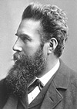
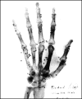
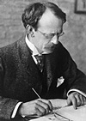
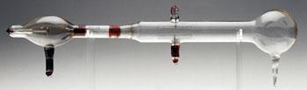
Discoveries of Electron
1895 Wilhelm Conrad Röntgen (1845 - 1923) discovered X rays, for which he received the first Nobel Prize for physics in 1901. The “hand” was taken in 1896 with cathode-ray discharge. He later demonstrated the metallurgical and medical use of X rays.
https://www.nobelprize.org/prizes/physics/1901/summary/
1897 Sir Joseph John Thomson (1856 - 1940) discovered and identified the electron, for which he received the Nobel Prize for physics in 1906. Thomson demonstrated that cathode rays were actually units of electrical current made up of negatively charged particles of subatomic size as an integral part of all matter and theorized the "plum pudding" model of atomic structure in which a quantity of negatively charged electrons was embedded in a sphere of positive electricity, the two charges neutralizing each other.
https://www.nobelprize.org/prizes/physics/1906/summary/

Slide 6
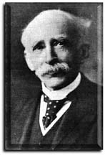
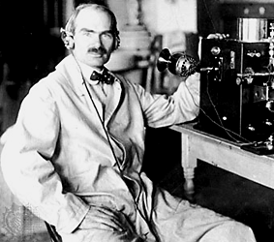
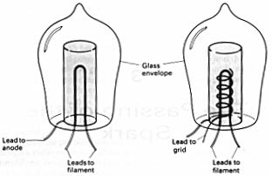
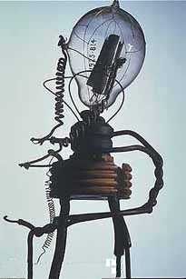
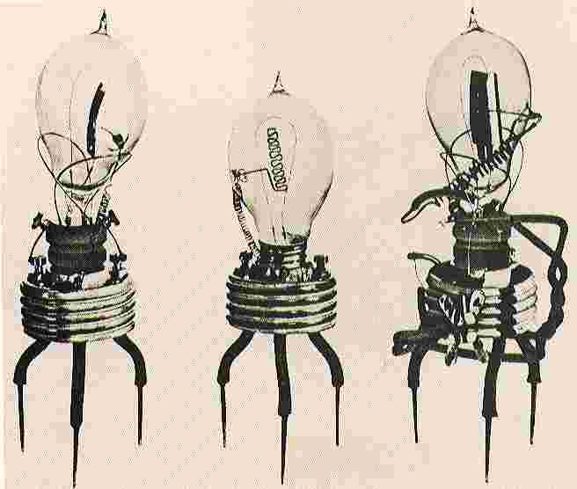
Innovations of Vacuum Electron Devices
1905 Sir John Ambrose Fleming (1849 - 1945) made
the first diode tube,
the Fleming valve.
The device had
three leads, two
for the heater and the
cathode and the other for the plate.
1907 Lee De Forest (1873 - 1961) added a grid electrode to
Flemings' valve and
created the triode tube,
later improved and
called the Audion.
He was a prolific inventor, and was
granted more than 300 patents in Electronics
https://madeupinbritain.uk/Vacuum_Tube
https://www.britannica.com/biography/Lee-de-Forest

Slide 7
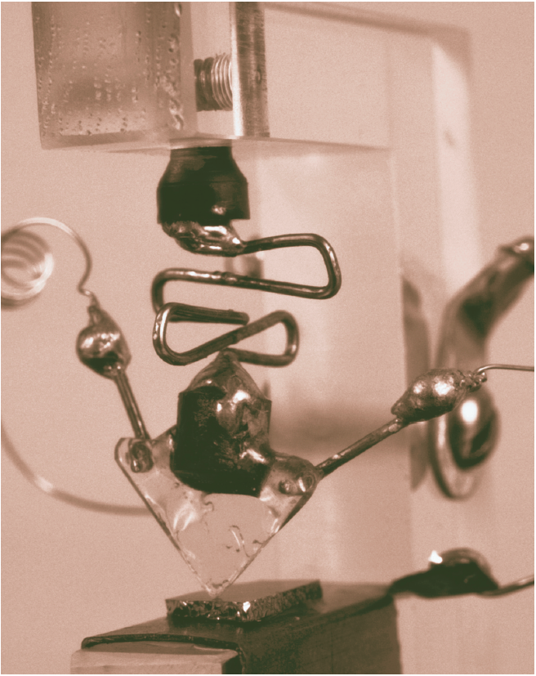
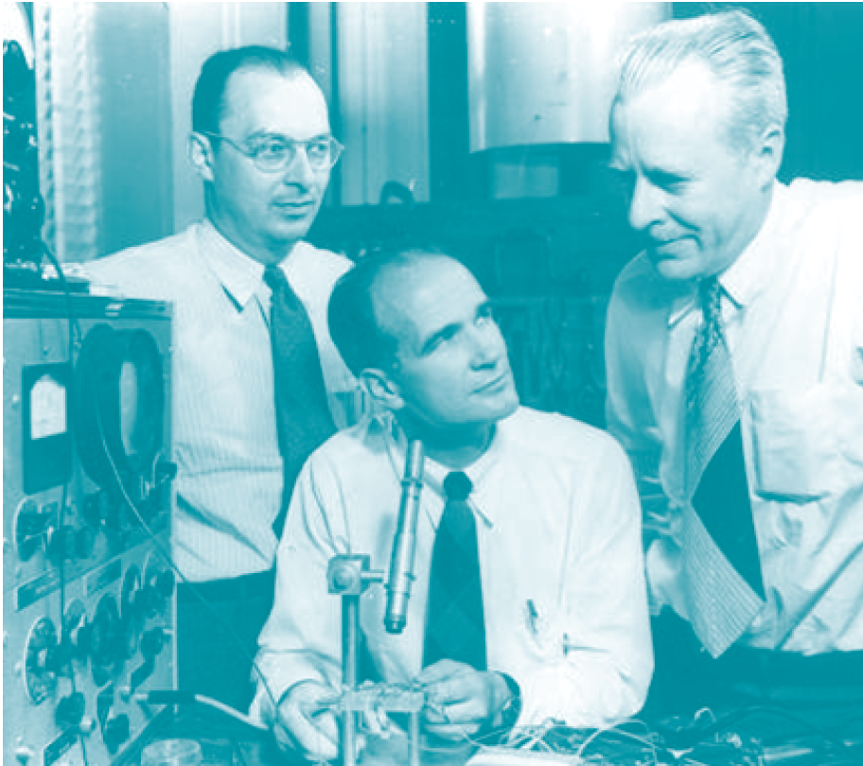
Revolution of Electronics –
From Vacuum Science to Solid State Physics
In 1948, John Bardeen (1908 - 1991), William Bradford Shockley (1910 - 1989), Walter Houser Brattain (1902 - 1987) invented the transistor for Bell labs, sharing the 1956 Nobel Physics prize for the invention.
Shockley’s insight of “minority carrier injection” became the bible of the new era
    [1] W. Shockley, “The Theory of P-N Junctions in Semiconductors and P-N Junction Transistors.” Nokia Bell Lab, July 1949
    [2] W. Shockley, “Electrons and Holes in Semiconductors: With Applications to Transistor Electronics”, Van Nostrand, Jan, 1050

Slide 8
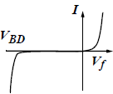
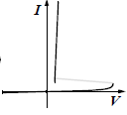
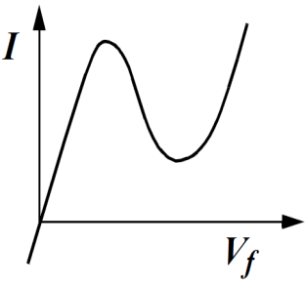
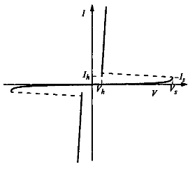
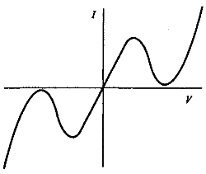
Thermionic emission (single-/dual-carrier) and beyond
Diode: two terminals and exhibiting a nonlinear I-V, IEEE Standard Dictionary of Electrical and Electronics Terms, 1980
§
§
§
Unidirectional
Asymmetric
Unipolar
L-Shape
S-Shape
N-Shape
¶
§
§
Bidirectional
Symmetric Ambipolar
§ : Kowk K. Ng, Complete guide to semiconductor devices, 2nd ed., 2002
¶ :https://www.digikey.com/en/articles/design-in-tvs-diode-protection-enhance-can-bus-reliability

Slide 9
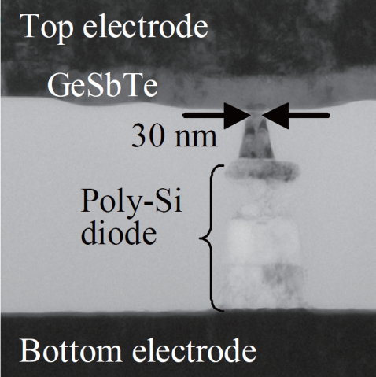
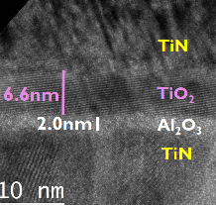
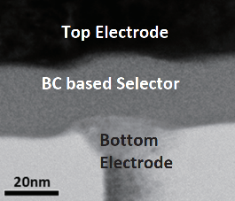
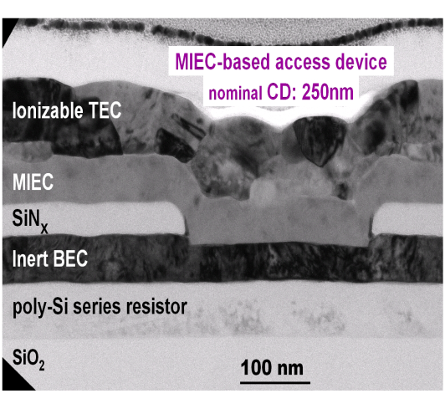
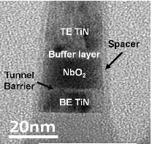
Thin Film Diode Candidates for Cross Point Memory
Y. Sasago, et. al.,
VLSI ’09. T2B-1
B. ﻿Govoreanu, et.al.,
IEDM’13. S10.2
S. Yasuda, et.al.,
VLSI, 2017. T2-4
OTS
K. Gopalakrishnan, et. al.,
VLSI ’10. TS19.41
S.G. Kim, et. al.,
IEDM ’15. S10.3
D. Kau, et. al.,
IEDM ’09. S27.1

Slide 10
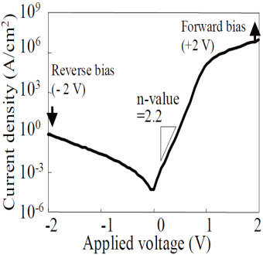
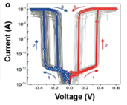
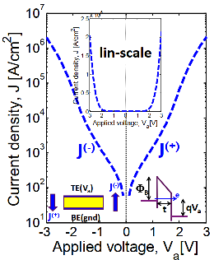
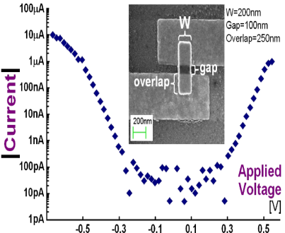
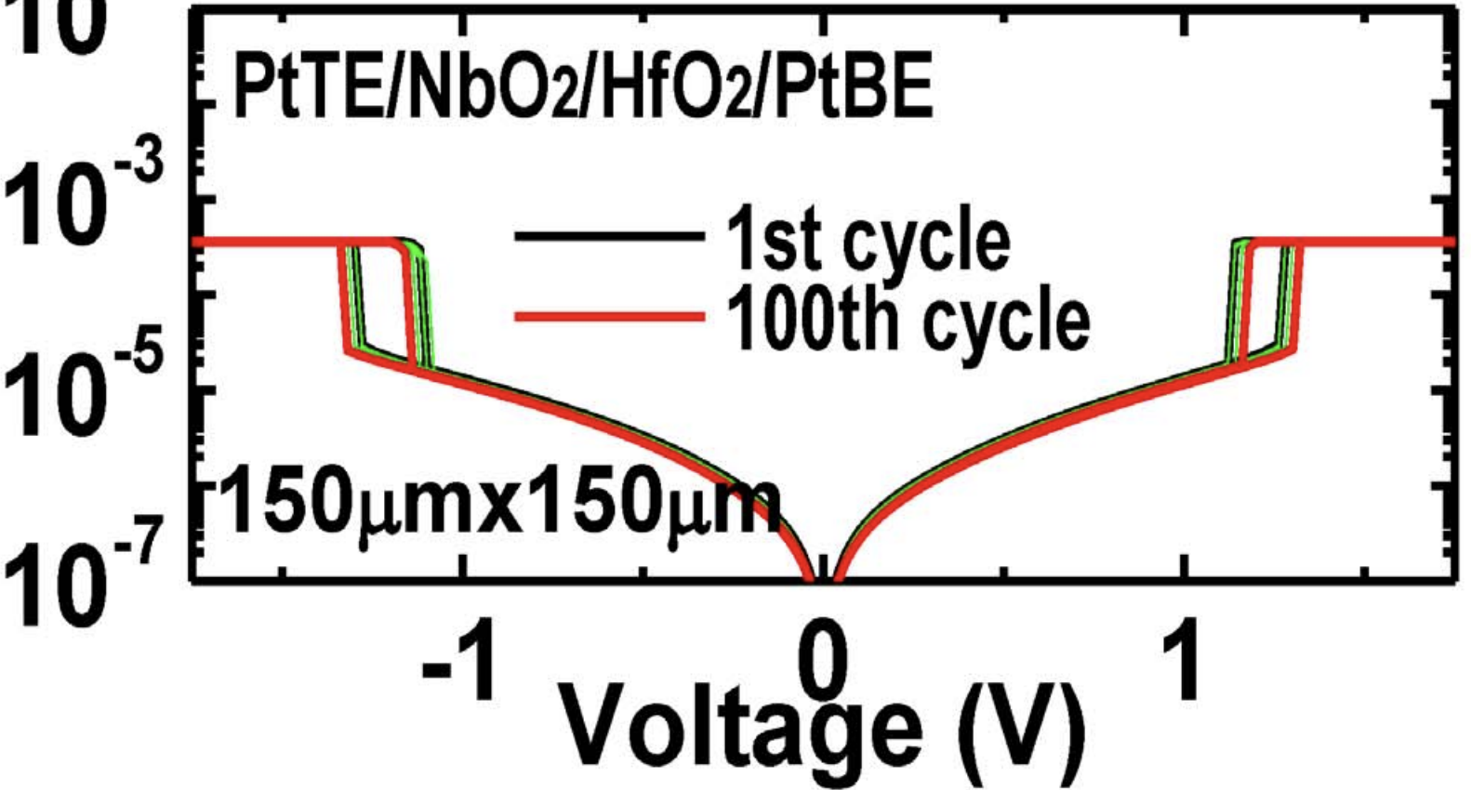
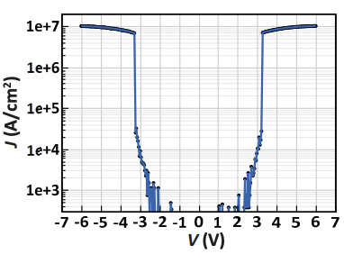
Threshold Switching Phenomenology & Mechanisms
Mechanism | Thermionic | Filamentation | Tunneling | MIEC | MIT | OTS
Construct. | P-N or M-S Jx | Ion (Ag⁺) in Ox | MIM | Cu⁺ in SE | NbO₂ | Chalcogenide
Switching | Electronic | Atomistic | Electronic | Atomistic | Atomistic | Electronic
Polarity | Unidirectional | Bidirectional | Bidirectional | Bidirectional | Bidirectional | Bidirectional
τ_{switch} | sub nsec | ns ~ 100s ns | ps or faster | ns ~ 100s ns | ns to 10s ns | sub ns
J_{MAX} | < 10MA/cm² | 1-10MA/cm² | < 1MA/cm² | ~10MA/cm² | > 10MA/cm² | > 10MA/cm²
J_{Inhibit} | <1A/cm² | <1KA/cm² | <1KA/cm² | <1KA/cm² | <1KA/cm² | <1KA/cm²
V_{Inhibit} | < 3V | < 1V | <3V | < 1V | < 3V | < 3V
I-V
Reference | Y. Sasago, et. al., VLSI ’09 | J. Yang, et.al., Adv Func Mtls (2018) | B. ﻿Govoreanu, et.al., IEDM’13. P10.2 | K. Gopalakrishnan, et.al., VLSI Symposium ’10. | X. Liu et.al., EDL Oct.’14 | S. Yasuda, et.al., VLSI symposium, ‘17,

Slide 11
State of Art of Memory Technologies
A chat at Graduate School of Advanced Technology at National Taiwan University May/29/2023
System hierarchy and incumbent deployment
A holistic view of Memories: Cell, Array and Subsystem

Slide 12
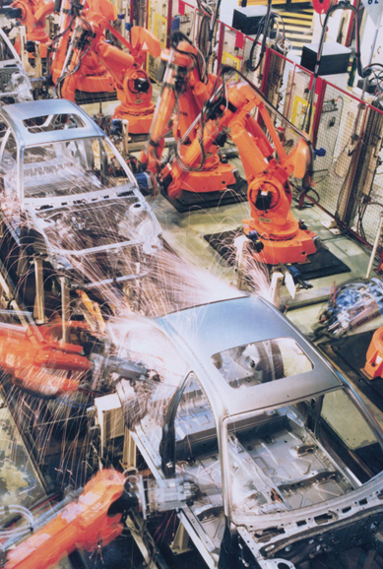



Every Day Data is EXPLODING
We are in a data-centric world
Data are
stored, processed, and analyzed
50 PB
Public Safety
1 PB
Smart Factory
40 TB
Airplane Data
3 TB
Smart Hospital
50 GB
Autonomous DRIVING
1.5 GB
Average
Internet User
https://www.cisco.com/c/dam/m/en_us/service-provider/ciscoknowledgenetwork/files/547_11_10-15-DocumentsCisco_GCI_Deck_2014-2019_for_CKN__10NOV2015_.pdf

Slide 13
Incumbent Technologies in Memory/Storage Hierarchy each of which has greater capacity than the preceding but which is less quickly accessible
“The Memory Organ – Ideally one would desire an indefinitely large memory capacity such that any particular … word would be immediately … available. … It does not seem possible physically to achieve such a capacity. …We are therefore forced to recognize the possibility of constructing a hierarchy of memories, each of which has greater capacity than the preceding but which is less quickly accessible.”
Preliminary Discussion of the Logical Design of an Electronic Computing Instrument
Arthur Burks, Herman Goldstine and John von Neumann, June/28/1946
SRAM
DRAM
HDD
SSD
Capacity, Latency
Bandwidth, Cost

Slide 14
A memory cell consists one storage element and one or more access switch(es)
Storage Elements:
  Latch: Circuit based or Thyristor device
  Electrostatic memory switch: Two terminal capacitor, floating gate/plate, charge traps devices
  Atomistic memory switch: Phase change, Magneto Tunnel Junction, Ferroelectric, Oxy-Vacancy (Filamentation)
Access Devices:
  3 terminal Transistor:
    Pass logic (1T) is typical used for read/write access.
    Gated common-source amp (2T) is used for read only access
    Biased Source-follower (1T) is used for read only access
  Two-terminal diodes: Thermionic (PN junction, Schottky barrier, DIAC & etc) , MIT, OTS MIEC, volatile filamentation and etc.
A₁
S
A₂
•••
•••
Brain teaser: multiple memory storage elements share one access device

Slide 15
Multi-ported SRAM Symmetry
1RW
2RW
B
W
B
B₁
W₁
B₁
W₁
U
V_{cc}
U
W₁
B₁
G₁
V_{ss}
G₁
B₁
B₂
G₂
D
D
G₂
B₂
U
U
D
U
G
B₂
W₂
B₂
W₂
W₂
G
D
D
G
G
U
D
R
2R1W
1R1W
WB
WW
WB
WB
WW
WB
RW₁
RW
RB₂
RW₂
RB₁
RB
U
U
U
U
D
U
D
D
G
RD
U
D
RD
G
D
D
G
G
RD
RG
RG
RD
RD
RG
RG
G
G
RG

Slide 16
Why “Multi-Port Memories”
﻿Multi-Port Memories have all the features of single-port memories
Used for multi-tasking
Parallel Processing – increase bandwidth without cycle time compressing
“Simultaneously” read and write data or read-while-write
Examples
  Dedicated Memory – In a branch-target-buffer memory to keep track branch prediction and decision
  Shared Memory – multiple requests for data from multi-cores or networked processors
Analysis and Synthesis
  Multi-port (MP) SRAM is a commonly used for cache design as it allows simultaneous R/W accesses.
  For CISC CPUs, such as the X86 architecture, MP cache such as mRnW configuration is used
  For RISC CPUs, such as the ARM architecture, SP cache such as 1RW with multi-bank (MB) configuration is used.
  Overall, the choice of cache memory organization and multiport SRAM configuration depends on the specific design goals, performance requirements, and trade-offs between cost, power consumption, and performance.

Slide 17
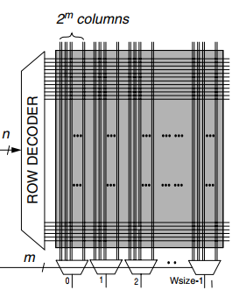
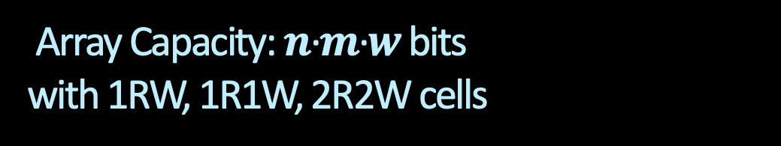
Array Capacity: $n$·$m\text{·}w$ bits with 1RW, 1R1W, 2R2W cells
Read D
Read C
m
0
1
2
W_{size}-1
m
0
1
2
W_{size}-1
12T cell
n·m·w b Bank
6T cell
1RW
8T cell
1R1W
16T cell
2R2W
Read
m
0
1
2
W_{size}-1
n
n
ROW DECODER – WWL-B
ROW DECODER – RWL-D
Bruce Jacob et.al, Memory System, p.265
8T cell
n·m·w b Bank
n
n
ROW DECODER – WWL-A
ROW DECODER – RWL-C
n
n
ROW DECODER - WWL
ROW DECODER - RWL
m
m
0
1
2
W_{size}-1
m
0
1
2
W_{size}-1
0
1
2
W_{size}-1
Write A
Read/Write
Write
Write B

Slide 18
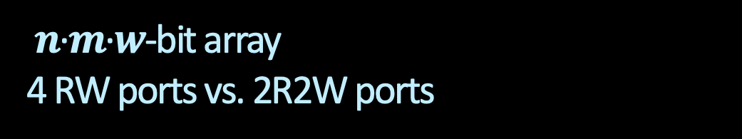
$n$·$m$·$w$-bit array
4 RW ports vs. 2R2W ports
Read D
Read C
m
0
1
2
W_{size}-1
m
0
1
2
W_{size}-1
12T cell
n·m·w b Bank
6T cell
1 RW port
1Bank
6T cell
4 RW ports
4 banks
16T cell
2R2W ports
1Bank
6T Cell
¼·n·m·w b Bank
n
n
n/2
ROW DECODER – WWL-B
ROW DECODER – RWL-D
Bruce Jacob et.al, Memory System, p.265
ROW DEC
n
n
ROW DECODER – WWL-A
ROW DECODER – RWL-C
m/2
0
1
2
W_{size}-1
0
1
2
W_{size}-1
Read/Write
Bank Logic: 4ports Cmd/Add + I/O
m
m
0
1
2
W_{size}-1
0
1
2
W_{size}-1
Read/Write
0
1
2
W_{size}-1
0
1
2
W_{size}-1
Write A
Write B

Slide 19
Memories in next decade
A chat at Graduate School of Advanced Technology at National Taiwan University May/29/2023
Cache, Memories and Storage
Near Memory and Storage Class Memory

Slide 20






Gaps to fill between Caches, Main Memory & Storage beyond scaling
“It’s the Memory, Stupid!
… Processor Speed Has Outstripped Memory … today’s chips are largely able to execute code faster than we can feed them with instructions and data. There are no longer performance bottlenecks in the floating- point ... The real design action is in memory subsystems—caches, buses, bandwidth, and latency…I expect that over the coming decade memory subsystem design will be the only important design issue for microprocessors.”
Architects Look to Processors of Future,
Microprocessor Report, V10, No. 10, Aug/5/1996
Dick Sites, Digital Equipment Corp

Slide 21
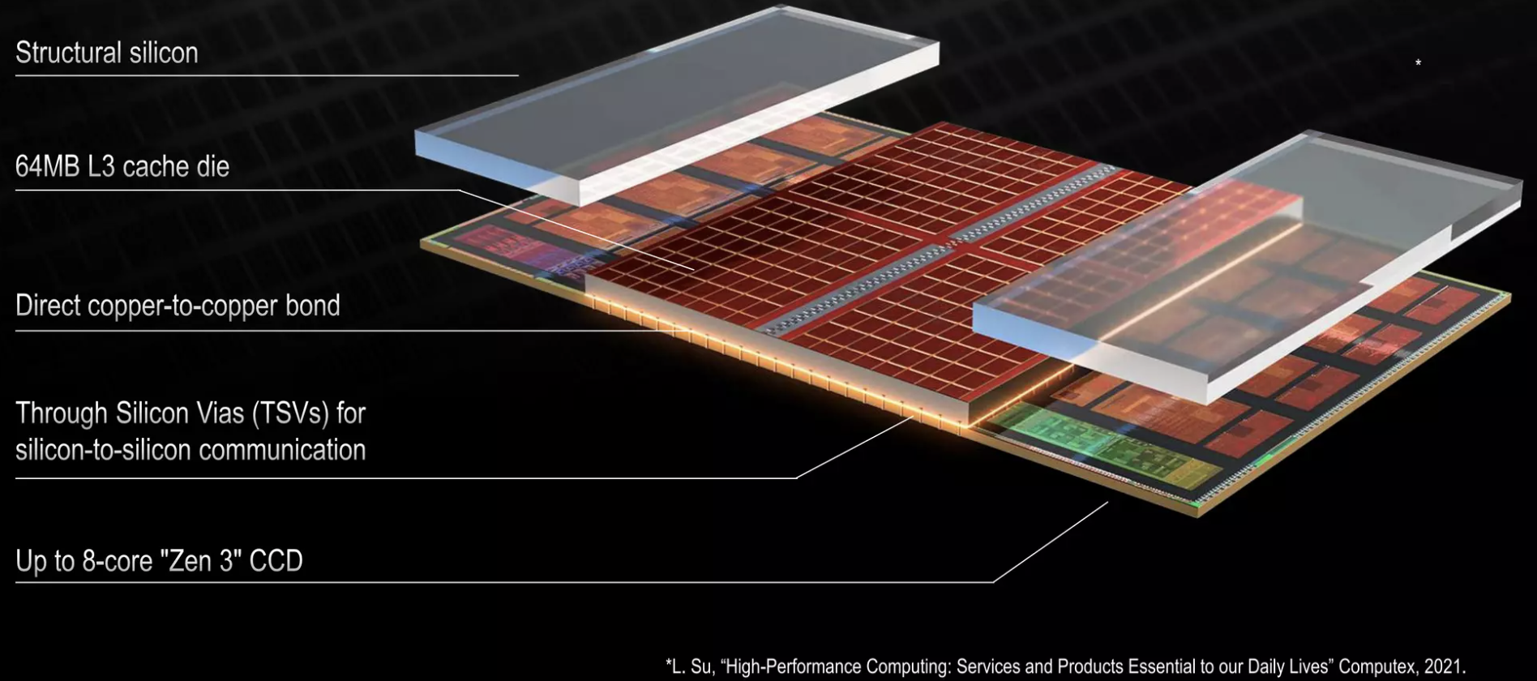
Cache Memory in next decade
Scaling trajectory of mainstream logic technology yet optimized for SRAM
IP folding to increase Cache capacity : Core
  Enabling technology: TSV, back-side metallization, reconstructed wafer, wafer-wafer (hybrid) bonding,
Key Challenges: Power and Thermal

Slide 22
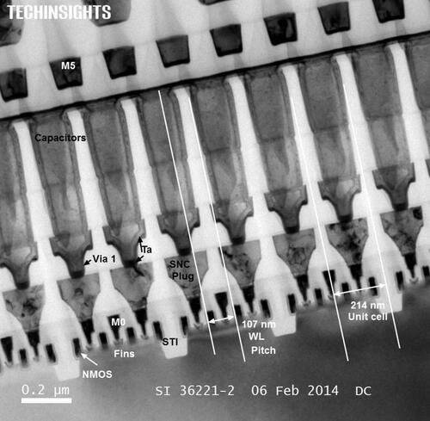
Emerging Memories for In Package Memory candidates
1T- 1X Array Architecture
Intel Gen 1 eDRAM [1T1C]
BL
SL
BL
SL
WL
WL
Y decoder
WL
Write Driver and Sense Amp
X –decoder and Multiplexer
Output driver and I/O
Access Transistor
Si channel planar / nonplanar XTOR
TFT channel planar / nonplanar XTOR
2T [independent read write] Option
High-k Capacitor
MRAM [STT/SOT]
Ferro-capacitor
Nano-structure change
Memory Element
Key Challenge: BW, Granularity

Slide 23
Compute Memory Disaggregation
Channel_{i}
Host
Memory Farm
Channel₀
Bank₀
Bank_{m-2}
….
Bank_{j}
…
…
Channel_{n-1}
RAS
SWD
Bank₁
Bank_{m-1}
….
Memory Mat
Logic
Logic
C/A
CSL
Mat
SA
CAS
Access Device
Decoder / Driver
Page
Si channel planar / nonplanar XTOR
TFT channel planar / nonplanar XTOR
2T [independent read write] Option
DQ + Metadata
High-k Capacitor
MRAM [STT/SOT]
Ferro-capacitor
Nanostructure change
Logic and Mix Signal
Memory Element
Memory Specific
SA / Data Latch
Mix Signal

Slide 24
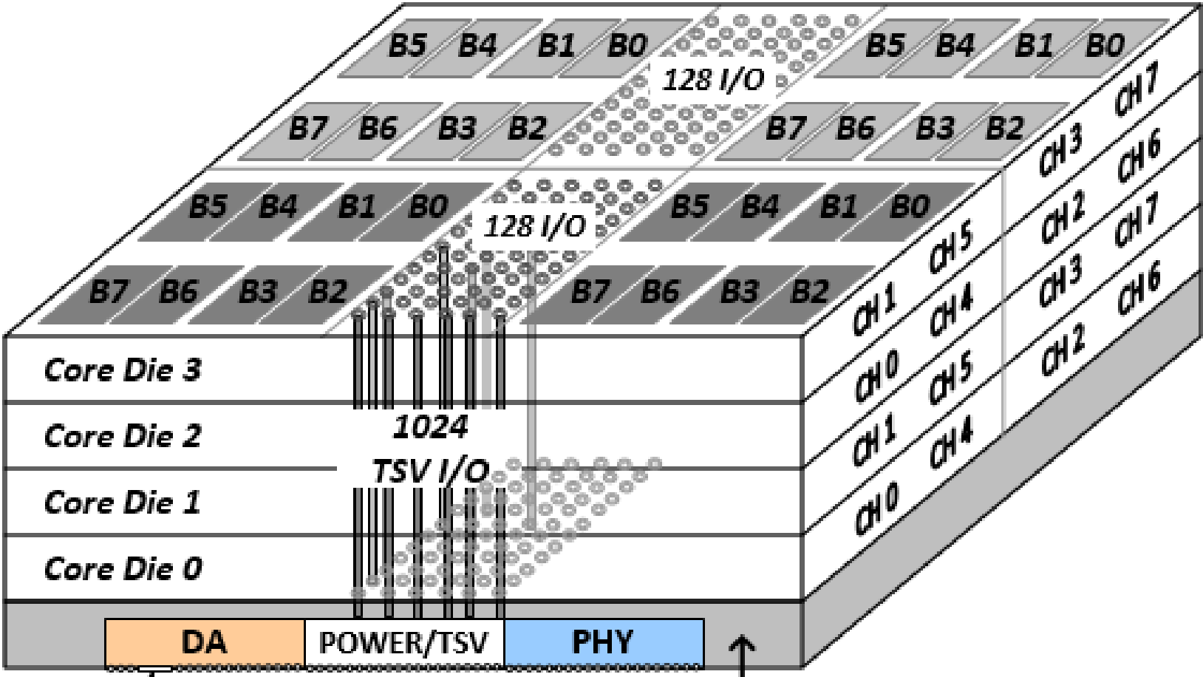
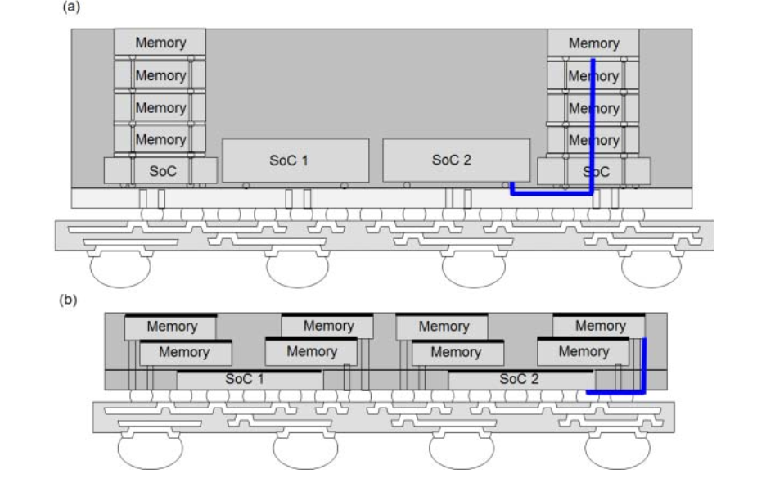
Chiplet stacking to improve packing density, Power and Bandwidth
M. O’connor, et.al., ACM/MICRO 2017
Bank
Bank
Bank
Bank
Fine-Grained DRAM Arch:
  Partition Bank into narrower pseudo-banks
  32 Dedicatedm Local 2 GB/s Channel
  Local, parallel I/O per bank at lower energy
Bank
Bank
HBM2 Channels:
  Shared 16 GB/s Channel
  16 banks per channel
  BW of idle banks is “wasted”
Quad-Bandwidth HBM Channels:
  Four 16 GB/s Channels
  Shared inter-bank bus
  High datapath & array act. energy
Bank
Bank
Bank
Bank
Bank
Bank
HBM, H Jun, et.al., IMW’2017
A. Su, et.al., ECTC2019

Slide 25
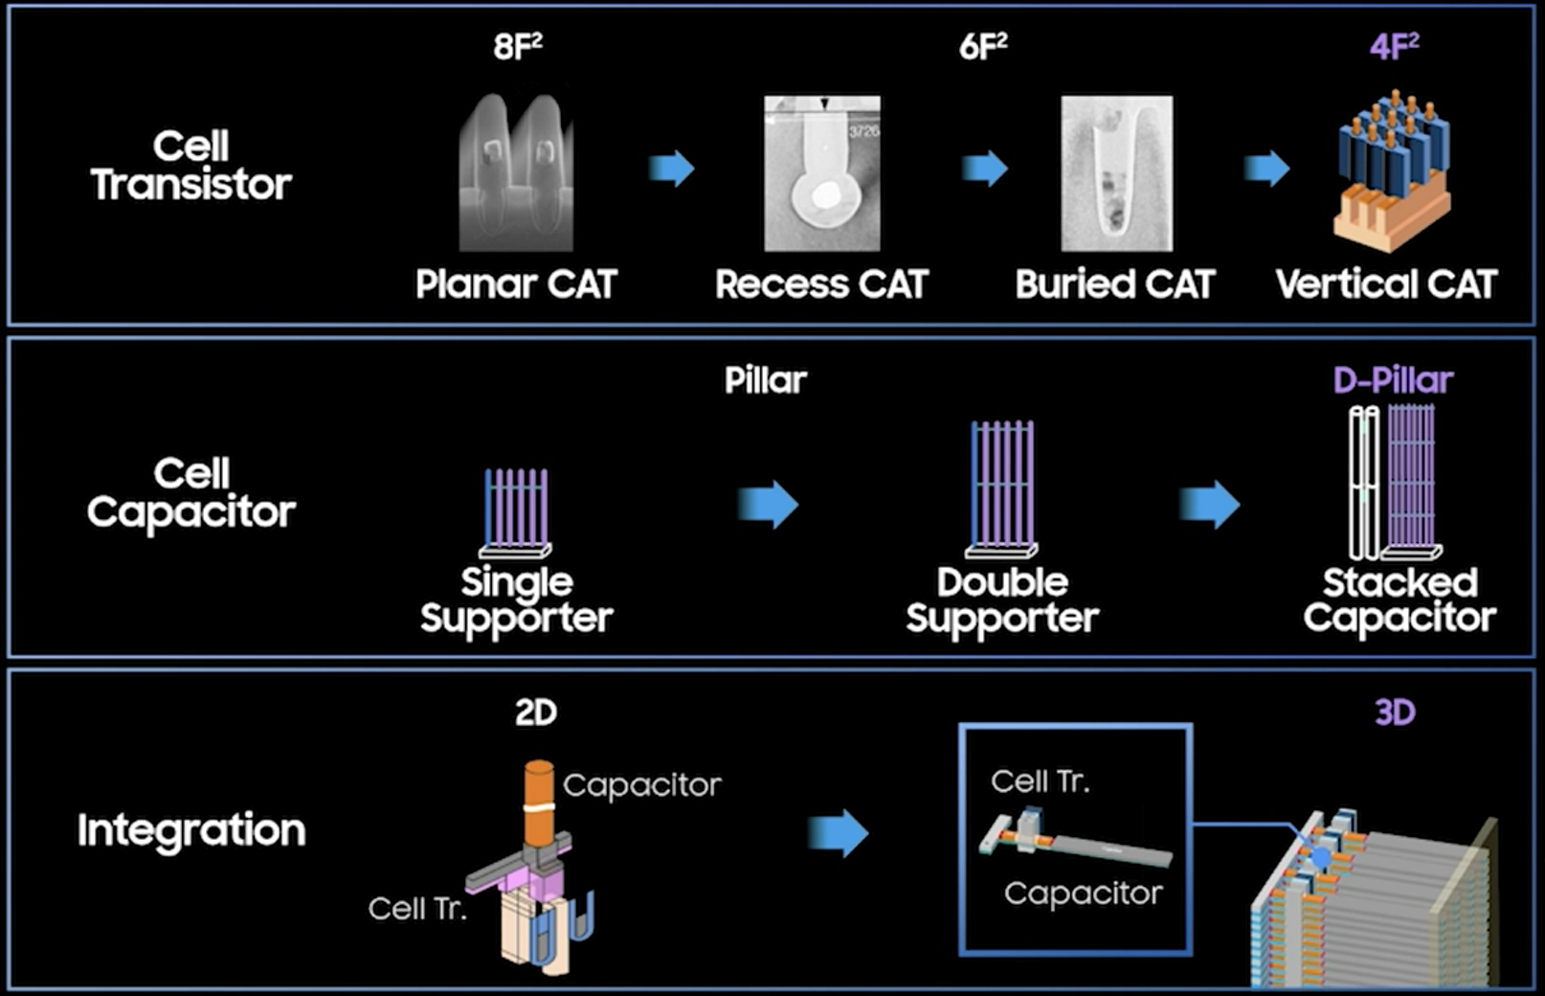
DRAM’s Journey beyond Trench Capacitor
Kinam Kim, IEDM’21, Plenary Session 1.1

Slide 26
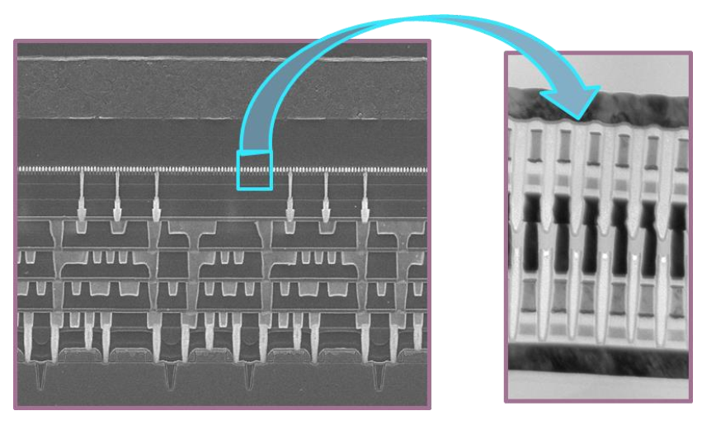
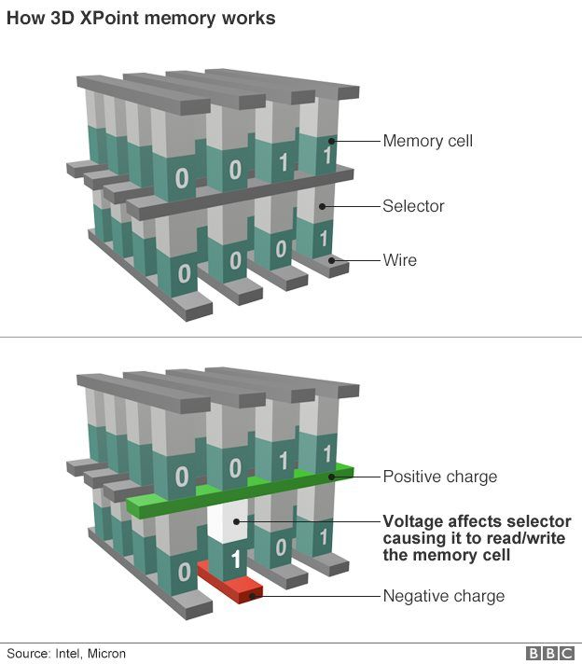
Emerging Memories for Persistent Memory in 3D Cross Point Architectures
Intel Gen 1 3D XPoint™
Access Diode
Thermionic
[diode, MIEC, ..]
Volatile filament
Metal-Insulator Transition
Ovonic Threshold
Magnetic
[MRAM, STT(SOT)MRAM]
Resistance Change ReRAM[1D, 2D], PCM [3D]
Ferroelectrics
Memory Element
Key Challenge: Matching Memory & Selector
INTEL CONFIDENTIAL

Slide 27
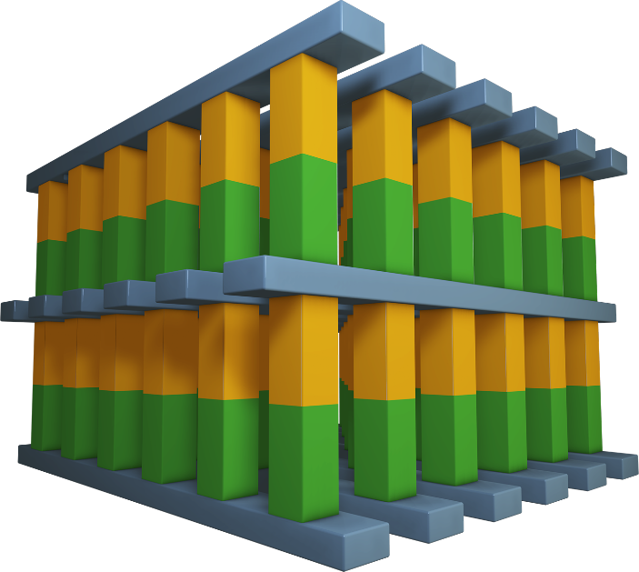
Consideration of architecting a cross point memory technology
Desirable Attributes: Nonvolatile, Low Cost, High Performance
Simple scalable, 3D stackable construction; low D·T, BEOL compatible with mainstream IC manufacturing
Memory switching in atomistic state (bulk); superior scalability than electrostatic memory switching physics
Individual cell access, small granularity
Fast switching materials + local low resistance metal interconnect
Challenge: to “mate” selector and memory in achieving a non-linear I-V for array access
Potential Memory Options:
  Spin polarization
  Phase change/segregation
  Ferroelectric hysteresis
  Interfacial barrier modulation
  Oxygen vacancy relocation
  Ionic transport
  NRAM (?)
Potential Selector Options:
  Unidirectional
  Homo/Heterogenous P/N Jx
  Schottky Barrier
  Bidirectional
  Mixed ionic-electronic conduction
  Tunneling barrier
  Metal–insulator transitions
  Ovonic threshold switching
Wordlines
Bitlines
Selector & Memory Devices
Wordlines

Slide 28
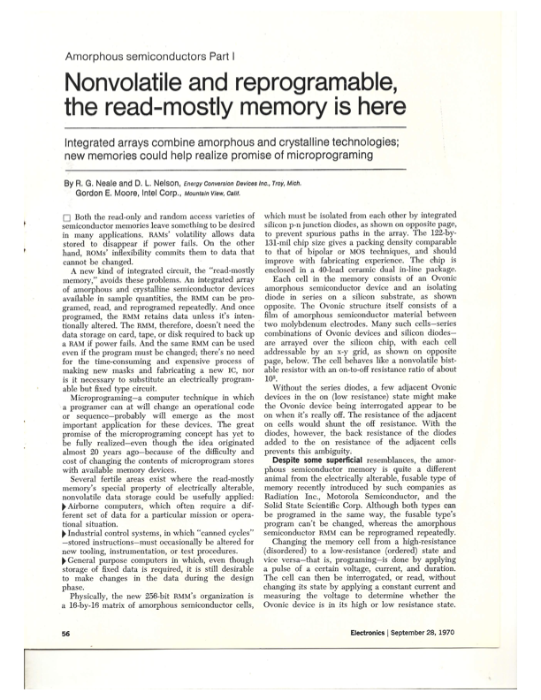
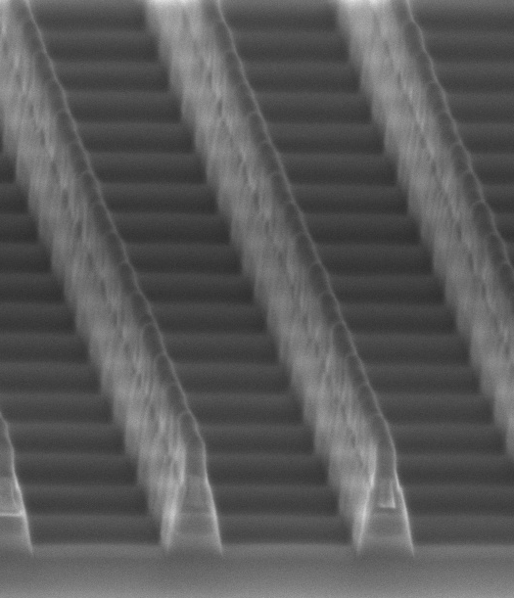
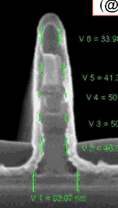
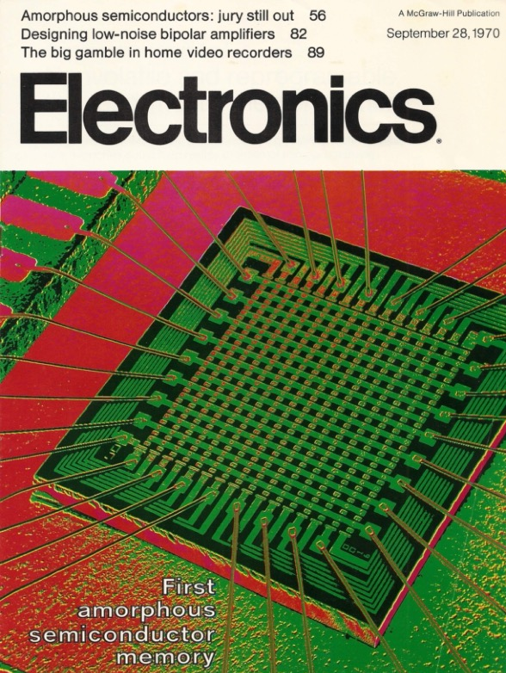
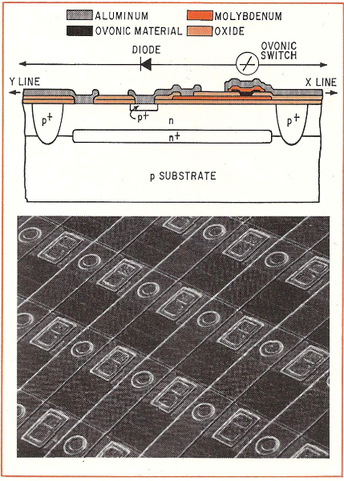
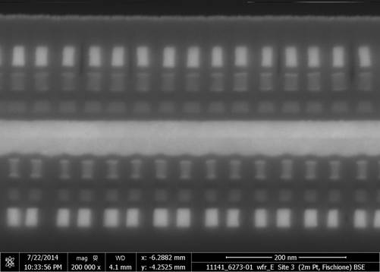
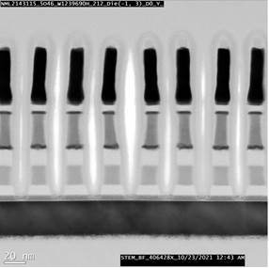
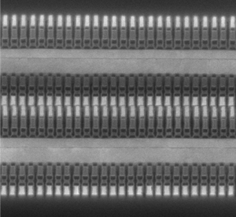
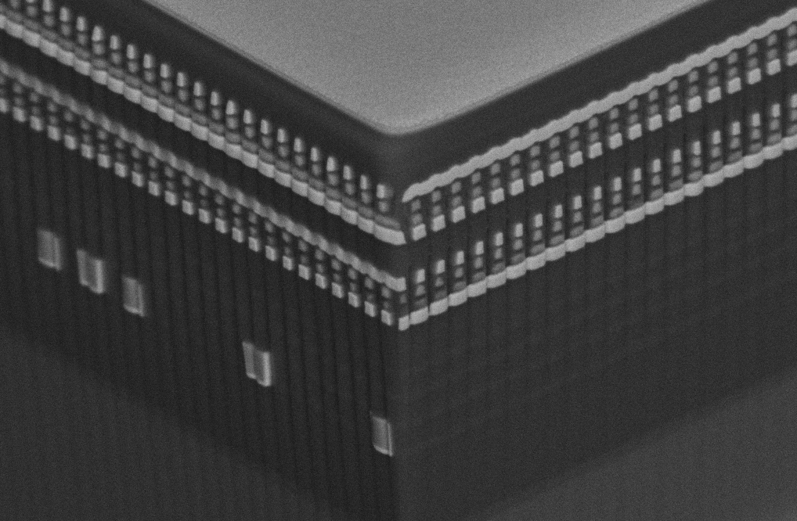
Long gestation of Disruptive Memory Technologies – An Intel’s example of 3D XPoint
4Kb 200nm feature, 4-mask Sublitho Heater
Damascene PM Subtractive SD
2003~2006 Santa Clara, CA
64Mb 180nm ½ Pitch 6-Mask Sublitho Heater Damascene PM, Subtractive SD
2007~2009 Santa Clara, CA
64Mb 100nm feature, 2-Mask
Self-Aligned, Subtractive Cell
2010~2011 Agrate, Italy
September 28, 1970
X-section along ROW
TiAlN
SD
C
W
PM
TiAlN
Selector
C
C
Selector
TiSiN
Memory
Mid Electrodes
TiSiN
Memory
cell
128Gb 41nm Pitch
Dual Deck Self Aligned Subtractive Cell
2013-2017 Boise, ID
256Gb 41nm Pitch
Quad Deck Self Aligned Subtractive Cell
2015-2020 Lehi, UT & Rio Rancho, NM
Scaled Line/Space
2019-2022 Rio Rancho, NM
64Mb 50nm ½ Pitch, 2-Mask
Dual Deck, Self Aligned Subtractive Cell
2012~2013 Agrate, Italy
3rd Production Generation
1st Production Generation
2nd Production Generation
3rd Generation Development
In Pursuit of a Dream ········ A Half Century Endeavor

Slide 29
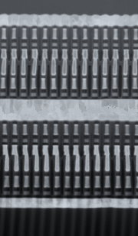
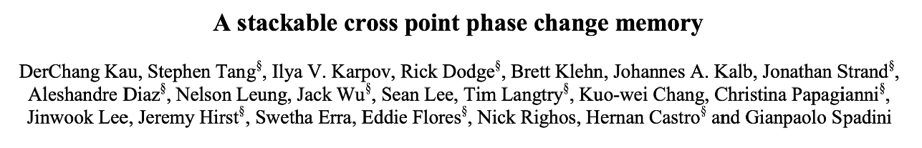


Long gestation of Disruptive Memory Technologies
In Pursuit of a Dream …
September 28
1970
August 13
2020
December 8
2009
A Half Century Endeavor
Conclusion

Slide 30


3D NAND in next decade will continue to drive $/bit on par with HDD
Kinam Kim, IEDM’21, Plenary Session 1.1
Tiering/Decking engineering + multi-level placement algorithm

Slide 31
Takeaway of Advances of Memory Technologies
Universal memory
  Universal memory often sought, but hierarchy always existed and likely always will be
  FoM must be benchmarked with respect to the corresponding hierarchy of memories
Disrupt memory technology
  ﻿Typically long gestation of Disruptive Memory Technologies
  Mainstream memories hard to establish; hard to displace or to replace;
  DRAM replaced Core memory in 1960’s and SSD displacing spin drive in 2000’s
  Memory technology research to productization can take decades and once productized, achieving mainstream is still not guaranteed
Memory Subsystem
  Modular, Modular, Modular
  Power/Thermal conscious: Energy from I/O and from moving bits back/forth becoming limiting
  3D (monolithic, wafer-wafer) and packaging of multi-chip
    TTM and Cost driven
  Pair memory tech research with compute architecture/hierarchy research.
  Software (often ignored ) enabling to alleviate adoption barriers or to unlock value

