Slide 1
Scaling in Electron Devices and Electronic Systems
A decadal projection in memory technologies
A chat at Graduate School of Advanced Technology at National Taiwan University May/29/2023
DerChang Kau (高德昌)
Intel Fellow, Director of External Technology Pathfinding
Corporate Planning Group

Slide 2
Abstract
Since 1897’s discovery of electron by Sir Joseph John Thomson (Nobel Laureate 1906), electron devices started the journey of the 2nd industrial evolution onward. Under the guidance of Moore’s Law and Dennard Scaling, electron devices’ density increase at cadence and electronic systems strive maintaining power density while improving performance. This talk invites participants first travel down the time tunnel of electron devices. We will jointly revisit researches in material synthesis and device exploration in atomistic switching physics to disrupt electrostatic switching mechanism. Memory technology will be used to project decadal electronic system advances in homogenous and heterogenous integration through VLSI fabrication and chiplet interconnect processes.
About DerChang Kau
An Intel Fellow and a Director of External Technology Pathfinding, exploring chip manufacturing and system integration technologies aligning with product roadmap. For more than 3 decades, DerChang has been involved in various technology pathfinding and scaling deployment, including logic, memory, flash, embedded memory, mixed-signal, radio and advanced packaging. He also led Intel’s efforts to define strategic direction for atomistic memory switching and threshold switching devices and drove the product initiatives of Optane Memory Technology. He holds MS degrees in Electrical Engineering from OSU.

Slide 3
Outline
Travel down the time tunnel of electron devices –
  A Centennial Journey of Electrical Charges
State of Art of Memory Technologies –
  System hierarchy and incumbent deployment
  A holistic view of Memories: Cell, Array and Subsystem
Memories in next decade –
  Cache, Memory and Storage
  Near Memory and Storage Class Memory

Slide 4
Travel down the time tunnel of electron devices
A chat at Graduate School of Advanced Technology at National Taiwan University May/29/2023
A Centennial Journey of Electrical Charges

Slide 5
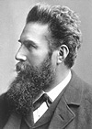
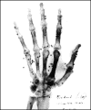
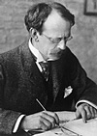
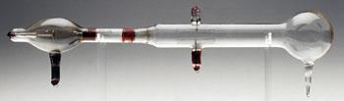
Discoveries of Electron
1895 Wilhelm Conrad Röntgen (1845 - 1923) discovered X rays, for which he received the first Nobel Prize for physics in 1901. The “hand” was taken in 1896 with cathode-ray discharge. He later demonstrated the metallurgical and medical use of X rays.
https://www.nobelprize.org/prizes/physics/1901/summary/
1897 Sir Joseph John Thomson (1856 - 1940) discovered and identified the electron, for which he received the Nobel Prize for physics in 1906. Thomson demonstrated that cathode rays were actually units of electrical current made up of negatively charged particles of subatomic size as an integral part of all matter and theorized the "plum pudding" model of atomic structure in which a quantity of negatively charged electrons was embedded in a sphere of positive electricity, the two charges neutralizing each other.
https://www.nobelprize.org/prizes/physics/1906/summary/

Slide 6
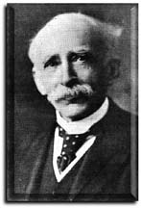
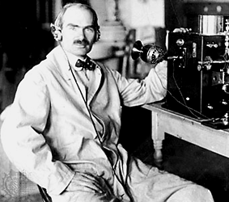
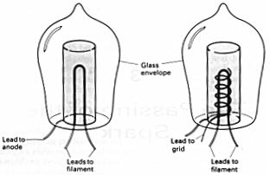

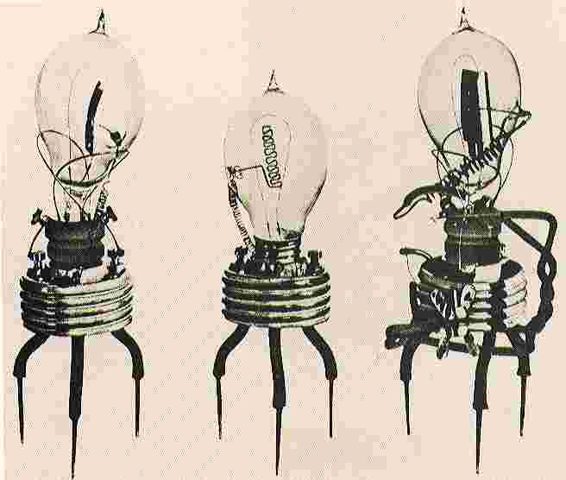
Innovations of Vacuum Electron Devices
1905 Sir John Ambrose Fleming (1849 - 1945) made
the first diode tube,
the Fleming valve.
The device had
three leads, two
for the heater and the
cathode and the other for the plate.
1907 Lee De Forest (1873 - 1961) added a grid electrode to
Flemings' valve and
created the triode tube,
later improved and
called the Audion.
He was a prolific inventor, and was
granted more than 300 patents in Electronics
https://madeupinbritain.uk/Vacuum_Tube
https://www.britannica.com/biography/Lee-de-Forest

Slide 7
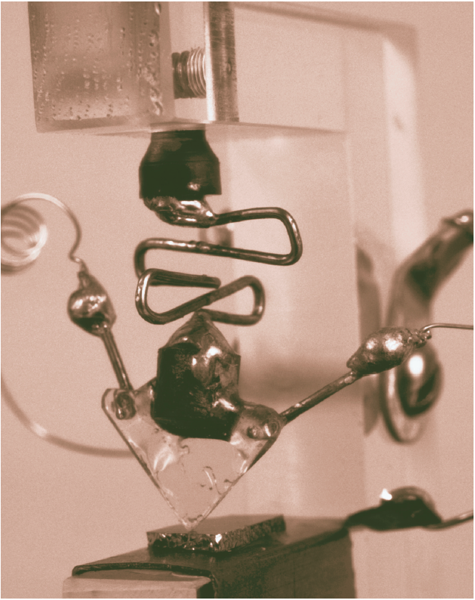
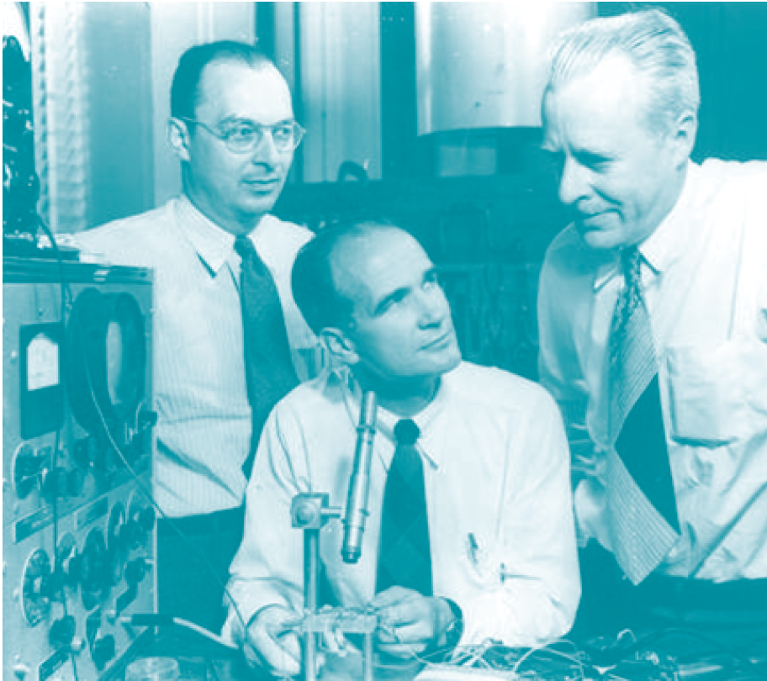
Revolution of Electronics –
From Vacuum Science to Solid State Physics
In 1948, John Bardeen (1908 - 1991), William Bradford Shockley (1910 - 1989), Walter Houser Brattain (1902 - 1987) invented the transistor for Bell labs, sharing the 1956 Nobel Physics prize for the invention.
Shockley’s insight of “minority carrier injection” became the bible of the new era
    [1] W. Shockley, “The Theory of P-N Junctions in Semiconductors and P-N Junction Transistors.” Nokia Bell Lab, July 1949
    [2] W. Shockley, “Electrons and Holes in Semiconductors: With Applications to Transistor Electronics”, Van Nostrand, Jan, 1050

Slide 8
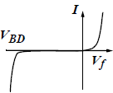
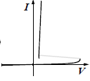
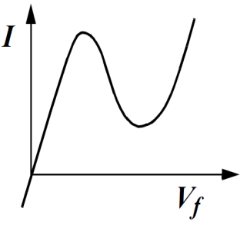
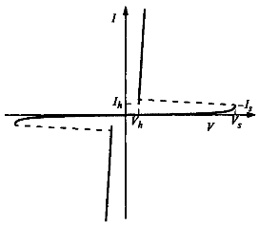
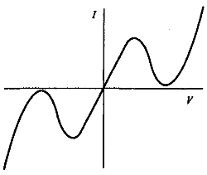
Thermionic emission (single-/dual-carrier) and beyond
Diode: two terminals and exhibiting a nonlinear I-V, IEEE Standard Dictionary of Electrical and Electronics Terms, 1980
§
§
§
Unidirectional
Asymmetric
Unipolar
L-Shape
S-Shape
N-Shape
¶
§
§
Bidirectional
Symmetric Ambipolar
§ : Kowk K. Ng, Complete guide to semiconductor devices, 2nd ed., 2002
¶ :https://www.digikey.com/en/articles/design-in-tvs-diode-protection-enhance-can-bus-reliability

Slide 9
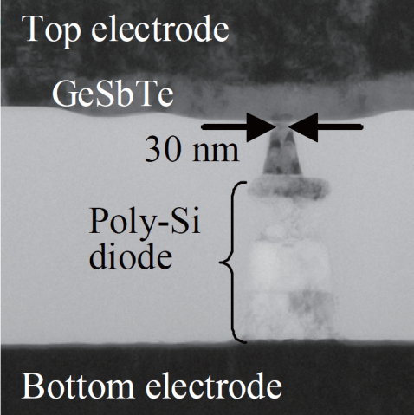
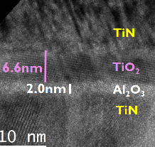
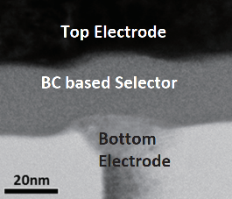
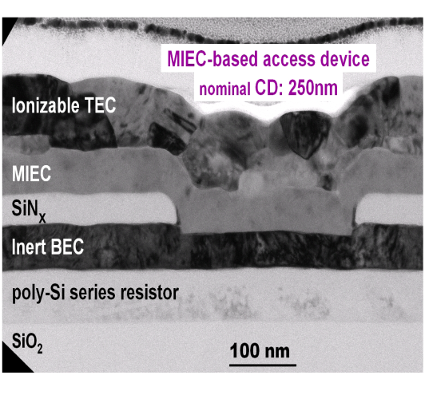
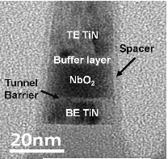
Thin Film Diode Candidates for Cross Point Memory
Y. Sasago, et. al.,
VLSI ’09. T2B-1
B. ﻿Govoreanu, et.al.,
IEDM’13. S10.2
S. Yasuda, et.al.,
VLSI, 2017. T2-4
OTS
K. Gopalakrishnan, et. al.,
VLSI ’10. TS19.41
S.G. Kim, et. al.,
IEDM ’15. S10.3
D. Kau, et. al.,
IEDM ’09. S27.1

Slide 10
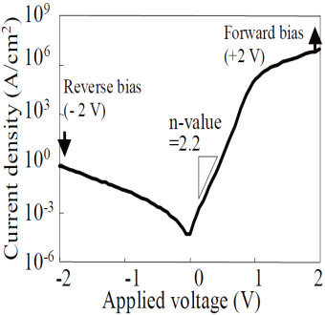
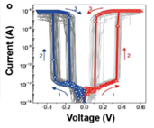
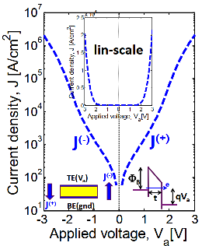
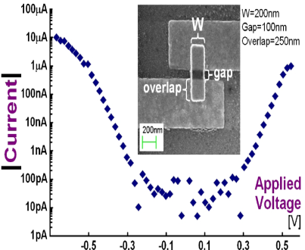
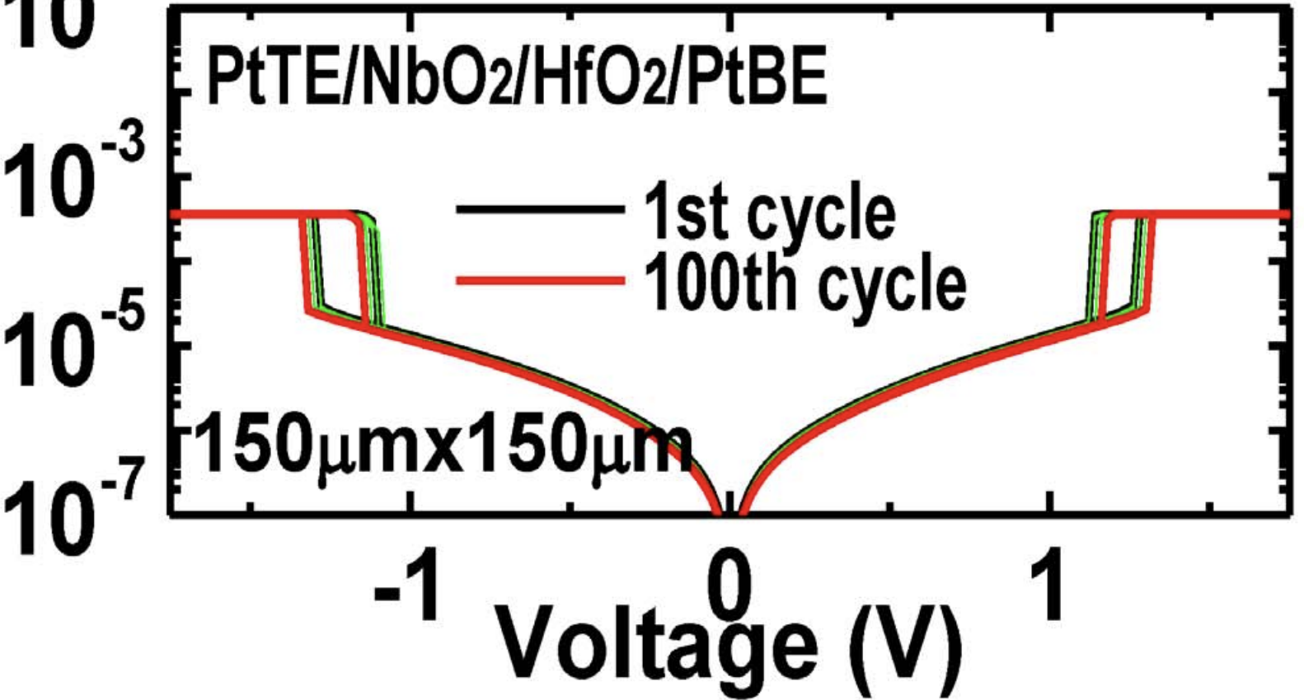
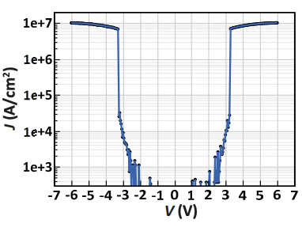
Threshold Switching Phenomenology & Mechanisms
Mechanism | Thermionic | Filamentation | Tunneling | MIEC | MIT | OTS
Construct. | P-N or M-S Jx | Ion (Ag⁺) in Ox | MIM | Cu⁺ in SE | NbO₂ | Chalcogenide
Switching | Electronic | Atomistic | Electronic | Atomistic | Atomistic | Electronic
Polarity | Unidirectional | Bidirectional | Bidirectional | Bidirectional | Bidirectional | Bidirectional
τ_{switch} | sub nsec | ns ~ 100s ns | ps or faster | ns ~ 100s ns | ns to 10s ns | sub ns
J_{MAX} | < 10MA/cm² | 1-10MA/cm² | < 1MA/cm² | ~10MA/cm² | > 10MA/cm² | > 10MA/cm²
J_{Inhibit} | <1A/cm² | <1KA/cm² | <1KA/cm² | <1KA/cm² | <1KA/cm² | <1KA/cm²
V_{Inhibit} | < 3V | < 1V | <3V | < 1V | < 3V | < 3V
I-V
Reference | Y. Sasago, et. al., VLSI ’09 | J. Yang, et.al., Adv Func Mtls (2018) | B. ﻿Govoreanu, et.al., IEDM’13. P10.2 | K. Gopalakrishnan, et.al., VLSI Symposium ’10. | X. Liu et.al., EDL Oct.’14 | S. Yasuda, et.al., VLSI symposium, ‘17,

Slide 11
klystron tube, a breakthru in vacuum electronics, revolutionized high-energy physics and microwave research – The dawn of wireless communications
Invention of Integrated Circuit –
Take The New Era to The Limit
Discovery of Electrons
1930s
1960s
1890s
1900s
1940s
1970s
Innovations of Vacuum Tubes –
Prelude of Electron devices
Invention of Transistor – Solid State Physics disrupts Vacuum Sciences
J.J. Ebers Award recognizes electron device engineering –
Explosion of Solid-State Components

Slide 12
EDS J.J. Ebers Award
“for outstanding technical contributions to electron devices”
1971 John L. Moll
1972 Charles W. Mueller
1973 Herbert Kroemer
1974 Andrew S. Grove
1975 Jacques I. Pankove
1976 Marion E. Hines
1977 Anthony E. Siegman
1978 Hung C. Lin
1979 James M. Early
1980 James D. Meindl
1981 Chih-Tang Sah
1982 Arthur G. Milnes
1983 Adolf Goetzberger
1984 Izuo Hayashi
1985 Walter F. Kosonocky
1986 Pallab K. Chatterjee
1987 Robert W. Dutton
1988 Al F. Tasch, Jr.
1989 Tak H. Ning
1990 Yoshiyuki Takeishi
1991 Simon M. Sze
1992 Louis C. Parrillo & Richard S. Payne
1993 Karl Hess
1994 Alfred U. Mac Rae
1995 Martin A. Green
1996 Tetsushi Sakai
1997 Marvin H. White
1998 B. Jayant Baliga
1999 James T. Clemens
2000 Bernard S. Meyerson
2001 Hiroshi Iwai
2002 Lester F. Eastman
2003 James D. Plummer
2004 Jerry G. Fossum
2005 Bijan Davari
2006 Ghavam G. Shahidi
2007 Stephen J. Pearton
2008 Mark R. Pinto
2009 Baruch Levush
2010 Mark E. Law
2011 Stuart Ross Wenham
2012 Yuan Taur
2013 Nobukazu Teranishi
2014 Joachim N. Burghartz
2015 Jack Yuan-Chen Sun
2016 Jaroslav Hynecek
2017 Kang L. Wang
2018 Michael Shur
2019 H.-S. Philip Wong
2020 Arokia Nathan
2021 Bruce Gnade
2022 Albert Wang

Slide 13
State of Art of Memory Technologies
A chat at Graduate School of Advanced Technology at National Taiwan University May/29/2023
System hierarchy and incumbent deployment
A holistic view of Memories: Cell, Array and Subsystem

Slide 14
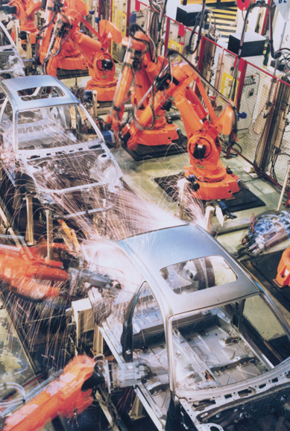



Every Day Data is EXPLODING
We are in a data-centric world
All data are stored, processed, and analyzed
50 PB
Public Safety
1 PB
Smart Factory
30 TB
Airplane Data
3 TB
Smart Hospital
>100 GB
Autonomous DRIVING
1.5 GB
Average
Internet User

Slide 15
Incumbent Technologies in Memory/Storage Hierarchy each of which has greater capacity than the preceding but which is less quickly accessible
“The Memory Organ – Ideally one would desire an indefinitely large memory capacity such that any particular … word would be immediately … available. … It does not seem possible physically to achieve such a capacity. …We are therefore forced to recognize the possibility of constructing a hierarchy of memories, each of which has greater capacity than the preceding but which is less quickly accessible.”
Preliminary Discussion of the Logical Design of an Electronic Computing Instrument
Arthur Burks, Herman Goldstine and John von Neumann, June/28/1946
SRAM
DRAM
HDD
SSD
Capacity, Latency
Bandwidth, Cost

Slide 16
A memory cell consists one storage element and one or more access switch(es)
Storage Elements:
  Latch: Circuit based or Thyristor device
  Electrostatic memory switch: Two terminal capacitor, floating gate/plate, charge traps devices
  Atomistic memory switch: Phase change, Magneto Tunnel Junction, Ferroelectric, Oxy-Vacancy (Filamentation)
Access Devices:
  3 terminal Transistor:
    Pass logic (1T) is typical used for read/write access.
    Gated common-source amp (2T) is used for read only access
    Biased Source-follower (1T) is used for read only access
  Two-terminal diodes: Thermionic (PN junction, Schottky barrier, DIAC & etc) , MIT, OTS MIEC, volatile filamentation and etc.
A₁
S
A₂
•••
•••
Brain teaser: multiple memory storage elements share one access device

Slide 17
Multi-ported SRAM Symmetry
1RW
2RW
B
W
B
B₁
W₁
B₁
W₁
U
V_{cc}
U
W₁
B₁
G₁
V_{ss}
G₁
B₁
B₂
G₂
D
D
G₂
B₂
U
U
D
U
G
B₂
W₂
B₂
W₂
W₂
G
D
D
G
G
U
D
R
2R1W
1R1W
WB
WW
WB
WB
WW
WB
RW₁
RW
RB₂
RW₂
RB₁
RB
U
U
U
U
D
U
D
D
G
RD
U
D
RD
G
D
D
G
G
RD
RG
RG
RD
RD
RG
RG
G
G
RG

Slide 18
Options “Multi-Port Memories” – Cell and Array
Used for multi-tasking
  “Simultaneously” read and write data or read-while-write
  Parallel Processing – increase bandwidth without cycle time compressing
  Dedicated Memory to keep track branch prediction and decision
  Shared Memory for multi-cores or networked processors
Multi-port SRAM is a commonly used for cache design
  For CISC CPUs, Multi-Port cell such as mRnW configuration is used
  For RISC CPUs, Single-Port cell such as 1RW with multi-bank configuration is used.

Slide 19
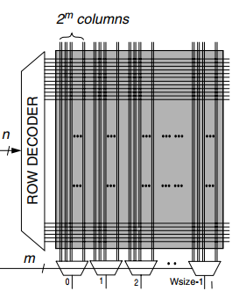

Array Capacity: $n$·$m\text{·}w$ bits with 1RW, 1R1W, 2R2W cells
Read D
Read C
m
0
1
2
W_{size}-1
m
0
1
2
W_{size}-1
12T cell
n·m·w b Bank
6T cell
1RW
8T cell
1R1W
16T cell
2R2W
Read
m
0
1
2
W_{size}-1
n
n
ROW DECODER – WWL-B
ROW DECODER – RWL-D
Bruce Jacob et.al, Memory System, p.265
8T cell
n·m·w b Bank
n
n
ROW DECODER – WWL-A
ROW DECODER – RWL-C
n
n
ROW DECODER - WWL
ROW DECODER - RWL
m
m
0
1
2
W_{size}-1
m
0
1
2
W_{size}-1
0
1
2
W_{size}-1
Write A
Read/Write
Write
Write B

Slide 20
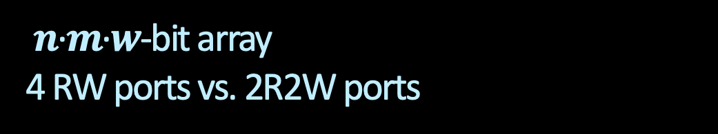
$n$·$m$·$w$-bit array
4 RW ports vs. 2R2W ports
Read D
Read C
m
0
1
2
W_{size}-1
m
0
1
2
W_{size}-1
12T cell
n·m·w b Bank
6T cell
1 RW port
1Bank
6T cell
4 RW ports
4 banks
16T cell
2R2W ports
1Bank
6T Cell
¼·n·m·w b Bank
n
n
n/2
ROW DECODER – WWL-B
ROW DECODER – RWL-D
Bruce Jacob et.al, Memory System, p.265
ROW DEC
n
n
ROW DECODER – WWL-A
ROW DECODER – RWL-C
m/2
0
1
2
W_{size}-1
0
1
2
W_{size}-1
Read/Write
Bank Logic: 4ports Cmd/Add + I/O
m
m
0
1
2
W_{size}-1
0
1
2
W_{size}-1
Read/Write
0
1
2
W_{size}-1
0
1
2
W_{size}-1
Write A
Write B

Slide 21
Pair memory technology research with
compute architecture/hierarchy research
A holistic system innovation and design is co-optimized
between
the choices of devices (cells) and circuit (array) architecture

Slide 22
Memories in next decade
A chat at Graduate School of Advanced Technology at National Taiwan University May/29/2023
Cache, Memories and Storage
Near Memory and Storage Class Memory

Slide 23






Gaps to fill between Caches, Main Memory & Storage beyond scaling
“It’s the Memory, Stupid!
… Processor Speed Has Outstripped Memory … today’s chips are largely able to execute code faster than we can feed them with instructions and data. There are no longer performance bottlenecks in the floating- point ... The real design action is in memory subsystems—caches, buses, bandwidth, and latency…I expect that over the coming decade memory subsystem design will be the only important design issue for microprocessors.”
Architects Look to Processors of Future,
Microprocessor Report, V10, No. 10, Aug/5/1996
Dick Sites, Digital Equipment Corp

Slide 24
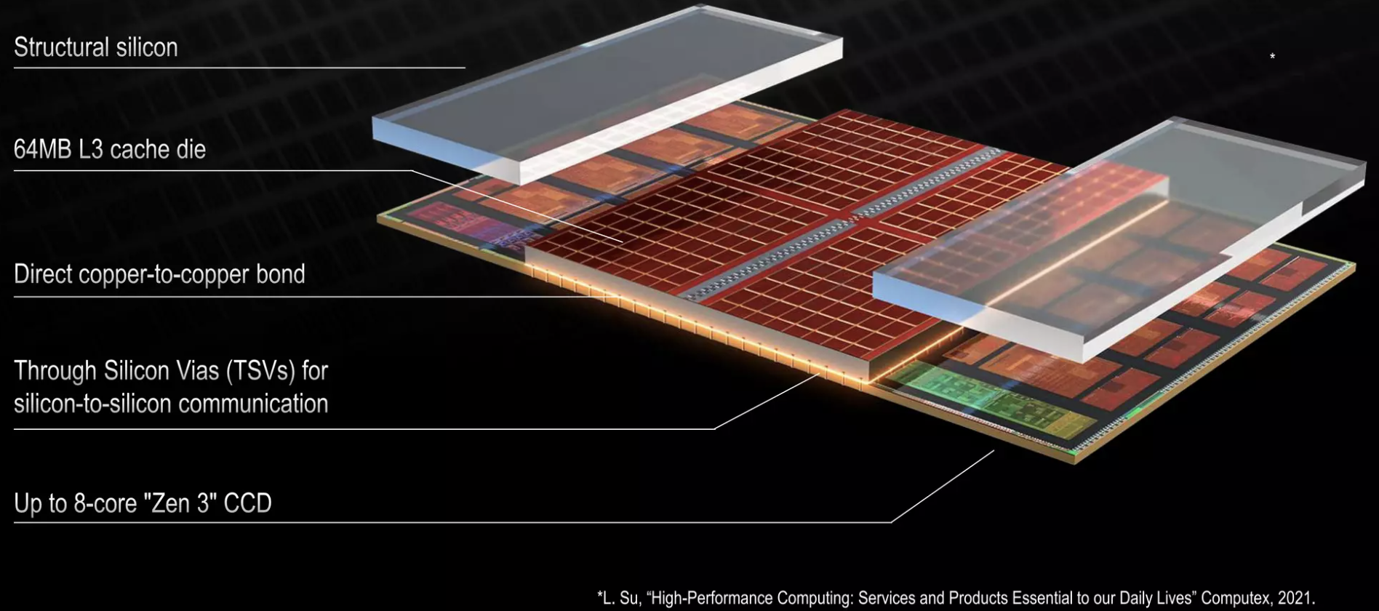
Cache Memory in next decade
Scaling trajectory of mainstream logic technology yet optimized for SRAM
IP folding to increase Cache capacity : Core
  Enabling technology: TSV, back-side metallization, reconstructed wafer, wafer-wafer (hybrid) bonding,
Key Challenges: Power and Thermal

Slide 25
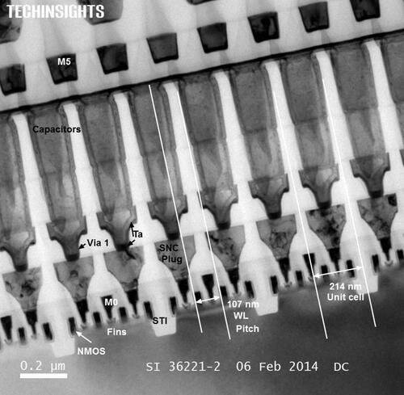
Emerging Memories for In Package Memory candidates
1T- 1X Array Architecture
Intel Gen 1 eDRAM [1T1C]
BL
SL
BL
SL
WL
WL
Y decoder
WL
Write Driver and Sense Amp
X –decoder and Multiplexer
Output driver and I/O
Access Transistor
Si channel planar / nonplanar XTOR
TFT channel planar / nonplanar XTOR
2T [independent read write] Option
High-k Capacitor
MRAM [STT/SOT]
Ferro-capacitor
Nano-structure change
Memory Element
Key Challenge: BW, Granularity

Slide 26
Compute Memory Disaggregation
Channel_{i}
Host
Memory Farm
Channel₀
Bank₀
Bank_{m-2}
….
Bank_{j}
…
…
Channel_{n-1}
RAS
SWD
Bank₁
Bank_{m-1}
….
Memory Mat
Logic
Logic
C/A
CSL
Mat
SA
CAS
Access Device
Decoder / Driver
Page
Si channel planar / nonplanar XTOR
TFT channel planar / nonplanar XTOR
2T [independent read write] Option
DQ + Metadata
High-k Capacitor
MRAM [STT/SOT]
Ferro-capacitor
Nanostructure change
Logic and Mix Signal
Memory Element
Memory Specific
SA / Data Latch
Mix Signal

Slide 27
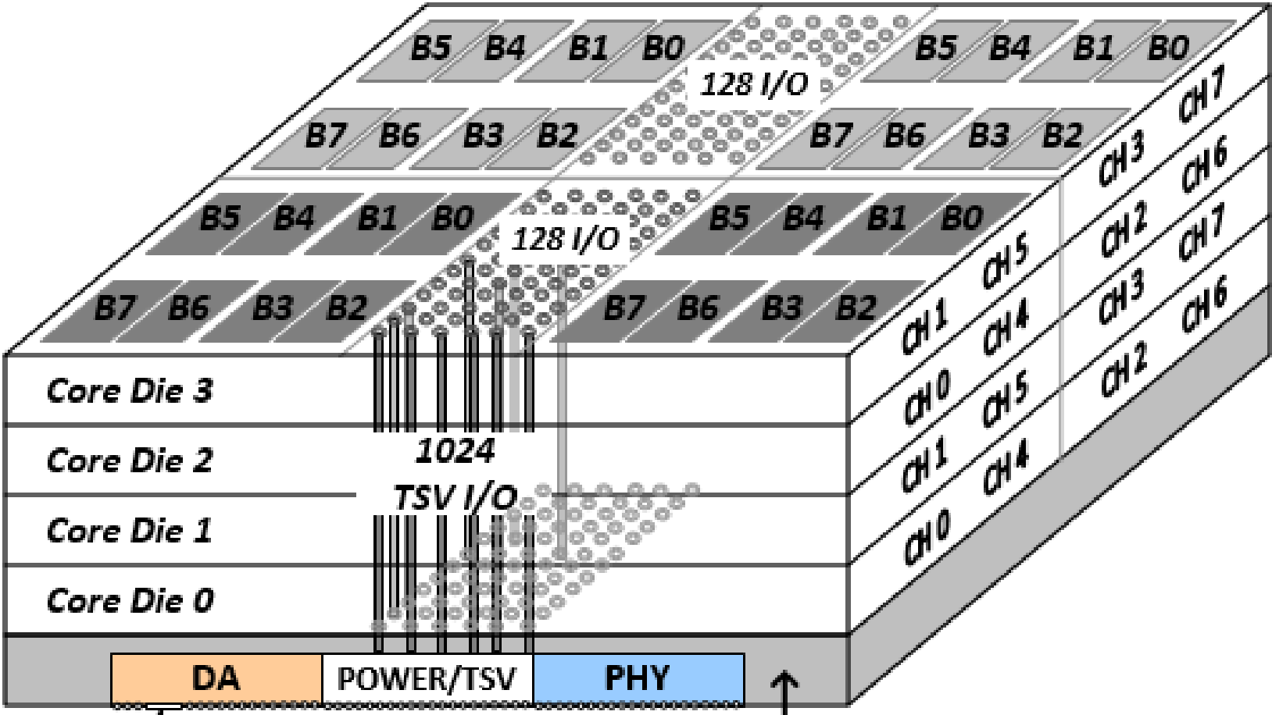
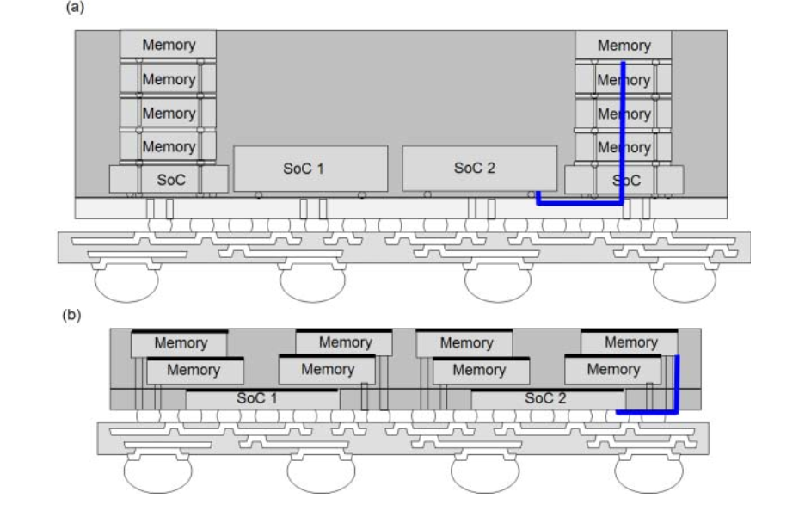
Chiplet stacking to improve packing density, Power and Bandwidth
M. O’connor, et.al., ACM/MICRO 2017
Bank
Bank
Bank
Bank
Fine-Grained DRAM Arch:
  Partition Bank into narrower pseudo-banks
  32 Dedicatedm Local 2 GB/s Channel
  Local, parallel I/O per bank at lower energy
Bank
Bank
HBM2 Channels:
  Shared 16 GB/s Channel
  16 banks per channel
  BW of idle banks is “wasted”
Quad-Bandwidth HBM Channels:
  Four 16 GB/s Channels
  Shared inter-bank bus
  High datapath & array act. energy
Bank
Bank
Bank
Bank
Bank
Bank
HBM, H Jun, et.al., IMW’2017
A. Su, et.al., ECTC2019

Slide 28
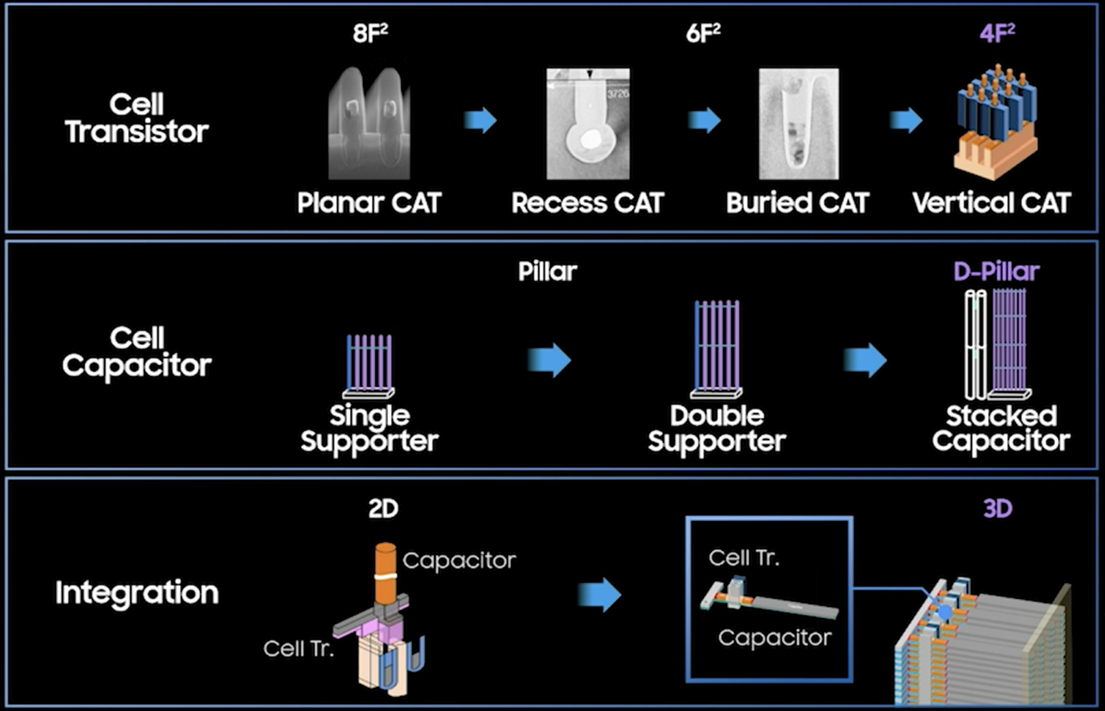
DRAM’s Journey beyond Trench Capacitor
Kinam Kim, IEDM’21, Plenary Session 1.1

Slide 29
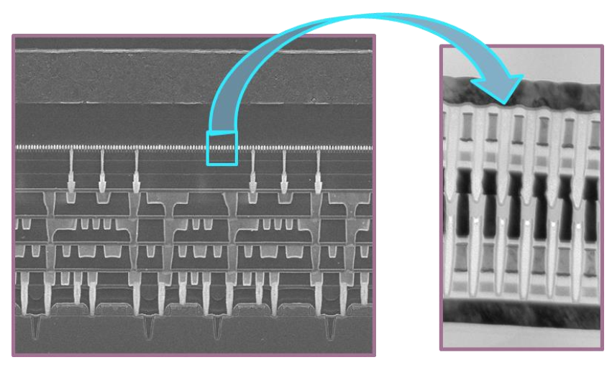
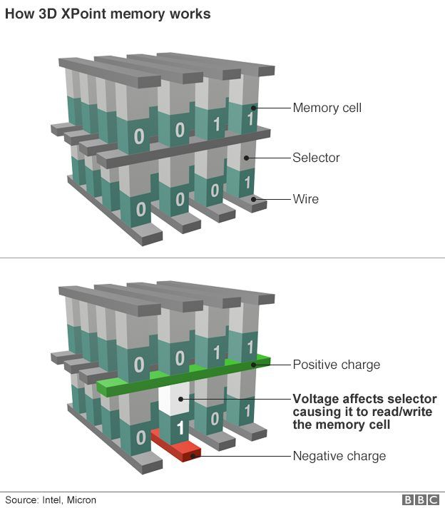
Emerging Memories for Persistent Memory in 3D Cross Point Architectures
Intel Gen 1 3D XPoint™
Access Diode
Thermionic
[diode, MIEC, ..]
Volatile filament
Metal-Insulator Transition
Ovonic Threshold
Magnetic
[MRAM, STT(SOT)MRAM]
Resistance Change ReRAM[1D, 2D], PCM [3D]
Ferroelectrics
Memory Element
Key Challenge: Matching Memory & Selector
INTEL CONFIDENTIAL

Slide 30
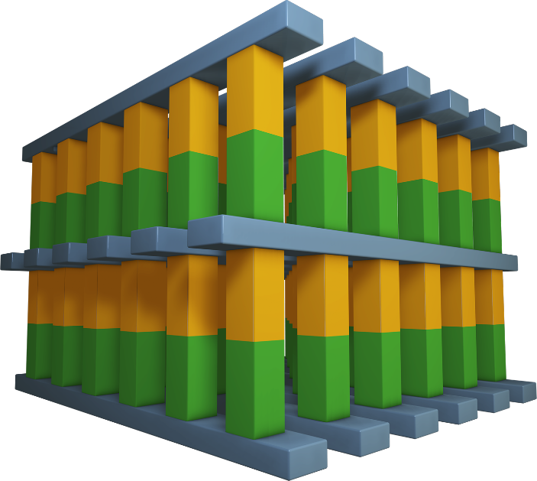
Consideration of architecting a cross point memory technology
Desirable Attributes: Nonvolatile, Low Cost, High Performance
Simple scalable, 3D stackable construction; low D·T, BEOL compatible with mainstream IC manufacturing
Memory switching in atomistic state (bulk); superior scalability than electrostatic memory switching physics
Individual cell access, small granularity
Fast switching materials + local low resistance metal interconnect
Challenge: to “mate” selector and memory in achieving a non-linear I-V for array access
Potential Memory Options:
  Spin polarization
  Phase change/segregation
  Ferroelectric hysteresis
  Interfacial barrier modulation
  Oxygen vacancy relocation
  Ionic transport
  NRAM (?)
Potential Selector Options:
  Unidirectional
  Homo/Heterogenous P/N Jx
  Schottky Barrier
  Bidirectional
  Mixed ionic-electronic conduction
  Tunneling barrier
  Metal–insulator transitions
  Ovonic threshold switching
Wordlines
Bitlines
Selector & Memory Devices
Wordlines

Slide 31
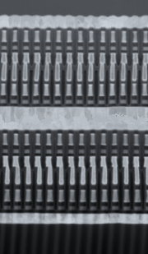
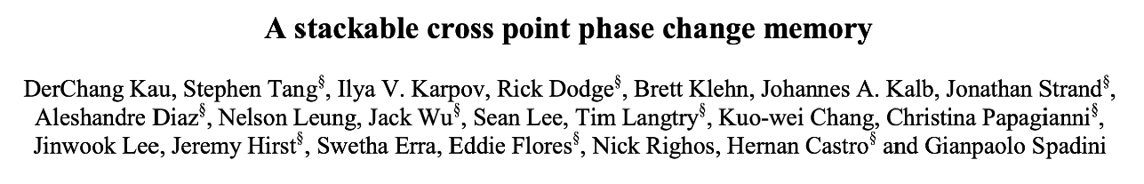
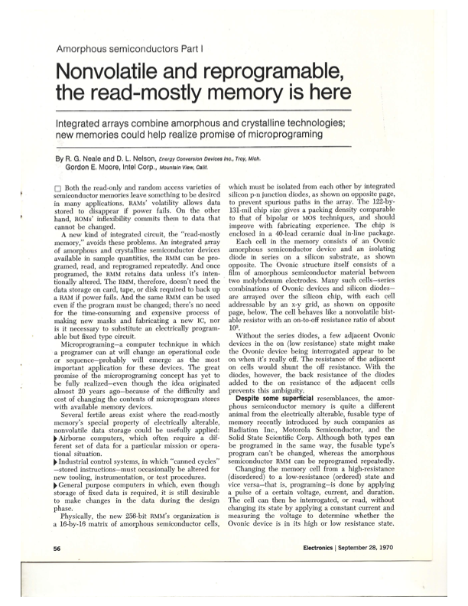
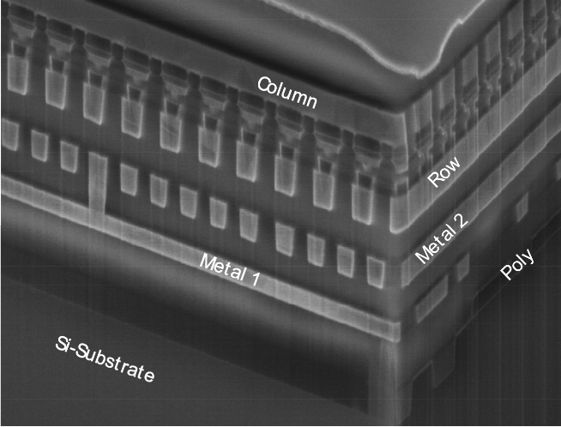
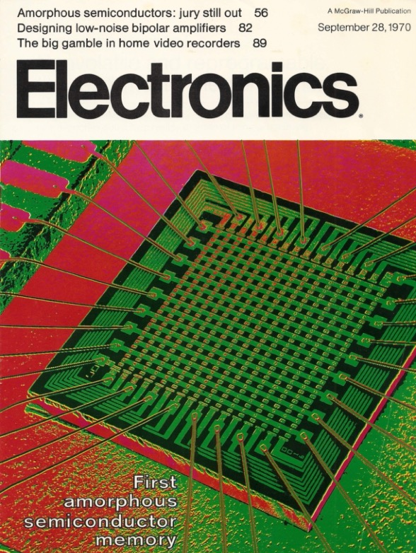
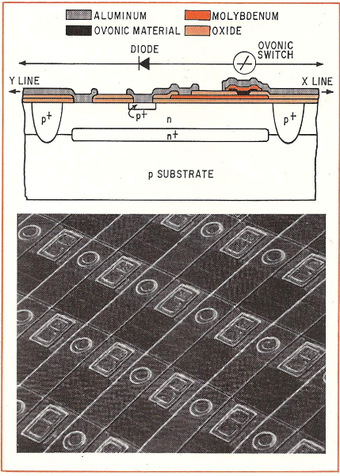
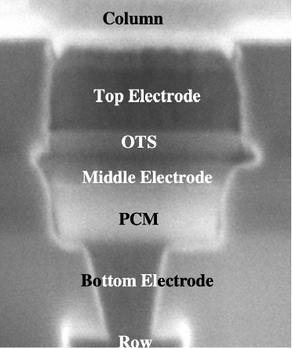
In Pursuit of a Dream …
September 28
1970
August 13
2020
December 8
2009
A Half Century Endeavor
Conclusion
D. Kau, VLSI-TSA 2021

Slide 32
Long gestation of Disruptive Memory Technologies
2nd Production Generation
PoC: Cell and Array
Research Graduation
64Mb
180nm ½ Pitch
6-Mask
Sublitho Heater
Damascene “M”,
Subtractive “S”
64Mb
50nm ½ Pitch,
2-Mask
One Deck,
Self Aligned
Subtractive Cell
256Gb
41nm Pitch
Quad Deck
Self Aligned
Subtractive Cell
Ideation
2007
2012
2015
1970
2003
2010
2013
2019
4Kb
200nm feature,
4-mask
Sublitho Heater
Damascene “M “
Subtractive “S”
128Gb
41nm Pitch
Dual Deck
Self Aligned Subtractive Cell
64Mb
100nm feature
2-Mask
Self-Aligned,
Subtractive Cell
Scaled
Line/Space
3rd Production Generation
PoC: Process Architecture
1st Production Generation
PoC: Electron Devices

Slide 33
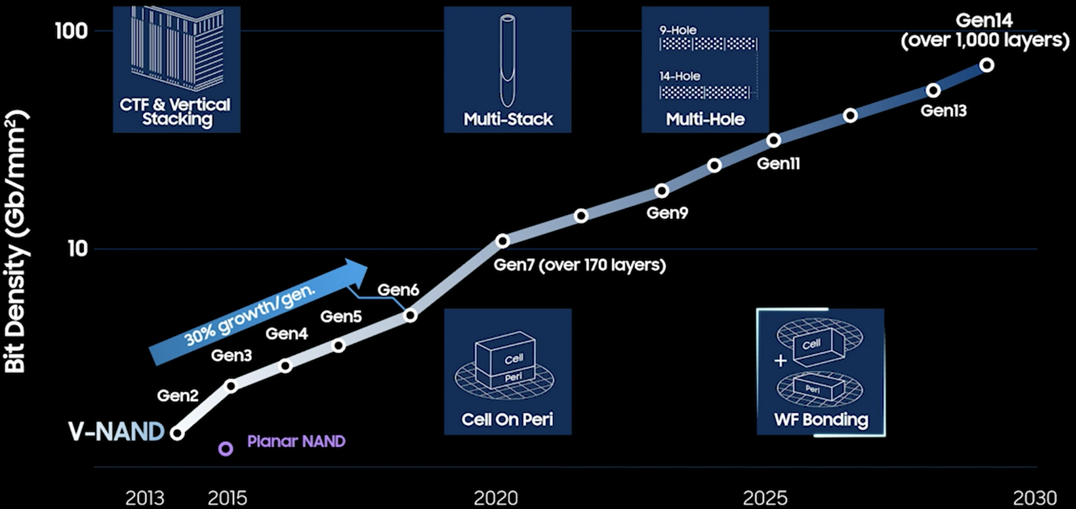
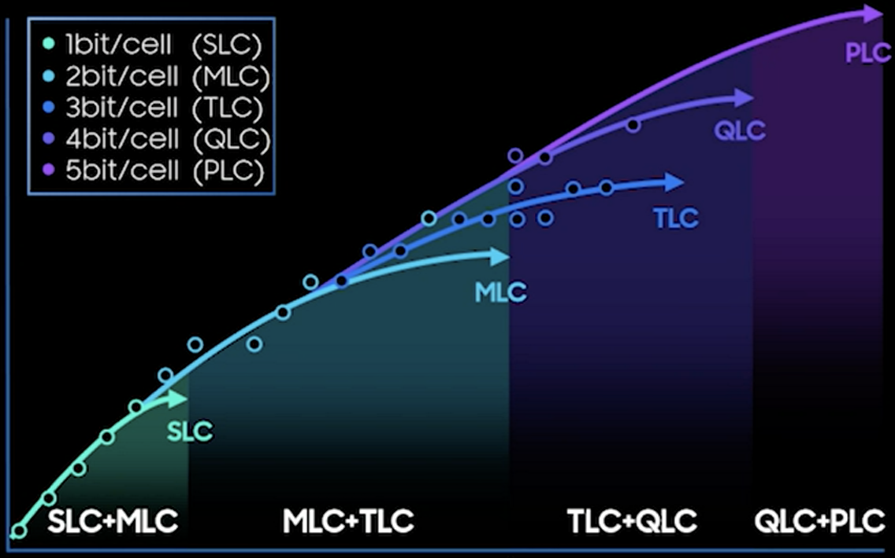
3D NAND in next decade will continue to drive $/bit on par with HDD
Kinam Kim, IEDM’21, Plenary Session 1.1
Tiering/Decking engineering + multi-level placement algorithm

Slide 34
Takeaway of Advances of Memory Technologies
Universal memory
  Universal memory often sought, but hierarchy always existed and likely always will be
  FoM must be benchmarked with respect to the corresponding hierarchy of memories
Disrupt memory technology
  ﻿Typical long gestation of Disruptive Memory Technologies
  Mainstream memories hard to establish; hard to displace or to replace;
  DRAM replaced Core memory in 1960’s and SSD displacing spin drive in 2000’s
  Memory technology research to productization can take decades and once productized, achieving mainstream is still not guaranteed
Memory Subsystem
  Modular, Modular, Modular
  Power/Thermal conscious: Energy of moving bits back and forth becoming limiting
  3DIC (monolithic, wafer-wafer) and packaging of multi-chip
    TTM and Cost driven
  Pair memory tech research with compute architecture/hierarchy research.
  Software (often ignored ) enabling to alleviate adoption barriers or to unlock value

