Slide 1
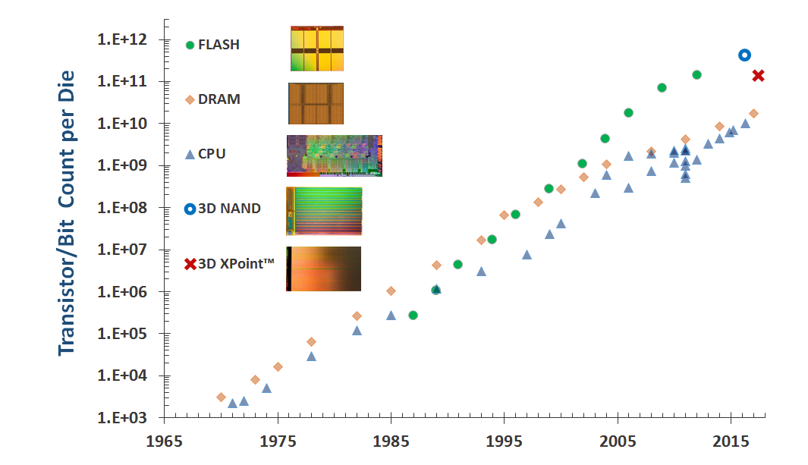
Moore’s Law: Non-Volatile Memories Leading the Way to 3D

Slide 2
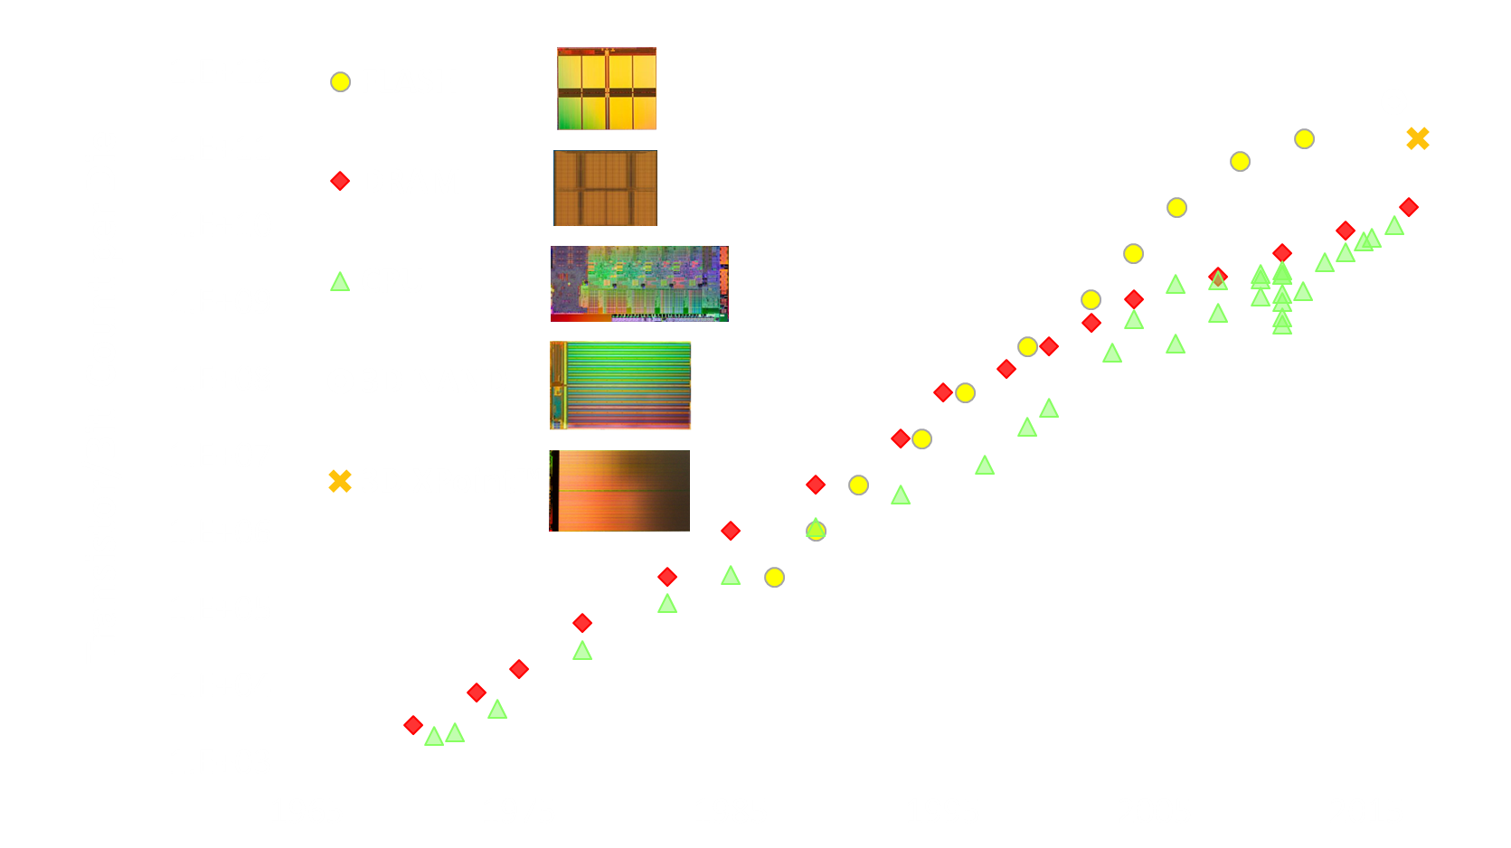
Moore’s Law: Non-Volatile Memories Leading the Way to 3D

