Slide 1
Q4
Exec Sync
Passdown
Slides
October 11, 2022

Slide 2
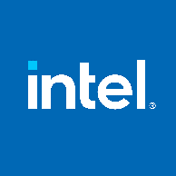

We are at a Strategic Inflection Point
IDM 2.0
We are here
IDM 1.0
Notes:
This is a momentous time for us that will define the trajectory of Intel for decades to come. A time where we all must rise to the challenge to ensure Intel’s long-term competitiveness.
Andy Grove said: “A strategic inflection point is that which causes you to make a fundamental change in business strategy. Nothing less is sufficient.” (Andy Grove 1998 speech: https://www.intel.com/pressroom/archive/speeches/ag080998.htm)
The alternative is falling further behind. We either commit to this path that will set Intel up for great success for decades to come, or we risk letting our company fall into mediocrity.
That’s what our IDM 2.0 strategy is designed for – putting us on the right path to regain our unquestioned process leadership and deliver leadership products in every category, with manufacturing at scale across a geographically diversified footprint.
That strategy remains the same and we should think of it in phases. In the first phase of our IDM 2.0 transformation, we made significant progress on our process roadmaps and capacity. We remain on track to deliver five process nodes in four years, and we’ve invested in the capacity required to meet the industry’s demand for semiconductors, bringing much-needed balance to the global supply chain.
IDM 2.0 is well underway and building momentum. But there are two fundamental barriers to achieving our goals that must be addressed now as we take the next step on this path.

Slide 3
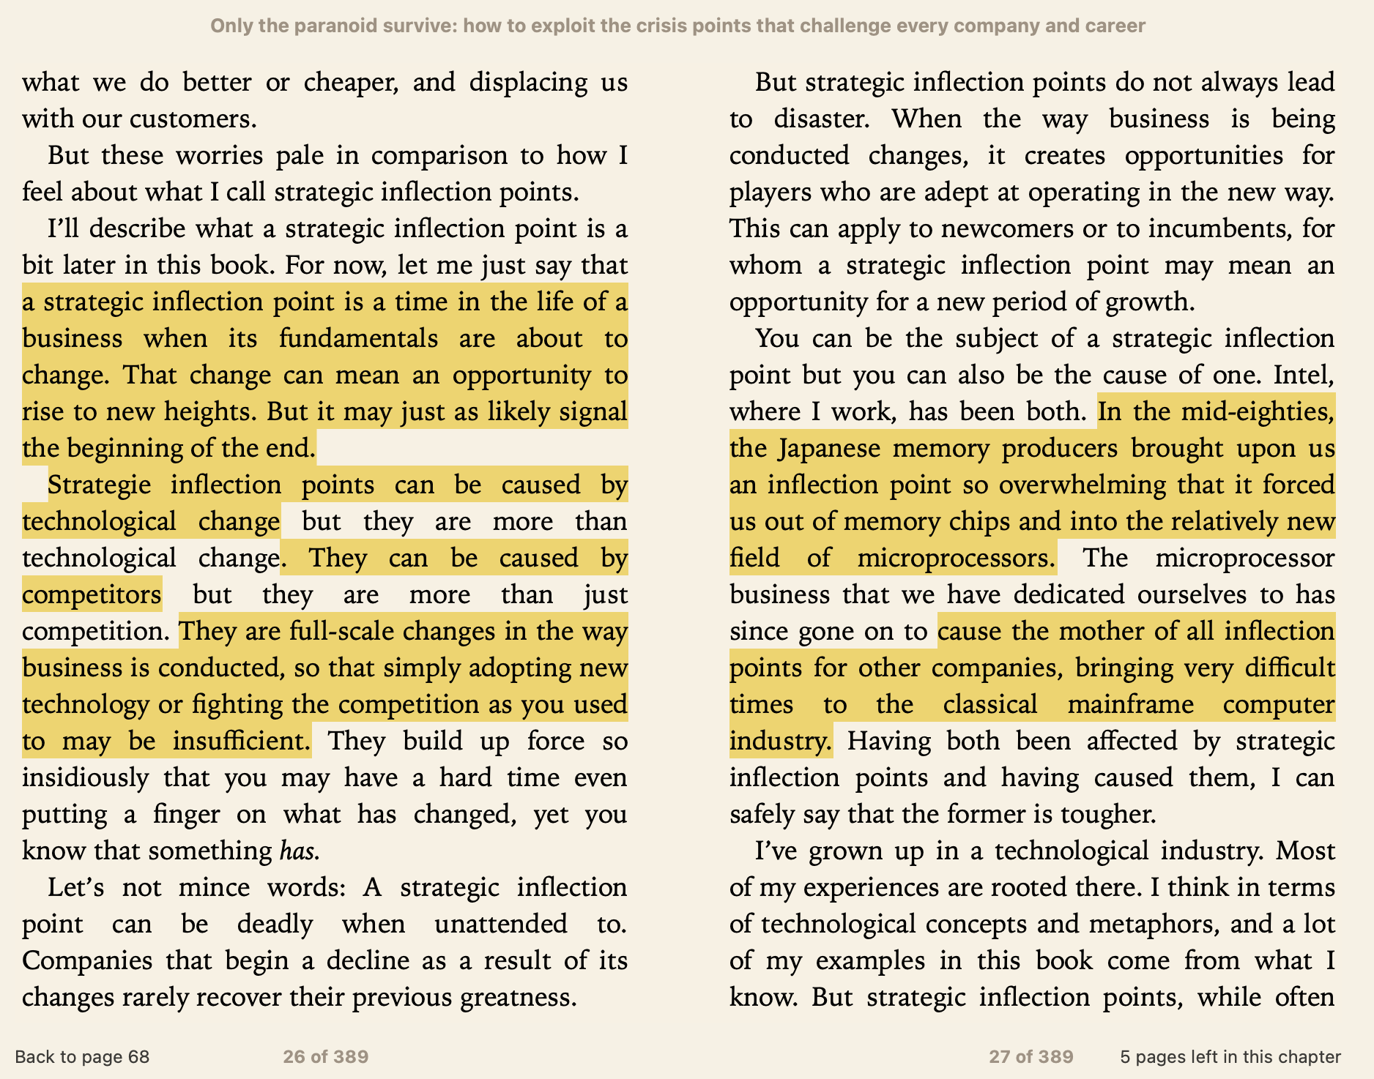

Slide 4
Margins Too Low, Costs Too High
Fabless and Foundry Peers Are Outpacing Us
Intel $73b
TSMC $70b
Nvidia $30b
TSMC $22b
AMD + TSMC “Synthetic IDM” Gross Margin is >20pts higher than Intel....
...while comp spends significantly less in relative SG&A and R&D
Gross Margin (%)
Consensus 2022
80%
= Intel
= TSMC
= AMD
= NVIDIA
AMD Synthetic IDM
18,000M
16,000M
14,000M
12,000M
10,000M
8,000M
6,000M
4,000M
2,000M
0
60%
AMD
Intel
40%
20%
Intel SG&A
Comp SG&A Combined
Intel R&D
Comp R&D Combined
0%
10%
5%
24%
11%
’15 ’16 ’17 ‘18 ’19 ’20 ‘21 ’22F ’23F ’24F ‘25F
Percentage of Revenue
Bain study, August 2022
Company estimates based on publicly available information
https://www.intc.com/news-events/press-releases/detail/1563/intel-reports-second-quarter-2022-financial-results
Notes:
Two barriers for achieving our goals: our margins are too low, and our costs are too high.
We must execute better, faster and more efficiently. We must meet our commitment to deliver a predictable cadence of leadership products, hitting our innovation milestones, consistently and repeatedly.
And, we must ground ourselves in the realities of the macro and industry environment we operate in. We must improve our cost structure to remain competitive and win in the marketplace. We must achieve faster growth and better margins to support our investments and sustain that performance. And we must spend significantly less to bring our costs down in line with comp.
The same systems and infrastructure of IDM 1.0 model will not enable us to achieve the full potential of IDM 2.0. We must begin to fundamentally shift how we think and operate.

Slide 5
IDM 2.0 Execution Excellence
Design and
Development
People
Results-Driven
Disciplined Approach
Performance Management
Disciplined Execution (OKRs)
Catalyze (Fearless Innovation, Results-Driven)
Tick-tock model
Gladius
Verification Culture
North Star, Polaris, Ursa Major
Culture of Execution Excellence
Operations
IDM 2.0 Transformation
New Systems, Tools and Processes
Internal Foundry Model
Notes:
To advance our IDM 2.0 strategy and set ourselves up for growth, we must deliver a predictable cadence of leadership products and a competitive cost structure.
This means driving execution excellence across everything we do, including more accountability, transparency and efficiency across our operations, our people and the way we design and develop hardware, software and services for customers and partners. This is how we will transform. This is how we will achieve IDM 2.0.
Operations:
The next phase of our IDM 2.0 journey requires a fundamental shift in mindset. We must embrace an internal foundry model, not only for our external customer commitments but also for our Intel product lines.
Implementing an internal foundry model means establishing consistent processes, systems and guardrails between our business unit, design and manufacturing teams. This will allow us to identify and address structural inefficiencies that exist in our current model by driving accountability and costs back to decision-makers in real time.
We will also create a foundry accounting model that encompasses manufacturing, technology development, and Intel Foundry Services to further enhance transparency and accountability across all areas of the company.
To operationalize this effectively, we have stood up an “IDM 2.0 Acceleration Office” that will be responsible for developing and implementing the systems and processes across the organization. Stuart Pann is taking on a dual role as ‘Chief Business Transformation Officer’ in addition to continuing to lead the Corporate Planning Group in SMG.
Design & Development:
We’re reforming our approach across the design and development cycle to optimize and accelerate processes, improve reliability, predictability and quality every step of the way.
We are reviving the “tick-tock” execution model, which is key to driving synchronized, repeatable and predictable process and product innovation cadence aligned to market windows, helping us meet our commitment to an annual, on-time rollout of our key technologies.
This complements some of the efforts already underway such as Gladius and North Star, Polaris and Ursa Major, which are delivering early successes in accelerating execution of our innovation roadmaps and improving quality. The tick-tock model governs cadence, supported by disciplined execution programs to achieve quality metrics.
People:
We’ve strengthened our teams, bringing in some of the best talent in the industry. We’ve also already made significant strides to reinstitute a results-driven culture and transparency across the company, from implementing OKRs to rewards to doubling down on our values and key behaviors like we went over in Catalyze. Looking ahead, we will continue to build on these efforts by reinvigorating performance management.
Across all these areas are measures we must continue to take as leaders to focus our resources on top priorities and reduce our spending.

Slide 6
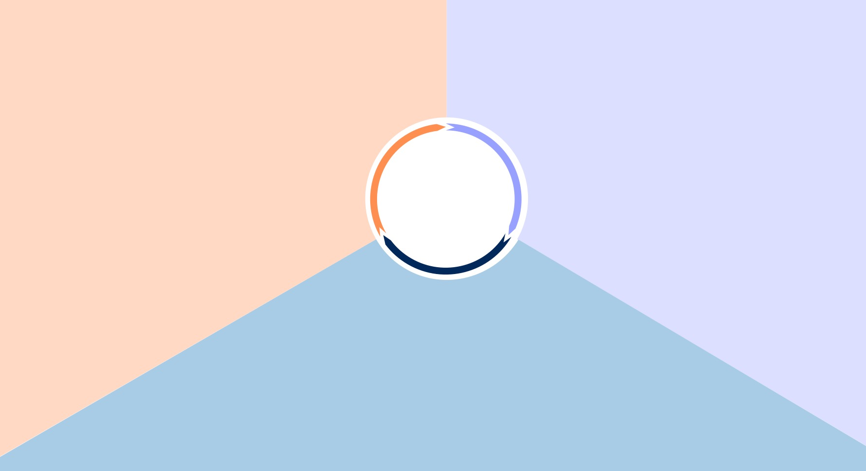
People: Drive belief, commitment and vision alignment for the journey.
Design and Development: Be decisive, direct, transparent, efficient and assume accountability.
CALL
TO ACTION
Operations: Be frugal, put the customer first and do what is right.

Slide 7
Operations
Dave Zinsner, EVP and CFO

Slide 8
What we hope to achieve….
Key considerations as we begin…
Added transparency that exposes the economics of the business
Driving costs back to the decisions as they are made
Positioning groups to focus on what they are good at
Creating the right motivations to ultimately drive better financial performance
Our desire to rapidly transform the operating model of the company
The need to make it real
Upholding One Intel value and navigating external optics
Dealing with spending implications
Notes:
Standing up the IDM 2.0 Acceleration Office to shift how we operate is one part of our overall Execution Excellence.
This enables us to expose the true economics of our business, drive costs back to decisions, enable you to focus, and ultimately drive better financial performance.
We cannot do this in a vacuum and must navigate the challenges of rapid change, converting from model to reality with all of us as leaders rowing in the same direction, remaining One Intel through the natural tension this can create, and like all of you, dealing with our current spending implications.

Slide 9
Unprecedented Macroeconomic Landscape…
GDP Markdowns
Inflation consistently under-called
US Dollar Strength
IHS Real GDP Forecast Stagger
Y/Y% Growth Forecast for 2022
By Month of Data Release
IHS CPI Forecast Stagger (LCU-Based)
Y/Y% Growth Forecast for 2022
By Month of Data Release
IHS Euro Forecast Stagger
USD Per Euro Forecast for 2022
By Month of Data Release
Real GDP growth expected to continue slowing in 2023
Inflationary pressures persist; expect some easing 2024
Forecasts indicate continued strengthening of the dollar in 2023
IHS Real GDP Forecast Y/Y% Growth
Forecast Date: Sep-2022
IHS CPI Forecast (LCU-Based), Y/Y% Growth
Forecast Date: Sep-2022
IHS USD Per Euro Forecast
Forecast Date: Sep-2022
…has led to swift 2022 Revenue and EPS decline and updates to forecast.
Notes:
We started the year targeting $78B revenue, $3.50 EPS and gross margin of 52%.
What changed? Historic highs on inflation, increasing interest rates, Russia Ukraine war, lockdowns in China. These are all impacting TAM growth. We’re monitoring closely and can anticipate it taking time to expect economy to be better.
BUT, as we all know, our house is also not in order…. We have our own execution issues. We are not simply victims of the challenging environment.

Slide 10
Gross Margin Gap Requires New Ways of Working
AMD + TSMC “Synthetic IDM” Gross Margin is >20pts higher than Intel....
...while comp spends significantly less in relative SG&A and R&D
Gross Margin (%)
Consensus 2022
80%
= Intel
= TSMC
= AMD
= NVIDIA
AMD Synthetic IDM
18,000M
16,000M
14,000M
12,000M
10,000M
8,000M
6,000M
4,000M
2,000M
0
60%
AMD
Intel
40%
20%
Intel SG&A
Comp SG&A Combined
Intel R&D
Comp R&D Combined
0%
10%
5%
24%
11%
’15 ’16 ’17 ‘18 ’19 ’20 ‘21 ’22F ’23F ’24F ‘25F
Percentage of Revenue
Bain study, August 2022
Company estimates based on publicly available information
Notes:
There’s a definitive call to action for Intel if we want to move forward. We are making changes in our business today to generate long-term success.
We have substantial gross margin gaps that require new ways of working to close. These areas being:
We have massive opportunity for efficiencies and cost gains. This can and will be improved by the new model. The upside is high for our business model if we can deliver on it.

Slide 11
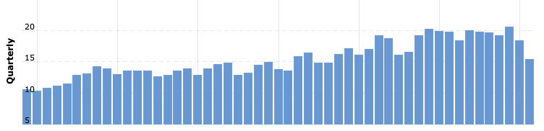
Revenue

Slide 12
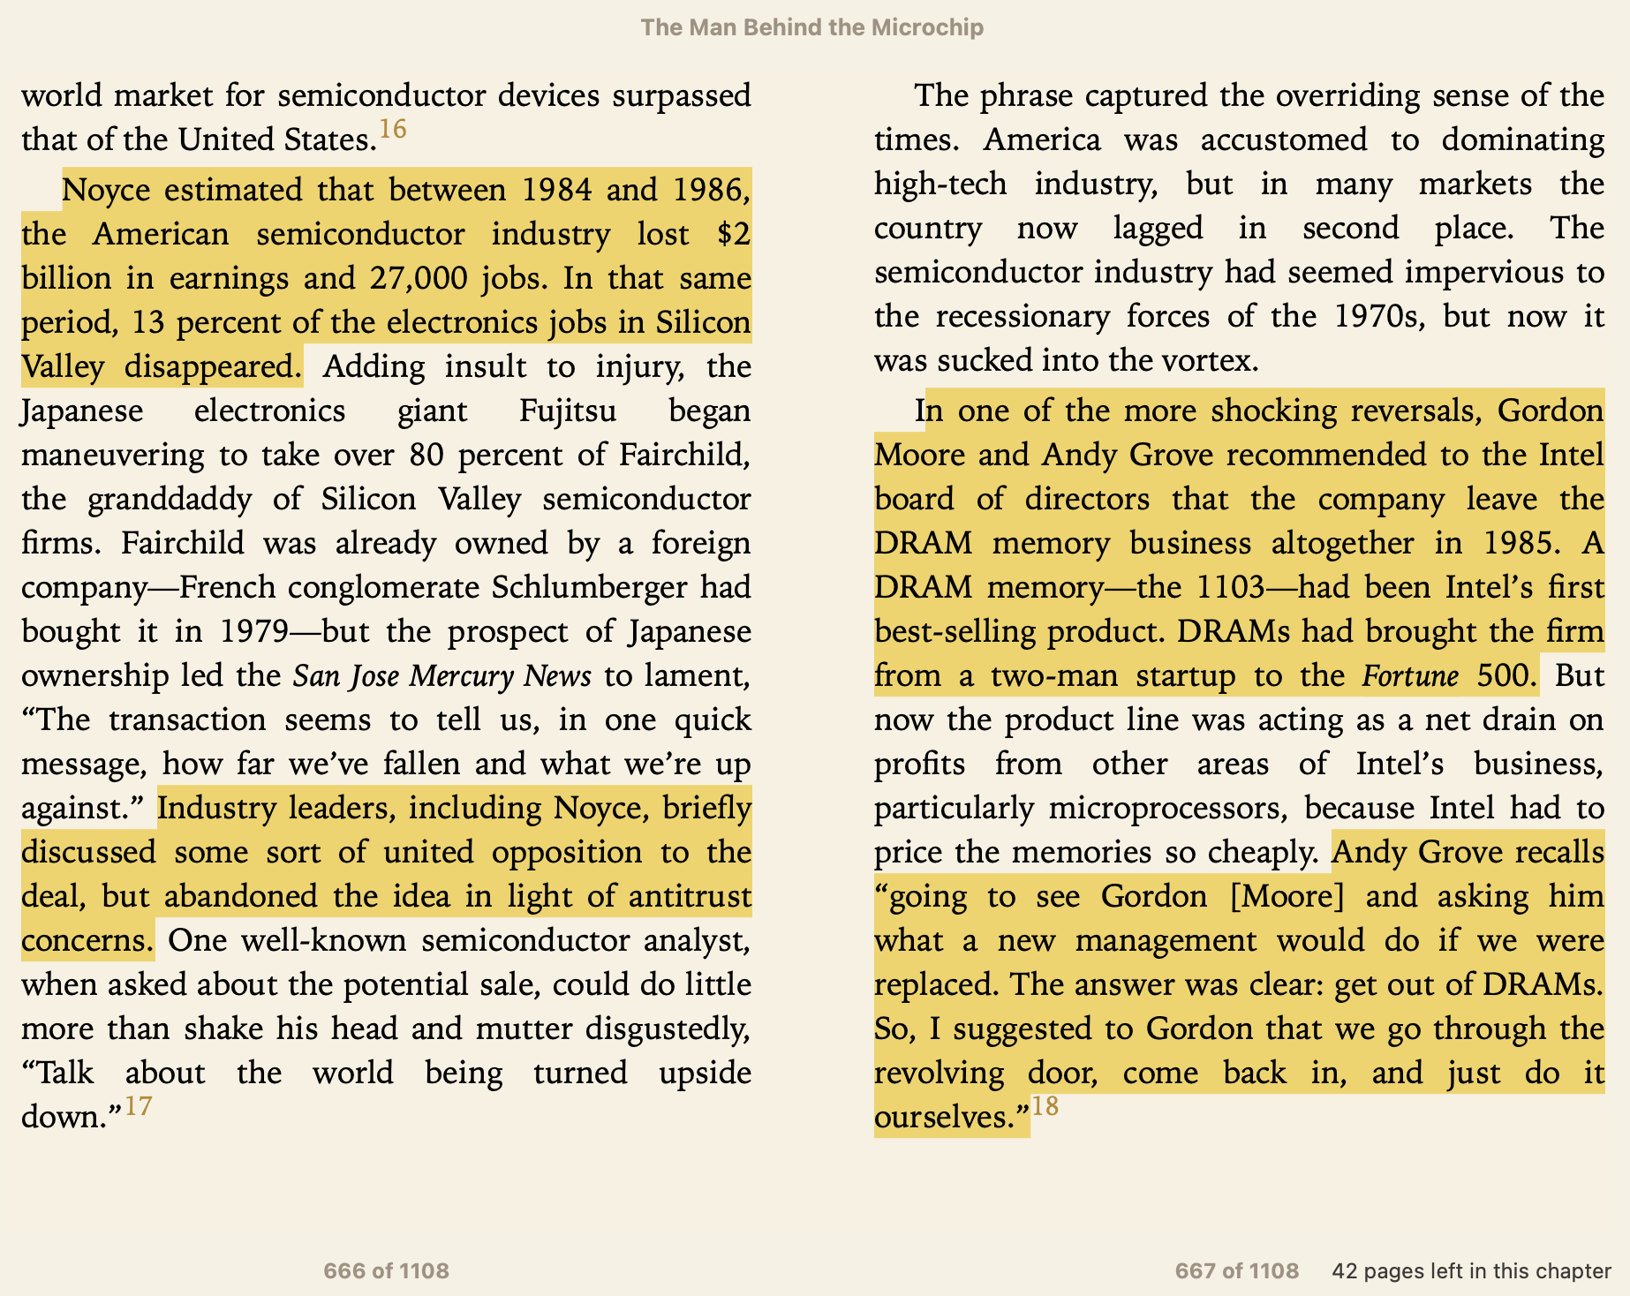

Slide 13
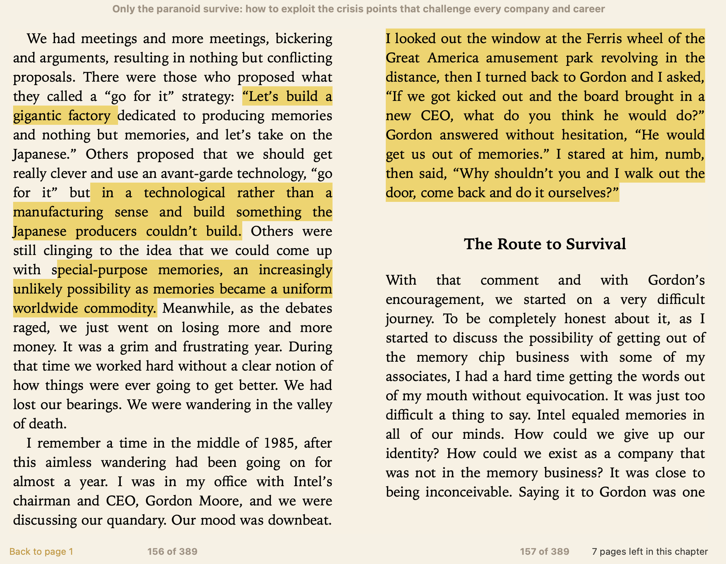

Slide 14
IAO
The next phase IDM 2.0 journey requires a fundamental shift
  Embrace an internal foundry model, ==> external customer commitments & Intel product lines.
  Identify and address manufacturing structural inefficiencies by driving accountability & costs
  Put product groups on a similar footing as external IFS customers and vice versa.
Create a foundry accounting model that encompasses manufacturing, technology development and Intel Foundry Services.
  Business unit and design teams able to assess the potential impact to margins due to stepping,
  Manufacturing team will be able to assess actual costs and impact on factory output.
  the tools and transparency.
IDM 2.0 Acceleration Office led by Stuart Pann, in addition to his CPG responsibility
  Chief Business Transformation Officer, reporting to CFO and joining the ELT
  IDM 2.0 Acceleration Office will work in close collaboration with all Bus, manufacturing and IFS to bring this new internal foundry model to life.

Slide 15
Internal Foundry Model (Future)
This interface will be modeled after a 3rd party foundry relationship
Mobileye
IDM Fab
DCAI
TSMC wafers
OSAT costs
other 3rd party costs
Wafers, packaged products and services charged at market pricing
Package
CCG
A/T, Die Prep
NEX
TD
AXG
Technical / Feature Requirements
Product Design / Eng
Sales to 3rd Parties
IFS
Volume Order from BUs
Software
Tower
Sales and Marketing | Strategy | Finance | Legal | HR | IT
Notes:
This is how we accelerate and achieve IDM 2.0. Key to advancing our IDM 2.0 strategy is aggressively investing to build-out capacity and enable our ambitious goal of delivering five nodes in four years. But we must also maintain a competitive cost structure and flexibility to further invest in our growth.
Establishing a leadership cost structure. We have massive opportunity for operational efficiencies and cost gains. This new model will help us identify and address the structural and inherent cost inefficiencies from IDM 1.0 model, ultimately improving our cost competitiveness across products and unlocking additional savings over time.
This is a phased implementation. We’re trialing some interface projects to see how things work. It’s a balancing act of making these changes while successfully running the company in a difficult environment.
Take action now. Don’t wait for these changes to be in place. They are simply enabling the conditions and system. We all should begin shifting our behaviors and how we operate today.
What’s next? We have a small working team on this now. With the Oct. 11 announcement, Stu kicked off building out the team to mobilize across the company. This is actively evolving so we will continue to keep the company updated.

Slide 16
Design and Development
Shlomit Weiss, SVP and
co-GM, Design Engineering Group

Slide 17
TICK-TOCK
Roadmap Cadence
NORTH
STAR
GLADIUS
Cadence trumps features
Managed risk
Built-in resiliency
Process Health Indicators
Executable
Product Lifecycles
PDK milestones
Industry standard
Transparent
Disciplined governance
Sustainable development
Accelerated software integration
Transparent
Long-range planning
Notes:
We are in the early stage of our IDM 2.0 strategy – a multi-year journey to transform the company and set ourselves up for growth.
Success requires execution excellence across everything we do.
This means delivering process and design innovation on a predictable, dependable cadence, without exception.
We are evolving our “tick-tock” execution model to synchronize process and design innovation on the predictable and dependable cadence expected by our customers.
Together, tick-tock, North Star and Gladius instill a culture of verification on both quality and cadence to deliver process and product innovation aligned to our customers’ market windows.
The tick-tock model and North Star and Gladius programs are interdependent and complementary to one another.
The tick-tock model governs cadence; Gladius and North Star provide the disciplined execution programs to achieve quality metrics.

Slide 18


Tick-Tock Top Principles
A corporate synchronized, repeatable, process/product cadence framework aligned with the marketing window
Leadership
Achieved by a yearly
cadence of our main technologies
Predictability
Increased by de-stacking risks between process and product complexity
Resiliency
Built-in upfront
Process technology & IP Performance
No single product “Quantum Leaps/Big Bangs”
Process and
new arch product
Predictable Cadence of our Main Technologies
Notes:
The goal of Tick-Tock Model is to establish a long term Corporate synchronized, repeatable process / product cadence that is aligned with the needed marketing windows.
Leadership – achieved by predictable yearly cadence of our main technologies: process and performance IPs.
Predictability – achieved by de-stacking risks between process, architecture, complexity of change.
Resiliency built up front with some trigger points to make sure there is a product even in the event of problems / complexity that was not expected.

Slide 19
What We Need to be Successful
Tick-tock sets the pace for our major moving parts
Delivers predictable, on-time cadence of leadership products
Targets and actions taken to improve our design and process development cycles
  All execution teams and BUs collaborate
  Make on-time decisions
  We all own making it happen – requires “One Intel” behavior
  After quality, cadence trumps all
  Verification mindset
  “Commit” is “Commit”
Will Win Together
Notes:
We are confident we have a good strategy and the directions and actions are the right ones that will make Intel lead again. We need to to work in all fronts as One Intel to make these happen.

Slide 20
People
Christy Pambianchi, EVP and Chief People Officer

