Slide 1
CPG Introduction
Derchang Kau – Intel Fellow, CPG/GEMS

Slide 2
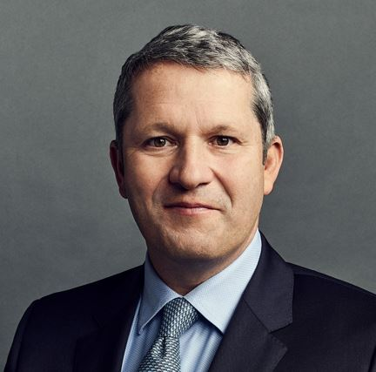
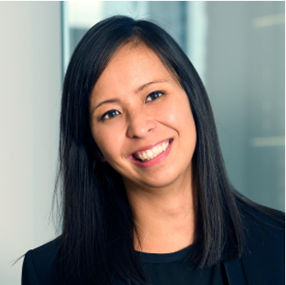

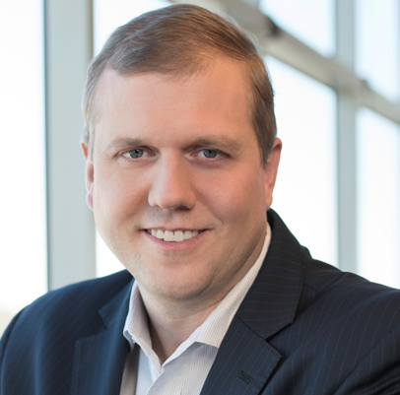
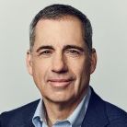
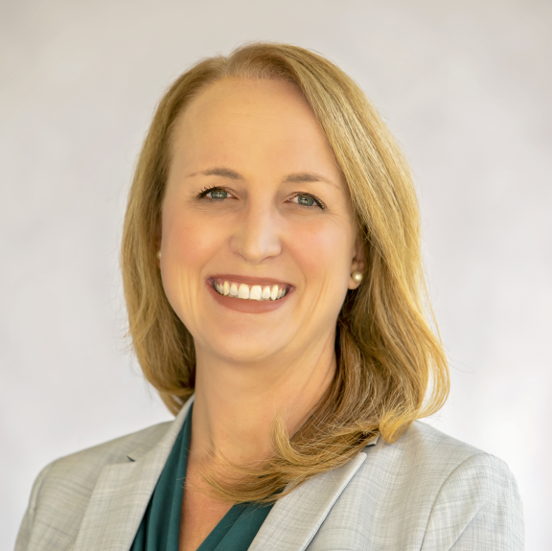
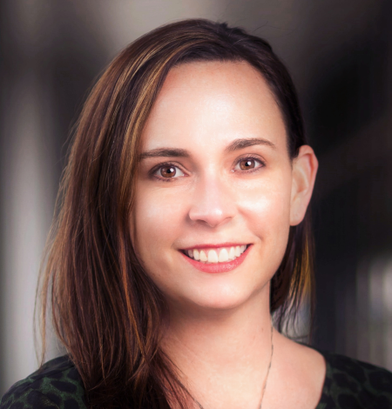
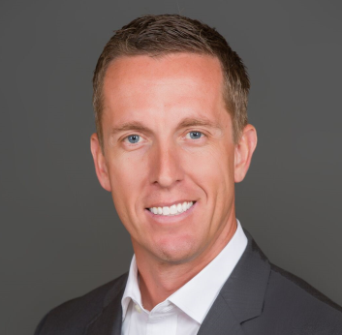
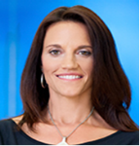
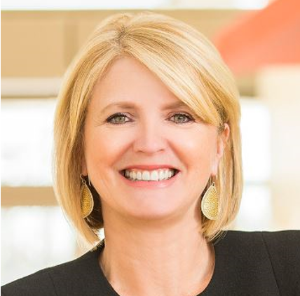
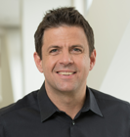
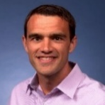
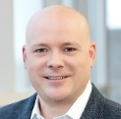
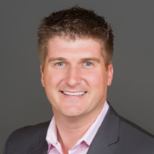
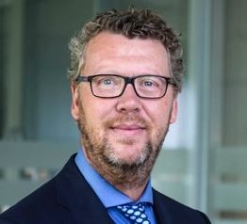
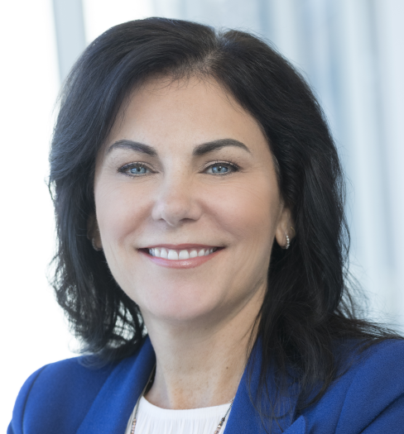
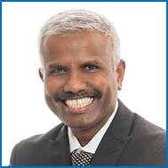
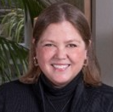
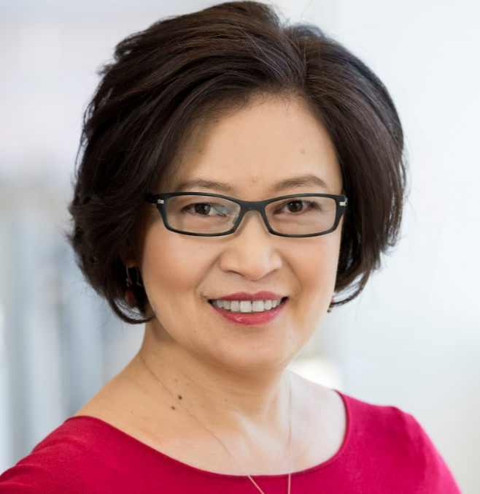
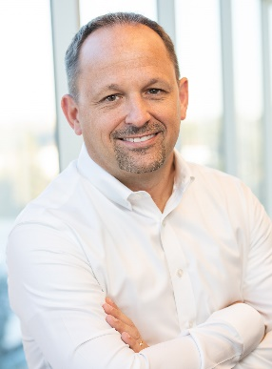
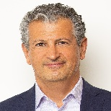

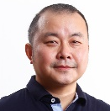
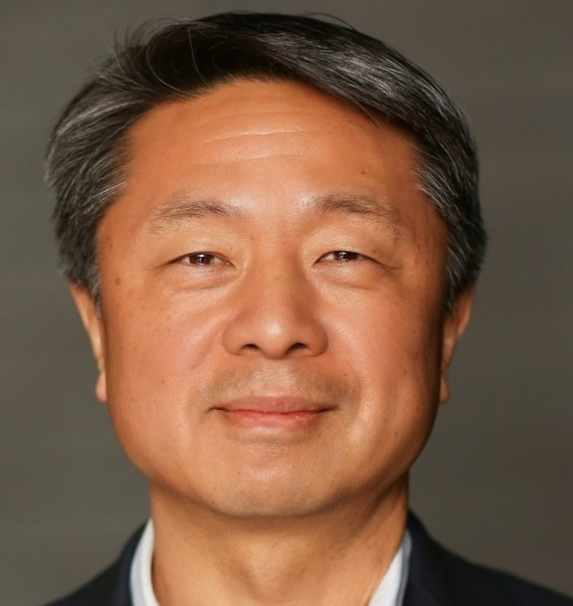
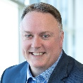
SMG Org Chart
Christoph Schell
EVP & Chief Commercial Officer Sales and Marketing Group
The Sales, Marketing, and Communications team exists to deliver a world class experience to our global, diverse, ever-expanding customers and their customers to maximize their economic value and enable the IDM 2.0 strategy.
Anna Torres
Chief of Staff
SMG Analytics & Operations
Tina Knudsen
Executive Assistant
SMG Lead Admin
Global Accounts
Region & Country Sales
Category & Planning
SMG Functions
Americas
CCG Category Sales
Global Comms
Tara Smith
Greg Ernst
Government
Caitlin Anderson
Education
Corporate Planning
Group
Stu Pann
DCAI Category Sales
Marketing, Events & Brand
Karen Walker
Ryan McCurdy
APJ
Rose Schooler
Sustainability , Security
Dell, HPI, Lenovo,
Amazon, MSFT, Google,
Qualcomm
Steve Long
Digital Manufacturing
Global Partners & Customer Support
John Kalvin
NEX Category Sales
EMEA
Brad Haczynski
Telco, Energy, Project Mgmt
Customer & Sales Excellence
Rebecca Brown
Software Category Sales
Frans Scheper
Olympics, Automotive
4P BMG
Trevor Vickers
AXG Category Sales
Nash Palaniswamy (Acting)
Finance
Emily De Grijs
Intel China
Rui Wang
Software Sales
TBH
FSI
People Team
Claudia Gilles
Planning Capabilities
Jason Grebe
Taher Behbehani
PRC
IFS Sales
Alan Wang
Legal
Chad Chambers
Hong Hao
Intel Confidential – Organizational changes are pending legal review, and/or Workers Councils’ consultation/approval where applicable.

Slide 3
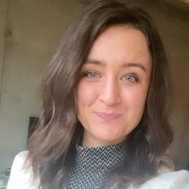

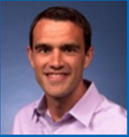
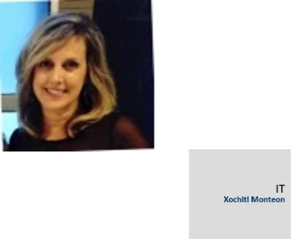


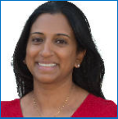
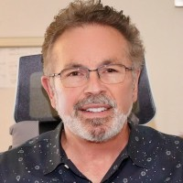
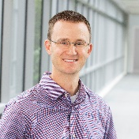
Corporate Planning
Group (CPG)
Rachel Brandt
Chief of Staff
Cassie Raimond
Executive Administrator
Stu Pann
SVP, Corporate Planning Group
Extended Staff/Partners
Trevor Vickers
VP, Business Management Group
Jason Grebe
CVP, Corporate Planning Capabilities
Julia Mendoza
HR
Melissa Boge
Legal
Dr. Hai Wang
CVP, Global External Manufacturing & Sourcing
Divya Kumar
VP, Corporate Supply Planning Operations
Jerry Bautista
Intel Roadmap, Operations
& Communications
Tyler Tatman
Finance
All CPG Nominees are from Hai Wang’s GEMS Organization

Slide 4
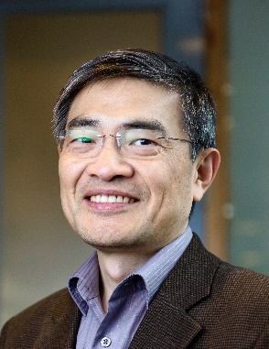
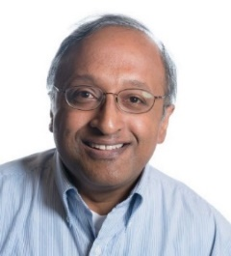
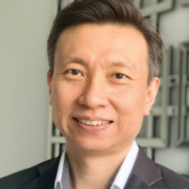
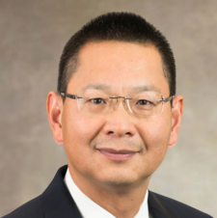
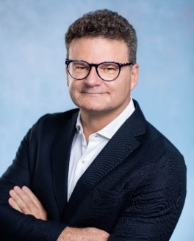
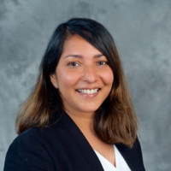
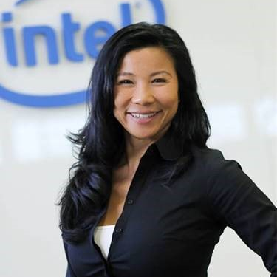
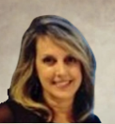
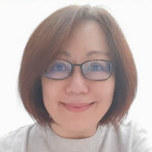
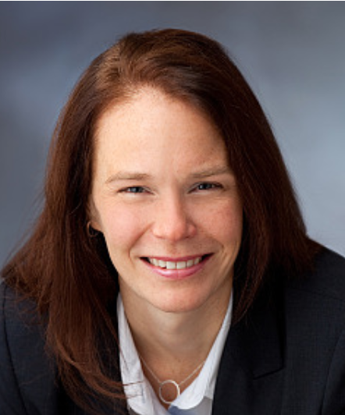
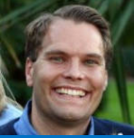

Global External Manufacturing
and Sourcing (GEMS)
Dr. Hai Wang
CVP Global External
Manufacturing & Sourcing
Drive, leverage, and manage external technology, engineering and manufacturing solutions to enable Intel to consistently achieve product leadership, capacity flexibility and revenue aspirations
Venky Sampath
Director
External Manufacturing Strategy and Planning (EMSP)
Ethan Sim
Senior Director
External Manufacturing Sourcing (EMS)
Dr. Changhong Dai
Vice President
Foundry Technology & Engineering (FTE)
Dr. Angelo Pinto
Vice President
External Manufacturing Production (EMP)
Sumitra Sukumaran
Chief of Staff /TA
Joy T. Lee
Executive Admin
Extended Staff/Partners
Julia Mendoza
HR
Pearl Choon Lan Wee
Legal
Kristina Holm
Legal
Markus Andersen
Finance
Jerry Bautista
Roadmap Operations and Communications

Slide 5
Expect to see CPG/GEMS nominations……….
Driven by GEMS charter to enable Intel product leadership leveraging the best external technologies have to offer
  Build word-class manufacturing interface connecting Intel Product to foundries, OSATs and EDA suppliers
  Acquire best-in-class expertise world-wide semiconductor communities.
GEMS assimilate technical leadership to encompass full scope of product life cycle.
  Wide range of job types across GEMS organization
  Strategic platform planning and competitive analytics
  Tech-Design Pathfinding., Produce Development, Post-Si Engineering
  HVM and supply chains expertise
As new and growing organization, you will see candidates who have joined us < 1 yr coming from external companies

Slide 6
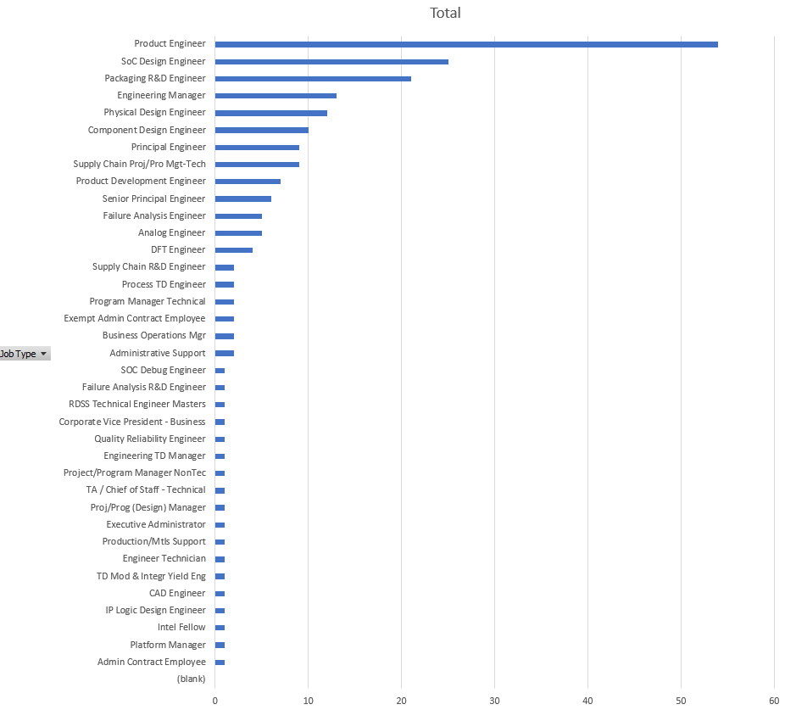
Job Types Across GEMS organization
Mostly composed of Pathfinding, Development, Post-Si Engineering, and Supply chain expertise

