Slide 1
2022 Reward Decision Making
WW03’ 22
GAR Reward Core Team

Slide 2
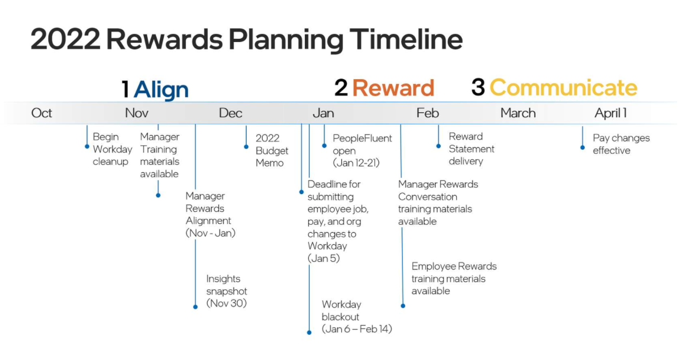
(Feb. 7 - 18)
PF open for G12-14 promo (Nov. 15-19)
GES OOC promo/demo request (Dec. 31)

Slide 3
WW | Dates | Rewards Activity | Notes
WW49 | 30-Nov | Rewards Eligibility Cutoff | New hires starting after Nov. 30 are not eligible for Rewards cycle
WW02 | 3-Jan | FTE 9 box assessment Workday submission due date G9+ promo template submission due date | All manager should submit team 9 box assessment (all grade level) via Workday (Promotion candidate should mark as “ready for promo” in Workday talent assessment) * G9+ promo candidate, mgr should complete SMG G10/87 promo template
 | 4-Jan | FTE staff Reward Alignment Session 1 (1hrs) | G9+ Promo candidate alignment date
 | 5-Jan | Last date for change Workday data | Employee job, grade, pay, and org information will reflect Workday data as of Jan. 7, 2022, in PeopleFluent.
WW03 | 10-Jan | Last day to enter job, grade, pay, or org changes in WD to appear correctly in PeopleFluent | * GEMS G9+ promo alignment with Hai (1 Page promo page due on Jan. 5)
WW03 | 11- Jan (4-7pm PST) | FTE staff Reward Alignment Session 2 (3hrs) | G7-9 promo; G8/9 (non-promo) Critical talents; All grade potential low performance
WW02-08 | Jan 6 - Feb 14 | Workday Blackout Period | Changes cannot be made to employee job, grade, or pay in WD - any pending changes during this time will not be reflected
WW03 | 12-Jan (8am PST) | PeopleFluent Opens to Managers | All FTE mgr should complete first round of decision input by Jan. 14 Chang Hong will do first round dashboard review on Jan. 17 Review with Hai on Jan. 18
WW04 | 19-Jan | All Rewards decisions due by EOD for SMG managers | * GEMS staffs should done review with Hai by Jan. 19
WW04-05 |  | Diversity Work | Owned by BHR
 | 21-Jan (12pm PST) | PeopleFluent Closes to Managers | SMG managers are held to the Jan 19th deadline.
WW05 | 24-Jan | Review with MJ: Budget allocation, differentiation in stock/merit, 10+ promos & diversity progression | If everyone comes in on budget, with good differentiation we might not need full reviews!
WW06 | 31-Jan | PeopleFluent Closes to BHR
WW07 | 7-Feb | Rewards Statements available for delivery
WW14 | 1-Apr | Rewards Decisions Effective/Rewards Statements closed for managers | For non-exempt employees in US and CR, effective date is Mar 13.

Slide 4
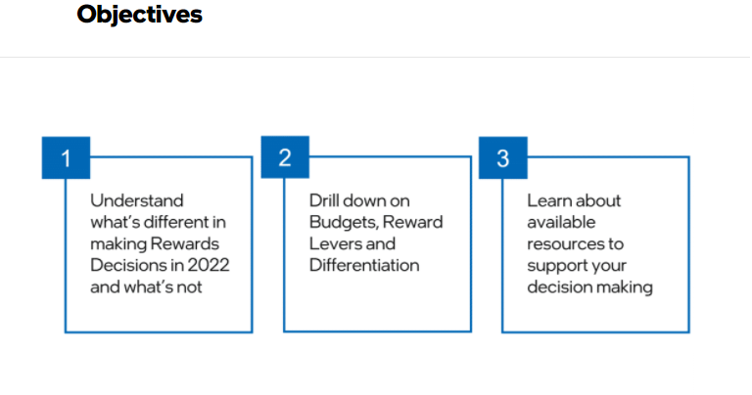
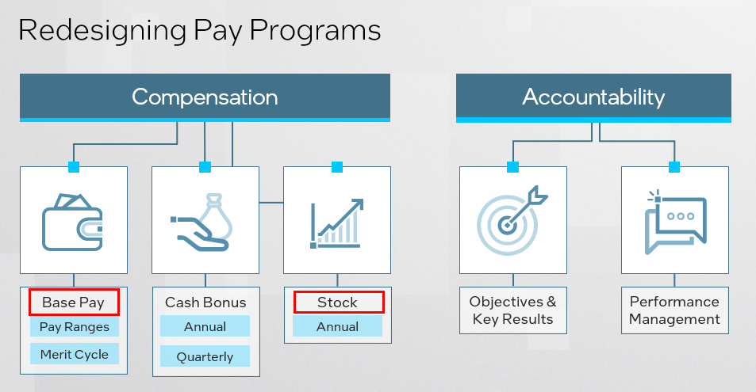
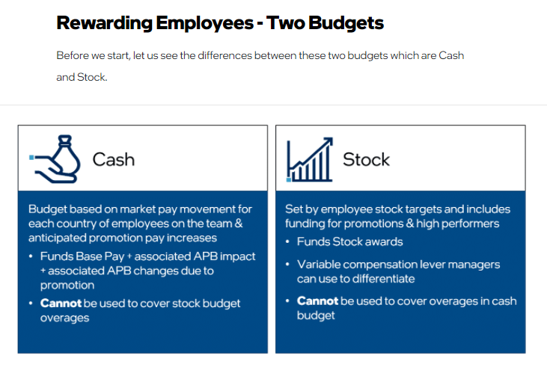
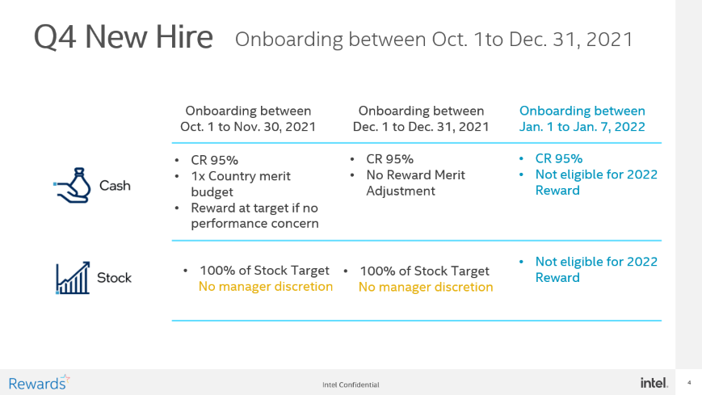

Slide 5


Q4 New Hire
Onboarding between Oct. 1to Dec. 31, 2021
Onboarding between Oct. 1 to Nov. 30, 2021
Onboarding between Dec. 1 to Dec. 31, 2021
Onboarding between Jan. 1 to Jan. 7, 2022
CR 95%
1x Country merit budget
Reward at target if no performance concern
CR 95%
No Reward Merit Adjustment
CR 95%
Not eligible for 2022 Reward
Not eligible for 2022 Reward
100% of Stock Target
No manager discretion
100% of Stock Target
No manager discretion

Slide 6
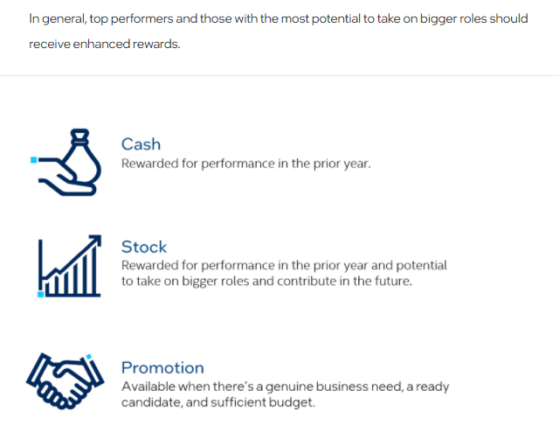
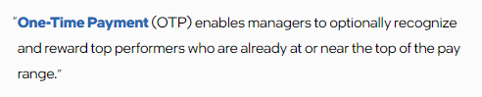
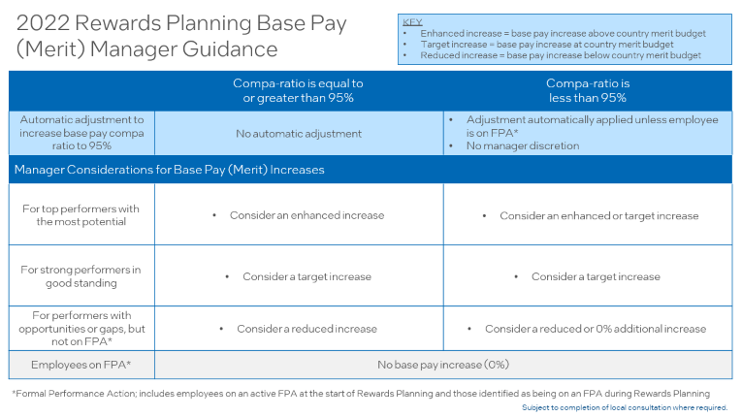
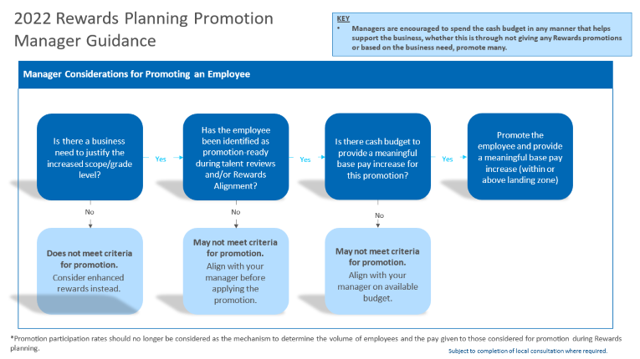
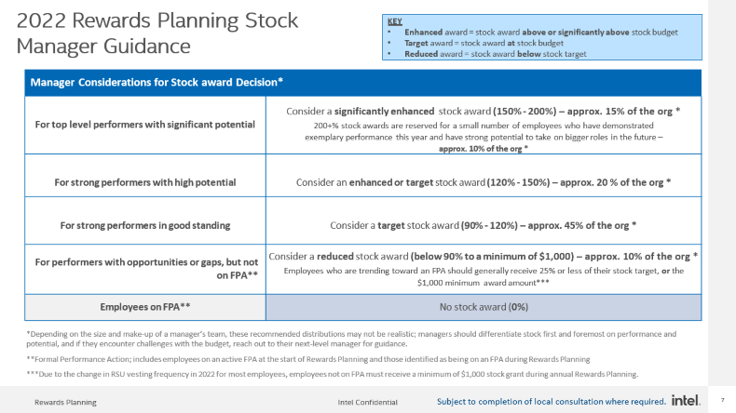

CR 95%, 1x country budget
2022 RSU- Quarterly vesting
Landing Zone: CR95% of new grade

Slide 7
2022 Rewards Planning Base Pay (Merit) Manager Guidance
KEY
Enhanced increase = base pay increase above country merit budget
Target increase = base pay increase at country merit budget
Reduced increase = base pay increase below country merit budget
 | Compa-ratio is equal to or greater than 95% | Compa-ratio is less than 95%
Automatic adjustment to increase base pay compa ratio to 95% | No automatic adjustment | Adjustment automatically applied unless employee is on FPA* No manager discretion
Manager Considerations for Base Pay (Merit) Increases
For top performers with the most potential | Consider an enhanced increase | Consider an enhanced or target increase
For strong performers in good standing | Consider a target increase | Consider a target increase
For performers with opportunities or gaps, but not on FPA* | Consider a reduced increase | Consider a reduced or 0% additional increase
Employees on FPA* | No base pay increase (0%)
*Formal Performance Action; includes employees on an active FPA at the start of Rewards Planning and those identified as being on an FPA during Rewards Planning
Subject to completion of local consultation where required.

Slide 8
Base Pay (Cash) | Automatic adjustment to new BTM of 95% Compa-ratio
Bring to Min 95% compa ratio (CR) of '22 Pay Range​
Employee current salary = $108,750 = 87% CR​ Minimum CR = 95%​ Manager opens PF and employee's currently below 95% CR adjusted salary = $118,750 = 95% CR​ Manager decides additional merit to apply​ See Illustration below​
Automatically adjusted upon Rewards planning opening​ All Rewards eligible employees in Non-Exempt to GR11 are in scope Employees already at/above 95% CR will not get an increase and their adjusted CR & salary will be the same as their current CR​ Budgeted before Rewards, so does not impact Rewards Cash budget/spend Cash budget is calculated from the Adjusted Salary Managers are not able to adjust​ Checking the FPA box zero's out employees currently on or placed on FPA during Rewards planning. Funds will not be available to use for others.​
Illustration
Current Salary | Current CR | Adjustment to 95% CR | Adjusted Salary | Adjusted CR | Merit Budget % | Merit Increase % | Increase Amt | Total Base Pay Increase % | New Salary | New CR
$108,750 | 87% | 9.2% | $118,750 | 95% | 5% | 5% | $5,937.50 | 14.7% | $124,687.50 | 99.8%
How is it calculated?
Current Salary / Midpoint of Pay Range
(Adjusted Salary – Current Salary) / Current Salary
Current Salary * Adjustment to 95% + Current Salary
Adjusted Salary / Midpoint of Pay Range
Country Budget %
Manager Enters Recommended Merit Increase
Adjusted Salary * Increase %
(New Salary – Current Salary) / Current Salary
Adjusted Salary + Increase Amt
New Salary / Midpoint of Pay Range
Automatic Bring to Min of 95% compa ratio
Automatically adjusted upon Rewards planning opening
Not part of the Rewards budget/spend in PeopleFluent
Managers are not able to adjust this structural change
Employees already at/above 95% CR will show their current CR in the adjusted CR fields
Subject to completion of local consultations where required

Slide 9

Continuing to slow down growth of our Annual Performance Bonus (APB)
APB
Manager will not adjust APB Goal% (targets):
APB Goal % above the range minimum are held flat.
APB payout ($) amounts over the range maximum are also held flat.
Promoted employees’ APB Goal % will be brought to the minimum of the new APB range or held flat if above.
.
New in 2022
Adjustments to APB made outside of Rewards Planning and PeopleFluent will be held the same rule
Notes:
Est. time: 2:00
Key point: To review how to use cash, specifically base pay, to reward performance in the prior year. Explain 2021 APB/frozen targets except in cases of promotion.
Speaker notes
Base pay is the foundational component of employee rewards, and each year, employees have an opportunity to earn an increase.
I mentioned before Intel’s philosophy to align base pay to the middle of the market, and reward employees based on their performance in the prior year.
In PeopleFluent, initial guidance is provided based on the employee’s current compa-ratio, their job, and their country rewards budget.
In order to drive Intel employee pay closer to the middle of the market, guidance is generally higher for employees with lower compa-ratio, and lower for employees with higher compa-ratio.
And, one-time-payments may be available to employees who are at or above 110% compa-ratio.
In addition to this guidance, you will take additional inputs into consideration when making base pay decisions, using Insights history to ensure that rewards match performance messaging given throughout the year.
Generally, employees performing strongly across Results, Culture, and Learning should receive base pay increases at or close to the top of increase guidance.
Moving on to bonus,
As we have talked about, Intel is continuing to shift more variable pay into stock while slowing down APB growth.
Our current APB program continues to pay out well above those of our peers, which is why last year condensed the APB ranges and capped them at what used to be the mid-point.
For 2021 rewards planning, APB Goal %s will remain flat, except when a promotion results in a higher APB Goal.
All eligible employees with an APB Goal below the minimum of the range will automatically be brought up the minimum of the new range.
APB payout amounts currently over the range maximum will also be held flat.
This means that this year, you will focus on differentiation through base pay and stock.

Slide 10
2022 Rewards Planning Stock Manager Guidance
KEY
Enhanced award = stock award above or significantly above stock budget
Target award = stock award at stock budget
Reduced award = stock award below stock target
Manager Considerations for Stock award Decision*
For top level performers with significant potential | Consider a significantly enhanced stock award (150% - 200%) – approx. 15% of the org * 200+% stock awards are reserved for a small number of employees who have demonstrated exemplary performance this year and have strong potential to take on bigger roles in the future – approx. 10% of the org *
For strong performers with high potential | Consider an enhanced or target stock award (120% - 150%) – approx. 20 % of the org *
For strong performers in good standing | Consider a target stock award (90% - 120%) – approx. 45% of the org *
For performers with opportunities or gaps, but not on FPA** | Consider a reduced stock award (below 90% to a minimum of $1,000) – approx. 10% of the org * Employees who are trending toward an FPA should generally receive 25% or less of their stock target, or the $1,000 minimum award amount***
Employees on FPA** | No stock award (0%)
*Depending on the size and make-up of a manager’s team, these recommended distributions may not be realistic; managers should differentiate stock first and foremost on performance and potential, and if they encounter challenges with the budget, reach out to their next-level manager for guidance.
**Formal Performance Action; includes employees on an active FPA at the start of Rewards Planning and those identified as being on an FPA during Rewards Planning
***Due to the change in RSU vesting frequency in 2022 for most employees, employees not on FPA must receive a minimum of $1,000 stock grant during annual Rewards Planning.
Subject to completion of local consultation where required.

Slide 11
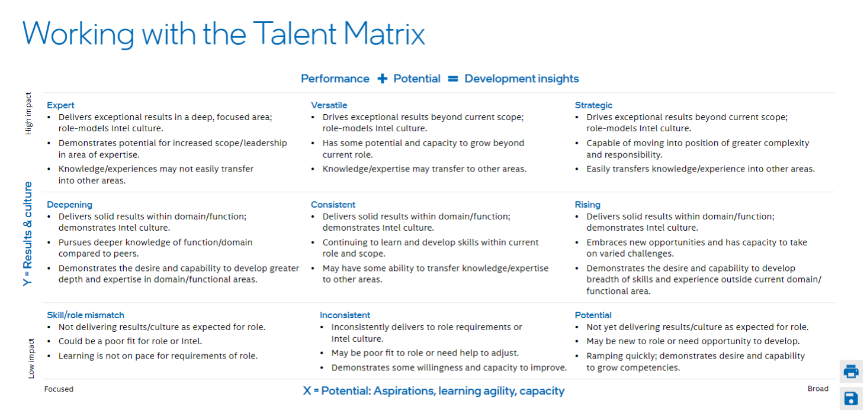
For FTE Reference purpose only For easily consider stock decision from 9 box assessment view
Stock Target 110- 130%
Stock Target 120-150%
Stock Target 150-270%
Stock Target 75- 90%
Stock Target 90-120%
Stock Target 150-200%
Stock Target 0%
Stock Target 25-75%
Stock Target 90- 120%
New comer (join within 6 months) Stock Target= 100%

Slide 12



2022 Rewards Planning Promotion Manager Guidance
KEY
Managers are encouraged to spend the cash budget in any manner that helps support the business, whether this is through not giving any Rewards promotions
or based on the business need, promote many.
Manager Considerations for Promoting an Employee
Is there a business need to justify the increased scope/grade level? | Yes | Has the employee been identified as promotion-ready during talent reviews and/or Rewards Alignment? | Yes | Is there cash budget to provide a meaningful base pay increase for this promotion? No May not meet criteria for promotion. Align with your manager on available budget. | Yes | Promote the employee and provide a meaningful base pay increase (within or above landing zone)
No |  | No
 |  | May not meet criteria
Does not meet criteria |  | for promotion.
for promotion. |  | Align with your
Consider enhanced rewards instead. |  | manager before applying the promotion.
*Promotion participation rates should no longer be considered as the mechanism to determine the volume of employees and the pay given to those considered for promotion during Rewards
planning.
Subject to completion of local consultation where required.

Slide 13
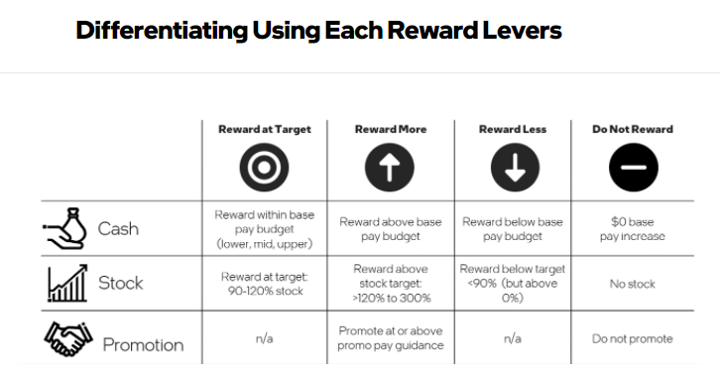

Slide 14
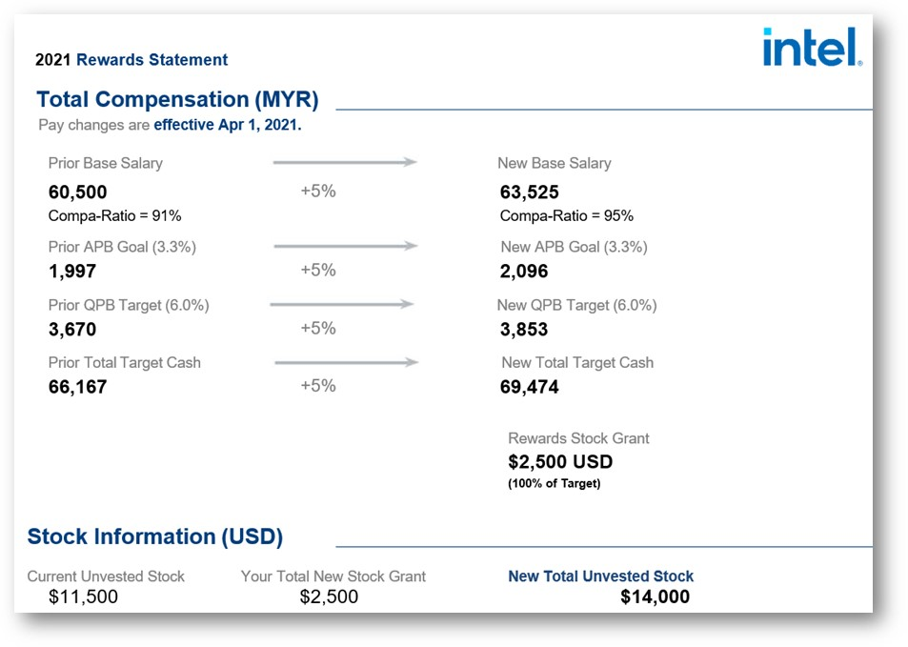
Rewards Conversations
Rewards Statements available starting Feb. 7
Hold Rewards Conversations before pay Feb. 18
Rewards Conversation Manager Training available in Feb. to help you prepare
Employee Rewards Planning Overviews available to learn more about Rewards Planning at Intel
WIP
Notes:
Est. time: 0:25
Key point: To provide an example of the rewards statement, and what the manager can expect in February.
Speaker notes
In early February, managers and BHR will have access to Rewards Statements for eligible employees on their team.
Rewards Conversations should be scheduled and occur before the employee’s pay effective date.
We’ll provide additional rewards conversation training for managers in Late January/early February to help them prepare.
At that same time, employees will also have an opportunity to attend training overviews to learn more about rewards planning at Intel.
This is an example of what a compensation statement might look like. There will be changes made prior to February.

Slide 15
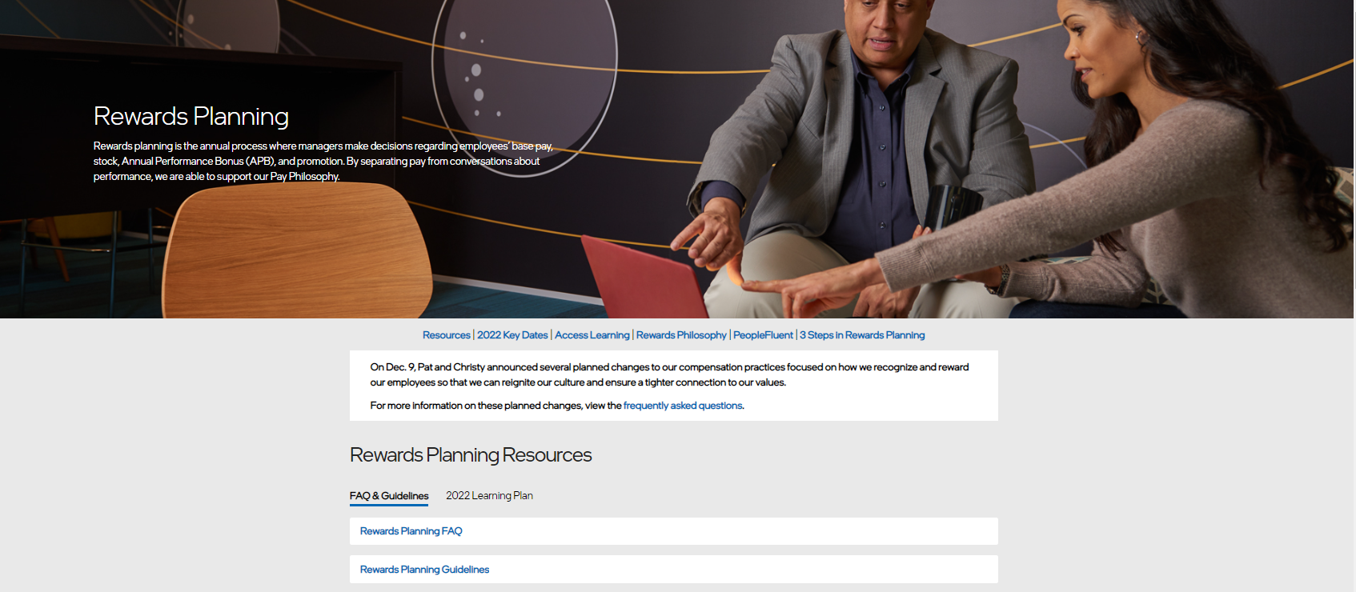
Rewards Planning goto/rewardsplanning

Slide 16
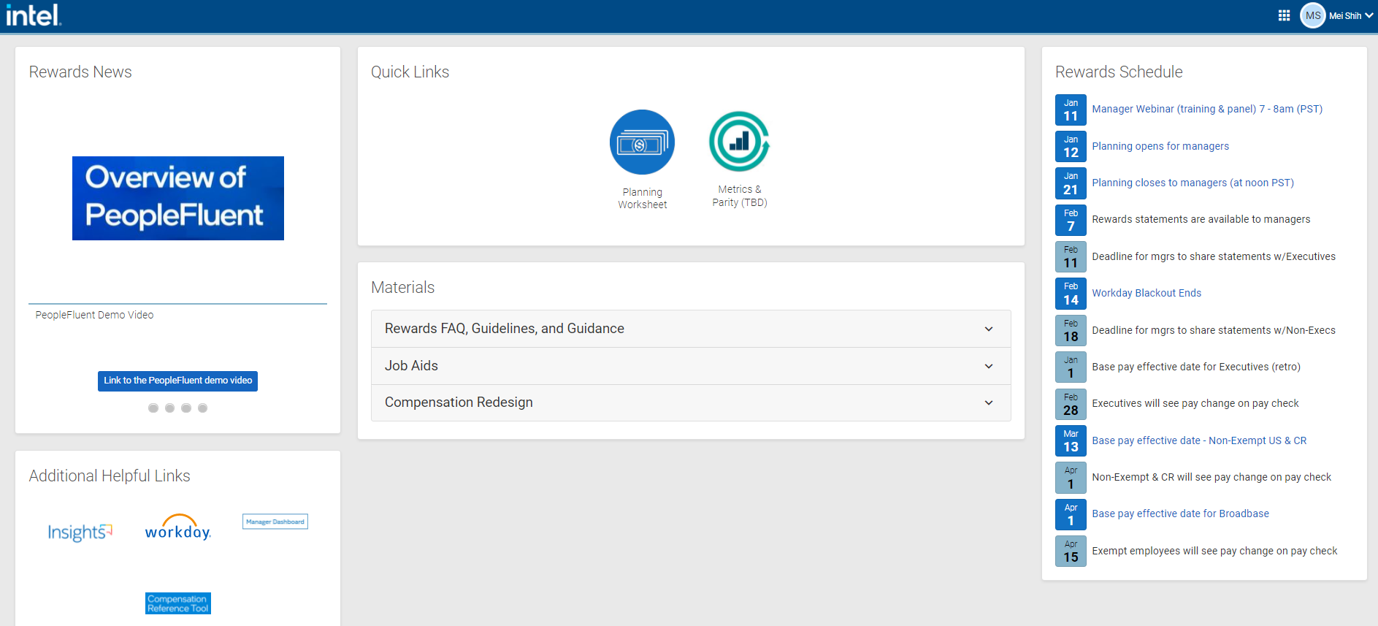
PeopleFluent goto/peoplefluent
~8mins tool demo video
Decision input
Dashboard for budget usage

Slide 17
Back up

Slide 18


Rewarding employees
In general, top performers and those with the most potential to take on bigger roles should receive enhanced rewards
Rewarded for performance in the prior year
Cash
Rewarded for performance in the prior year and potential to take on bigger roles and contribute in the future.
Stock
Available when there’s a genuine business need, a ready candidate, and sufficient budget.
Promotion
Notes:
Est. time: 0:45
Key point: To introduce the next section, talking about each of the reward levers.
Speaker notes:
This year you have three ways to reward and recognize employee performance.
Each of these has its own nuances, guidelines, and impact – so it’s important to understand each one independently.
It’s also important to recognize that depending on performance, potential, current compensation, budget, and other factors, these levers may be pulled in different ways for different employees.
I’ll explain more about that as I go.
We’ll start by talking about cash, which is rewarded for performance in the prior year.
Then I’ll talk about stock, which is rewarded for both performance in the prior year as well as the employee’s potential to take on bigger roles in the future.
And finally I’ll talk about promotion, when you have both a ready candidate and a genuine business need justifying the promotion.
Let’s start by talking about cash.

Slide 19
Rewarded for performance in the prior year, balancing base pay increases with market position and capability in role.
Cash
Base pay guidance in PeopleFluent is based on Country Rewards budget
One-time payments (OTP) may be available for employees who are at or above 110% compa-ratio.
Managers take into consideration feedback provided via Insights regarding performance to Results, Culture, and Learning in the prior year
Employees performing strongly should generally receive base pay increases above guidance. While underperformers should generally receive base pay increases below guidance
New in 2022
New hires on or after Dec. 1, 2021, will not be eligible for a base pay increase
Cash budgets will fund increases for employees hired before Dec.1, 2021
All employees, regardless of Compa-ratio position brings 100% country budget funding
Manager and Recruiter are expected to include any necessary increases into the employee’s offer as appropriate
Notes:
Est. time: 2:00
Key point: To review how to use cash, specifically base pay, to reward performance in the prior year. Explain 2021 APB/frozen targets except in cases of promotion.
Speaker notes
Base pay is the foundational component of employee rewards, and each year, employees have an opportunity to earn an increase.
I mentioned before Intel’s philosophy to align base pay to the middle of the market, and reward employees based on their performance in the prior year.
In PeopleFluent, initial guidance is provided based on the employee’s current compa-ratio, their job, and their country rewards budget.
In order to drive Intel employee pay closer to the middle of the market, guidance is generally higher for employees with lower compa-ratio, and lower for employees with higher compa-ratio.
And, one-time-payments may be available to employees who are at or above 110% compa-ratio.
In addition to this guidance, you will take additional inputs into consideration when making base pay decisions, using Insights history to ensure that rewards match performance messaging given throughout the year.
Generally, employees performing strongly across Results, Culture, and Learning should receive base pay increases at or close to the top of increase guidance.
Moving on to bonus,
As we have talked about, Intel is continuing to shift more variable pay into stock while slowing down APB growth.
Our current APB program continues to pay out well above those of our peers, which is why last year condensed the APB ranges and capped them at what used to be the mid-point.
For 2021 rewards planning, APB Goal %s will remain flat, except when a promotion results in a higher APB Goal.
All eligible employees with an APB Goal below the minimum of the range will automatically be brought up the minimum of the new range.
APB payout amounts currently over the range maximum will also be held flat.
This means that this year, you will focus on differentiation through base pay and stock.

Slide 20





Cash | One-Time Payment
One-time payments enable managers to optionally recognize and reward top performers who are already at or near the top of the pay range
Cash: Need to Know
Cash: Need to Know
Any OTPs allocations will be deducted from the Cash budget
Refer to Job Aid in PF for the steps
~10% of employee population eligible for consideration of receiving a OTP based on their current compa-ratio
Employee A At or above 110% compa-ratio but NOT over the max
Options:
Base pay increase
One-time payment (OTP)
Combination of base pay increase & OTP
Employee B Above max of the pay range for grade level
Option: One-time payment only
MIN
90%
100%
110%
MAX
Entry to Market
Market Target
Top of Market
Employee A
Employee B
For Illustration Purposes Only
20
Notes:
Est. time: 1:20
Key point: To explain the one-time payment option in PeopleFluent, where it may apply, and how it impacts base pay reward budgets.
This year, about 10% of employees are eligible for a One-Time Payment as an option -- when appropriate -- to reward top performers who are already at -- or near -- the top of their pay range.
In PeopleFluent, base pay and One-Time Payment increases will be deducted from your Cash Budget
Use the handy job aid in the system for help to ensure you follow the recommended process steps.
It is important to remember that
Rewarding an employee with a one-time payment will not add to their base pay OR increase their ABP target.
And, one-time payments will come out of your base pay budget.
There are a couple of scenarios in which a manager may opt to do a one-time payment:
First, employees at or above 110% compa-ratio, but NOT over the maximum of their pay range, can be rewarded in one of three ways:
With a base pay increase
With a one-time payment -- instead of a base pay increase -- in the form of a lump sum -- one-time payment -- paid out on their rewards effective date
OR with a combination of BOTH a base pay increase AND a one-time payment
In any of these scenarios, the employee’s base pay CANNOT exceed the maximum of the pay range
Second, employees who are already above the maximum of their pay range can ONLY be rewarded with a one-time payment in lieu of an increase.
More information about one-time payments is included in the Rewards Planning Guideline available on Circuit.
>>> Next Slide <<<

Slide 21
Continuing to slow down growth of our Annual Performance Bonus (APB)
APB
Manager will not adjust APB Goal% (targets):
APB Goal % above the range minimum are held flat.
APB payout ($) amounts over the range maximum are also held flat.
Promoted employees’ APB Goal % will be brought to the minimum of the new APB range or held flat if above.
.
New in 2022
Adjustments to APB made outside of Rewards Planning and PeopleFluent will be held the same rule
Notes:
Est. time: 2:00
Key point: To review how to use cash, specifically base pay, to reward performance in the prior year. Explain 2021 APB/frozen targets except in cases of promotion.
Speaker notes
Base pay is the foundational component of employee rewards, and each year, employees have an opportunity to earn an increase.
I mentioned before Intel’s philosophy to align base pay to the middle of the market, and reward employees based on their performance in the prior year.
In PeopleFluent, initial guidance is provided based on the employee’s current compa-ratio, their job, and their country rewards budget.
In order to drive Intel employee pay closer to the middle of the market, guidance is generally higher for employees with lower compa-ratio, and lower for employees with higher compa-ratio.
And, one-time-payments may be available to employees who are at or above 110% compa-ratio.
In addition to this guidance, you will take additional inputs into consideration when making base pay decisions, using Insights history to ensure that rewards match performance messaging given throughout the year.
Generally, employees performing strongly across Results, Culture, and Learning should receive base pay increases at or close to the top of increase guidance.
Moving on to bonus,
As we have talked about, Intel is continuing to shift more variable pay into stock while slowing down APB growth.
Our current APB program continues to pay out well above those of our peers, which is why last year condensed the APB ranges and capped them at what used to be the mid-point.
For 2021 rewards planning, APB Goal %s will remain flat, except when a promotion results in a higher APB Goal.
All eligible employees with an APB Goal below the minimum of the range will automatically be brought up the minimum of the new range.
APB payout amounts currently over the range maximum will also be held flat.
This means that this year, you will focus on differentiation through base pay and stock.

Slide 22

Base Pay Competitiveness & Compa-Ratio
Examples
Compa-ratio helps managers reward employees competitively in the market by comparing their base pay compensation to the midpoint of the pay range for the employee’s job, grade level, and location.
Non-commissioned
Employee’s base pay: 68,500
Market range midpoint: 65,000
= 105% compa-ratio
Commissioned
Employee’s base pay +
Commission target: 131,500
Market range midpoint: 125,000
= 105% compa-ratio
90%
100%
110%
Interpreting compa-ratio
Entry to Market
Market Target
Top of Market
New to role, building skills and capabilities
Fully demonstrates skills and capabilities
Industry leader in skills and capabilities
Notes:
Est. time: 1:30
Key point: To provide a brief refresher on compa-ratio.
Speaker notes
I want to spend a little more time talking about compa-ratio, and base pay competitiveness.
Compa-ratio, our measurement of employee base pay within the pay range, helps you ensure that you are rewarding employees competitively in the market based on their skills and capabilities.
Employee compa-ratio is based on their job, grade level, and location, and managers have the ability to move compa-ratio up or down depending on the employee’s performance and growth in their role.
There is no “bad” compa-ratio, and we would expect to see employees newer in their role in the ‘Entry to Market’ range.
‘Entry to Market’ does not mean that the employee is new in the workforce; it means they are newer, or less experienced, in the role they are currently in.
‘Market Target’ means that the employee is performing well in their role and is proficient in the required skills and capabilities.
Market target corresponds to about 90-110% compa-ratio, and is where we expect most employees to be.
‘Top of Market’ means that the employee is an expert in their role; an industry leader and is a consistently strong performer.
If your you or your employees want to learn more about compa-ratio, you can access learning materials for a quick on-demand video on compa-ratio and other Rewards Planning concepts by visiting goto/rewardsplanning.
Next, I’m going to transition from cash to talk a little bit about rewarding stock.

Slide 23
Long-term incentive rewarded for performance in the prior year and potential to take on bigger roles and contribute in the future.
Stock
Managers take into consideration:
Performance trend
Employee potential to take on bigger roles in the future
Employee’s unvested stock value
Top performers with significant potential should generally receive bigger stock awards, up to 300%
Stock guidance in PeopleFluent is based on employee stock target for their job, grade level, and location.
In the spirit of transparency, employee stock grants will be shown as a percentage of their stock targets on the annual Rewards Statement.
New in 2022
New hires on or after Oct. 1, 2021, eligible for Rewards planning, will automatically receive 100% of stock target without the ability to adjust
The stock budget will include funding to award new hires at 100%
Notes:
Est. time: 2:20
Key point: To review how to use stock to reward performance and potential, using all available inputs including unvested stock.
Speaker notes
Stock is a long-term investment that is granted to reward continuous performance and future potential at Intel.
Employee stock targets are based on their job and grade level.
Managers can choose to reward anywhere from 0 to 300% of the employee’s stock target.
Country rewards budgets will determine how much total stock a manager can award, and it is your job as the manager to differentiate rewards appropriately across a team.
We expect most employees to receive between 90 to 110% of their stock target, which indicates that they are performing well with some potential to grow at Intel.
And, top performers with significant potential should receive more stock, significantly above the 90-110% target range.
Employees with performance concerns, downward trends, or little to no potential to grow with the company should receive less than 90% of their stock target.
Last year, we began showing the employee’s stock award in relation to their stock target.
Again this year, eligible employees will see their stock award as a percentage of their stock target on their rewards statements.
This is to drive transparency for employees about their performance and rewards.
The one piece that will be new to most managers this year is the inclusion of unvested stock values as a field in PeopleFluent.
Unvested stock is the cumulative value of an employee’s stock grants that have not yet vested.
It’s the total value that the employee would forgo if they were to leave Intel today.
You should take unvested stock into consideration when making rewards decisions across your team, prioritizing stock budgets to reward critical employees who have been strong performers, contributed substantially to the business, and possess the potential to grow into bigger roles in the future.
This should not be the only data point you consider when making stock decisions.
In some cases, strong performers with high potential may already have a lot of unvested stock, and awarding them more may still be appropriate.
There are additional resources and a video module explaining more about stock, including unvested stock, at goto/rewardsplanning.
Use your stock budget to your advantage – retain the people we want and need to keep at Intel to help us succeed.
The last decision you may have an opportunity to make in rewards planning is promotion.

Slide 24



Stock | Differentiation
Stock: Need to Know
Stock enables managers to recognize and reward top performers who also demonstrate future potential.
Stock targets are based on employee job, grade level, and location. Adjust tool guidance from 0% up to 300%.
Unvested Stock shows for ALL EEs as an additional data point reference
Managers can differentiate stock awards for all employees
Stock Target shows as Full Time in PeopleFluent
% of target will show on statements
$1,000 minimum stock award unless employee is on FPA
90-120% TARGET STOCK
Good Rewards
Most employees fall into this range
<90% OF TARGET
Reduced Rewards
>120-300% OF TARGET
Enhanced Rewards
No Stock
<90% OF TARGET
Reduced Rewards
HIGH
Growth Potential
LOW
Always consider both employee performance trend and potential when making stock decisions.
Performance Trend
LOW
HIGH
For Illustration Purposes Only
24
Notes:
Est. time: 1:58
Key point: To review how to use stock to reward performance and potential, using all available inputs including unvested stock.
Speaker:
Now let’s take a look at STOCK. This long-term variable investment rewards BOTH continuous performance trend AND future potential
Stock targets are based on your employee’s job AND grade level -- and you can reward from 0 to 300% of their target.
This is where you’re really able to flex your differentiation muscle.
Stock budget is determined based on an employee’s stock target PLUS an additional funding % to enable differentiation
Use your stock budget to recognize and retain the people we want -- and need -- to keep at Intel
Most employees will receive between 90 to 110% of their stock target which indicates they are performing well WITH some potential to grow at Intel.
Your TOP performers with significant potential should receive enhanced stock rewards significantly above the 90-110% target range.
And where there are performance concerns, downward trends, or little to no potential to grow, they should receive reduced rewards below 90% of their stock target.
What you need to know is:
Unvested Stock values will show for ALL employees in your PeopleFluent worksheet.
This is the cumulative value of an employee’s stock that has not vested yet, and it provides an indication of holding power.
It offers an additional data point to consider when making stock decisions.
We’ll take a closer look at Unvested Stock next.
Note that in PeopleFluent, all stock awards will reflect full time hours and will not be pro-rated
On Rewards Statements -- eligible employees will see their stock award as a percentage of their stock target.
We’ll share more on Rewards Statements in upcoming COMMUNICATE training.
>>> Next Slide <<<
[FAQ REFERENCE]
Employee stock ownership is an important part of our culture and a valuable part of our total compensation package both for delivering rewards and focusing employees on the future success of the organization. We believe that building up a broad employee ownership stake in the company links employees to the long-term growth of the company, and incentivizes behaviors that are in the best interests of the company, our customers, and investors.
We are deeply committed to ensuring competitive pay by element (base, bonus, stock) and overall. We must do this to attract, engage and retain the talent we need to deliver to our company roadmap. Intel benchmarks itself annually against the most relevant list of competitors operating in our industry and we look at our competitiveness in both cash and stock to ensure we are investing in the right areas to remain competitive overall and that we have the right mix of short and long term incentives. The stock target values we deliver to employees annually is intended to keep total compensation competitive.
Additionally, stock ownership allows our employees to continue increasing value through stock appreciation. Over the last 5 years our stock has grown, but not without short-term volatility as we have seen recently. It’s important to remember we have the largest market opportunity in our history and are indexed to the major tech growth inflections driving our industry (Cloud, AI, edge, autonomous driving, 5G). Execution will be key to increasing investor confidence and we all play a role in executing to our company roadmap, delivering on each new opportunity and contributing to the growth of our stock price. If we execute with discipline, we are positioned to lead all the indices and our direct peers in value accretion over the next 5 years.
Top performers with the most potential should generally receive rewards above target rewards (“enhanced rewards”).
Underperformers should generally receive rewards below target rewards (“reduced rewards”).

Slide 25
Stock | Unvested Stock
This year, managers will have visibility to unvested stock value for ALL employees in PeopleFluent.
This value represents the amount of stock awarded throughout an employee’s tenure that has not yet vested and what the employee might lose if they left Intel.
EXAMPLE
Employee A has $25,000 USD in unvested stock
Employee B has $4,500 USD in unvested stock
Unvested Stock
$25,000
$4,500
Employee A
Employee B
The unvested stock, of Employee A’s stock is significantly stronger than Employee B’s
If Employee B is one of your top performers with high potential to excel at Intel, consider rewarding them with more stock to incentivize them to stay at Intel
For Illustration Purposes Only
25
Notes:
Est. time: 1:26
Key point: To explain how to use unvested stock as a reference point in making stock decisions
Speaker notes
Here’s a closer look at Unvested Stock.
You’ll see this in your worksheet as a cumulative value of your employee’s stock that has not vested yet.
In some cases, strong performers with high potential may already have a lot of unvested stock, and awarding them MORE may still be appropriate to provide an incentive to stay.
In this example, we have a simple comparison of two employees.
Employee A has a lot of unvested stock,
Whereas Employee B has significantly less.
If Employee B is one of your TOP performers and has high potential to take on bigger roles -- you might consider giving them a stock award that is above their target.
If Employee A is ALSO a TOP performer with potential, you can still give them more stock — just because they have a lot of stock does not mean you shouldn’t give them any, OR give them less.
Ultimately -- you need to make rewards decisions that recognize and reward performance and potential -- consider unvested stock where appropriate -- and of course stay within your budget.
You'll find a short video explaining more about stock at goto/rewardslearning.
>>> Next Slide <<<

Slide 26
Available when there’s increased scope, a genuine business need, a ready candidate, and sufficient budget.
Promotion
Promotion guidance in PeopleFluent is based on:
Recommended base pay guidance to position employee appropriately in the new grade level
APB and stock targets are adjusted for the new grade level (APB Goal % adjusted to min. of the range) and held flat if APB Goal % is higher than the new range minimum
Managers take into consideration:
Business need
Employee readiness including performance trend and growth potential
Alignment across the broader organization
New in 2022
Promotions are included in the Cash Budget/Spend to ensure that money is spent where needed whether that is through base pay increases or promotions
Notes:
Est. time: 2:15
Key point: To review how to use promotion to recognize increased job scope and complexity in addition to employee readiness, reinforcing the importance of aligning promotions to business needs and strategies.
Speaker notes
I mentioned at the beginning of this section that promotion is not just about rewarding performance.
Promotion is also a function of business need – when the scope, complexity, or impact of a job increases, the necessary job skills and requirements may also become larger – this is when a promotion may be appropriate.
Promotions come with added costs to the business, making it critical to prioritize promotions not only for employees who are ready for the increased scope, but for roles where there is a genuine business need to justify the increased grade level.
This is part of the broader alignment conversation you may have with your leader and peer managers.
Once a manager has aligned with their peers and leader on promoting an employee, they will do this in the PeopleFluent system.
Promotions are one of the most impactful events to an employee’s compensation and it is important that managers deliver meaningful increases to go with the promotion.
We have changed the way that PeopleFluent recommends promotion pay increases, to ensure that employees land at a minimum compa-ratio for the new grade in their country.
The system will help managers give appropriate increases and land their employee’s pay in a strong position within their new pay range,
There is also a new flag in PeopleFluent this year that will notify managers if the base pay increase they are applying for the promotion leads to a position that is too low in the pay range.
In the past, we’ve observed managers scaling back base pay increases to promoted employees.
However, this has resulted in employees starting out with an unreasonably low compa-ratio in their new pay range.
Promotion budget should NOT be used to offset overspends in the cash budget; doing so, could have long term impacts to promoted employee’s pay progression.
The flag in the system is not a hard flag, meaning that managers can still choose to pay outside of guidance, but we expect this to be the exception rather than the norm.
Paying fairly and equitably, and in-line with business needs and strategies, should be top of mind when making promotion decisions.

Slide 27

Promotion | Driven by Opportunity & Readiness
Promotions require an available opportunity and a ready candidate.
Opportunities are defined by business need and available budget, while readiness is demonstrated through performance and capability.
Promotion candidates must demonstrate performance across Results, Culture and Learning.
Promo: Need to Know
Based on opportunity, candidate readiness, and budget affordability
Use Rewards Alignment sessions to align on candidates before decisions
System alert if promo increase is below guidance; ensures a strong post promo pay position
All promos, including into new job roles, can be done directly in PeopleFluent
Promotions utilize the cash budget
Managers own ensuring promoted employees have a strong post promo pay position.
Notes:
Est. time: 1:17
Key point: To review how to use promotion to recognize increased job scope and complexity in addition to employee readiness, reinforcing the importance of aligning promotions to business needs and strategies.
Speaker notes
And finally, the last decision you may have an opportunity to make is a PROMOTION.
You may have aligned on promotion candidates as part of a Rewards Alignment session in your business group.
Essential ingredients for ANY promotion are -- clear opportunity for increased scope -- along with business need -- a ready candidate -- and sufficient budget.
Promotion candidates MUST demonstrate strong performance ACROSS Results, Culture AND Learning.
This is particularly important for those promoted into people manager and business leader positions where role modeling this is expected.
For this year - what you need to know is
A System alert will trigger if your promotion increase falls below promotion guidance
This helps ensure that promoted employees land in a strong pay position in the range for their new grade level.
While you can override this-- it is your responsibility to recognize this significant event by delivering meaningful increases that recognize their promotion.
ALL promotions can be done directly in PeopleFluent
Promotion budget should only be used for promotions and NOT used to offset overspends in the cash budget; diminishing promotion increases could have long term negative impacts to the employee’s pay progression.
Finally, if you don’t have promotion candidates on your team, don’t spend this promo budget – save it for the rest of your organization.
>>> Next Slide <<<

Slide 28




Differentiating with reward levers
Avoid giving all employees rewards around the midpoint of base pay range guidance and between 90%-120% stock targets (“target rewards”).
Top performers with the most potential should generally receive rewards above target rewards (“enhanced rewards”).
Underperformers should generally receive rewards below target rewards (“reduced rewards”).
Target rewards represent strong rewards and positive performance messages.
There are many factors to consider when making rewards decisions.
Consider pulling different reward levers for employees on your team depending on their performance, impact, potential, current compa-ratio, and holding power (unvested stock), in addition to business needs, budget, and equity across the team.
Notes:
Est. time: 2:30
Key point: Summarize the previous slides and reinforce that target rewards represent good rewards and performance messages.
Speaker notes
We’ve talked about why differentiation is important, and the different ways in which managers can apply rewards to employees with significantly better or worse performance.
When you make rewards decisions for your own employees, it’s important that you apply these concepts.
While many employees can and should receive rewards around the middle of base pay range guidance and between 90 and 110% of their stock target, we expect to see some employees across the organization receiving rewards significantly above target, and some receiving rewards below target, or even zero rewards.
We do not enforce any distribution curve, but in reality, most organizations have some employees who stand out above the rest and should receive significantly higher rewards.
And some will have employees who are not meeting performance expectations.
While we are reinforcing the importance of differentiation, it’s equally important to bear in mind that base pay increases around the midpoint of range guidance or stock awards between 90-110% target are GOOD rewards representing a POSITIVE performance message.
Receiving rewards on-target means that you’re performing well, and that there are no serious performance concerns.
Finally, remember that there are MANY factors that you should consider when making decisions about employee rewards.
We’ve included unvested stock values and compa-ratio in the system for you to have in front of you when you’re making your decisions.
You should also take the time to pull up Insights history, and any additional feedback you’ve provided your employees, including recognition.
The rewards budget, equity across the team, as well as current or near-term business needs, should also be taken into consideration.
There’s no formula that will produce precise rewards for your employees.
It’s your job as a manager to take all of these factors into consideration, and make informed and equitable rewards decisions.
On the next slide, we will discuss a few more things to be mindful of to help you make fair and balanced pay decisions.
>>> Next slide <<<

Slide 29
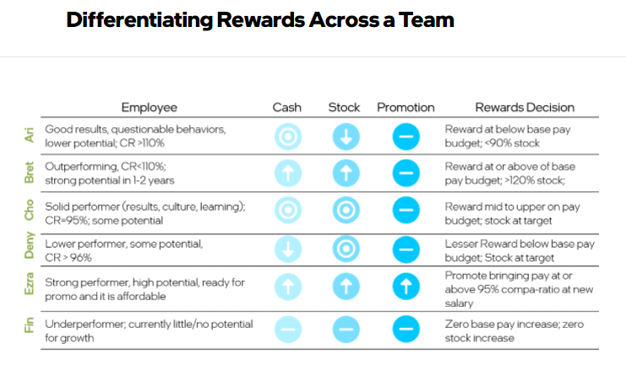

Slide 30
2022 Change call out in BLUE text
APJ BHR’s “cheat sheet”
 | Q4 ’21 New Hire *New hire onboard b/t Jan. 1-7, 2022 will show in PF and eligible for MCP CR95% adjustment but no Reward Stock. | Top Performer with the most potential | Strong Performance in good standing | Performers with opportunities or gaps but not on FPA | FPA Employee
Merit * Enhanced increase = Above Country Merit Budget * Target increase = At Country merit budget * Reduced increase= Below Country Merit Budget | 1. Onboard b/t Oct. 1-Nov. 30: 1) MCP: CR95% 2) 1x Country merit budget 3) Consider at target unless performance concerns exist 2. Onboard b/t Dec. 1- Dec. 31: 1) MCP: CR95% 2) Zero merit budget; not eligible for merit increases. No decisions are able to be made by the direct manager | 1. If CR<95%: 1) MCP: CR95% 2) Based on MCP increase, consider how much additional differentiation mgr want to apply based on EE’s performance 2. If CR≥95%: consider an enhanced increase | 1. If CR<95%: 1) MCP: CR95% 2) Consider at Target increase 2. If CR≥95%: consider at Target increase | 1. If CR<95%: 1) MCP: CR95% 2) Consider Reduce or 0% increase 2. If CR≥95%: consider Reduced increase | 1. No MCP CR95% adjustment 2. Merit =0%
OTP | CR ≥ 110% : 1) Base pay adjustment, 2) OTP only, 3) Base Pay + OTP (Suggest to add base pay if CR<120%). CR> Max: only OTP for significant achievement in 2021
APB | Managers will not adjust APB Goal % (targets) as last year: 1. APB Goal % above the range minimum are held flat. 2. APB payout ($) amounts over the range maximum are also held flat.
Stock (MCP: Quarterly or Semi-annually vesting schedule from 2022) | 100% Stock Target will be grant and manager cannot make changes | 1. 150% - 200% as significant enhance (~15% of org) 2. 200%+ to show exemplary performance (~10% of org) | 1. High potential: 120%-150% Stock Target (~20% of org) 2. In good standing: 90%-120% Stock Target (~45% or org) | <90% to a Min of $1,000 * EE who are trending toward an FPA should generally receive 25% or less of their stock target, or the $1,000 minimum award amount (~10% or org) | No Stock
Promotion | Not eligible | 1. Merit: 1) Landing Zone: CR95% of new grade 2) Original base pay > Landing Zone: 5% Merit increase is recommended 2. APB goal % adjusted to Min or held flat if current APB Goal % > new grade Min 3. Stock: ≥ 100% of new grade target | N/A | N/A | N/A
Budget/Guidance change in 2022: 1. 2 Budget buckets: Cash & Stock budgets. (Consolidate Base Pay, associated APB, OTP, and Promotions into one Cash Budget) 2. Base pay budget and guidance is based on 1x country merit budget (no different CR position funding factor) 3. Stock Due to the vesting schedule change in 2022, NEX minimum increases from USD800 to USD1000. 4. Promo: budget is funded based new landing zone & promo participation but no promo participation provided as a manager guidance (Mgrs are expected to meaningfully fund all promo given)
Notes:
PRC G3 target 1200. if <90%, will <USD1000.

