Slide 1
The Pursuit of Atomistic Switching and Cross Point Memory
2021 International Symposium on VLSI Technology, System and Application
April 19-22, 2021, Hsinchu, Taiwan
DerChang Kau
Intel Corporation

Slide 2
Outline
Introduction
Problem Statement and Solution Space
Cross Point Memory Array and Choices of Selector
3D XPoint Memory Technology
Conclusion

Slide 3
Outline
Introduction
Problem Statement and Solution Space
Cross Point Memory Array and Choices of Selector
3D XPoint Memory Technology
Conclusion

Slide 4
Computer Architecture 101: Hierarchy of Memory each has greater capacity than the preceding but less quickly accessible
“The Memory Organ – Ideally one would desire an indefinitely large memory capacity such that any particular … word would be immediately … available. … It does not seem possible physically to achieve such a capacity. …We are therefore forced to recognize the possibility of constructing a hierarchy of memories, each of which has greater capacity than the preceding but which is less quickly accessible.”
Preliminary Discussion of the Logical Design of an Electronic Computing Instrument
Arthur Burks, Herman Goldstine and John von Neumann, June/28/1946
Cache
Primary Storage
Secondary Storage and Archive
Main Memory
Capacity, Latency
Bandwidth, Cost
Introduction

Slide 5
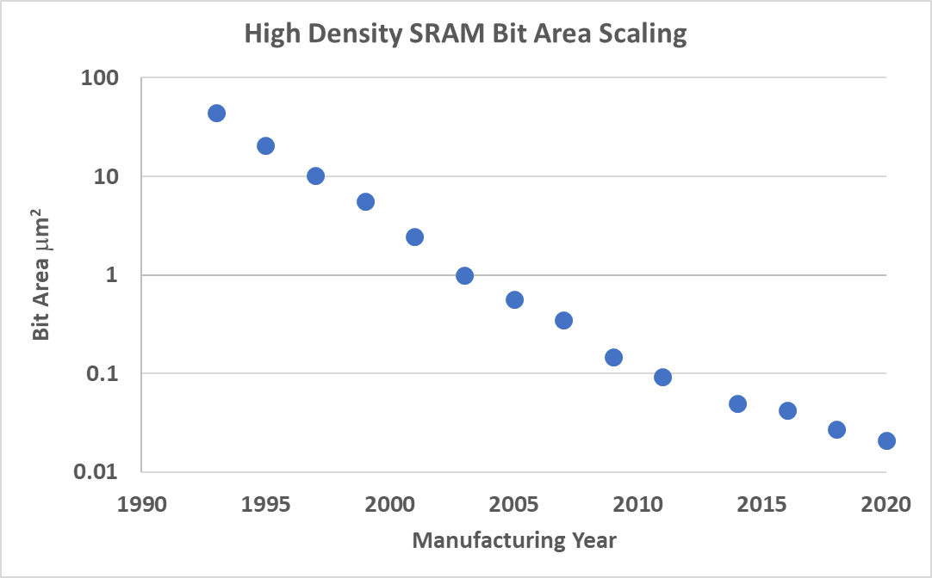
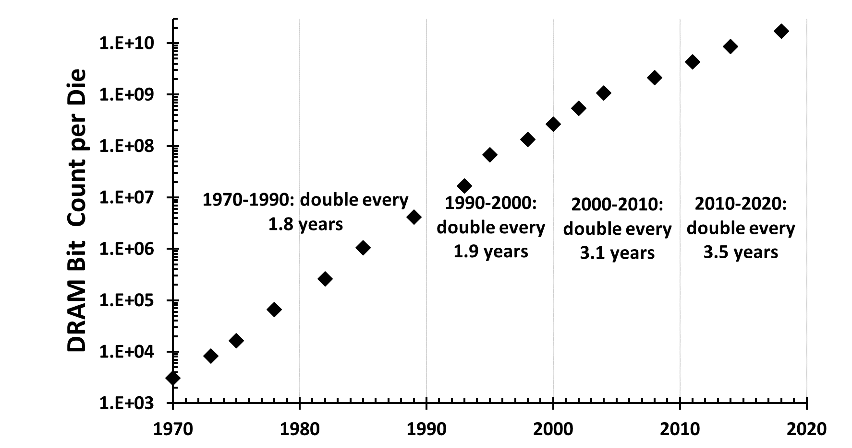
Cache and Main Memory Scaling SRAM and DRAM scaling have significantly slowed
Introduction

Slide 6
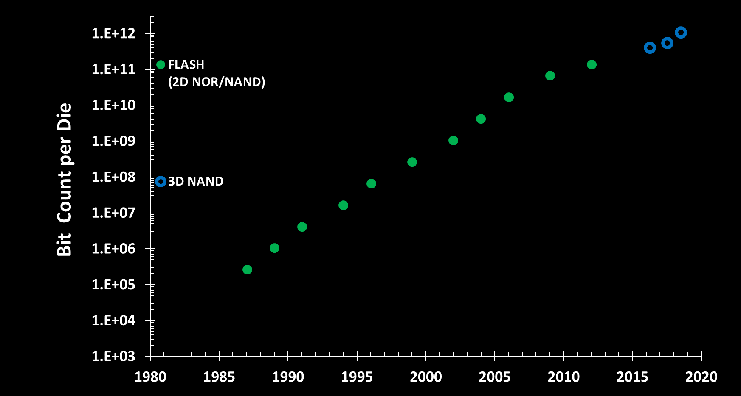
Storage Scaling – Flash based Solid State Drive displaces Hard Disk Drive* 3D NAND warrants Cost scaling superiority for path ahead
*: Intel Ships Enterprise-Class Solid-State Drives https://www.intel.com/pressroom/archive/releases/2008/20081015comp.htm
Introduction

Slide 7
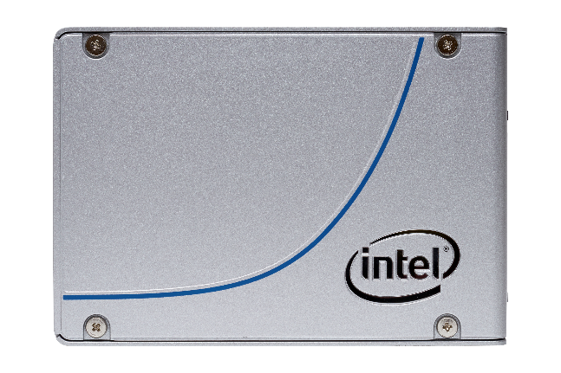
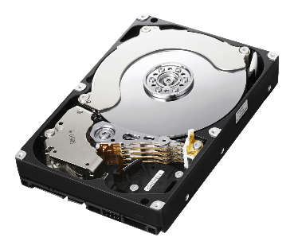
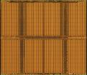

Yet … there are still gaps in Computing Memory Hierarchy
MEMORY
Storage
SRAM
DRAM
NAND SSD
HDD
Latency: 1X
Capacity: 1X
Latency: ~10X
Capacity: ~100X
Latency: ~100,000X
Capacity: ~4,000X-8,000X
Latency: ~10 Million X
Capacity: ~10,000X
Technology claims are based on comparisons of latency, density and write cycling metrics amongst memory technologies
recorded on published specifications of in-market memory products against internal Intel specifications.
Introduction

Slide 8
Outline
Introduction
Problem Statement and Solution Space
Cross Point Memory Array and Choices of Selector
3D XPoint Memory Technology
Conclusion

Slide 9
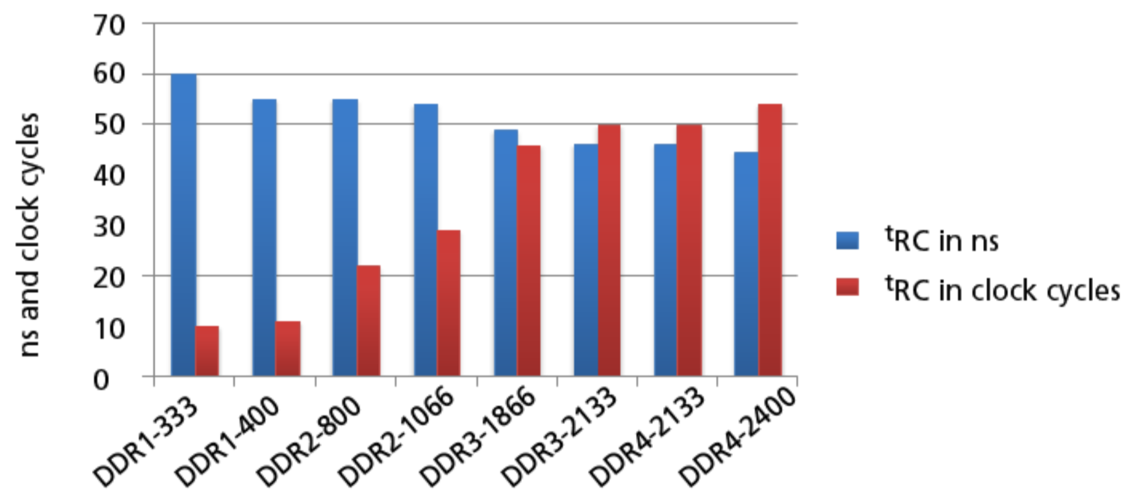
“It’s the Memory, Stupid! … Processor Speed Has Outstripped Memory … today’s chips are largely able to execute code faster than we can feed them with instructions and data. There are no longer performance bottlenecks in the floating- point ... The real design action is in memory subsystems—caches, buses, bandwidth, and latency…I expect that over the coming decade memory subsystem design will be the only important design issue for microprocessors.”
Architects Look to Processors of Future, Microprocessor Report, V10, No. 10, Aug/5/1996
Dick Sites, an architect and a co-lead of the Alpha architecture at Digital Equipment Corp
Main memory performance – Transfer rate increased while latency unchanged
https://www.micron.com/media/documents/products/technical-note/dram/tn_4003_ddr4_network_design_guide.pdf
Problem Statement

Slide 10
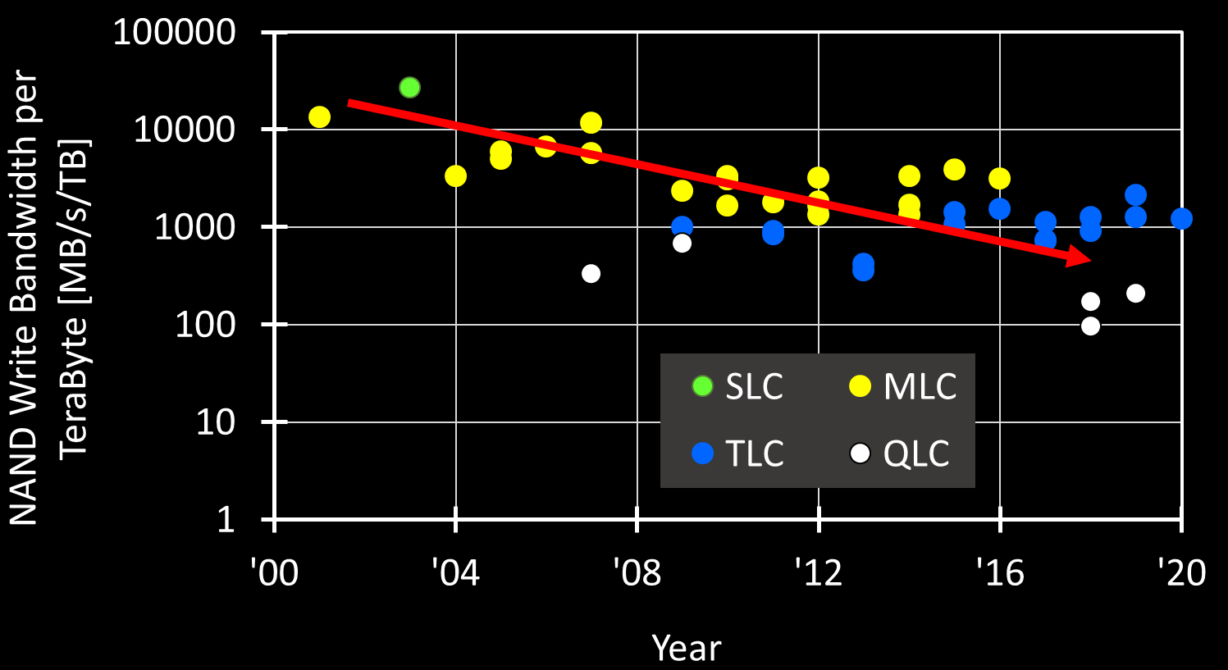
And … storage hardly improves bandwidth without adding capacity
While capacity has grown for NAND, performance – write performance and in particular as more bits per cell are added – has not kept up with capacity growth.
BW/Capacity scaling critical, as BW goals often solved by brute force (parallel die) ➔ cost barriers to adoption, amplifies scaling challenges.
Source: various IEEE, ISSCC, IEDM, and IMW papers.
Problem Statement

Slide 11
The opportunity … Filling the gap between memory and storage
MEMORY
Storage
SRAM
DRAM
NAND SSD
HDD
Latency: 1X
Capacity: 1X
Latency: ~10X
Capacity: ~100X
Latency: ~100,000X
Capacity: ~4,000X-8,000X
Latency: ~10 Million X
Capacity: ~10,000X
Problem Statement

Slide 12
The anticipated solution to bridge the gap
von Neumann architecture gave away the answer long ago –
large memory capacity
word
immediately available
Cross Point Memory is a promising scalable solution
Simple scalable structure + 3D technology ➔ Large Memory Capacity
Individual Cell Access ➔ Word (small granularity accessible)
Fast switching materials + local low resistance metal interconnect ➔ Immediately Available
Challenge: Mating a selector device with non-linear I-V & a memory element with tight distribution
Solution Proposal

Slide 13
Outline
Introduction
Problem Statement and Solution Space
Cross Point Memory Array and Choices of Selector
3D XPoint Memory Technology
Conclusion

Slide 14
Cross Point Memory Array – ½ voltage biased scheme
The selected bit (•) is at the cross point of the selected bitline (BL) and wordline (WL)
Functionality –
A fully networked x-y resistive array ➔ Sneak paths thru all de-selected cells (•) connect the selected BL/WL
Reliability –
All bits on selected BL (•) and selected WL (•) are biased ➔ Read/Write disturbance and retention
A selector isolates memory cells in an array, improves access accuracy and strengthens reliability.
Cross Point Memory Array

Slide 15
Selector of a cross-point memory cell is a diode
Diode: two terminals and exhibiting a nonlinear I-V, IEEE Standard Dictionary of Electrical and Electronics Terms, 1980
Unidirectional
Asymmetric
Unipolar
Bidirectional
Symmetric Ambipolar
§ : Kowk K. Ng, Complete guide to semiconductor devices, 2nd ed., 2002 ¶ :https://www.digikey.com/en/articles/design-in-tvs-diode-protection-enhance-can-bus-reliability

Slide 16
Random Access of a Memory in Cross Point Array
Unidirectional L-Shape Selector
Bidirectional S-Shape Selector
A rectifying selector turns on one bit with forward bias and isolates others with reverse bias.
Selected BL/WL are toggled between 0V and V
All bits but selected WL/BL are reversed biasd
Subject to V_{drop} at each cross points, the selected bit is triggered, and the unselected bits are blocked.
Selected BL/WL are toggled between 0V and ±V
All bits but selected WL/BL are 0 biased
Cross Point Memory Array

Slide 17
Thin Film Diode Candidates for Cross Point Memory
Y. Sasago, et. al.,
VLSI ’09. T2B-1
B. ﻿Govoreanu, et.al.,
IEDM’13. S10.2
S. Yasuda, et.al.,
VLSI, 2017. T2-4
K. Gopalakrishnan, et. al.,
VLSI ’10. TS19.41
S.G. Kim, et. al.,
IEDM ’15. S10.3
D. Kau, et. al.,
IEDM ’09. S27.1
Selector Devices

Slide 18
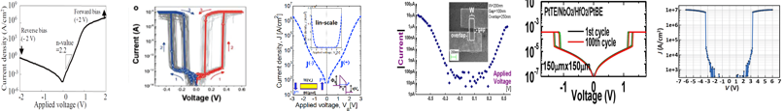
Threshold Switching Phenomenology & Mechanisms
Mechanism | Thermionic | Filamentation | Tunneling | MIEC | MIT | OTS
Construct. | P-N or M-S Jx | Ion (Ag⁺) in Ox | MIM | Cu⁺ in SE | NbO₂ | Chalcogenide
Switching | Electronic | Atomistic | Electronic | Atomistic | Atomistic | Electronic
Polarity | Unidirectional | Bidirectional | Bidirectional | Bidirectional | Bidirectional | Bidirectional
τ_{switch} | sub nsec | ns ~ 100s ns | ps or faster | ns ~ 100s ns | ns to 10s ns | sub ns
J_{MAX} | < 10MA/cm² | 1-10MA/cm² | < 1MA/cm² | ~10MA/cm² | > 10MA/cm² | > 10MA/cm²
J_{Inhibit} | <1A/cm² | <1KA/cm² | <1KA/cm² | <1KA/cm² | <1KA/cm² | <1KA/cm²
V_{Inhibit} | < 3V | < 1V | <3V | < 1V | < 3V | < 3V
I-V
Reference | Y. Sasago, et. al., VLSI ’09 | Z. Wang, et.al., Adv Func Mtls (2018) | B. ﻿Govoreanu, et.al., IEDM’13. P10.2 | K. Gopalakrishnan, et.al., VLSI Symposium ’10. | X. Liu et.al., EDL Oct.’14 | S. Yasuda, et.al., VLSI symposium, ‘17,
Selector Devices

Slide 19
Outline
Introduction
Problem Statement and Solution Space
Cross Point Memory Array and Choices of Selector
3D XPoint Memory Technology
Conclusion

Slide 20
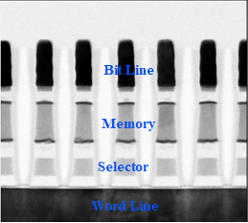
Memory Cell
Sandwiched at the cross point of wordline and bitline metals
Selector device is based on Ovonic threshold switches
Storage element is based on chalcogenide alloy with power efficient memory switching without sub-lithography feature
Carbon electrode has two jobs: electrical connector and chemical barrier
3D XPoint Memory Technology

Slide 21
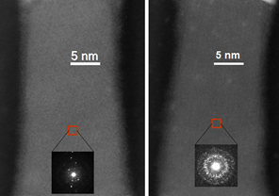
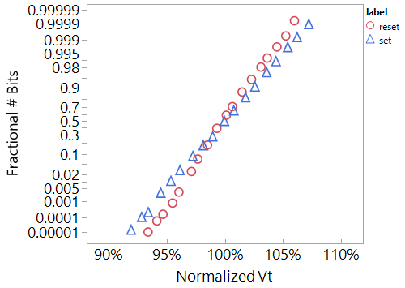
Memory Switching
Tight statistical control: The entire volume of memory material undergoes bonding transformations between high (fully crystalline) and low (fully amorphous) conductivity with no partial switching.
Deterministic write algorithms: While it shares a chalcogenide-based genealogy with PCM, it does not rely on stochastic crystallization growth processes initiated at the amorphous-crystalline interface no program verification is required.
These fundamental architectural advantages enable low latency, high bandwidth, AND high endurance NVM subsystems.
3D XPoint Memory Technology

Slide 22
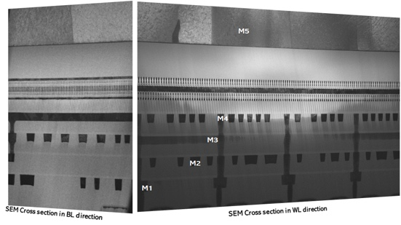
High-Volume Manufacturing Proven
1st Generation 3D XPoint Media Attributes
Attribute | Value
Cell Feature Size (half pitch) | 20nm
# Decks | 2
Die Capacity | 128 Gbits
Bank Access Size | 16 Bytes
# Independent Banks | 16
Read Latency per Bank | 100nSec
Write Latency per Bank | 500nSec
Write Bandwidth (MB/s) per TB | >35,000MByte/sec/TB
First generation 128Gb 3D XPoint Memory featuring 5-level metal CMOS Under Array technology delivers high density, low latency nonvolatile memory.
3D XPoint Memory Technology

Slide 23
Scaling Direction
Physical Scaling (Density)
Increase deck count ➔ Vertical scaling
Pitch reduction ➔ Lateral scaling
Energy scaling
Variation tightening for supply reduction
Circuit efficiency improvement to reduce AC and DC dissipation
BW scaling
Protocol and circuit optimization to reduce access latency
Increase bank count for concurrency
Material tuning for performance improvement
Flash inspired (NOR and NAND)
Multi-Level Cell
Architecture augmentation
3D XPoint Memory Technology

Slide 24
Outline
Introduction
Problem Statement and Solution Space
Cross Point Memory Array and Choices of Selector
3D XPoint Memory Technology
Conclusion

Slide 25
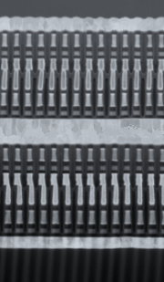
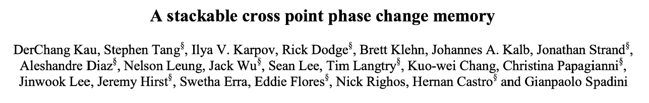
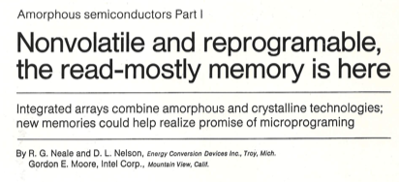
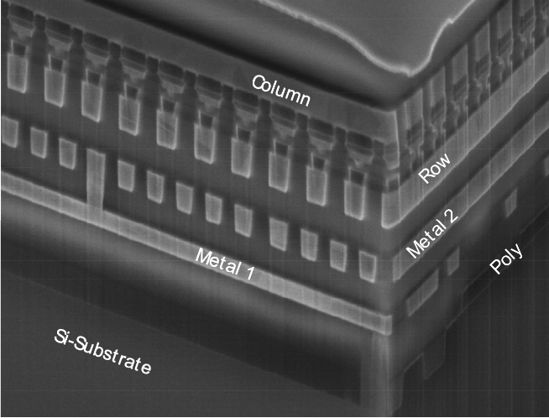
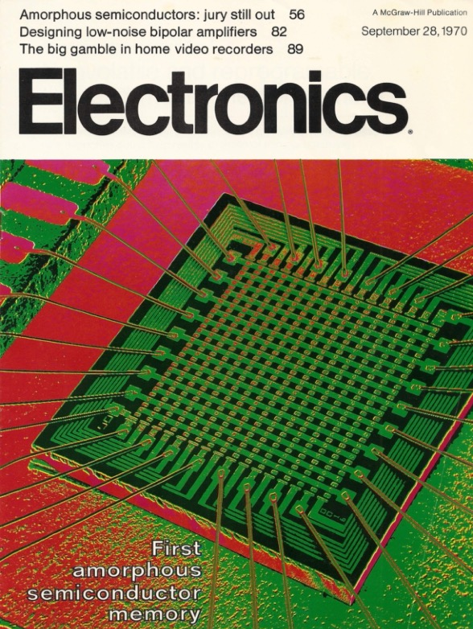
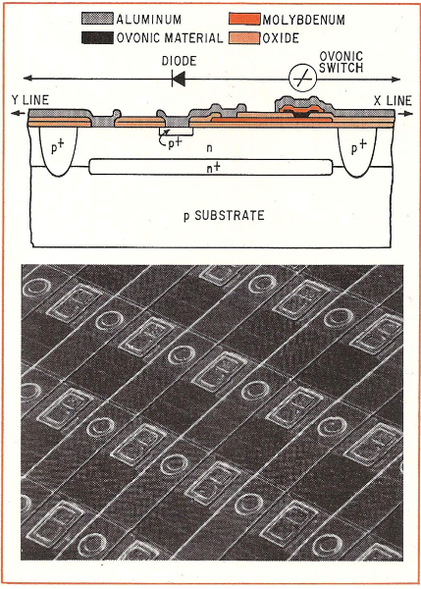
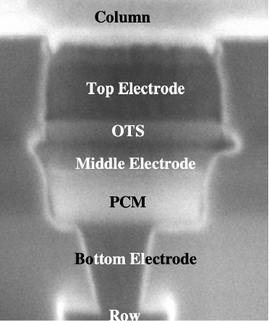
In Pursuit of a Dream …
September 28
1970
August 13
2020
December 8
2009
An endeavor started half century ago…
Conclusion

Slide 26
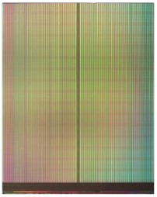
3D XPoint Technology Bridges Memory-Storage Gap
MEMORY
+
Storage
SRAM
DRAM
3D XPoint™
NAND SSD
HDD
Latency: 1X
Capacity: 1X
Latency: ~10X
Capacity: ~100X
Latency: ~100X
Capacity: ~1,000X
Latency: ~100,000X
Capacity: ~4,000X-8,000X
Latency: ~10 Million X
Capacity: ~10,000X
Conclusion
Technology claims are based on comparisons of latency, density and write cycling metrics amongst memory technologies recorded on published specifications of in-market memory products against internal Intel specifications.

Slide 27
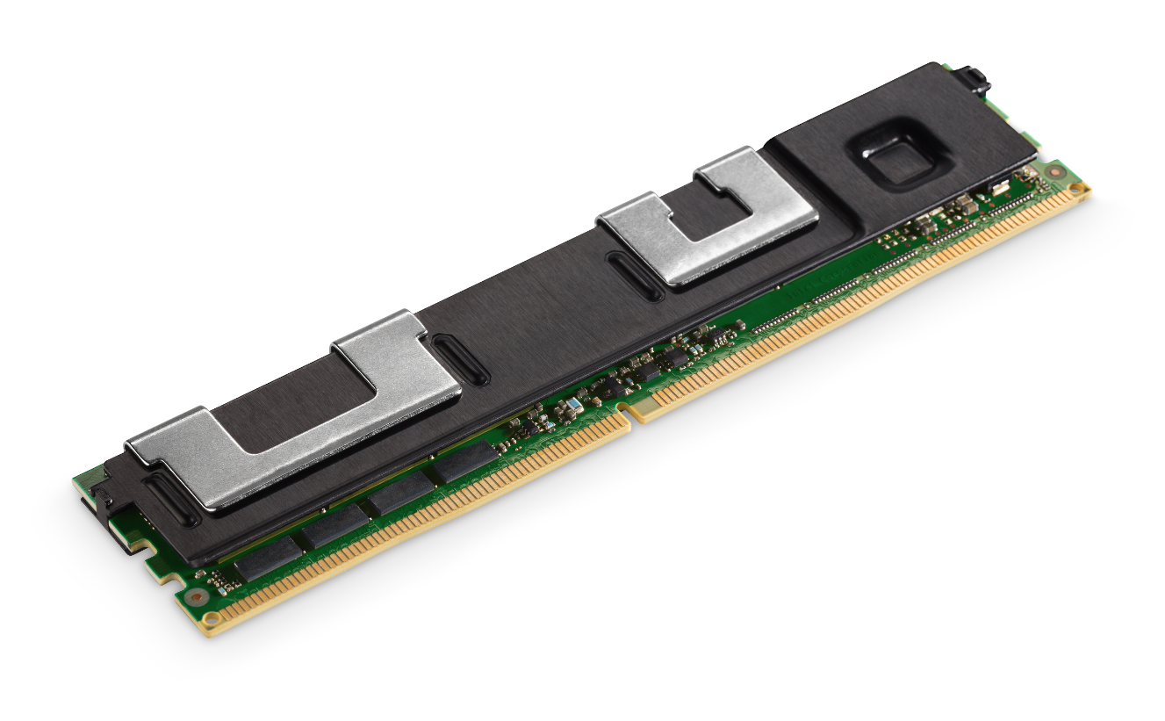


Optane™ based on 3D XPoint
~pS
SRAM
Intel® Optane™ Data Center Persistent Memory
~128GB
~10’s nS
DRAM
~512GB
Optane™ DC Persistent Memory
~100’s nS
Higher Capacity* / Lower Cost
Intel® Optane™ SSD’s
Latency*
~1.5TB
Optane™ SSD
~1’s μS
Bandwidth
~8TB
~10-100’s μS
NAND SSD
~10’s TB
~>mS
Hard Disk Drives
Conclusion

