Slide 1
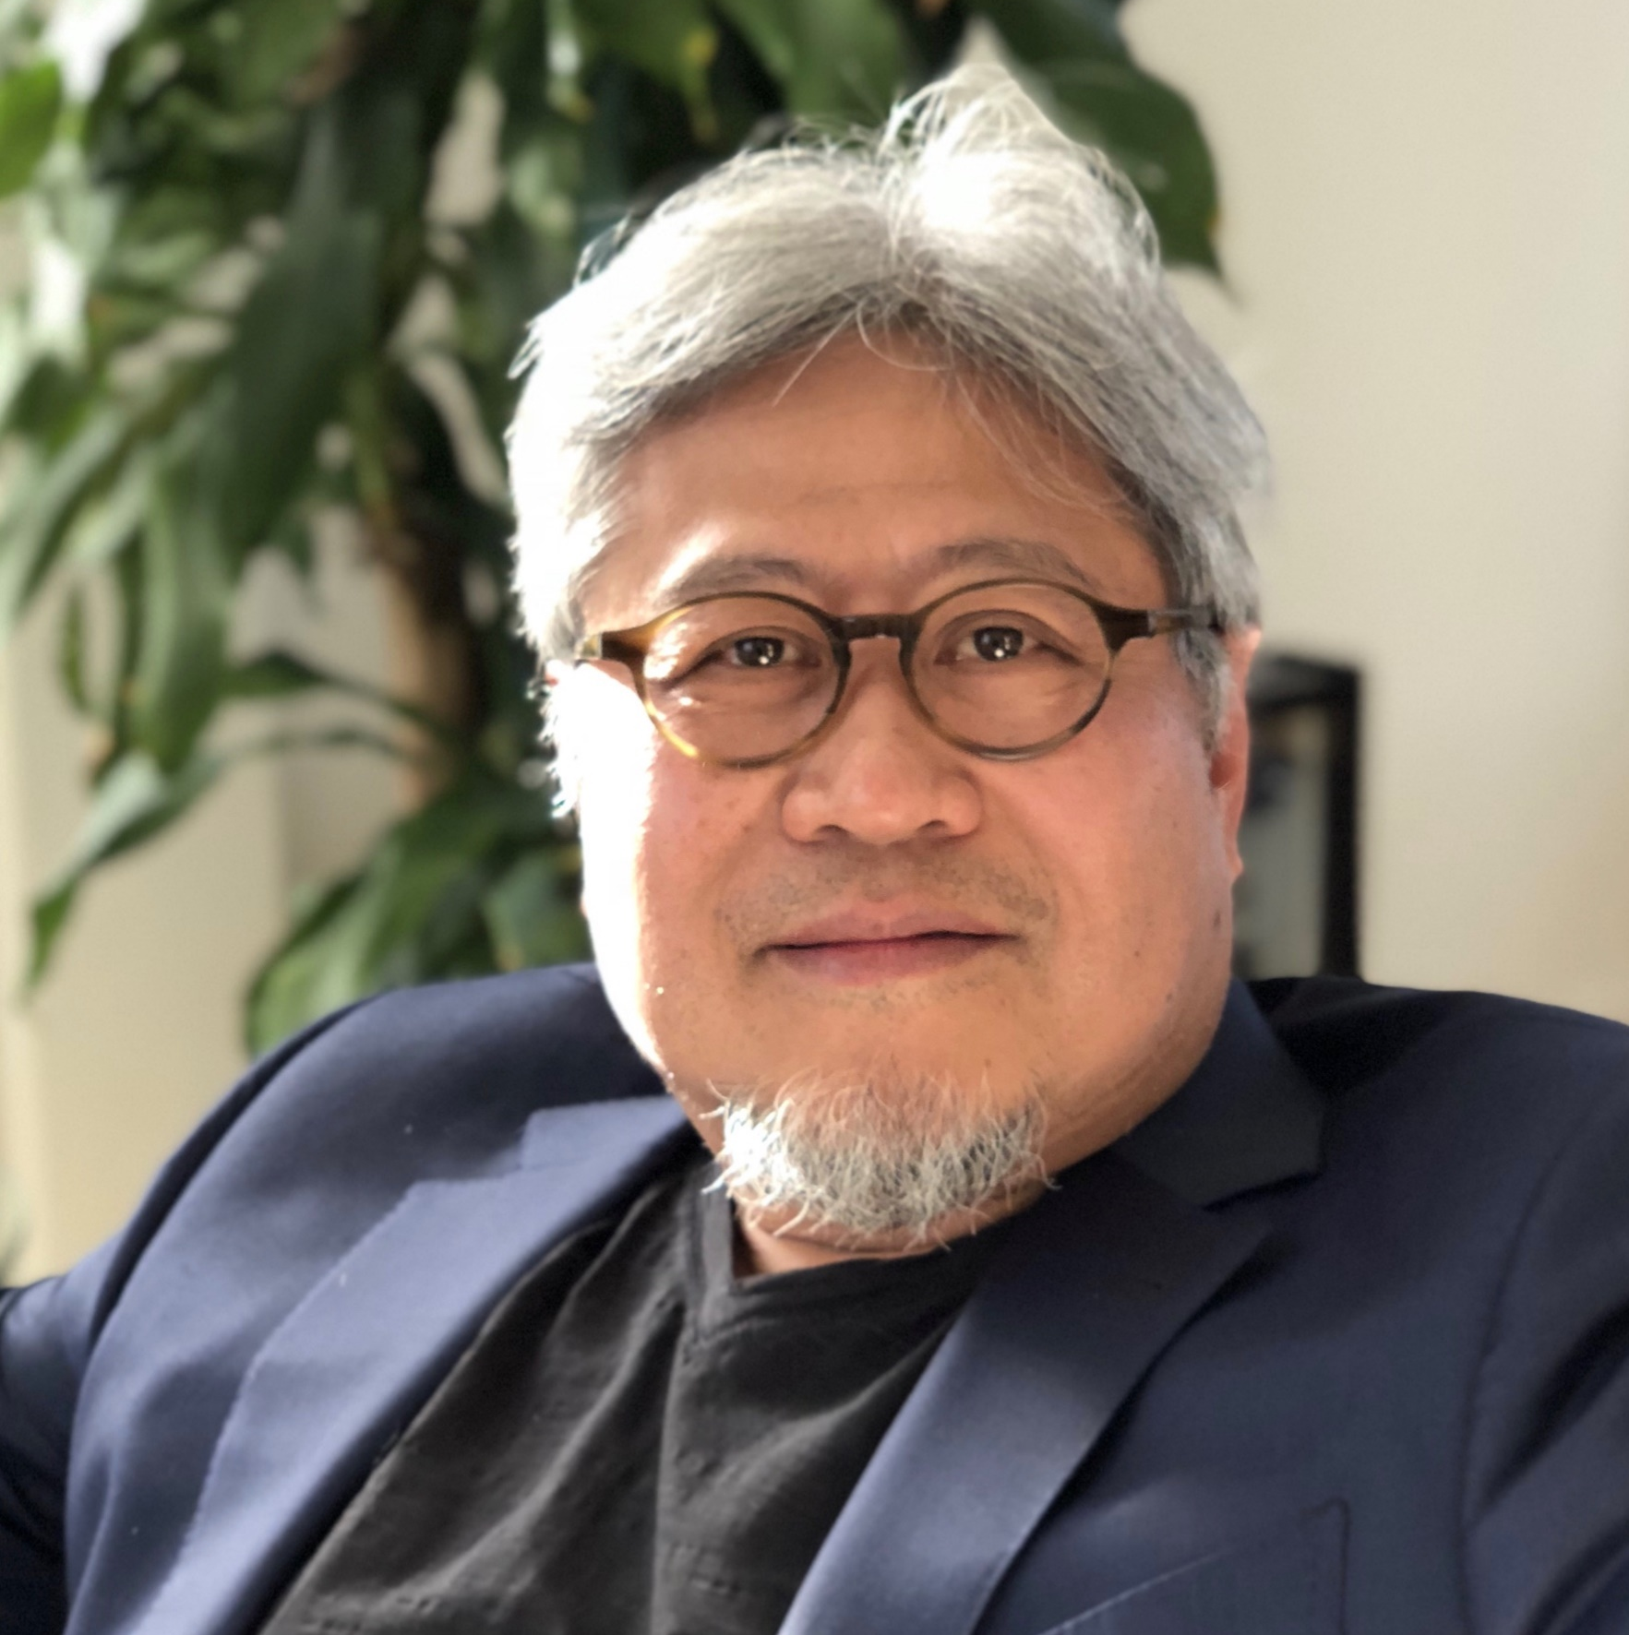
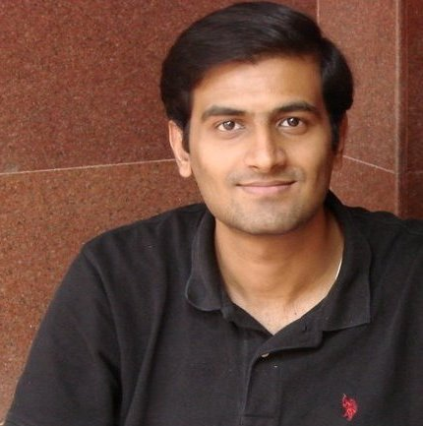
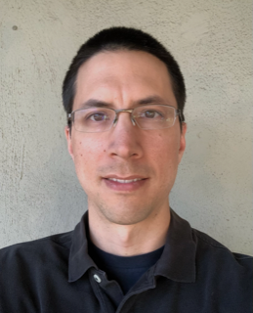
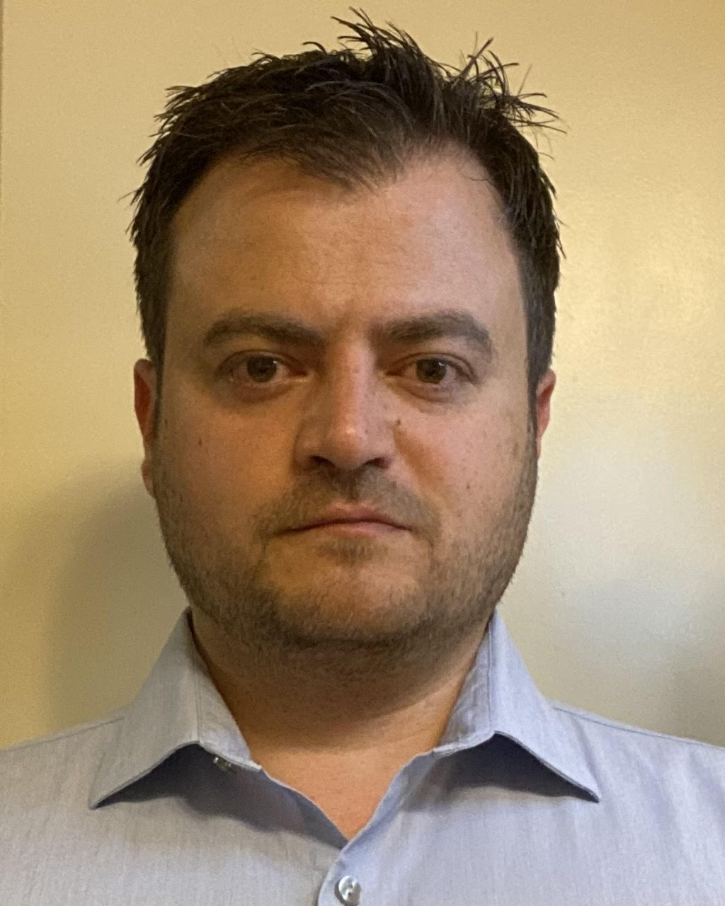
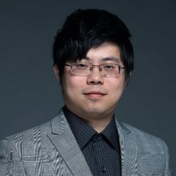
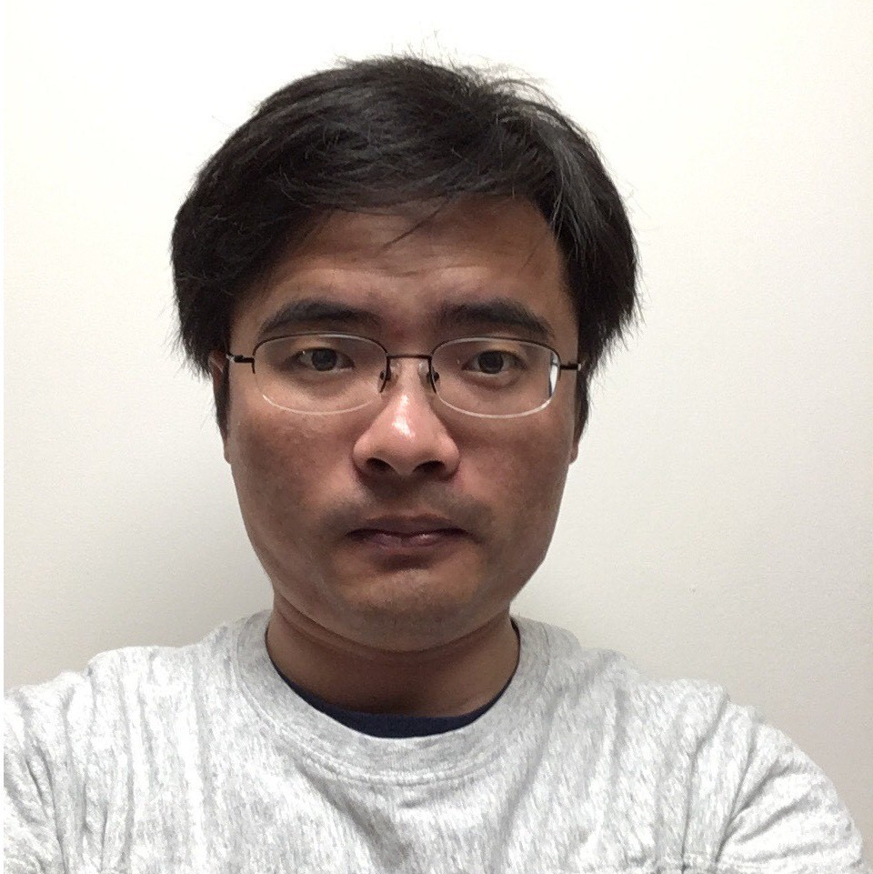

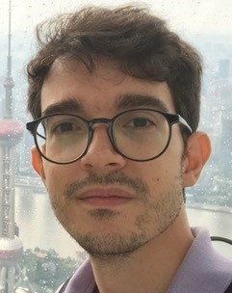
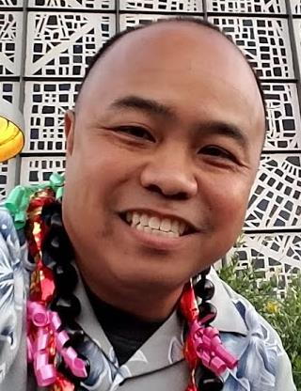
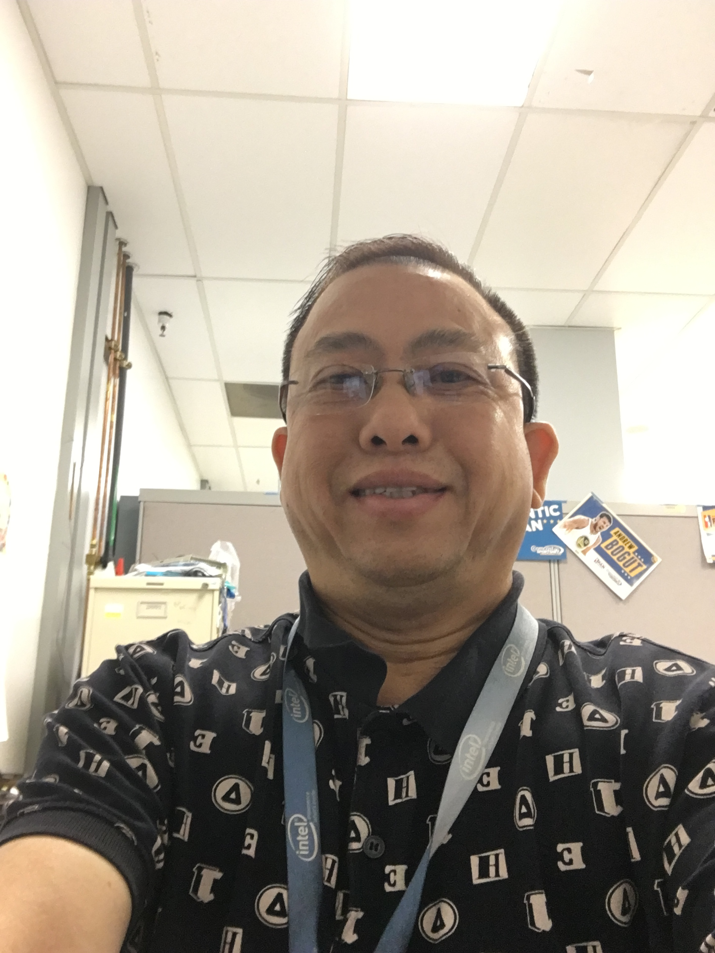
DerChang Kau
Fellow
SPICE Modeling
Technology CAD
Device Technology
tbh
tbh
Ananth Kaushik
Leitao Liu
Dany Ly-Gagnon
Davide Fugazza
Principal Engineer
Lu Liu
Memory Cell
Hank Wang
Roberto Carboni
Art Tubera
Louis Luong

Slide 2
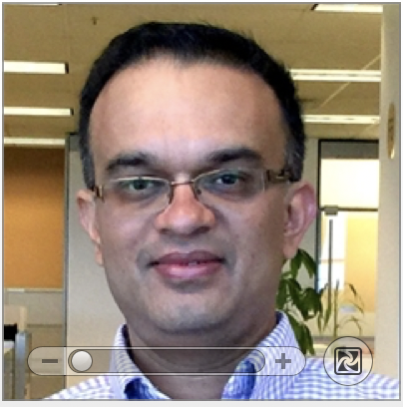
Kiran Pangal
Fellow
Davide Fugazza
PE
Technology CAD
Device & Array
Ananth Kaushik
Leitao Liu
Dany Ly-Gagnon
Lu Liu
Hank Wang
Device/Media Lab
Roberto Carboni
Art Tubera
Louis Luong

Slide 3
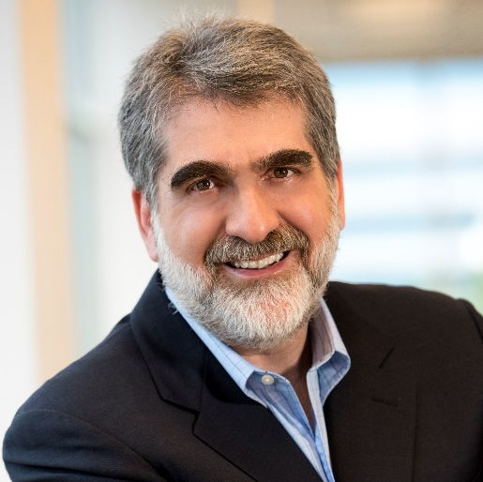
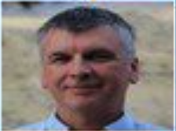
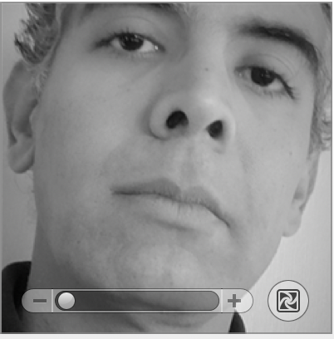
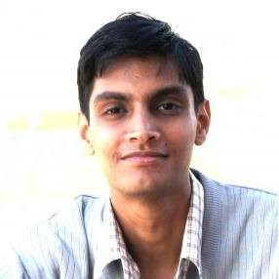

Al Fazio
Senior Fellow
Max Hineman
Sr. Principal Engineer
Kiran Pangal
Fellow
Device & Array
Technology CAD
Optane Architecture
Dany Ly-Gagnon
Lu Liu
Ananth Kaushik
Leitao Liu
Davide Fugazza
Principal Engineer
Kumar Virmani
Principal Engineer
Hemant Rao
Device/Media Lab
Memory Cell
Art Tubera
Louis Luong
Hank Wang
Roberto Carboni
Phoebe Yeoh

