Slide 1
Optane TD Org Design
January - February 2021

Slide 2
vision/mission statement
To lead the industry in Optane technology development
With maximum learning velocity, empowered teams, world class innovation and culture
We deliver Optane components with high quality, predictable schedules and low cost
Notes:
Your vision statement is a simple way to illustrate what you want to do, how, and why?

Slide 3
L1 Organization Functional View
Alper Ilkbahar, IOG
Ted Taylor, Optane TD / Al Fazio, Advanced Pathfinding:
Scope:
Memory and CMOS roadmap and definition
Media architecture, integration and qualification
Photo Mask Definition and Procurement
Equipment, material and process development enabling Optane qualification and high volume manufacturing
Optane component programs including process integration, device engineering, yield, reliability and qualification
RTD business operations including training and technical documentation, automation systems management, staffing, budgeting
and business systems
Partnership / relationships with Fab 11X (NMDM/TMG), CQN/ QnR Labs,
Top 3-5 Outputs:
Optane media roadmap aligned to IOG systems and platform
Qualified Optane components capable of cost effective high volume manufacturing
Low volume manufacturing including PDT samples
Mfg/Transfer Documentation: Process flow, recipes, equipment/material/process specifications, factory automation,
process training – all documentation required to manufacture Optane.
Notes:
3

Slide 4
Organizational Capabilities, Functions & Outputs
RTD/Pathfinding
Process Integration,
Device and Yield
Process
Development
OPC / Tape Out
Business Operations
NVM Pathfinding
Optane Component
Architecture
Function / Scope:
Process Integration
Yield
Device
Function / Scope:
Process Eng
Equip Qual
& Sustaining
Process
improvements
Deliver MOR
Function / Scope:
Generator optimization
OPC models
OPC optimization
Tapeout flow
Mask definition
Function / Scope:
Business Planning
PMO
Change Management
Training & Docs
Function / Scope:
Scaling Roadmap
Physics Exploration
Design Collateral
Development
Function / Scope:
Array Architecture
Module-Media
Integration
Top 3-5 Outputs:
Delivery of new
technodes on schedule
meeting performance
and cost
PLS, LVM, PRQ
Top 3-5 Outputs:
New process
capability
PRI maturity
Silicon quality
Equip capacity
Cost
Top 3-5 Outputs:
Generator solutions
Optimized illumination
OPC solutions
Mask Specs
All Optane masks
Top 3-5 Outputs:
POR/LRP Plan
Fab Standards
Fab Systems Setup
Training Content
Fab Specs
Top 3-5 Outputs:
Memory Cell
CMOS
Materials
Compact Models
Top 3-5 Outputs:
Media Architecture
and Definition
Media Integration
and Development
Media Qualification
Chuck
Narahari
Todd
Tash
DerChang
Kiran
Notes:
4
Group to align on this before moving to roles and responsibilities

Slide 5
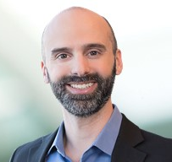
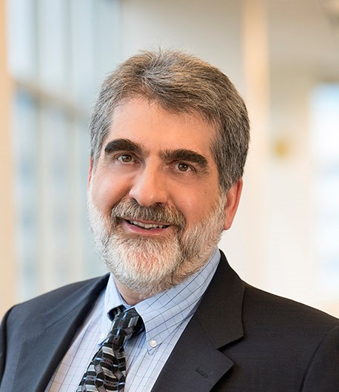
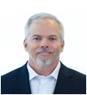
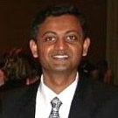
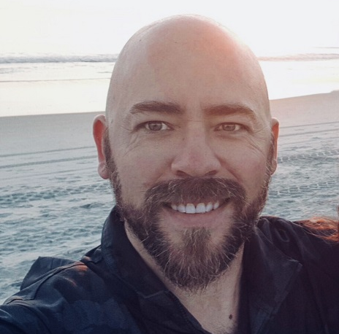
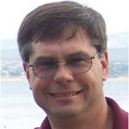
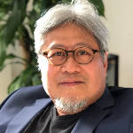
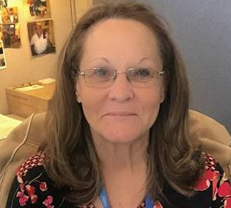
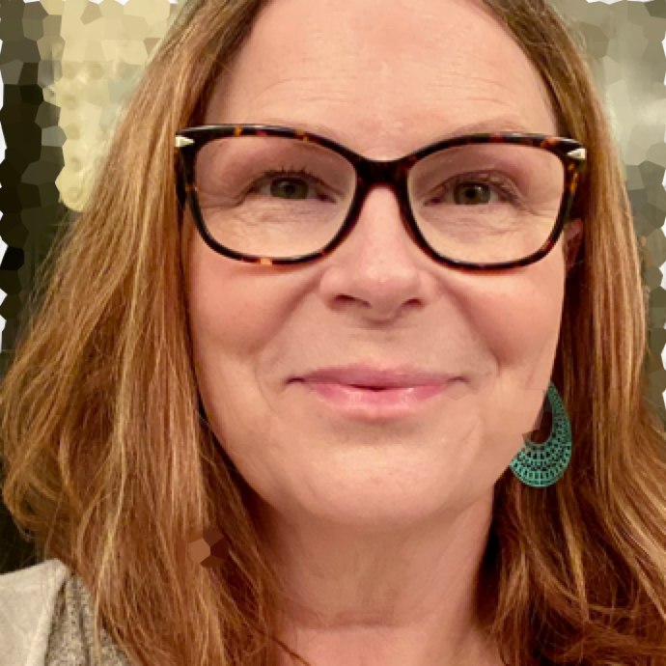
Optane Technology Development
Vision To be the industry leading NVM technology innovation engine.
Mission To drive world class innovation at the speed required to meet platform cadence.
Ted Taylor, VP Optane TD
Al Fazio, Sr. Fellow
Advanced Pathfinding
RTD Optane Technology Development
Chuck Dennison, VP
RTD Integration, Yield and Device
Narahari Ramanuja
RTD Process Director
Tash Anestos
RTD Business Operations
Todd Lukanc
OPC and Collateral
Derchang Kau, Fellow
NVM Pathfinding
Business Partners
F11X Partners
Media Engineering
QnR
Manufacturing
Automation:
IE / Planning / MOR:
GSM Account Mgmt
Finance:
HR:
Ed Fozo (acting)
Venkat Vasudevan
Bert Blaha
Harman Katoch
Young Spaulding
Ben Fullmer
Bryce Browning
Gina Gutierrez
Factory
Fab/Sort Operations
CS / Facilities
Construction
CMOS
Probe Engineering
Labs
GSM Procurement:
Katie Prouty
Brian Chavez
Mindy Koch
Lee Sneddon
Summer H.
David Lett
Gavin Corcoran
Kristina Torsiello
Dinah Gevedon
Admin. Support
Kiran Pangal, Fellow
Optane Component Architecture
Marci Lane
Admin. Support
Intel Confidential
Ted Taylor reports to Alper Ilkbahar, Optane GM

Slide 6
overall_1_132139274990056324 columns_1_132139274990056324
Change & Transition Management (CTM) implications
What ⎯ Overview description of the change in your BU.
What is changing ⎯ overview Includes scale and scope. | What is NOT changing. Briefly describe what is not changing. (This helps deal with peoples’ fear of change.) | Success Criteria. If this change were to turn out as well as it possibly could, what would that look like?
CMOS device engineering (9 HC) consolidated into RTD device team TO/OPC (11 HC) moved from collateral team to Ted TCAD and Compact Modeling (4 HC) moved from collateral team to DerChang Component Architecture (23 HC) team moved from MCD to Al | No change to majority of Optane TD organization. Process engineering, business operations, process integration, pathfinding teams are unaffected by re-org. | Optane development strengthened by closer collaboration with groups moved into TD and Advanced Pathfinding orgs.

Slide 7
Strategy alignment: clarifying priorities
GROUP EXERCISE: How does our strategy impact the PRIORITIES of our team?
What things can’t we do this year?
(due to budget, resource, constraints – gaps)
Must find a way to support:
S26A Manufacturing Output
ATF Wafer cost reduction
  Technology cost improvements
  Capital reuse strategy definition and tool qualification
Cost effective manufacturing plan
Most important initiatives, priorities, or focus areas for our team this year?
Must Do’s:
Safety
ATF Development
Bow Falls Pathfinding
S26A healthy baseline
Factory CT 1.5x – 2x improvement
1.5-2x Lab capacity (TEM)
L4 MT Training
TIQ (36 tools)
Automation Uplift
Control CAPEX and OPEX to plan
NAND Independence
NAND Pathfinding
Culture, OD and org efficiency
What should we pause, de-emphasize, stop, or slow down?(ZBB)
ZBB Items:
S26A PG1 qualification
S26A yield ramp and cost reduction
S26A CMOS in F11X

Slide 9
**Strategy alignment: clarifying priorities
GROUP EXERCISE: How does our strategy impact the PRIORITIES of our team?
What things can’t we do this year?
(due to budget, resource, constraints – gaps)
Must find a way to support:
SomoLake, DIMM NPIs
Resolve all BE component shortages (ASICs, IC’s, PMICs, Passives, …). Need Megan, Russielle, Mengshu coverage
Maintain IOG systems (Blue Yonder, Qual Filter, …)
Meet RTD IE needs
Achieve timely Shopping Cart/PO’s
Improve BE quality to healthy level
Develop/deploy the new technologies into MFG to support NPIs, e.g., LTS for ATF products, IPC Gen 5.0 for DPS, Chasis Gen 3.0, …
Drive Mfgr process optimization and automation solution for cost saving, shorter cycle time, …
Most important initiatives, priorities, or focus areas for our team this year?
Must Do’s:
Safely complete RTD Construction for TD/LVM fab of Optane products
Develop Mfgr Strategy
  - March WSA Negotiation
  - Q2 Long Lead decision
  - F11X prod worthy + in LRP
  - Dispo ~$20M tools in F68
  - Cogent BE plan (contract, consol)
Independence from NAND
  - People
  Systems/Processes/Contracts
  BE capacity (lose leverage on CAPEX to purchase capacities /lower prices/underload charge)
Secure USG Incentive funding
Deliver to All Mfgr commits
Develop org capability
What should we pause, de-emphasize, stop, or slow down?(ZBB)
ZBB Items:
Pre-PRQ GSC support (DQ Buffers, …)
Mfgr presence/control in Taiwan
Crisp reactions to demand changes that require BE coordination
Must limit number of LRP/POR WIF analysis iterations – do not have enough heads, those that stay may leave. Deep analysis on non-process fab tool (Labs, Probe, …) needs.
BE DEB (fast CT) process/investment at PTI (OSAT & ODM)
New supplier startup (OSAT/ODM) on the top of what we have today
Software only products(VROC, RST, )
BE has lots of Quality risks! Will do incremental approach only for now.

Slide 10
Gaps
Org Function | Strategic Focus (Ops, product, customer)​ | Current State | Decisions / Next steps
Pre-PRQ GSC materials support | Product | Items like LRDIMM/DQ Buffers are not currently in our responsibility. The shear volume of work will overwhelm us. | Look at “what it would take” and develop a plan in 2H’21 – do NOT rely on us solely right now for this activity – no heads to support yet
SomoLake, DIMM support | Product | Jerry Yan (SH) working with multiple folks to understand what is needed and how to resolve gap in resources | Unclear – need help?
BE quick turns in TWN | Ops | 1 low level engineer in TWN – all work done thru GSC – no IOG specific DEB process split out yet and many quality concerns | Muddle through for now – future hiring will be focused in TWN
LRP/XPOR Analysis | Ops | Current number of analysis loops outstrips team’s capability. We are missing a level of optimizations/burning out folks. | Muddle though for now – this is a future hire need
People Development | People | Will need help from Genevieve’s team to customize a learning plan for several high potential leaders | Genevieve 1 on 1 set up on this item
Working With David Tuhy on Partnership Items

