Slide 1
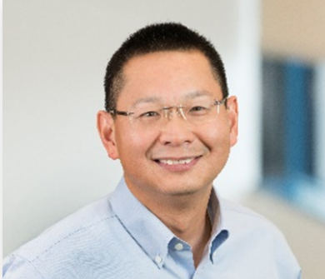


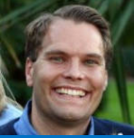

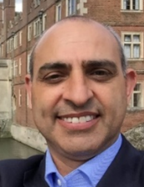



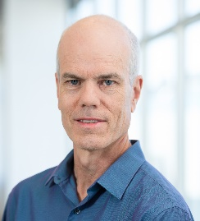
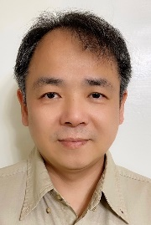
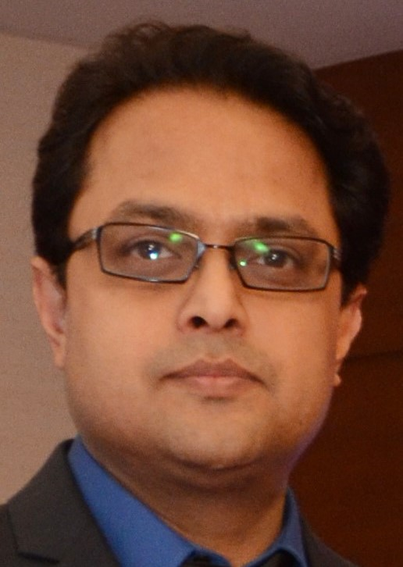
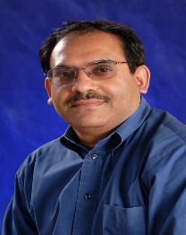
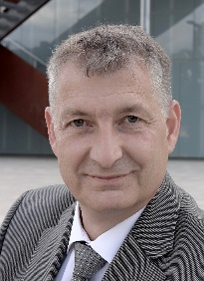
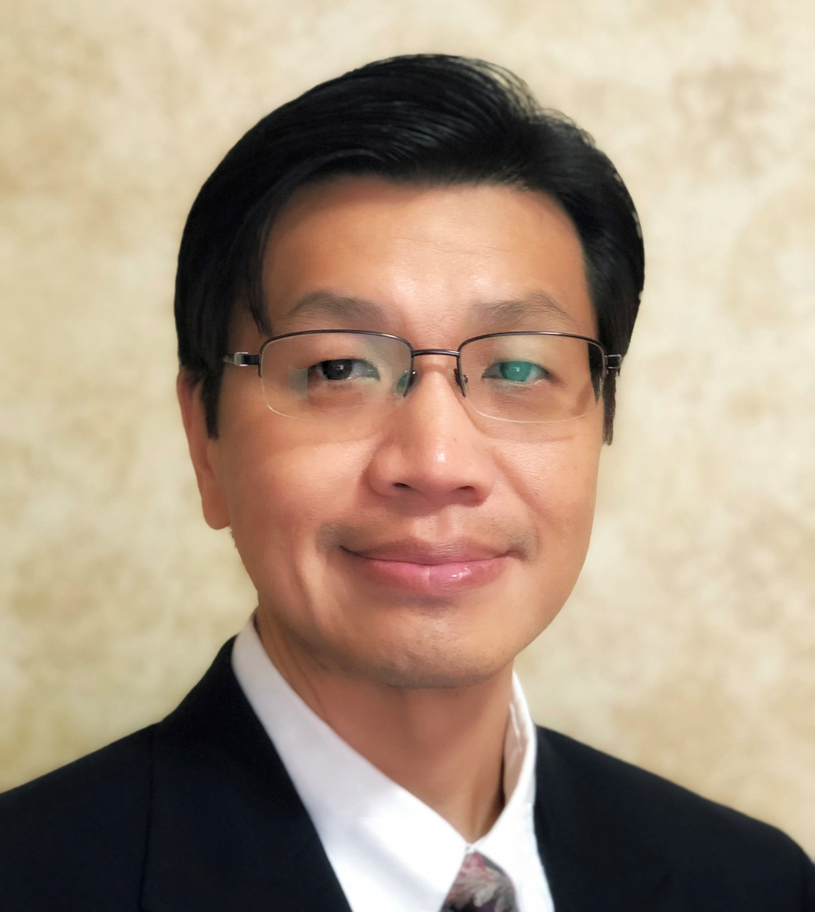
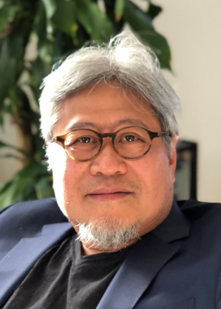

Foundry Technology & Engineering
Changhong Dai
Partners
HR
Julia Mendoza
Legal
Jo Levy
Finance
Markus Andersen
Lamin Juwara
Executive Assistant
Cielo Pangilinan
Chief of Staff &
FTE Operations
Mario Abravanel
Quality
& Reliability
Thad Gardner
Foundry
Technology in
PATHFINDING
(2nm & Beyond)
Srini Rajagopalan
Jeff Watt
Foundry
Technology in
DEVELOPMENT
(3nm & Equivalent)
Kingsley Lai
Foundry
Technology in
MANUFACTURING
(5nm & Older)
Sourav Chakravarty
TEST
&
Post Silicon
Engineering
Rajesh Galivanche
External
PACKAGE
& Assembly Engineering
Thomas Huber
External Technology PLATFORM Planning
Chee How Lim
External Modular INTEGRATION
& Memory
DerChang Kau
Pei Hua Wang

Slide 2
FTE Organizational Structure
Product Planning
DTCO/STCO Pathfinding
TR/Supplier Enabling
Design Support
New Product Introduction
High Volume Manufacturing
External Technology
PLATFORM
Planning
Foundry
Technology in
PATHFINDING
Foundry
Technology in
DEVELOPMENT
Foundry
Technology in
MANUFACTURING
2nm & Beyond
3nm & Equivalent
5nm & Older
External Modular INTEGRATION & Memory
TEST & Post Si Engineering
External PACKAGE & Assembly Engineering
Quality & Reliability (CQN)
  Providing End-to-End Technical Management of External Foundries & OSATs to
  Enable Leadership Products at a Predictable Cadence

Slide 3
FTE Organizational Structure
Product Planning
DTCO/STCO Pathfinding
TR/Supplier Enabling
Design Support
New Product Introduction
High Volume Manufacturing
  Roadmap & Pathfinding
  Technology/Ecosystem Trend
  Competitor/Supplier Analysis
  Product/Platform Roadmap
  Technology Pathfinding
  System Innovation
  Logic-Memory-Package STCO
  Foresight
  DTCO & Design Support
  Tech Program Management
  TR and Design Support
  Foundational IP
  Technology PPA
  Block PPA
  Test Chip
  Agility
External Technology
PLATFORM
Planning
Foundry
Technology in
PATHFINDING
Foundry
Technology in
DEVELOPMENT
Foundry
Technology in
MANUFACTURING
  NPI and Production:
  TO Support
  Test & Debug
  Post-Si Optimization
  Quality Checking
  TPT Tracking
  Yield Improvement
  Discipline
2nm & Beyond
3nm & Equivalent
5nm & Older
External Modular INTEGRATION & Memory
TEST & Post Si Engineering
External PACKAGE & Assembly Engineering
Quality & Reliability (CQN)
  Providing End-to-End Technical Management of External Foundries & OSATs to
  Enable Leadership Products at a Predictable Cadence

Slide 4
FTE Organizational Structure
Product Planning
DTCO/STCO Pathfinding
TR/Supplier Enabling
Design Support
New Product Introduction
High Volume Manufacturing
NPI
& Post-Si Optimization
Test, Debug,
eFA & pFA and Unit Level Engineering
N3 Program & Design Execution
External Technology
PLATFORM
Planning
Foundry
Technology in
PATHFINDING
Foundry
Technology in
DEVELOPMENT
Foundry
Technology in
MANUFACTURING
2nm & Beyond
3nm & Equivalent
5nm & Older
External Modular INTEGRATION & Memory
TEST & Post Si Engineering
External PACKAGE & Assembly Engineering
Quality & Reliability (CQN)
  Providing End-to-End Technical Management of External Foundries & OSATs to
  Enable Leadership Products at a Predictable Cadence

Slide 5
Staff Meeting
DerChang Kau
Sourav Chakravarty
Mike Goldsmith
vF2F
Plan’22: staff requests, post-Si optimization, FIP dev, FPA (Q&R), Stress Test
Tape-Out Review, Yield Modeling
N2 (Jeff), N3 (Kingsley), T&PS (Rajesh), Ops (JM), Far Backend, product roadmap

Slide 6
Foundry Technology & Engineering

Slide 7
Foundry Technology & Engineering
Supply Chain Technical Management
Foundry Technology
in
Pathfinding
Foundry Technology
in Manufacturing
Test
&
Post-Si Engineering
External Package
&
Assembly Engineering
Foundry Technology
in Development
Quality
&
Reliability
Manage Foundry and OSAT to deliver compelling, timely, Intel-aligned technology and enable Intel to leverage it most effectively for hybrid, leadership product design and manufacturing
Mission
End-to-End
Intel leveraging Foundry and OSAT technology to deliver a predictable cadence of leadership products
Vision

Slide 8
Business Need for the FTE Organization
Intel’s market ambition of $300B TAM, our die disaggregation strategy, and increased 5nm/3nm/2nm usage are all driving a non-linear expansion of external foundry usage
  Corporate Acquisition and Die-Disaggregation Architectures created 50% growth in future NPIs on Advanced Nodes
  External Foundry volume is trending to grow more than 5X in the next 5yrs
  BUs expect GSC to partner with Foundry/OSAT suppliers to ensure they meet Intel product requirements, and drive execution accountability
To meet the growing demand for External Foundry and meet the requirement of deep Technical Engagement as a Lead Partner, FTE growth will focus on three capabilities …
Capability | Pre-Product Enablement | Technical experts in Process, Product, and Design to drive Optimized Technology for Intel Demonstrate leadership Design Technology Co-Optimization through Test Chips
 | Scale | Support for increased NPIs on multiple TSMC and Samsung nodes Drive improved Yield on increased number of products and increased wafer volume
 | Co-Location | Enable Taiwan & Korea growth for GSC. Drive Co-Location with key suppliers. Large pool of experienced resources to draw from
  FTE is Accountable to drive Foundry & OSAT Technology & Manufacturing for Intel’s Success

Slide 9
FTE Organizational Structure
Product Planning
DTCO/STCO Pathfinding
TR/Supplier Enabling
Design Support
New Product Introduction
High Volume Manufacturing
External Technology
PLATFORM
Planning
Foundry
Technology in
PATHFINDING
Foundry
Technology in
DEVELOPMENT
Foundry
Technology in
MANUFACTURING
2nm & Beyond
3nm & Equivalent
5nm & Older
External Modular INTEGRATION & Memory
TEST & Post Si Engineering
External PACKAGE & Assembly Engineering
Quality & Reliability (CQN)
  Providing End-to-End Technical Management of External Foundries & OSATs to
  Enable Leadership Products at a Predictable Cadence

Slide 10

Enabling Products for External Foundry
Concept
Execution
Production
Architecture
Feasibility
UPLC
Product Concept Approved
Execution Commit
Tape-In
Production Release
EOL
FTE
Product Planning
DTCO/STCO Pathfinding
TR/Supplier Enabling
Design Support
New Product Introduction
High Volume Manufacturing
End-to-End Supplier Technical Management
Capabilities | Achieving Intel Product Leadership Through Supply Chain Excellence |  | Ecosystem Development
 | External Technology Platform Planning | Multi-Foundry Technology Platform Definition for Products
 | External Modular Integration & Memory | System Integration for Advanced Si-Package Interactions, including Embedded Memory
 | Foundry Technology in Pathfinding | Drive Process Technology Definition with Foundry to Enable Process Optimization for Intel
 | Foundry Technology in Development | Assess PPA for Advanced Nodes; Define and Implement Testchips to support assessment Technical Program Management and Ongoing DTCO with Product Design Teams
 | Foundry Technology in Manufacturing | Drive Introduction of New Products Manage Low Yield correlation, FIFA & Technical Stability of HVM
 | Test & Post-Si Engineering | Enable Qualification of OSATS for Test; monitor Technical Stability Assist in power-performance, yield, and bin-split issues; Drive Test Time Reduction
 | External Package & Assembly Engineering | Assess New Package Technology and Early Partnering with OSATs to Enable for Intel needs Qualification of Assembly Manufacturing Sites/Equipment/Process and Validation

Slide 11
Foundry Technology & Engineering
Changhong Dai
Partners
HR
Julia Mendoza
Legal
Jo Levy
Finance
Markus Andersen
Lamin Juwara
Executive Assistant
Cielo Pangilinan
Chief of Staff &
FTE Operations
Mario Abravanel
Quality
& Reliability
Thad Gardner
Foundry
Technology in
PATHFINDING
(2nm & Beyond)
Srini Rajagopalan
Jeff Watt
Foundry
Technology in
DEVELOPMENT
(3nm & Equivalent)
Kingsley Lai
Foundry
Technology in
MANUFACTURING
(5nm & Older)
Sourav Chakravarty
TEST
&
Post Silicon
Engineering
Rajesh Galivanche
External
PACKAGE
& Assembly Engineering
Thomas Huber
External Technology PLATFORM Planning
Chee How Lim
External Modular INTEGRATION
& Memory
DerChang Kau
Pei Hua Wang

Slide 12
Foundry Technology & Engineer Deliverables
Top Ten Goals - 2021 | 1 | Execute to Achieve all Committed NPI/HVM project Schedule and Yield targets using external manufacturing
 | 2 | Manage successful end-to-end Execution of Branch projects from supplier deliverables to product engineering
 | 3 | Expand Competitive Analysis and Ecosystem Learning to improve Intel product quality & development efficiency
 | 4 | Complete Samsung 4LPP and 3GAP Process Evaluation/definition including test chip strategy and execution
 | 5 | Drive TSMC N3P and N2 DTCO/STCO with feature requirements for Intel product roadmap & differentiation
 | 6 | Evaluate and Experiment key Assembly & Packaging Capabilities from OSAT including 2.3D and Hybrid Bonding
 | 7 | Build engineering capability and infrastructure for FOM and Block Level PPA Assessment/Optimization
 | 8 | Support Multi-Sourcing / 2-Way Door Initiatives between Intel & external foundry processes for product flexibility
 | 9 | Grow FTE Capability and the new mindset needed to support Intel’s mainstream products; Meet 2021 Hiring Target
 | 10 | Enable Sort/Test Data Throughput for Fast Yield Learning required for leading edge foundry engagement

Slide 13
Key Projects / Hot Topics | 28nm Capacity Shortfall | Industry 28nm Capacity tightness + Upside demand created capacity shortfall Enabled HrPk2 on 28nm TSMC. Achieved PRQ in WW10 as planned! 2nd source enablement in 4 months. 6 options for +capacity evaluated; reduced to 2 near-term commercial, and 2 longer-term technical
 | 14nm 2nd Source for PCH | Working on a blind port from Samsung Foundry to Global Foundries for a 2nd source of the 14nm PCH GF has a preliminary schedule that shows risk production as early as Q1’22, assuming TO by EO June’21
 | N3 Execution | Testchips Taped out on time! (Olivia Creek, Kapoli Spring and Koenigssee) Demonstrated design feasibility for BigCore IP on TSMC N3 by improving design rules. The result was ~10% IP area reduction which led to >8% potential server products’ die size reduction.
 | Semco 2nd Substrate Qual | Nokia had upside demand, which cannot be supported by Kyocera (lead-time 52wks) 2nd substrate supplier needed which requires new qualification
 | N3 Sort @ TSMC for Yield Learning | Proposal to enable Sort @ TSMC for faster Yield learnings Ratified One-Team Kicked off with TSMC & Intel. Sort manager & Tech Lead Hired.
 | On Time Tape Out | Intel’s OTTO success rate with TSMC is significantly worse than the Industry rate Working with Design teams to understand problem and propose new methodology
 | 2nm Pathfinding | Evaluating Technology: Gate-all-around, Buried Power Rails, Backside Power, and overall PPA Meeting held with TSMC in ww24; presented internal project intercept options for N2

Slide 14
BACKUP

Slide 15
Foundry Technology & Engineering
Drive process technology definition & early engagements on leading nodes
Engage with foundry on Pathfinding and DTCO/STCO activities to assess and improve capability of process
Partner with BU during TR to ensure process technology is ready to meet PPACS goals for product
Scout industry technology trends & developments
Supplier Roadmap Analysis
Foundry
Technology in
PATHFINDING
2nm & Beyond
Technical Management of early Foundry/OSAT Engagement including co-ordination across FTE, FOM, DEG, BU, TEG, ATTD, MPE
Ongoing DTCO with Product Design Teams
Manage BU/SoC’s ask of Foundry/OSAT
Develop and implement methodology for PPA Assessment of Digital, Analog and Memory blocks including L0 (device/interconnect), L1 (cell/path) and L2 (block) metrics; Scaling analysis using ARM cores
Define Testchips during pathfinding phase to support PPA assessment and DTCO/STCO
Physical Design, Place and Route of Testchips
Provide insight into BU Roadmaps & Product needs
Ensure Compliance to GSC PLC Process
Foundry
Technology in
DEVELOPMENT
3nm & Equivalent
Test Chip Development

Slide 16
Foundry Technology & Engineering
Program Manage the Introduction of New Products
Drive FIFA Activites for product teams
Work with Foundry on low yield correlation
Define Manufacturing Spec for each Si Node and Ensure Compliance
Track Product Execution and Manage Schedule
Support SoC Mock Tapeout Flow
Define Inline Monitors for Si Tracking and Limits for Maverick lot detection
Define Skewed Si Targets and Device Retargeting to Optimize YieldDevelop Yield Model and provide Yield Targets for BU; Yield Target Setting
Program Manage the Execution of HVM
Technical Stability of HVM at Foundry & OSATs
Manage Lot On Hold, Yield Health and Excursions; Yield optimization
Change Management for Platforms, Packaging, and Test
Foundry
Technology in
MANUFACTURING
5nm & Older
New Product Introduction
High Volume Manufacturing

Slide 17
Foundry Technology & Engineering
TEST & Post Si Engineering
Drive Testability Requirements with Design Team and Foundry to Influence Design-For-Test
Ensure Test for Reliability and Drive Test Infrastructure, Yield Optimization Planning & Integration
Enable FIFA Capabilities and Yield Explorer
Act as First Line of Defense for NPI/HVM in resolving power-performance, yield, and bin-split issues
Enable Test at OSATs; Drive Test Time Reduction
Technical Stability of Test at Suppliers
SIU/TIU Maintenance and Tracking
External PACKAGE & Assembly Engineering
New Package Technology testing; Early OSAT Partner Enablement
Roadmaps & product needs
Technical Inputs for Make vs. Buy Decision
Enable Passive Data Collection for yield montioring of HVM ramp
Manufacturing Sites/Equipment/Process Qualification and Validation
Continued Supplier Quality Assessment, Technical On-site Support and Product Ramp-up

